Slide 2
Machine learning and databases
OakTable World 2016
Eric Grancher
Notes:
Introduce myself: 8 years data engineering, data analytics (make sense)

Slide 3
Outline
Machine Learning in 2016
Database data for Machine Learning
Machine Learning with databases

Slide 4
Machine learning
“A computer program is said to learn from experience E with respect to some class of tasks T and performance measure P, if its performance at tasks in T, as measured by P, improves with experience E.” Mitchell, Tom M. Machine learning. WCB.
Supported by theory (“Multilayer feedforward networks are universal approximators” Hornik, Stinchcombe, and White, Neural Networks 2, 359-366 1989)
Applies to many fields: image, speech recognition, … physics (ex: Higgs Boson Machine Learning Challenge) (flight prices, etc.)
Lot of enthusiasm, competition (ex: Kaggle), smart and innovative people
Possible now thanks to advances in models and computation power, including GPUs and parallelism
Even if can be complicated, easily accessible thanks to good open-source implementation with high-level language integration (ex: Google’s TensorFlow)

Slide 5

ML and data
Apart from images, sound, videos… (“Hello World” is handwritten number recognition, MNIST)
ML requires clean, structured data
… database (even missing/NULL) stored data following
(DB) de-normalisation
(statistics) normalisation
Data preparation is a critical part of the work

Slide 6
ML platform, DB integration (1/2)
Training is very processing intensive, optimised libraries (ex: TensorFlow, C++/CUDA)
Deployment on CPU, offload (GPUs, dedicated processors like TPU…), parallelism
Database integration
Some (Oracle DB) have built-in functions, ex: DBMS_DATA_MINING
Integrations exist with R: “Oracle R Enterprise”, “Oracle R Advanced Analytics for Hadoop”

Slide 7
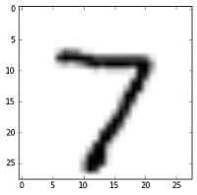
ML platform, DB integration (2/2)
TensorFlow is an open source C++/CUDA library by Google.
Example 1: teach with TF, infer with OracleDB UTL_NLA
Example 2: valve detection, R and ORE
credit: Luca Canali
SQL> exec mnist.init
PL/SQL procedure successfully completed.
SQL> select mnist.score(image_array), label from testdata_array where rownum=1;
MNIST.SCORE(IMAGE_ARRAY) LABEL
------------------------ ----------
7 7

Slide 8

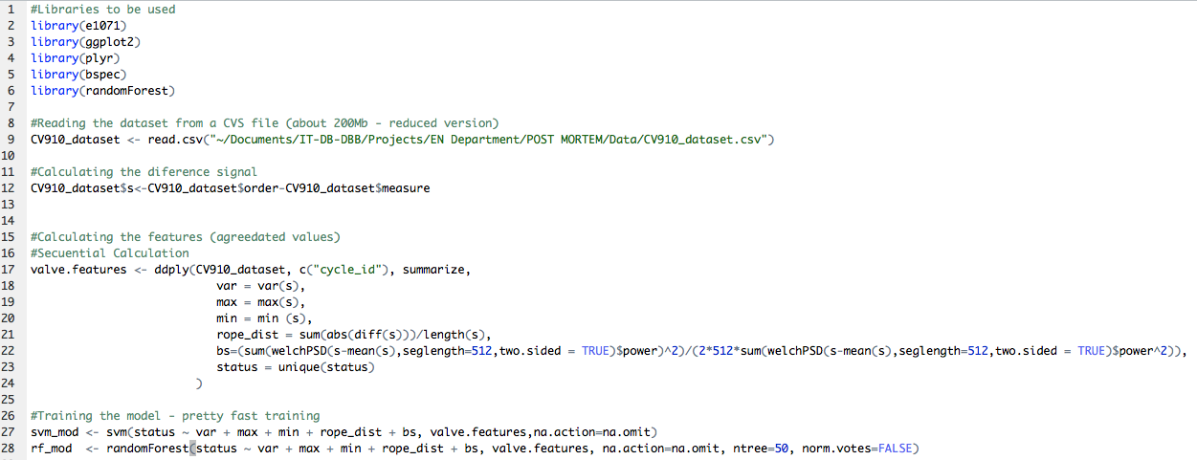
Faulty Cryogenics Valve Detection with R
Credit: Manuel Martín Márquez
Notes:
Focus on data reduction
We group the data using plyr package (R package with a set of tools for Splitting, Applying and Combining Data)
It run sequentially so good for prototyping but I wish luck and patience if you want to scale this or run it on an reasonably big dataset
Training the model is not a problem

Slide 9
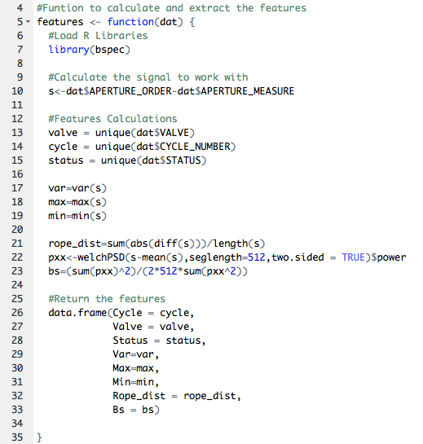
Cryo Valves – Parallel Features Extraction in ORE
Credit: Manuel Martín Márquez
Instrument/Actuators | Total
Temperature [1.6 – 300 K] Pressure [0 – 20 bar] Level Flow Control valves On/Off valves Manual valves Virtual flow meters Controllers (PID) | 10361 2300 923 2633 3692 1835 1916 325 4833
93600 points per cycle (about 24 hours)
Notes:
3692 valves * 93600 points (scalability)
Explain the code function to calculate the features but now not pylr package ORE will do the dirty work in a parallel manner using the transparency layer

Slide 10
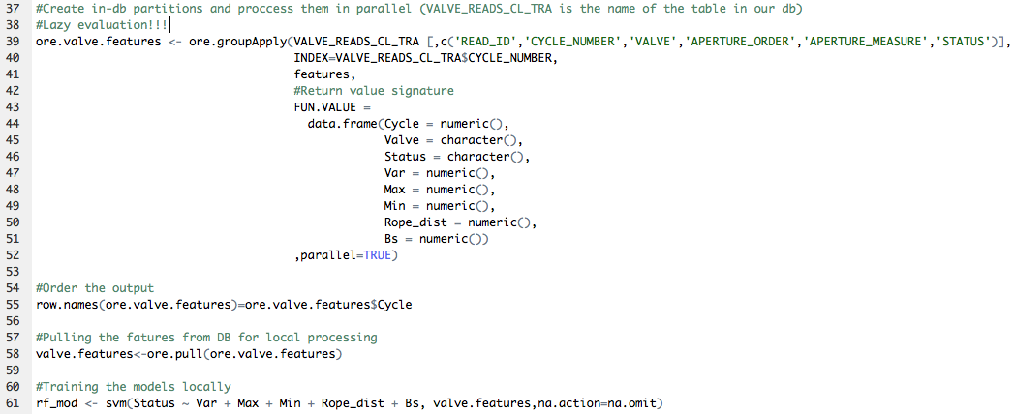
Cryo Valves – Parallel Features Extraction in ORE
Credit: Manuel Martín Márquez
Notes:
- Table view as a dataframe thanks to the transparency layer
We apply the groupby concept from database which will parallelize the execution
Lazy Evaluation the code is executed on the pull line

Slide 11
DB - ML close integration schema
Distributed ML,
efficient with GPU / dedicated processors
Database
1. exec ML.train('select x from y', 'model1', parameters);
2. select ML.score('model1',…) from z;

Slide 12
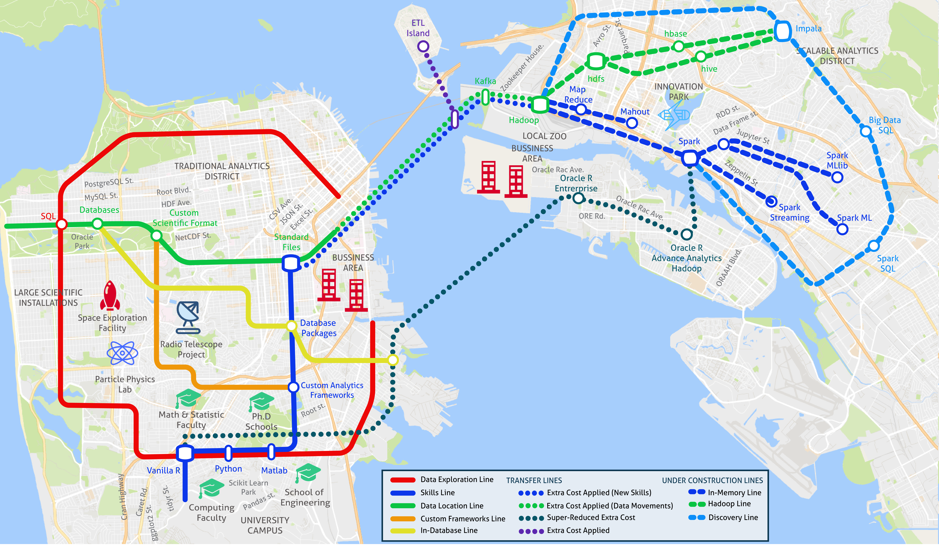
Credit: Manuel Martín Márquez

Slide 13
What to investigate…
ML+DB: lot to be done, interesting potential
classification
anomaly detection
Examples / ideas
About database data…
About database instance/s
Overload coming
Capacity issue, latency increase
Identify applications with similar patterns / anti-patterns
...
Active Session History
Blocked situation which does not unblock itself ”rapidly”
…
SQL execution
Incorrect cardinality estimates
Incorrect cost / time estimate
Execution never finishes

Slide 14
References
Playground TensorFlow http://playground.tensorflow.org/
Why big tech companies are open-sourcing their AI systems http://theconversation.com/why-big-tech-companies-are-open-sourcing-their-ai-systems-54437
The MNIST database http://yann.lecun.com/exdb/mnist/
Overcoming Missing Values In A Random Forest Classifier http://nerds.airbnb.com/overcoming-missing-values-in-a-rfc/
Higgs Boson Machine Learning Challenge https://www.kaggle.com/c/higgs-boson https://higgsml.lal.in2p3.fr/documentation/ “The goal of the Challenge is to improve the procedure that produces the selection region. We provide a training set with signal/background labels and with weights, a test set (without labels and weights), and a formal objective representing an approximation of the median significance (AMS) of the counting test.”
Hornik, Stinchcombe, and White, Neural Networks 2, 359-366 1989 http://deeplearning.cs.cmu.edu/pdfs/Kornick_et_al.pdf
Google TensorFlow https://www.tensorflow.org/ and playground https://cloud.google.com/blog/big-data/2016/07/understanding-neural-networks-with-tensorflow-playground
Advances and Challenges in Log Analysis http://queue.acm.org/detail.cfm?id=2082137
Introduction to Machine Learning for Oracle Database Professionals http://www.slideshare.net/alexgorbachev/introduction-to-machine-learning-for-oracle-database-professionals
Climate Change: Earth Surface Temperature Data https://www.kaggle.com/berkeleyearth/climate-change-earth-surface-temperature-data
CERN IT-DB Blog https://db-blog.web.cern.ch/ (A neural network scoring engine in PL/SQL for recognizing handwritten digits: http://db-blog.web.cern.ch/blog/luca-canali/2016-07-neural-network-scoring-engine-plsql-recognizing-handwritten-digits)

Slide 15
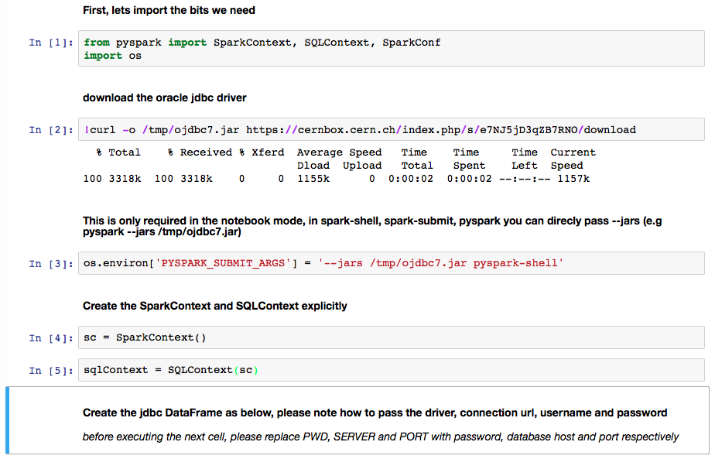
Takeaway
Credit: Manuel Martin Marquez, Antonio Romero Marin, Joeri Hermans
ML here to stay/change
Has the potential to help on some problems
Integration with the database(s)
+ Python (and R)
+ Spark
+ Notebooks

