Slide 1
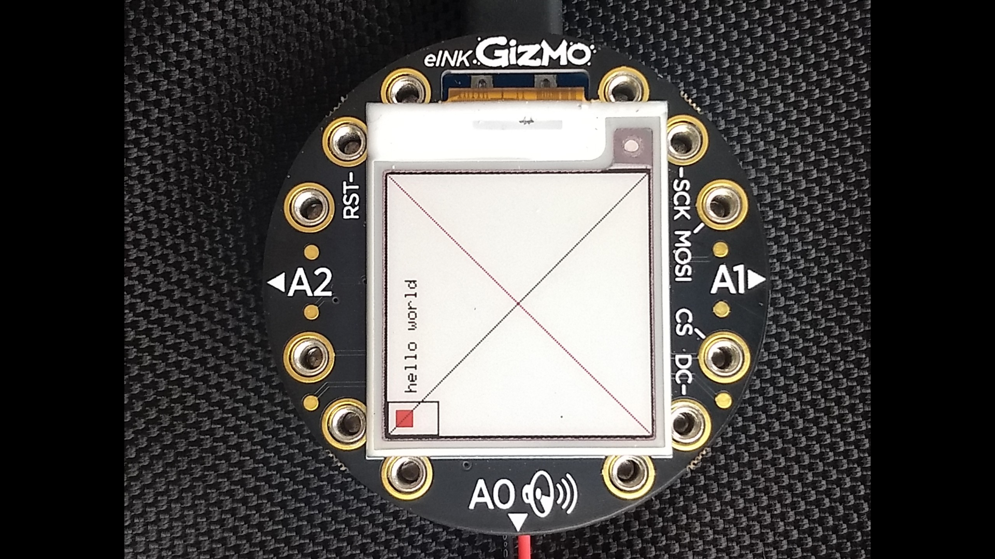

Slide 2
123,456
123,456
123,456
typeface challenge finalists
123,456
123,456
123,456
123,456

Slide 4

4 hours
123,456

Slide 5
123,456
123,456
4 hours

Slide 6
123,456
123,456
4 hours

Slide 7
123,456
4 hours

Slide 8
123,456
4 hours

Slide 9
123,456
4 hours

Slide 10
4 hours
123,456

Slide 11
4 hours
123,456

Slide 12
123,456
4 hours

Slide 13
4 hours
123,456

Slide 14
4 hours
123,456

Slide 15
0
1
2
3
4
5
6
7
8
9
,

Slide 17
123,456
123,456
123,456
123,456
123,456
123,456

Slide 18
123,456
123,456
123,456
123,456
123,456

Slide 19
123,456
123,456
123,456
123,456
123,456
123,456

Slide 20
123,456
123,456
123,456
123,456
123,456

Slide 21
123,456
123,456
123,456
123,456
123,456
123,456
123,456

Slide 22
123,456
123,456
123,456
123456
123,456
123,456

Slide 23
123,456
123,456
123,456
123,456
123,456

Slide 24
123,456

Slide 25
4 hrs
123,456

Slide 26
