Slide 1
Machine Listening for Music and Sound Analysis
Lecture 1 – Audio Representations
Muhammad Ateeque Zaryab
Dr.-Ing. Jakob Abeßer
Fraunhofer IDMT
Jakob.abesser@idmt.fraunhofer.de
https://machinelistening.github.io

Slide 2
Learning Objectives
Sound categories
Music representations
Audio representations
Audio signal decomposition
Audio features

Slide 3
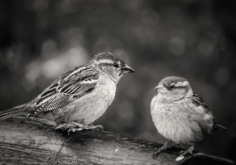
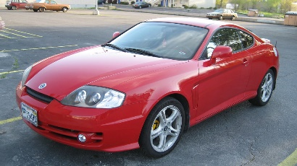


Sound Categories
Environmental Sounds
Sound sources
  Nature, climate, humans, machines
Sound characteristics
  Structured or unstructured, stationary or non-stationary, repetitive or without any predictable nature
Sound duration
  From very short (gun shot, door knock, shouts) to very long and almost stationary (running machines , wind, rain)
https://freesound.org/people/{InspectorJ/sounds/416529, prometheus888/sounds/458461, MrAuralization/sounds/317361}
https://ccsearch-dev.creativecommons.org/photos/{39451123-ee45-4ec3-ad8d-b42d856bca06, c69d3b07-76bd-43e2-a44e-8742edc8447a, ab3062ab-fe0f-420d-b93d-7451db166b4e}

Slide 4
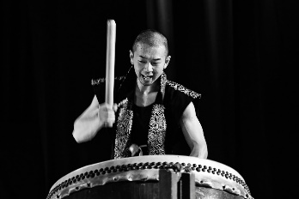
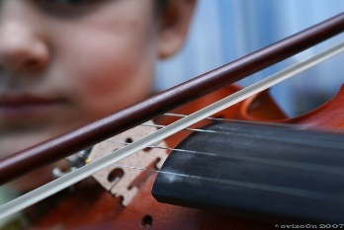
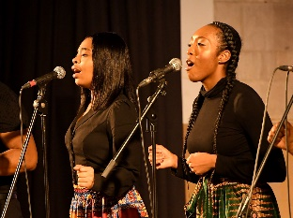
Sound Categories
Music signals
Sound sources
  Music instruments
      Sound production mechanisms (brass, wind, string, percussive)
  Singing Voice
Sound characteristics
  Mostly well structured along
      Frequency (pitch, overtone relationships, harmony)
      Time (onset, rhythm, structure)
https://freesound.org/people/{whatsanickname4u/sounds/127337, jcveliz/sounds/92002, klankbeeld/sounds/192691}
https://ccsearch-dev.creativecommons.org/photos/{a27a7541-45f5-4176-91a4-e2cb70eea266, photos/79d466c1-cfa6-417e-9832-34438678bf5d, 269394a4-5803-47fd-abaa-57ef92735e24}

Slide 5
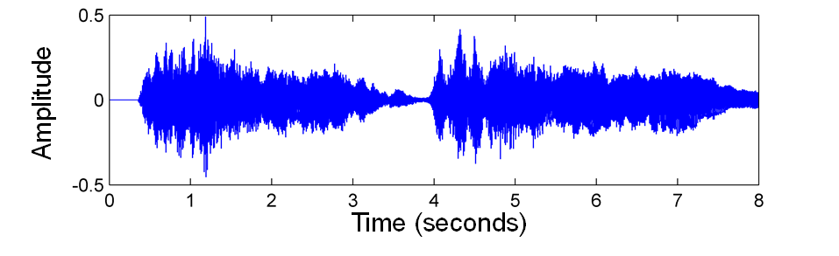
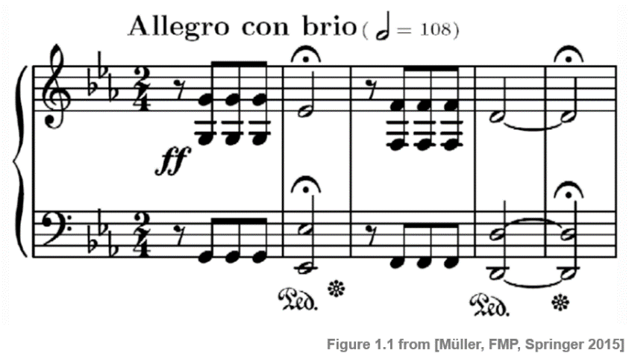
Music Representations
Recording & Notation
Music recording (waveform)
Music notation (score)
https://www.audiolabs-erlangen.de/resources/MIR/FMP/C1/C1S1_SheetMusic.html

Slide 6
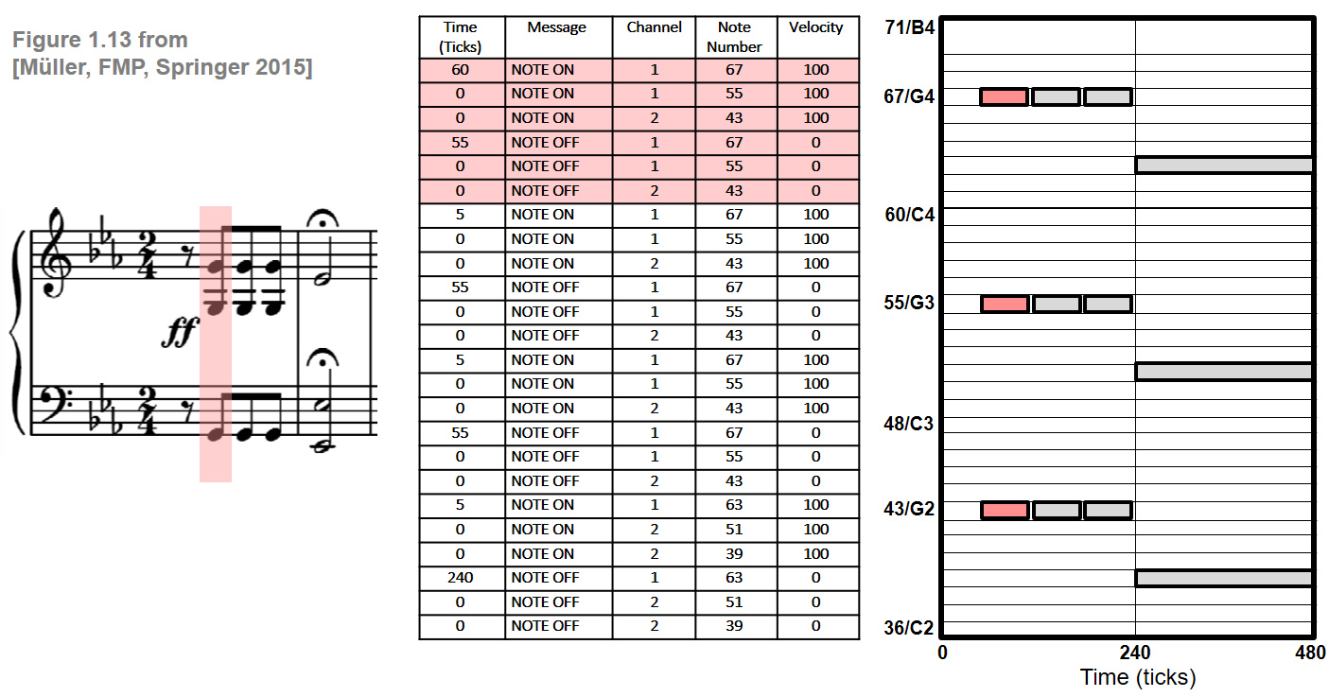
Music Representations
MIDI
Sequence of note events (MIDI)
https://www.audiolabs-erlangen.de/resources/MIR/FMP/C1/C1S2_MIDI.html

Slide 7
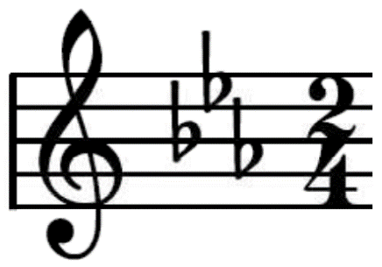
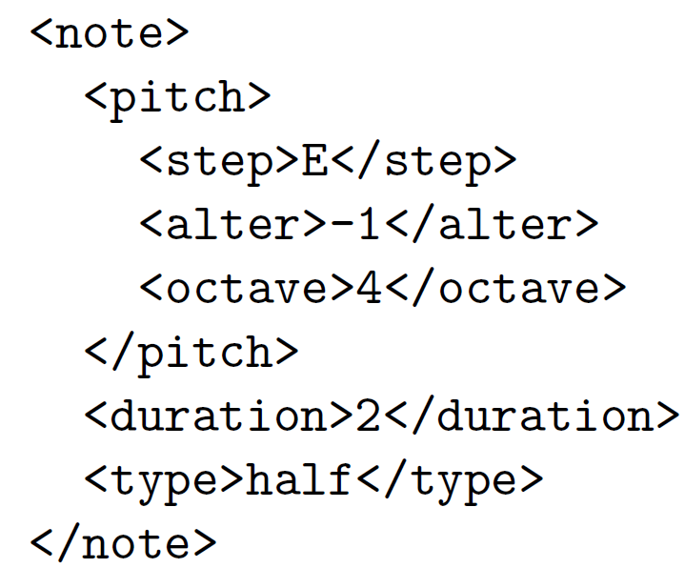
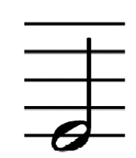
Music Representations
MusicXML
Sequence of note events (MusicXML)
Meinard Müller, Fundamentals of Music Processing, Figure 1.15, Springer 2015

Slide 8
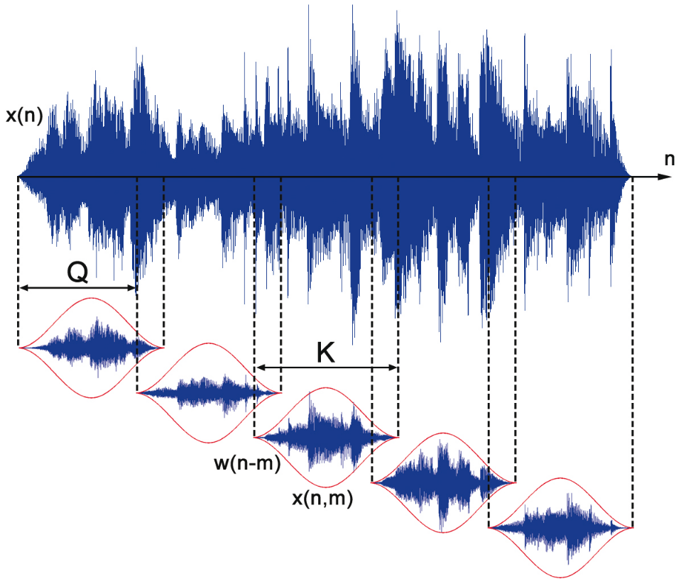
Audio Representations
Short-term (frame-by-frame) analysis of audio signals
  x(n) digital audio signal
  w(n) windowing function
  Q hopsize
  K windowsize / blocksize
Notes:
TODO replace Q -> H, K -> N
- Avoid spectral leakage by filtering

Slide 9
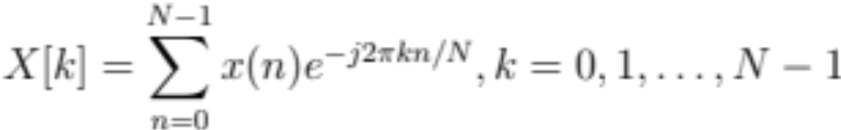
Audio Representations
Short-term Fourier Transform (STFT)
Short-term Fourier Transform (STFT)
  Discrete Fourier Transform (DFT)
  Instead of full signal, short (overlapping) windowed segments are used
  Linearly-spaced frequency axis & fixed resolution
  Trade-off between
    Frequency resolution (separate close frequency components)
    Time resolution
https://www.audiolabs-erlangen.de/resources/MIR/FMP/C2/C2_STFT-Basic.html
Notes:
Eq1 X[k] = \sum_{n=0}^{N-1} x(n) e^{-j2\pi kn / N}, k = 0,1,\ldots, N-1

Slide 10
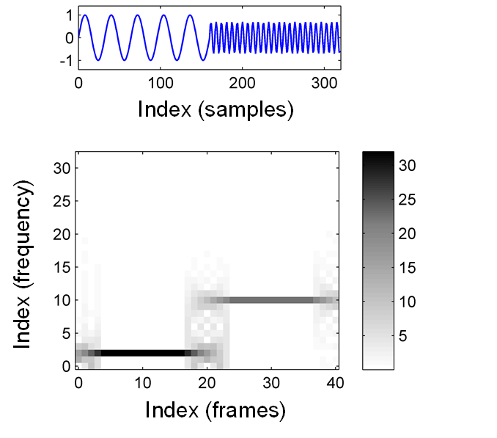
Audio Representations
Short-term Fourier Transform (STFT)
Example: Sinosoid signal, two frequencies
Meinard Müller, Fundamentals of Music Processing, Figure 2.9, Springer 2015

Slide 11
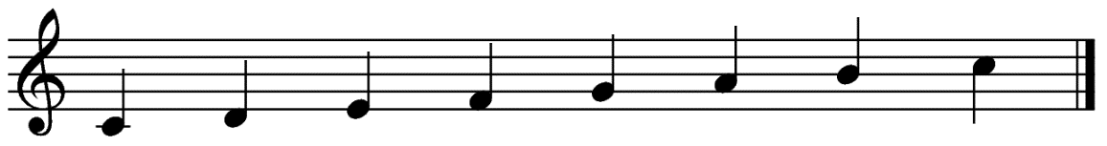
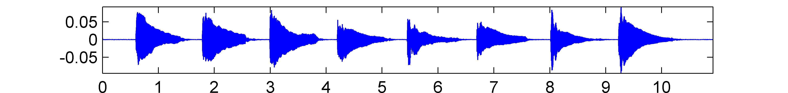
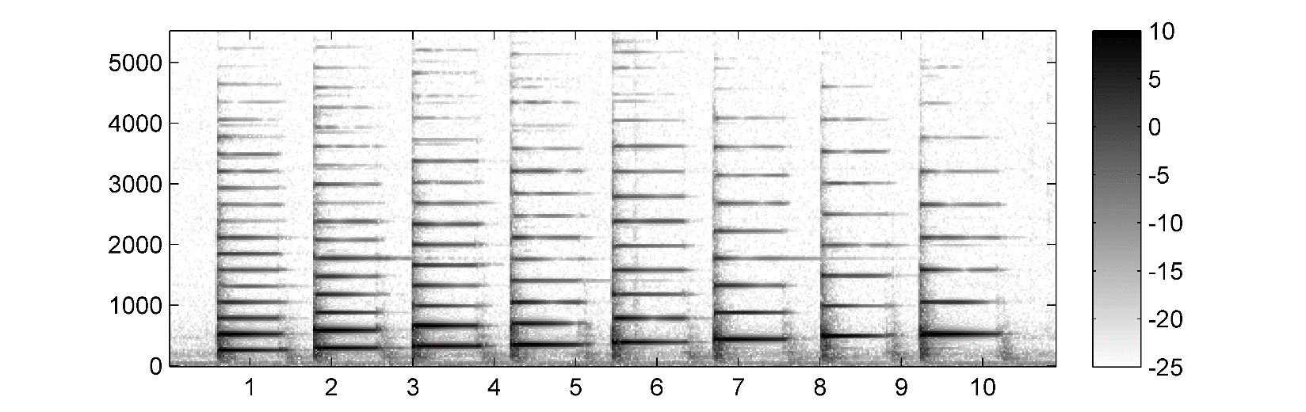
Audio Representations
Short-term Fourier Transform (STFT)
Example: C major scale, fundamental frequency & overtones
Meinard Müller, Fundamentals of Music Processing, Figure 2.10, Springer 2015
Notes:
https://www.audiolabs-erlangen.de/resources/MIR/FMP/C2/C2_STFT-Basic.html#Example

Slide 12
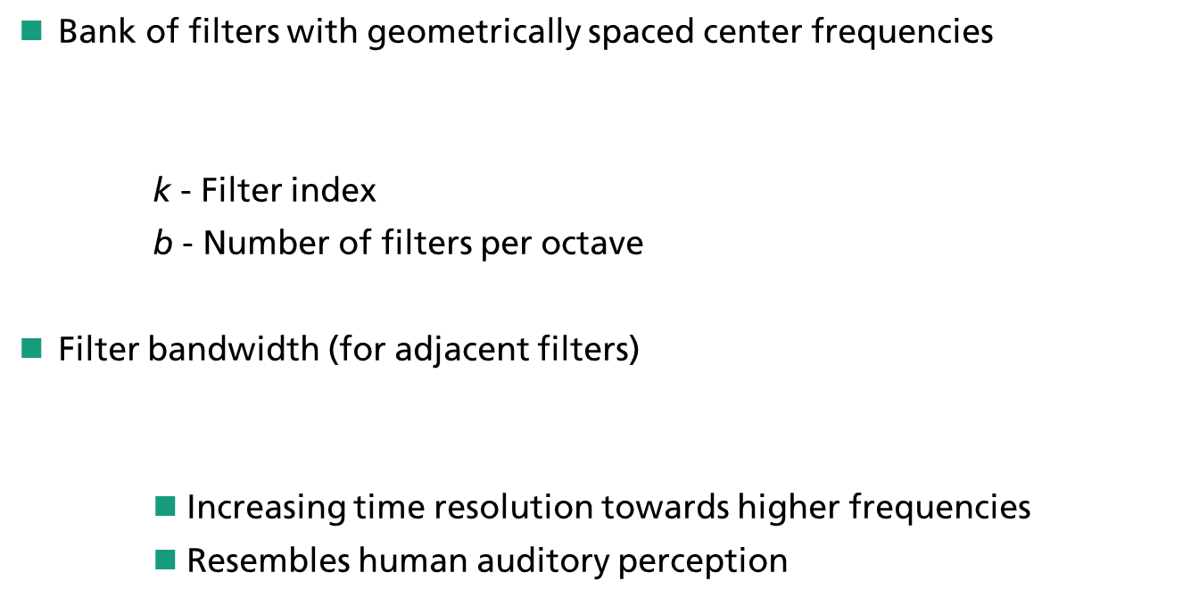

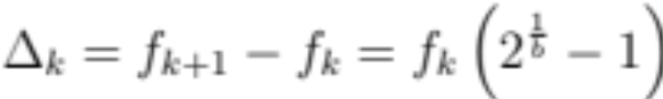
Audio Representations
Constant-Q Transform (CQT)
Notes:
TODO: plot filter?
http://doc.ml.tu-berlin.de/bbci/material/publications/Bla_constQ.pdf
https://latex.codecogs.com/legacy/eqneditor/editor.php
Eq 1
f_k = f_0 \cdot 2^{k/b}
Eq 2
\Delta_k = f_{k+1} - f_k = f_k\left( 2^{\frac{1}{b}} - 1\right)
Eq 3
Q = \frac{f_k}{\Delta_k} = \frac{1}{2^{\frac{1}{b}-1}}
Eq 4
f_m \text{[Hz]} = 440 \cdot 2^{\frac{m-69}{12}}

Slide 13
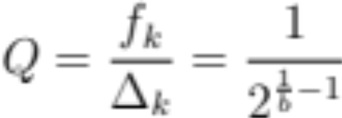

Audio Representations
Constant-Q Transform (CQT)
Constant frequency-to-resolution ratio
Correspondence to musical note frequencies
    m – MIDI pitch
    A4 (440 Hz) – reference pitch
Notes:
TODO add alternative to second eqn without -69 term
http://doc.ml.tu-berlin.de/bbci/material/publications/Bla_constQ.pdf
https://latex.codecogs.com/legacy/eqneditor/editor.php
Eq 1
f_k = f_0 \cdot 2^{k/b}
Eq 2
\Delta_k = f_{k+1} - f_k = f_k\left( 2^{\frac{1}{b}} - 1\right)
Eq 3
Q = \frac{f_k}{\Delta_k} = \frac{1}{2^{\frac{1}{b}-1}}
Eq 4
f_m \text{[Hz]} = 440 \cdot 2^{\frac{m-69}{12}}

Slide 14
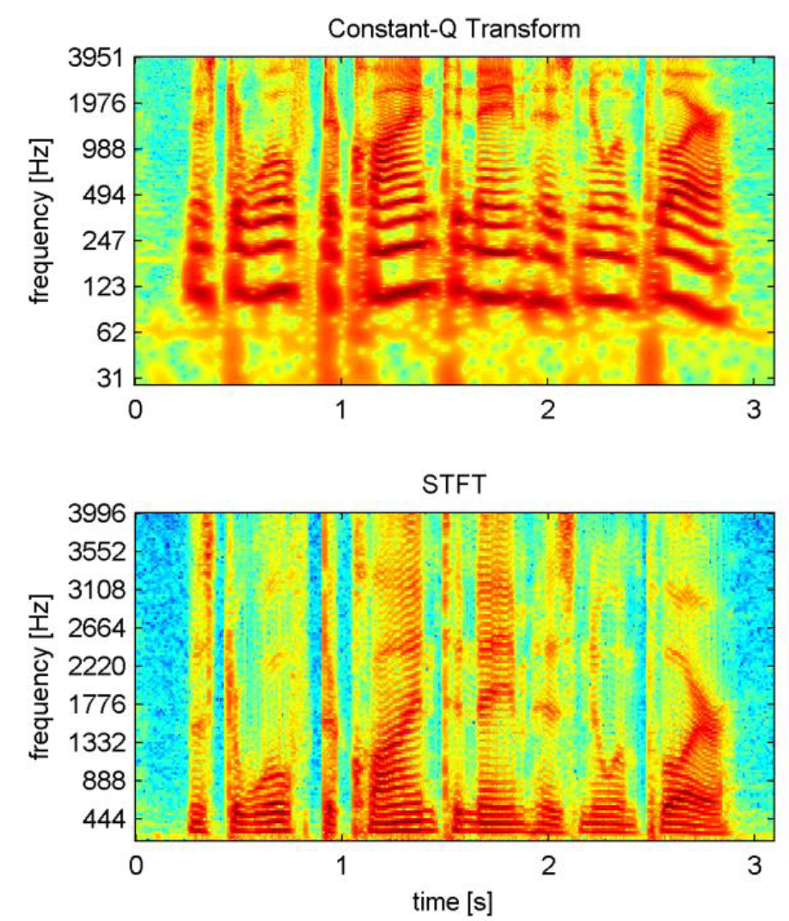
Audio Representations
Constant-Q Transform (CQT)
Example signal (CQT vs. STFT)

Slide 15
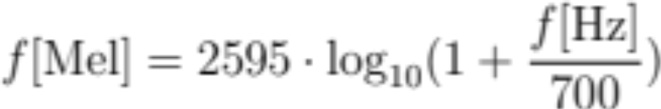
Audio Representations
Mel Spectrogram
Mel frequency scale (Stevens et al., 1937)
    Describes perceived pitch of sinosoidal frequencies
Mel spectrogram
    Time-frequency representation sampled around
      Equally spaced times
      Frequency points along the mel-scale
Notes:
TODO plot fmel vs. fhz
https://www.fon.hum.uva.nl/praat/manual/MelSpectrogram.html
Eq4
f\text{[Mel]} = 2595 \cdot \log_{10}(1+\frac{f\text{[Hz]}}{700})

Slide 16
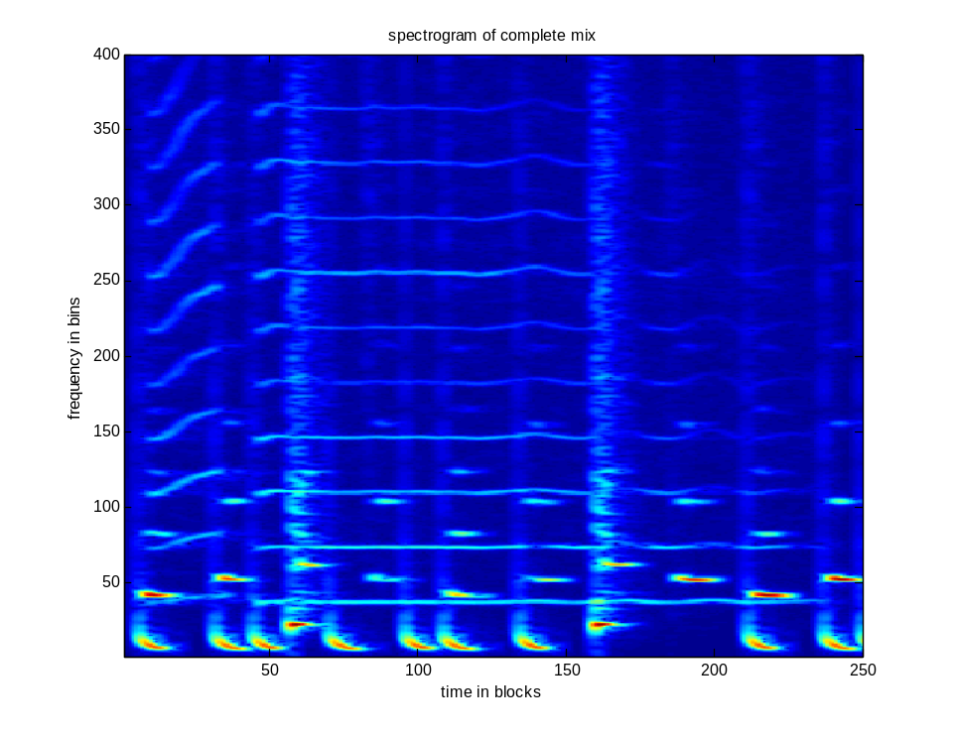
Audio Signal Decomposition
Music mixtures
Instrument mixture (STFT magnitude spectrogram)
  Bass + melody (saxophone) + drums

Slide 17
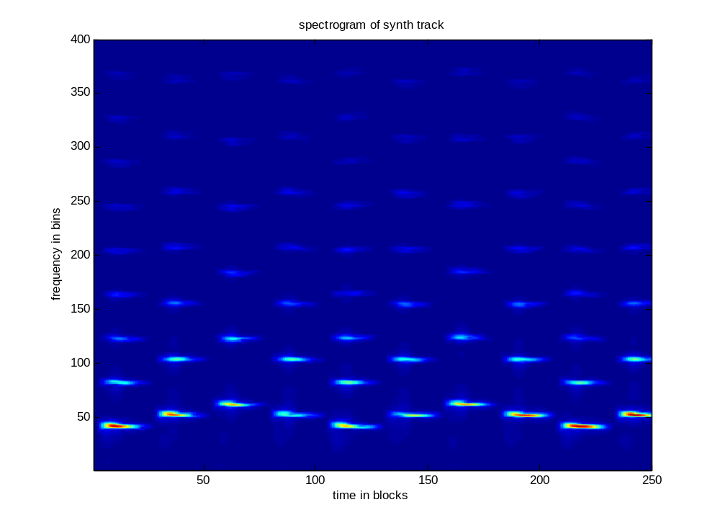
Audio Signal Decomposition
Music mixtures
Bass
  Harmonic structure, stable tones
Higher pitch - spectrum stretched
Lower pitch - spectrum compressed

Slide 18
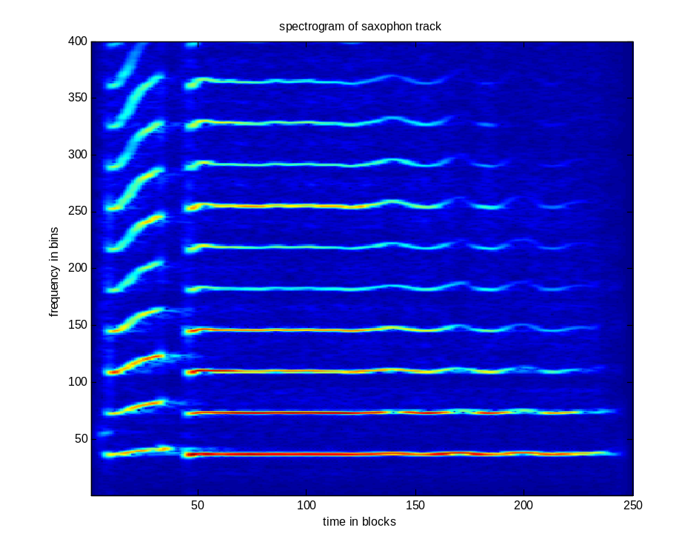
Audio Signal Decomposition
Music mixtures
Melody (saxophone)
  Harmonic components (melody)
Harmonic overtones
≈ timbre
Fundamental frequency f₀ ≈ pitch

Slide 19
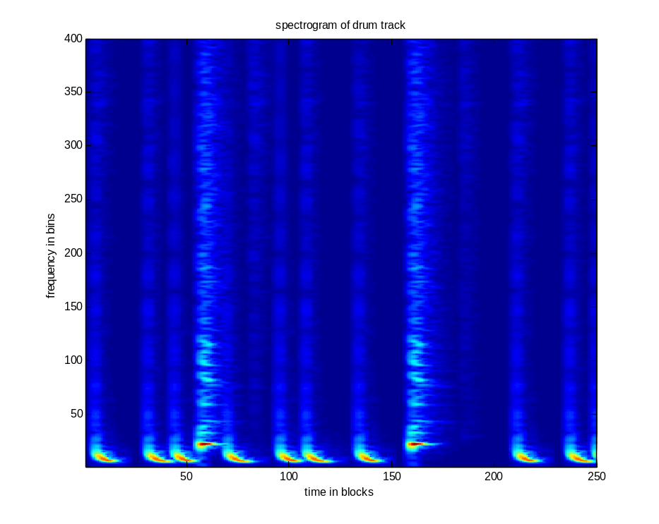
Audio Signal Decomposition
Music mixtures
Drums
  Percussive components (noise-like, inharmonic spectra)
Snare drum (low frequencies)
Bass drum (low frequencies)

Slide 20
Audio Signal Decomposition
Music mixtures
Instrument mixture (magnitude STFT)
  All components add up to the mix signal

Slide 21
Audio Features
Motivation
Compact representation of audio signal for machine learning applications
Capture different properties at different semantic levels
  Timbre – perceived sound, instrumentation
  Rhythm – tempo, meter
  Melody/Tonality – pitches, harmonies
  Structure - repetitions
Notes:
TODO add that this captures local information
TODO introduce notation ?

Slide 22
Audio Features
Categorization
 | Timbre | Rhythm | Tonality
Low-level (Q~10 ms) | Zero Crossing Rate (ZCR) Linear Predictive Coding (LPC) Spectral centroid / flatness
Mid-level (Q ~ 2.5s) | Mel-frequency Cepstral Coefficients (MFCC) Octave-based Spectral Contrast (OSC) Loudness | Tempogram Log-lag Autocorrelation (ACF) | Chromagram Enhanced Pitch Class Profiles (EPCP)
High-level | Instrumentation | Tempo Time signature Rhythm patterns | Key Scales Chords

Slide 23
Audio Features
Timbre
Timbre
  Timbre distinguishes musical sounds that have the same pitch (fundamental frequency) and loudness
  Affected by different acoustic phenomena such as
    Spectral structure / envelope of overtones
    Noise-like components
    Formants (speech)
    Inharmonicity (inharmonic relationship between overtones)
    Variations over time: frequency (vibrato) or loudness (tremolo)
https://www.audiolabs-erlangen.de/resources/MIR/FMP/C1/C1S3_Timbre.html

Slide 24
Audio Features
Timbre
Timbre
  When looking at musical instruments, we need to consider
    Instrument construction
    Sound production principles
      Membranophones, chordophones, aerophones, electrophones
    Human performance
      Playing techniques, expressivity, dynamics, style
How do design features to quantify these acoustic phenomena?

Slide 25
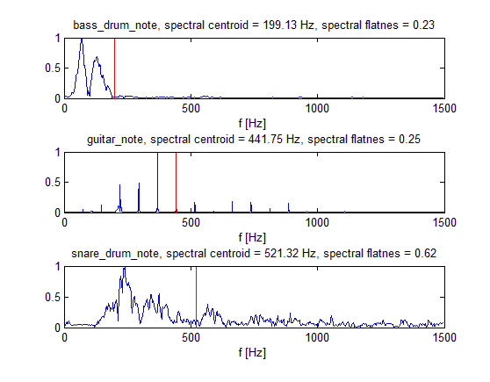
Audio Features
Low-level Audio Features
Spectral Centroid (SC):
  Center of mass in the magnitude spectrogram
  Low-pitched vs. high-pitched sounds
Spectral Flatness Measure (SFM)
  Measure of flatness
  Harmonic sounds (sparse energy distribution) vs. percussive sounds (wideband energy distribution)

Slide 26
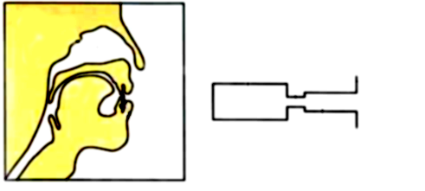
Audio Features
Timbre Mid-level Audio Features: MFCC
Convolutive excitation * filter model
  Excitation: vibration of vocal folds
  Filter: resonance of the vocal tract
FFT magnitude spectrum
  Multiplicative excitation · filter model
Logarithm of magnitude spectrum
  Additive excitation + filter model
Separation into
  Smooth spectral envelope
  Fine-structured excitation spectrum via „liftering“→ commonly done via Discrete Cosine Transform (and inverse)

Slide 27
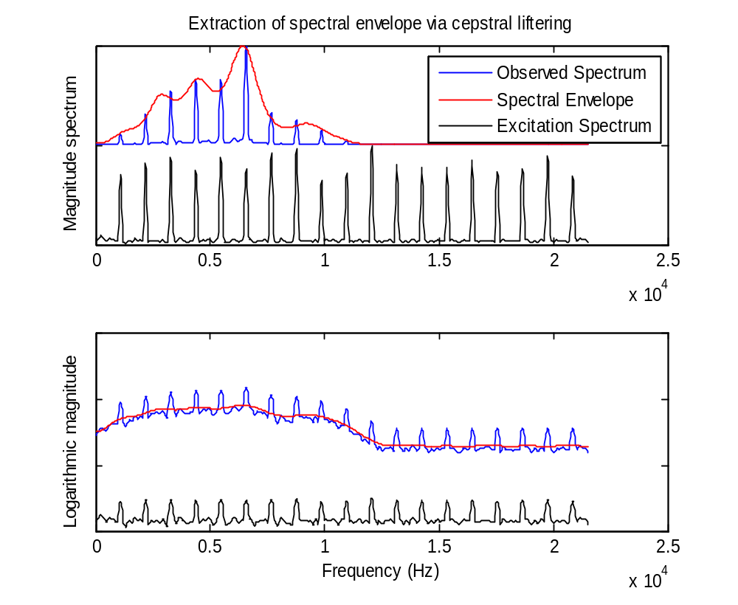
Audio Features
Timbre Mid-level Audio Features: MFCC
Example

Slide 28
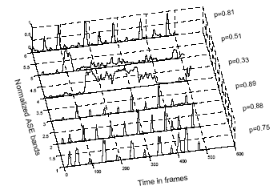
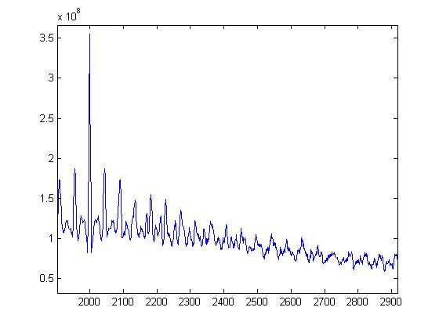
Audio Features
Rhythmic Mid-level Audio Features
Rhythmic properties important for audio classification
Audio Spectral Energy (ASE)
  Weighted sum of energy slope in single bands
  Find Periodicities via auto-correlation Function (ACF) on resulting detection function

Slide 29
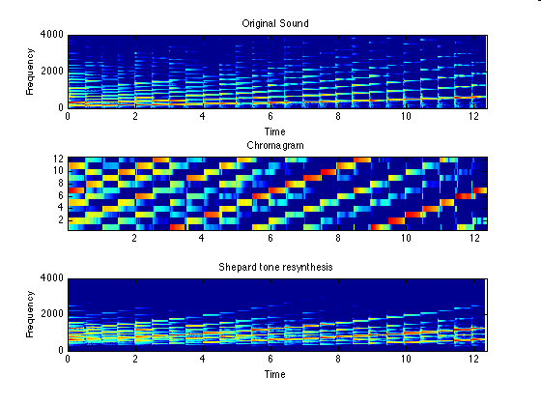
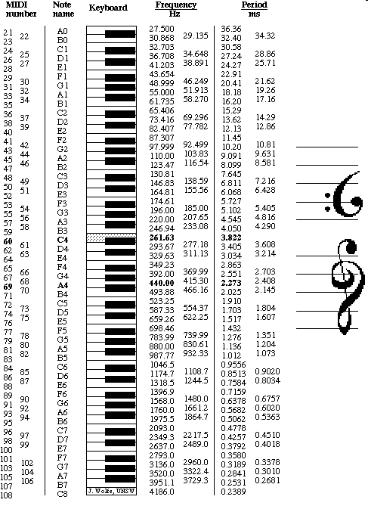
Audio Features
Tonal Mid-level Audio Features
Chromagram

Slide 30
Summary
Sound categories
Music representations
Audio representations
Audio signal decomposition
Audio features

Slide 31
Thank you!
Any questions?
Dr.-Ing. Jakob Abeßer
Fraunhofer IDMT
Jakob.abesser@idmt.fraunhofer.de
https://machinelistening.github.io

