Slide 1
Machine Listening for Music and Sound Analysis
Lecture 2 – Machine Learning
Muhammad Ateeque Zaryab
Dr.-Ing. Jakob Abeßer
Fraunhofer IDMT
Jakob.abesser@idmt.fraunhofer.de
https://machinelistening.github.io

Slide 2
Learning Objectives
Introduction
Learning paradigms
Machine learning (ML) project pipeline
Deep learning
Notes:
Introduction – Terminology, Application Scenarios
Deep Learning – Learning Principle, Architectures

Slide 3
Introduction
Goals
  “...give computers the ability to learn without being explicitly programmed“ [Samuels, 1959]
  Learning structures in given (un)labeled data to make predictions on new / unseen data
Paradigm change
  Now: joint representation learning (features) & data modeling (classification)
  Before: manually designed / general-purpose features
Related disciplines
  Statistics, data science, optimization

Slide 4
Introduction
Terminology
Artificial Intelligence (AI)
  „an agent‘s ability to achieve goals in a wide range of environments“ [Legg & Hutter, 2007]
Machine Learning (ML)
  Pattern recognition, data modeling, learning, prediction
Deep Learning (DL)
  (Brain-inspired) artificial neural networks (ANN)
Data Science
  Knowledge extraction from data
Artificial
Intelligence
Machine Learning
Deep Learning
Data Science

Slide 5
Introduction
Application Scenarios
Computational finance (credit scoring, algorithmic trading)
Computer vision (face & object recognition, motion detection)
Computational biology (tumor detection, drug discovery, DNA sequencing)
Energy (price & load forecasting)
Predictive Maintenance (automotive, aerospace, manufacturing)
Natural language processing (sentiment classification, text search, translation)
Machine Listening (music transcription, instrument recognition, sound event detection, acoustic scene classification)

Slide 6
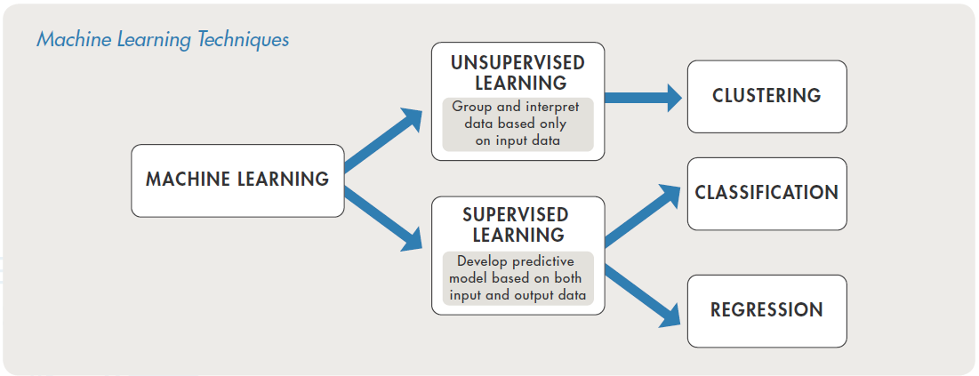
Learning Paradigms
https://images.app.goo.gl/QPWQZ3yXnN6CgTn49

Slide 7
Learning Paradigms
[2]
https://images.app.goo.gl/QPWQZ3yXnN6CgTn49

Slide 8
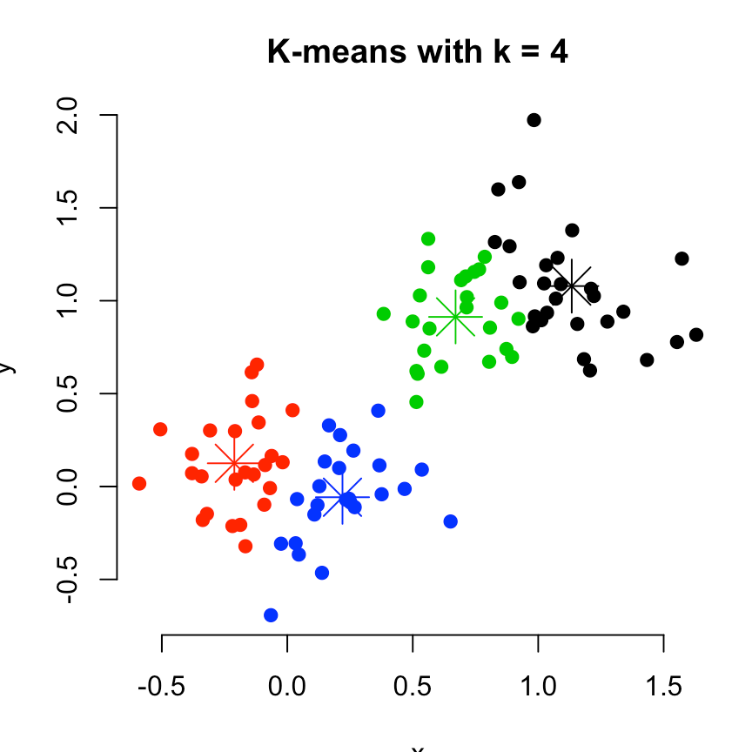
Learning Paradigms
Unsupervised Learning
Goal
  Model hidden structure in data
  Density estimation
Example
  K-means clustering
    Data partitioning into K clusters
    Minimize within-cluster variance
https://i0.wp.com/www.sthda.com/sthda/RDoc/figure/clustering/ partitioning-cluster-analysis-k-means-plot-4-groups-1.png

Slide 9
Learning Paradigms
Supervised Learning
[2]
https://images.app.goo.gl/QPWQZ3yXnN6CgTn49

Slide 10
Learning Paradigms
Supervised Learning
Model parameters
Θ
Update
Features
X
Prediction
function
Cost function
e.g. images, audio samples
Targets
y
e.g. object class (cat, dog, …) or quantity (e.g. house price)

Slide 11
Learning Paradigms
Supervised Learning - Classification
[2]
https://images.app.goo.gl/QPWQZ3yXnN6CgTn49

Slide 12
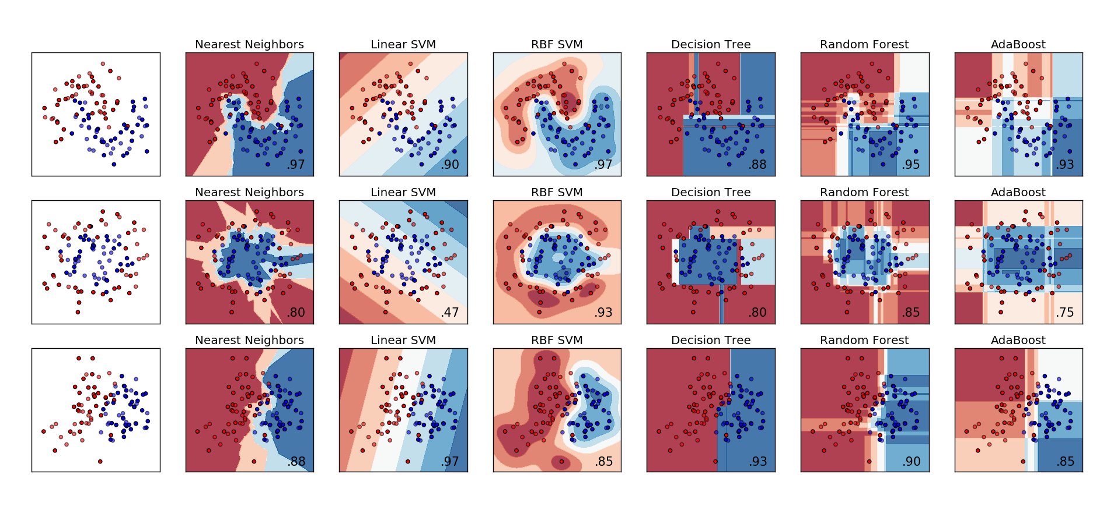
Learning Paradigms
Supervised Learning - Classification
Predict one / multiple categorical label from features
  Examples → music genre, instrument(s), key
Feature space modeling (Example: 2 classes)
https://scikit-learn.org/stable/auto_examples/classification/ plot_classifier_comparison.html
https://i.stack.imgur.com/hsilO.png
Notes:
https://i.stack.imgur.com/hsilO.png

Slide 13
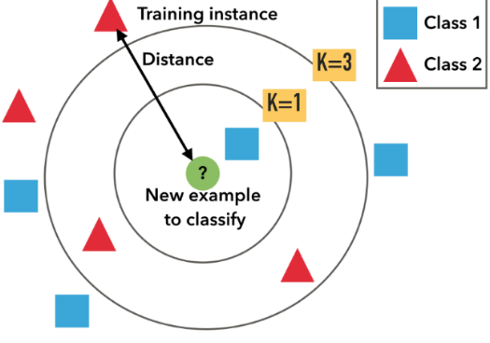
Learning Paradigms
Supervised Learning - Classification
Example: K-Nearest Neighbors
  Training → store all examples
  Development → find best K
  Test → assign test item to dominant class label of the K closest training data items
Distance measures
  Euclidean distance, manhattan distance, cosine distance, …
https://miro.medium.com/max/975/1*OyYyr9qY-w8RkaRh2TKo0w.png
Notes:
https://i0.wp.com/www.sthda.com/sthda/RDoc/figure/clustering/partitioning-cluster-analysis-k-means-plot-4-groups-1.png

Slide 14
Machine Learning
https://images.app.goo.gl/QPWQZ3yXnN6CgTn49

Slide 15
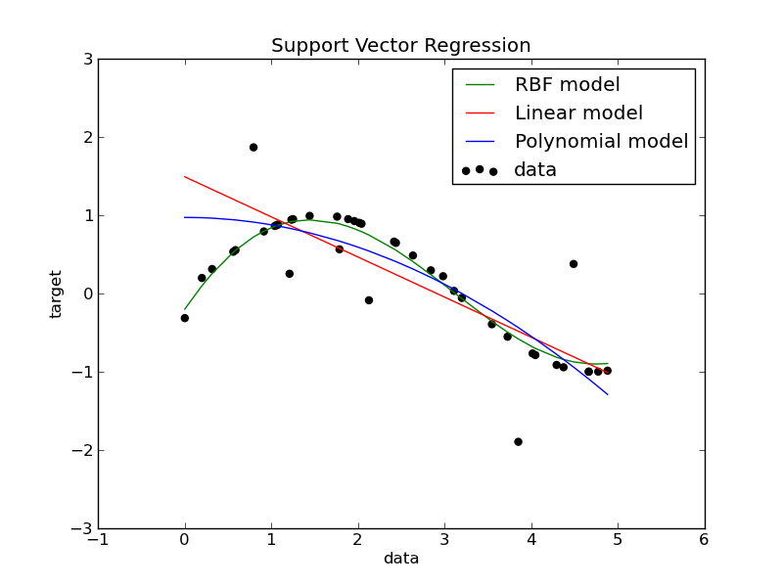
Learning Paradigms
Supervised Learning - Regression
Predicting a continuous quantity from features
Examples
  House price prediction
Notes:
https://i0.wp.com/www.sthda.com/sthda/RDoc/figure/clustering/partitioning-cluster-analysis-k-means-plot-4-groups-1.png

Slide 16
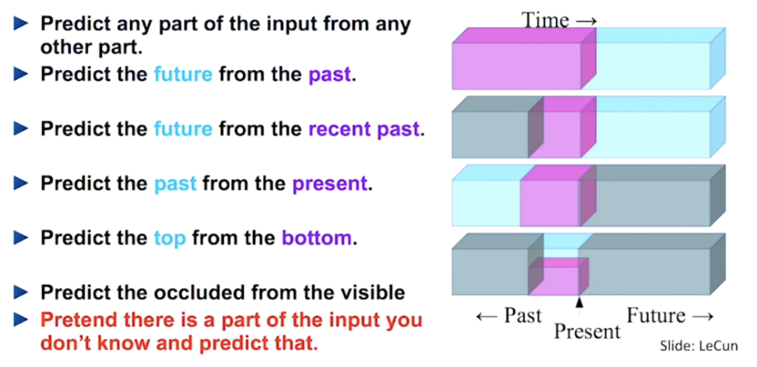
Learning Paradigms
Self-supervised Learning
Problem:
  Supervised learning requires a lot of (annotated) data → expensive!
Solution:
  Train model on related (proxy) task (derive labels from the data!)
  Transfer learning → Train model with fewer data on target task (e.g. sentiment classification in text)
https://lilianweng.github.io/lil-log/assets/images/self-sup-lecun.png

Slide 17
ML Project Pipeline
Data Collection & Pre-Processing
X, y
Data Split
e.g. 80%
10%
10%
Training Data
Validation Data
Test Data
Model Selection
Model Training
Model Validation
Model Testing
Parameter Optimization
Metrics

Slide 18
ML Project Pipeline
Data Collection & Pre-Processing
Data collection
  Check for available data resources for given (or related) task
  Collect / record / annotate new data
  Ensure data variability
    Example (acoustic condition monitoring) → include different motor engine types & conditions, recording locations, microphones, …
Data pre-processing
  Cleanup remove errors, silence, empty files, …
  Balance dataset (proportion among class examples)
  Normalize (depends on the model)

Slide 19
ML Project Pipeline
Data Split
Training Set
  Model learns from this data
Validation Set (a.k.a development / dev set)
  Used to fine-tune the model (hyper)parameters
  Model occasionally sees but does not learn from this data
Test set
  Only used once after the model training & tuning is completed
  Should reflect the targeted real-world use case for the model
Common split ratios
  80% - 10% - 10% or even 98% - 1% - 1% (for bigger datasets)

Slide 20
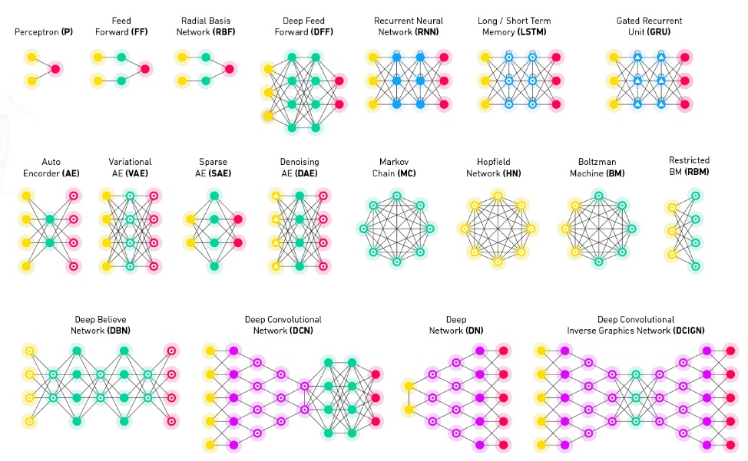
ML Project Pipeline
Model Selection
Many models and approaches exist
  Types (SVM, GMM, logistic regression, DNNs)
  Hyperparameters (SVM kernel functions, DNN layer types)
Often constrained by the use-case / task
  Model complexity (memory, training time, training data amount)
Different models require different feature pre-processing
Use simple models for simple tasks
https://docs.paperspace.com/machine-learning/wiki/machine-learning-models-explained

Slide 21
ML Project Pipeline
Model Training
Iterative process
  Use (batches) of training data to iteratively improve model predictions (optimization)
    Learn from examples
  Update model parameters according to loss function
Often start with random parameter initialization

Slide 22
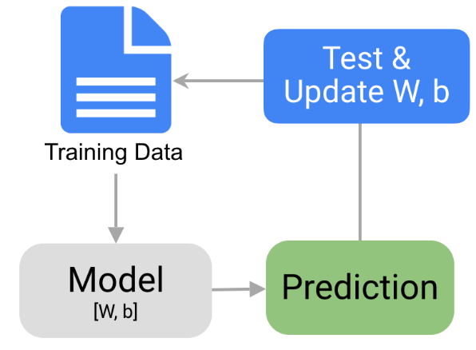
ML Project Pipeline
Model Training
Example: linear regression
Training loop
y → target (output)
x → features (input)
W → weights
b → bias
y = W · x + b

Slide 23
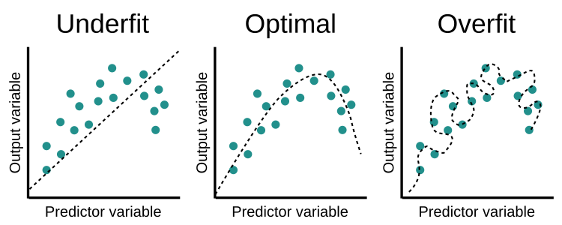
ML Project Pipeline
Model Validation
Unbiased evaluation of the model after each training iteration
Helps to
  optimize model (hyper)parameters
  detect overfitting on training data
  stop the training
Stop here!
Validation data
Loss
Training data
Training Iterations
https://www.educative.io/api/edpresso/shot/6668977167138816/
image/5033807687188480
Notes:
https://www.educative.io/api/edpresso/shot/6668977167138816/image/5033807687188480

Slide 24
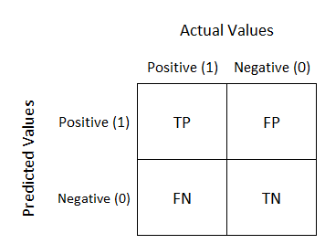
ML Project Pipeline
Model Testing
Final model evaluation
Test set should reflect final application scenario (same data distribution)
Evaluation metrics (binary classification)
  Accuracy – % of correct classifications
  Recall - % of actual positive examples were classified as positive
  Precision - % of positive predictions are actually positive
  F-Score – harmonic mean of precision and recall
https://miro.medium.com/max/534/1*Z54JgbS4DUwWSknhDCvNTQ.png
Notes:
https://miro.medium.com/max/534/1*Z54JgbS4DUwWSknhDCvNTQ.png

Slide 25
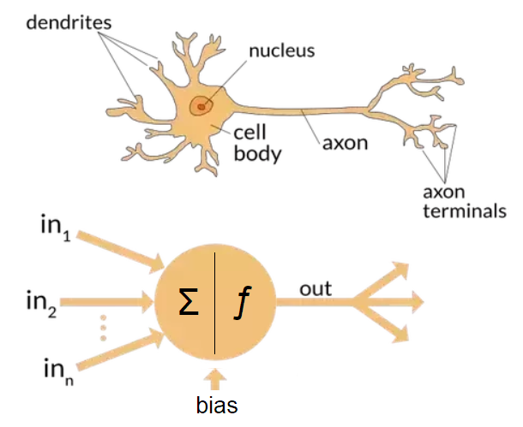
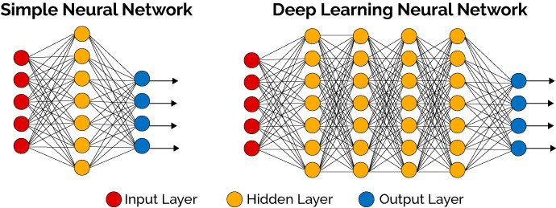
Deep Learning
Introduction
Artificial neural networks → mimic brain processing
  Connected neurons (weighted input summation & non-linear processing)
Deep neural networks → multiple layers
https://miro.medium.com/max/915/1*SJPacPhP4KDEB1AdhOFy_Q.png
https://www.skampakis.com/wp-content/uploads/2018/03/simple_neural_network_vs_deep_learning.jpg
Notes:
https://www.skampakis.com/wp-content/uploads/2018/03/simple_neural_network_vs_deep_learning.jpg

Slide 26
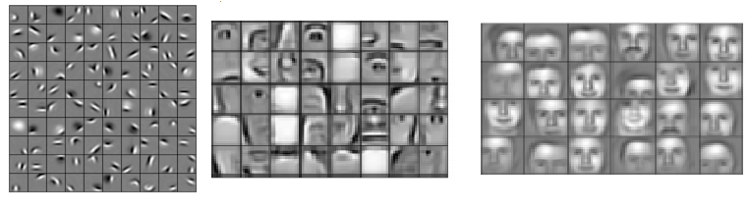
Deep Learning
Introduction
Hierarchical feature learning
  Example (face recognition)
Edges, curves
Shapes, object parts
Objects (faces)
First layers
Final layers
https://pic4.zhimg.com/80/v2-057b248288a8af2f01272a956f862873_1440w.png
Notes:
https://pic4.zhimg.com/80/v2-057b248288a8af2f01272a956f862873_1440w.png

Slide 27
Deep Learning
Deep Neural Networks
Input layer
Hidden layers
Output layer
x
a₁
a₂
a₃
y
z₄ = W₄ a₃ + b₄
y = g(z₄)
1) Weights w & bias b
2) Non-linear activation function g(z)
W₁, b₁
W₂, b₂
W₃, b₃
z₁ = W₁ x + b₁
a₁ = g(z₁)
z₂ = W₂ a₁ + b₂
a₂ = g(z₂)
z₃ = W₃ a₂ + b₃
a₃ = g(z₃)
Notes:
https://miro.medium.com/max/534/1*Z54JgbS4DUwWSknhDCvNTQ.png

Slide 28
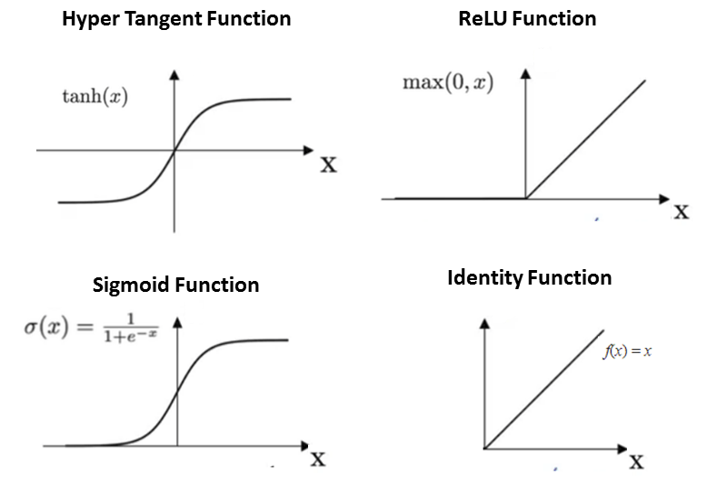
Deep Learning
Activation Functions
Activation functions add non-linearity
Make networks more powerful in (complex) pattern recognition
Examples:
https://blog.e-kursy.it/deeplearning4j-workshop/video/html/ presentation_specific/img/4_activation_functions.png
Notes:
https://miro.medium.com/max/534/1*Z54JgbS4DUwWSknhDCvNTQ.png

Slide 29
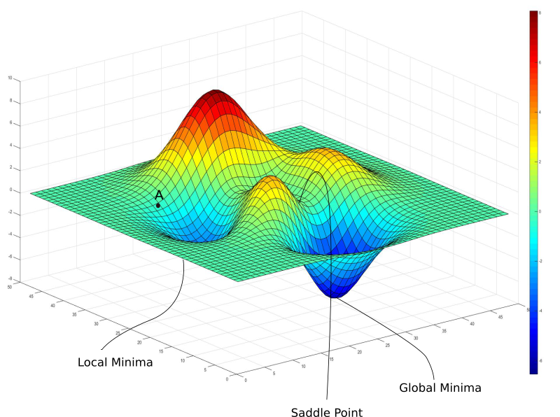
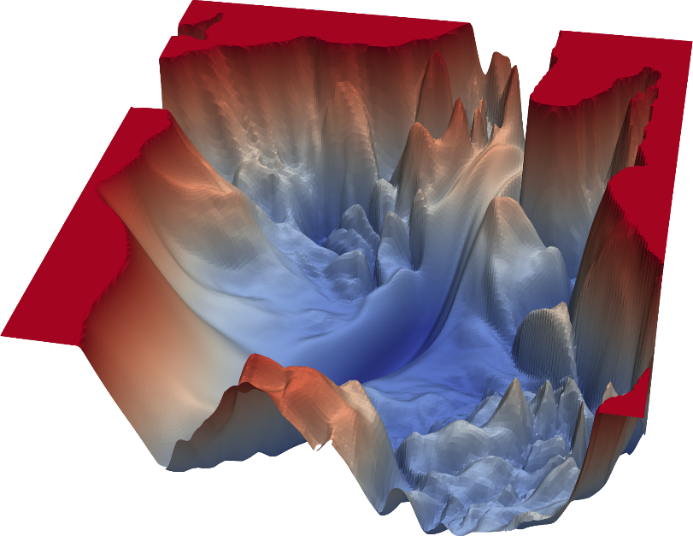
Deep Learning
Training
Loss contour
  Goal → find global minima
Toy example
Complex DNN
https://blog.paperspace.com/content/images/2018/05/challenges-1.png
https://www.cs.umd.edu/~tomg/img/landscapes/noshort.png

Slide 30
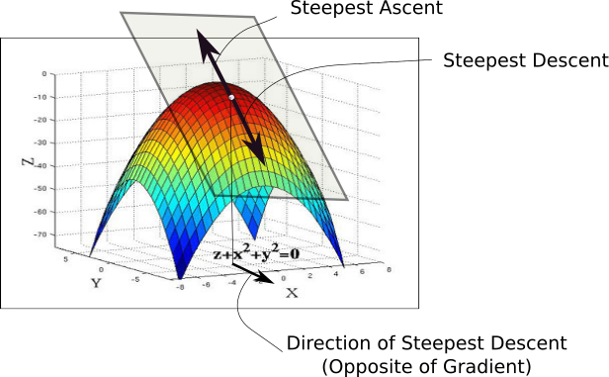
Deep Learning
Training
Gradient descend
  Move into opposite direction of gradient
  Learning rate effects step size
https://blog.paperspace.com/content/images/2018/05/grad.png

Slide 31
Deep Learning
Training
Back propagation
Model parameters
Θ
Weight update
Gradient w.r.t model weights
https://www.skampakis.com/wp-content/uploads/2018/03/simple_neural_network_vs_deep_learning.jpg
Backward propagation
Features
X
DNN
Loss
Forward propagation
Prediction y
^
Targets
y

Slide 32
Deep Learning
Playground
A neural network playground!
  https://playground.tensorflow.org

Slide 33
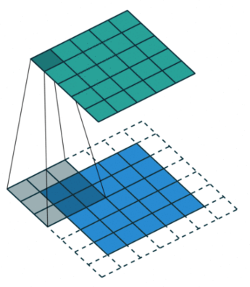
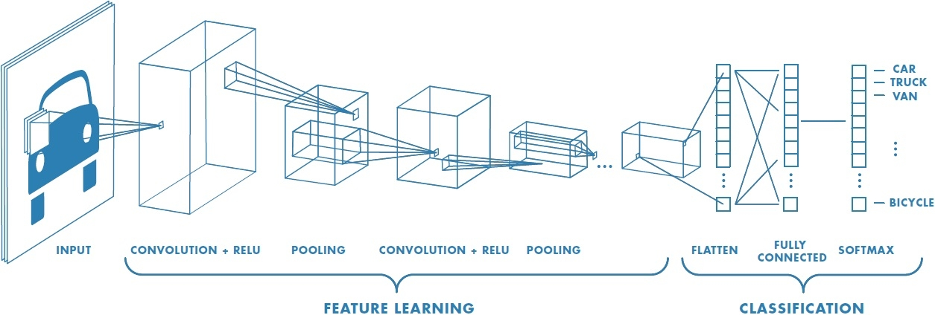
Deep Learning
Convolutional Neural Networks (CNN)
Convolutional layers
  Local connectivity → receptive field
  Shared weights
  Translation Equivariance → translation of input = translation of activations
Pooling → local aggregation
https://www.wandb.com/articles/intro-to-cnns-with-wandb
https://www.freecodecamp.org/news/an-intuitive-guide-to-convolutional-neural-networks-260c2de0a050/
Notes:
TODO add URLs

Slide 34
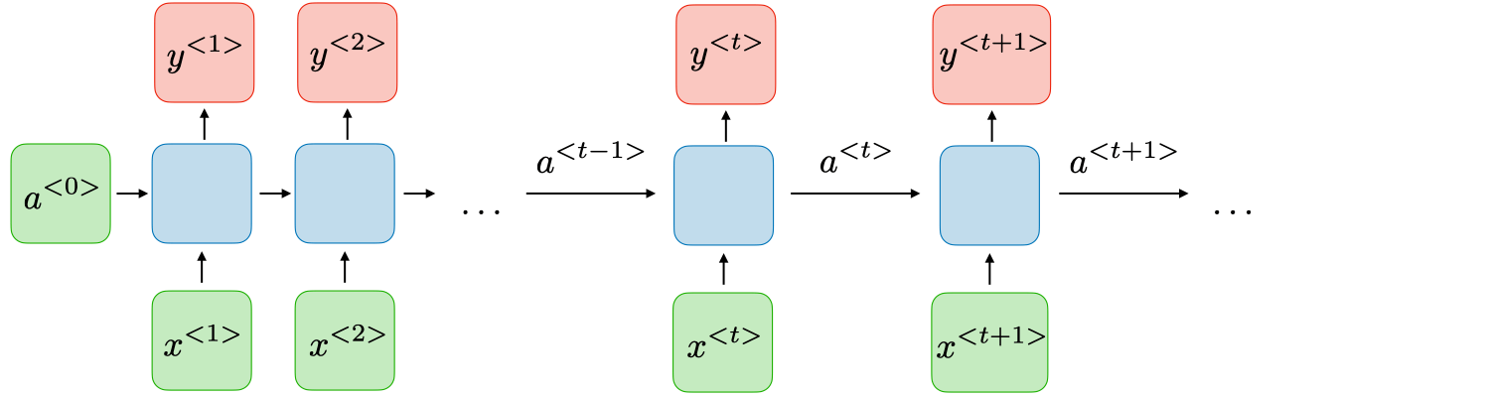
Deep Learning
Recurrent Neural Networks (RNN)
Recurrent layers
  Model sequential data → model dynamic temporal behaviour
  Internal memory state(s) → memorize previous data for future predictions
Vanishing gradient problem
  Gating mechanisms (Gated Recurrent Units (GRU), Long Short-term Memory (LSTM)
Output
Input
https://wiki.tum.de/download/attachments/22578349/RNN1.png
Notes:
https://wiki.tum.de/download/attachments/22578349/RNN1.png

Slide 35
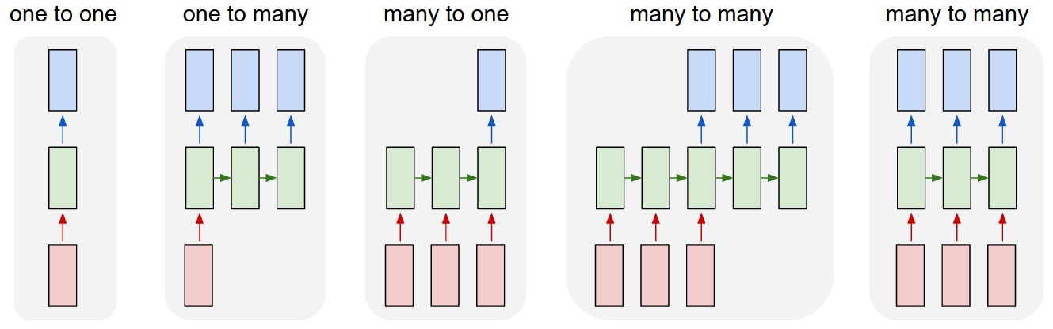
Deep Learning
Recurrent Neural Networks (RNN)
Application Examples
  One-to-many: sequential music generation (given a starting note)
  Many-to-one: sentiment classification (positive vs. negative)
  Many-to-many: machine translation (e.g. Spanish to German)
https://stanford.edu/~shervine/teaching/cs-230/
illustrations/architecture-rnn-ltr.png

Slide 36
Deep Learning
Autoencoders
Symmetric architecture (decoder & encoder)
Objective: minimize reconstruction error (e.g. mean squared error)
Compression of input (embedding)
Prioritize on important information → learn useful representations
Encoder
Decoder
Input
Output
x
y
Embeddings
MSE
Notes:
https://miro.medium.com/max/534/1*Z54JgbS4DUwWSknhDCvNTQ.png

Slide 37
Summary
Introduction
  Terminology, application scenarios
Learning Paradigms
  Unsupervised, supervised, self-supervised learning
ML project pipeline
  Data collection, pre-processing, split
  Model selection, validation, training, testing
Deep Learning
  DNN, CNN, RNN, Autoencoders

Slide 38
References
S. Legg, M. Hutter (2007). Universal Intelligence: A Definition of Machine Intelligence. Minds & Machines. 17 (4): 391-444.
A. L. Samuel (1959). Some studies in machine learning using the game of checkers. IBM Journal of research and development. 3(3), 210-229.

