Slide 1
Machine Listening for Music and Sound Analysis
Muhammad Ateeque Zaryab
Dr.-Ing. Jakob Abeßer
Fraunhofer IDMT
Jakob.abesser@idmt.fraunhofer.de

Slide 2
Overview
Lecture Structure
  Basics
    L1 - Audio Representations
    L2 - Machine Learning
  Applications
    L3 - Music Information Retrieval
    L4 - Environmental Sound Analysis
Additional Content
  Insights into projects & current research @ Fraunhofer IDMT
  Open student topics
Audio Representations (DSP)
Machine Learning
Music Information Retrieval
Environmental Sound Analysis

Slide 3
Overview
Seminar Structure
  S1 – Introduction to Python programming
  S2 – Audio processing basics
  S3 – Sound classification
Notes
  Programming in IPython notebooks / Google Colaboratory
  Additional course material (audio samples, libraries)

Slide 4
Course Website
https://machinelistening.github.io

Slide 5

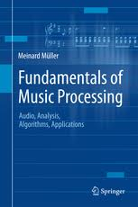
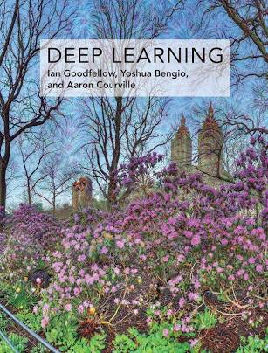
Further Resources: Books
Virtanen, T. et al.: Computational Analysis of Sound Scenes and Events, Springer, 2018.
Müller, M.: Fundamentals of Music Processing, Springer, 2015.
Goodfellow, I., et al.: Deep Learning, 2016.

Slide 6
Further Resources: Webpages
Deep Learning
  https://www.deeplearningbook.org/
  http://www.coursera.org (online courses)
  http://www.udemy.com (online courses)
Music Information Retrieval
  https://www.audiolabs-erlangen.de/FMP (FMP notebooks)
  https://musicinformationretrieval.com (iPython notebooks)
Environmental Sound Recognition
  http://dcase.community/ (DCASE challenges & workshop)

Slide 7
Further Resources: Programming Libraries
General
  numpy, scipy, scikit-learn, matplotlib
Machine Learning / Deep Learning
  scikit-learn, tensorflow 2.3 (keras), (pytorch)
Audio Processing / MIR (Python)
  pysox, soundfile (audio I/O & manipulation)
  librosa, madmon, FMP notebooks (audio / music processing)
  Music21, MeloSpyLib (symbolic music processing)
  (MIR Toolbox – Matlab)

