Slide 1
AI-based Audio Analysis of Music and Soundscapes
Deep Learning
Muhammad Ateeque Zaryab
Dr.-Ing. Jakob Abeßer
Fraunhofer IDMT
jakob.abesser@idmt.fraunhofer.de
Notes:
1

Slide 2
Deep Learning
Outline
Introduction
Fully Connected Neural Networks
Convolutional Neural Networks
Notes:
2

Slide 3
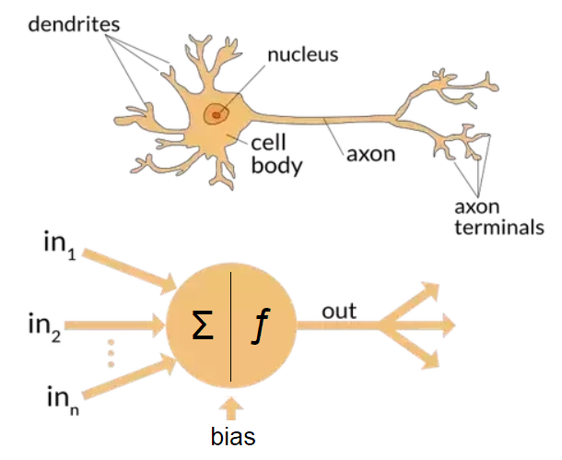
Deep Learning
Introduction
Artificial neural networks → mimic brain processing
Connected neurons
Weighted input summation
Non-linear processing
Fig. 9
Notes:
3

Slide 4
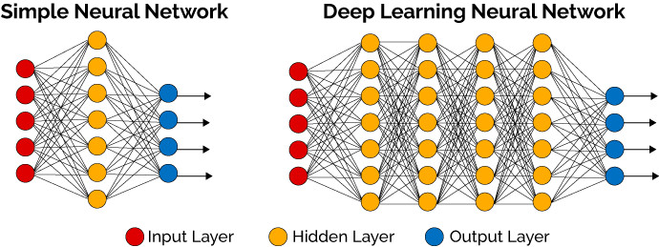
Deep Learning
Introduction
Artificial neural networks → mimic brain processing
Connected neurons
Weighted input summation
Non-linear processing
Shallow networks
Fig. 9
Fig. 10
Notes:
4

Slide 5
Deep Learning
Introduction
Artificial neural networks → mimic brain processing
Connected neurons
Weighted input summation
Non-linear processing
Shallow networks → deep networks
Fig. 9
Fig. 10
Notes:
5

Slide 6
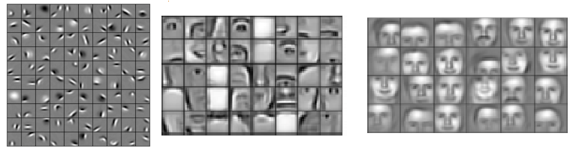
Deep Learning
Introduction
Hierarchical feature learning
Example (face recognition)
Edges, curves
Fig. 11
First layers
Final layers
Notes:
6
https://pic4.zhimg.com/80/v2-057b248288a8af2f01272a956f862873_1440w.png

Slide 7
Deep Learning
Introduction
Hierarchical feature learning
Example (face recognition)
Edges, curves
Shapes, object parts
Fig. 11
First layers
Final layers
Notes:
7
https://pic4.zhimg.com/80/v2-057b248288a8af2f01272a956f862873_1440w.png

Slide 8
Deep Learning
Introduction
Hierarchical feature learning
Example (face recognition)
Edges, curves
Shapes, object parts
Objects (faces)
Fig. 11
First layers
Final layers
Notes:
8
https://pic4.zhimg.com/80/v2-057b248288a8af2f01272a956f862873_1440w.png

Slide 9

Deep Learning
Fully-connected (Deep) Neural Networks
Input layer
Own
Notes:
9

Slide 10

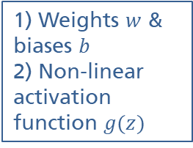

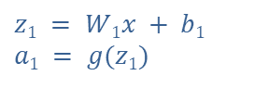
Deep Learning
Fully-connected (Deep) Neural Networks
Input layer
Hidden layers
Own
Notes:
10

Slide 11


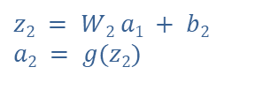
Deep Learning
Fully-connected (Deep) Neural Networks
Input layer
Hidden layers
Own
Notes:
11

Slide 12



Deep Learning
Fully-connected (Deep) Neural Networks
Input layer
Hidden layers
Own
Notes:
12

Slide 13

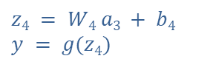
Deep Learning
Fully-connected (Deep) Neural Networks
Input layer
Hidden layers
Output layer
Own
Notes:
13

Slide 14
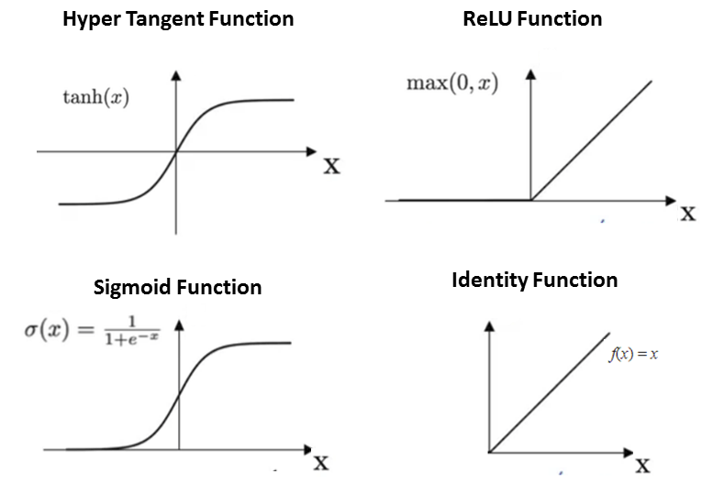
Deep Learning
Activation Functions
Activation functions add non-linearity
Make networks more powerful in (complex) pattern recognition
Examples:
Fig. 12
Notes:
14
https://miro.medium.com/max/534/1*Z54JgbS4DUwWSknhDCvNTQ.png

Slide 15
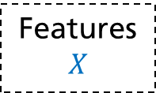
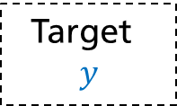
Deep Learning
Training
Overview
Own
Notes:
15

Slide 16
Deep Learning
Training
Overview
https://www.skampakis.com/wp-content/uploads/2018/03/simple_neural_network_vs_deep_learning.jpg
DNN
Forward propagation
Own
Notes:
16

Slide 17

Deep Learning
Training
Overview
https://www.skampakis.com/wp-content/uploads/2018/03/simple_neural_network_vs_deep_learning.jpg
DNN
Loss
Forward propagation
Own
Notes:
17

Slide 18
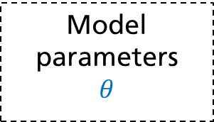
Deep Learning
Training
Overview
Weight update
Gradient w.r.t model weights
https://www.skampakis.com/wp-content/uploads/2018/03/simple_neural_network_vs_deep_learning.jpg
Back-propagation
DNN
Loss
Forward propagation
Own
Notes:
18

Slide 19
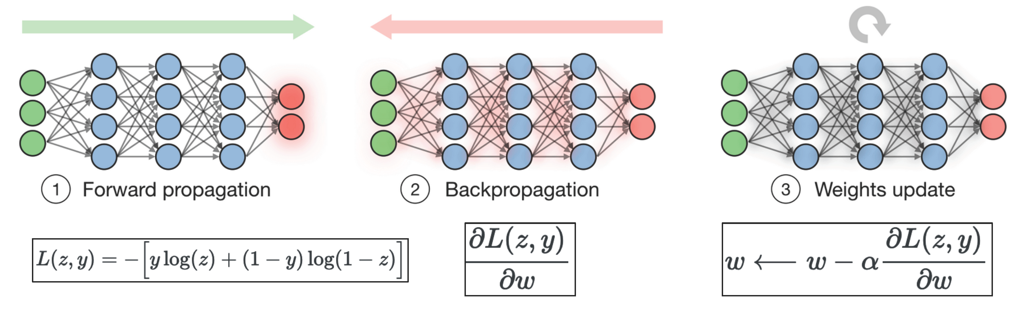
Deep Learning
Training
Forward propagation → propagate batch of training data through the network → compute loss (compare to targets)
Fig. 20
Notes:
19

Slide 20
Deep Learning
Training
Forward propagation → propagate batch of training data through the network → compute loss (compare to targets)
Backpropagation → backpropagate loss → compute gradients of loss w.r.t. weights
Fig. 20
Notes:
20

Slide 21
Deep Learning
Training
Forward propagation → propagate batch of training data through the network → compute loss (compare to targets)
Backpropagation → backpropagate loss → compute gradients of loss w.r.t. weights
Weights update → use gradients & learning rate to update weights
Fig. 20
Notes:
21

Slide 22
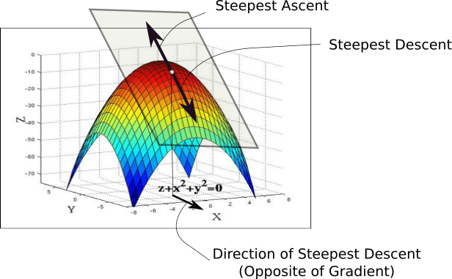
Deep Learning
Training
Gradient descent
Move in opposite direction of gradient
Learning rate effects step size
Fig. 15
Notes:
22

Slide 23
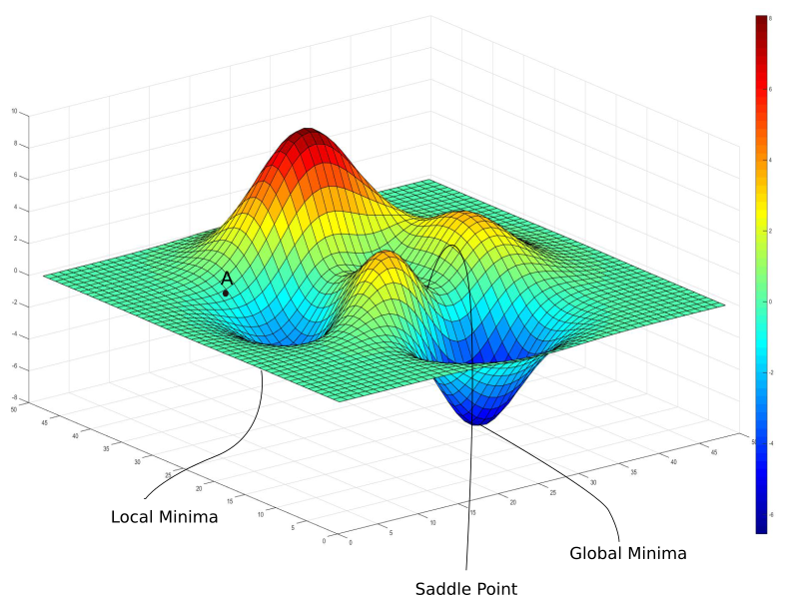
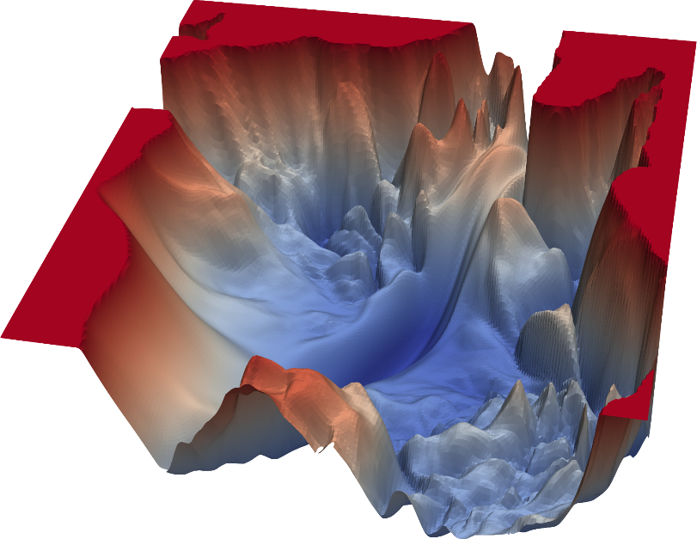
Deep Learning
Training
Loss contour
Goal → find global minima
Toy example
Complex DNN
Fig. 13
Fig. 14
Notes:
23

Slide 24
Deep Learning
Playground
A neural network playground!
https://playground.tensorflow.org
Notes:
24

Slide 25
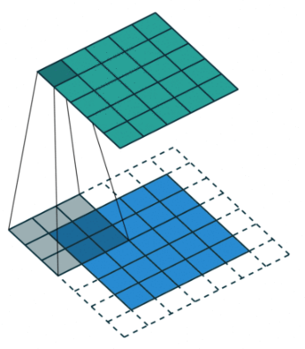
Deep Learning
Convolutional Neural Networks (CNN)
Convolutional layers
“Convolution” → (local) dot-product between filter and input
Feature Map
Filter / Kernel
Input
Fig. 16
Notes:
25
TODO add URLs

Slide 26
Deep Learning
Convolutional Neural Networks (CNN)
Convolutional layers
“Convolution” → (local) dot-product between filter and input
Shared weights (across input)
Feature Map
Filter / Kernel
Input
Fig. 16
Notes:
26
TODO add URLs

Slide 27
Deep Learning
Convolutional Neural Networks (CNN)
Convolutional layers
“Convolution” → (local) dot-product between filter and input
Shared weights (across input)
translation of input → translation of activations (equivariance)
Feature Map
Filter / Kernel
Input
Fig. 16
Notes:
27
TODO add URLs

Slide 28
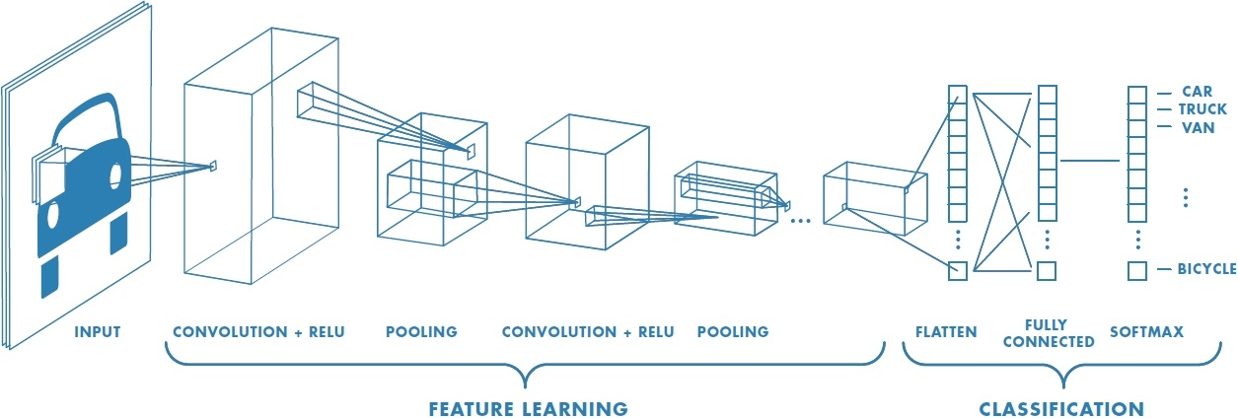
Deep Learning
Convolutional Neural Networks (CNN)
Convolutional layers
“Convolution” → (local) dot-product between filter and input
Shared weights (across input)
translation of input → translation of activations (equivariance)
Pooling → local aggregation / down-sampling
Feature Map
Filter / Kernel
Input
Fig. 16
Fig. 17
Notes:
28
TODO add URLs

Slide 29
References
Introducing Machine Learning. (2016). Retrieved from https://www.mathworks.com/content/dam/mathworks/tag-team/Objects/i/88174_92991v00_machine_learning_section1_ebook.pdf
S. Legg, M. Hutter (2007). Universal Intelligence: A Definition of Machine Intelligence. Minds & Machines. 17 (4): 391-444.
L. Samuel (1959). Some studies in machine learning using the game of checkers. IBM Journal of research and development. 3(3), 210-229
Srihari, S. N. (2020). Forward Propagation and Backward Propagation (Deep Learning Lecture). Retrieved from https://cedar.buffalo.edu/~srihari/CSE676/6.5.0 Forward Backward.pdf
Virtanen, T., Plumbley, M. D., & Ellis, D. (Eds.). (2018). Computational Analysis of Sound Scenes and Events. Cham, Switzerland: Springer International Publishing.
Notes:
29

Slide 30
Images
Fig. 1: [Machine Learning, 2016], p. 4, Fig. 2
Fig. 2: https://i0.wp.com/www.sthda.com/sthda/RDoc/figure/clustering/ partitioning-cluster-analysis-k-means-plot-4-groups-1.png
Fig. 3: https://i.stack.imgur.com/hsilO.png (https://scikit-learn.org/stable/auto_examples/classification/ plot_classifier_comparison.html)
Fig. 4: https://miro.medium.com/max/975/1*OyYyr9qY-w8RkaRh2TKo0w.png (reproduced)
Fig. 5: https://lilianweng.github.io/lil-log/assets/images/self-sup-lecun.png
Fig. 6: https://www.asimovinstitute.org/wp-content/uploads/2019/04/NeuralNetworkZoo20042019.png
Fig. 7: https://www.educative.io/api/edpresso/shot/6668977167138816/image/5033807687188480
Fig. 8: [Virtanen, 2018], p. 170, Fig. 6.7
Fig. 9: https://miro.medium.com/max/915/1*SJPacPhP4KDEB1AdhOFy_Q.png
Fig. 10: https://www.skampakis.com/wp-content/uploads/2018/03/simple_neural_network_vs_deep_learning.jpg
Fig. 11: https://pic4.zhimg.com/80/v2-057b248288a8af2f01272a956f862873_1440w.png
Fig. 12: https://blog.e-kursy.it/deeplearning4j-workshop/video/html/presentation_specific/img/4_activation_functions.png
Notes:
30

Slide 31
Images
Fig. 13: https://blog.paperspace.com/content/images/2018/05/challenges-1.png
Fig. 14: https://www.cs.umd.edu/~tomg/img/landscapes/noshort.png
Fig. 15: https://blog.paperspace.com/content/images/2018/05/grad.png
Fig. 16: https://www.wandb.com/articles/intro-to-cnns-with-wandb
Fig. 17: https://www.freecodecamp.org/news/an-intuitive-guide-to-convolutional-neural-networks-260c2de0a050/
Fig. 18: https://wiki.tum.de/download/attachments/22578349/RNN1.png
Fig. 19: https://stanford.edu/~shervine/teaching/cs-230/illustrations/architecture-rnn-ltr.png
Fig. 20: [Srihari, 2020], p.8, (Fig. 1)
Notes:
31

Slide 32
Images
Fig. 1:
Notes:
32

Slide 33
References
[1] Sternberg, R. J. (2022). human intelligence. Encyclopedia Britannica. https://www.britannica.com/science/human-intelligence-psychology
[2] Gross, R., Psychology (2015). The Science of Mind and Behaviour, Hodder Education
[3] Legg, S., Hutter, M. (2007). Universal Intelligence: A Definition of Machine Intelligence. Minds & Machines 17, 391–444
[4] Russell, S., Norvig, P. (2016). Artificial Intelligence: A Modern Appoach, PEV, third ed.
[5] Koza, J. R., Bennett, F. H., Andre, D., Keane, M. A. (1996). Automated Design of Both the Topology and Sizing of Analog Electrical Circuits Using Genetic Programming. Artificial Intelligence in Design '96. Springer. pp. 151–170.
Notes:
33

Slide 34
Audio
[Audio 1] https://freesound.org/people/xserra/sounds/196765/
[Audio 2] https://freesound.org/people/IliasFlou/sounds/498058/ (~0:00 – 0:05)
[Audio 3] https://freesound.org/people/danlucaz/sounds/517860/ (~0:00 – 0:05)
[Audio 4] https://freesound.org/people/IENBA/sounds/489398/ (~0:00 – 0:07)
Notes:
34

