Slide 1
Sky and Sea
Disaster analysis and
remediation using new technology
By Anne Song

Slide 2
sky
Flight disasters

Slide 3
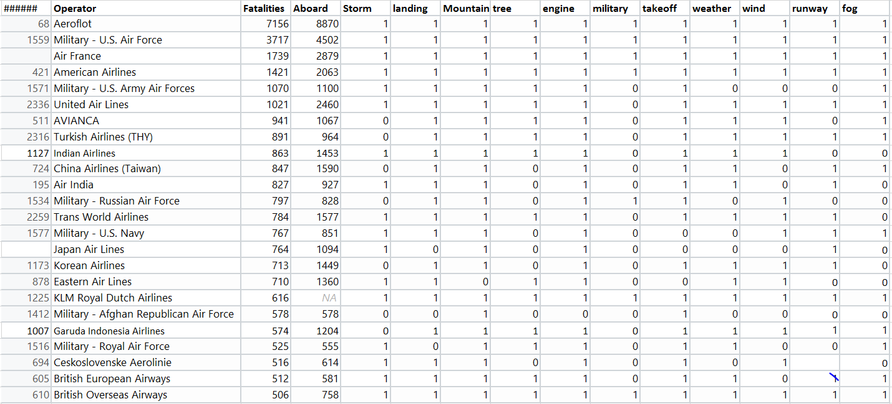
Airline Accidents by Numbers Descending Order (1908- )
Total 5268 obs. -> grouped by Operator 2476 obs.

Slide 4
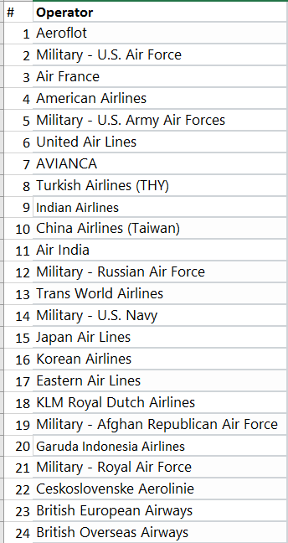
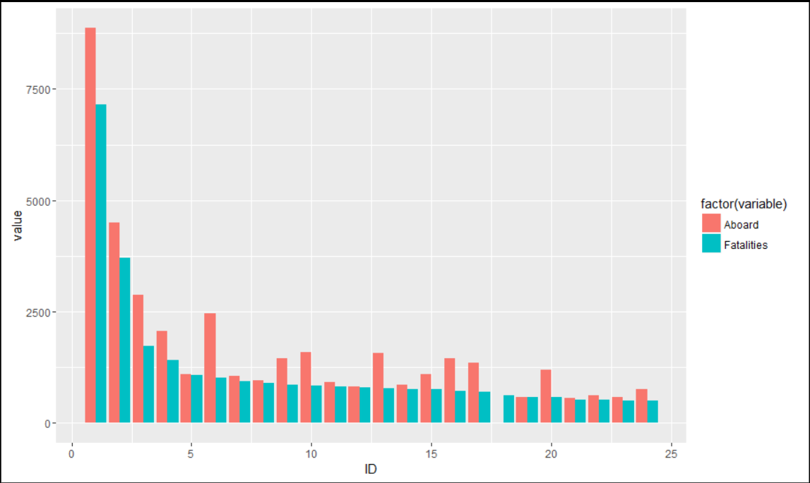
ABOARD vs FATALITY

Slide 5
Key words frequency
Key Words | Frequency
military | 861
mountain | 754
engine | 750
runway | 703
landing | 609
weather | 552
takeoff | 461
fog | 323
tree | 304
storm | 255
wind | 201

Slide 6
SEA
Oil spill

Slide 7
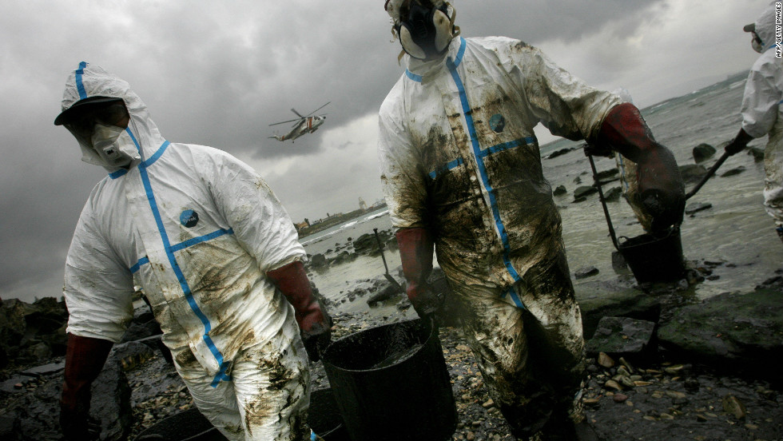
Researchers hope the use of magnets will allow them to recover more oil and lead to an easier clean up operation

Slide 8
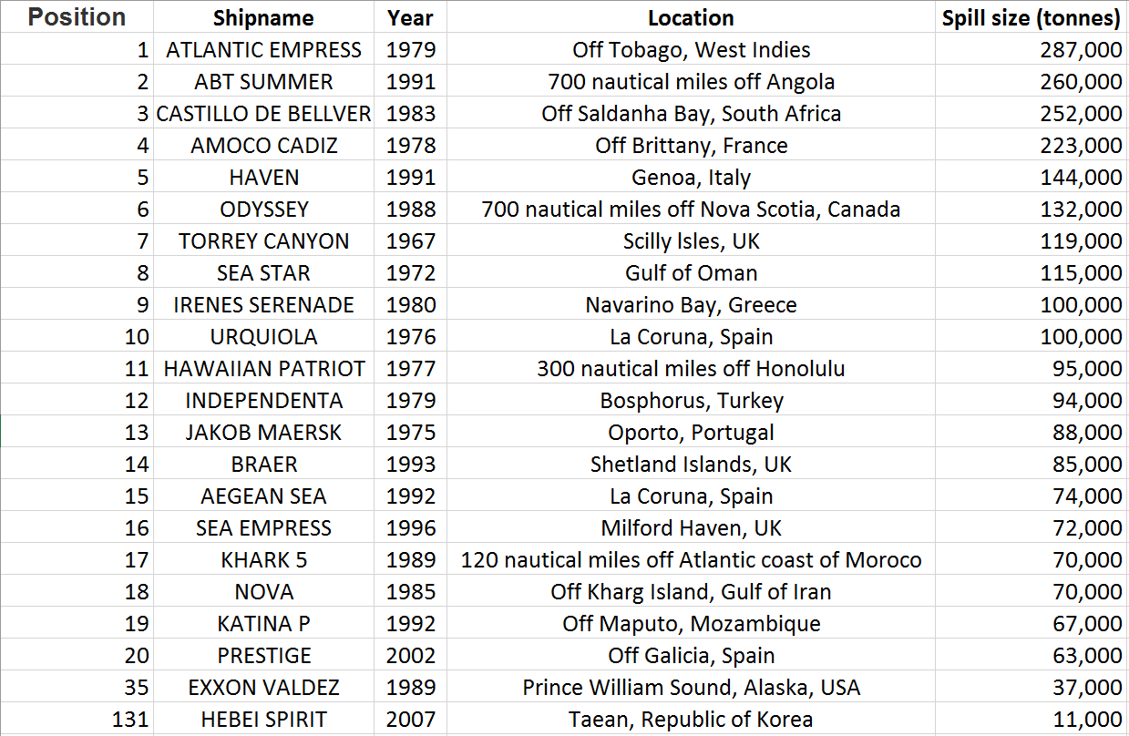
Major Oil Spill stats
Source(ITOPF)

Slide 9
New Technology on the horizon
Oil spills from container ships or offshore platforms are a frequent hazard to marine and coastal ecosystems.
Cleaning up oil spills could be very expensive operation. Bp Gulf of mexico oil spill in 2010, the worst environmental disaster in Us history costed BP $40 billion.
Recently, MIT scientists found a method of recovering oil after a spill using magnets, potentially saving companies like bp money in clean up bills.
On it’s own, oil is not magnetic. But when mixed with water-repellant nanoparticles that contain iron, the oil can be magnetically separated from the water. The nanoparticles can later be removed to enable the re-use of the oil.

Slide 10
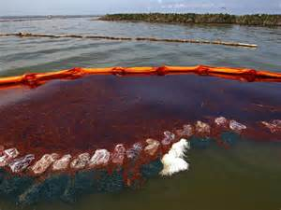
Nanotechnology Cleaning up oil spills

Slide 11
Other proposed solutions for oil spill
Use of microorganisms to digest the oil
Mechanical means like skimmers, booms, pumps, mechanical separators
Sorbents to remove oil from water through adsorption and/or absorption
Use of chemical dispersants like detergents
#Conventional techniques are not adequate to solve the problem of massive oil spills.
In recent years, nanotechnology has emerged as a potential source of novel solutions to many of the
world’s outstanding problems.

Slide 12
Nanomaterials for oil Spill cleanup
Aerogels
-Hydrophobic Aerogel
-Aeroclays
-Rice husk derived silica aerogel
Nanodispersants
-Micelles forming
-Colloidal solution of bio- based chemicals
Magnetic Nanocomposites
-Nano-hybrids of magnetic Fe-oxide NPs in organo-clays
-Magnetic carbon-metal nanocomposites

Slide 13
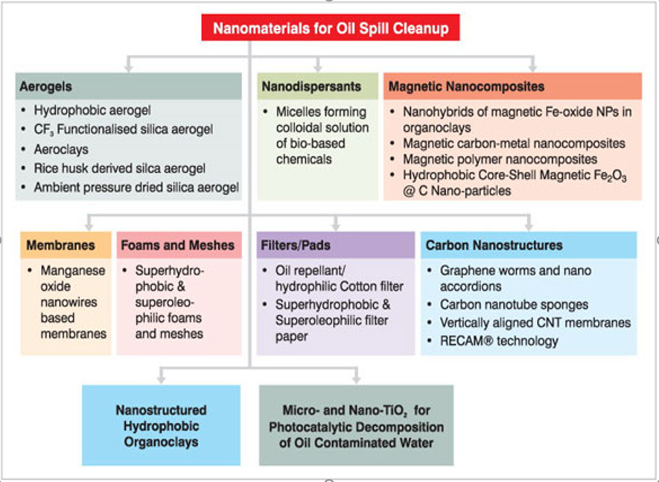

Slide 14
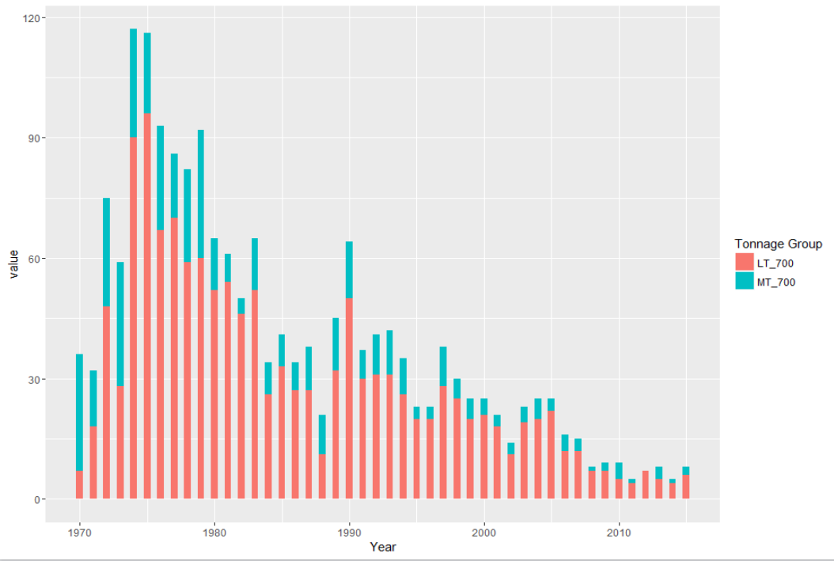
Oil Spill 1970 - 2015

Slide 15
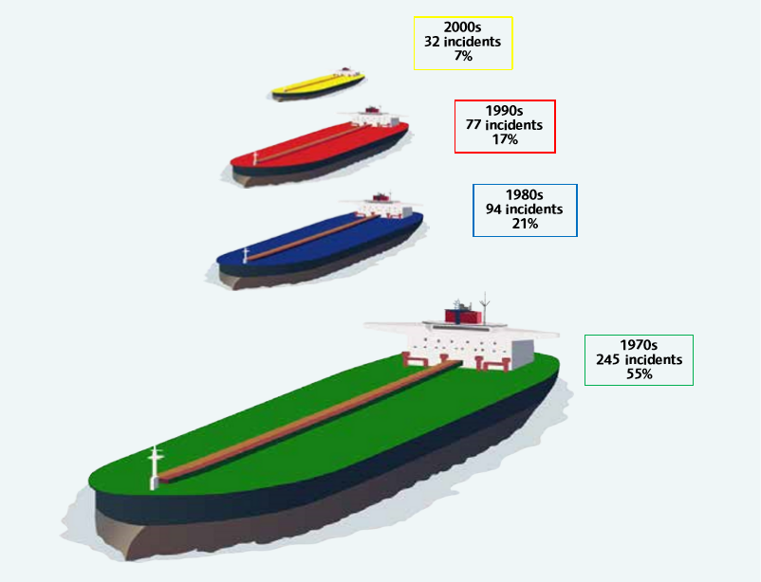
Trend of Oil Spill

Slide 16
Code
library(dplyr)
AirFatal <- read.csv('AirPlaneFatal.csv')
By_Operator <- group_by(AirFatal, Operator) %>%
summarise(Sum.Fatalies = sum(Fatalities),
Sum.Aboard = sum(Aboard),
Summaries = paste(Summary, collapse = ' '))
create.data <- function(vec, old.data) {
temp <- seq(1,nrow(old.data), by = 1)
df <- data.frame(temp)
for (i in vec) {
values <- c()
for (j in 1:nrow(old.data)) {
val <- ifelse(test = (grep(i, By_Operator$Summaries[j])), yes = 1, no = 0)
values <- c(values, length(val))
}
df[i] = values
}
return(df)
}
key.vec <- c('storm', 'landing', 'mountain', 'tree', 'engine', 'military', 'takeoff',
'weather', 'wind', 'runway', 'fog')
data <- create.data(key.vec, By_Operator)
data <- data[,-1]
new.data <- cbind(By_Operator[,-4], data)

