Slide 1
Pump it up, Drill it down:
An Analysis of Tanzanian Water Projects
Linlin Cheng lc1603@nyu.edu
NYC Data Science Academy
September 18, 2016
Capstone Project Presentation

Slide 2
Overview
Linlin Cheng | lc1603@nyu.edu
Question:
How to classify the functionality of water projects, which are functional, which need some repair, and which don’t work at all?
Methodology:
Data Visualization
Extreme Gradient Boosting
Result:
i) Significantly negative impact observed on regional and cross-regional regressions.
ii) Obscured effects from macroeconomic indicators.
iii) Case Study: Cambodia, an outlier
Further research:
i) Case study for other outliers: Haiti, Jamaica and Tajikistan.
ii) Reasons behind obscured effects from macroeconomic indicators.
iii) Policy implications in minimizing the cost of de-dollarization.

Slide 3

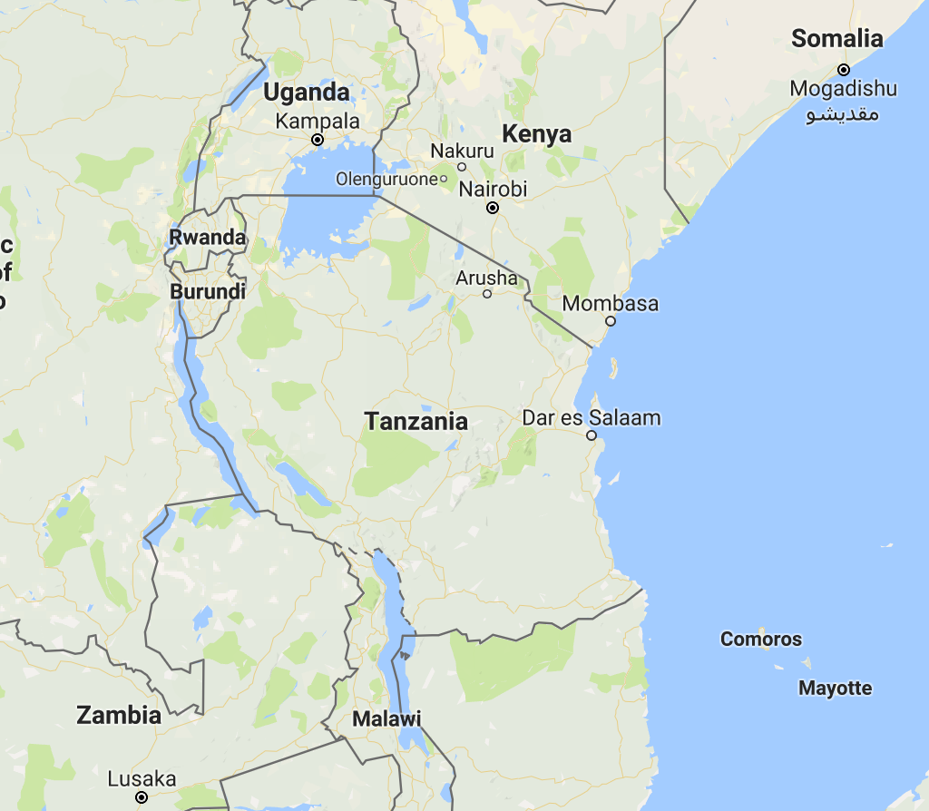
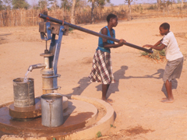
I. Tanzania, so much water, what is the problem?
Tanzania, borders three of the largest fresh water lakes in the world:
Lake Victoria
Lake Tanganyika
Lake Malawi
Yet huge numbers of the country have only minimal or none access to water:
54% of rural lack access to water
92% of rural lack sanitation
Due to:
Lack of safe water supply infrastructure
Ground water contaminations
Distant surface water source
Mixed pattern overall
Common increase during crisis
Increasing: Cambodia, Haiti. Jamaica
Decreasing: Laos, Vietnam, Bolivia, Paraguay, Costa Rica, Kyrgyz Republic, Azerbaijan
Unclear: Indonesia, Tajikistan, Kazakhstan
Notes:
Ground water contaminations: leakage from poorly constructed drainage system
Surface water extraction: which usually involves walking several miles per day each way, and most of this cumbersome but daily tasks are carried out by women, especially young girls who are supposed to be at school. And it is not hard to infer that this long walk is exacerbating the already quite severed social and gender inequalities.
Social , gender inequalities

Slide 4
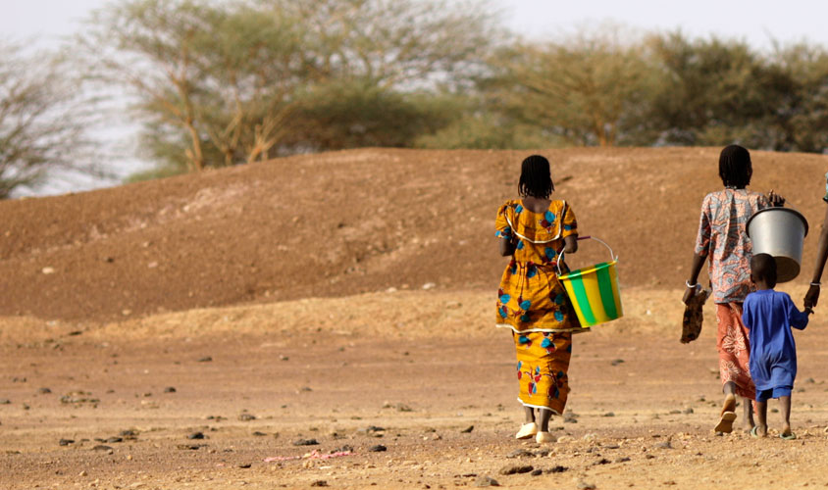
Imagine walking 3-5 miles per day for some questionable buckets of water…
Notes:
This is actually a nice picture of the long walk, since you see there is a group of family or friends, holding hands
But in fact most of the work is carried out on an individual basis, where the girls are exposed to all kinds of dangers from wild animals to their fellow human beings.
And the quality of the water that they transferred are also questionable and may indeed carry numerous water-borne diseases.

Slide 5
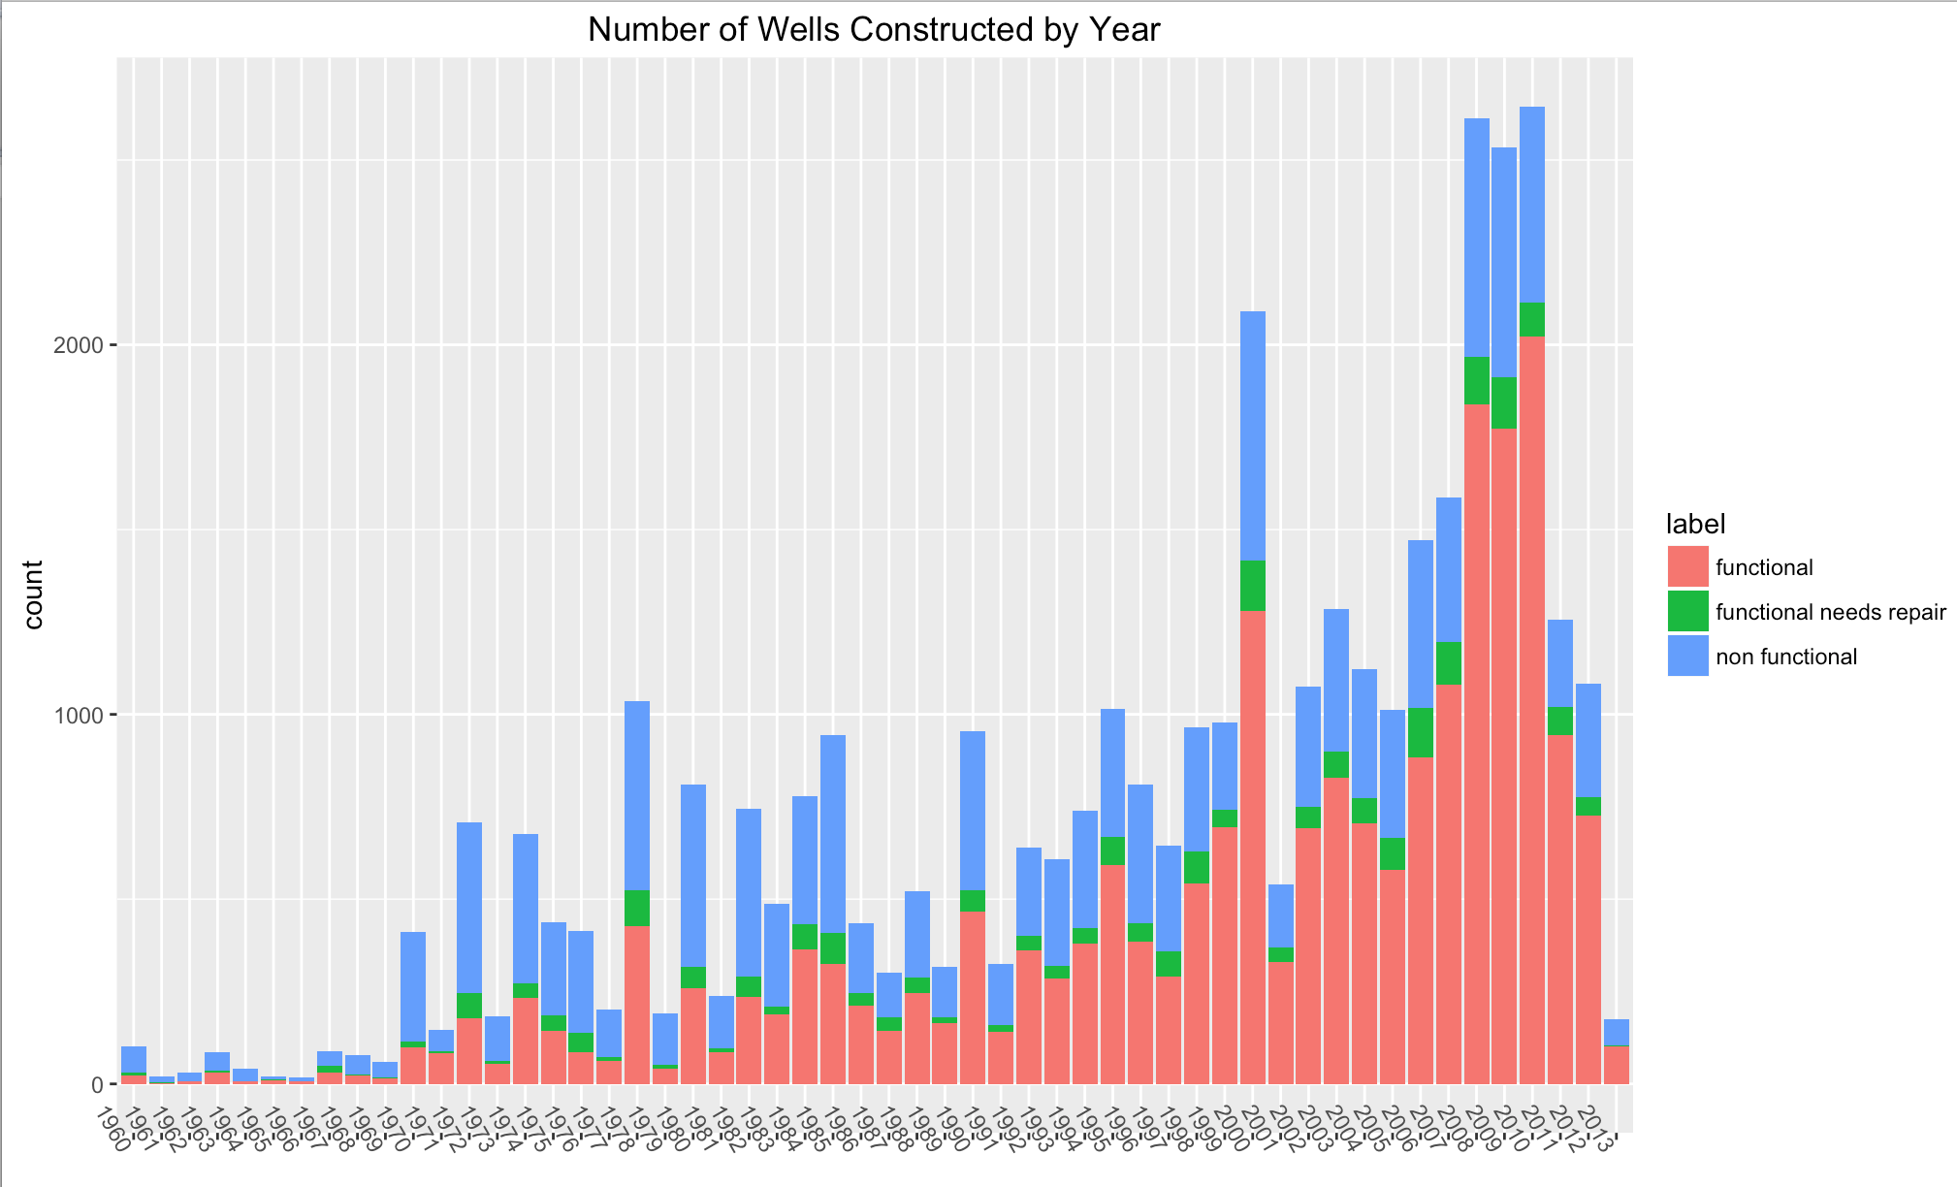
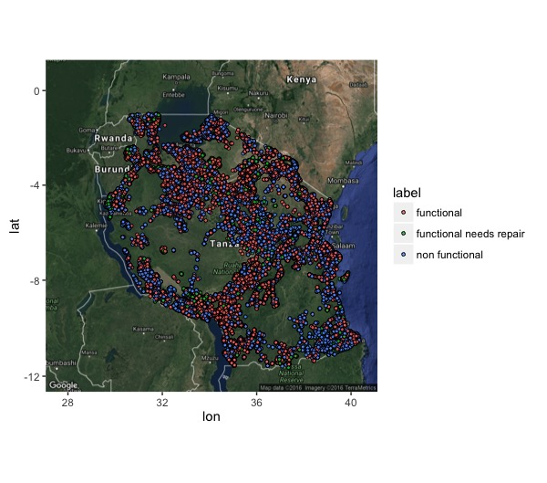
II. Water Projects, an effective solution?
NGOs, Central governments,
and local communities have
stepped in to build individual
Improved water points.
How effective are they?
Notes:
Therefore, having witness the severity of the whole situation, or even just part of it, many NGOs, Central Governments, local communities and individuals
Have stepped in to invest in building waterpoints, so as to shorten this long walk.
And here on the left, each of the dot here represents a water point project sponsors by all types of funders, and in particulate, the red dots represent the projects that are still functioning, the blue dots represent those that are no longer working, and the few green dots are the ones that are functioning, but needs repair or else they will soon become the part of the non-functioning category.
But as we can see, the distribution of the colored dots are quite uneven, for example, with more functioning ones on the southwest of the country, and more non functioning ones on the southeast coast of the country.
On the right, there is a plot of the number of projects constructed each year from 1960 to 2013, with the observations on 2013 incomplete.
General trend of growth for the number of projects, mostly from international donors, and as time goes by, we can also infer from the graph that the ratio of blue bars to red bars, that is the ratio of nonfunctional projects to functional projects increases a lot along with time.
And also, as we go back to the time in early 70s, there is almost no green bars, the functional but needs repair category almost all faded into the malfunctioning category.
So the question that we may wonder is, hey look, there are so many projects going on, and people are spending a lot of money, how effective are the projects,
Why are some of the possible reasons that they are not as effective as they should be?

Slide 6
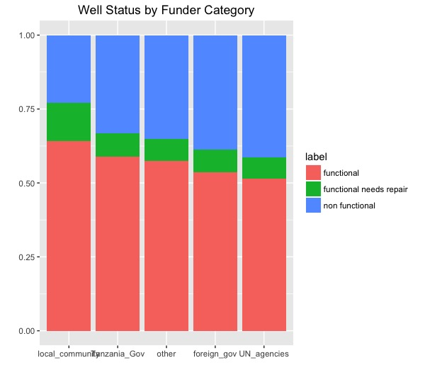
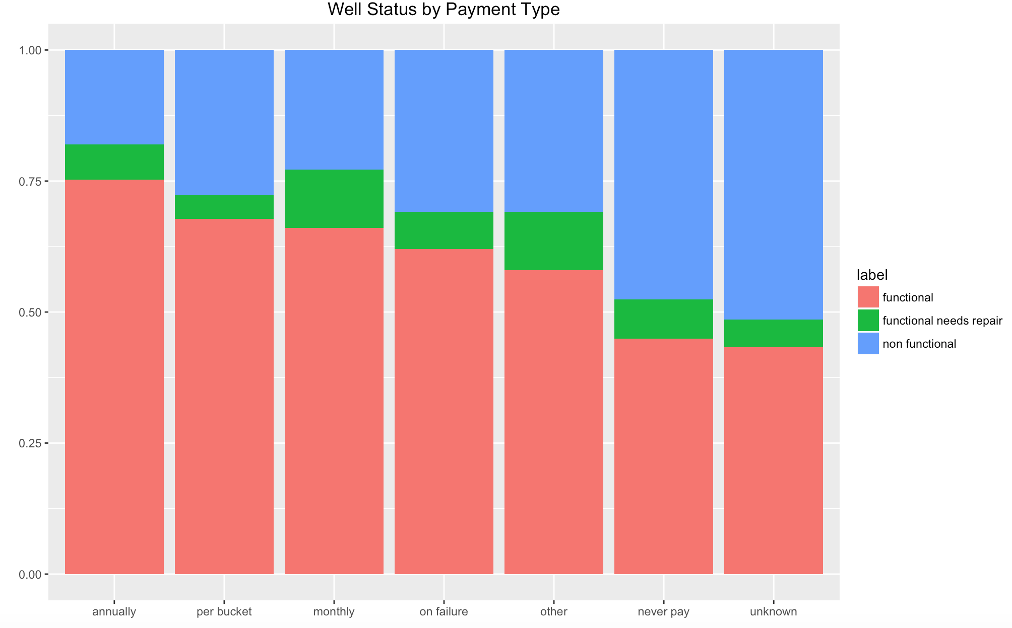
III. Exploratory Data Analysis
Market
Non-Market
Searcher
Planner
Due to lack of feedback loop and lack of
market existence, local communities are doing
better jobs but in need to more funding
Notes:
So here I list two of the possible causes based on my past life as an economist, the inefficient management system from the donors, and the lack of proper market incentives due to the institution created by the inefficient donors.
Here I roughly separate funders into two broad categories: local community and the Tanzanian government as the searchers, who have specific knowledge of the logistics of their individual projects but don’t have enough funding, and the foreign governments and international agencies, such as UN, World Bank and its subsidiaries as the Planners, who have the funding to spend but not as efficiently.
And from the first bar charts we can see, the searchers have quite an edge in terms of effectiveness comparing to the planners, and their percentages of functioning but need repair category are much higher than the other category, so they are the ones that in fact need more money.
Money charged for the accessed water, profit, no matter how minimal, not only provide certain employment opportunities for the locals, thus income, and growth, but also establish a feedback loop, so that people have incentive to maintain the functionality of the projects, and get rewarded for their endeavors.

Slide 7
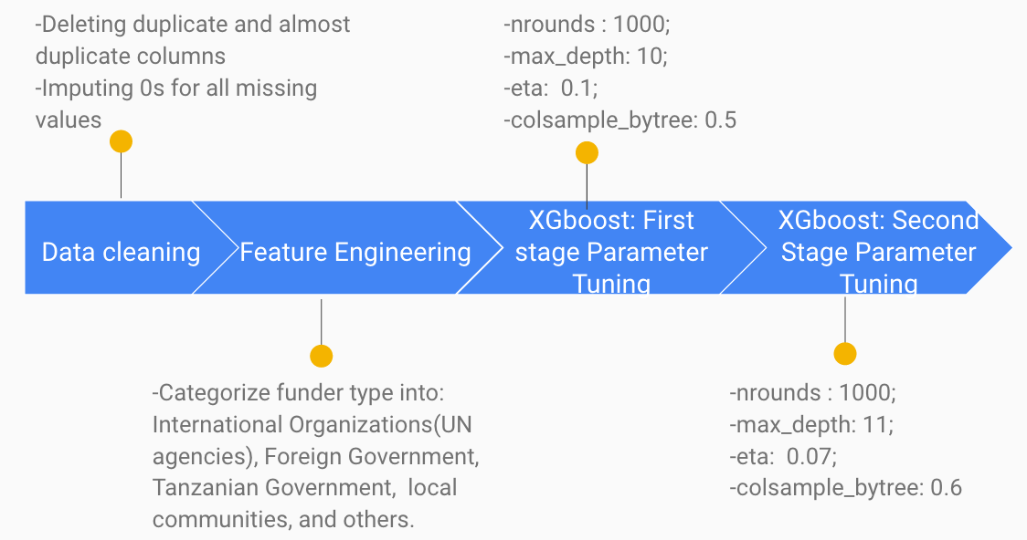
III. A Machine learning approach to identify functionality of future projects
Data:
Source: DrivenData.org (collected from Taarifa and Tanzanian Ministry of Water)
Sample Size: 41 features with 59,400 observations
Notes:
Fuzz matching
Identify the reasons for malfunctioning projects and predict the possibility of success of new ones,

Slide 8
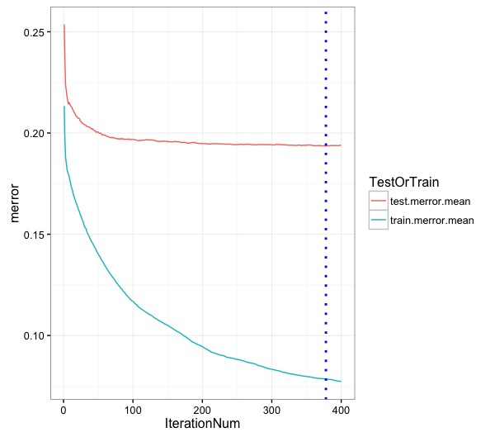
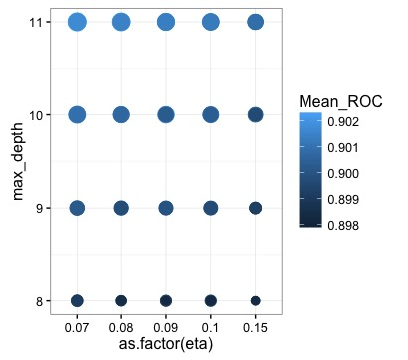
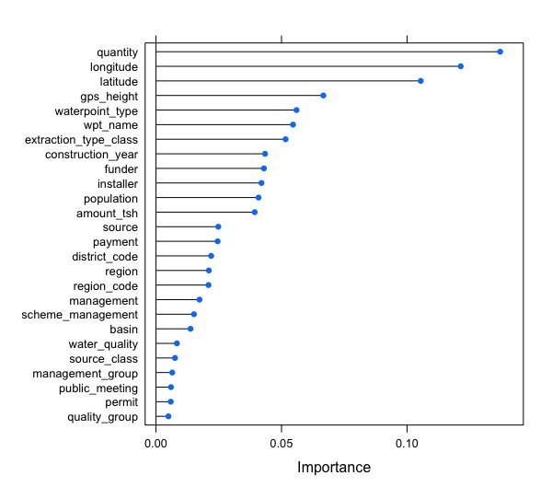
IV. Result
Parameter Tuning results:
Importance Plot based on XGboost tuning
Accuracy: 81%

Slide 9
V. Conclusion
What is needed isn’t more money, but better spending:
1. Without further accountability and feedback loop, international donors are not as efficient as local communities.
2. Free goods are often exploited. We need to create a market to reward for project construction and maintenance.
This model aims at:
pointing out room for improvement
redirecting funds to the most efficient players
Identifying potential success of proposed projects
Suggestion: Drill international funds down to local searchers, create incentives where there is none, and establish systems for maintenance.

Slide 10
VI. Further Research
Further feature engineering
Investigate other applicable algorithms
Post-analysis on miss-classification
Shiny-app on agency donation recommendation and geo-location recommendation

Slide 11
Thank you for your time. Questions?

