Slide 4
Butler Tutoring Lab
cade was here

Slide 5
Sharpen your skills at the tutoring lab today!
cade was here

Slide 6
cade was here

Slide 7



Follow us on Twitter, Instagram and Facebook!!!
@butler_tutoring
cade was here

Slide 8
Quality is not an act, it is a habit
cade was here

Slide 10
WE want to help you today!!!
cade was here

Slide 11

Study tips!!!
Pick a place and time. Everyone has their own idea about the best place and time to study.
Study every day.
Plan your time.
Discover your learning style.
Review and revise.
Take breaks.
Ask for help.
Stay motivated.
cade was here

Slide 12
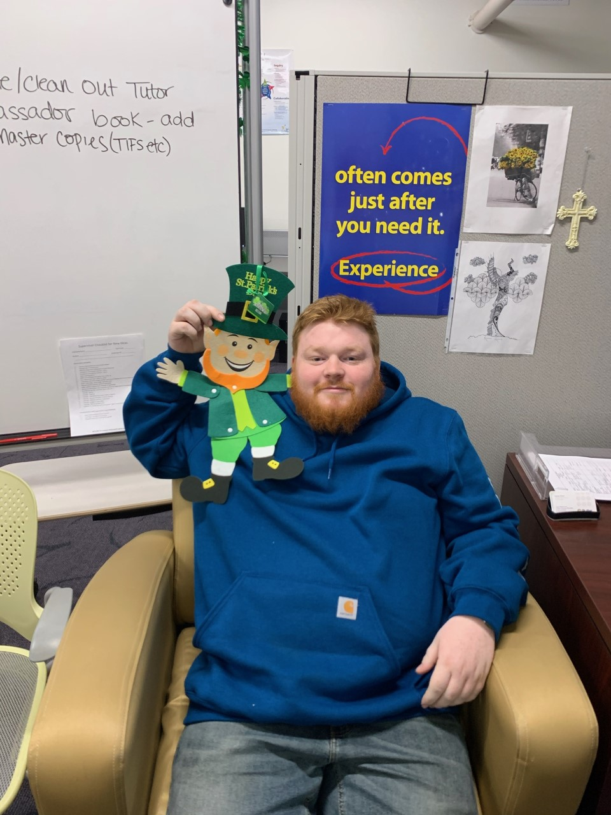
Meet our tutors
Red Green
I love Colorado and my dream is to work to conserve wildlife for future generations to enjoy. I enjoy alcoholic beverages mixed with melancholy and can be found on campus doing Ms. Z’s bidding.
cade was here

Slide 13
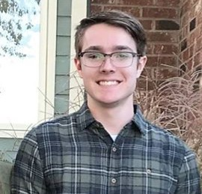
Meet our tutors
Cade McGill
My name is Cade McGill and I am a first year Industrial Engineering major. I enjoy eating guacamole and playing chess in my free time.
cade was here, or was he?

Slide 14
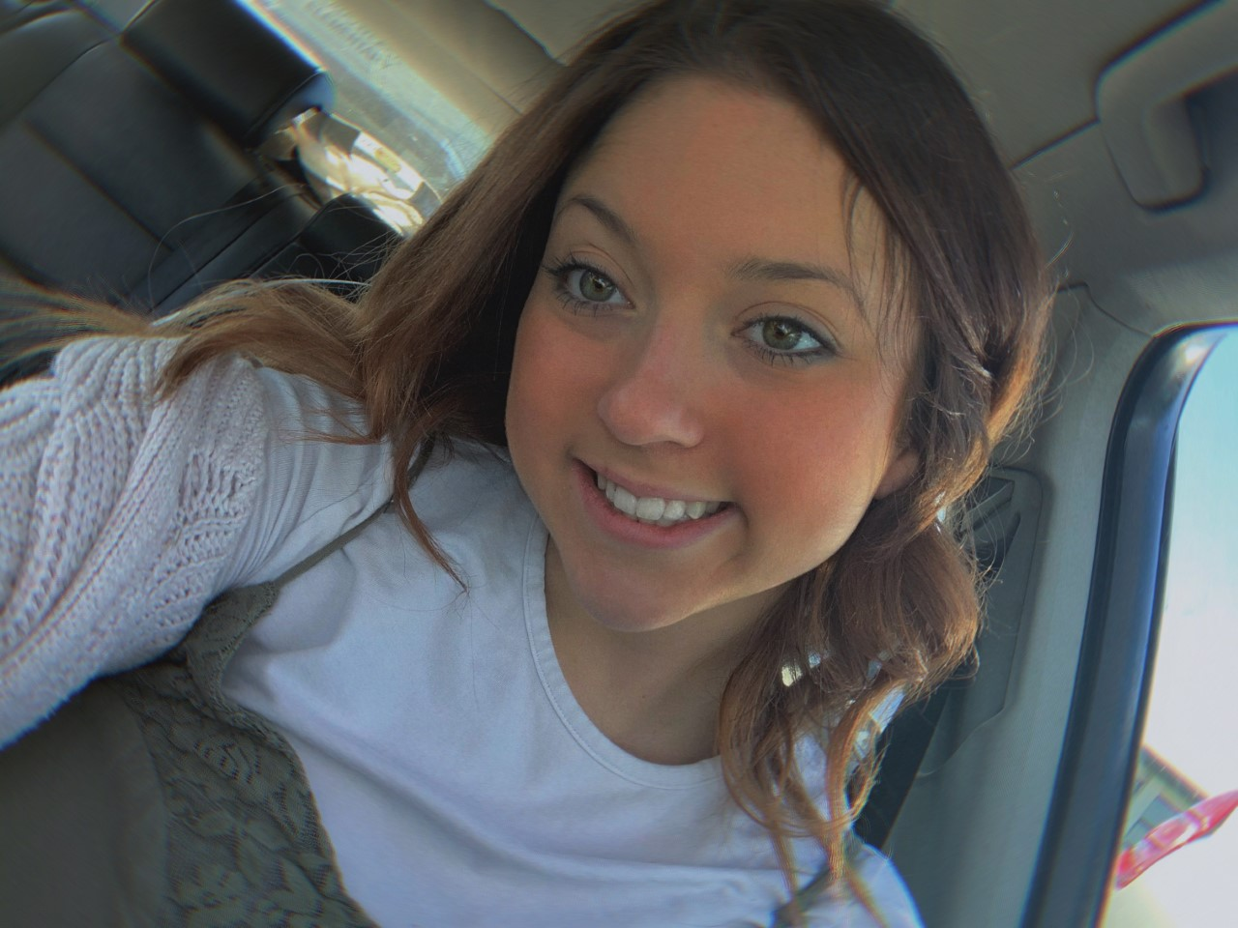
Meet our tutors
Kassidy Bratton
Hi! I am Kassidy Bratton, a tutor ambassador in Andover currently studying Elementary Education. After Butler, I plan on finishing my degree at Wichita State in order to get my teaching license and become a kindergarten teacher. In my free time I love volunteering with kids, playing with my dog, baking, and hanging out with close friends and family. It has always been a passion of mine to help others and this position allows me to do it often!
cade was here

Slide 15
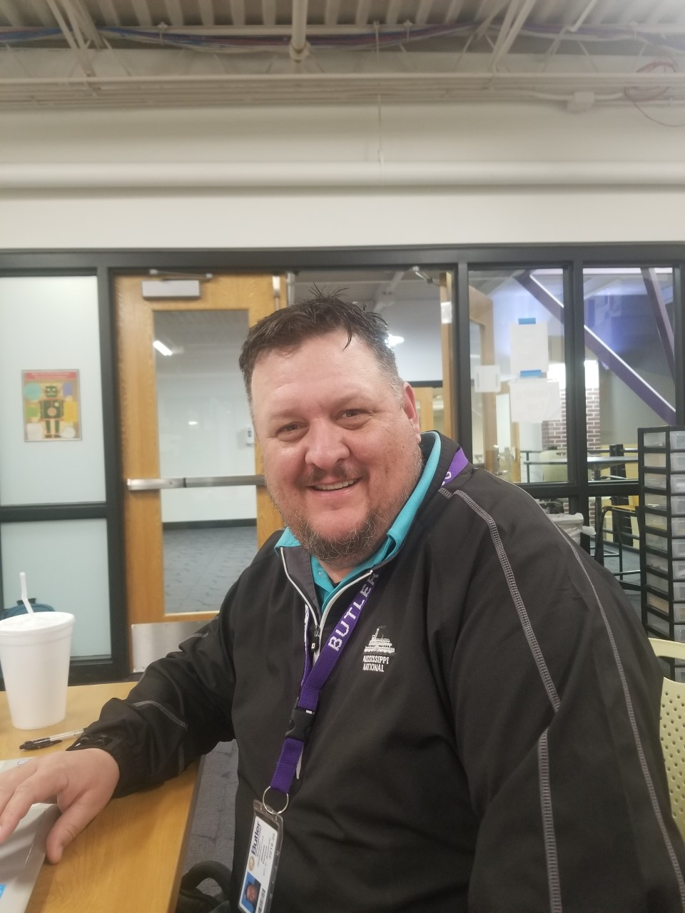
Meet our tutors
William Parsons
Hello everybody,
My name is William Parsons. I am currently Sophomore status here at BCC pursuing my Associates in Elementary Education. When I am not studying for my classes or working in the tutoring lab, I enjoy golfing, spending time with my family, and going on weekend getaways to new places.
I look forward to making it a great day here in the tutoring lab.
cade was here

Slide 16
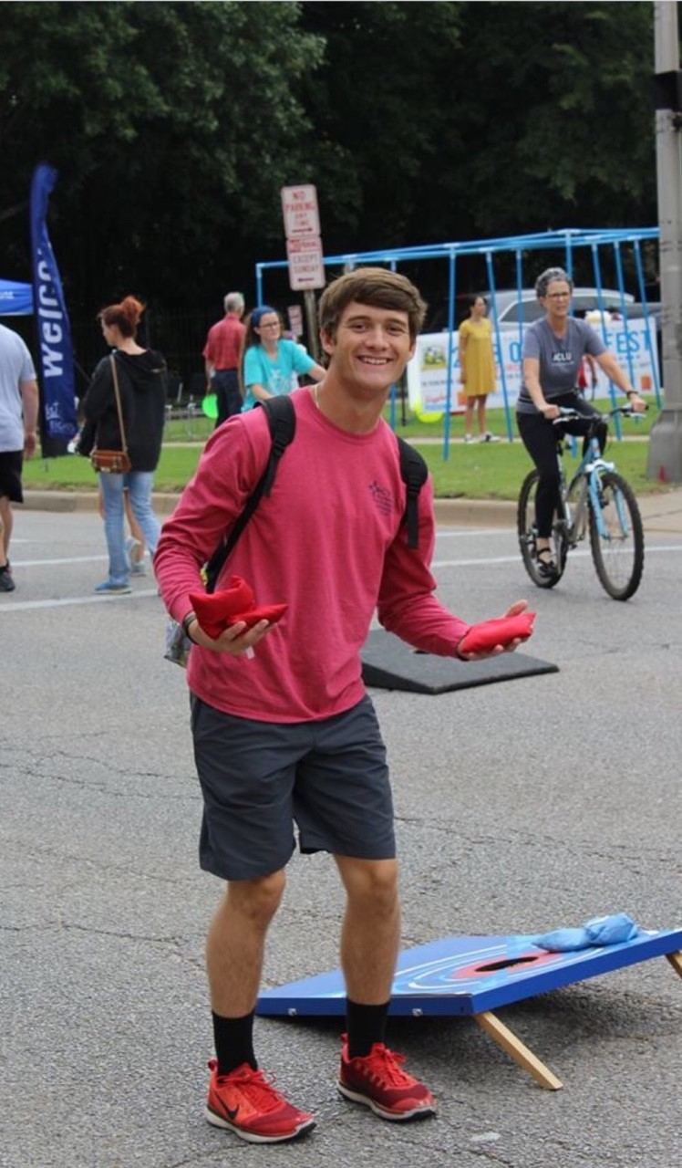
Meet our tutors
Braden Barr
Hello, my name is Braden Barr. I am currently majoring in Secondary Education for Math. Baseball and Star Wars are my two true loves in life. I am more than excited to help anybody with various levels of math!
cade was here

Slide 17
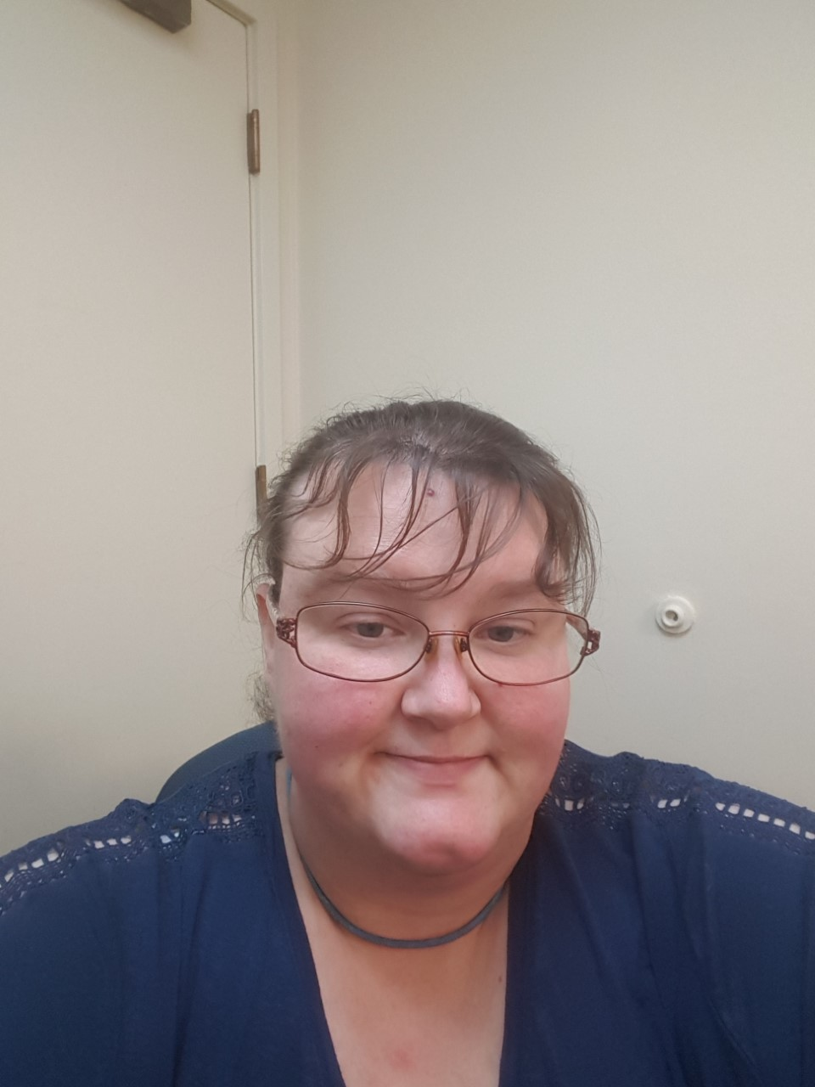
Meet our tutors
California Meadows
My name is California Meadows and I enjoy helping people succeed. In my spare time I like to read, write, and spend time with my daughter.
cade was here

Slide 18
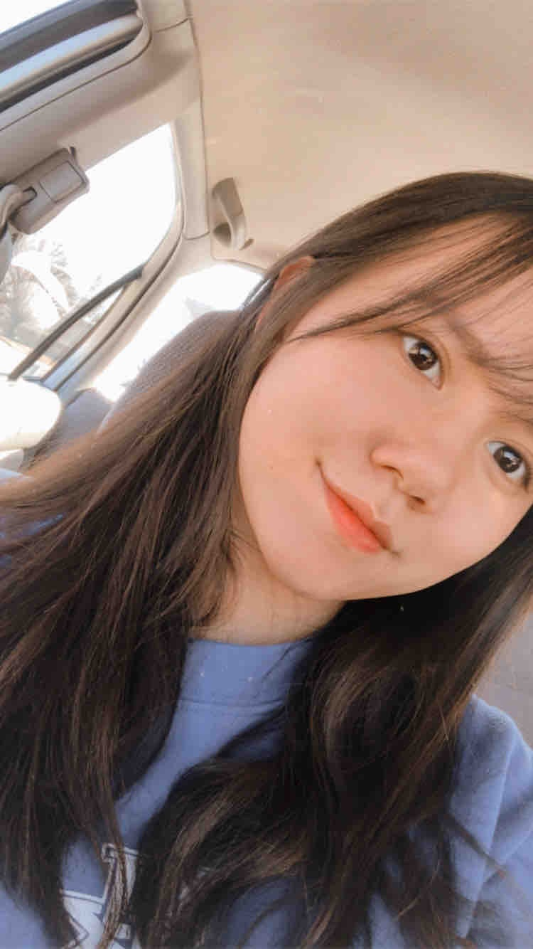
Meet our tutors
Jenny Pham
Hi, my name is Trinh Pham, but I would like to go by Jenny. I am majoring in Pre-Nursing at Butler. I love to watch movies as my hobby and sometimes, drive around when the weather is nice!
cade was here

Slide 19
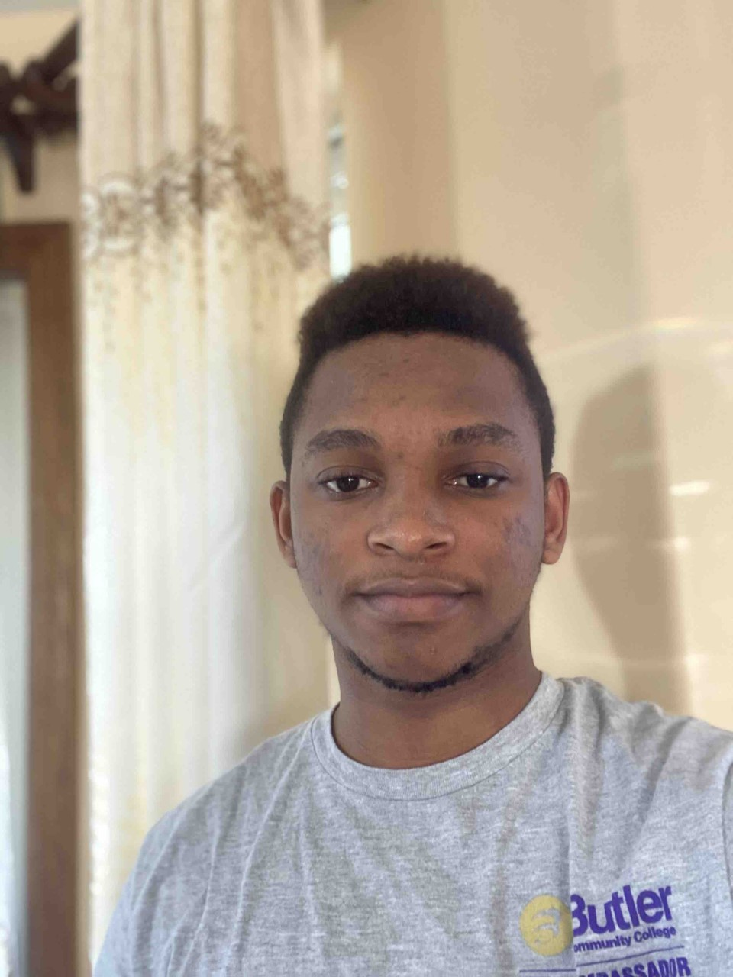
Meet our tutors
Raphael Mfuko
I am Raphael and I’m Doing pre-med here at BCC and I enjoy watching movies in my free time.
cade was here

Slide 20
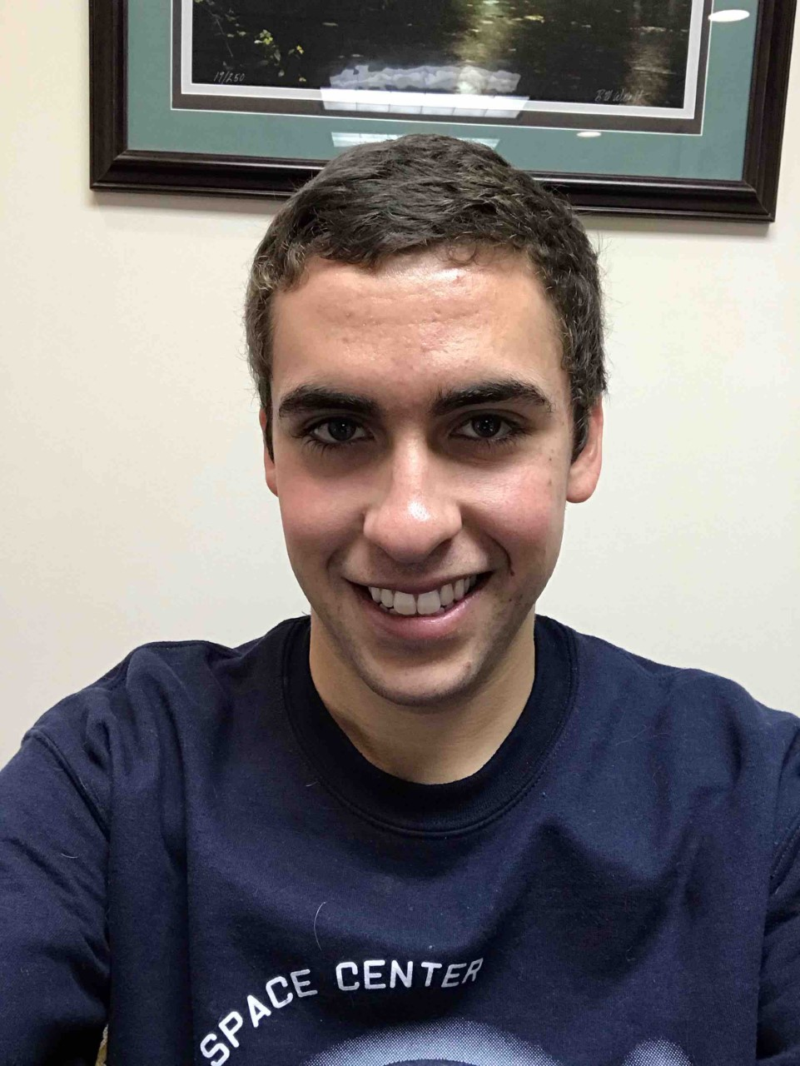
Meet our tutors
Octavio Pacheco
I am Octavio Pacheco. I am physics major. I enjoy studying and exercising. My biggest dream is working for NASA one day.
cade was here

Slide 21
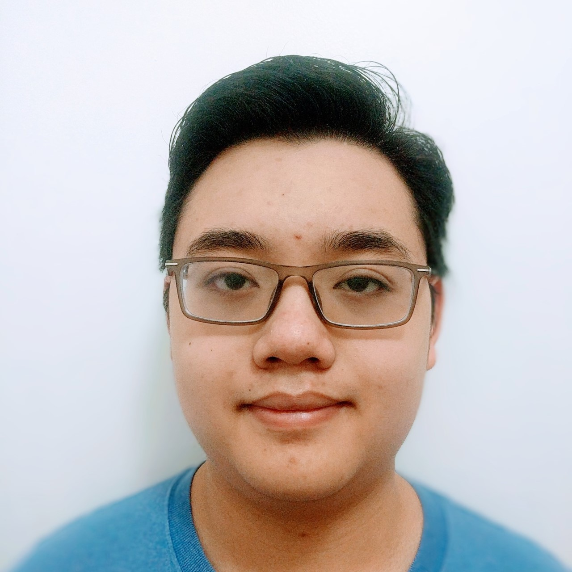
Meet our tutors
Jason Wibowo
My name is Jason Wibowo and I am studying to be an Electrical engineer. I am currently taking public speaking, trigonometry, engineering graphics 2, 3D modeling and CAD and electrical circuits. I tutor College algebra and AutoCAD and am available in the math lab from 12:30 - 3:30 on Tuesday and Thursdays.
cade was here

Slide 22
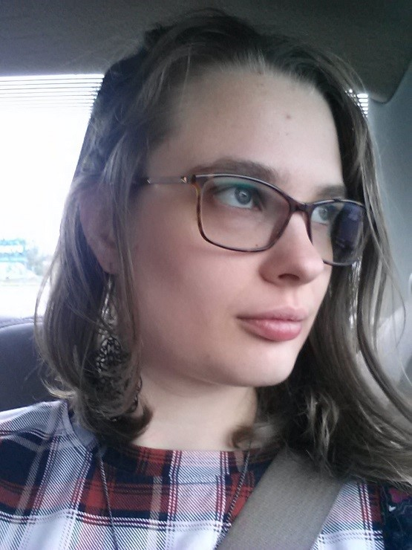
Meet our tutors
Sarah Penick
My name is Sarah, and I am majoring in Psychology. For all of my life, I have wanted to help people, and this major will help me accomplish that goal by paving the way for me to obtain a Master of Science in Marriage and Family Therapy. My main hobbies include reading, writing, crocheting, drawing, and being sat on by cats.
cade was here

Slide 23
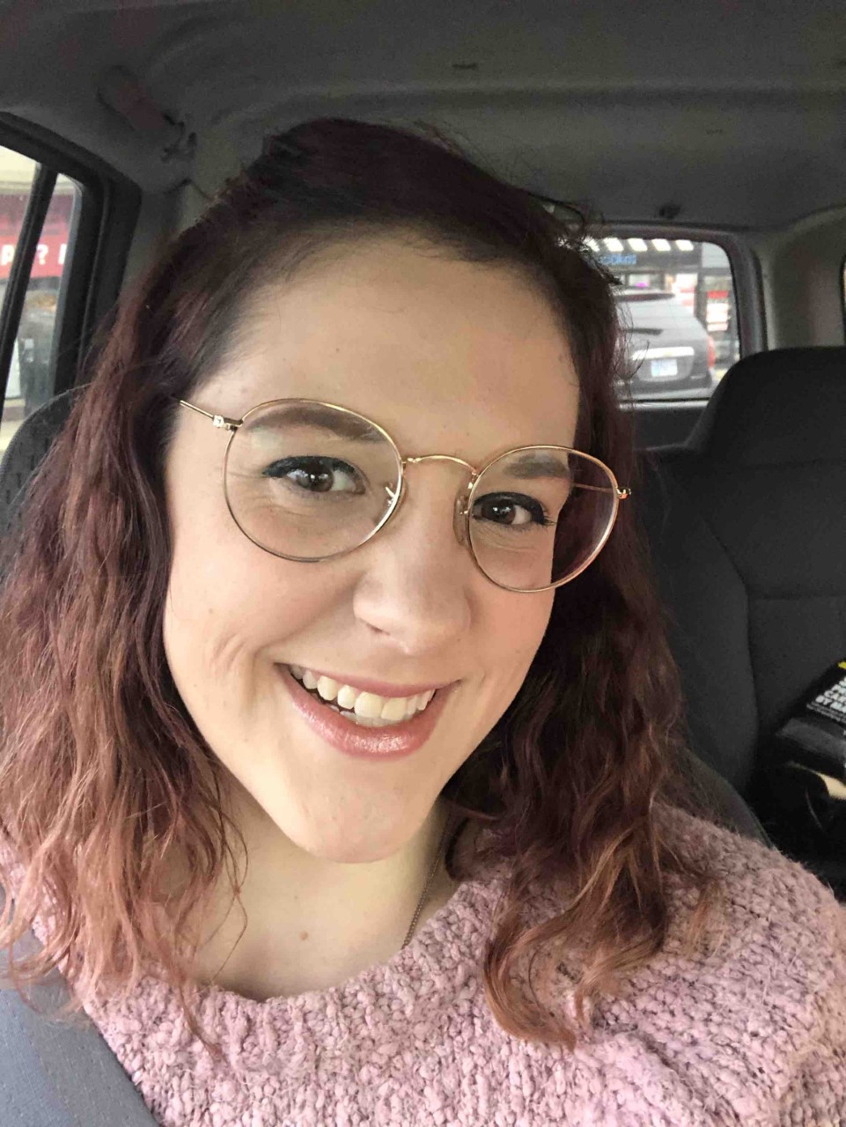
Meet our tutors
Kaylie Hansen
Hi, I’m Kaylie and I’m a premed major! My dream is to be a physician. I love volunteering and spending time in nature.
cade was here

