Slide 1
CHL7001H Y1 Course Project
Instructor: Dr. Wei Xu
Student Name : Shu Guo

Slide 2
Data Description
The dataset including:
1. Genetic data:
541903 SNPs from 497 individuals
Covers all the autosomal chromosomes (1—22)
First three principal components for 540 individuals
2. Phenotype data:
Overall survival
Event free survival
Secondary primary cancer
Six toxicity endpoints
3. Covariate variables

Slide 3
Genetic Data Checking
Conduct initial data checking using plink
Check MAF(--freq) : no SNP with overall allele frequency less than 1%.
HWE (--hardy) : no SNP with strong departures from HWE(p < 0.001).
Missingness(--missing): no individual with > 5% missing genotypes, no SNP has more than 1% missing genetic data.
Check highly related samples by calculating pairwise genomewide identity-by-state (IBS)
plink --bfile mydata --genome --geno 0 --mind 1 --out ibsibd –noweb
#use gwak to find the pair of subjects with excessive relatedness
gawk '$10 > 8' ibsibd.genome
FID1 IID1 FID2 IID2 RT EZ Z0 Z1 Z2 PI_HAT PHE DST PPC RATIO

Slide 4
Create Phenotype and Covariate data set
Choose Larynx Acute Max (LAM) as phenotype variable: set individuals with LAM values of 0 and 1 as controls and 2, 3, 4 as cases.
Choose 3 PCAs and Treatment Groups as predict variables.
Delete individuals with missing PCAs.
There are 475 individuals with complete phenotype and covariate variables.
Use plink to fit logistic models for all SNPs:
plink --bfile mydata --1 --logistic --pheno Phenolam.txt --covar CovarLam.txt --allow-no-sex --hide-covar

Slide 5
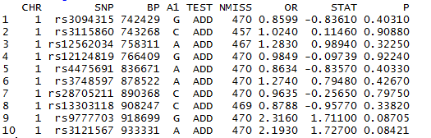
Logistic regression models
The plink output file is plink.assoc.logistic
Can read the data file in R

Slide 6
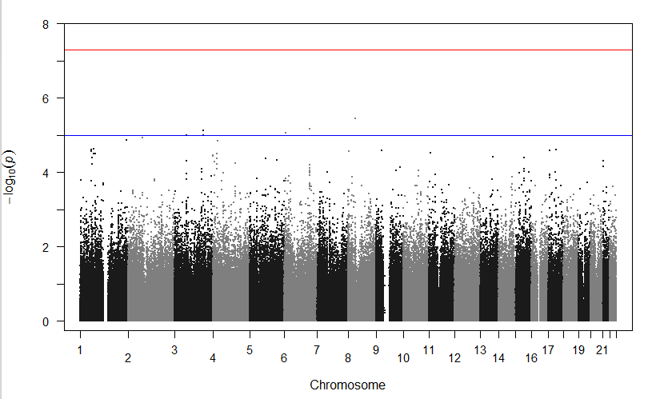
Manhattan Plot

Slide 7
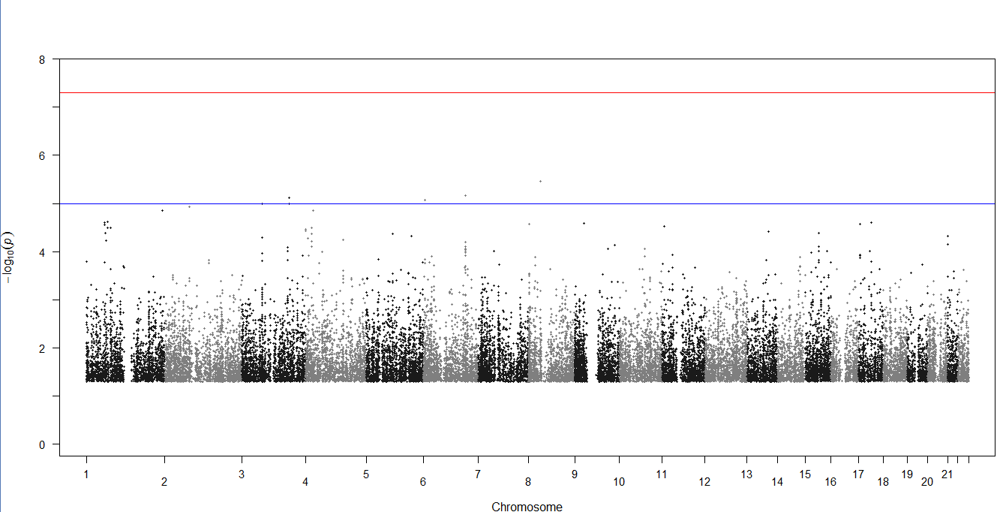
Manhattan Plot for SNPs with P < 0.05

Slide 8
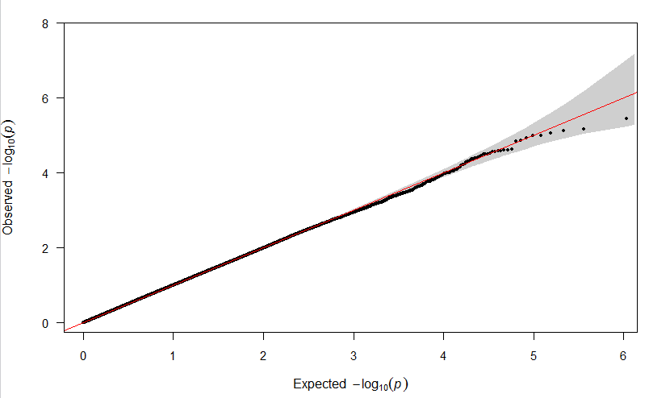
QQ Plot

Slide 9
P-values Adjustement
> head(sort(hochbergP <- p.adjust(logidata$P, method = "hochberg"))) [1] 1 1 1 1 1 1
> head(sort(BHP <- p.adjust(logidata$P, method = "BH")))
[1] 0.847175 0.847175 0.847175 0.847175 0.847175 0.847175
> head(sort(BYP <- p.adjust(logidata$P, method = "BY")))
[1] 1 1 1 1 1 1
> Pfilter <- logidata$P[logidata$P < 0.05]
head(sort(p.adjust(Pfilter, method = "BH")), n = 10)
[1] 0.04257738 0.04257738 0.04257738 0.04257738 0.04257738 0.04257738 0.04257738 [8] 0.04257738

Slide 10
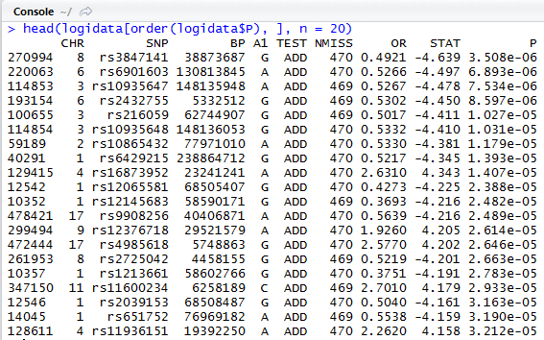
SNPs with Small P Values

Slide 11
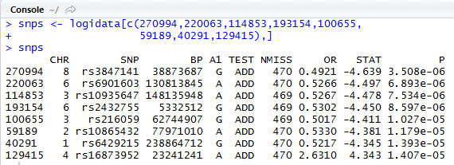
Choose SNPs for Logistic Regression Models

Slide 12
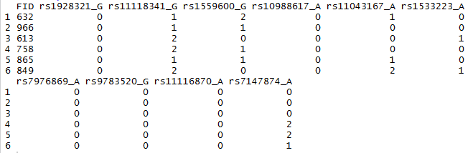
Extract SNPs Using PLINK
Use following command to extract the SNP list:
plink --bfile mydata --recodeA
-- snps rs3847141,rs6901603,rs10935647,rs2432755,rs216059,
rs10865432,rs6429215,rs16873952
The name of the output file is plink.raw

Slide 13
Logistic Regression Model
Create the data set:
Covariate variables include SNPs, 3 PCs, treatment, total RT dose, cancer stage, sex and body mass index
Fit the logistic model with R:
model1 <- glm(lam ~ ., family = binomial, data = data1)

Slide 14
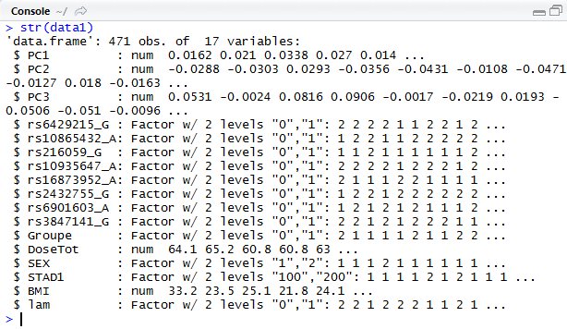

Slide 15
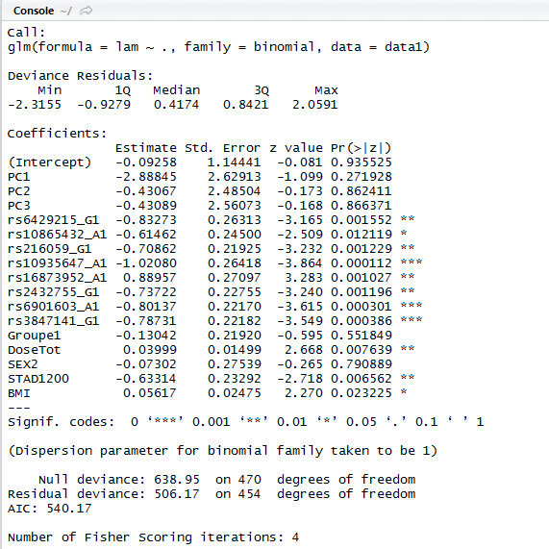

Slide 16
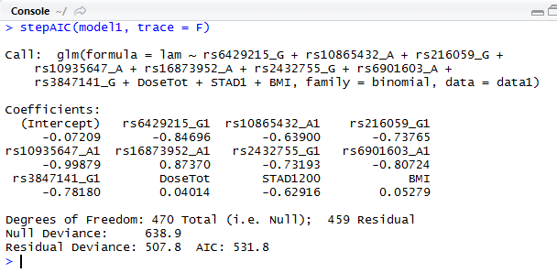
Model Selection
Use function stepAIC to choose final model:

Slide 17
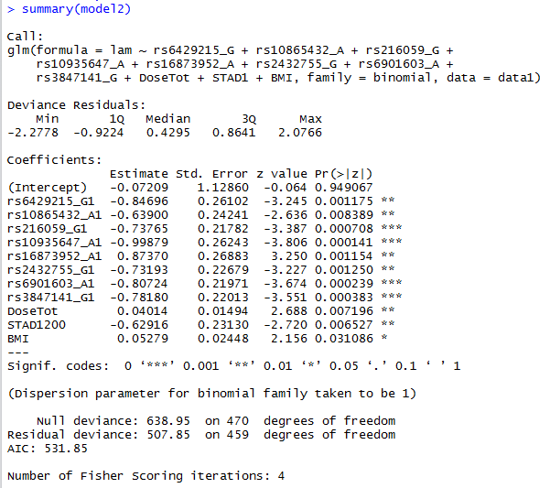

Slide 18
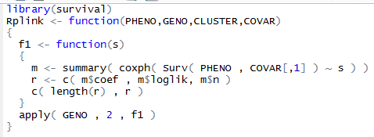
Overall Survival
Want to determine which SNPs and covariates associated with overall survival of patients.
Use PLINK and Rserve to conduct genome wide search for significant SNPs by fit Cox Proportional Hazard models for every SNP:

Slide 19
Overall Survival
The PLINK command to conduct the survival analysis is:
plink --bfile mydata --allow-no-sex --noweb --pheno ospheno.txt --covar oscovar.txt --R myscript.R
Ospheno.txt contains survival time information:
ID IID osday
460 1 3.425051335
461 1 7.175906913
462 1 7.238877481
463 1 7.482546201
......

Slide 20
Overall Survival
oscovar.txt contains all the covariate variables:
osdays, 2 PCs and treatment group:
ID IID os PC1 PC2 PC3 Group
460 1 1 0.0191 0.038 -0.0853 1
461 1 0 0.0265 -0.012 0.0337 0
462 1 0 0.0259 0.0335 0.0078 0
463 1 0 0.0308 -0.0232 0.0196 0
464 1 1 0.0102 0.037 0.0423 1
. . . . . .

Slide 21
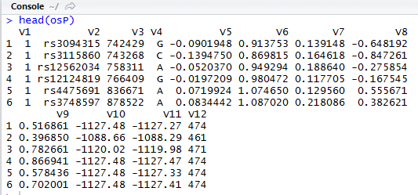
Overall Survival
The PLINK command generates a file, plink.auto.R, which contains the raw output for each SNP.

Slide 22
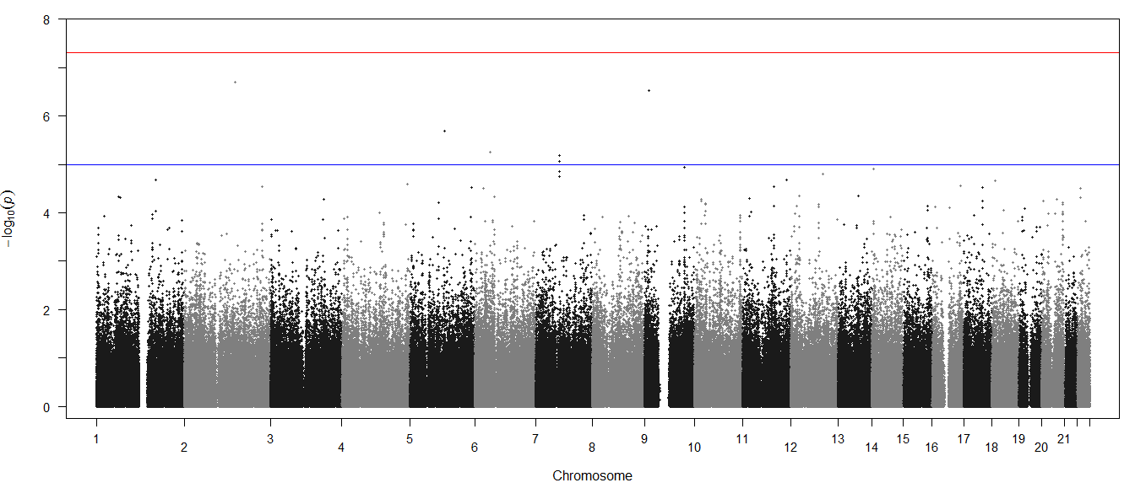
Manhattan Plot

Slide 23
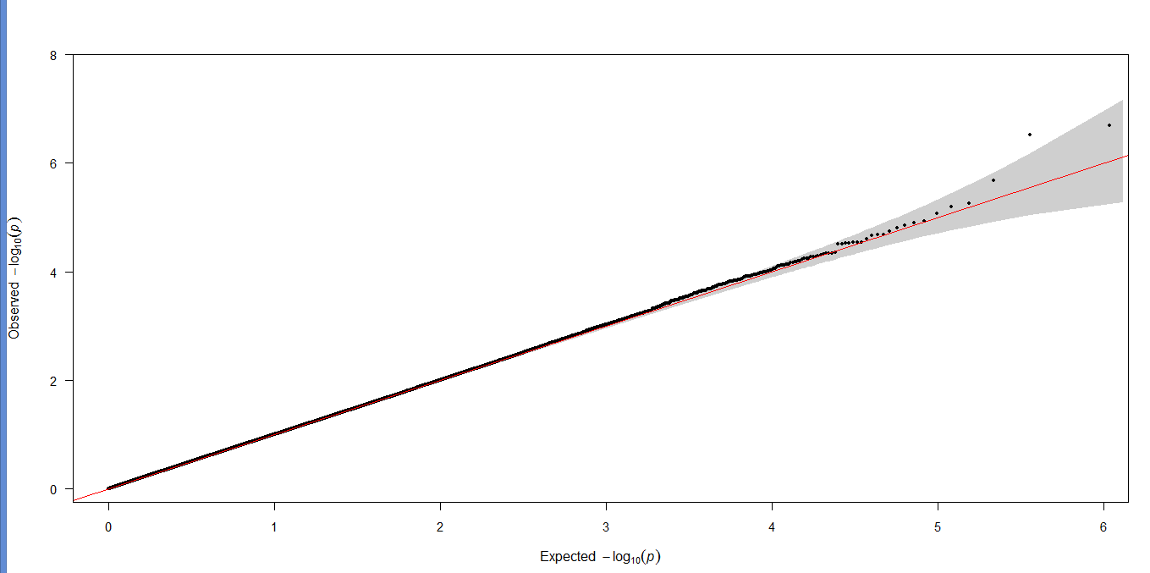
QQ Plot

Slide 24
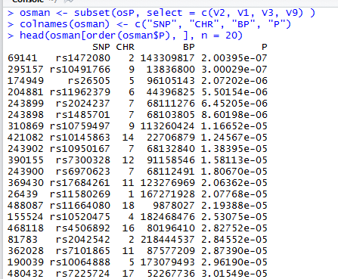
Create Data Set for Survival Analysis
Select SNPs with small P values:

Slide 25
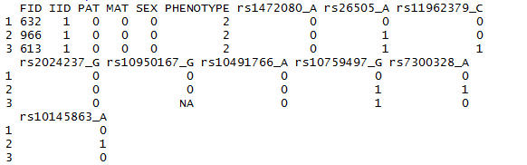
Create Data Set for Survival Analysis
Choose following SNPs:
plink --bfile mydata --recodeA --snps rs1472080,rs10491766,rs26505,rs11962379,rs2024237,rs10759497,rs10145863,rs10950167,rs7300328

Slide 26
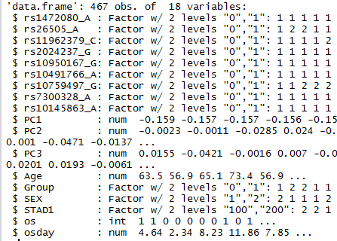
Create Data Set for Survival Analysis
Final data set including:
9 SNPs, 3PCs, treatment, age, stage, and gender

Slide 27
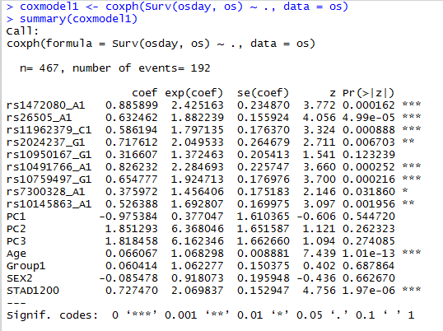
Cox Proportional Hazard Model
Fit Cox PH model using R:

Slide 28
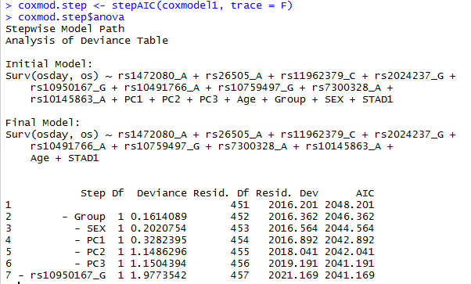
Model Selection
Use stepAIC function to select the best model according to AIC statistics

Slide 29
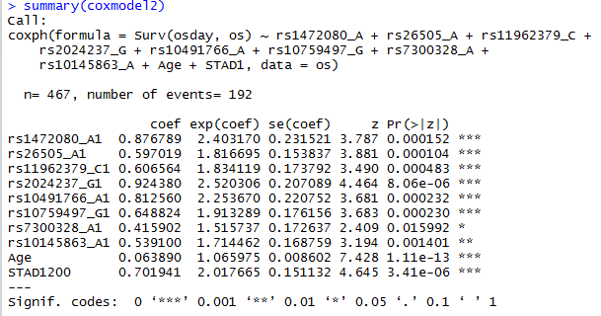
Model Selection

Slide 30
Model Selection
LRT for SNP rs7300328_A1
Fit a reduced model without the above SNP:
coxmodel3 <- coxph(Surv(osday, os) ~ rs1472080_A + rs26505_A + rs11962379_C +
rs2024237_G + rs10491766_A + rs10759497_G +
rs10145863_A + Age + STAD1, data = os)
Conduct LRT:
> -2*coxmodel3$loglik[2] + 2*coxmodel2$loglik[2]
> [1] 5.443447
> 1 - pchisq(5.443447, 1)
> [1] 0.01964187
Retain the model selected by stepAIC

Slide 31
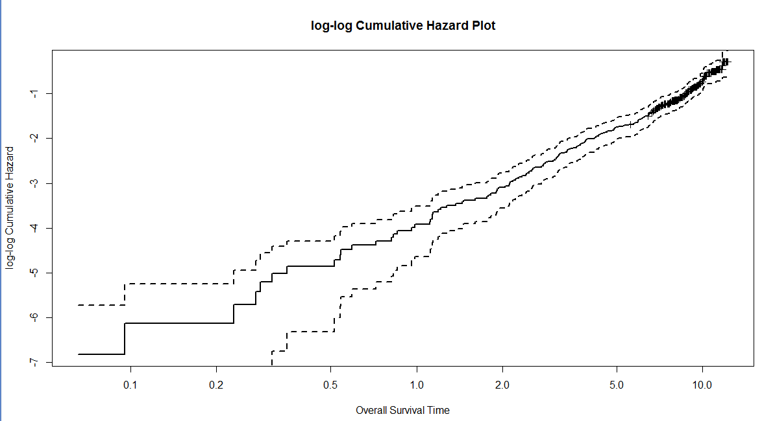
Model Checking

Slide 32
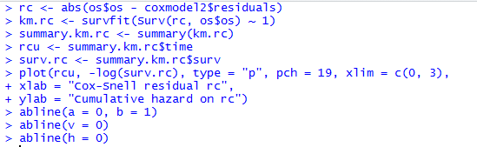
Model Checking
Cox-Snell residuals for assessing the overall fit.
Should be a 45 degree line through the origin.

Slide 33
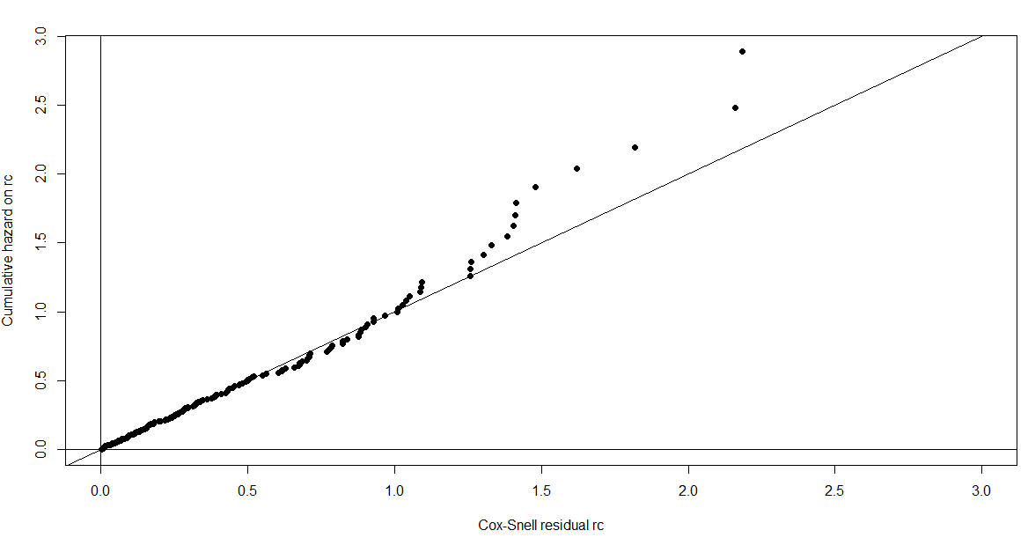

Slide 34
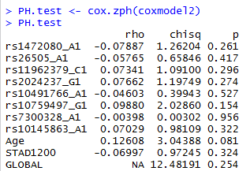
Grambsch and Therneau’s test for PH assumption
For a time-varying coefficient β(t) = β + θg(t), we have score test for
H₀ : θ = 0

Slide 35
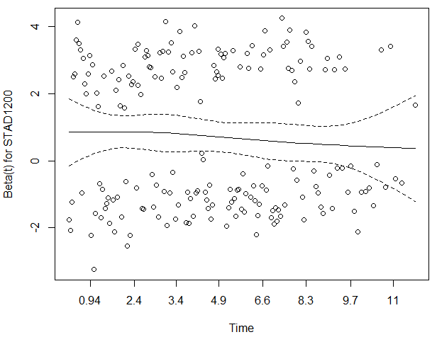
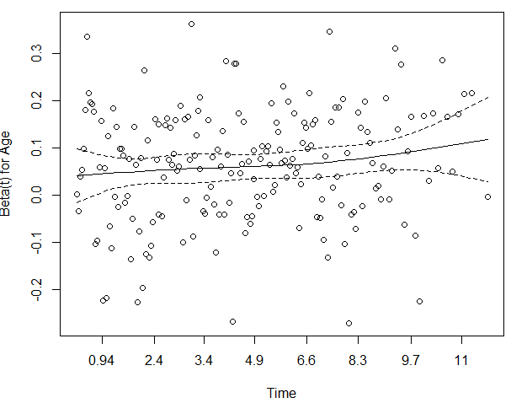
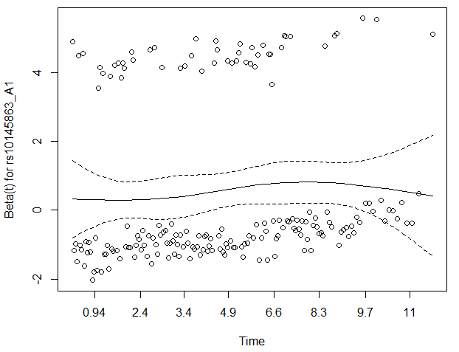
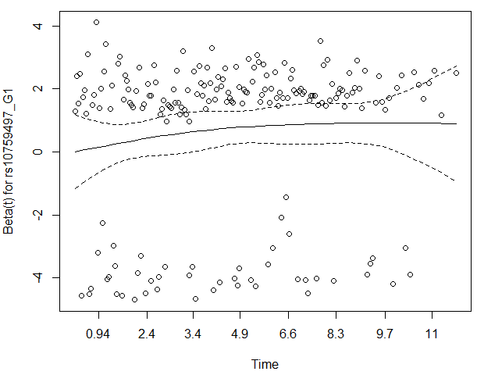

Slide 36
Trees – Based Methods
Regression and classification trees are an method to find relationship among predictor variables and a continuous or categorical trait.
An algorithm method for identifying structure in high-dimensional data.
Regression trees apply to continuous variables, while classification trees apply to categorical variables.

Slide 37

Partitioning Methods
Regression Trees
First partition a single predictor by choosing a point alone the range of that predictor to make the split.
Take the mean of the response in each partition and minimize the residual sum of squares(RSS)
Subpartition the partition in a recursive manner

Slide 38
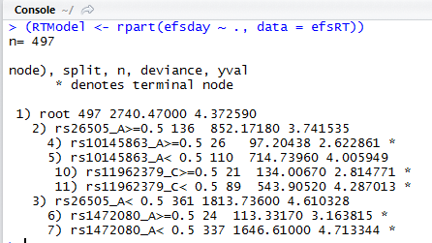
Regression Tree Model for SNP data
Fit regression tree mode for event free survival days using (17) SNP data in logistic and overall survival models.

Slide 39
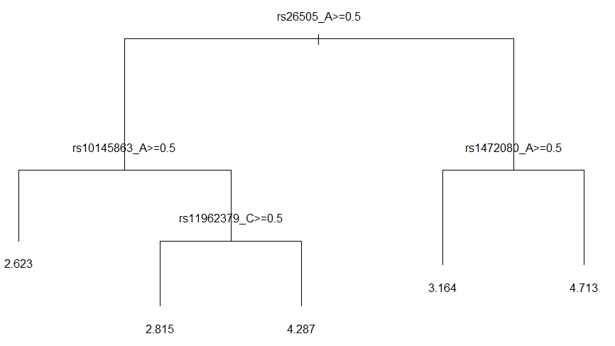

Slide 40
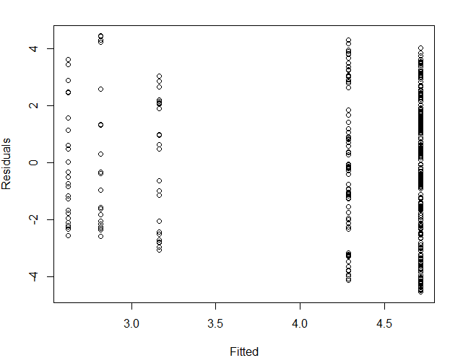

Slide 41
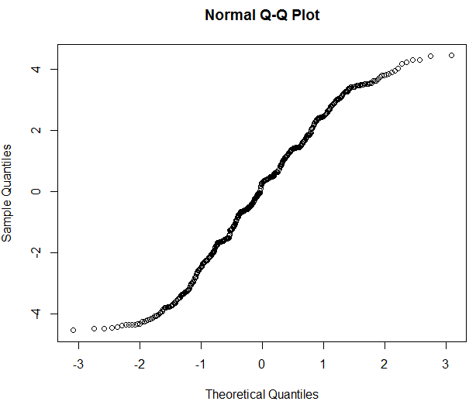

Slide 42
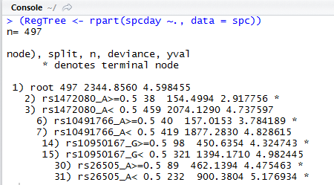
Regression Tree Model for SNP data
Using the same SNP data fit regression tree for spcdays:

Slide 43
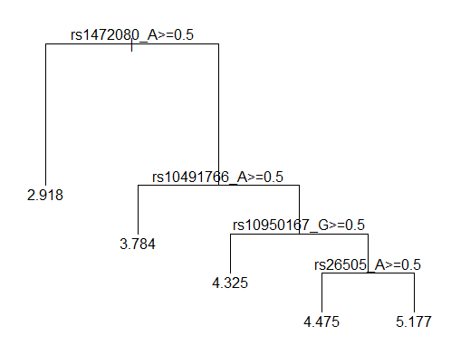

Slide 44
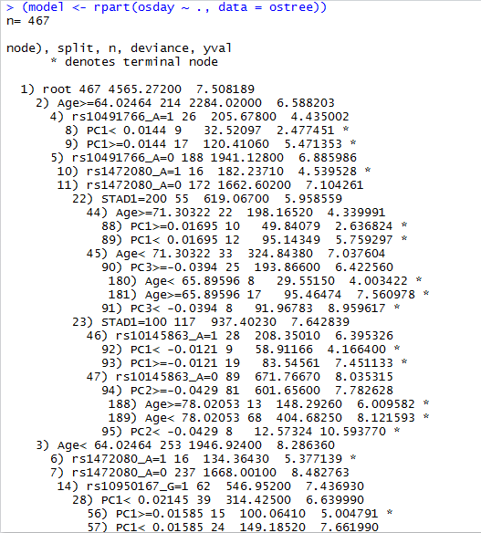
Regression Tree for Overall Survival Data

Slide 45
