Slide 1
Optimal Mismatch Algorithm Maximal Shift Algorithm
CS 655 : Analyzing Sequences
Presented by :Archana

Slide 2
Optimal Mismatch Algorithm
Sunday D.M. , 1990
Idea : Scan pattern from least frequent to most frequent character

Slide 3
Optimal Mismatch Algorithm
Sunday D.M. , 1990
Idea : Scan pattern from least frequent to most frequent character
Need to know frequency of each character in alphabet

Slide 4
Preprocessing
Sort pattern based on frequency
Bad-character shift
Good-suffix shift

Slide 5
Sorting pattern
Text = gcatcgcagagagtatacagtacg
Pattern = gcagagag

Slide 6
Sorting pattern
Text = gcatcgcagagagtatacagtacg
Pattern = gcagagag
Character | g
Frequency | 7

Slide 7
Sorting pattern
Text = gcatcgcagagagtatacagtacg
Pattern = gcagagag
Character | g | c | a | t
Frequency | 7 | 5 | 8 | 4

Slide 8
Sorting pattern
Text = gcatcgcagagagtatacagtacg
Pattern = gcagagag
Character | g | c | a | t
Frequency | 7 | 5 | 8 | 4
i | 0 | 1 | 2 | 3 | 4 | 5 | 6 | 7
x[i] | g | c | a | g | a | g | a | g
pat[i].loc
pat[i].c

Slide 9
Sorting pattern
Text = gcatcgcagagagtatacagtacg
Pattern = gcagagag
Character | g | c | a | t
Frequency | 7 | 5 | 8 | 4
i | 0 | 1 | 2 | 3 | 4 | 5 | 6 | 7
x[i] | g | c | a | g | a | g | a | g
pat[i].loc
pat[i].c

Slide 10
Sorting pattern
Text = gcatcgcagagagtatacagtacg
Pattern = gcagagag
Character | g | c | a | t
Frequency | 7 | 5 | 8 | 4
i | 0 | 1 | 2 | 3 | 4 | 5 | 6 | 7
x[i] | g | c | a | g | a | g | a | g
pat[i].loc | 1
pat[i].c | c

Slide 11
Sorting pattern
Text = gcatcgcagagagtatacagtacg
Pattern = gcagagag
Character | g | c | a | t
Frequency | 7 | 5 | 8 | 4
i | 0 | 1 | 2 | 3 | 4 | 5 | 6 | 7
x[i] | g | c | a | g | a | g | a | g
pat[i].loc | 1 | 7 | 5 | 3 | 0
pat[i].c | c | g | g | g | g

Slide 12
Sorting pattern
Text = gcatcgcagagagtatacagtacg
Pattern = gcagagag
Character | g | c | a | t
Frequency | 7 | 5 | 8 | 4
i | 0 | 1 | 2 | 3 | 4 | 5 | 6 | 7
x[i] | g | c | a | g | a | g | a | g
pat[i].loc | 1 | 7 | 5 | 3 | 0 | 6 | 4 | 2
pat[i].c | c | g | g | g | g | a | a | a

Slide 13
Preprocessing
Sort pattern based on frequency
Bad-character shift
Good-suffix shift

Slide 14
Bad Character Shift

Slide 15
Bad Character Shift
T[k+m] is always involved in the next match

Slide 16
Bad Character Shift
T[k+m] is always involved in the next match
k | 0 | 1 | 2 | 3 | 4 | 5 | 6 | 7
T[k] | g | c | a | a | g | c | a | g
x[i] | g | c | a | g | a | g | a | g

Slide 17
Bad Character Shift
T[k+m] is always involved in the next match
k | 0 | 1 | 2 | 3 | 4 | 5 | 6 | 7
T[k] | g | c | a | a | g | c | a | g | a
x[i] | g | c | a | g | a | g | a | g
Character | a
B-C shift

Slide 18
Bad Character Shift
T[k+m] is always involved in the next match
k | 0 | 1 | 2 | 3 | 4 | 5 | 6 | 7
T[k] | g | c | a | a | g | c | a | g | a
x[i] | g | c | a | g | a | g | a | g
Character | a
B-C shift | 8-6

Slide 19
Bad Character Shift
T[k+m] is always involved in the next match
k | 0 | 1 | 2 | 3 | 4 | 5 | 6 | 7
T[k] | g | c | a | a | g | c | a | g | a
x[i] | g | c | a | g | a | g | a | g
Character | a
B-C shift | 2

Slide 20
Bad Character Shift
T[k+m] is always involved in the next match
k | 0 | 1 | 2 | 3 | 4 | 5 | 6 | 7
T[k] | g | c | a | a | g | c | a | g | c
x[i] | g | c | a | g | a | g | a | g
Character | a | c
B-C shift | 2 | 7

Slide 21
Bad Character Shift
T[k+m] is always involved in the next match
k | 0 | 1 | 2 | 3 | 4 | 5 | 6 | 7
T[k] | g | c | a | a | g | c | a | g | g
x[i] | g | c | a | g | a | g | a | g
Character | a | c | g
B-C shift | 2 | 7 | 1

Slide 22
Bad Character Shift
T[k+m] is always involved in the next match
k | 0 | 1 | 2 | 3 | 4 | 5 | 6 | 7
T[k] | g | c | a | a | g | c | a | g | t
x[i] | g | c | a | g | a | g | a | g
Character | a | c | g | t
B-C shift | 2 | 7 | 1 | 9

Slide 23
Preprocessing
Sort pattern based on frequency
Bad-character shift
Good-suffix shift

Slide 24
Good-Suffix Shift
GS[j] is the minimum left shift so that pat[I[0]]....pat[I[j-1]] matched their aligned characters in pat, but pat[I[j]] does not
i | 0 | 1 | 2 | 3 | 4 | 5 | 6 | 7 | 8
adaptegGs | 1 | 3 | 4 | 2 | 7 | 7 | 7 | 7 | 7

Slide 25
Example
g c a t c g c a g a g a g t a t a c a g t a c g
g c a g a g a g
i | 0 | 1 | 2 | 3 | 4 | 5 | 6 | 7
pat[i].loc | 1 | 7 | 5 | 3 | 0 | 6 | 4 | 2
pat[i].c | c | g | g | g | g | a | a | a
adaptegGs | 1 | 3 | 4 | 2 | 7 | 7 | 7 | 7
Character | a | c | g | t
B-C shift | 2 | 7 | 1 | 9

Slide 26
Example
g c a t c g c a g a g a g t a t a c a g t a c g
g c a g a g a g
i | 0 | 1 | 2 | 3 | 4 | 5 | 6 | 7
pat[i].loc | 1 | 7 | 5 | 3 | 0 | 6 | 4 | 2
pat[i].c | c | g | g | g | g | a | a | a
adaptegGs | 1 | 3 | 4 | 2 | 7 | 7 | 7 | 7
Character | a | c | g | t
B-C shift | 2 | 7 | 1 | 9

Slide 27
Example
g c a t c g c a g a g a g t a t a c a g t a c g
g c a g a g a g
i | 0 | 1 | 2 | 3 | 4 | 5 | 6 | 7
pat[i].loc | 1 | 7 | 5 | 3 | 0 | 6 | 4 | 2
pat[i].c | c | g | g | g | g | a | a | a
adaptegGs | 1 | 3 | 4 | 2 | 7 | 7 | 7 | 7
Character | a | c | g | t
B-C shift | 2 | 7 | 1 | 9

Slide 28
Example
g c a t c g c a g a g a g t a t a c a g t a c g
g c a g a g a g
i | 0 | 1 | 2 | 3 | 4 | 5 | 6 | 7
pat[i].loc | 1 | 7 | 5 | 3 | 0 | 6 | 4 | 2
pat[i].c | c | g | g | g | g | a | a | a
adaptegGs | 1 | 3 | 4 | 2 | 7 | 7 | 7 | 7
Character | a | c | g | t
B-C shift | 2 | 7 | 1 | 9

Slide 29
Example
g c a t c g c a g a g a g t a t a c a g t a c g
g c a g a g a g
i | 0 | 1 | 2 | 3 | 4 | 5 | 6 | 7
pat[i].loc | 1 | 7 | 5 | 3 | 0 | 6 | 4 | 2
pat[i].c | c | g | g | g | g | a | a | a
adaptegGs | 1 | 3 | 4 | 2 | 7 | 7 | 7 | 7
Character | a | c | g | t
B-C shift | 2 | 7 | 1 | 9

Slide 30
Example
g c a t c g c a g a g a g t a t a c a g t a c g
g c a g a g a g
i | 0 | 1 | 2 | 3 | 4 | 5 | 6 | 7
pat[i].loc | 1 | 7 | 5 | 3 | 0 | 6 | 4 | 2
pat[i].c | c | g | g | g | g | a | a | a
adaptegGs | 1 | 3 | 4 | 2 | 7 | 7 | 7 | 7
Character | a | c | g | t
B-C shift | 2 | 7 | 1 | 9

Slide 31
Example
g c a t c g c a g a g a g t a t a c a g t a c g
g c a g a g a g
i | 0 | 1 | 2 | 3 | 4 | 5 | 6 | 7
pat[i].loc | 1 | 7 | 5 | 3 | 0 | 6 | 4 | 2
pat[i].c | c | g | g | g | g | a | a | a
adaptegGs | 1 | 3 | 4 | 2 | 7 | 7 | 7 | 7
Character | a | c | g | t
B-C shift | 2 | 7 | 1 | 9

Slide 32
Example
g c a t c g c a g a g a g t a t a c a g t a c g
g c a g a g a g
i | 0 | 1 | 2 | 3 | 4 | 5 | 6 | 7
pat[i].loc | 1 | 7 | 5 | 3 | 0 | 6 | 4 | 2
pat[i].c | c | g | g | g | g | a | a | a
adaptegGs | 1 | 3 | 4 | 2 | 7 | 7 | 7 | 7
Character | a | c | g | t
B-C shift | 2 | 7 | 1 | 9

Slide 33
Maximal Shift Algorithm
Pattern is scanned from the character that gives to the maximum shift to that which gives minimum shift.

Slide 34
Maximal Shift Algorithm
Pattern is scanned from the character that gives to the maximum shift to that which gives minimum shift.
i | 0 | 1 | 2 | 3 | 4 | 5 | 6 | 7
x[i] | g | c | a | g | a | g | a | g
minShift[i] | 1 | 2 | 3 | 3 | 2 | 2 | 2 | 2
pat[i].loc
pat[i].c

Slide 35
Maximal Shift Algorithm
Pattern is scanned from the character that gives to the maximum shift to that which gives minimum shift.
i | 0 | 1 | 2 | 3 | 4 | 5 | 6 | 7
x[i] | g | c | a | g | a | g | a | g
minShift[i] | 1 | 2 | 3 | 3 | 2 | 2 | 2 | 2
pat[i].loc | 3
pat[i].c | g

Slide 36
Maximal Shift Algorithm
Pattern is scanned from the character that gives to the maximum shift to that which gives minimum shift.
i | 0 | 1 | 2 | 3 | 4 | 5 | 6 | 7
x[i] | g | c | a | g | a | g | a | g
minShift[i] | 1 | 2 | 3 | 3 | 2 | 2 | 2 | 2
pat[i].loc | 3 | 2
pat[i].c | g | a

Slide 37
Maximal Shift Algorithm
Pattern is scanned from the character that gives to the maximum shift to that which gives minimum shift.
i | 0 | 1 | 2 | 3 | 4 | 5 | 6 | 7
x[i] | g | c | a | g | a | g | a | g
minShift[i] | 1 | 2 | 3 | 3 | 2 | 2 | 2 | 2
pat[i].loc | 3 | 2 | 7 | 6 | 5 | 4 | 1
pat[i].c | g | a | g | a | g | a | c

Slide 38
Maximal Shift Algorithm
Pattern is scanned from the character that gives to the maximum shift to that which gives minimum shift.
i | 0 | 1 | 2 | 3 | 4 | 5 | 6 | 7
x[i] | g | c | a | g | a | g | a | g
minShift[i] | 1 | 2 | 3 | 3 | 2 | 2 | 2 | 2
pat[i].loc | 3 | 2 | 7 | 6 | 5 | 4 | 1 | 0
pat[i].c | g | a | g | a | g | a | c | 9

Slide 39
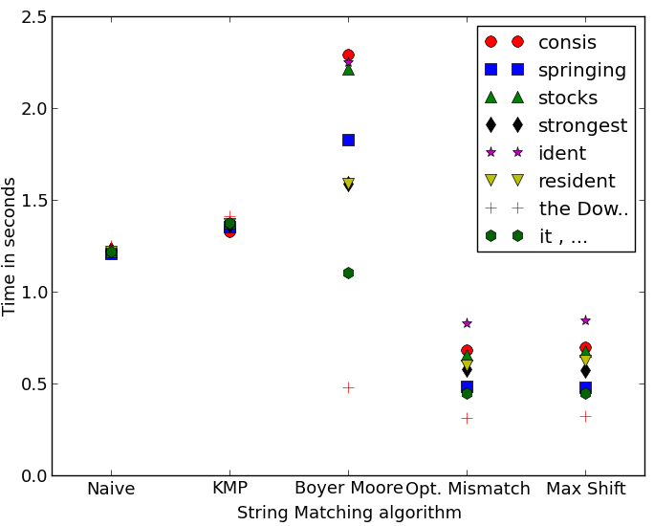
Newswire text

Slide 40
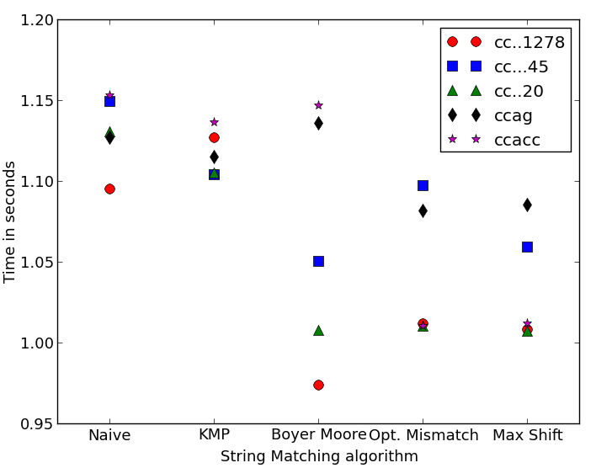
Nucleotide bases

Slide 41
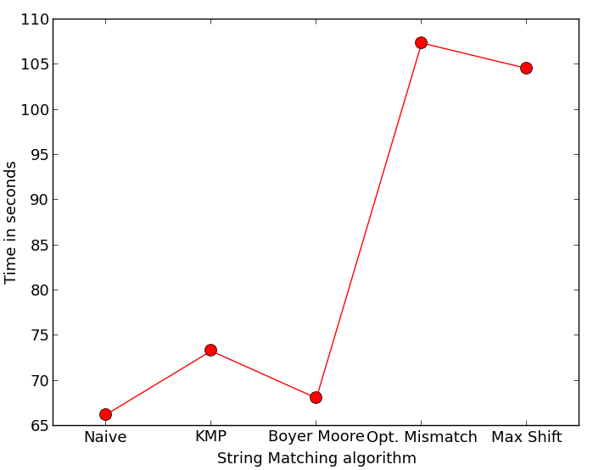
Worst-case scenario

