Slide 1
Cloud 9 Tetris
Markus Kahl, Stephanie Platz, Patrick Schilf
Web-based Software Development Environments
Software Architecture Group
SS 2012
Notes:
1

Slide 2
Tetris
Client-side Javascript
DEMO

Slide 3
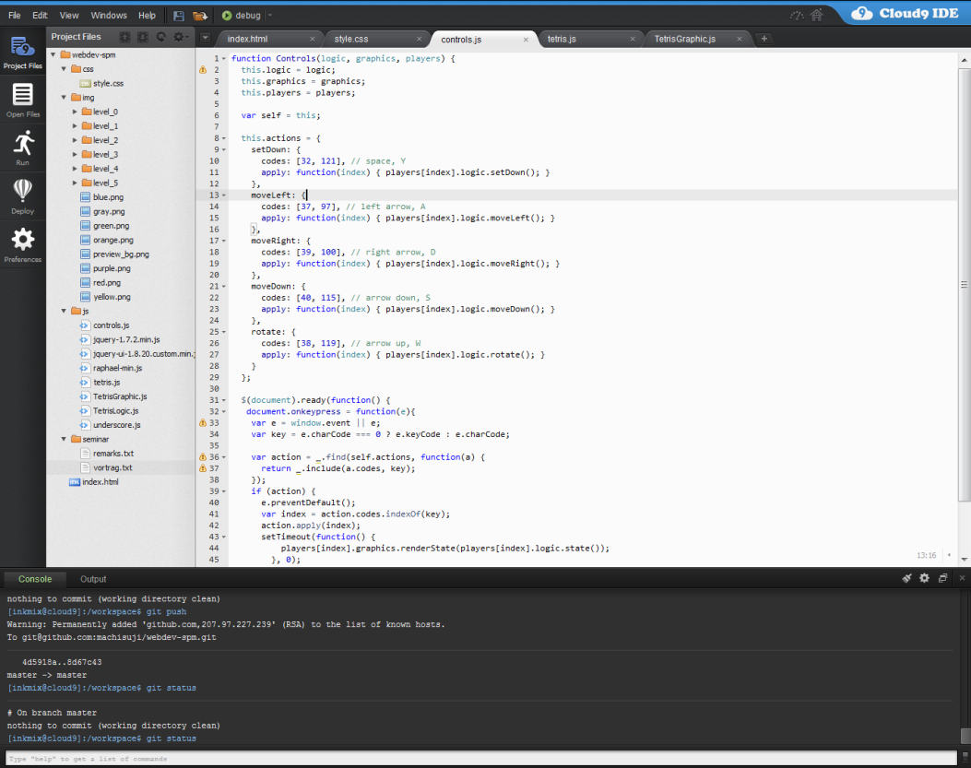
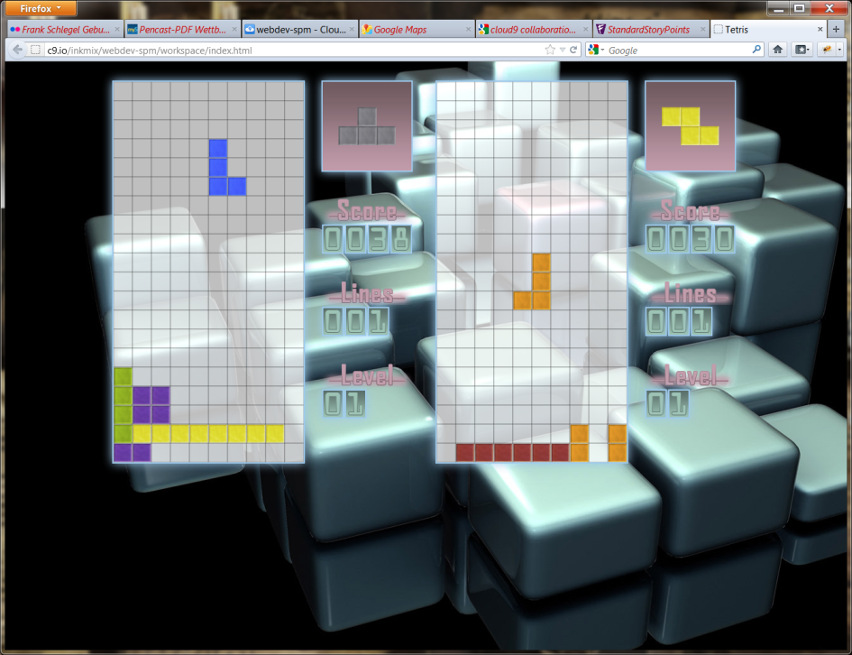
Development Workflow
Switching back and forth between windows:
no debug support from Cloud9 → debug in browser integrated debuggers (firebug, etc)

Slide 4
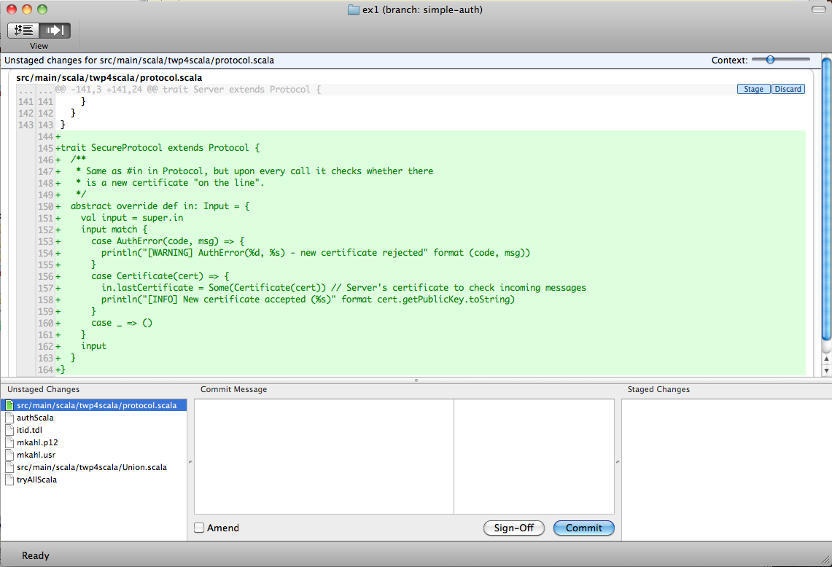
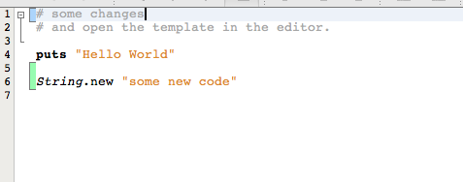
Development Workflow
git pull → coding → trying out → git commit
git workflow is not properly supported by Cloud9

