Slide 1
Cloud 9 Gitc
Markus Kahl, Stephanie Platz, Patrick Schilf
Web-based Software Development Environments
Software Architecture Group
SS 2012
Notes:
1

Slide 2
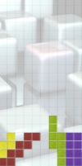






Development Workflow
window switch
debug
check out
code
console switch
commit, pull, push, …
Notes:
Tetris

Slide 3
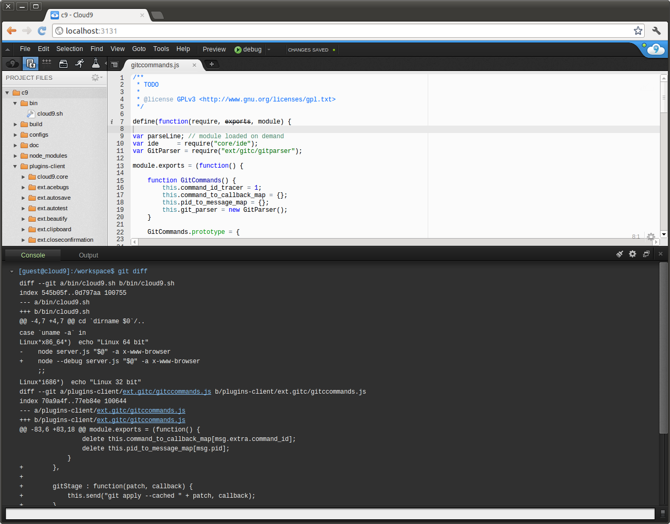
Development Workflow (cont.)
Git workflow is not properly supported by Cloud9
Switching back and forth between editor and cumbersome console

Slide 4
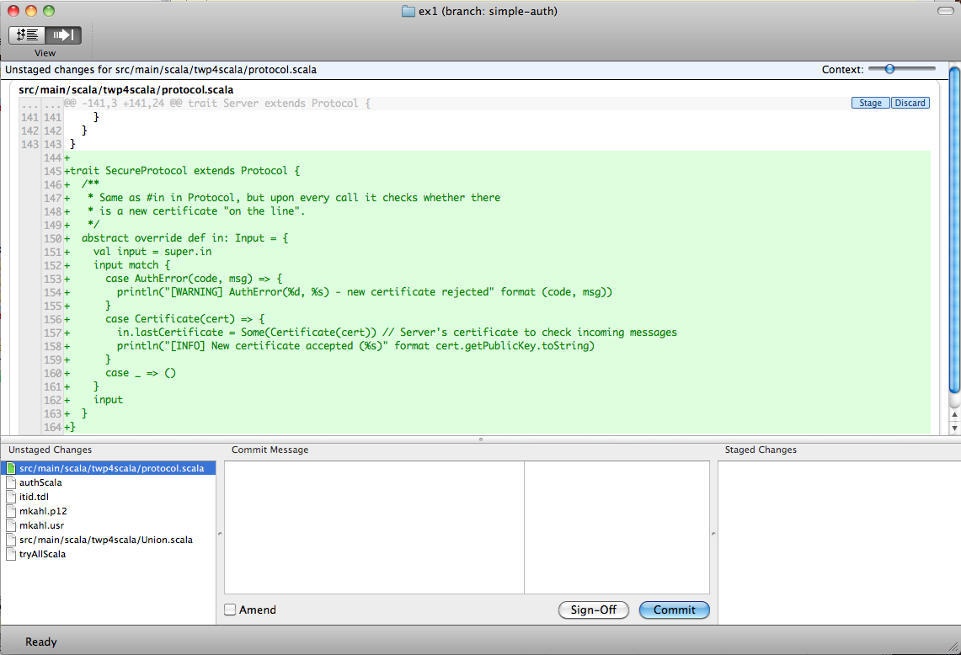

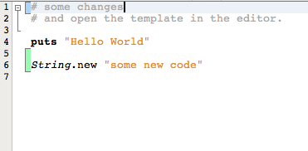
Idea to Improve Git-Workflow
Proper git integration in editor / IDE
Work without console
Visualize changes
gitx
netbeans
Notes:
Explain stage, unstage

Slide 5
Idea to Improve Git-Workflow
Proper git integration in editor / IDE
Work without console
Visualize changes
Outcome:
Visualization of unstaged, staged changes in code-editor with ability to revert, stage, unstage them

Slide 6
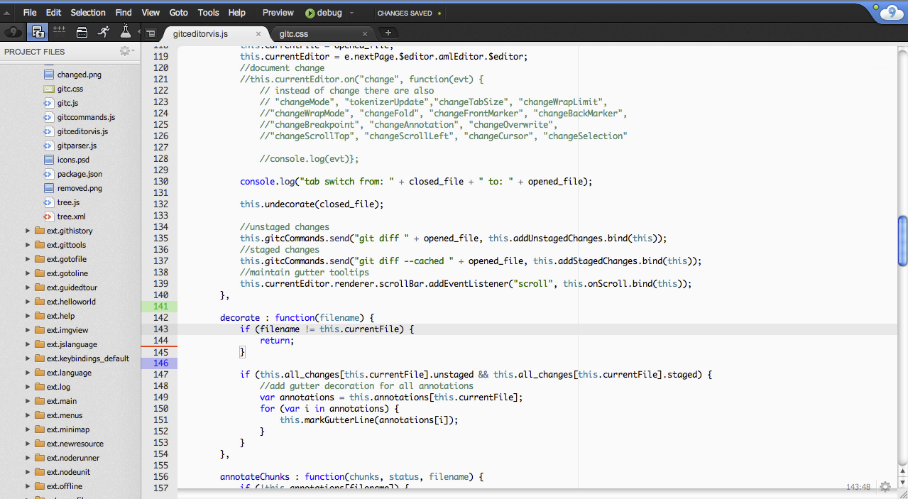
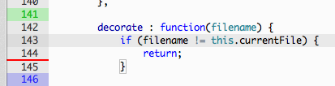

Slide 7
Idea to Improve Git-Workflow
Proper git integration in editor / IDE
Work without console
Visualize changes
Outcome:
Visualization of unstaged, staged changes in code-editor with ability to revert, stage, unstage them
Diff-View: revert, stage, unstage, commit, (push, pull)

Slide 8
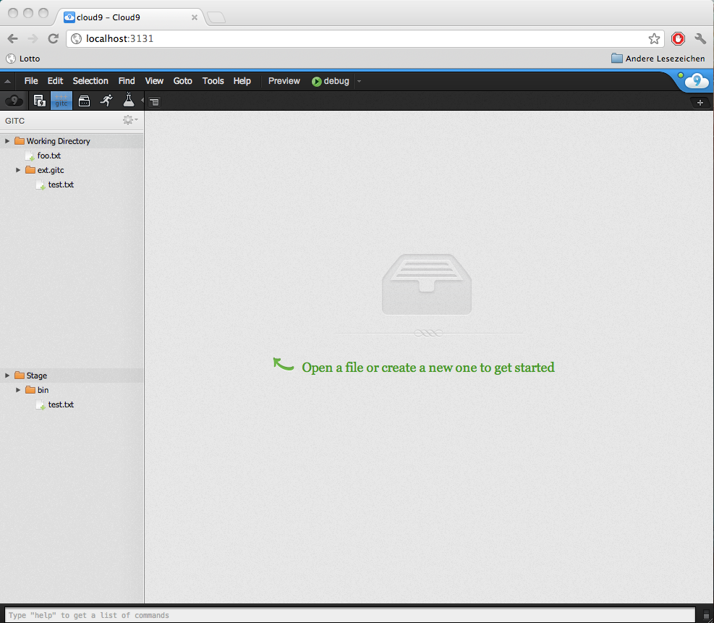
TODO: update, and zoom

Slide 9
Idea to Improve Git-Workflow
Proper git integration in editor / IDE
Work without console
Visualize changes
Outcome:
Visualization of unstaged, staged changes in code-editor with ability to revert, stage, unstage them
Diff-View: revert, stage, unstage, commit, (push, pull)
One thing left: live-tracking of user input

Slide 10
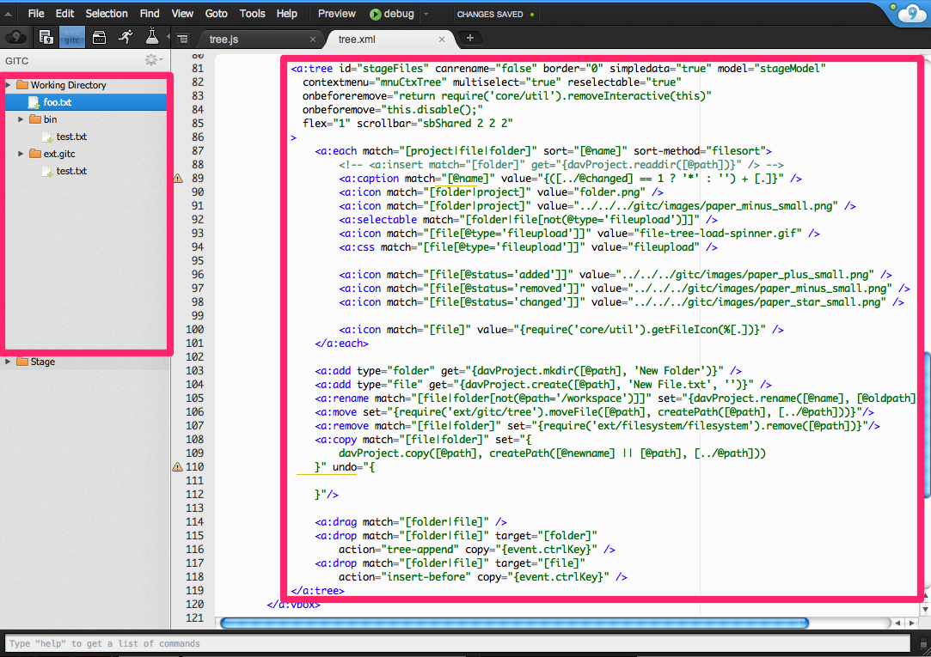
Extending Cloud9
Client-side Front-end
Build diff-pane, diff-tree
Notes:
Was haben wir gemacht womit
What kind of problems during development with cloud
Web-based devel.
Cloud9 plugins: mostly no documentation → difficult to understand interaction between them
APF: ui.ajax.org/#docs not helpful
Ace: ace.ajax.org/api/ wrong/outdated

Slide 11


Extending Cloud9
Client-side Front-end
Build diff-pane, diff-tree
Register on editor events to
Set line markers / annotations / tooltip
Track user input
Notes:
Was haben wir gemacht womit
What kind of problems during development with cloud
Web-based devel.
Cloud9 plugins: mostly no documentation → difficult to understand interaction between them
APF: ui.ajax.org/#docs not helpful
Ace: ace.ajax.org/api/ wrong/outdated

Slide 12
Extending Cloud9
Client-side (gitc.js)
Server-side (gitc.js)
this.send = function (command, callback) {
ide.send( {command: argv[0],
argv: argv,
cwd: ide.workspaceDir,
requireshandling: false,
extra : {
command_id: tracer} });
}
this.onMessage = function (e) {
}
this.command = function (user,message,client) {
processmanager.spawn("shell", {
command: args[0],
args: args.slice(1),
cwd: message.cwd,
env: this.gitEnv,
extra: message.extra
}, this.channel, errorfunction); }
this.init = function () {
}
if "gitc" command, execute actual command
command
argv
cwd
…
command
args
register callback
cwd
…
treat event if events message type is of our concern
call output on registered callback
register ide broadcast to messages on this.channel on eventbus
Notes:
this.channel = workspace.workspaceId + "::gitc“
ide broadcast:
each user: user.broadcast(msg, scope (gitc));
each client: client.send(msg);

Slide 13
Web-based development
No installation, code and tools everywhere accessible
Offline development restricted
Turn-around time: one page reload
Implement in what you implement
No need to switch window
Git generally used in extra console
Likely to break ide during development
Notes:
What kind of problems during development with cloud
Web-based devel.
Cloud9 plugins: mostly no documentation → difficult to understand interaction between them
APF: ui.ajax.org/#docs not helpful
Ace: ace.ajax.org/api/ wrong/outdated

Slide 14
Conclusion
Cloud9 + our extension
No need to use console for git
Ability to (un)stage single chunks
Instant visual feedback of changes
Experiences with Cloud9
Plug-in architecture
Cloud9 and its third party software not well documented
Contact via email fast and helpful
Notes:
Cloud9 plugins: mostly no documentation → difficult to understand interaction between them
APF: ui.ajax.org/#docs not helpful
Ace: ace.ajax.org/api/ wrong/outdated

