Slide 1
Cloud 9 Gitc
Markus Kahl, Stephanie Platz, Patrick Schilf
Web-based Software Development Environments
Software Architecture Group
SS 2012
Notes:
1

Slide 2
Pros and Cons
Access IDE online
Drag & Drop
Github / Bitbucket integration
Syntax highlighting for many languages
simplistic editor
lexical autocompletion
Git integration insufficient
Console is main tool
Rough edges
Notes:
* crtl+l
* tab suggestions/autocomplete
* execute refresh after certain commands (git pull, rm, ...)
* colors (git config color.status auto)
* close console when click into text
* reconfigurable shortcuts (alt+space instead of Shift+ESC for instance)
* no indication of when a command's console output ends (i.e. the is done)

Slide 3
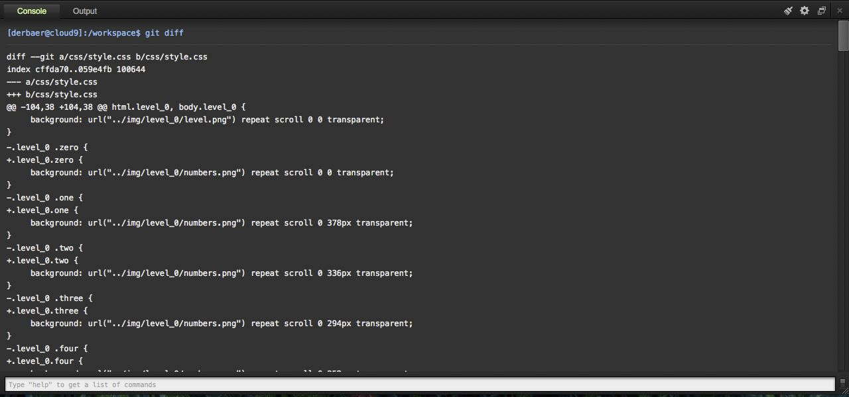
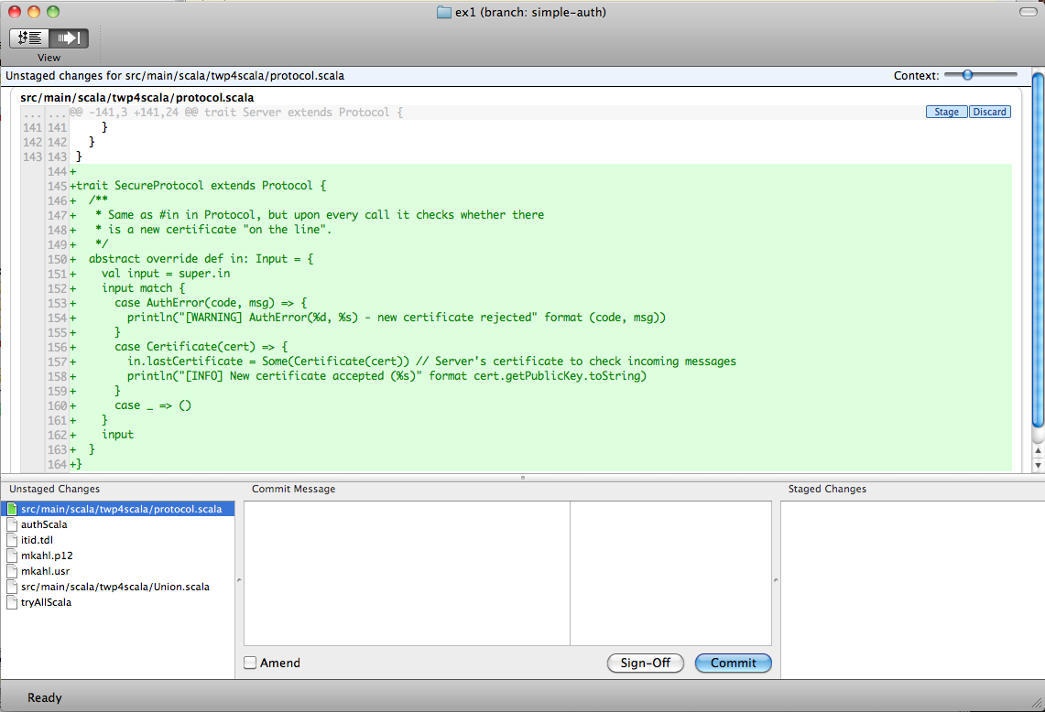
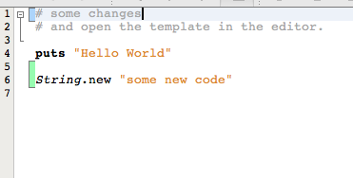
(part of our) Development Workflow
git workflow is not properly supported by Cloud9
Switching back and forth between editor and cumbersome console

Slide 4
Idea to Improve Git-Workflow
Proper git integration in editor / IDE
Work without console
Visualize changes
(Branches, History, Tags, …)
Outcome:
Visualization of unstaged, staged changes in code-editor with ability to revert, stage, unstage them

Slide 5
BILD FÜR EDITOR

Slide 6
Idea to Improve Git-Workflow
Proper git integration in editor / IDE
Work without console
Visualize changes
(Branches, History, Tags, …)
Outcome:
Visualization of unstaged, staged changes in code-editor with ability to revert, stage, unstage them
Diff-View: revert, stage, unstage, commit, (push, pull)

Slide 7
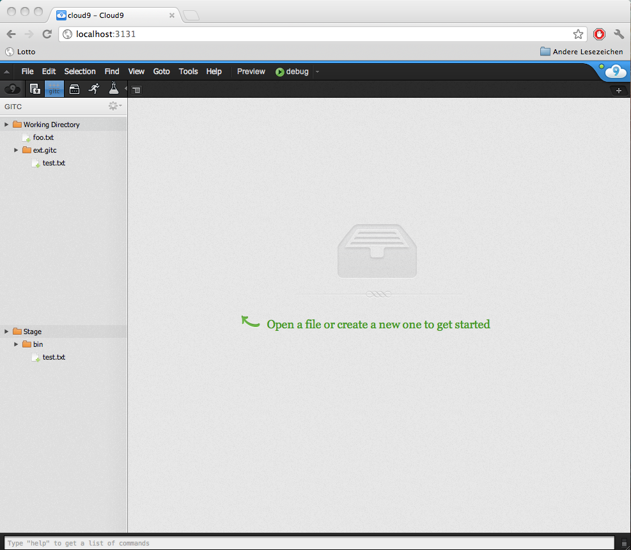
update me!

Slide 8

also…
Implement in what you implement
No noticeable deployment time
Documentation rarely available, outdated, wrong
Cloud9 plugins: mostly no documentation → difficult to understand interaction between them
APF: ui.ajax.org/#docs not helpful
Ace: ace.ajax.org/api/ wrong/outdated

