Slide 1
Cloud 9 Tetris
Markus Kahl, Stephanie Platz, Patrick Schilf
Web-based Software Development Environments
Software Architecture Group
SS 2012
Notes:
1

Slide 2
Tetris
Client-side Javascript
DEMO

Slide 3
Pros and Cons
Access IDE online
Drag & Drop
Github / Bitbucket integration
Syntax highlighting for many languages
simplistic editor
lexical autocompletion
Git integration insufficient
Console is main tool
Rough edges
Notes:
* crtl+l
* tab suggestions/autocomplete
* execute refresh after certain commands (git pull, rm, ...)
* colors (git config color.status auto)
* close console when click into text
* reconfigurable shortcuts (alt+space instead of Shift+ESC for instance)
* no indication of when a command's console output ends (i.e. the is done)

Slide 4
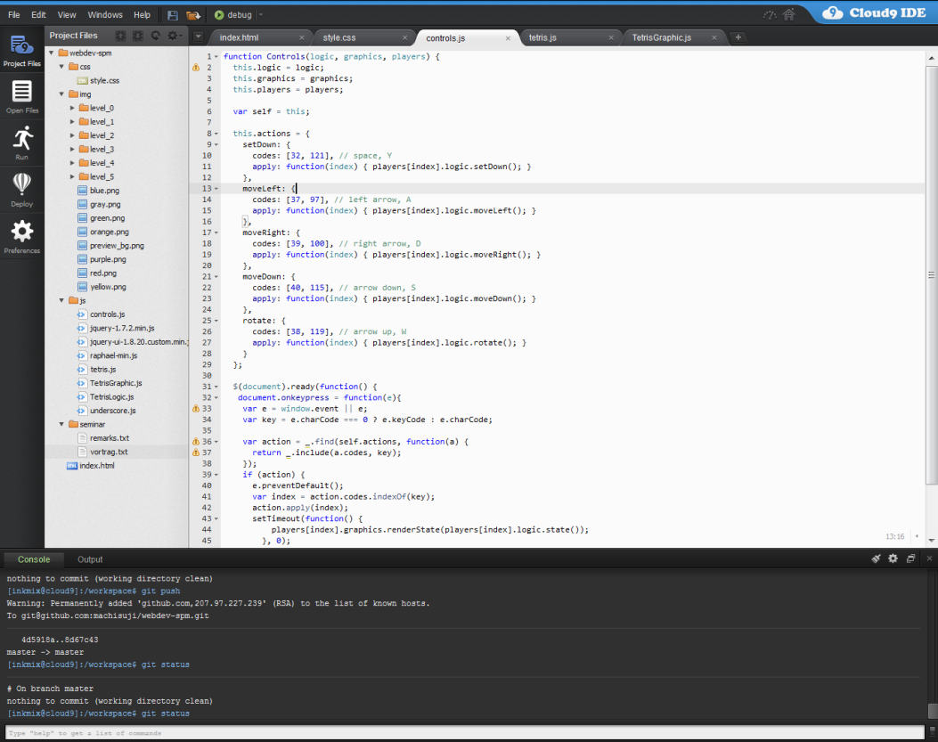
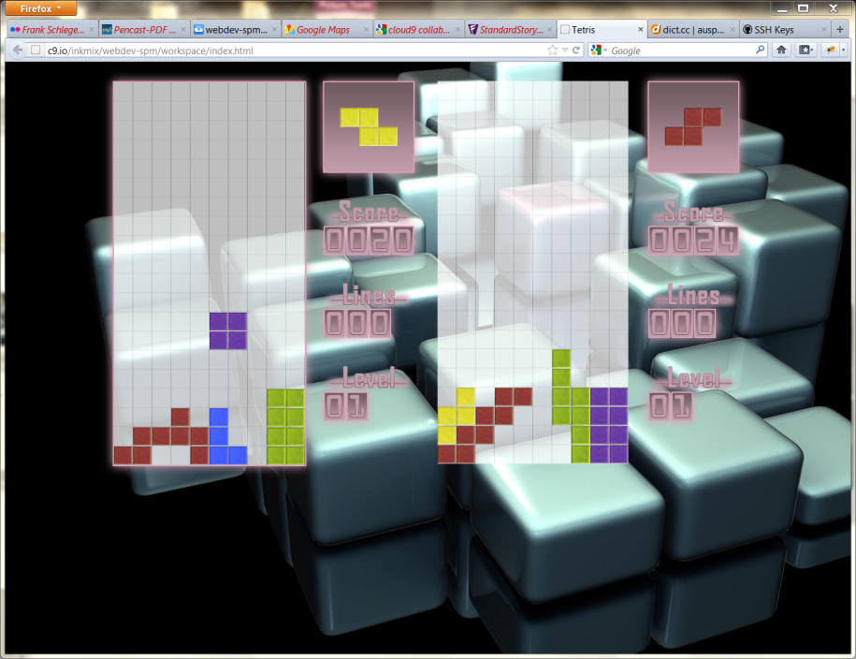
Development Workflow
Switching back and forth between windows:
Debugging in browser integrated debuggers (firebug, etc)

Slide 5
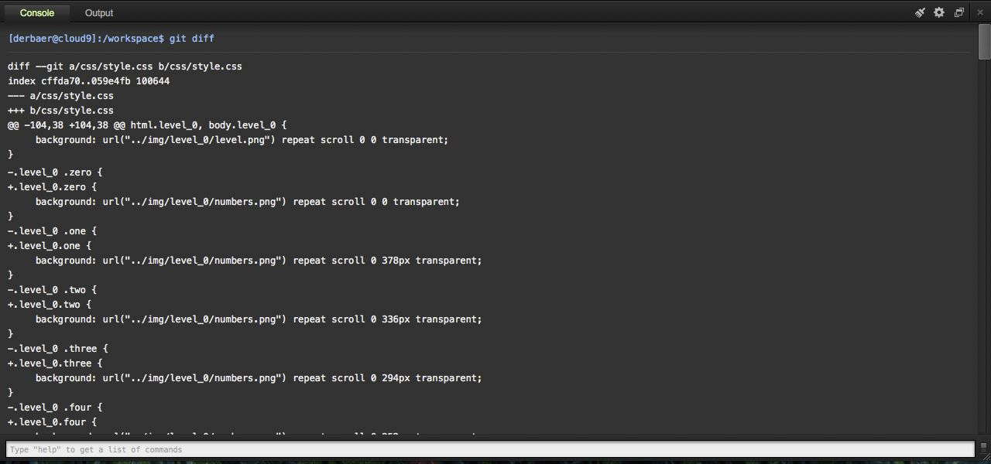
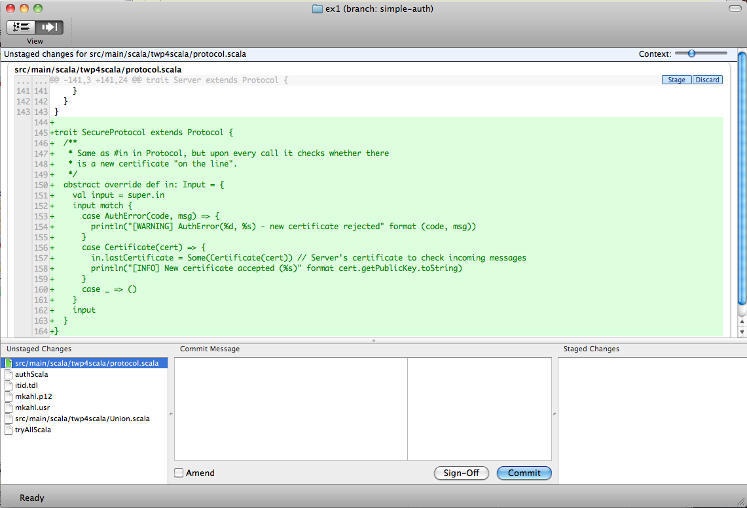
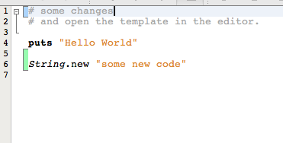
Development Workflow
git pull → coding → trying out → git commit
git workflow is not properly supported by Cloud9

Slide 6
Ideas
Collaboration
See what other team members do in real-time
But: will be released in ~3 weeks
Proper git integration in editor / IDE
Work without console
Visualize changes
(Branches, History, Tags, …)
IDE-based Issue-Tracking
Measure time and assign to tickets
Automatically create tickets while coding

