Slide 1
Cloud 9 Gitc
Markus Kahl, Stephanie Platz, Patrick Schilf
Web-based Software Development Environments
Software Architecture Group
SS 2012
Notes:
1

Slide 2
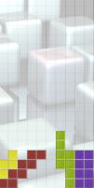






Development Workflow
window switch
debug
check out
code
console switch
commit, pull, push, …
Notes:
Tetris

Slide 3
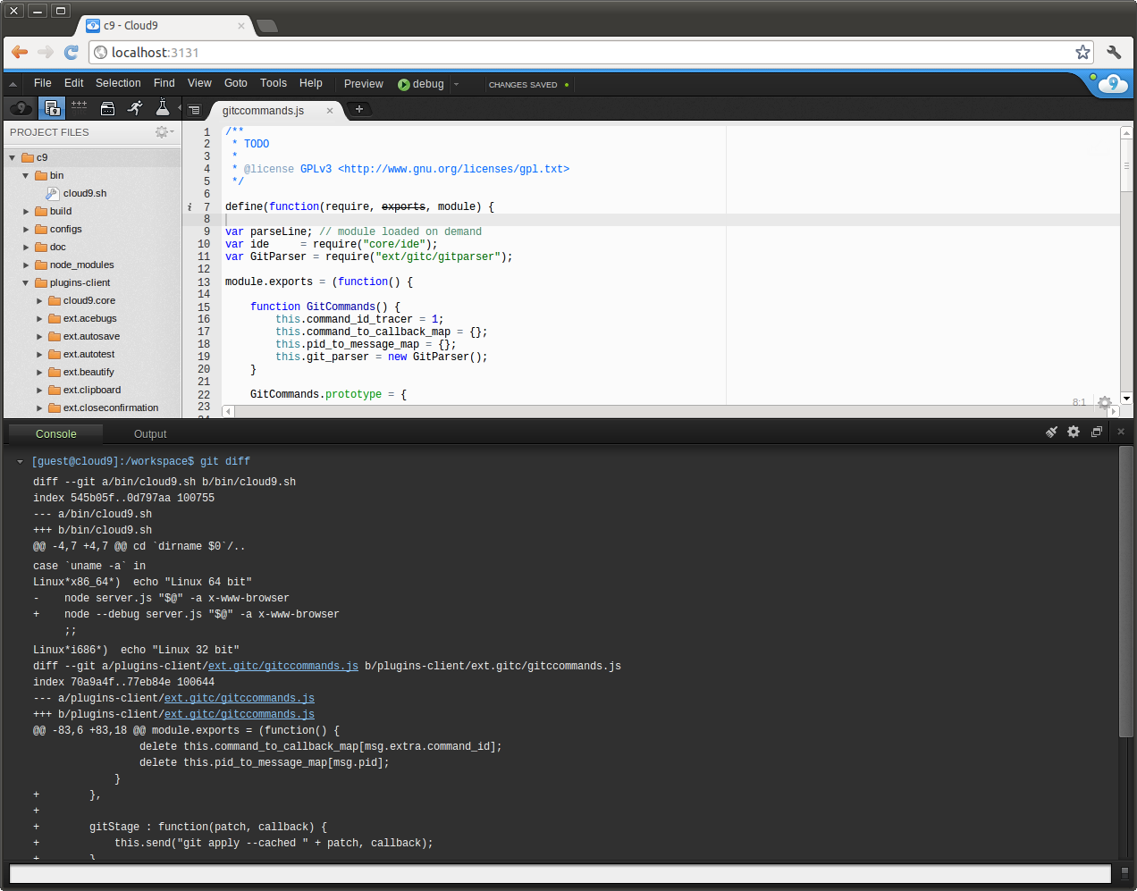
Development Workflow (cont.)
Git workflow is not properly supported by Cloud9
Switching back and forth between editor and cumbersome console

Slide 4
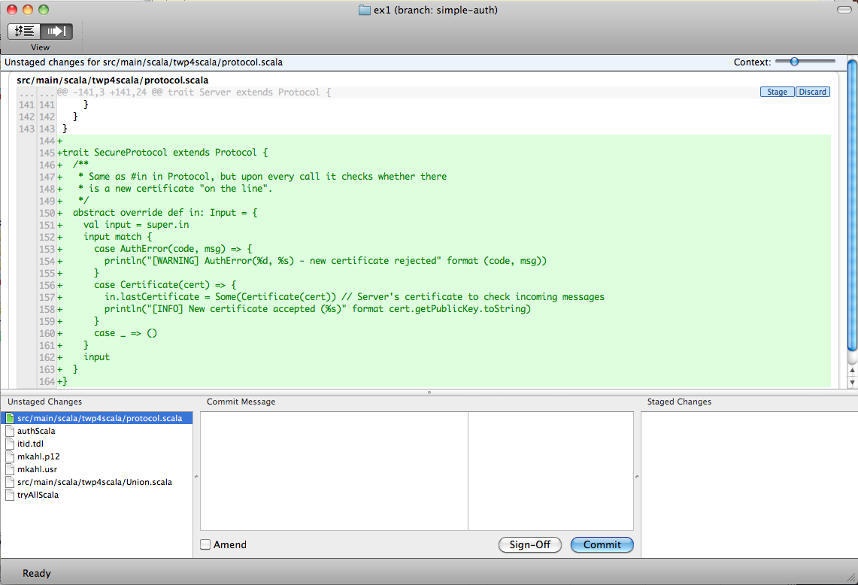

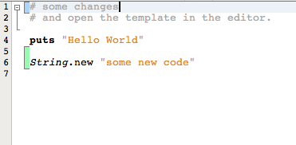
Idea to Improve Git-Workflow
Proper git integration in editor / IDE
Work without console
Visualize changes
gitx
netbeans

Slide 5
Idea to Improve Git-Workflow
Proper git integration in editor / IDE
Work without console
Visualize changes
Outcome:
Visualization of unstaged, staged changes in code-editor with ability to revert, stage, unstage them

Slide 6
BILD FÜR EDITOR

Slide 7
Idea to Improve Git-Workflow
Proper git integration in editor / IDE
Work without console
Visualize changes
Outcome:
Visualization of unstaged, staged changes in code-editor with ability to revert, stage, unstage them
Diff-View: revert, stage, unstage, commit, (push, pull)

Slide 8
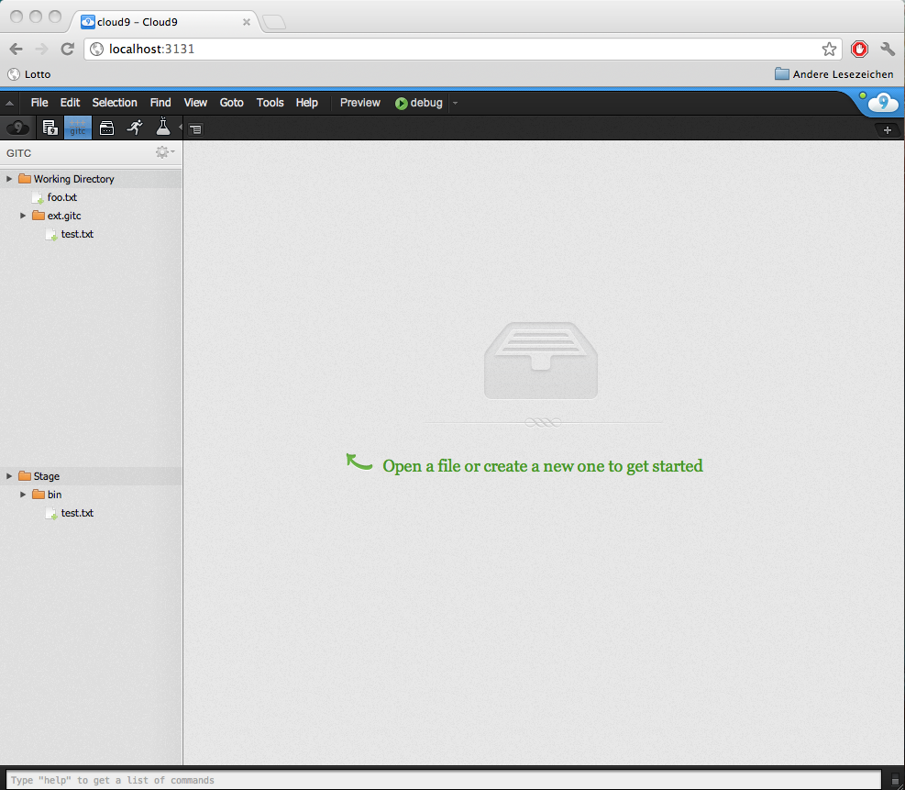
update me!

Slide 9
Idea to Improve Git-Workflow
Proper git integration in editor / IDE
Work without console
Visualize changes
Outcome:
Visualization of unstaged, staged changes in code-editor with ability to revert, stage, unstage them
Diff-View: revert, stage, unstage, commit, (push, pull)
One thing left: live-tracking of user input

Slide 10
What we have done
Client-side Front-end
apf → usage of aml
ace →
Notes:
What kind of problems during development with cloud
Web-based devel.
Cloud9 plugins: mostly no documentation → difficult to understand interaction between them
APF: ui.ajax.org/#docs not helpful
Ace: ace.ajax.org/api/ wrong/outdated

Slide 11
What we have done
Ide stuff (client to server communication)
Notes:
What kind of problems during development with cloud
Web-based devel.
Cloud9 plugins: mostly no documentation → difficult to understand interaction between them
APF: ui.ajax.org/#docs not helpful
Ace: ace.ajax.org/api/ wrong/outdated

Slide 12
Web-based development
Pros: no installation, code and tools everywhere accessible
Implement in what you implement
Offline development restricted
Turn-around time: one page reload
Notes:
What kind of problems during development with cloud
Web-based devel.
Cloud9 plugins: mostly no documentation → difficult to understand interaction between them
APF: ui.ajax.org/#docs not helpful
Ace: ace.ajax.org/api/ wrong/outdated

Slide 13
conclusion
With our extension..
No need to use console for git
Ability to (un)stage single chunks
Instant visual feedback of changes
Experiences with c9
Plug-in architecture
C9 and its third party software not well documented
Contact via email fast and helpful
Notes:
Cloud9 plugins: mostly no documentation → difficult to understand interaction between them
APF: ui.ajax.org/#docs not helpful
Ace: ace.ajax.org/api/ wrong/outdated

