Slide 1
Password Cracking
Xinming (Simon) Ou

Slide 2
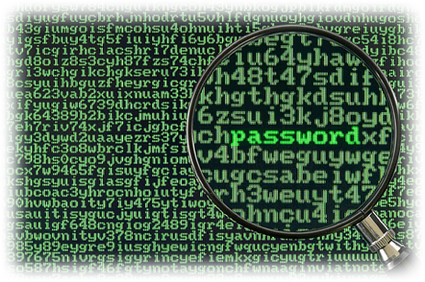
Passwords
Used to:
  Authenticate users that use a system or a service
  Protect sensitive information
Passwords (especially “weak” ones) can be:
  Guessed
  Cracked

Slide 3
Good or Bad Passwords?
7@Ack i love soccer
07deserteagle chuck#0123
5lakers5 oliveoil7
john1 eagle1900
beethoven5th PTL!1g1M05
Pizza qwerty123
dhx@yahoo.com justin_bieber_sux!
h.o.u.s.e {T@!4u2N9^}&
$trongPassword WeRtheChamp10n
!ILh2dW&%D@etF1 zeppelinIV
Notes:
From the LIST: Indicate “bad” passwords and the reason you think it is bad.
Bad passwords:
Can be associated with the person (name, hobbies, home town etc.)
Hard to remember
Easy to type (common patterns like “qwerty”) and therefore obvious

Slide 4
Good vs. Bad Passwords
A bad password is usually:
  Easily guessed or cracked
  OR
  Difficult to remember and use
A good password is:
  NOT easily guessed or cracked
  AND
  Easy to remember and use

Slide 5
Tradeoffs
Selecting Passwords
  Humans often select weak passwords (easy to remember)
  Computers usually generate strong passwords that are hard to remember
Long & Complex Passwords
  Long and complex passwords are often hard to guess and crack
  Long and complex passwords are often hard to remember by humans
Number of Passwords
  Many passwords limit the exposure and potentially the damage
  Many passwords are hard to remember by humans
Notes:
Hard to remember => humans will write it down

Slide 6
Attacking Techniques (1/2)
Guessing – automated trial of default, well-known passwords
  Advantage: No special access to the target system is needed
  Disadvantage: Likely to be detected or/and logged

Slide 7

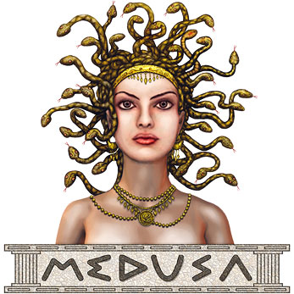
THC-Hydra & Medusa
Fast network logon hackers which support many different services
“Guess” passwords on many network services: FTP, HTTP, VNC, POP3 etc.
Usually complement each other (Medusa supports services that Hydra doesn’t and vice versa):
  http://www.foofus.net/~jmk/medusa/medusa-compare.html
Hydra: http://thc.org/thc-hydra/
Medusa: http://www.foofus.net/~jmk/medusa/medusa.html

Slide 8
Practice 1
Use Medusa or Hydra to guess the FTP server credentials (username & password) on the CDC network
  Hint: Use the provided usernames and password lists from the Canvas

Slide 9
“Guessing” FTP Server Credentials using Medusa
medusa -h 10.247.49.150 -U ~/Desktop/usernames.txt -P ~/Desktop/passwordList.txt -M ftp
  -h target host
  -U is the username list
  -P specify wordlist
  -M specify service name module (ftp in this case)
Notes:
10.247.49.150 metasploitable 1
10.247.49.152 metasploitable 2

Slide 10
“Guessing” FTP Server Credentials using Hydra
hydra -s 21 -L ~/Desktop/usernames.txt -P ~/Desktop/passwordList.txt -vV 10.247.49.152 -f ftp
  -s is the port number
  -L username list
  -P password list
  -vV verbose (show details about each attempt)
  ftp target service name
Notes:
10.247.49.150 metasploitable 1
10.247.49.152 metasploitable 2

Slide 11
Attacking Techniques (2/2)
Cracking
  Get a copy of the authentication database (in hashed or encrypted form)
  Run a tool that attempts to crack the hash or encryption and recover passwords
Advantage: Cracking is typically offline (not on the victim’s machine)
Disadvantage: Requires a copy of the authentication database

Slide 12
Authentication Database
What is an authentication database ?
  A database that stores “authentication state” that can be used to verify users’ login credentials
How are authentication databases protected ?
  Cryptographic Hash
XP, Win7: %SystemRoot%\system32\config\sam
Accessed from registry HKLM/SAM
Linux: /etc/passwd and /etc/shadow
Notes:
%WinDir%\system32\config\sam
C:\users\username\AppData\Roaming\Microsoft\credentials

Slide 13
Cryptographic Hash
Text Message
(variable length)
Cryptographic Hash Function
“Unique” Fixed-length String (Hash or Digest)
  If the message content is changed, the hash will be different (provides integrity guarantee)
  Knowing the hash does not reveal the input message
  Hashing is NOT encryption!
  Examples: SHA-1, SHA-2
Notes:
Properties of a Cryptographic Hash Function:
Given the clear text message, easy to compute the hash
Given the “unique” fixed-length string, hard to find the corresponding clear text message (preimage resistance)
Given one clear text message, hard to find a different clear text message so that their images (fixed-length strings) are the same (second-preimage resistance)
Hard to find two clear text messages so that their images are the same (collision resistance)
A salt is a message that is typically concatenated to the Hash function’s input.
Used to increase the input space of the hash
Increase the difficulty for brute-forcing attacks

Slide 14
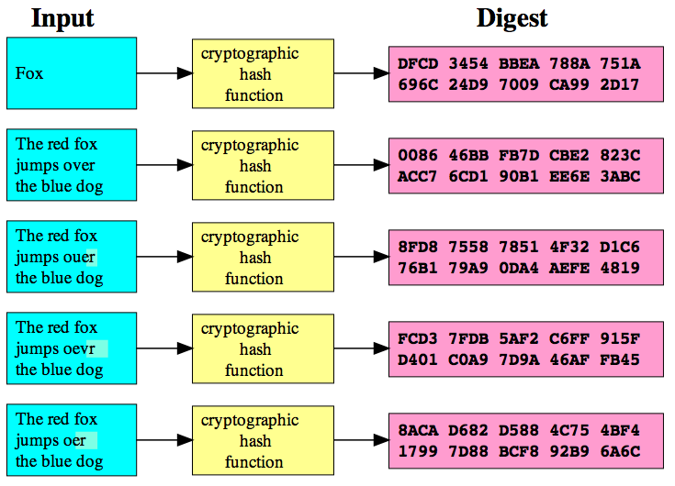
Image source: http://en.wikipedia.org/wiki/File:Cryptographic_Hash_Function.svg
Cryptographic Hash Example (SHA-1)

Slide 15
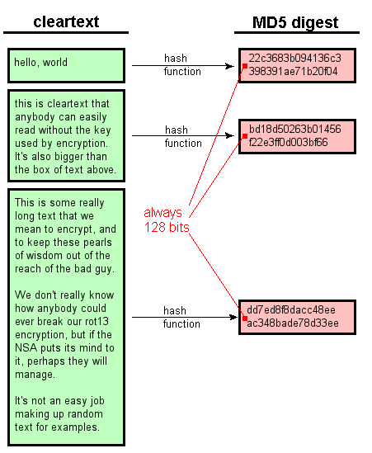
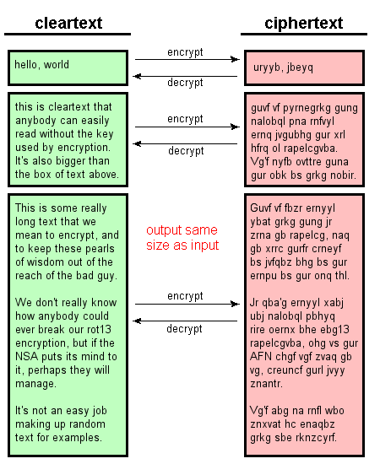
Encryption vs. Hashing
Image source: http://www.unixwiz.net/techtips/iguide-crypto-hashes.html

Slide 16
Brute Force Cracking (1/2)
Try all possible passwords of length 1, then of length 2 etc. :
  1, 2, 3 ... 9, 0, a, … z, A, … Z, etc.
  Aa, AA, AB, A1 … etc.
  etc.
Problem: Unless passwords are short (or the attacker is very lucky) this could take a long time
Notes:
Many password cracking programs try this only as a last resort after other (more efficient methods) have been exhausted

Slide 17
Brute Force Cracking (2/2)
Assumption:
  Passwords can be made up of upper (A-Z) and lower (a-z) case letters and digits (0-9)
    62 different characters
  Passwords must be 8 characters long
There are 62⁸ (≈2 ×10¹⁴) possible passwords of length 8
Assuming a system (using GPU) can try three billion (3×10⁹) passwords per second it would take about 66,667 seconds to try them all
  Approximately 18.5 hours

Slide 18
Dictionary Attacks
Password dictionaries are collections of words that people often use as passwords
Many password dictionaries are available online
  Sometimes they contain hundreds of thousands of entries
  All words in the dictionary can usually be tried in a matter of seconds, minutes or a few hours
Advantage: Password is in the dictionary => it will be cracked
Disadvantage: Password is not in the dictionary => will NOT be cracked

Slide 19
Hybrid Password Attacks
In general people prefer to choose dictionary words as passwords
Many people vary dictionary words in predictable ways to create passwords
Hybrid cracking – applies all common transformations to each word in the dictionary to generate password guesses:
  Dictionary word: password
  Try: drowssap, PaSaWoRd, password1, paswrd, pa$$w0rd, etc.

Slide 20
Rainbow Tables
Rainbow tables are:
  Pre-computed lookup tables for recovering plaintext passwords (up to a certain length and consisting of a limited set of characters) from password hashes
  Pre-computed table for reversing cryptographic hash functions
Time-space tradeoff (less CPU at the cost of more storage)
Notes:
What makes this attack infeasible? Salt

Slide 21
Ophcrack – Rainbow Tables (1/2)
Windows password cracker based on rainbow tables
Home page: http://ophcrack.sourceforge.net
Download tables from:
  http://ophcrack.sourceforge.net/tables.php
Available in Kali and Backtrack 5 (type ophcrack in a terminal)

Slide 22
Practice 2: Ophcrack – Rainbow Tables (2/2)
Run Ophcrack GUI
Click Tables
Choose the table to install
Click Install
Browse to the where the table was downloaded
Select Load to load your hash
Click Crack

Slide 23
Salt of Hash
A salt is a message that is typically concatenated to the Hash function’s input.
  Used to increase the input space of the hash
  Increase the difficulty for brute-forcing attacks
For Example: Linux
  salt is a two-character string chosen from the set [a-zA-Z0-9./]. This string is used to perturb the algorithm in one of 4096 different ways.

Slide 24
Password Crackers Tools
Top 10 Pass Crackers:
  http://sectools.org/crackers.html
GPU Password Cracker:
  Ighashgpu (http://www.golubev.com/hashgpu.htm)

Slide 25
John the Ripper (1/2)
Free and open source password cracking tool
Home page: http://www.openwall.com/john/
Runs on Windows, DOS, BeOS, OpenVMS and many flavors of Unix

Slide 26
John the Ripper (2/2)
Supports different cracking techniques
  Dictionary
  Hybrid
  Brute force
Automatically detects the type of password file
Prints results to the screen as they are obtained
There is also a distributed version:
  Server divides cracking passwords among several client machines

Slide 27
Practice 3
Install John-the-Ripper
Download password hashes file: Password_hashes.txt
Use John to crack the passwords
Were you able to get something? Show us your results

Slide 28
Practice 3
You have root/administrative privileges on your machine
  Can you get the authentication database on your machine?
  (Hint: Look at SAMInside for Windows and unshadow for Linux)

Slide 29
Practice 3 -Solution
Kali:
  Crack the provided hashes:
  # john ~/Desktop/Password_Hashes.txt
  Unshadow Passwords:
  # unshadow /etc/passwd /etc/shadow > ~/ Desktop/unshadowedPasswords.txt
  # john ~/Desktop/unshadowedPasswords.txt -- format=crypt -show

Slide 30
Summary
Bad passwords can be:
  Guessed
  Cracked (brute-forced, dictionary and hybrid attack)
Usually the biggest challenge is obtaining a copy of the authentication database

Slide 31
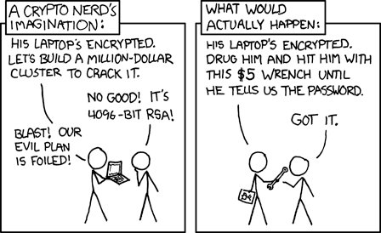
Image Source: http://xkcd.com/538/

Slide 32
Sources of Information
John-the-Ripper - http://www.openwall.com/john/
Computing LM Hash and NT Hash - http://www.arsitech.com/cryptography/windows/password/
CS635 SP2010 – Slides (Dr. Brett Tjaden - JMU)
Notes:
After class reading homework:
https://www.nccgroup.trust/us/about-us/newsroom-and-events/blog/2007/july/enough-with-the-rainbow-tables-what-you-need-to-know-about-secure-password-schemes/
https://www.nccgroup.trust/us/about-us/newsroom-and-events/blog/2015/march/enough-with-the-salts-updates-on-secure-password-schemes/

Slide 33
LM Hashes
Are used by default on older Windows versions including Windows XP SP 3 (unless disabled)
Passwords have to be 14 characters or less:
Creating an LM hash from a password:
  Pad the password to 14 characters (if necessary)
  Lower case characters are converted to upper case
  The password is split into two 7-character halves
  No salt
  Each half is used as a separate DES key to encrypt a constant ASCII string (KGS!@#$%). (2*95⁷) even worth with only upper case (2*69⁷)
  The two resulting 8-byte values are concatenated to form the 16-byte LM hash

Slide 34
“Better” Password Hashes
Windows - NT Hashes
  Applies the MD4 message digest algorithm to the password.
  The 16-byte output represents NT hash of the password
Linux
  Concatenate a salt value to the password
  Hash the result

