Slide 1
Security Operation Centers

Slide 2
What is a SOC?
Business unit that performs continuous cyber-threat monitoring
Run by academic, corporate, and government entities
Responsibilities
Monitor, detect, and respond to cyber-threats

Slide 3

Typical SOC

Slide 4
Elements of a SOC
People
Process
Technology
No silver bullet!

Slide 5
People
Security analysts are the key personnel in any SOC
Usefulness of tools determined by skill set of the analysts
Hierarchy of analysts
Level-1, level-2, incident response, forensics, etc.
Other teams
Software developers and IT management

Slide 6
Process
Processes refer to Standard Operating Procedures (SOPs)
SOPs are guidelines for responding to security incidents
Ensure expected behavior and knowledge sharing among analysts in different shifts
SOPs are a way to retain operational knowledge in the light of employee churn
Unfortunately this has led to a perverse incentive!

Slide 7
Technology
Security Information and Event Management (SIEM)
Predominant tool in operations
SIEM features
Collect logs from myriad of sensors
Index them for fast searches
Other tools used
IDS, traffic interceptors, etc.

Slide 8
Intrusion Detection System (IDS)
IDS is the most common sensor found in any SOC
Signature based IDS
Performs deep packet inspection of network traffic in real time
Fires an alert when packet contents match known malicious pattern
Anomaly detector
First develops a model for benign system usage
Detects deviations from the model and fires alert
Has ability to detect previously unknown threats
All IDSs suffer from high false positive rendering them less useful.

Slide 9
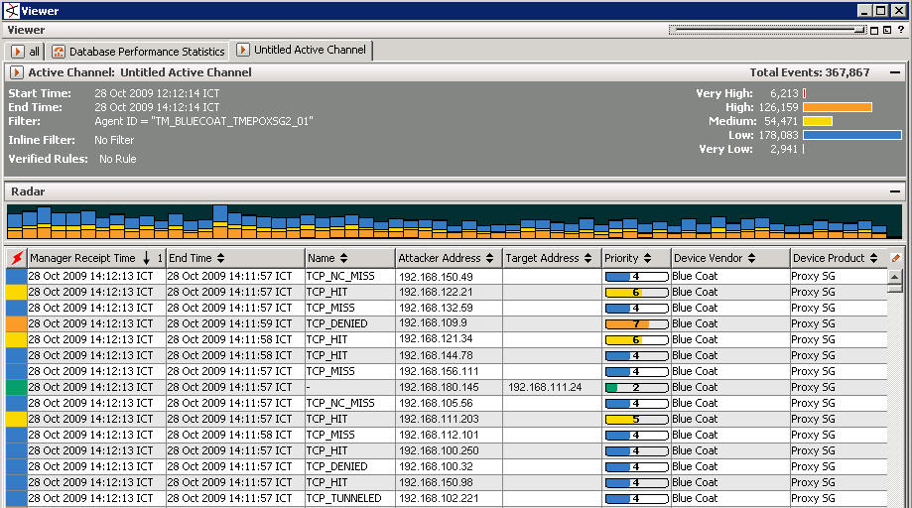


A Typical SOC Workflow
Alert Stream
Analyst uses SOPs to guide investigation
Classified events
True Positive
False Positive
Requires Assistance

Slide 10
Metrics
How to communicate SOC operations to management?
Buffer overflows and cross-site-scripting mean nothing to them
Technical operations need to be mapped to risk mitigation
Requires analysts skilled in effective communication
Some bad metrics
Tickets closed, time spent on events ☹

Slide 11
Types of SOCs
In-house SOC
Built/managed by the organization
Managed SOC
The SOC operator is a service provider
Operator manages hundreds of customers remotely

Slide 12
In-house SOC
Pros
High network visibility
Easy to build trust with other business units
Security event data stays within the organization
Cons
Expensive to build, operate, and sustain
Localized visibility of threat landscape

Slide 13
Managed SOC
Pros
Relatively less expensive compared with in-house SOC
Threat detection across customers
Cons
Security event data might leave the organization
Harder to forge trust relations with other business units
Reduced network visibility

Slide 14
Being Successful as an Analyst
Reflect periodically on your tasks
Identify repetitions and automate them
The final project gives you some training on this aspect
Effectively communicate what you do
Learn not to use too many jargons
Understand the context of your organization while presenting your findings

