Slide 1
Enterprise Network Security

Slide 2

Multi-step Attacks
Internet
Firewall 1
buffer overrun
Demilitarized zone (DMZ)
webServer
Firewall 2
NFS shell
sharedBinary
Trojan horse
Corporation
workStation
webPages
fileServer

Slide 3
Enterprise Network Security
Perimeter control
Firewalls
Securing end points
Host-based vulnerability scanner
Anti-virus software
Intrusion Detection Systems (IDS)
Network-based and host-based
Monitoring
Logging and auditing
Security Information and Event Management Systems (SIEMs)
Security Operation Centers (SOCs)

Slide 4
Firewalls
A router/host with the capability to inspect and control network traffic flowing through it.
Establishes a barrier between network segments, e.g., internal and external
Controls network traffic based on predefined policy
Types of firewalls:
Packet filters
Stateful inspections
Application gateway
Notes:
Traffic monitoring and reporting.
Intrusion detection and prevention.
Packet or Protocol filtering based on user defined rules.
Incorporate VPN gateways (Enterprise Level Firewalls).
Load balancing & Failover (Enterprise Level Firewalls).

Slide 5
Example –Packet Filters
Internet
Filtering interfaces
portal
DMZ
firewall
dnsServer
CORP
workStation
fileServer

Slide 6
Packet Filtering
Looks at IP address, port numbers, and protocol type to determine if that packet should be allowed or blocked
Policy format:
<protocol, srcIP, srcPort, dstIP, dstPort, action>
e.g. <ip, blackListIP, -, *, -, drop>
<udp, dnsServerIP, *, *, 53, allow>
<tcp, *, *, portalIP, 80, allow>
<nfs, portalIP, -, fileServerIP, -, allow>

Slide 7
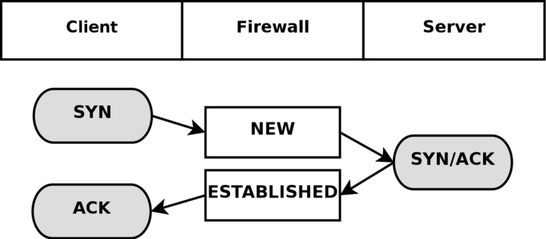
“Stateful” Filtering
Maintains info on all existing connections
Policy can specify that only packets matching a specific connection state are allowed
dynamically insert a new filtering rule to let in the return traffic
Policy format:
<protocol, srcIP, srcPort, dstIP, dstPort, state, action>

Slide 8
Network Address Translation (NAT)
Why NAT?
Main reason: IPV4 address space is limited
Usually a large organization needs a Class A or a Class B network
e.g. USF public range is 134.247.*.*
There are only about 16K class B networks
The NAT solution:
Use private IP addresses within an organization
The private IPs all share a small number of public routable IP addresses
Use different port numbers to differentiate the different internal IP addresses
A border firewall/router rewrites the <private IP, port> pair to the <routable IP, port> and vice versa.
Observation
Hosts within the NAT setup cannot be directly accessed from the internet, without cooperation of the router; thus NAT provides some security benefit by design

Slide 9
192.168.4.2
172.18.6.7
192.168.4.5
NAT Table
Internal IP | Internal Port | External IP | External Port

Slide 10
Source IP | Source Port | Destination IP | Destination Port
192.168.4.5 | 1122 | 216.58.219.132 | 80
www.google.com
(216.58.219.132)
192.168.4.2
172.18.6.7
192.168.4.5
NAT Table
Internal IP | Internal Port | External IP | External Port
192.168.4.5 | 1122

Slide 11
Source IP | Source Port | Destination IP | Destination Port
172.18.6.7 | 5555 | 216.58.219.132 | 80
www.google.com
(216.58.219.132)
192.168.4.2
172.18.6.7
192.168.4.5
NAT Table
Internal IP | Internal Port | External IP | External Port
192.168.4.5 | 1122 | 172.18.6.7 | 5555

Slide 12
Source IP | Source Port | Destination IP | Destination Port
216.58.219.132 | 80 | 172.18.6.7 | 5555
www.google.com
(216.58.219.132)
192.168.4.2
172.18.6.7
192.168.4.5
NAT Table
Internal IP | Internal Port | External IP | External Port
192.168.4.5 | 1122 | 172.18.6.7 | 5555

Slide 13
Source IP | Source Port | Destination IP | Destination Port
216.58.219.132 | 80 | 192.168.4.5 | 1122
www.google.com
(216.58.219.132)
192.168.4.2
172.18.6.7
192.168.4.5
NAT Table
Internal IP | Internal Port | External IP | External Port
192.168.4.5 | 1122 | 172.18.6.7 | 5555

Slide 14
A day in the life of a real Security Analyst (SA)
Abnormally high traffic
Some servers communicating with known BotNet IPs
Seemingly malicious code modules
Found IRC connections with other servers
Network Monitoring Tools
netflow dump
memory dump
These servers are certainly compromised!
Notes:
Challenges?
5-10 GB per day netflow data, 1.1 million Snort IDS alerts in a three-day period in the CIS departmental network alone
Uncertainty is the major challenge.
If there is a way to automatically present the analyst these relevant pieces of information, it would dramatically help the analyst’s job.
What question did the analyst have when he saw the first event?
What made him go after the subsequent events?
How he made the conclusion that the servers were compromised?
Why did he need to look at multiple pieces of information to reach a conclusion?
This is the tacit dimension of the personal knowledge

Slide 15

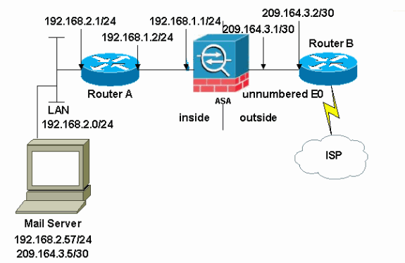
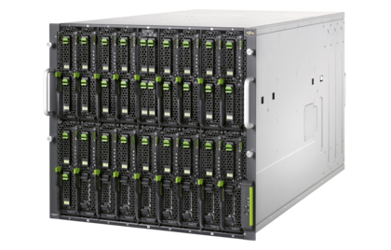
A Security Analyst’s Job
Users and data assets
IDS alerts
Automation
Reasoning System
Network configuration,
Server logs, etc.
Host scan
reports
Shellshock
vulnerability!
Security advisories
Notes:
Defending a network system is highly labor intensive. Often times the defender has to look at multiple places and connect the dots to understand a problem and mitigate it.
My research has been focused on how to design automation techniques to assist the defenders. The key challenge is the reasoning system that can perform some of the tasks
that currently a human has to do.

Slide 16
Logging
Process of recording events
Log message can go to console, file, or sent over the network to a log aggregator
Provides information about system performance, usage, and security
Useful in diagnosis and auditing
Logs are extremely valuable for analyzing security breaches
Notes:
So far we discussed techniques to prevent security violations

Slide 17
Example Logs
Entries for successful or failed operations
User logins and logouts
Creation of user accounts
Execution of certain commands (e.g., sudo)
File access
Starting and turning off the system or services

Slide 18
Common Linux Logs
Some common Linux log files:
/var/log/syslog: General message and system related information
/var/log/auth.log: Authenication log
/var/log/kern.log: Kernel log
/var/log/mail.log: Mail server log
/var/log/boot.log : System boot log
/var/log/utmp or /var/log/wtmp : Login records file
/var/log/yum.log: Yum log files
Specific applications:
/var/log/apache2/: Apache access and error logs directory
/var/log/nginx/ : Nginx access and error logs directory
/var/log/mysql: MySQL database server log file
Notes:
Syslog is a standard for computer message logging. It enables the separation of the software that generates messages from the system that stores them and the software that reports and analyzes them.
splunk

Slide 19
Important Logs for Enterprise Security
Network Address Translation (NAT) logs
Authentication log (e.g., RADIUS, AD, etc.)
DHCP log
ARP log
DNS log
Netflow log
Firewall log
IDS log
Syslogs
Database log
Web server log

Slide 20
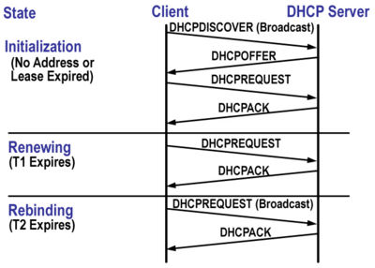
DHCP
Dynamic Host Configuration Protocol (DHCP)
Handles allocation and de-allocation of IP addresses
Each host (MAC) is assigned an IP address for a certain period of time
Busy networks should be set to have shorter lease times
Protocol (DORA)
Discovery (D)
Offer (O)
Request (R)
Acknowledge (A)
Renewal time
50% of lease time
Rebinding time
87.5% of lease time

Slide 21
Sample DHCP Transaction
galaxy dhcpd: DHCPDISCOVER from 00:0d:62:d7:a0:12 via eth0 galaxy dhcpd: DHCPOFFER on 192.168.1.5 to 00:0d:62:d7:a0:12 via eth0 galaxy dhcpd: DHCPREQUEST for 192.168.1.5 (192.168.1.1) from 00:0d:62:d7:a0:12 via eth0 galaxy dhcpd: DHCPACK on 192.168.1.5 to 00:0d:62:d7:a0:12 via eth0
Source: http://www.brennan.id.au/10-DHCP_Server.html

Slide 22
Challenges in log analysis
High volume
Incomplete data
Log collection uses Syslog that runs over UDP
Connectionless and unreliable
Logs of same type have different format
Cisco vs Juniper
Much of the analysis time is spent on data pre-processing
Then the problem of identifying needle in the haystack

