Slide 1
Phishing
Sathya Chandran Sundaramurthy

Slide 2
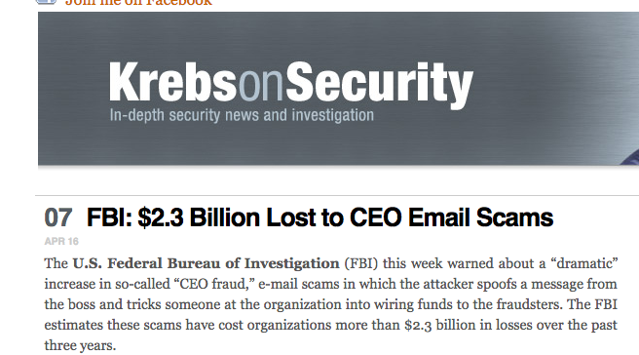
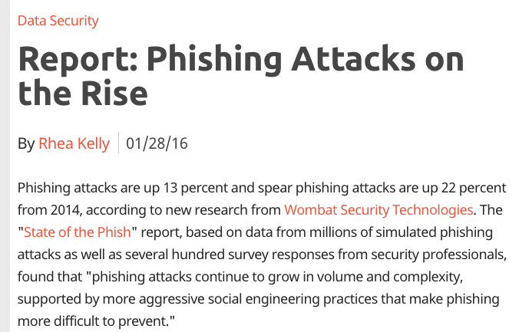
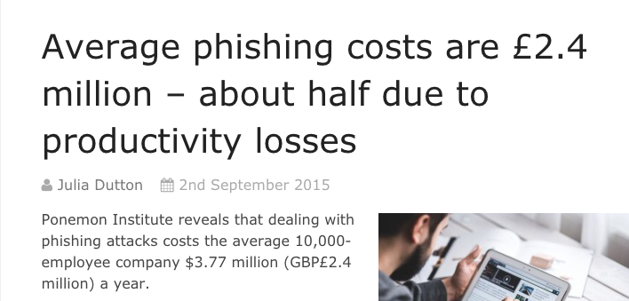
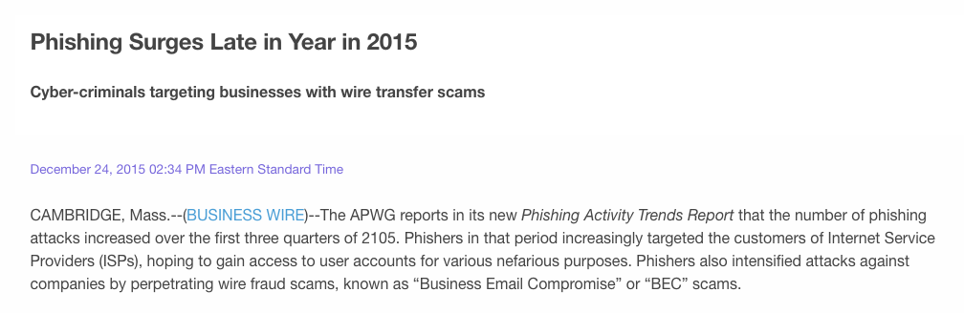
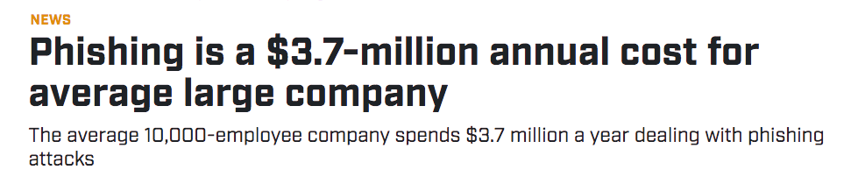

Slide 3
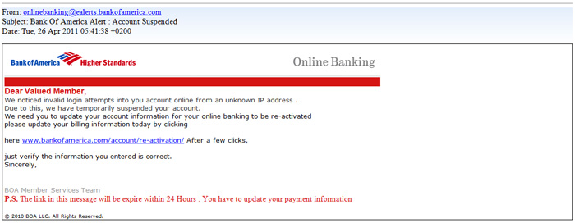

Link Based Phishing
Attacker

Slide 4

Link Based Phishing
Internet Users
Attacker

Slide 5
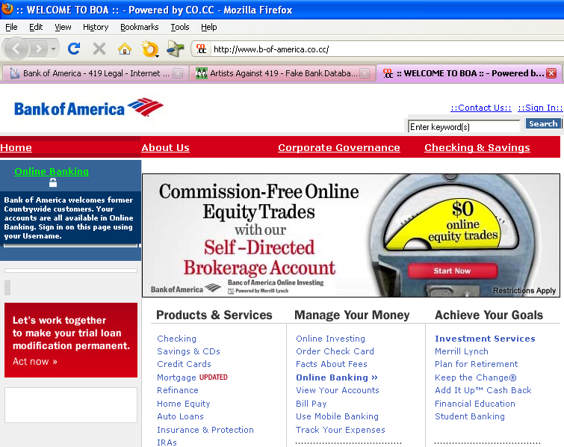
Link Based Phishing
Internet Users
Attacker

Slide 6
Link Based Phishing
Internet Users
Attacker

Slide 7

Link Based Phishing
Internet Users
Attacker
Stolen
Credentials DB
Notes:
Reduce to 2 slides

Slide 8
Types of Phishing
Campaigns
Sent to maximum number of users
Goal is to get maximum return on investment (ROI)
Usually sent in waves
Spear phishing
Targeted against a very high profile employee
High-value target (HVT)

Slide 9
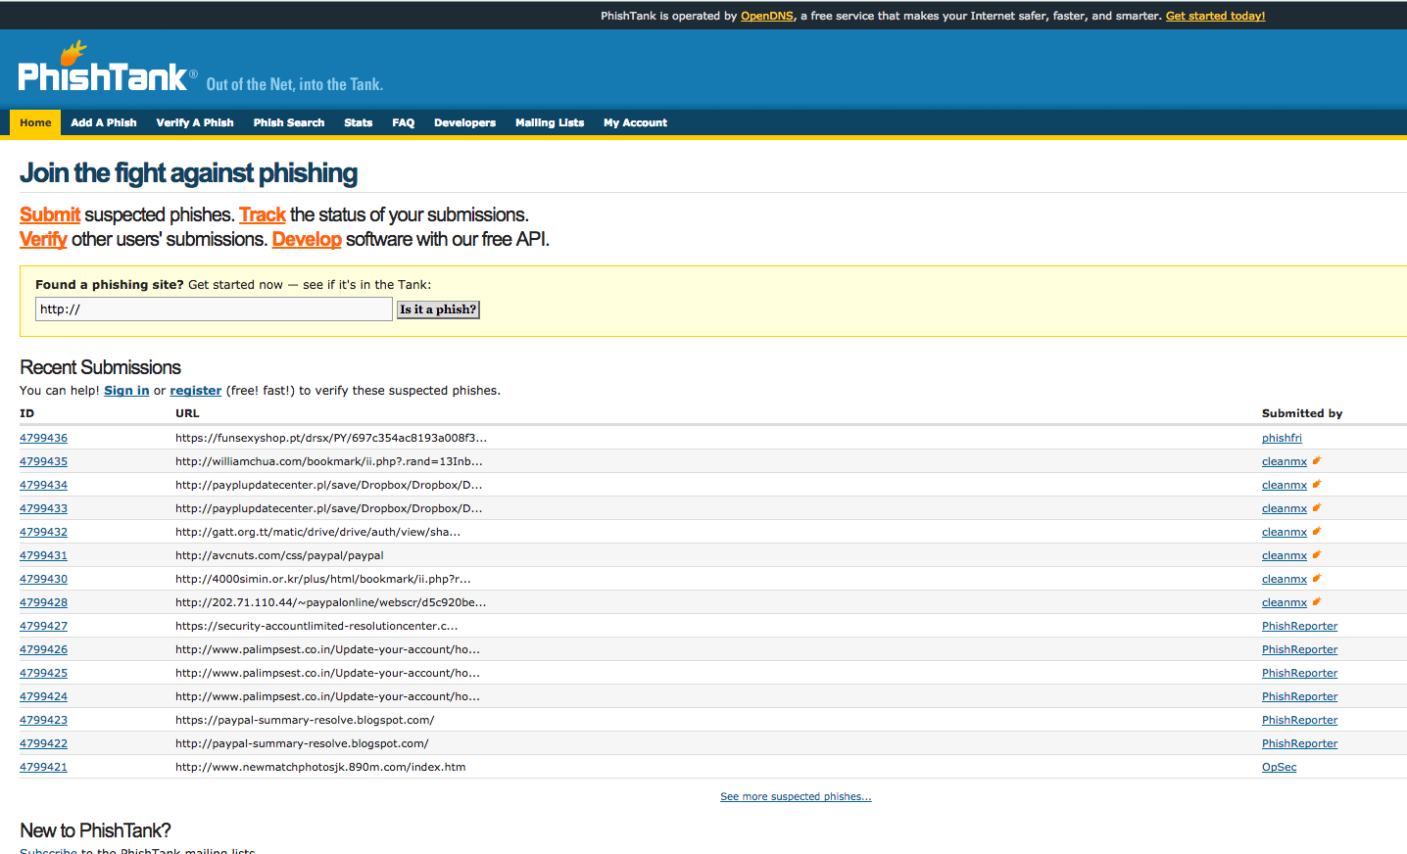
Defense
URL sharing
https://www.phishtank.com/
Lookalike name detection
bank0fam3rica.com

Slide 10
Cons of Link Based Phishing
Costly for the attacker
Have to design and setup web pages for new campaigns
Easy to defeat
Links can be shared and blacklisted
E.g. PhishTank

Slide 11
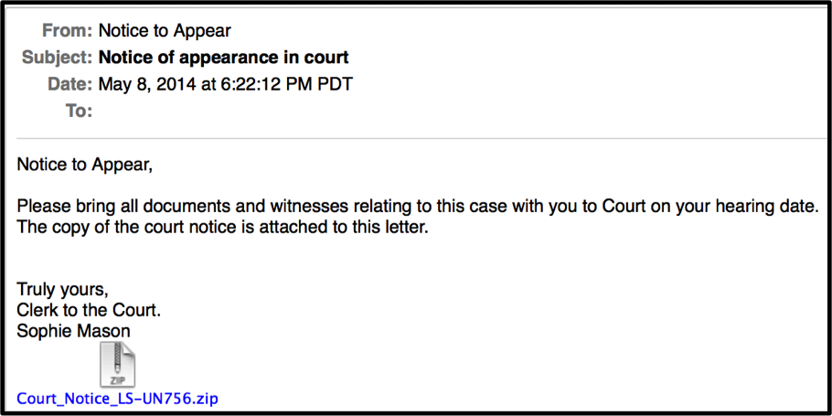
Phishing via Attachments
Attacker

Slide 12
Phishing via Attachments
Internet Users
Attacker

Slide 13

Phishing via Attachments
Internet Users
Attacker
Malware
Callback
Internet
Attacker server/DB

Slide 14
Common Attack Vectors
VBA macros embedded inside MS Word documents
JavaScript inside PDF

Slide 15
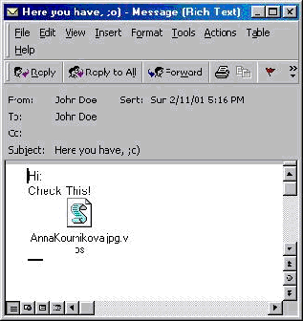
Macro Virus
Remember Melissa worm (Mar 26, 1999)?
First successful macro malware
Mass emails first 50 users in Outlook

Slide 16
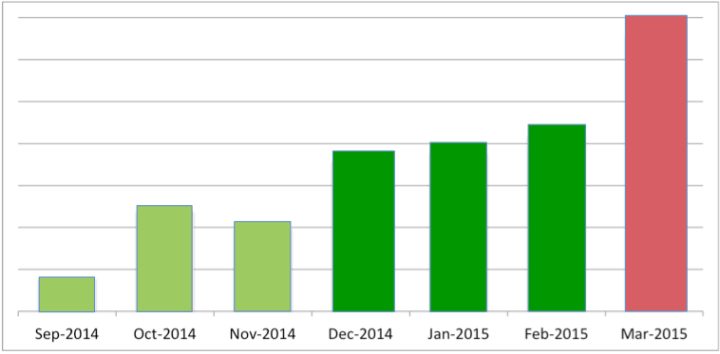
Macro Email Attacks (Cisco)

Slide 17
Pros of Phishing via Attachments
Cost effective
Easy to introduce perturbations in content
By passes enterprise security controls
Information sharing not effective anymore
Fine-grained access to victims

Slide 18
What is a Macro
Piece of VBA code embedded in .DOC files
VBA – Visual Basic for Applications
Executes when
Document opened or closed
Can perform arbitrary tasks on execution

Slide 19
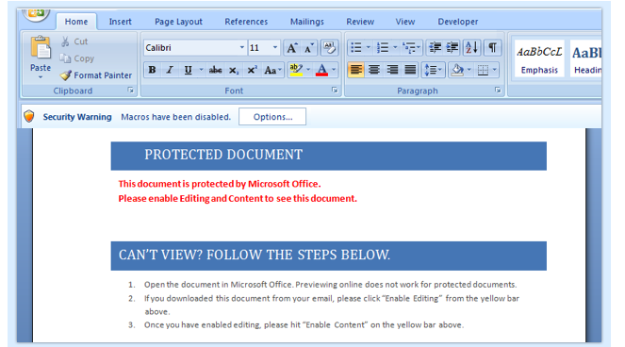
First Step - Social Engineering

Slide 20
Phishing Detection Case Study
Ethnographic Study at a Major IT organization SOC

Slide 21
Phishing Detection Problem
No real-time detection mechanism
Defenses did not keep up with attackers
Analysts know how to detect phishing but do not have time for tool building

Slide 22
Empirical Study of Phishing Campaigns
Corporate emails at a major IT organization
July – Nov 2016 (five months)
330, 000 emails with .doc attachments
75 campaign waves identified
69 unique ones

Slide 23
Detection by File Hashes
10,803 unique files
99.94 % of unique files appeared in only ONE campaign

Slide 24
Detection by Sender Email
6,138 unique senders
91.4 % of senders appeared in only ONE campaign

Slide 25
Detection by Origin IP
2,526 unique IPs
75.85 % of IPs appeared in only ONE campaign

Slide 26


Detection by SMTP Relays
2,458 unique SMTP relays
75.87 % of relays appeared in only ONE campaign

Slide 27

Insights from Empirical Study
State-of-the-art phishing cannot be detected by supervised approaches
We have to go after attackers’ TTP
Tactics, Techniques, and Procedures
What are the attackers actually doing?
Notes:
Make TTP as title

Slide 28
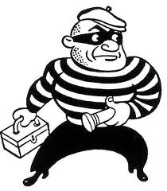

Attacker Technique
Design a VBA exploit
Crawl the internet for potential victims
LinkedIn, Pastebin etc.
Try to obtain maximum ROI
How?

Slide 29
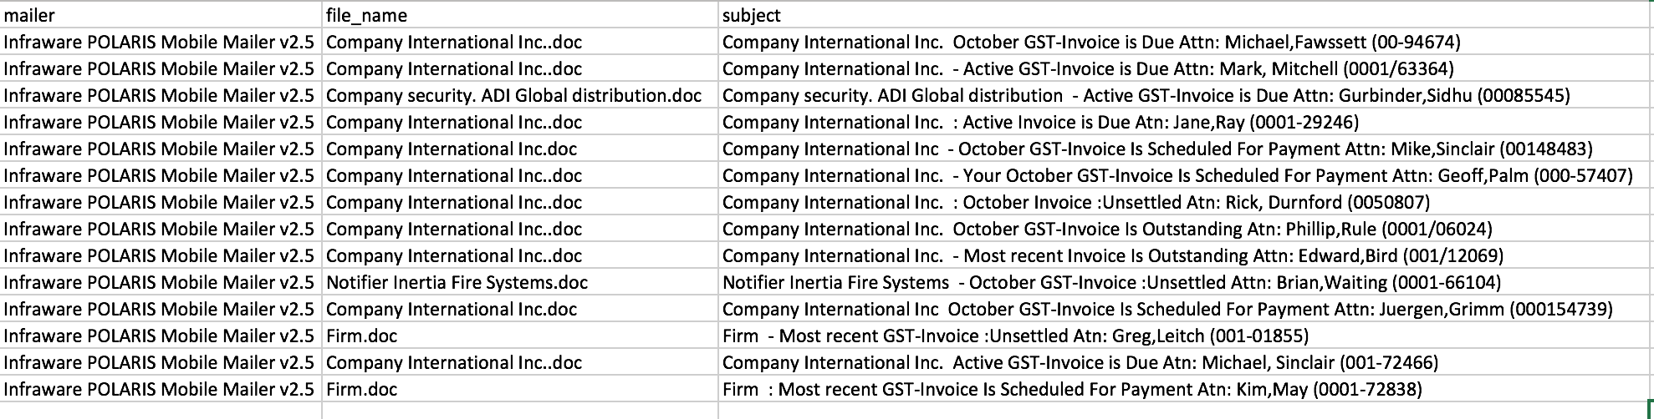
Campaign - 1

Slide 30
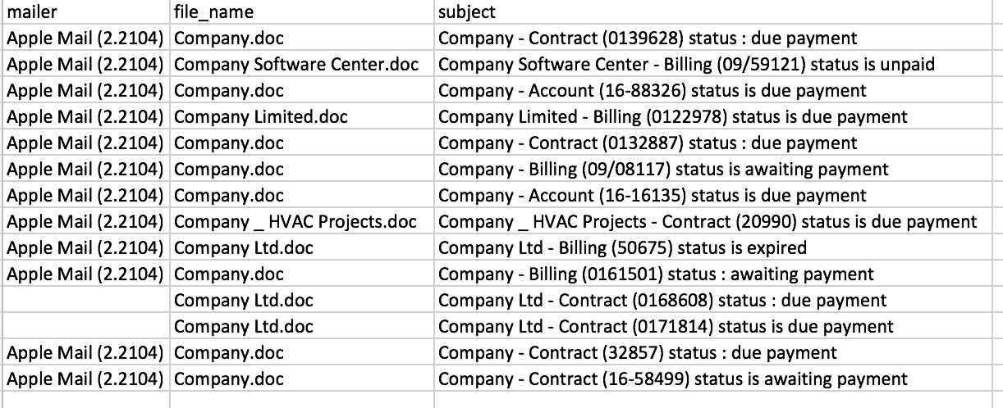
Campaign - 2

Slide 31
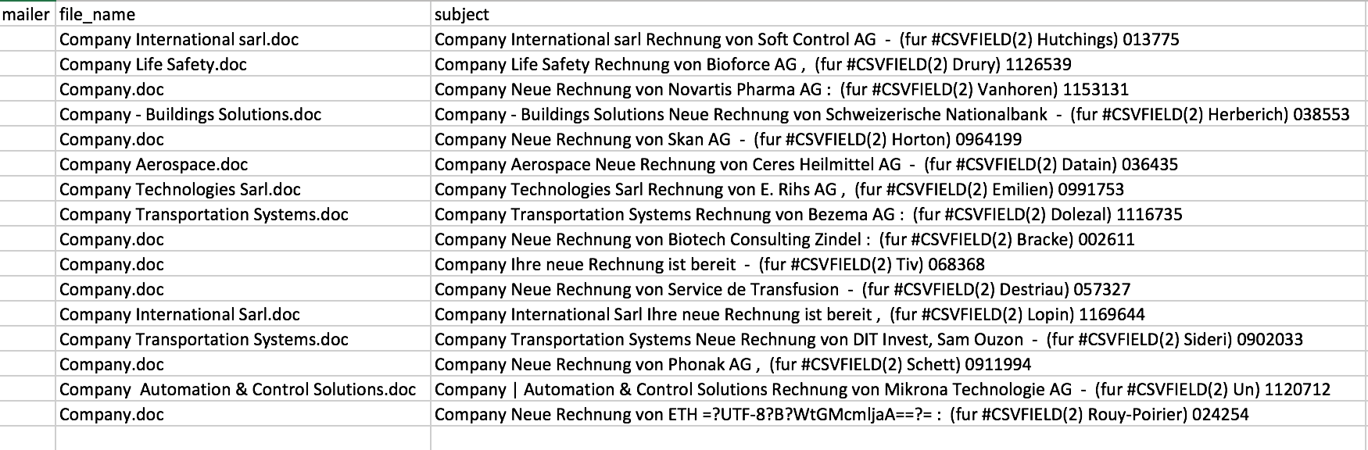
Campaign - 3
Ihre neue rechnung ist bereit = Your new bill is ready

Slide 32

Intuition
Group .DOC emails
Mailer, filename, and subject as features
Isolate phishing campaigns
Based on certain criteria

Slide 33
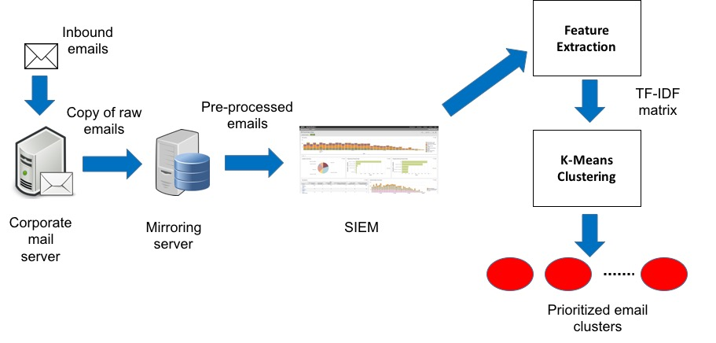
Phishing Detection Framework Architecture

Slide 34
Feature Extraction
Each email transformed into a string
Mailer +” “+File Name+” “+Subject
Tokenizing
Remove stop words – of, a, an, the etc.
Stemming
Reduce words to their root – waiting to wait

Slide 35
Document Clustering
Term frequency - inverse document frequency (tf-idf) weighing
Popular technique from information retrieval
TF(t,d) = # of occurrences of t in d / # of terms in d
IDF(t) = log (# of documents / # of documents containing t)
TF-IDF(t,d) = TF(t) * IDF(t)

Slide 36
TF-IDF Example
There are 10M documents and the word cat appears in 1,000 of them. The word cat also appears 3 times in a document d that has 100 words.
TF(cat,d) = 3 / 100 = 0.03
IDF(cat) = log(10,000,000 / 1,000) = log(10⁴) = 4
TF-IDF(cat,d) = 0.03 * 4 = 0.12

Slide 37
TF-IDF Matrix
Email-1
Email-2
Email-3
Email-4
Email-5
Email-6
Email-7
Email-8
Email-9
Email-10
Term-1
8 | 2 | 0 | 0 | 0 | 3 | 4 | 2 | 0 | 0
0 | 0 | 20 | 2 | 2 | 2 | 1 | 1 | 0 | 0
0 | 0 | 0 | 13 | 1 | 1 | 1 | 3 | 8 | 9
1 | 1 | 1 | 0 | 0 | 0 | 19 | 2 | 1 | 0
1 | 1 | 0 | 0 | 0 | 15 | 1 | 2 | 2 | 2
2 | 3 | 4 | 1 | 25 | 0 | 2 | 1 | 8 | 4
2 | 7 | 6 | 1 | 2 | 0 | 0 | 20 | 0 | 0
Term-2
Term-3
Word Vector
Term-4
Term-5
Term-6
Term-7
Document Vector

Slide 38
Phishing Detection Framework Architecture

Slide 39
Estimating Number of Clusters k
Attackers are highly adaptive
Must predict k at every clustering
k = (d * t) / nz
d = # of emails
t = # of terms
nz = # of non-zero cells in TF-IDF matrix

Slide 40
Phishing Detection Framework Architecture

Slide 41
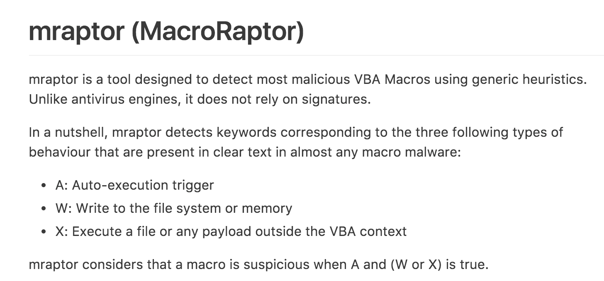
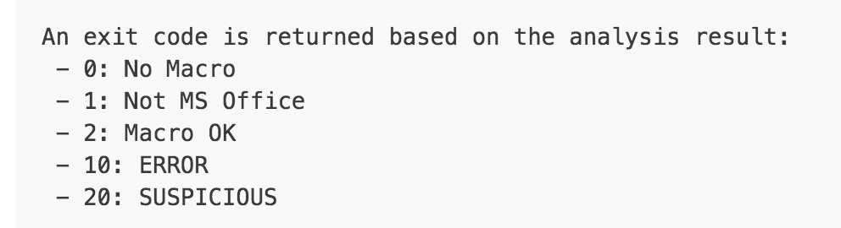
Filtering Phishing Clusters
Characteristics of a phish
Contains macro

Slide 42
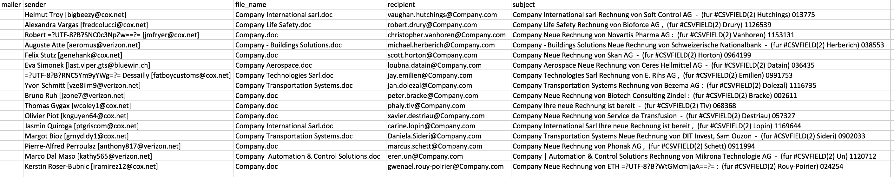

Slide 43
Filtering Phishing Clusters
Characteristics of a phish
Contains macro
Sent to single or undisclosed recipient(s)

Slide 44
Identifying Campaigns
Campaign
Cluster or cluster(s) of emails embedded with same exploit
Why group emails?
Prioritize effort towards analyzing new malware

Slide 45
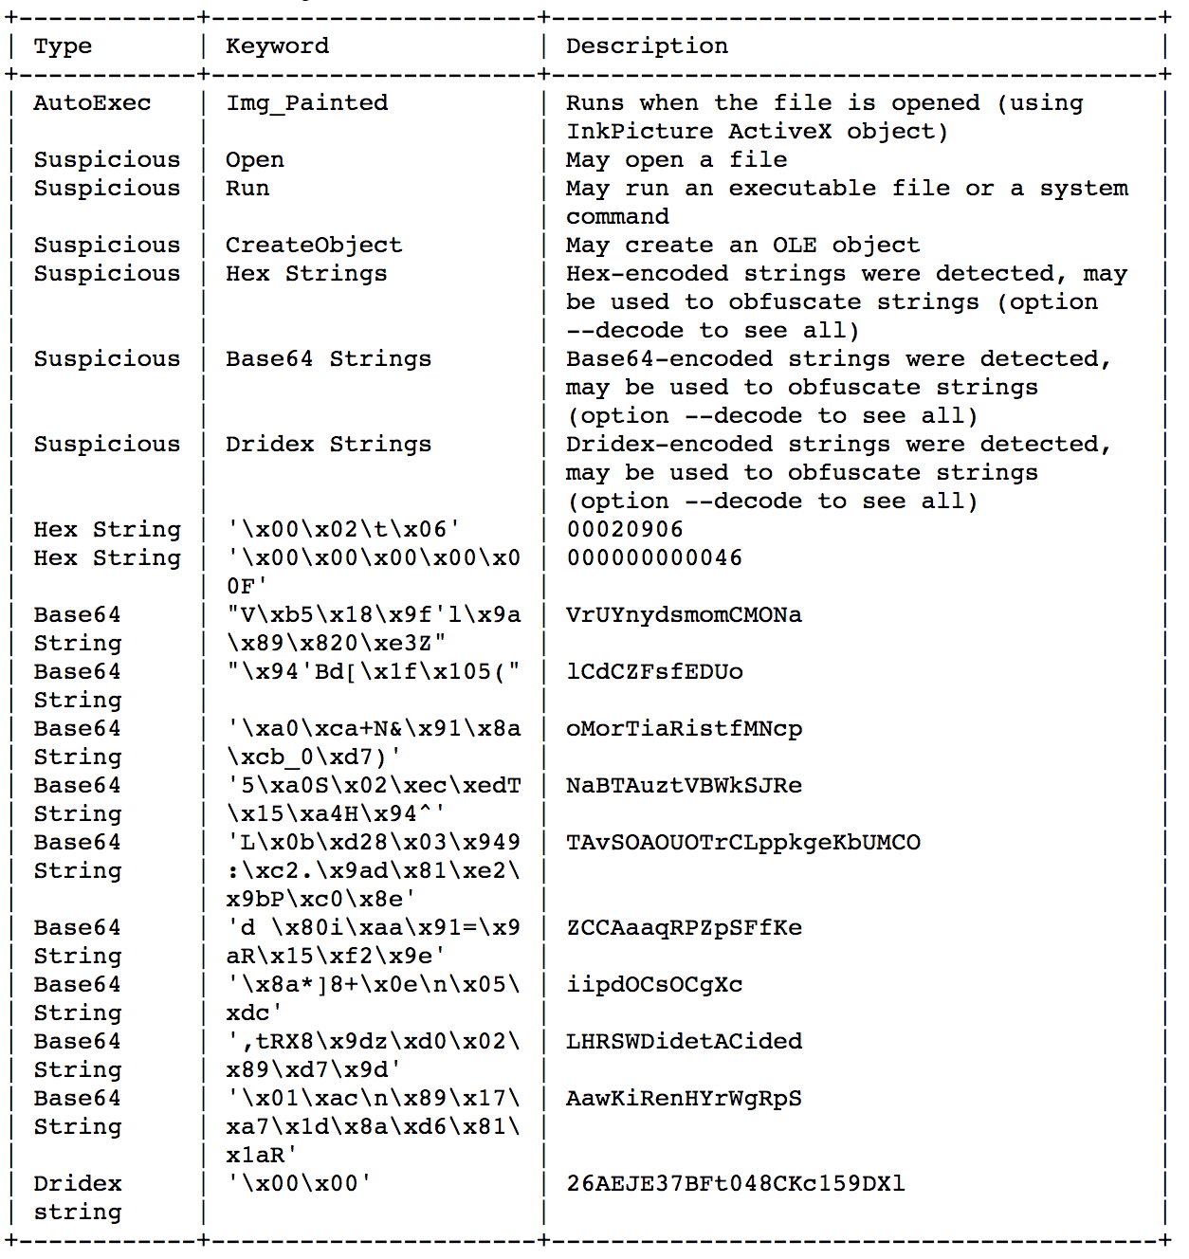
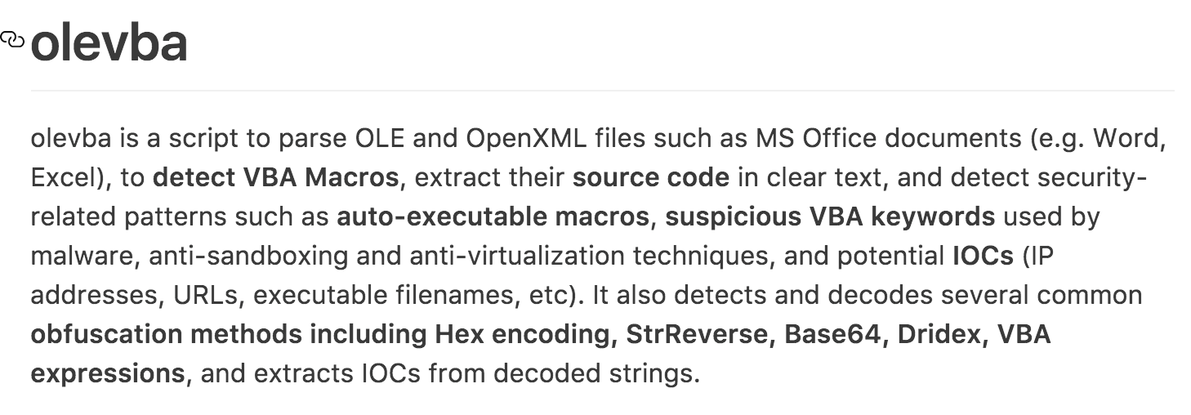
Identifying Campaigns

Slide 46

Malware Behavior

Slide 47

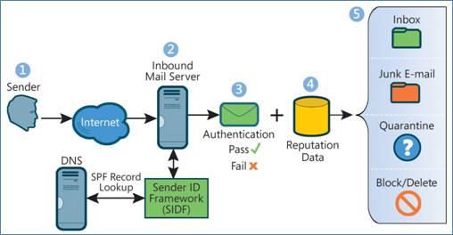
Interesting Observations
Training -> Paranoia -> Too many false positives!
Sender Policy Framework (SPF)

Slide 48
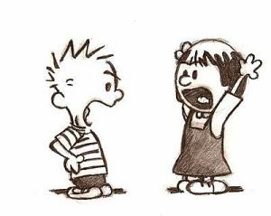
Take Away
Humans not software are attackers’ target
This applies to any cybersecurity problem not just phishing
Defenders must try to attain attacker’s viewpoint
Identify their TTPs
Attackers are highly adaptive
No defense is a permanent solution

