Slide 1
Denial of Service Attacks (DoS)

Slide 2
What is a DoS/DDoS attack ?
An explicit attempt by attackers to prevent legitimate users of a service from using that service
When multiple attackers or bots act in a coordinated fashion towards a common attack target => distributed denial-of-service (DDoS) attack
Examples of DoS attacks:
attempts to "flood" a network => preventing legitimate network traffic
attempts to disrupt connections between two machines => preventing access to a service
attempts to prevent a particular individual from accessing a service
attempts to disrupt service to a specific system or person
Notes:
Illegitimate use of resources may also result in denial of service.
For example, an intruder may use your anonymous ftp area as a place to store illegal copies of commercial software, consuming disk space and generating network traffic
Not all service outages, even those that result from malicious activity, are necessarily denial-of-service attacks.
Denial of service may be part of a larger attack.
Source: http://www.cert.org/tech_tips/denial_of_service.html

Slide 3
DoS/DDoS Types
Vulnerability-based DoS attack
e.g., Ping of Death, Nuke
End-point resource exhaustion DoS attack
e.g., SYN flood, Slowloris
Flooding DoS attacks
Direct flooding
e.g., ICMP flood, UDP flood
Reflective flooding
e.g., smurf attacks, DNS reflection attacks

Slide 4
Vulnerability-based DoS
Apache HTTP Server 1.3.x, 2.0.x through 2.0.64, and 2.2.x through 2.2.19 allows remote attackers to cause a denial of service (mostly CPU consumption) – CVE-2011-3192
More information:
http://www.securityfocus.com/bid/49303/info
http://www.hackersgarage.com/apache-killer-denial-of-service-flaw-in-apache-webserver.html

Slide 5
Vulnerability-based DoS
Ping-of-Death:
Attacker constructs an ICMP echo request message containing 65,510 data octets and sends it to a victim host
The total size of the resulting datagram (65,538 octets) is larger than the limit specified by the IP protocol (65,536 octet)
Several systems did not handle this oversized IP datagram => machines froze, crashed or rebooted
Solution: Fixed by software patches
Nuke attacks (similar to Ping-of-Death):
Send a NetBIOS (port 139 on a Windows box) packet with an ”Urgent Pointer” field to the target, which causes the system to crash
Notes:
56 byte in size + 28 header = 84 byte 65535 byte
Nuke attack TCP 139 win95 to win98 2000 a new version of WinNuke surfaced affact Win NT 2000, Xp but soon be patched

Slide 6
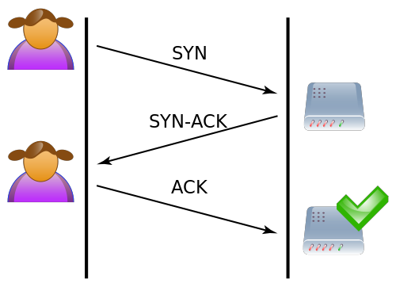
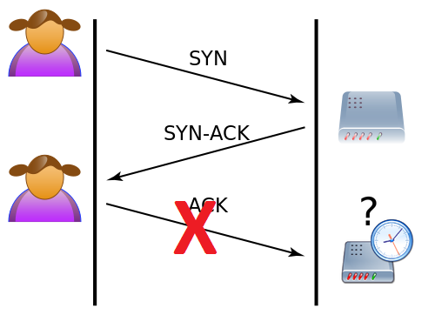
TCP 3-way Handshake vs. TCP Half-Open Connections
Half Open Connection
(TCP 3-way Handshake is incorrectly performed)
TCP 3-way Handshake is correctly performed
Diagram: http://en.wikipedia.org/wiki/SYN_flood

Slide 7
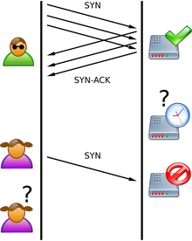
SYN Flood
Diagram: http://en.wikipedia.org/wiki/SYN_flood
Notes:
SYN Flood. The attacker sends several packets but does not send the "ACK" back to the server. The connections are hence half-opened and consuming server resources. Alice, a legitimate user, tries to connect but the server refuses to open a connection resulting in a denial of service.

Slide 8
SYN Flood
Attacker sends a flood of TCP/SYN packets (often with a forged sender address)
Victim machine handles each of these packets like a connection request (spawns a half-open connection and sends back a TCP/SYN-ACK packet) and waits for a packet in response from the sender address
Sender address is forged => the response never comes
These half-open connections saturate the number of available connections the server is able to make
Result: Victim host cannot respond to legitimate requests
Solution: SYN Cookies
Notes:
Solution: SYN Cookies - "particular choices of initial TCP sequence numbers by TCP servers." In particular, the use of SYN Cookies allows a server to avoid dropping connections when the SYN queue fills up. Instead, the server behaves as if the SYN queue had been enlarged. The server sends back the appropriate SYN+ACK response to the client but discards the SYN queue entry. If the server then receives a subsequent ACK response from the client, the server is able to reconstruct the SYN queue entry using information encoded in the TCP sequence number.

Slide 9
Slowloris
A type of attacks that try to keep many connections to the target server (usually web server) open and hold them open as long as possible
Example:
Slowloris HTTP DoS (http://ckers.org/slowloris/)

Slide 10
UDP Flood
A huge amount of UDP packets are sent to the target host; target machine will respond with ICMP packets
Result: Target host becomes overloaded and can no longer reply to requests from legitimate users
Solutions: Not too many
Most UDP packet filters are based on simple patterns => a lot of false positives and complaining users

Slide 11
UDP Flooding: Countermeasures
Filter UDP traffic at the firewall level. Only allow legitimate traffic such as UDP port 53 (DNS)
Intrusion Detection Systems (IDS)

Slide 12
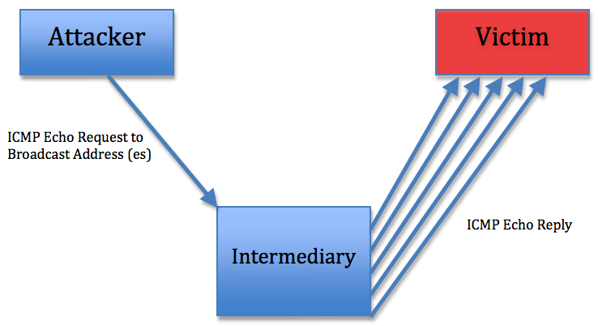
Reflective Flooding
Smurf Attack:
LAN
- Attacker sends ICMP echo request messages to a broadcast address at an intermediate site (source address in each request packet is spoofed so that replies are sent to a victim machine)
- Solution: Machines have been configured not to respond to ICMP echo requests sent to a broadcast address
Notes:
Result: the victim’s machine/network is flooded by ICMP echo replies

Slide 13
DoS Tool
LOIC (Low Orbit Ion Canon) - an open source network stress testing application, written in C#:
three types of attacks, each using a different packet type: UDP, TCP and HTTP.
All attack types are similar:
They send packets to the same target host continuously
The source IP address is NOT spoofed
Runs primarily on Windows (was ported to Unix systems as well):
http://sourceforge.net/projects/loic/

Slide 14
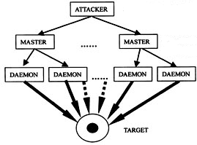
DDoS Tools
Linux:
Trin00
Tribe Flood Network
Stacheldraht
Notes:
Trinoo daemons running on over 200 different machines flooded a University of Minnesota host for several days (August 1999)
Used against major e-commerce websites in February 2000.

Slide 15
Detecting a DoS flooding attack
Probably the simplest way is to use a network traffic sniffer on the target machine:
Wireshark (http://www.wireshark.org/)
tcpdump
Block the IP addresses that send you a huge amount of unrequested traffic

Slide 16
Exercise
Use hping3 or any other flooding tool
Flood a target lab machine of your choice (NOT the gateway)
Run Wireshark/Tcpdump on the target machine
Synchronize your attack with a few classmates and perform a DDoS attack
How many machines do you need to render a lab machine unusable (“cut” the network connection)?
How many packets (per second) were sent to the target to “cut” the network connection?
Is there any difference if the target host is running Windows or Unix based OS?

Slide 17
hping3
hping is a free packet generator and analyzer for TCP/IP protocol
Open terminal
hping3 -help
SYN flood
hping3 --flood -S -p [port] [IP]
S indicates SYN flag
UDP flood
hping3 --udp -p [port] --destport [port] --flood [IP]
ICMP flood
hping3 --icmp --spoof [target IP] --flood [IP]

Slide 18
Sources of Information
DoS Overview –
http://www.cert.org/tech_tips/denial_of_service.html
DoS Classification –
http://dvlabs.tippingpoint.com/blog/2011/02/28/dos-and-ddos-yesterday-and-today
Slowloris Attacks –
https://en.wikipedia.org/wiki/Slowloris
http://ckers.org/slowloris/

