Slide 1
Information Gathering and Reconnaissance
Notes:
Firewall

Slide 2
Hacking Stages
Information Gathering/Reconnaissance
Getting Access
Maintaining Access
Clearing Tracks

Slide 3

What is Reconnaissance ?
Before launching an attack, skilled computer attackers often try to learn as much as possible about:
The target systems and networks
Hardware and software
Topology
Typical operation
Administrators, Users, Owners

Slide 4
Reconnaissance Steps
Reconnaissance can be divided in two steps:
Step 1 – Intelligence gathering about the victim
Open-source information: webpage, business partners, search engines etc.
Social Engineering
Physical Break-ins
Dumpster Diving
Step 2 – Intelligence gathering about the system
There are scanning tools available to automatically scan:
Hosts
Network devices
Services
Vulnerabilities
Notes:
- bank robber example

Slide 5
Step 1
Identifying url, IP addresses, and sub-domains
Usually one of the first steps, it is important to identify the ip ranges and sub-domains associated with your target(s).
Identifying People
Identifying names, email addresses, phone numbers and other personal information that can be valuable for phishing or other social engineering activities.
Identifying Technologies
Identifying the types and versions of the systems and software applications in use by organization is an important precursor to identifying potential vulnerabilities.
Methods
Browsing company web site
Googling
Use automated tools

Slide 6

Practice 1
theHarvester - a tool for gathering e-mail accounts, user names and hostnames/subdomains from different public sources like search engines and PGP key servers
Download: https://github.com/laramies/theHarvester
Gather information about cse.usf.edu using theHarvester
Unzip: unzip theHarvester-master.zip
View theHarvester options: python theHarvester.py
Notes:
tar xvf theHarvester-XX.tar.gz

Slide 7
Practice 1
theHarvester (unzip: unzip theHarvester-master.zip)
View options: python theHarvester.py
Full harvest on cse.usf.edu:
python theHarvester.py -d cse.usf.edu -l 1000 -b bing
Used options (flags):
d: Domain to search or company name
b: Data source (google, bing, bingapi, pgp, linkedin, google- profiles,people123,jigsaw,all)
l: Limit the number of results

Slide 8
Maltego
Maltego, open-source intelligence and forensics software developed by Paterva
Comprehensive GUI with relational graph
Advanced framework, allows customized plugins
Use big data and social network to analyze real-world relationships between people, websites, domain, networks, internet infrastructure, etc.
Notes:
http://mtg-bi.com/

Slide 9
Practice 2
Use Maltego to analyze cse.usf.edu network structure
Start Maltego from menu
Following registration wizard
username: cdcusf@gmail.com
Password: password
Drag a domain entity and start explore!
What kind of information can we get?
Notes:
Download soctialnet from http://packetninjas.net/tools/socialnet.html

Slide 10

Network Scanning
Scan a network to determine:
Live hosts
Network topology
“Important” hosts
Routers
Firewalls
Intrusion Detection Systems
OSes
Ports (services) open
Vulnerabilities

Slide 11

Nmap
Well-known port scanner, ping sweep and OS fingerprinting tool
Available for Linux, OS X and Windows:
http://www.insecure.org/nmap/
Nmap and Zenmap (the graphical front end) are available in several versions and formats
Notes:
Scan methods: http://www.auditmypc.com/port-scanning.asp

Slide 12
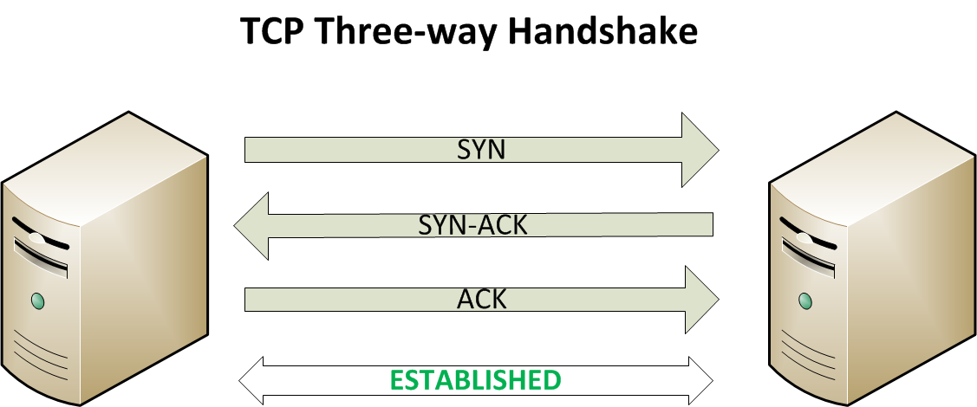
Nmap Scans
Ping sweeps
Example: nmap –sP target_ip
TCP connect
Three-way handshake
Example:
nmap [-sT] target_ip
UDP
Send a UDP packet
Example:
nmap –sU target_ip

Slide 13
TCP/IP
In TCP/IP services are referenced using two components: an IP address and a port number
There are 65536 distinct ports
A request of service on a port generally falls into one of three categories:
Open: the host responds to your request indicating a service is listening on the port
Closed: the host responds but denies the request
Blocked: there is no reply

Slide 14
Port Scanning – TCP mode
Connect scan (completes the TCP three-way handshake)
Send a TCP SYN segment to a target port
If a SYN-ACK is returned
The port is open
Complete the three-way handshake with an ACK
Terminate the connection with a FIN
If no response, a RST, or an ICMP Port Unreachable is returned
The port is closed
Unlikely to cause any problems on scanned host
Downside: Usually very easy to detect

Slide 15
Port Scanning – UDP mode
There is no three-way handshake and no sequence numbers
Send an ICMP packet to a target port
If an ICMP Port Unreachable is returned
The port is closed
If no response is returned
Assume the port is open or blocked
Downside :
Easy to detect
Unreliable
Can be very slow when outgoing ICMP messages are rate-limited

Slide 16
Nmap Scans – TCP SYN mode
Three-way handshake is not completed
Sends SYN
Awaits SYN-ACK
Instead of final ACK, send RST or nothing
Example:
nmap [-sS] target_ip
Slightly stealthy

Slide 17
Nmap Scans – TCP FIN mode
Send a TCP FIN to a target port (violation of the TCP specification):
If a RST is returned
The port is closed
If no response is returned
The port may be open
Example:
nmap [-sF] target_ip
More stealthy
Note: Will not work on Microsoft systems which do not follow the standard
Notes:
TCP Protocol says that if somebody sends a FIN packet to a port that they haven’t already opened a connection on, then you have to send a RST back.

Slide 18
Nmap Scans – Xmas Tree mode
Send a TCP segment to a target port with FIN, URG, and PSH code bits set (violation of the TCP specification)
If a RST is returned
The port is closed
If no response is returned
The port may be open
Example:
nmap [-sX] target_ip
Note: Will not work on Microsoft systems which do not follow the standard
Notes:
https://en.wikipedia.org/wiki/Christmas_tree_packet

Slide 19
Nmap Scans – Null mode
Send a TCP segment to a target port with no flags set (violation of the TCP specification)
If a RST is returned
The port is closed
If no response is returned
The port may be open
Example:
nmap [-sN] target_ip
More stealthy
Note: Will not work on Microsoft systems which do not follow standard

Slide 20
Nmap Scans – TCP ACK mode
Send a TCP ACK to a target port (violation of the TCP specification)
If a RST is returned
The packet made it through the filter
The port is unfiltered (established connections allowed)
If no response or ICMP Port Unreachable is returned
The packet didn’t make it through the filter (e.g. firewall blocked the packet)
The port is filtered
Example:
nmap [-sA] target_ip
Could be used to determine what rules a packet filter applies
Notes:
Works for stateless firewalls (ex. built-in Windows firewall)
Iptables is a stateful firewall.

Slide 21
Nmap Scans – other options
Specifying port ranges
Scan only selected ports with the –p flag
Setting source ports
Set source port (e.g. 80 or 25) so that the packets won’t be blocked (hopefully)
Using decoys
Obscure the source of scans by sending decoy packets with a decoy source address

Slide 22
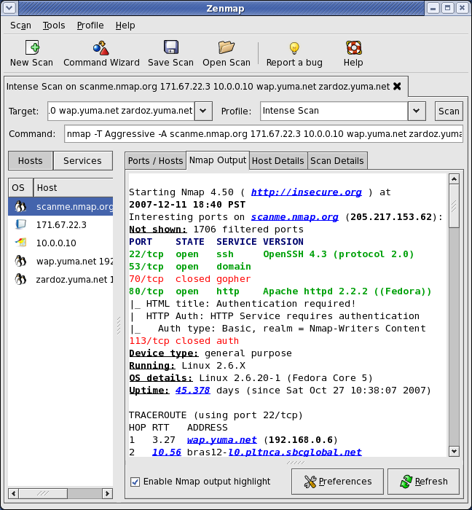
Practice 3
Scan the playground network using Nmap
Any interesting information in the report?
Hint: It might be easier to use Zenmap (GUI for Nmap)

Slide 23
Vulnerability Scanning
After scanning the network, attackers can start searching for vulnerabilities
Manually
Automatically
Vulnerability scanners are automated tools that scan hosts and networks for known vulnerabilities and weaknesses
Used together with other reconnaissance information to prepare for and plan attacks
Credentialed and Non-Credentialed Vulnerability Scanner
Notes:
Vulnerabilities:
Common configuration errors (ex. weak/no passwords)
Default configuration weaknesses (default accounts and passwords)
Well-known system/application vulnerabilities ( ex. Missing OS patches or an old, vulnerable version of a web server)

Slide 24
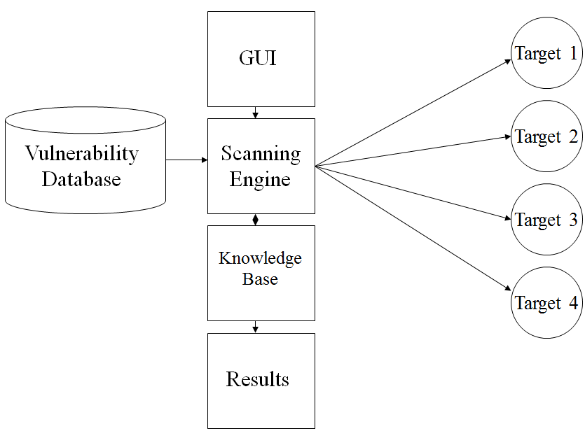
Vulnerability Scanner
Source: “CS635 SP2010 – Slides (Dr. Brett Tjaden - JMU)”
Notes:
Scanning with credentials has opened a new frontier for security assessment. Here’s an analogy: traditional vulnerability scanning is like a mechanic evaluating a car just by looking at the outside and listening to the motor run. It’s useful but there is so much more information available by looking under the hood and plugging into the on-board diagnostics. That level of insight and internal perspective is what credentialed scanning lends to a security assessment. But even beyond the additional perspective, there are other benefits specific to control system environments that are worth noting. The number of people who use Nessus or other scanners who do not take advantage of credentialed scanning continually surprises me. Whether you are an owner/operator, an integrator, or consultant concerned with control system security, make sure you know what is available to you. Here are three reasons to get you started.

Slide 25

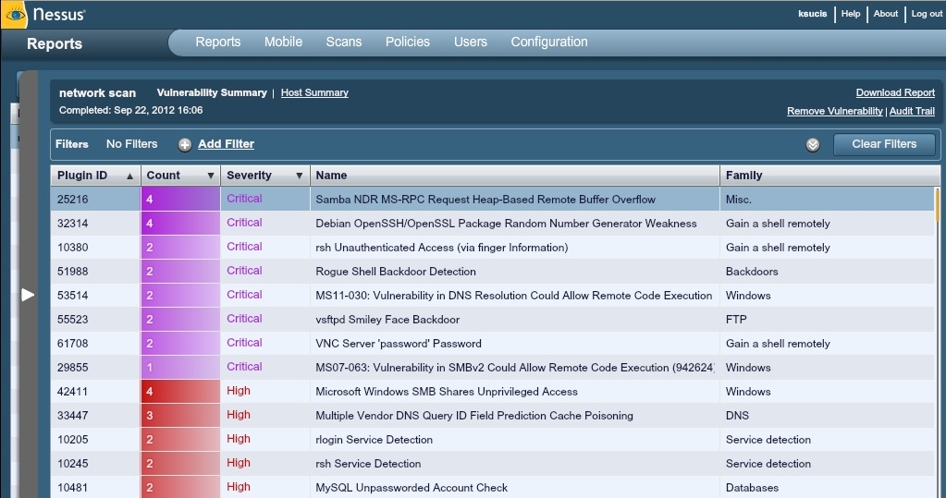
Nessus
Vulnerability scanner (free for Home use)
Runs on Windows, Linux, Mac OS X, FreeBSD and Solaris
http://www.tenable.com/products/nessus/nessus-download-agreement
Two major components:
Server
Vulnerability database
Scanning engine
Client
Create Policy
Run scans
View results of a scan
Image Source: http://www.tenable.com/products/nessus
Notes:
https://localhost:8834

Slide 26
Nessus Plugins (1/2)
A plugin is a simple program which checks for a given flaw
Every audit in Tenable Nessus is coded as a plugin
There are currently over 55,000 different plugins used by Nessus, covering local and remote flaws.
Plugins are customizable – user can write new plug-ins in Nessus Attack-Scripting Language (NASL)
Image Source: http://www.tenable.com/plugins/

Slide 27
Nessus Plugins (2/2)
Some major plugin groups:
Backdoors
CGI abuses
CISCO
Databases
Debian Local Security Checks
Default Unix Accounts
Denial of Service
DNS
Fedora Local Security Checks
Firewalls
Web Servers
Windows
All major plugin groups :http://www.tenable.com/plugins/index.php?view=all

Slide 28
Running a Nessus Scan
Open Browser (Firefox, Safari, IE, etc.)
Connect to server (https://server_ip:8834/)
Create Policy (select which plug-ins to use)
Select target systems to scan
Run the scan
View the results

Slide 29
Nessus Results
Vulnerabilities Severity: critical, high, medium, low or info
Need to be checked (and interpreted)
Can be used to search for or create exploits along with previous information collected:
OS type (Windows or Unix based)
List of open ports
List of services and versions
List of vulnerabilities

Slide 30

MagicTree
Information management tool that aggregates data from a variety of other tools
Proprietary, but free
Strength is storing and sharing data
Imports tool output from Nmap, Nessus, etc.
Supports command execution from inside the tool
Supports data searching and manipulation
Included in Kali and BackTrack 5:
Backtrack 5 – in Terminal: /pentest/reporting/magictree
Kali – in Terminal: magictree

Slide 31
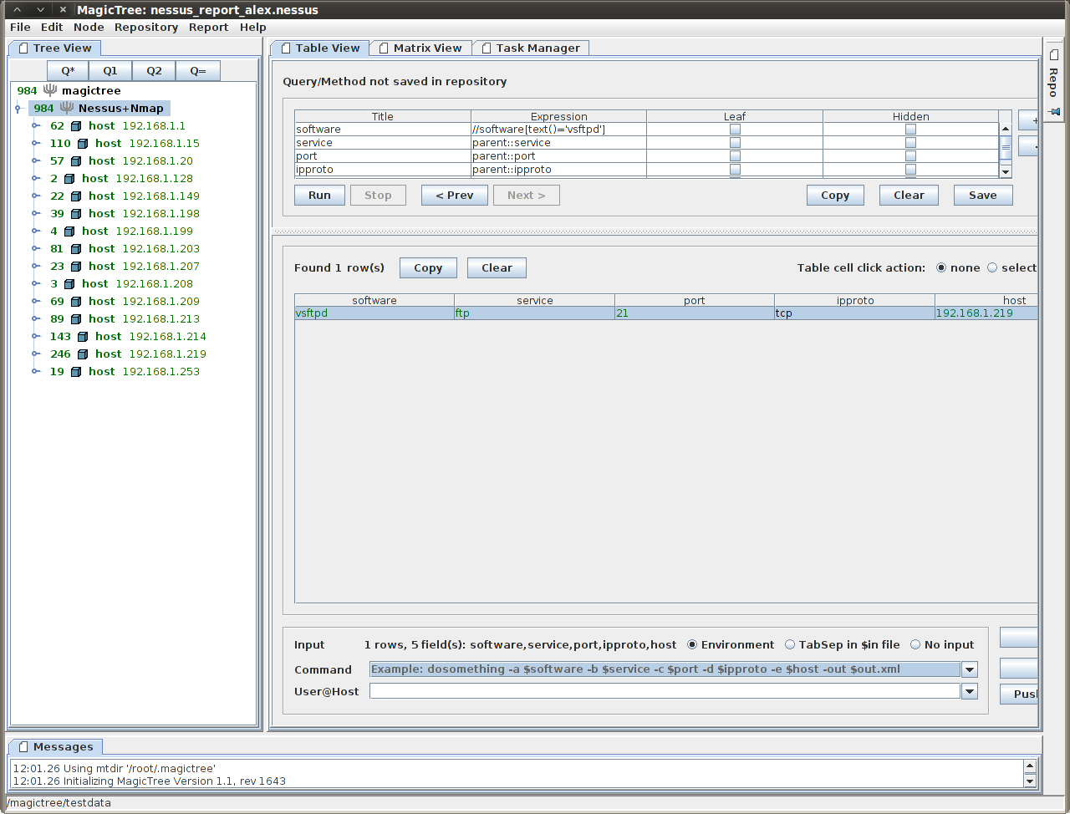
Practice 4
Run Nmap and Nessus scans
Upload the scans in MagicTree
Interesting information in the reports?
MagicTree (Nessus and Nmap merged scans example)

Slide 32
Sources of Information
Nessus: http://www.nessus.org/plugins/
Nmap: http://nmap.org/download
MagicTree: http://www.gremwell.com/
theHarvester: http://www.edge-security.com/theHarvester.php

