Slide 1
Iterators and Sorting

Slide 2
Iterating and Copying Collections
Once we have collections of data items, it is natural to want to iterate over all the items they contain.
An iterator can be seen as a pointer to a container
That is, a list-like structure that can iterate over all the elements of this container.
This abstraction enables the programmer to access all the elements of a container without any deeper knowledge of the data structure of this container object.
Generators are a special kind of function, which we can use to create iterators; they will be covered later
Iterators are a "fundamental" concept of Python.
Mostly, iterators are implicitly used, like in the for loop.

Slide 3
Iterators and Iterable Operations and Functions
An iterable data type is one that can return each of its items one at a time.
A sequence is an object that has a __getitem__() method taking integer arguments starting from 0
Any sequence and any object that has an __iter__() method is an iterable and can provide an iterator
An iterator is an object that provides a __next__() method which
  returns each successive item in turn; and
  raises a StopIteration exception when there are no more items

Slide 4
Iterators and Iterable Operations and Functions
The order in which items are returned by an iterator depends on the underlying iterable.
In the case of lists and tuples, items are normally returned in sequential order starting from the first item
However, some iterators return the items in an arbitrary order—for example, dictionary and set iterators.

Slide 5
Iterator Example
>>> cities = ["Paris", "Berlin", "Hamburg", "Frankfurt",
"London", "Vienna", "Amsterdam", "Den Haag"]
>>> for location in cities:
... print("location: " + location)
...
location: Paris
location: Berlin
location: Hamburg
location: Frankfurt
location: London
location: Vienna
location: Amsterdam
location: Den Haag
>>>

Slide 6
Types That Support Iteration
The sequential base types
The majority of the Python standard library classes
The dictionary data type dict , where the iteration runs over the keys of the dictionary
>>> capitals = { "France":"Paris",
"Netherlands":"Amsterdam",
"Germany":"Berlin",
"Switzerland":"Bern",
"Austria":"Vienna"}
>>> for country in capitals:
... print("The capital city of %s is %s"
... %(country, capitals[country]))
...
The capital city of Switzerland is Bern
The capital city of Netherlands is Amsterdam
The capital city of Germany is Berlin
The capital city of France is Paris
>>>

Slide 7
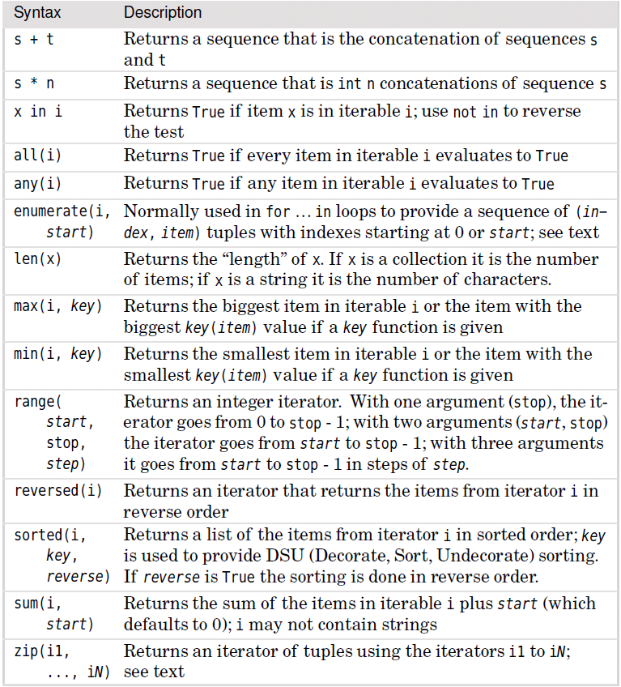
Common Iterable Operators and Functions

Slide 8
Common Iterable Operators and Functions

Slide 9
Iterators and Iterable Operations and Functions
The second iter() behavior occurs when the function is passed a callable and a sentinel value.
In this case the function passed in is called once at each iteration
if the return value equals the sentinel, it raises a StopIteration exception
Otherwise it returns the value

Slide 10
Iterators
When we use a for item in iterable loop, Python in effect calls iter(iterable) to get an iterator.
This iterator’s __next__() method is then called at each loop iteration to get the next item
When the StopIteration exception is raised, it is caught and the loop is terminated.
Another way to get an iterator’s next item is to call the built-in next() function.

Slide 11
Iterators and Iterable Operations and Functions
product = 1
for i in [1, 2, 4, 8]:
product *= i
print(product) # prints: 64
product = 1
i = iter([1, 2, 4, 8])
while True:
try:
product *= next(i)
except StopIteration:
break
print(product) # prints: 64
Any (finite) iterable, i, can be converted into a tuple by calling tuple(i), or can be converted into a list by calling list(i)

Slide 12
Iterators and Iterable Operations and Functions
The all() and any() functions can be used on iterators and are often used in functional-style programming.
Examples:
>>> x = [-2, 9, 7, -4, 3]
>>> all(x), any(x), len(x), min(x), max(x), sum(x)
(True, True, 5, -4, 9, 13)
>>> x.append(0)
>>> all(x), any(x), len(x), min(x), max(x), sum(x)
(False, True, 6, -4, 9, 13)
Of these little functions, len() is probably the most frequently used.

Slide 13
enumerate()
The enumerate() function takes an iterator and returns an enumerator object.
This object can be treated like an iterator, and at each iteration it returns a 2-tuple with
  first entry the iteration number (by default starting from 0)
  second entry the next item from iterator that was passed in.
Next we will look at enumerate()’s use in the context of a tiny but complete program
The grepword.py program takes a word and one or more filenames on the command line
It outputs the filename, line number, and line whenever the line contains the given word

Slide 14
Sample Run of grepword.py
  grepword.py Dom data/forenames.txt
  data/forenames.txt:615:Dominykas
  data/forenames.txt:1435:Dominik
  data/forenames.txt:1611:Domhnall
  data/forenames.txt:3314:Dominic)

Slide 15
grepword.py
Data files data/forenames.txt and data/surnames.txt contain unsorted lists of names, one per line
Apart from the sys import, the program is just ten lines long:
if len(sys.argv) < 3: # must have at least 2 arguments
print("usage: grepword.py word infile1 [infile2 "
"[... infileN]]")
sys.exit()
word = sys.argv[1] # the word being searched for
for filename in sys.argv[2:]:
for lino, line in enumerate(open(filename), start=1):
if word in line:
print("{0}:{1}:{2:.40}".format(filename,
lino,line.rstrip()))

Slide 16
range()
Quite often we don’t need an enumerator, but rather an iterator that returns successive integers.
This is exactly what the range() generator function provides.
If we need a list or tuple of integers, we can convert the iterator returned by range() by using the appropriate conversion function.
Here are a few examples:
>>> list(range(5)), list(range(9, 14)), tuple(range(10, -11, -5))
([0, 1, 2, 3, 4], [9, 10, 11, 12, 13], (10, 5, 0, -5, -10))
The range() function is most commonly used for two purposes:
  to create lists or tuples of integers; and
  to provide loop counting in for…in loops.

Slide 17
range()
These two equivalent examples ensure that list x’s items are all non-negative:
for i in range(len(x)):
x[i] = abs(x[i])
In both cases, if list x was originally
[11, -3, -12, 8, -1]
then afterward it will be
[11, 3, 12, 8, 1].
i = 0
while i < len(x):
x[i] = abs(x[i])
i += 1

Slide 18
Unpacking the range Iterator
Since * can be used to unpack an iterable, we can us it unpack the iterator returned by the range() function
Example: function calculate() that takes four arguments.
Here are some ways we could call it with arguments, 1, 2, 3, and 4:
calculate(1, 2, 3, 4)
t = (1, 2, 3, 4)
calculate(*t)
calculate(*range(1, 5))
In all three calls, four arguments are passed.
The second call unpacks a 4-tuple, and the third call unpacks the iterator returned by the range() function.

Slide 19
Generators
A generator is a function that produces a sequence of results instead of a single value.
Generators are a simple and powerful method for the creation (or generation) of iterators.
These iterators are called generator objects.
The word "generator" is ambiguously used to mean both the generator function itself and the objects which are produced by a generator
On the surface they look like functions, but there is both a syntactic and a semantic difference
Where you would expect return statements in a function, you will find yield statements
You may see one or more yield statements in a generator.

Slide 20
Generators
Another important feature of generators: the local variables and the execution position are automatically saved between calls
This is necessary, because unlike an ordinary function, successive calls to a generator function don't start execution at the beginning of the function
Instead, the new call to a generator function will resume execution right after the yield statement in the code where the last call exited
When the Python interpreter finds a yield statement inside of an iterator generated by a generator, it
  records the position of this statement and the values of local variables; and
  returns from the iterator.
The next time this iterator is called, it will resume execution at the line following the previous yield statement

Slide 21
Generators
There may be more than one yield statement in the code of a generator or the yield statement might be inside the body of a loop.
If there is a return statement in the code of a generator, the execution will stop with a StopIteration exception error
Everything that can be done with a generator can be implemented with a class based iterator as well.
But the crucial advantage of generators consists in automatically creating the methods __iter__() and next().
Generators provide a very neat way of producing data which is huge or infinite.

Slide 22
####### city_generator.py ########
# A silly example of a generator #
##################################
def city_generator():
yield("London")
yield("Hamburg")
yield("Konstanz")
yield("Amsterdam")
yield("Berlin")
yield("Zurich")
yield("Schaffhausen")
yield("Stuttgart")

Slide 23
Types That Support Iteration
>>> from city_generator import city_generator
>>> city = city_generator()
>>> print(next(city))
London
>>> print(next(city))
Hamburg
>>> print(next(city))
Konstanz
>>> print(next(city))
Amsterdam
>>> print(next(city))
Berlin
>>> print(next(city))
Zurich
>>> print(next(city))
Schaffhausen
>>> print(next(city))
Stuttgart
>>> print(next(x))
Traceback (most recent call last):
File "<stdin>", line 1, in <module>
StopIteration

Slide 24
Generators
In the previous example, we generated an iterator x in the interactive shell.
Every call of the method next() returns another city.
After the last city, i.e. Stuttgart, has been created, another call of next(x) raises an exception
The StopIteration exception indicates that the iteration has stopped
We cannot reset to an iterator so that it can start the iteration all over again
Although there is no reset, we can create another generator.
This can be done, e.g., by using the statement again using the statement "x = city_generator()"

Slide 25
Fibonacci Iterator
def fibonacci():
"""A Fibonacci Number Generator"""
a, b = 0, 1
while True:
yield a
a, b = b, a + b
f = fibonacci()
counter = 0
for x in f:
# no linefeed is enforced by end="":
print(x, " ", end="")
counter += 1
if counter > 10:
break
print()

Slide 26
Functions sorted() and reversed()
The sorted() function returns a list with the items sorted
The reversed() function returns an iterator that iterates in the reverse order of the iterator it is given as its argument.
Neither function modifies the list passed as an argument
Examples of reversed():
>>> list(range(6))
[0, 1, 2, 3, 4, 5]
>>> list(reversed(range(6)))
[5, 4, 3, 2, 1, 0]

Slide 27
Function sorted()
The sorted() function is more sophisticated, as these examples show:
>>> x = []
>>> for t in zip(range(-10, 0, 1), range(0, 10, 2),
range(1, 10, 2)):
x += t
>>> x
[-10, 0, 1, -9, 2, 3, -8, 4, 5, -7, 6, 7, -6, 8, 9]
>>> sorted(x)
[-10, -9, -8, -7, -6, 0, 1, 2, 3, 4, 5, 6, 7, 8, 9]
>>> sorted(x, reverse=True)
[9, 8, 7, 6, 5, 4, 3, 2, 1, 0, -6, -7, -8, -9, -10]
>>> sorted(x, key=abs)
[0, 1, 2, 3, 4, 5, 6, -6, -7, 7, -8, 8, -9, 9, -10]

Slide 28
key Parameter of sorted()Function
Notice that since Python functions are objects like any other, they can be
  passed as arguments to other function; and
  stored in collections without formality.
Recall that a function’s name is an object reference to the function
It is the parentheses that follow the name that tell Python to call the function.

Slide 29
key Parameter of sorted()Function
>>> sorted(x, key=abs)
[0, 1, 2, 3, 4, 5, 6, -6, -7, 7, -8, 8, -9, 9, -10]
When a key function is passed (in this case abs()), it is called once for every item in the list to create a “decorated” list.
Then the decorated list is sorted, and the sorted list without the decoration is returned as the result.
We are free to use our own custom function as the key function, as we will see shortly.

Slide 30
Example: Case Insensitive Sort
x = ["Sloop", "Yawl", "Cutter", "schooner", "ketch"]
We can sort x case-insensitively using DSU (Decorate, Sort, Undecorate)
With one line of code by passing a key function:
x = sorted(x, key=str.lower)
By doing the DSU explicitly:
temp = []
for item in x:
temp.append((item.lower(), item))
x = []
for key, value in sorted(temp):
x.append(value)
x is now
["Cutter", "ketch", "schooner", "Sloop", "Yawl"]

Slide 31
timsort
Python's sort methods use the timsort algorithm (Tim Peters)
It is an adaptive stable mergesort that is both fast and smart
adaptive: it adapts to circumstances—for example, taking advantage of partially sorted data.
stable: items that sort equally are not moved in relation to each other
mergesort : the generic name for the sorting algorithm used

Slide 32
Examples
Python can sort collections that contain collections, working recursively to any depth.
For example:
>>> x = list(zip((1, 3, 1, 3),
("pram", "dorie", "kayak", "canoe")))
>>> x
[(1, 'pram'),(3, 'dorie'),(1, 'kayak'),(3, 'canoe')]
>>> sorted(x)
[(1, 'kayak'),(1, 'pram'),(3, 'canoe'),(3, 'dorie')]
The first item of each tuple is compared, and when these are the same, second items are compared

Slide 33
sorted()
We can force the previous sort to be based on the strings and use the integers as tiebreakers by defining a simple key function:
def swap(t):
return t[1], t[0]
The swap() function takes a 2-tuple and returns a new 2-tuple with the arguments swapped.
Assuming that we have entered the swap() function in IDLE, we can now do this:
>>> sorted(x, key=swap)
[(3, 'canoe')(3, 'dorie'), (1, 'kayak'),(1, 'pram')]

Slide 34
sort()
Lists can also be sorted in-place using the list.sort() method
It takes the same optional arguments as sorted()

Slide 35
sorted() and sort()
Sorting can be applied only to collections where all the items can be compared with each other:
sorted([3, 8, -7.5, 0, 1.3])
# returns: [-7.5, 0, 1.3, 3, 8]
sorted([3, "spanner", -7.5, 0, 1.3])
# raises a TypeError
The first succeeds because numbers of any type can be compared.
The second fails because has a string cannot be sensibly compared with a number

Slide 36
Sorting
If we want to sort a list of strings and numbers, we can give float() as the key function:
sorted(["1.3", -7.5, "5", 4, "-2.4", 1],
key=float)
This returns the list [-7.5, '-2.4', 1, '1.3', 4, '5']
Notice that the list’s values are not changed, so strings remain strings.
If any of the strings cannot be converted to a number (e.g., “spanner”), a ValueError exception will be raised.

