Slide 1
MappingTypes

Slide 2
Dictionaries
Mappings are collections of key–value items and provide methods for accessing items and their keys and values.
When iterated, unordered mapping types provide their items in an arbitrary order.
Mapping types support the membership operator in and the size function len(), and are iterable
When iterated, unordered mapping types provide their items in an arbitrary order.

Slide 3
Dictionaries
Unordered mapping types:
  the built-in dict type
  the standard library’s collections.defaultdict type
The collections.OrderedDict is a dictionary that has the same methods and properties (i.e., the same API) as the built-in dict, but stores its items in insertion order.
We will use the term dictionary to refer to any of these types when the difference doesn’t matter

Slide 4
Dictionaries
Dictionary types can be compared using the standard equality comparison operators (== and !=)
The comparisons are applied item by item (and recursively for nested items such as tuples or dictionaries inside dictionaries).
The other comparison operators (<, <=, >=, >) are not supported
They don’t make sense for unordered collections such as dictionaries.

Slide 5
The dict Type
A dict is an unordered collection of zero or more key–value pairs whose
  keys are object references that refer to hashable objects; and
  values are object references referring to objects of any type
Dictionaries are mutable, so we can easily add or remove items
Since they are unordered they have no notion of index position and so cannot be sliced or strided.

Slide 6
The dict Type
The dict data type can be called as a function, dict()
With no arguments it returns an empty dictionary
With a mapping argument it returns a dictionary based on the argument
For example, it returning a shallow copy if the argument is a dictionary.
Dictionaries can also be created using braces
{} create an empty dictionary
Nonempty braces must contain one or more comma separated items, each of which consists of a key, a literal colon, and a value.

Slide 7
The dict Type
The dict data type can be called as a function, dict()
It is also possible to use a sequence argument, provided that
  each item is a sequence of two objects
  the first of is to be the key of an entry; and
  the second is to be the value mapped by the key

Slide 8
The dict Type
Here are some examples to illustrate the various syntaxes—they all produce the same dictionary:
d1 = dict({"id": 1948, "name": "Washer", "size": 3})
d2 = dict(id=1948, name="Washer", size=3)
d3 = dict([("id", 1948), ("name", "Washer"), ("size", 3)])
d4 = dict(zip(("id", "name", "size"), (1948, "Washer", 3)))
d5 = {"id": 1948, "name": "Washer", "size": 3}
The keyword argument syntax (used to create dictionary d2) is usually the most compact and convenient, providing the keys are valid identifiers.

Slide 9
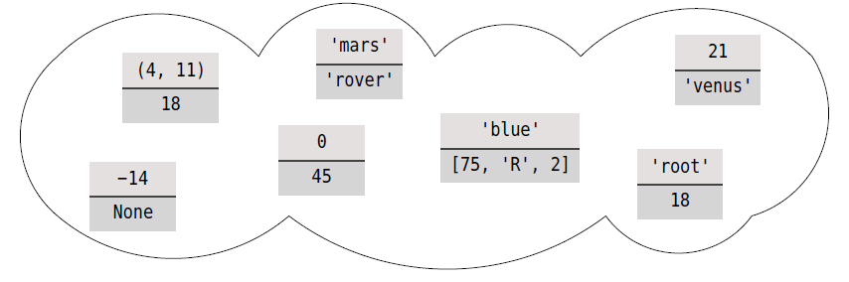
Example
d = {"root": 18, "blue": [75, "R", 2], 21: "venus",
-14: None, "mars": "rover", (4, 11): 18, 0: 45}

Slide 10
The dict Type
Dictionary keys are unique
If we add a key–value item whose key is the same as an existing key, the effect is to replace that key’s value with a new value.
Brackets are used to access individual values
If d is the example on the preceding slide, then
  d["root"] returns 18
  d[21] returns the string "venus“
  d[91] causes a KeyError exception to be raised

Slide 11
The dict Type
Brackets can also be used to add and delete dictionary items.
To add an item, we use the = operator, for example, d["X"] = 59
And to delete an item we use the del statement
del d["mars"] will delete the item whose key is “mars” from the dictionary, or raise a KeyError exception if no item has that key

Slide 12
The dict Type
Items can also be removed (and returned) from the dictionary using the dict.pop() method
Dictionaries support the built-in len() function, and for their keys, fast membership testing with in and not in.
All the dictionary methods are listed in the following table

Slide 13
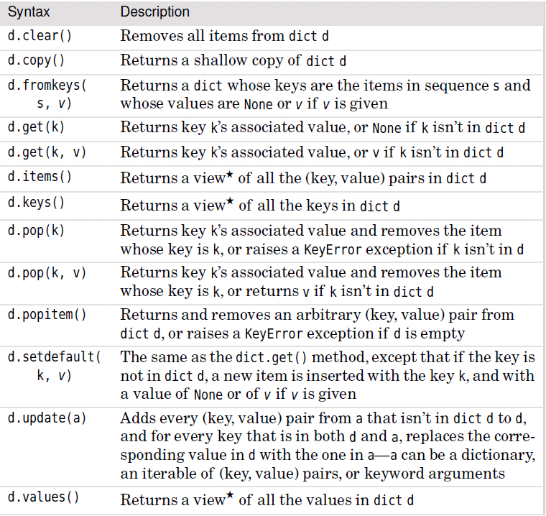

Slide 14
Dictionary Views
The dict.items(), dict.keys(), and dict.values() methods all return dictionary views.
A dictionary view is effectively a read-only iterable object that appears to hold the dictionary’s items or keys or values, depending on the view we have asked for.
In general, we can simply treat views as iterables.
However, two things make a view different from a normal iterable.
One is that if the dictionary the view refers to is changed, the view reflects the change.
The other is that key and item views support some set-like operations.

Slide 15
Dictionary Views
Given dictionary view v and set or dictionary view x, the supported operations are:
v & x # Intersection
v | x # Union
v - x # Difference
v ^ x # Symmetric difference
We can use the membership operator, in, to see whether a particular key is in a dictionary, for example, x in d.
And we can use the intersection operator to see which keys from a given set are in a dictionary:
d = dict.fromkeys("ABCD", 3)
# d == {'A': 3, 'B': 3, 'C': 3, 'D': 3}
s = set("ACX") # s == {'A', 'C', 'X'}
matches = d.keys() & s # matches == {'A', 'C'}

Slide 16
Application of Dictionaries
Dictionaries are often used to keep counts of unique items.
One such example of this is counting the number of occurrences of each unique word of length 3 or more in a file.
The complete program (uniquewords1.py) that lists every word and the number of times it occurs in alphabetical order for all the files listed on the command line
It makes use of the get method of views
If D is a dictionary, then get(k,v) will return D[k] if k is a key of D and will return v if k is not a key of D.

Slide 17
str.strip()
A method of the str class
It removes characters at the beginning and end of a string
If called witih no argument, it strips whitespace characters
If called with a string argument, it strips all characters from the argument string

Slide 18
Dictionary Views
import string
import sys
words = {} # empty dictionary
strip = (string.whitespace + string.punctuation +
string.digits + "\"'") # ignore quotes
for filename in sys.argv[1:]:
for line in open(filename):
for word in line.lower().split():
word = word.strip(strip)
if len(word) > 2:
words[word] = words.get(word, 0) + 1
for word in sorted(words):
print("'{0}' occurs {1} times".format(word,
words[word]))

Slide 19
Dictionary Comprehensions
A dictionary comprehension is an expression and a loop with an optional condition enclosed in braces, very similar to a set comprehension.
Like list and set comprehensions, two syntaxes are supported:
  {keyexpression: valueexpression for key, value in iterable}
  {keyexpression: valueexpression for key, value in iterable if condition}

Slide 20
Dictionary Comprehensions
file_sizes = {name: os.path.getsize(name)
for name in os.listdir()}
We can avoid directories and other non-file entries by adding a condition:
file_sizes = {name: os.path.getsize(name)
for name in os.listdir(".")
if os.path.isfile(name)}
The os.path module’s os.path.isfile() function returns True if the path is that of a file, and False otherwise
Thus, it returns False for directories, links, etc.

Slide 21
Dictionary Comprehensions
A dictionary comprehension can also be used to create an inverted dictionary.
For example, given dictionary d, we can produce a new dictionary whose keys are d’s values and whose values are d’s keys:
inverted_d = {v: k for k, v in d.items()}
The resultant dictionary can be inverted back to the original dictionary if all the original dictionary’s values are unique
But the inversion will fail with a TypeError being raised if any value is not hashable.

