Slide 1

A Presentation on REAL TIME CYBER INCIDENT MONITOORING AND ANALYZING TOOL
Presented By
Rajeev Kumar Sharma (Roll No - 2101200100116)
Anchal Verma (Roll No - 2101200100031)
Under Guidance of
Mr .Vidya Sagar
Assistant Professor
Department of CSE
Institute of Technology and Management, GIDA, Gorakhpur
Session: 2024-25

Slide 2
Content ​
Introduction
Abstract
Objective
Literature survey
Proposed model
Technology /Methodology used
Project Steps
Flow Chart of project
Algorithm used
Conclusion & future Work
Reference

Slide 3
Introduction
The Cyber Incident Monitoring System is an innovative tool designed to provide real-time updates on cyber incidents affecting Indian cyberspace. It gathers data from diverse sources, including social media platforms (e.g., Twitter), news websites, and other relevant channels. Using machine learning, the system classifies incidents, analyzes patterns, and generates comprehensive reports. This helps stakeholders quickly understand the nature, frequency, and potential impact of cyber threats as they occur.
This project aligns with NCIIPC’s mission by developing a comprehensive tool for real-time monitoring of cyber incidents in Indian cyberspace.
The project features a full-stack application:
Backend: Responsible for collecting, processing, and securely storing data.
Frontend: Delivers a user-friendly, interactive dashboard to visualize and explore
insights effectively.
By bridging advanced technology and usability, this tool empowers organizations to strengthen their response to cyber threats and ensure better digital security.

Slide 4
Objective
Developing a tool to provide for real time feeds of cyber incident pertaining to Indian Cyber Space.
This tool will track and report incidents like cyberattacks, data breaches, or hacking activities as they happen, helping cybersecurity teams, government organizations, and other stakeholders stay informed and take quick action.
The focus is on ensuring that India’s digital infrastructure remains secure by quickly identifying and responding to cyber threats.

Slide 5
Literature survey
Table: 01 (Literature Survey)
S NO | Title | Author | Year | Objective
1. | Analysis of cyber attacks and security intelligence: Identity theft | Virmani DC, Kaushik N, M, Mathur V, Saxena S | July 17, 2020 | Researcher has emphasized the need for security solution and listed the steps to achieve security. An integrated view of identity theft and watermarking is formulated and proposed.
2. | Real-Time Cybersecurity threat detection using machine learning and big data analytics: A comprehensive approach | Kingsley David Onyewuchi Ofoegbu1, Olajide Soji Osundare2, Chidiebere Somadina Ike3, Ololade Gilbert Fakeyede4, & Adebimpe Bolatito Ige5 | December 30, 23 | The integration of ML and big data analytics has proven to be highly effective in advancing real-time cybersecurity threat detection.
3. | Cybersecurity: A Study On Attacks, Threats, And Vulnerabilities | Adam Musa Safiyanu, Abubakar Suleiman, Awal Jibrin Yakubu | August 8, 2024 | The research suggests that the most effective defense against cybersecurity incidents involves increasing computer literacy among users
4. | Securing the Digital Frontier: Navigating Cybersecurity Threats with Effective Mitigation Strategies | Basit Abbas Department of Computer Science, University of Cambridge | February 12, 2024 | exploring various types of cyber threats, analyzing their impact, discussing existing challenges, and proposing treatments, this study contributes to the field of cybersecurity

Slide 6
Proposed Model
The proposed solution involves: ​
Threat Detection and Monitoring - (malware, DDoS, or unauthorized access)​
Incident Analysis (Cyber threats)​
Real-Time Alerts​
Data-Driven Decision Making​
Compliance and Reporting (Cybersecurity regulations)​
Open-Source Tool Integration (OWASP ZAP, Burp Suite, and DVWA to enhance detection and analysis capabilities.​
Real-Time Actionable Insights​​

Slide 7
Technologies Used
Programming Languages (Python - scripting and analysis) (HTML , CSS , JS – User Interface)​
Machine Learning and Data Science (Py Lib) -Scikit-learn, TensorFlow, Pandas, NumPy, Matplotlib​
Cybersecurity Tools - OWASP ZAP (Zed Attack Proxy)Testing and identifying vulnerabilities in web applications ,Burp Suite(For intercepting, analyzing, and testing HTTP/S traffic),Nmap (Network scanner for mapping and identifying vulnerabilities)​
Open-Source Libraries -Flask: For building the backend of the web application. Requests: For making API calls to fetch threat intelligence ​
Threat Intelligence Platforms - Virus Total API: For scanning URLs, IPs, and files to identify potential threats.​
Cloud and Deployment- Docker ​
Database Management - MySQL ​
Communication and Notification -Twilio API: For SMS-based incident alerts.​
Web Security Tools - SSL​
Automation and Scripting - Selenium (Security Testing)​
Anomaly and Threat Detection - TensorFlow (advanced threat detection models.)​
Apache Kafka: For processing and analyzing streaming data in real time.​ (real time data processing)
Social Media Platform APIs - Twitter API , Youtube API , Linkedin API , Telegram Bot API ​
Threat Intelligence APIs -VirusTotal API (for scanning URL , Domain , IP )​
Security Tools Integration APIs - OWASP ZAP API ( Find vulnerability )​​
Version Control – Git, IDE - VsCode

Slide 8
Methodology
1- Problem Identification - (phishing, malware, data leaks, misinformation, and malicious activities.)
2- Data Collection Source Identification (APIs from multiple social media platforms for data scraping and real-time monitoring)
3- Centralized Storage – Collect Date in Structured format using a database (My SQL)
4- Data Preprocessing – Data Cleaning (Remove duplicates, null values, irrelevant data points , lowercasing, removing special characters)
5- Threat Analysis - Natural Language Processing (NLP) , Anomaly Detection
6- Real-Time Monitoring - Streaming APIs (receive real-time data for immediate analysis) Give Alert for high-risk content (eg . malicious URLs or dangerous hashtags).
7- Incident Response – Notification System
Data Collection
Data Preprocessing
Threat Analysis
Real- time monitoring
Incident Response
Reporting & feedback

Slide 9
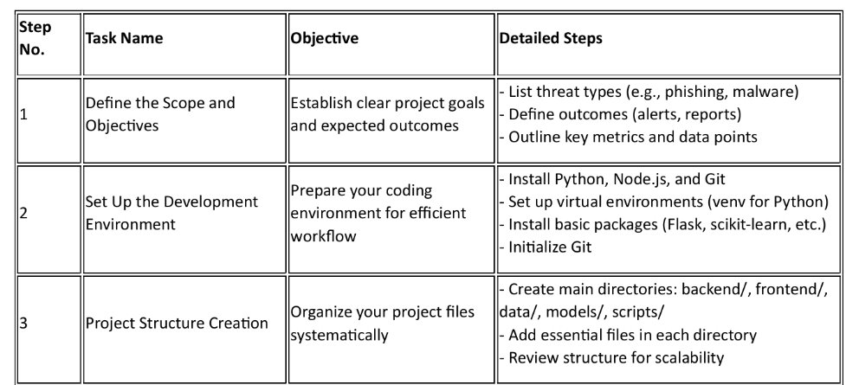
Project Steps
Table: 02 (Project Steps)

Slide 10
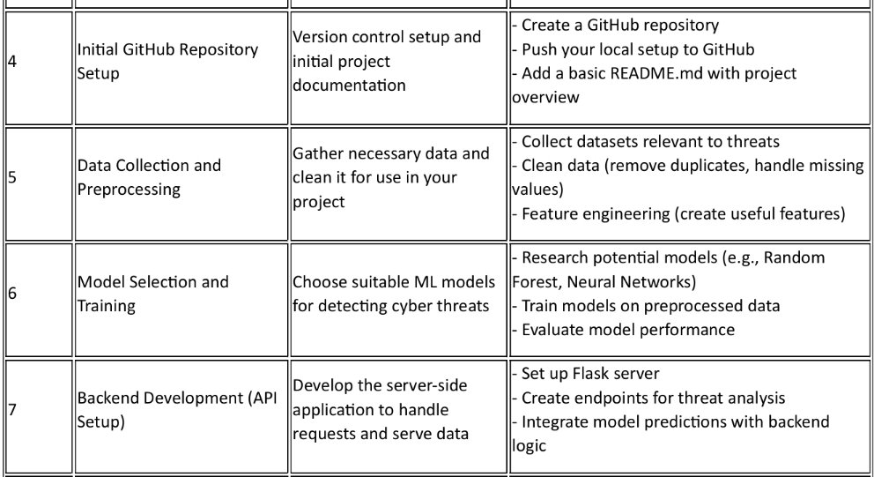

Slide 11
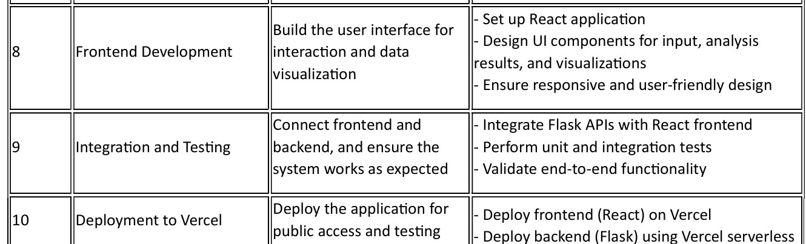
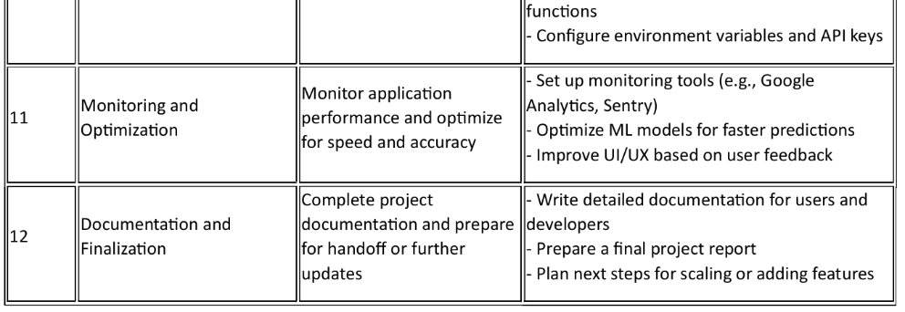

Slide 12
Incident Data Sources
User
Flow Chart of Project
Data ingestion and Processing (scraping)
Scrapes data from from external source
Store incident data in incident database
Incident Management Process
Processes incidents
Classifies incident using ML model
Stores processed incidents in incident DB
Machine Learning Model
Analyzes & classifies incidents
Provide predictions or severity
Incident Database
User Database
Report Generation Process
Generates reports for users
Stores reports in report database
Report Database

Slide 13
Algorithms used in your Cyber Incident Monitoring and Threat Analysis
Machine Learning Algorithms
Algorithms | Purpose | Why
Random Forest, Support Vector Machine (SVM) | Detect malicious or threatening content | Allow to identify diverse threats.

Slide 14
Algorithms | Purpose | Why
Natural Language Processing (NLP) Algorithms | Perform advanced NLP tasks like sentiment analysis | Understanding contextual nuances in text and identifying complex patterns.
14
14

Slide 15
Algorithms | Purpose | Why
Machine Learning model / TextBlob | Determine the sentiment of a post or comment (e.g., positive, neutral, negative). | Helps assess public mood and identify potentially harmful content.
15

Slide 16
Conclusion & Future work
The National Critical Information Infrastructure Protection Centre (NCIIPC) plays a critical role in safeguarding the country's infrastructure against cyber threats, aiming to enhance resilience and minimize risks to national security and economy. As cyber-attacks become more sophisticated and pervasive, it is crucial for national security organizations to stay ahead of these threats.
The goal of the project is to provide a solution that offers real-time feeds of cyber incidents occurring within Indian cyberspace, ensuring timely detection, analysis, and response.
By leveraging data from multiple social media platforms, this tool will provide insights into cyber incidents that may not be detected by traditional methods, such as malware attacks or phishing campaigns.
The integration of machine learning models for analysis, alongside social media monitoring, will allow the system to detect emerging threats and patterns of malicious activities in real-time.
This project also helps bridge the gap between national cybersecurity goals and localized, actionable intelligence, contributing significantly to proactive defense strategies.
The capability of the tool to aggregate data from multiple sources and provide actionable insights makes it a valuable asset for national cybersecurity efforts, aligning well with the objectives of organizations like NCIIPC.

Slide 17
Future Work
Enhanced Threat Detection Models:
Develop more sophisticated machine learning and deep learning models, such as Transformer-based architectures, for more accurate threat detection and classification.
Integration with National Frameworks:
Collaborate with national organizations like NCIIPC to integrate this system into existing cybersecurity frameworks, ensuring its application at a broader scale.
Real-Time Threat Response:
Implement automated threat response mechanisms that can neutralize threats as they are detected, reducing the time window for exploitation.
Cross-Border Threat Analysis:
Extend the system to monitor global cyber trends and identify cross-border threats, fostering international collaboration on cybersecurity.
Dynamic Risk Assessment:
Introduce a dynamic risk assessment module to quantify the severity and potential impact of identified threats, enabling more targeted interventions.
Scalability and Adaptability:
Expand the platform to include additional social media platforms, data sources, and threat vectors, ensuring adaptability to evolving challenges.
Public Awareness and Reporting:
Develop user-friendly dashboards and reporting mechanisms to empower organizations and individuals to understand and respond to threats effectively.

Slide 18
References
Mohammad, I., Pandey, R., & Khatoon, A. (2014). A Review of types of Security Attacks and Malicious Software in Network Security. International Journal of Advanced Research in Computer Science and Software Engineering (IJARCSSE), 4(5)
Conteh, N. Y., & Schmick, P. J. (2021). Cybersecurity risks, vulnerabilities, and countermeasures to prevent social engineering attacks. In Ethical hacking techniques and countermeasures for cybercrime prevention (pp. 19-31). IGI Global.
Kingsley David Onyewuchi Ofoegbu1, Olajide Soji Osundare2, Chidiebere Somadina Ike3, Ololade Gilbert Fakeyede4, & Adebimpe Bolatito Ige5. Real-Time Cybersecurity threat detection using machine learning and big data analytics: A comprehensive approach.
Chio, C., & Freeman, D. (2018). Machine learning and security: Protecting systems with data and algorithms. O'Reilly Media.
Cheng, X., Wu, X., & Zhang, Y. (2021). Big data analytics for cybersecurity: A survey. IEEE Access, 9, 980-995.

Slide 19
Chen, X., Li, Y., & Wang, Y. (2023). Enhancing cybersecurity through machine learning and artificial intelligence: A survey of applications, challenges, and future directions. Journal of Computer Security, 98, 102452.
Yadav, V. (2020). A Study of Threats, Detection and Prevention in Cybersecurity. International Research Journal of Engineering and Technology (IRJET), May, 1150-1153.
ao R. S., Pais A. R.: Detection of phishing websites using an efficient feature-based ma chine learning framework. Neural Computing and Applications (2019), pp. 3851-3873, Springer, (2019).

Slide 20
THANK YOU !

