Slide 1
New Fitness center in Paris (The battle of neighborhoods)
Author: Rodica Militaru
Date: November 22, 2019

Slide 2
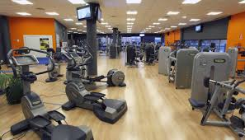
Introduction/Business Problem
Paris is the capital of France and its largest city. Well known for its cuisine, art and fashion, its economic and cultural life is flourishing.
It is the most crowded city in Europe and one of the most important political and educational centers in EU.
People are living well, but what are they doing in order to maintain their health?
The question this project aims to answer is: where, in Paris, would be the best place to open a fitness center?

Slide 3
Data
Paris has 20 boroughs, each with 4 neighborhoods. We will try to identify the place for a new gym based on the density of population and the number of gyms in each area.
This will be our starting point to finally identify the most appropriate place to open a gym.
The data for this project will be taken from 2 sources:
- a wikipedia page: https://en.wikipedia.org/wiki/Quarters_of_Paris with info about the population in each neighborhood;
- a file from the French government with latitude and longitude of each neighborhood: https://www.data.gouv.fr/en/datasets/quartiers-administratifs

Slide 4
Methodology
We will use pandas, folium, heatmaps and foursquare to identify the already existing gyms.
First, we will process the two files, in order to be able to merge them.
Secondly, we will get the information about the gyms from foursquare and place it into a new dataframe.
Thirdly, we will merge this dataframe with the previous one, keeping only the necessary information.
The next step is to use the describe function to find the mean for population and gyms.
Once this is done, we will drop from our dataframe the values: less than mean for population and greater than mean for gyms and we will generate a heatmap showing the best places to open a gym.

Slide 5
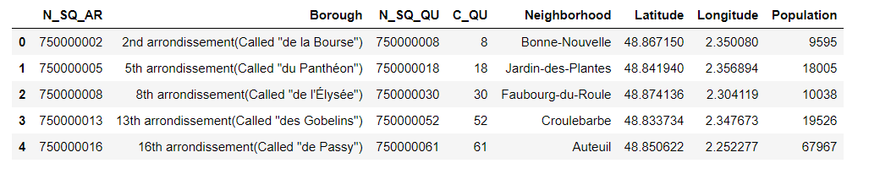
We have now the neighborhoods, population, latitude and longitude, all in one table.
The table used to find the info we need looks like this:

Slide 6
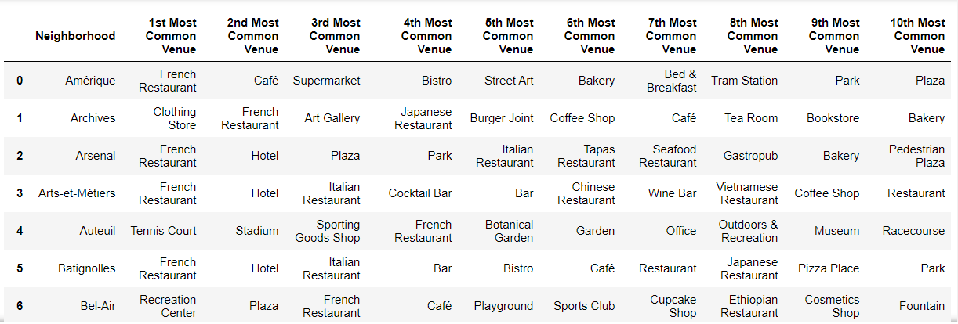
The first info I get is not very encouraging or it is very encouraging, depending on how you look at the situation: gyms are not too present in top 10 venues of Paris’s neighborhoods. This could mean that either French people are not very fond of sport or that there are not enough investments in this area yet.

Slide 7
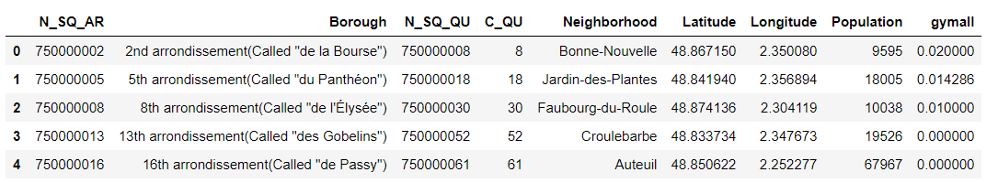
Finally, I created a new dataframe with all the info, merging the previous table with the information regarding the gyms from foursquare:

Slide 8
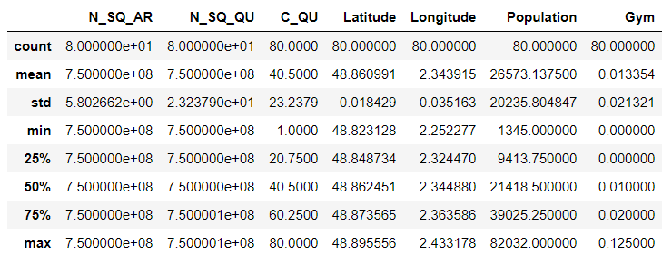
Now, we are able to see the general statistics in the dataframe:

Slide 9
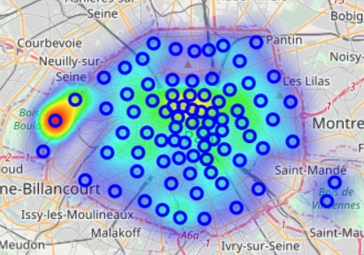
It is now clear that our area of interest in Paris will be reduced to those neighborhoods with a population of more than 26573 (the mean) and a Gym value of less than 0.013 ( the mean).
The initial heatmap of Paris was this:

Slide 10
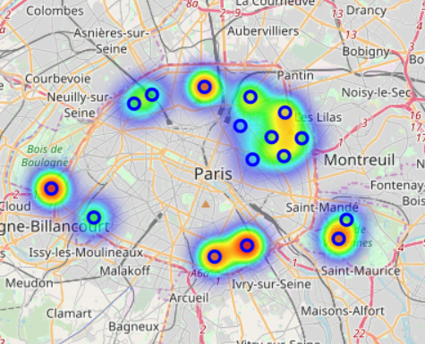
Results
After eliminating the neighborhoods with a small number of inhabitants and a high number of gyms, the new map was this:

Slide 11
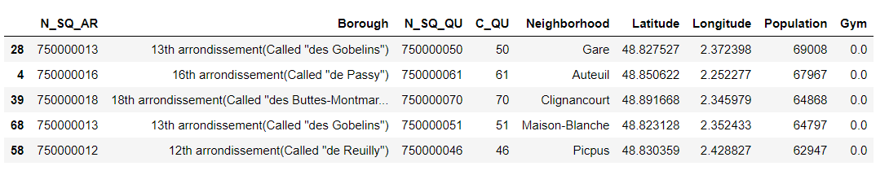
According to the map, we have 16 potential neighborhoods were new gyms can be opened, and the top 5 neighborhoods that could be good options are in the boroughs 12,13,16,18:

Slide 12
Discussion
Based on the number of population and number of gyms, we identified 16 potential neighborhoods were gym can be opened, out of which 5 seem to be best options.
However, this research is very limited, as the information for population is old (1999) and it only takes into account 2 parameters. For the necessary space for the gym, a rent will have to be paid, so the average rent in every neighborhood is definitely an important factor in making a decision, as many areas of Paris are very expensive. At the time of this research, we didn’t have any information regarding the average rent.
Also, the small number of gyms is a red flag for me; maybe a deeper analysis is needed to identify why this happens. Maybe the French people don’t train too much, so a gym could be a bad investment.

Slide 13
Conclusion
We identified 5 best options for a new gym in Paris: Gare, Auteuil, Clignancourt, Maison-Blanche and Picpus. They have a large number of inhabitants and no gyms, so the potential is unlimited.
A final decision should be taken, however, after consulting the average rent in every neighborhood.

