Slide 1
Expedited Training - SQL
Maciej Fec

Slide 2
Agenda
Introduction
What is SQL
Key Aspects of SQL
Interactive Session
Introduction to Database
Joins
Aggregation
Pivots
Summary
Questions

Slide 3
What is SQL
SQL stands for Structured Query Language
SQL allows for manipulation of Relational Databases
SQL is used by Relational Database Management Systems (RDBMS)
SQL Server
PostgreSQL
MySQL

Slide 4
Key Aspects of SQL
SQL
DQL
DDL
DML
DCL
TCL
SELECT
CREATE
INSERT
GRANT
COMMIT
ALTER
UPDATE
REVOKE
ROLLBACK
DROP
DELETE
SAVEPOINT

Slide 5
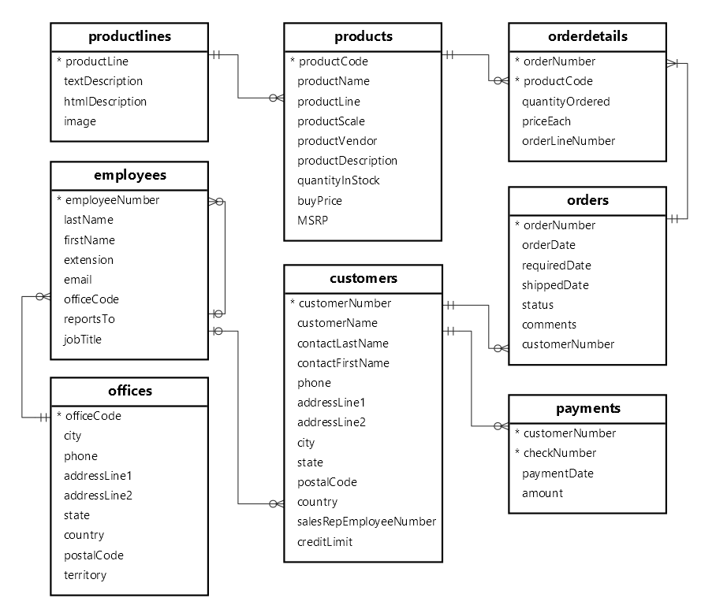
Introduction to Database
MySQL Sample Database
Mimics an online toy vehicle models store/supplier

Slide 6
Joins
Inner Join
Outer Joins
Cross Join

Slide 7
Inner Join
id | name | address
1 | Sally | 33/4 Fake Street
2 | Ben | 122 Fake Avenue
3 | Adam | 91 Fake Place
4 | Steve | 1/2 Even Faker Street
id | name | address
2 | Ben | 122 Fake Avenue
4 | Steve | 1/2 Even Faker Street
id | customer_id | order_date
412 | 2 | 23/11/2023
413 | 4 | 23/11/2023
id | customer_id | order_date
412 | 2 | 23/11/2023
413 | 4 | 23/11/2023

Slide 8
Outer Joins
Left Join
Right Join
Full Outer Join

Slide 9
Left Join
id | name | address
1 | Sally | 33/4 Fake Street
2 | Ben | 122 Fake Avenue
3 | Adam | 91 Fake Place
4 | Steve | 1/2 Even Faker Street
id | name | address
1 | Sally | 33/4 Fake Street
2 | Ben | 122 Fake Avenue
3 | Adam | 91 Fake Place
4 | Steve | 1/2 Even Faker Street
id | customer_id | order_date
NULL | NULL | NULL
412 | 2 | 23/11/2023
NULL | NULL | NULL
413 | 4 | 23/11/2023
id | customer_id | order_date
412 | 2 | 23/11/2023
413 | 4 | 23/11/2023
414 | 7 | 24/11/2023

Slide 10
Right Join
id | name | address
1 | Sally | 33/4 Fake Street
2 | Ben | 122 Fake Avenue
3 | Adam | 91 Fake Place
4 | Steve | 1/2 Even Faker Street
id | name | address
2 | Ben | 122 Fake Avenue
4 | Steve | 1/2 Even Faker Street
NULL | NULL | NULL
id | customer_id | order_date
412 | 2 | 23/11/2023
413 | 4 | 23/11/2023
414 | 7 | 24/11/2023
id | customer_id | order_date
412 | 2 | 23/11/2023
413 | 4 | 23/11/2023
414 | 7 | 24/11/2023

Slide 11
Full Outer Join
id | name | address
1 | Sally | 33/4 Fake Street
2 | Ben | 122 Fake Avenue
3 | Adam | 91 Fake Place
4 | Steve | 1/2 Even Faker Street
id | name | address
1 | Sally | 33/4 Fake Street
2 | Ben | 122 Fake Avenue
3 | Adam | 91 Fake Place
4 | Steve | 1/2 Even Faker Street
NULL | NULL | NULL
id | customer_id | order_date
NULL | NULL | NULL
412 | 2 | 23/11/2023
NULL | NULL | NULL
413 | 4 | 23/11/2023
417 | 7 | 24/11/2023
id | customer_id | order_date
412 | 2 | 23/11/2023
413 | 4 | 23/11/2023
417 | 7 | 24/11/2023

Slide 12
Cross Join
id | name | address
1 | Sally | 33/4 Fake Street
1 | Sally | 33/4 Fake Street
2 | Ben | 122 Fake Avenue
2 | Ben | 122 Fake Avenue
3 | Adam | 91 Fake Place
3 | Adam | 91 Fake Place
4 | Steve | 1/2 Even Faker Street
4 | Steve | 1/2 Even Faker Street
id | customer_id | order_date
412 | 2 | 23/11/2023
413 | 4 | 23/11/2023
412 | 2 | 23/11/2023
413 | 4 | 23/11/2023
412 | 2 | 23/11/2023
413 | 4 | 23/11/2023
412 | 2 | 23/11/2023
413 | 4 | 23/11/2023
id | name | address
1 | Sally | 33/4 Fake Street
2 | Ben | 122 Fake Avenue
3 | Adam | 91 Fake Place
4 | Steve | 1/2 Even Faker Street
id | customer_id | order_date
412 | 2 | 23/11/2023
413 | 4 | 23/11/2023

Slide 13
Joins Summary
1
2
Inner Join
Left Join
Full Outer Join
1
1
1
2
1
1
2
1
3
4
1
3
4
Cross Join
1
1
1
2
2
2
1
3
4
1
3
4
Right Join
1
1
3
4

Slide 14
Aggregation
AVG (Average)
COUNT (Count)
MAX (Maximum)
MIN (Minimum)
SUM (Sum)
GROUP_CONCAT (Group Concatenation)
id | date | amount
1 | 01/12/2023 | 24.99
2 | 10/01/2024 | 10.99
3 | 24/01/2024 | 31.49
4 | 02/02/2024 | 2.99
average | maximum | minimum | sum
17.62 | 31.49 | 2.99 | 70.46

Slide 15
Pivots
PostgreSQL vs SQL Server vs MySQL
Problem Statement
MySQL Solution

Slide 16



Pivots
PostgreSQL
SQL Server
MySQL
No built-in function for pivots out of the box but installing the tablefunc extension allows for using the crosstab function to create pivot tables.
Provides PIVOT and UNPIVOT functions to create pivot tables.
No built-in function for pivots.

Slide 17
Problem Statement
productLine | productScale | total models
Classic Cars | 1:10 | 3
Classic Cars | 1:12 | 6
Classic Cars | 1:18 | 18
Classic Cars | 1:24 | 11
Motorcycles | 1:10 | 3
Motorcycles | 1:12 | 1
Motorcycles | 1:18 | 2
Motorcycles | 1:24 | 3
Motorcycles | 1:32 | 3
Motorcycles | 1:50 | 1
Planes | 1:18 | 1
Planes | 1:24 | 4
Product Line | Scale 1:10 Total Models | Scale 1:12 Total Models | Scale 1:18 Total Models | Scale 1:24 Total Models | Scale 1:32 Total Models | Scale 1:50 Total Models | Scale 1:72 Total Models | Scale 1:700 Total Models
Classic Cars | 3 | 6 | 18 | 11 | 0 | 0 | 0 | 0
Motorcycles | 3 | 1 | 2 | 3 | 3 | 1 | 0 | 0
Planes | 0 | 0 | 1 | 4 | 0 | 0 | 3 | 4

Slide 18
Summary
Introduction
What is SQL
Key Aspects of SQL
Interactive Session
Introduction to Database
Joins
Aggregation
Pivots

Slide 19
Questions?

