Slide 1
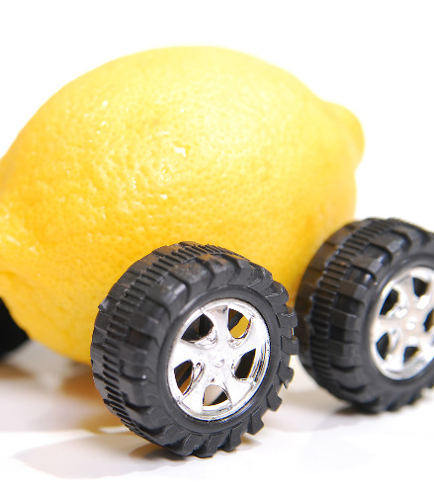
What makes a car a ‘lemon’?
Michalina Cieślak, Maciej Świtała
Machine Learning 2, final project: classification, big dataset

Slide 2


Agenda
4. Choosing the ‘best’ model
5. Investigation
3. Estimating different models
2. Exploratory data analyses
1. Issue & motivation

Slide 3


1. Issue & motivation
Predicting if a car purchased at auction was crashed before
Information asymmetry (G. Akerlof, The Market for Lemons: Quality Uncertainty and the Market Mechanism)
Analysis from different authors (e.g. O. F. Domejean, Data Science with Kaggle’s Competition „Don’t Get kicked!”)

Slide 4
2. Exploratory data analyses (1/4)
Dataset comes from: https://www.kaggle.com/c/DontGetKicked/overview
72 983 rows x 34 columns
Variables: purchase’s date, vehicle’s age, model, color, size, price…
Columns with >25% share of NAs removed, in case of remaining NAs – removing rows
Continuous variables highly correlated, still we use it
Categorical variables recoded (at most 15 levels; no levels with <1% share)

Slide 5
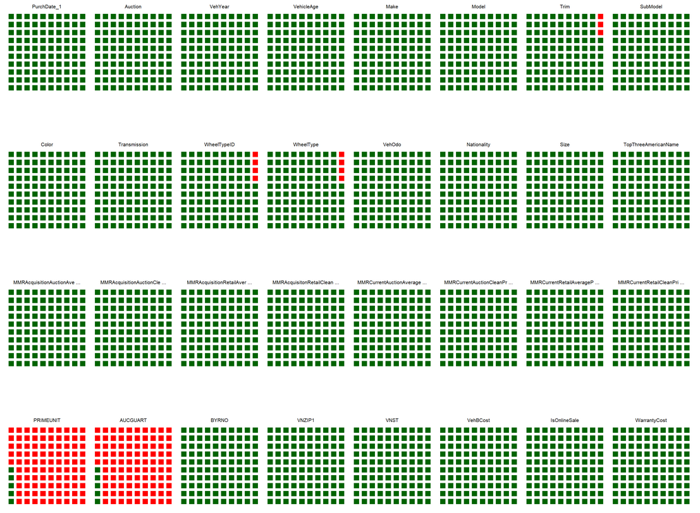
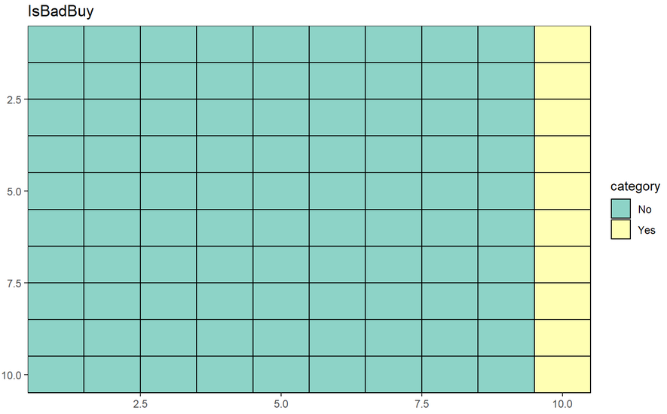
2. Exploratory data analyses (2/4)
^ Missing values; each waffle plot depicts one variable; each cell is 1% of variable’s values; red color means missing values; two almost empty columns – omitted in further analysis
^ Waffle plot describing distribution of the dependent variable’s levels; 10% of purchases were previously crashed cars

Slide 6
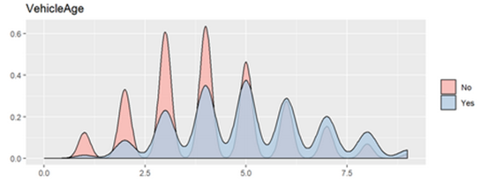
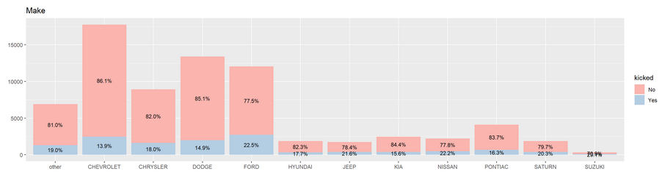
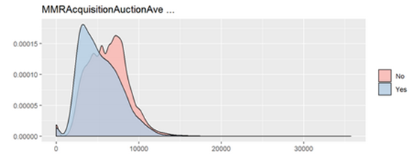
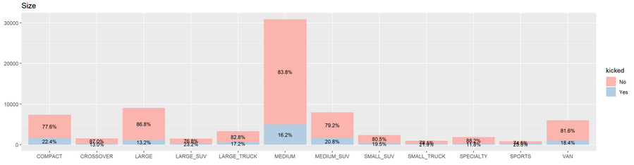
2. Exploratory data analyses (3/4)
^ Conditional density plots & stacked barplots for most promising variables; seems that vehicle’s age, price, maker and size are most important for being crashed before auction

Slide 7
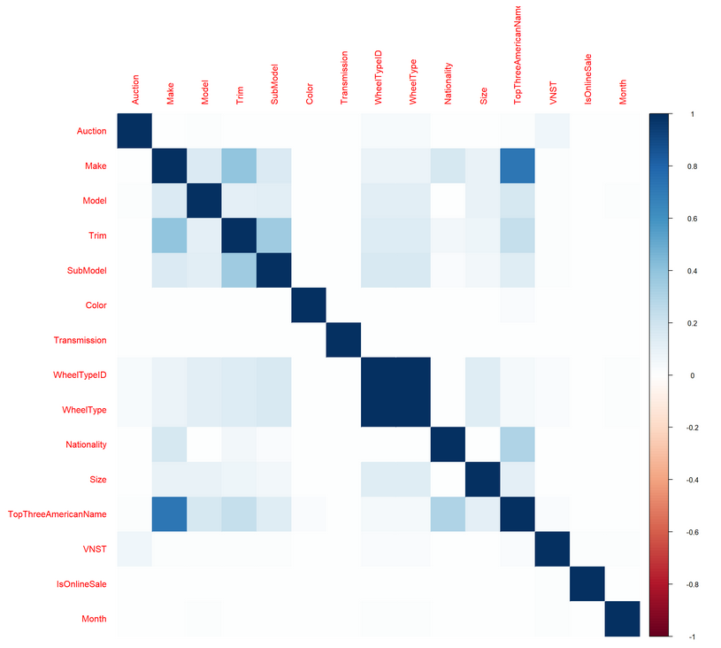
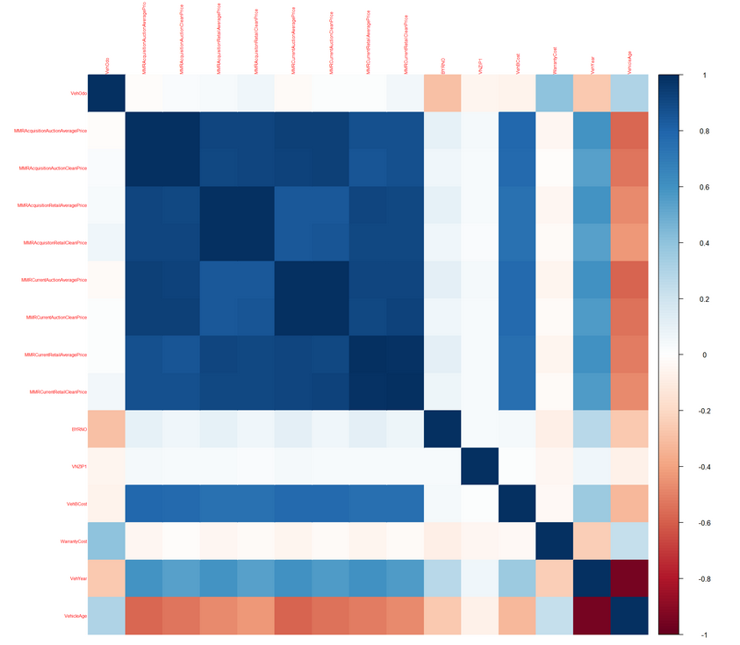
2. Exploratory data analyses (4/4)
^ Correlations for continuous variables (Pearson’s measure); price and age highly correlated
^ Correlations for categorical variables (Goodman/Kruskal’s measure)

Slide 8
3. Estimating different models - assumptions
Train : test ~ 60 : 40
Stratified sampling
5-folds-cross-validation in grid search
AUC metric used for measuring models’ performance

Slide 9
3. Estimating different models - assumptions
Logistic regression
Correlated variables were removed
One-hot-encoding
Decision tree
Reasonably chosen parameters
Random forest
Parameters mtry, ntree optimalized using grid search
Extreme gradient boosting
Multiple parameters optimalized using grid search
Should cope with correlated variables; one-hot-encoding seems to be unnecessary.

Slide 10
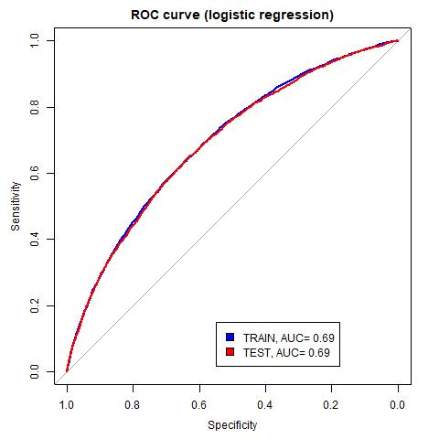
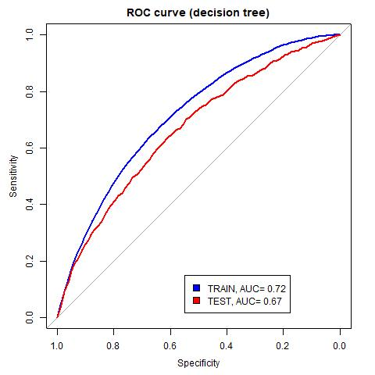
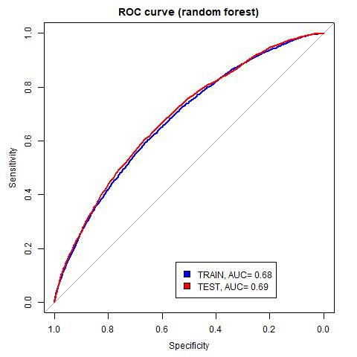
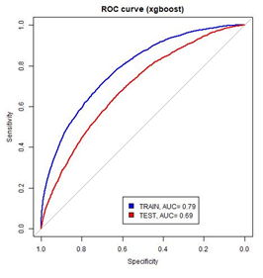
4. Choosing the ‘best’ model
Logistic regression | Decision tree | Random forest | XGBoost
AUC (train) = 0.69 | AUC (train) = 0.72 | AUC (train) = 0.68 | AUC (train) = 0.79
AUC (test) = 0.69 | AUC (test) = 0.67 | AUC (test) = 0.68 | AUC (test) = 0.70
O. F. Domejean, Data Science with Kaggle’s Competition „Don’t Get kicked!”) – much worse random forest models; neural nets with similiar performance to our XGBoost; SVM with 0,97 (suspicious, isn’t it?)

Slide 11
5. Investigation – using XGBoost’s results
Feature importance
Accumulated Local Effects (ALE) plots
Enable investigating relationship between the dependent variable and chosen predictor
Here: we have done ALE plots on all the observations from train subset
Show difference in prediction on y-axis
Better than Partial Dependence Plots – no problem with correlated variables since it uses conditional probabilities
For more see: P. Biecek, DALEX: Descriptive mAchine Learning Explanations,
For even more: C. Molnar, Interpretable Machine Learning. A guide for Making Black Box Models Explainable.

Slide 12
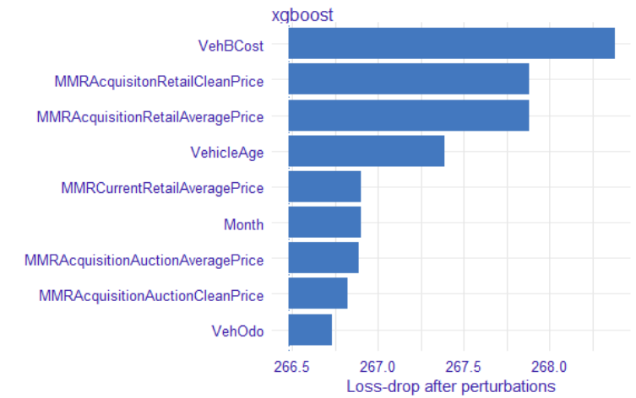
5. Investigation – feature importance

Slide 13
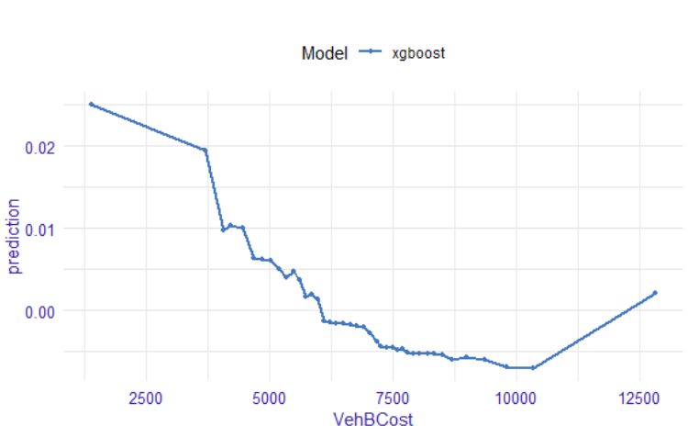
5. Investigation – initial price (ALE plot)
Main conclusion: The higher price, the lower probability of buying a ‘lemon’.

Slide 14
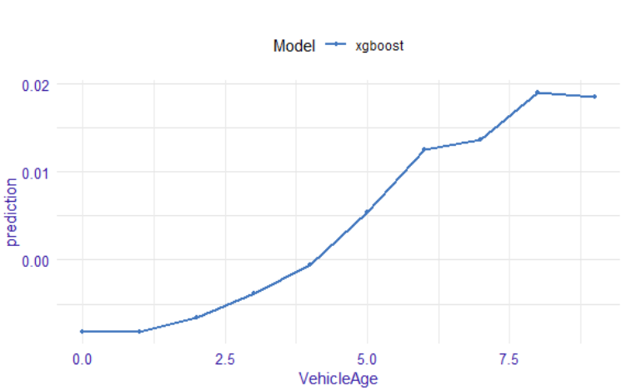
5. Investigation – vehicle age (ALE plot)
Main conclusion: The higher vehicle’s age, the higher probability of buying a ‘lemon’.

Slide 15
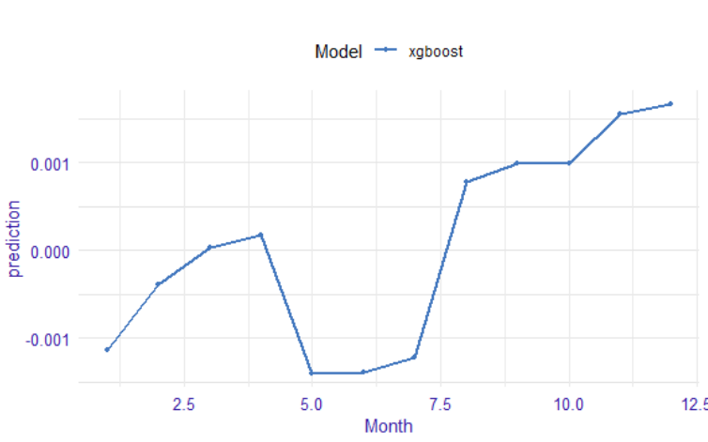
5. Investigation – purchase’s month (ALE plot)
Main conclusion: Buying on May, June, July helps avoiding ‘lemons’.

Slide 16
Further steps
Looking for better performance, we tried:
Running ML models without correlated variables
Normalization of the variables
Creating new variables considering time (e.g. day of month, weekday)
Variables’ transformations (e.g. warranty/price, price variations during auction)
Aggregates (e.g. number of cars bought by the same buyer on one auction, mean price/age of all purchased vehicles etc.)
Resampling (SMOTE algorithm, both over- and under- tried)
We can still try:
Neural nets
SVM

