Slide 1
Oprogramowanie
Systemowe
  Introducing
  eXtensible
  File
  Transfer
  Protocol

Slide 2
Table of contents
Preface
Protocol overview
Implementation
Possible future development

Slide 3
Preface
Current technologies
  FTP
  SFTP
  Other
XFTP as a solution
Why XML
Why SCTP

Slide 4
Current technologies:
FTP
Advantages:
Disadvantages:
Popular, widely used
Implementations for virtually any platform
Easy to implement
Passwords as plain text
Multiple TCP connections are used
High latency
No integrity check on client side
No metadata
VFS unfriendly

Slide 5
Current technologies: SFTP
Advantages:
Disadvantages:
Secure: based on the award winning OpenSSL
Easily routable (one TCP connection)
UNIX metadata
VFS friendly
Low throughput
Portability issues
Interoperability issues
Single correct implementation (difficult to implement)

Slide 6
Current technologies: other (SMB, NFS)
Advantages:
Disadvantages:
Useful for file sharing in local workgroup
High throughput
Relatively low latency
OS-specific low level protocols.
Useless as public file server
Difficult to implement
Security issues

Slide 7
Proposed solution:
XFTP
Advantages:
Disadvantages:
SCTP based (possible throughput boost)
XML based:
  Portable
  Extensible
  Flexible
Optional security
VFS Friendly
Low latency for bulk transfer (stacking many messages in one XML block)
SCTP based (not yet popular technology)
XML based
  Complexity
  Possible performance issues
  Bloated messages (circumvented w/ compression)

Slide 8
Why XML?
Extensibility
  Protocol specification allows usage of extensions (additional metadata, possible encryption, data filters etc) while preserving general XFTP compatibility
Interoperability
  XML processing libraries are widely availble and well documented
  Metadata fields for various operating systems may be supported (due to extensibility)

Slide 9
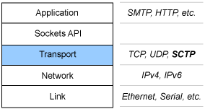
Why SCTP?
Possible performance boost
Mitigation of packet loss effects
Better VFS support due to usage of multiple streams
Initiation protections prevents some DoS attack techniques.
Allows multi-homing for single SCTP association

Slide 10
Protocol Overview
Concept of SCTP stream
Control streams and data streams
Client-server dialogue
Fallback TCP connections

Slide 11
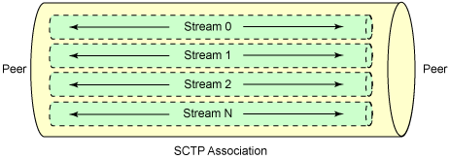
Concept of SCTP Stream
Up to 65536 discrete streams per single connection are available
Usage of multiple streams allows improved concurrency
Figure below describes concept of multiplexed streams.

Slide 12
Control streams and data streams
XFTP differentiates two specific types of streams: data streams and control streams.
Control streams are used to transfer XML XFTP commands and metadata
Data streams are used to transfer raw bytes (i.e. Uploaded files and downloaded files)
XFTP does not specify maximum number of data streams, nor does it specify maximum number of control ones.

Slide 13
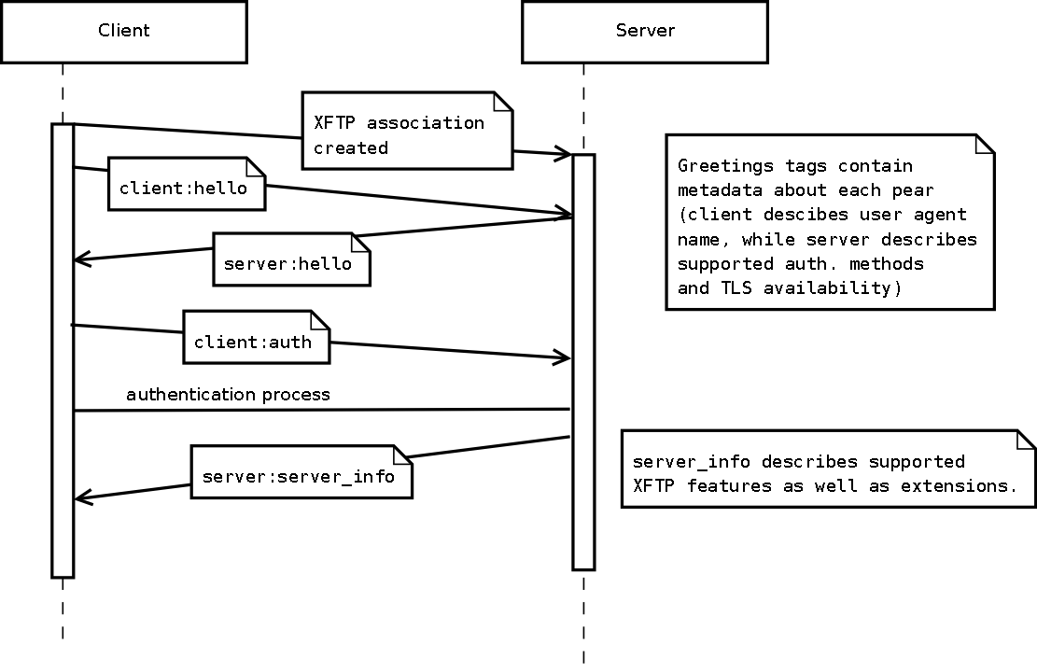
Client-server dialogue
Connection initialization

Slide 14
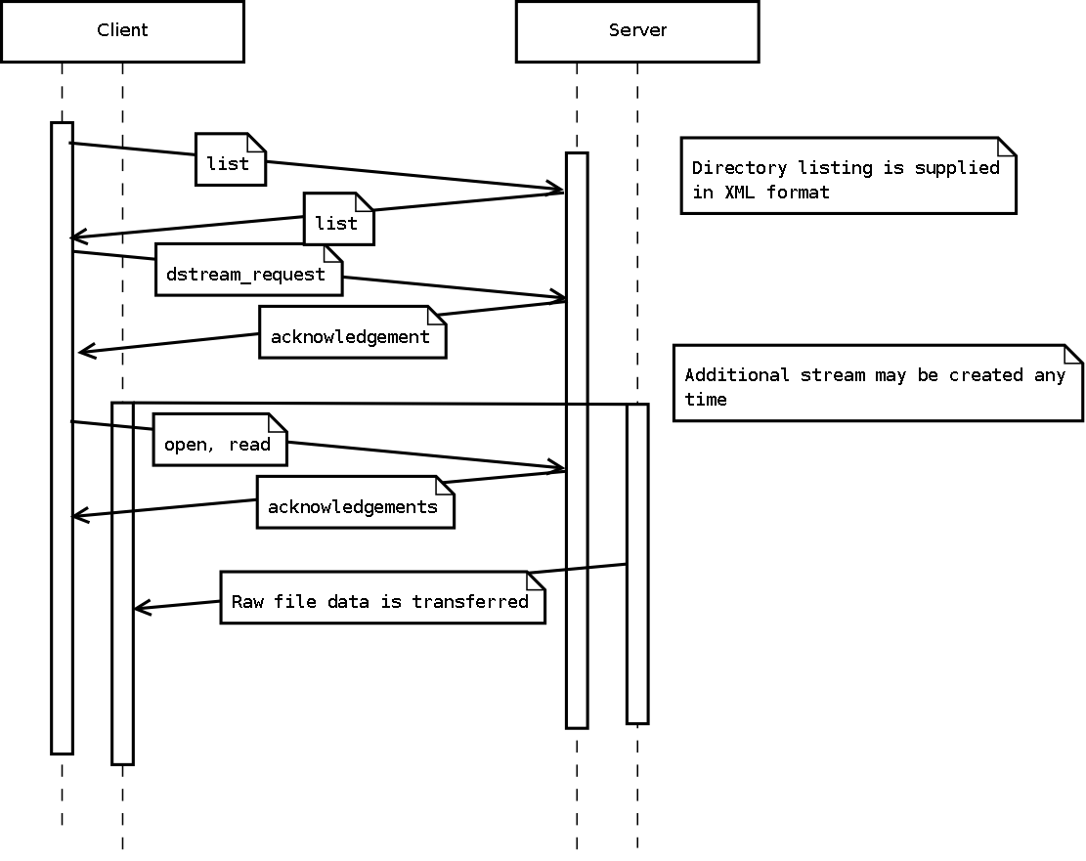
Client-server dialogue
Data transfer example

Slide 15
Fallback TCP Connections
May be used when SCTP routing is not available (i.e. some NAT services)
May be used by OS-es, that do not support SCTP
Generally is portability vs. performance tradeoff
Is not required by XFTP specification
May be implemented via multiplexing streams into single TCP connection

Slide 16
Implementation
State of the art
Program structure
Possible lacks
Code analysis and quality
Dependencies

Slide 17
State of the Art
XML standard compliant
High quality assurance standards
Widely documented
Open source
Largely proof-of-concept implementation (core features available, but other may be missing or low quality)

Slide 18
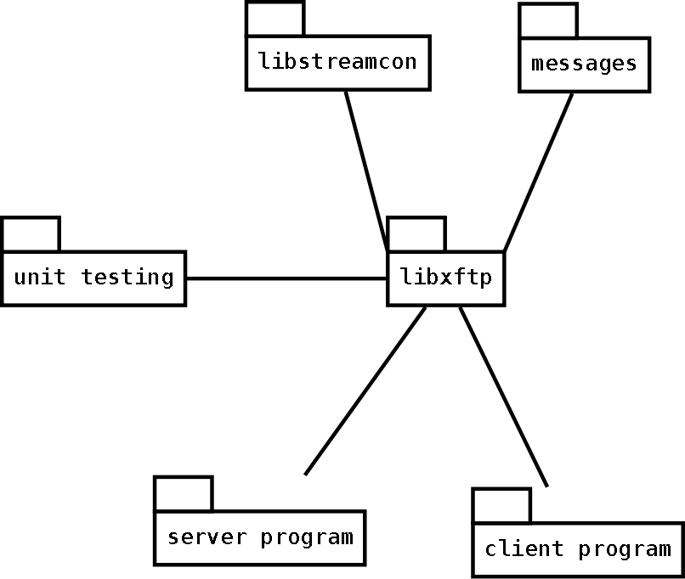
Program structure
XFTP client and server programs
Common code as shared libraries
Unit tests to verify this common code
libxftp based upon
libstreamcon provides
XML based
connectivity
(see subsequent slides)

Slide 19
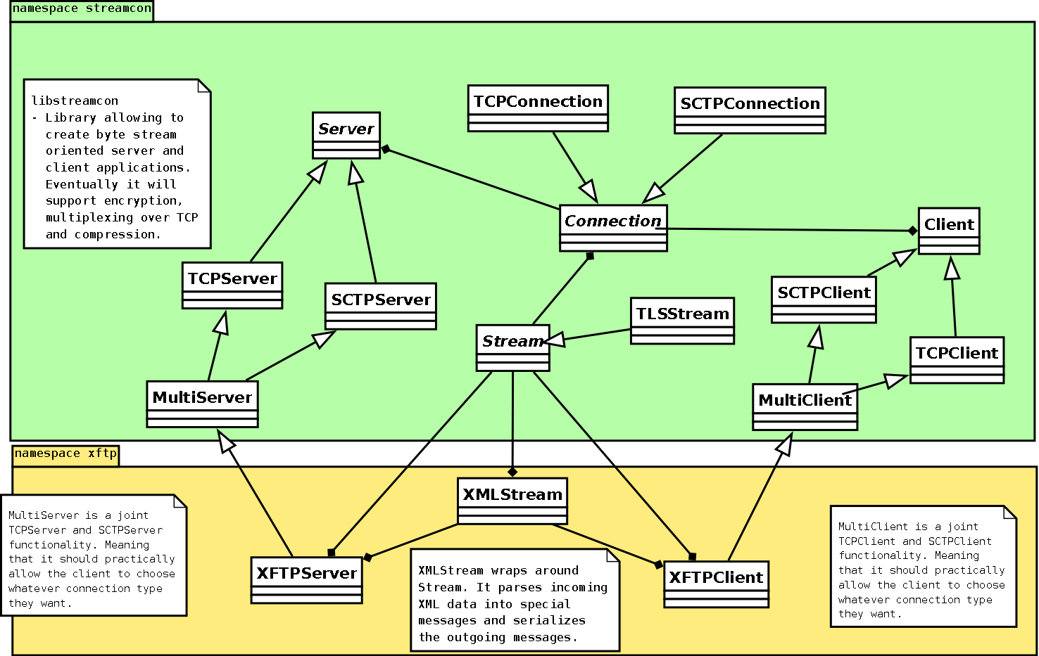
Program structure

Slide 20
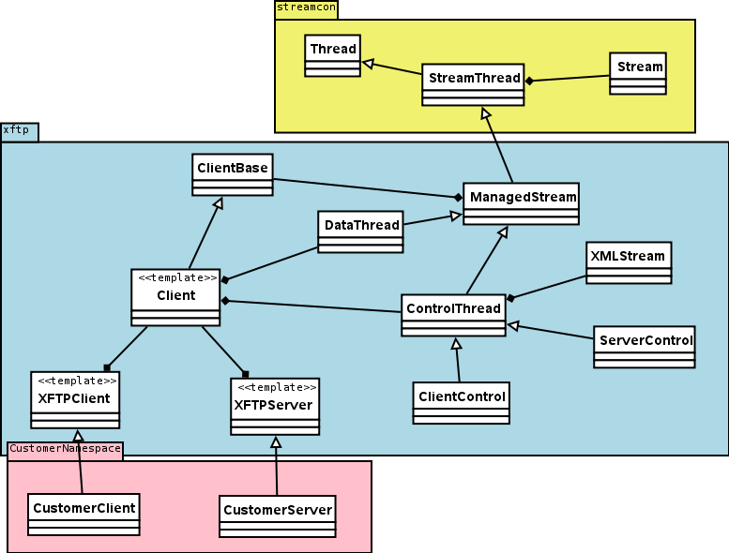
Program structure

Slide 21
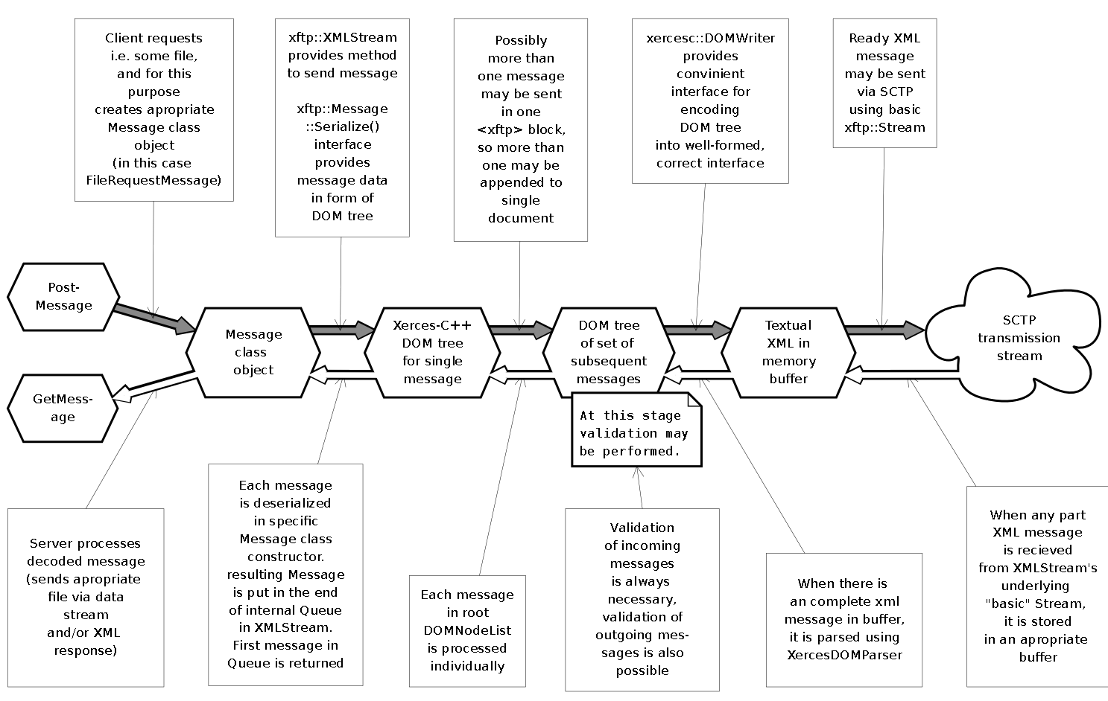
Program structure:
XML processing model

Slide 22
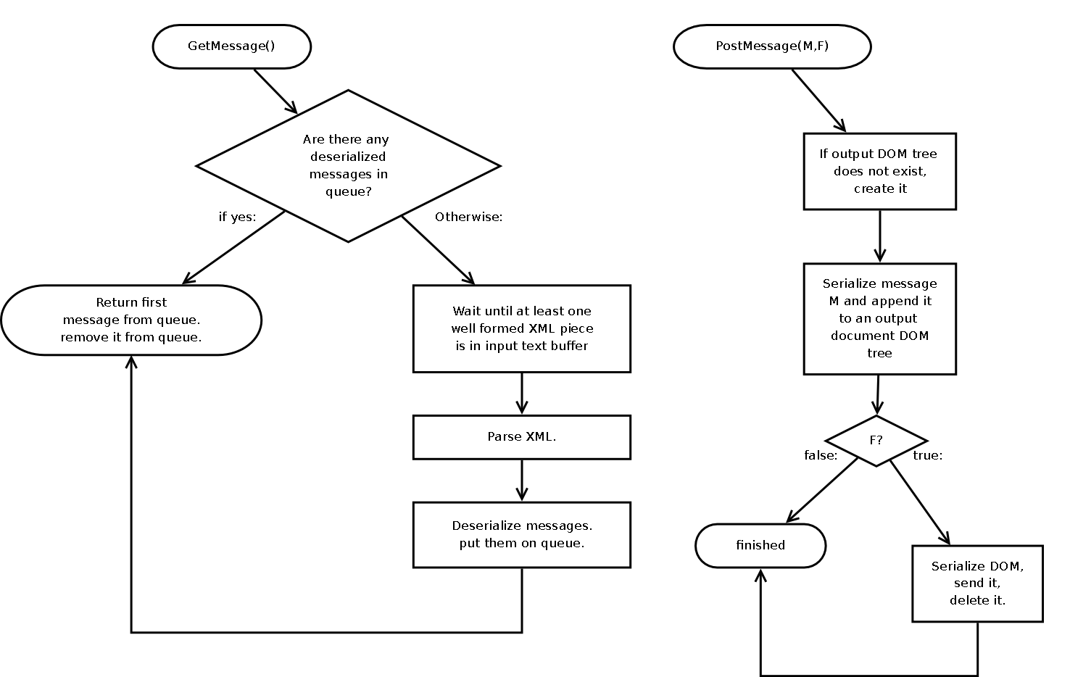
Program structure:
Operations of basic XMLStream subroutines

Slide 23
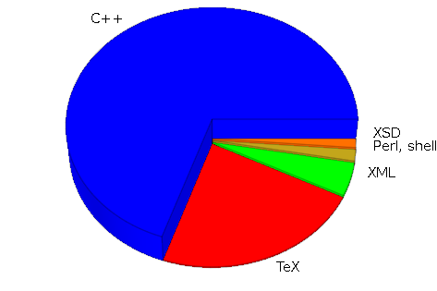
Code Analysis
Program is written mostly in C++
(over 10k lines, 17% comments)
Documentation is stored in TeX files
XFTP examples are
saved as XML files
XML Schemas are
part of the project
So are perl and bash
scripts, that assist
build and testing process

Slide 24
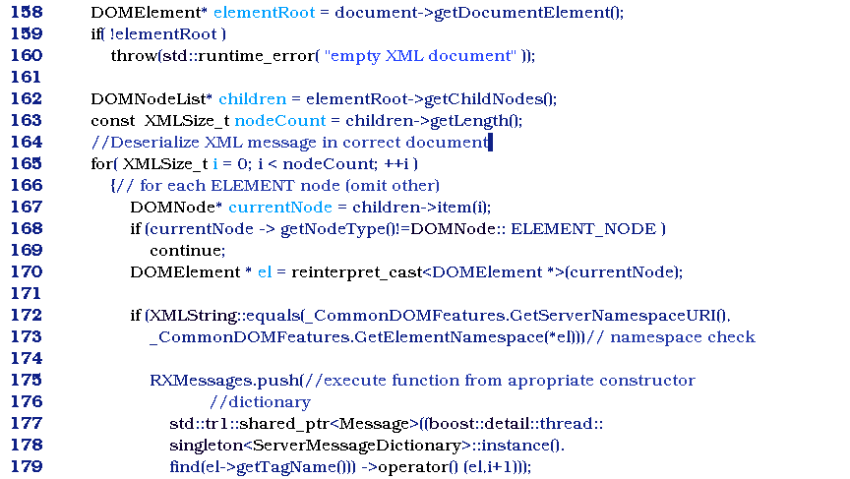
Code example

Slide 25
Dependencies
XFTP programs use many external libraries:
  Apache Xerces XML processor (part of Xalan)
  SCTP API
  Boost C++ libraries (threads, containers, lambda expressions, memory management etc)
  GNU Readline for client program
  Zlib for runtime compression
  OpenSSL for runtime encryption
In consequence:
  We gain quality of established technologies
  We had to develop glue to link all those layers
  Usage of external libraries gave us substantial performance improvements and productivity boost

Slide 26
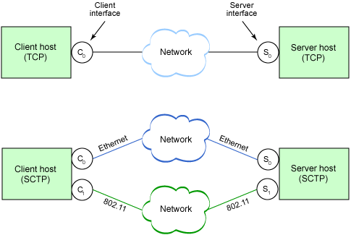
Possible future development
XFTP may be apropriate solution for wide variety of IT applications
Common SCTP implementations will support multi-ho-
ming and provide
significant perfor-
mance boost
XFTP may be
extended to fulfill
new application
requirements

