Slide 1

Komodo Training
Version 1

Slide 2
Introduction
GUI Front end
Components
Run a job
Track a job
Schedule a job

Slide 3
Komodo MI9
Introduction

Slide 4

MI 9 Komodo introduction
The Komodo data load tool is intended to be used by implementation teams to create, update and execute jobs that will load and transform client data. Komodo will provide users with the ability to seamlessly add external resources to meet the needs of complex job design and execution.
Targeted to provide higher performance than Xtelligent
Highly scalable architecture with 32 bit and 64 bit platform support
Easy to use IDE with resizable panels and drag & drop interface

Slide 5
Komodo Documentation
RESOURCE CENTER > Products & Solutions > Mobile Intelligence Suite > Technical Documents > Mobile Intelligence Suite 9 > Final Rel Docs
MI 9 Komodo User Guide
MI 9 Komodo Quick Reference
MI 9 Data Load Quick Reference
DID MI 9
DID_DataTemplate_MI9

Slide 6
Komodo basics
A Komodo project is the container of jobs, shared global resources, global variables and users.
A Komodo job consists of configurable tasks that are added to form the job workflow, tasks are connected to each other with Job task connectors. These connectors act as queues to pass data from one task to another.
Komodo runtime reads the metadata in the repository and executes the job as defined by the user. The metadata of a job provides details about the tasks, the input data a task expects and the output data the tasks will generate. Based on the metadata, Komodo runtime host comes up with a job execution plan.

Slide 7
Komodo Installation for MI
Komodo is included with MI installer, but is not part of MI
Komodo website is installed using Framework setup. The process is exactly the same as setting up MI and Force Admin web sites
Komodo services are installed using Framework setup. The process is exactly the same as setting up other MI services
KomodoHost service must be running
64-bit OS is recommended
Komodo service loads data into the MI database that is associated with the Framework Service running for a MI Client Configuration

Slide 8
Data Requirements
Complete records should be provided for database insert and update operations
Duplicate records should not be in the same data file.
Komodo is multi-threaded. Each database operations is executed in a separate thread. In the case of duplicate records with different operations, the order in which each thread applies the transaction is not guaranteed.

Slide 9
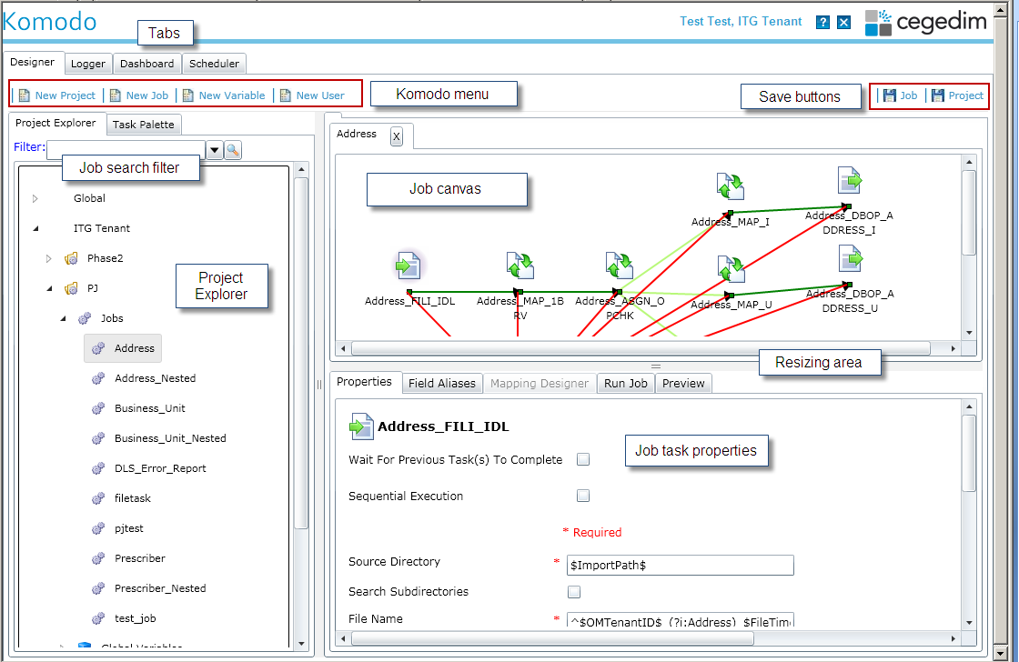
Komodo MI 9

Slide 10
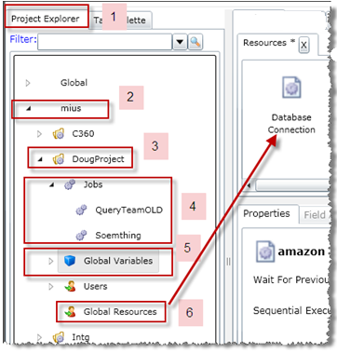
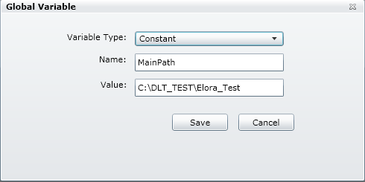
Komodo MI 9 GUI
Project Explorer components
Project Explorer tab
Tenant
Project under tenant
Expanded Jobs in Project
Global Variables
Select, Right click and click Open
Displays: Type, Name and Value
Global Resources – shared at Project level
(Double click to Open the list under the Designer tab in a Resources tab)

Slide 11

Komodo user
Each user will be assigned 1 of 4 permission roles :
Super User
By default the Komodo repository requires one Super User.
Super User credentials are used to create tenant Standard Users and Tenant Administrators. They can run, view and modify all tenants, and corresponding Projects and Jobs in the Project Explorer.
The Super User is created during the Komodo installation.
Tenant Administrator
A Tenant Administrator can view and edit all projects in the tenant they are associated with. They can create new Standard Users and additional Tenant Administrators.
By default they have Write and Run access to all the projects in the tenant.
A Tenant Administrator has Run and read only access to Projects in the “Global” baseline tenant (0), jobs that are submitted will run with Global variable values from the Project level.
It is recommended to create a Tenant Administrator for the baseline Global tenant in addition to the Super User.

Slide 12
Komodo user
Standard User
A Standard User is associated with one tenant and selected projects in that tenant. Selected projects will be assigned Write or Read permission.
A tenant Standard User with Write permission to a specific project can create, modify and Run jobs that belong to that project. With Read permission they can view and Run jobs.
By default they have Run and read only access to the “Global” baseline tenant (0).
Jobs submitted by a user with Read permission will execute with the current Global variable values from the Project level.
Monitoring User
A Monitoring User will have a restricted Komodo display. They will have only the Logger and Dashboard tabs available.
This user type will allow monitoring of jobs in the tenant the user is associated with and the Global tenant, but without the ability to modify, create or Submit jobs.

Slide 13
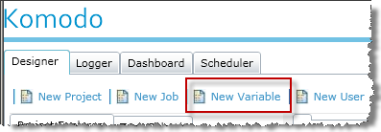
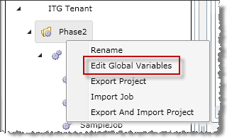
Global Variables
To create a new variable, click on the New Variable icon from the main menu
To open the list of global variables, right click on Project and select Edit Global Variables. With proper permissions you will be able to modify the values assigned.

Slide 14
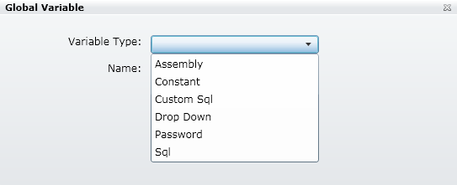
Create a Global Variable
Variable names must be unique at the Project level and are case insensitive.
Note: Project Write permission is required
Select the Variable Type, choices are:
Assembly
Constant
Custom Sql
Drop Down
Password
Sql
Required fields will vary depending on the variable type selected – see list below.
$ is a reserved character and should not be used for values in global variables.

Slide 15
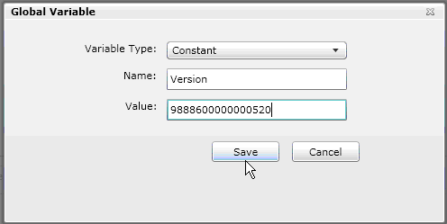
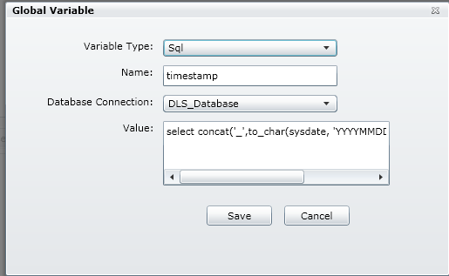
Global variable types
Constant
For a Constant enter a variable Name and Value
(‘ ‘ or “ “ not required for literal value)
Click Save
Sql
Enter
variable Name
Value (SQL statement)
Database Connection (select from a list of Global Resources)
Click Save

Slide 16
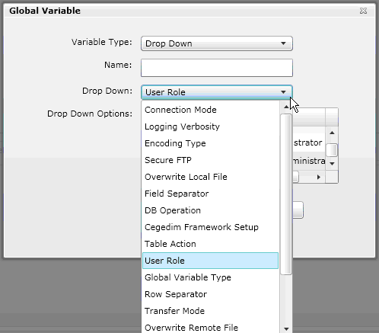
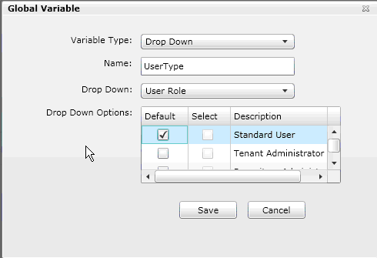
Global variable types cont.
Drop Down
Extensive predefined list of parameters with associated values that, if selected, will display in a drop down control for selection in the Project or Job Schedule form.
Drop Down values are:
Connection Mode
Logging Verbosity
Encoding Type
Secure FTP
Overwrite Local File
Field Separator
DB Operation
Cegedim Framework Setup
User Role
Table Action
Transfer Mode
Global Variable Type
Row Separator
Category Type
DB Vendor
Overwrite Remote File
Escape Character
Text Enclosure
Project User Role
Notes:
The choices in the Drop Down Options are dependent on the Drop Down value selected, click to select the values to display in a drop down list.
Only one value can be selected as the default – if multiple values are selected the last value selected will be the default value after a Save

Slide 17
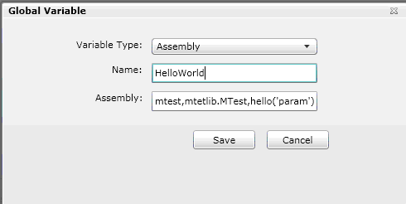
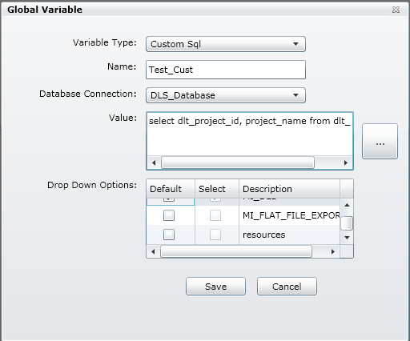
Global variable types cont.
Assembly
Assigns a value based on the result of a function call in the assembly/DLL.
Enter
Descriptive Name
A function call in the Assembly field.
Use the syntax: dllname,Assembly.Type,function(‘parameter’)
Custom SQL
Assigns values based on the result of a SQL statement.
Enter
Descriptive Name
A Database Connection
Value as a valid SQL statement
Click … to execute SQL statement
Result set will populate the Drop Down Options

Slide 18
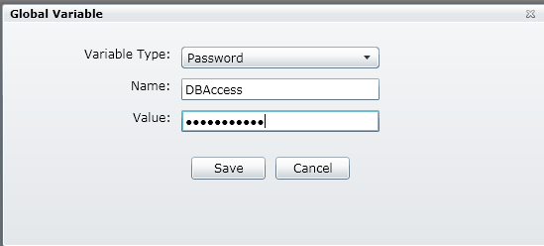
Global variable types cont.
Password
A variable that is a Password type will always have the value assigned to the variable masked .

Slide 19
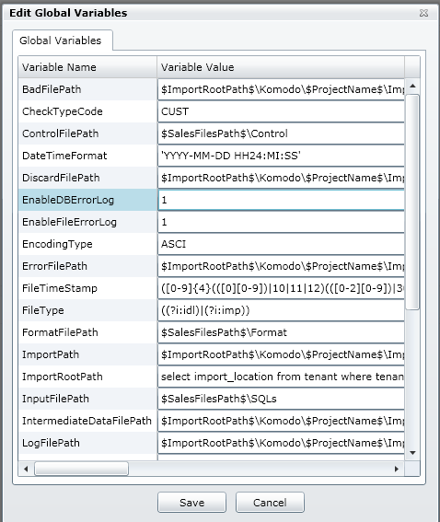
DLT Global variables
There is a list of predefined Global Variables used in the baseline Global tenant jobs that are defined in the MI 9 DID
Part of the Komodo installation process is to update the values of these variables to point to the correct path in Komodo directory structure on the Komodo server
The variables and their default values can be easily displayed, modified and Saved on the Edit Global Variable display at the project level

Slide 20
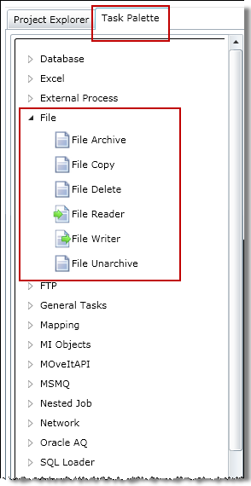
Task Palette
The Task Palette is a logical grouping of all Tasks (plug-ins) that are available to a Komodo user for the creation of a Job.
Tasks are dragged and dropped onto the Job Canvas and initialized by setting the Task properties. With the exception of Global Resources which are dragged onto the Resources tab.
Tasks are arranged by Category within the Task Palette explorer.

Slide 21


Task types
A task can be one of the following 5 types:
Producer : The task generates data that is passed to a target task through a task connector. The task notifies the runtime when it has finished generating data. A producer task should only be connected to a task that accepts data. A condition may be associated with the job task connector, the producer task will only write to the next task if the conditions are met (indicated with different display colors). The connector internally uses a buffered queue which has a maximum limit on the pending records. Once the queue hits the max limit, it will block the produced task from pushing more data into the queue until the count of the pending records fall below the max limit. A File Reader task and Database Reader are examples of producer tasks.
Displayed with the icon.
Consumer : The task waits for data to come from the previous task. It does not return data on successful processing of the data that was received. File Writer and Database Writer are examples of consumer tasks. A Consumer task can be connected to a Producer or a task that acts as Producer and Consumer.
Displayed with the icon.
Notes:
Tasks are the key components in the creation of a job. Komodo runtime reads the metadata in the repository and executes the job as defined by the user. The runtime will start each task simultaneously and run concurrently. Task(s) that should not start before certain tasks have completed should have the Wait for Previous Task(s) to Complete option selected, this will force sequential execution.
A connector to a task with the “Waiting for previous task to complete” flag on will transfer execution control to the linked task (as a Phase)

Slide 22



Task types
Both: The task accepts data and returns data upon successful processing, acting as a Producer and Consumer task. A Mapping task is an example of this type of task. This task can be connected to a Producer task.
Displayed with the icon.
Neither: The task does not need any data and will not pass any data via connectors. Examples of these are File Copy and FTP Get. As these task do not need any data , they typically have the Wait for Previous Task to Complete flag set.
Displayed with the icon.
Resource: This is a special type of task, it is used as a resource in property parameters by the above task types. They cannot be part of a job but are defined in Global Resources with a Project level scope. Examples of resources are Database Connection and FTP Connection.
Displayed with the icon ( dragged into the Resource’s canvas not the Job Canvas)

Slide 23
Designer tab
The Designer tab contains a Job Canvas Panel for each Job. This is the staging area for all tasks that make up the Job.
Users drag and drop individual Tasks from the Task Palette explorer onto the job canvas, connectors are used to join relevant tasks to create a continuous job workflow.
Task names default to the task type, they should be changed to a unique, descriptive name.
Tasks and connections can be removed from the workflow.
Unsaved changes to a job workflow are indicated with an * asterisk in the job tab.
Multiple jobs can be opened and edited at the same time, indicated by multiple job tabs.
Notes:
Note: just moving a task – which changes the X & Y coordinates will flag the job as * changed – requiring a save

Slide 24
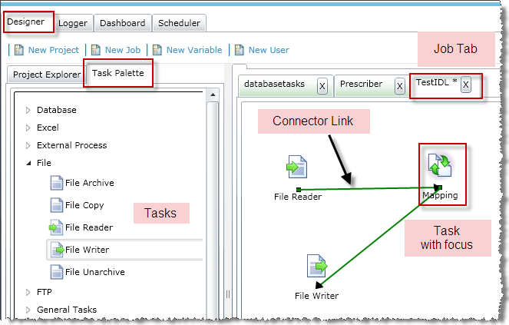
Designer tab
Notes:
Note: just moving a task – which changes the X & Y coordinates will flag the job as * changed – requiring a save

Slide 25
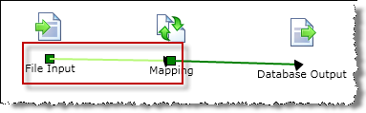
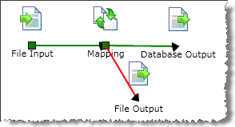
Job Task Connector condition
A Connector Link with a Success result type condition associated with it will be displayed in Light Green
A Failure result type condition associated with a connector will be displayed in Red

Slide 26
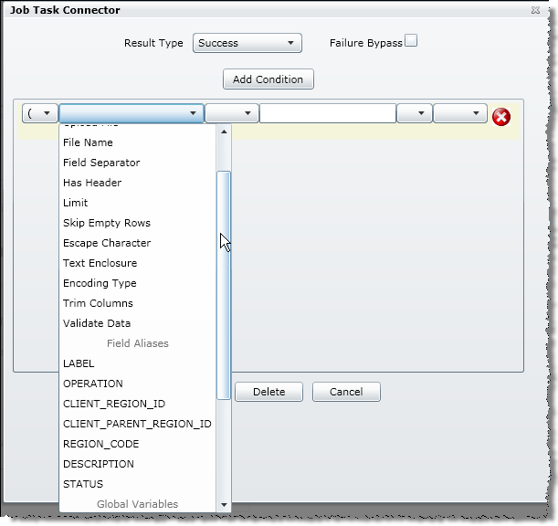
Create a Job Task Connector condition
Select the Result Type:
Success – normal data processing
Failure – exception, data errors
Select Failure Bypass to continue processing even if this task fails
Build the flow conditional test that defines the input file condition, this determines the processed record’s flow.
Use the following form controls
Compare Field
Condition Type
Compare To
Logical Operator
Precedence

Slide 27
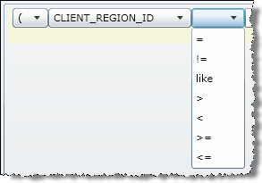
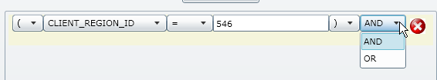
Create a Job Task Connector condition- cont.
Compare Field:
The output field to compare. Must be a valid output alias name.
Condition Type:
Equal to, not equal to, greater than, less than, greater than or equal to, less than or equal to, like
Compare To:
Value to compare against. Can be any literal value.
Categories for Compare Field are:
Properties
Field Aliases
Global Variables

Slide 28
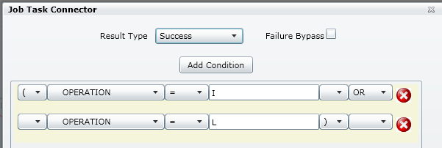
Create a Job Task Connector condition- cont.
Precedence:
Begin ‘(‘ or End ‘)’. Indicates a priority set of conditions to run. Nested levels of precedence are not supported.
Logical Operator:
AND, OR
Click Add Condition to add another conditional test (for AND or OR)
Click to delete a conditional test
Click Save

Slide 29
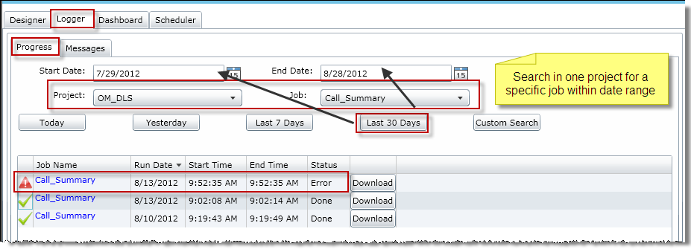
Logger tab
The Logger tab contains a Progress and Messages tab for each submitted job.
The Progress tab displays real-time run statistics for process duration.
The window contains Tenant, Project, Job Name, running time frame, and Status of the run.
Click on the Job Name to open the Messages tab for the job
Notes:
1 Project and 1 Job single click Job name to open in the Messages tab

Slide 30
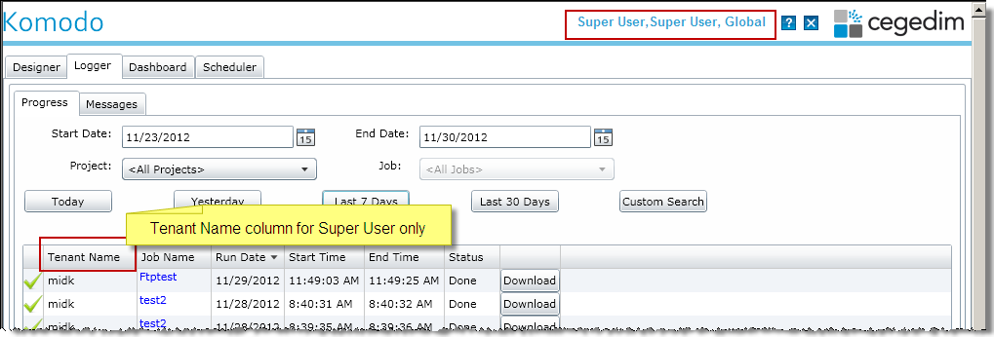
Logger tab
A Super User has an additional Tenant Name column to identify the location of the job.
Notes:
1 Project and 1 Job single click Job name to open in the Messages tab

Slide 31
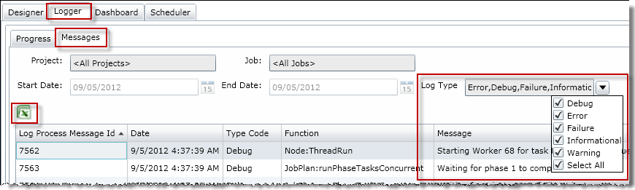
Messages tab
The Messages tab displays the Project, Job Name, running time frame, and Log Messages generated by the run. The Log Process Run Id is the unique identifier of each run.
You select the verbosity to be displayed by selecting one or more of the Log Types from the drop down list
Notes:
Log Type Code choices : Debug, Error, Failure, Informational, Warning and Select ALL, these can be changed after the initial display and will dynamically update the log list. Select All will toggle all choices on or off.
A multi page log output will display a scroll bar to advance to content.
Click in any column header to Sort display.

Slide 32
Dashboard tab
The Dashboard tab displays jobs and statistics for jobs that have the status of Processing, Done or Error within the current tenant
Select the Project, Date Range and individual Job from the dropdown fields.
Convenient buttons adjust the time frame to Today, Yesterday, Last 7 Days, or Last 30 Days
You can select – ( All Projects - & - All Jobs ) or (1 Project – All Jobs) or (1 Project – 1 Job)
The Custom Search button will refresh the Job list and corresponding statistics.

Slide 33
Dashboard tab
The bottom portions lists statistics by Task of the job run selected from the top section
Click in the column header to sort on that value by Ascending or Descending order – EX: Start Time
Grab a column separator and drag left or right to size
You can export the Job list ( top grid of screen) and the job result (bottom grid of screen) to a local Excel .csv (Comma Separated Values) file by clicking
A Super User has an additional Tenant Name column to identify the location of the job.

Slide 34
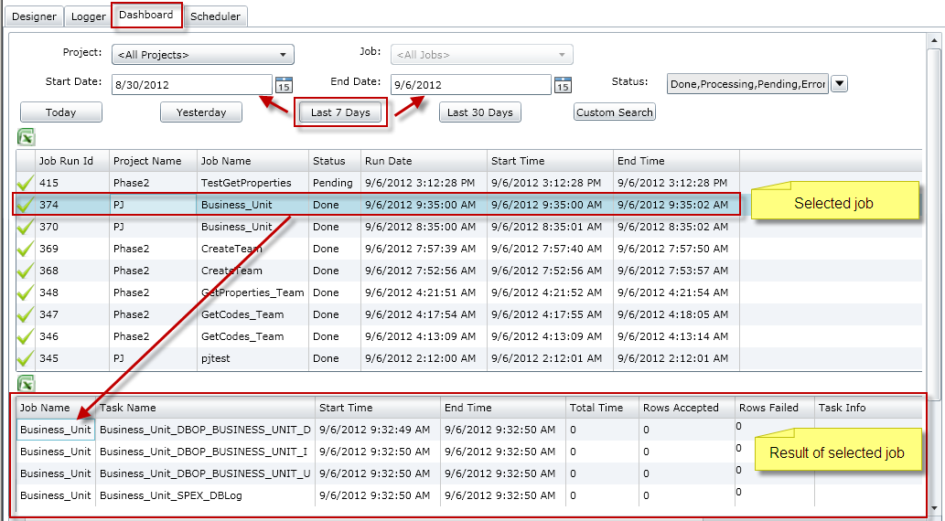
Dashboard tab

Slide 35
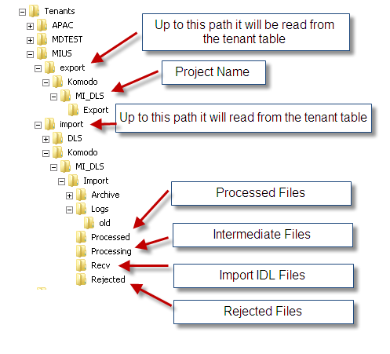
Server directory structure for MI_DLS project

Slide 36
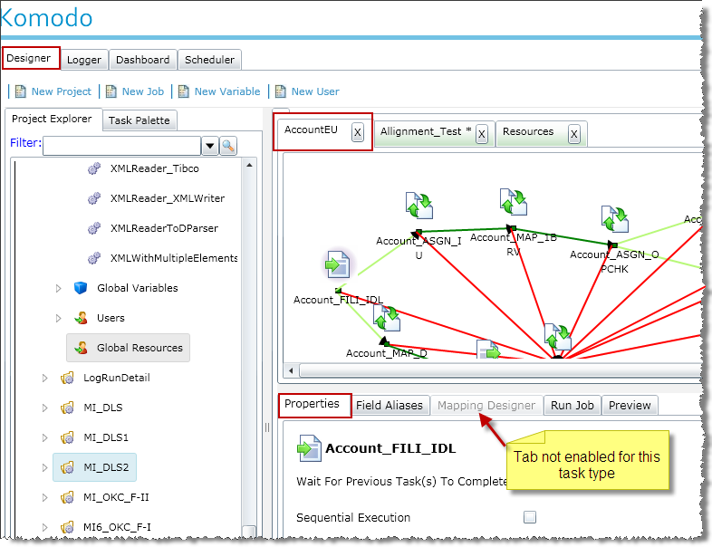
Job Task Panel
The Job Task Panel is a series of tabs that allow users to view and configure properties of a selected task, run the Job and if applicable expose field collections and view and edit field mapping.
It contains the Properties, Field Aliases, Mapping Designer, Run Job and Preview tabs.
Notes:
Note: Tabs will be enabled based on the Task type and configuration settings of the selected task in the Job Canvas Panel. The selected task has a subtle background focus shadow.

Slide 37

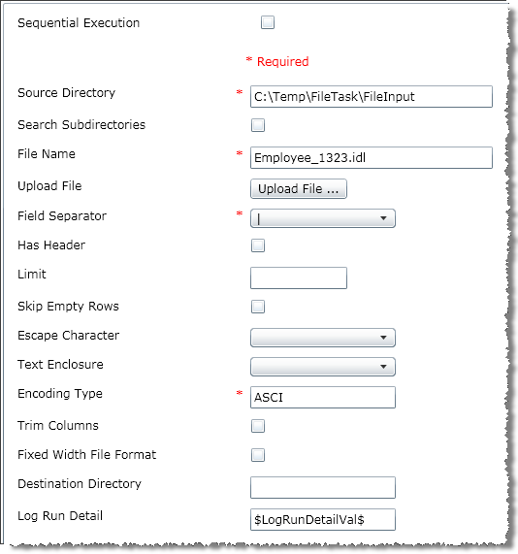
File Reader properties

Slide 38
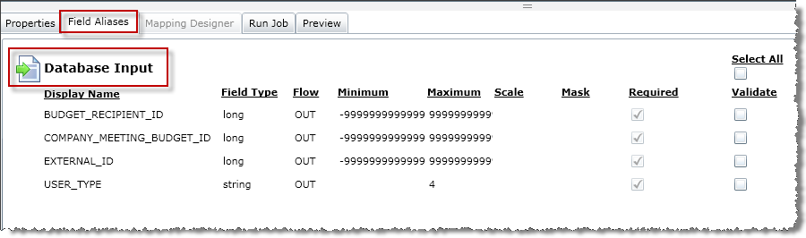
Field Aliases
The Field Aliases tab is a collection of fields that pertain to the task that is selected on the job canvas.
Task properties must be configured and Saved to enable this display.
The user can define an alternate field name for other connected downstream tasks.
The Field Aliases tab is enabled for Producer, Consumer and Assign tasks

Slide 39
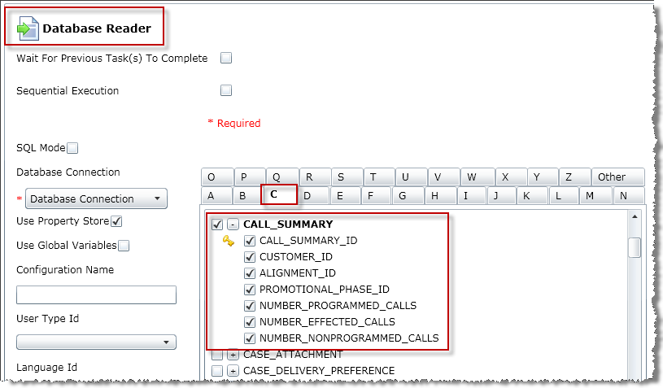
Database Reader properties
Select the input tables. Click the first check box to select the table and all columns, individual columns may be deselected. Right click to display table and column context menu.
Alphabetic tabs with a table selected are in BOLD as a visual hint. Selected tables and columns are displayed with a check mark.

Slide 40
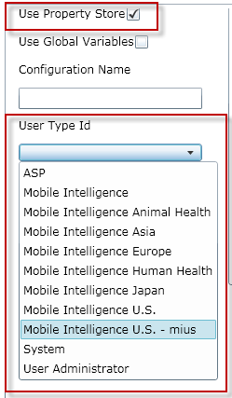
Database Reader – using Dynamic Tables
Requires Property Store values to be entered
Displays in bold blue, with out selecting
Select a User Type Id from the list associated with the tenant 0, the descriptive value will display and the Id will be passed to the task.
EX: Mobile Intelligence U.S.-mius = 5888000000000000
To allow the user to use Global Variables or to manually enter values for the Property Store fields (except for the Property Role field) select the Use Global Variables option. All values selected from the list of values will be converted to the explicit code that will be passed to the task. The property store fields are now editable text box fields.

Slide 41
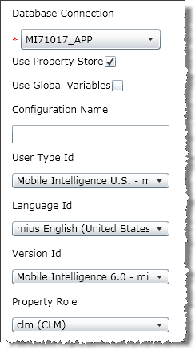
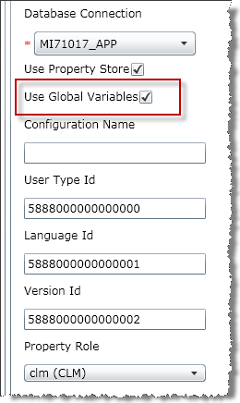
Database Reader – using Dynamic Tables

Slide 42
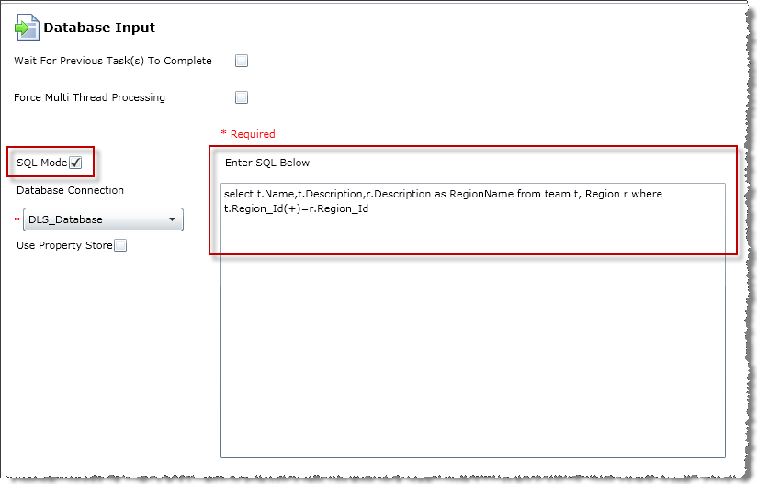
Database Input properties - SQL Mode

Slide 43
Mapping Designer
This is applicable for a Mapping task. It shows a read only view of the fields that are used when the field names of the source and target task are not identical or other transform processes are to be executed.
The transformation process will be executed on the source field and the results are copied to the target field.
The Mapping task must have a single source task connected to it and one or more target tasks.
The Edit All button opens the Map Designer window and allows users to add or modify all the transformation processes.
Double click on an individual New Process display to open just that process.
The New Transform button opens an empty Map Designer window.

Slide 44
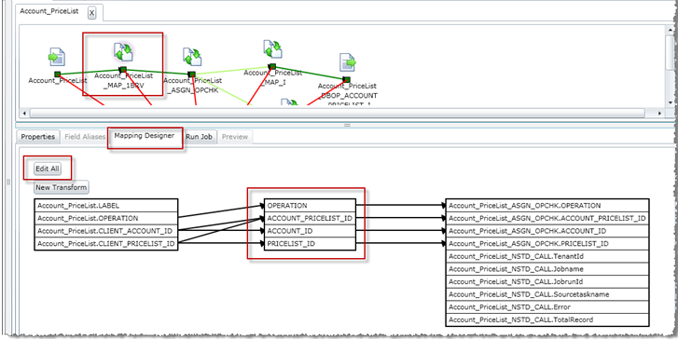
Mapping Designer
Notes:
Fields are listed using a Dot notation to identify relationships EX: TaskName.Field_name , if the task name is changed on the Job Canvas the field names will automatically reflect the new task name in the Dot notation

Slide 45
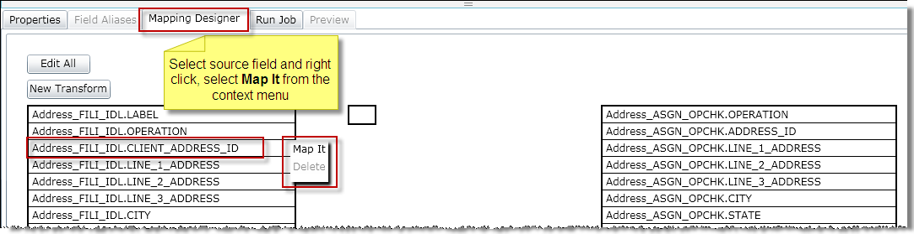
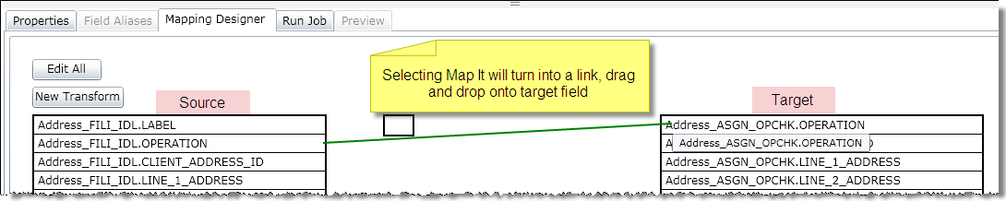
Mapping Designer
Notes:
Fields are listed using a Dot notation to identify relationships EX: TaskName.Field_name , if the task name is changed on the Job Canvas the field names will automatically reflect the new task name in the Dot notation

Slide 46
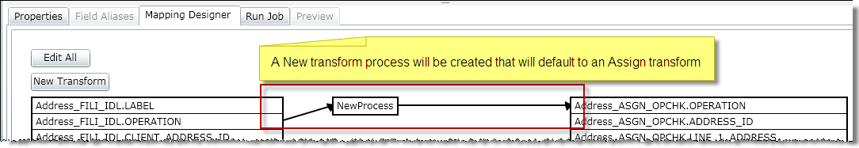
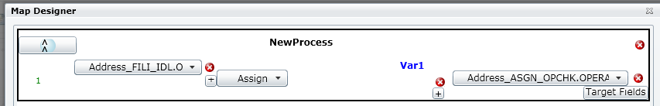
Mapping Designer
Notes:
Fields are listed using a Dot notation to identify relationships EX: TaskName.Field_name , if the task name is changed on the Job Canvas the field names will automatically reflect the new task name in the Dot notation

Slide 47
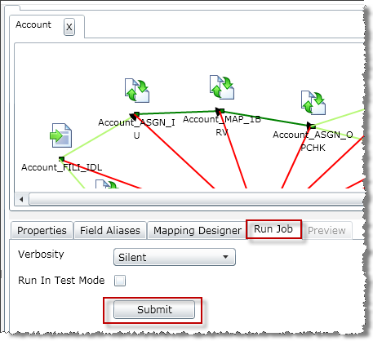
Run Job
This tab is tied to the open job and is used to submit the job for execution.
It contains information and controls relating to the current Job Workflow.
The submitted job is picked for processing by the Komodo runtime service.
Verbosity choices
Silent: Neither Job Execution nor Data Processing Logs will be captured. Best performance.
Low : Job Execution and summary Data Processing Logs will be captured.
Medium(Default): Job Execution and initial data error per row for Data Processing Logs will be captured.
High: Job Execution and full Data Processing Logs will be captured. Worst performance.

Slide 48
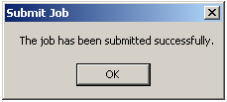
Run Job
A Job Submitted Confirmation dialog displays, Click OK.
Check status and Log messages from the Logger tab

Slide 49
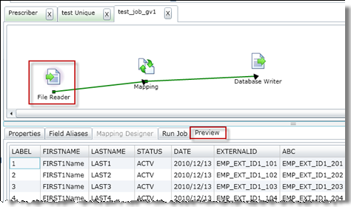
Preview
This tab is specific to the Task that is selected. It is applicable for producer Tasks like File Reader, Excel Reader, and Database Reader (in SQL mode).
The Properties of the tasks needs to be entered and saved prior to using the Preview tab.
Preview will display the first fifteen records of the file (for non XML).
Notes:
Note: The file name property must not have wild cards for the file preview to work. Currently the preview will not work if a Global variable is used for the Encoding type field ( File Input)

Slide 50
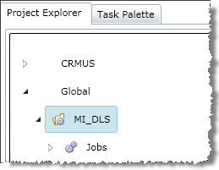
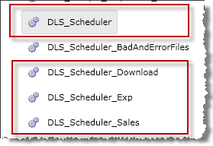
MI_DLS Project
The MI_DLS project is the Komodo Global tenant baseline data load project that was built for MI 9 flat file loads.
There are four Global baseline “Main” nested Scheduler jobs. These jobs should be scheduled and run to control the sequential execution of all related jobs in the proper order. They are categorized by the type of data they load.
It utilizes DLT global variables to provide easy configuration options to submit and track the DLS_Scheduler and other “Main” nested jobs.
Users are expected to schedule DLS_Scheduler and DLS_Scheduler_Exp jobs at all times.

Slide 51
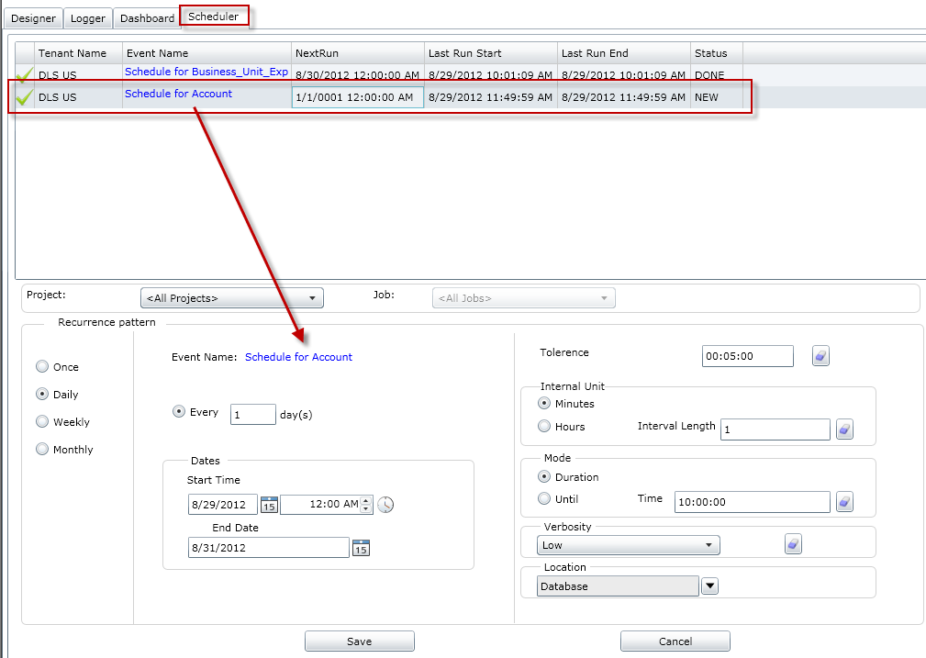
Schedule parameters
Notes:
The parameters specified on the Schedule Parameters tab are the same as the Force Administrator parameters for managing Event schedules.

Slide 52
Schedule options
The parameters specified on the Komodo Schedule Parameters tab are the same as the Force Administrator parameters for managing Event schedules ( In FA Services > Scheduler)
The first column will display a for Active events ( Activated in FA) or if the event has been Inactivated in FA.
Required parameters are outlined in red and the values will be validated when control leaves the field

Slide 53
Schedule Job
A job can be individually scheduled to run ( recommended)
Assigning scheduling parameters at the job level will override the Project level scheduling parameters
Requires Tenant Administrator or Super User permission
The parameters specified on the Schedule Parameters tab are the same as the Force Administrator parameters for managing Event schedules and the same as the Project Schedule parameters.

Slide 54
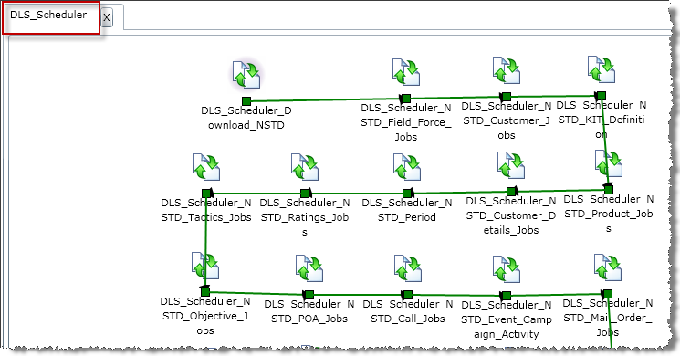
DLS_Scheduler
The DLS_Scheduler is a Komodo Global tenant baseline job in the MI_DLS project. This job is the main job that will sequentially execute all MI related non OneKey data load jobs (interfaces).
This Job should be individually scheduled to run as opposed to providing scheduling options at the Project level.
Refer to the MI Data Load Quick Reference for more information

Slide 55
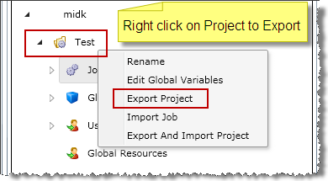
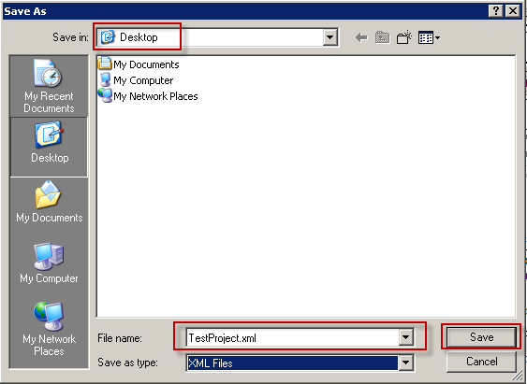
Export Project
A project can be exported to an XML file. The XML file contains all the properties and components associated with the project. The project should first be expanded, which will load all the information related to the project, both user supplied and system generated. Once this is done, right click to export the project.
From the Project Explorer select and expand the Tenant where the Project is stored
Select the Project to export
Click to expand the Project
Right click and click Export Project from the context menu
Click Save at prompt
Select the Directory to store the XML file in
Enter a descriptive File name with an .xml extension and file type as XML
Click on Save
NOTE: KomodoHost must be Running and it requires the service setting “NetTcpHostAddress“ to be updated by the user the default the value is MachineName:Port.
For example MI530SP01:8800
Notes:
Tenant Administration or Super User permission is required.

Slide 56
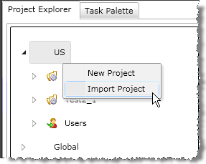

Import project
Select the tenant in the Project Explorer
Right click and select Import Project from the context menu
Click Browse… to display the Open file dialog
To Export/Import a project Super User or Tenant Administrator permission is required.

Slide 57


Import Project
Search for the XML project file
Click Open
To Import with the original project name click Import
Note: The project name value specified in the PROJECT_NAME XML tag must not exist in the tenant, if it does an error message will be displayed.

Slide 58

Export Job
A single Job can be Exported to an XML file and then Imported to another Project or back to the same Project with a new Job name
Expand the Project and Jobs node in the Project Explorer
Right click on the Job to Export and select Export Job from the context menu
Select a Directory to store the XML file in
Enter a descriptive File name with an .xml extension and file type as XML
Click on Save

Slide 59


Import Job
Select and expand the target tenant in the Project Explorer – (same or different tenant)
Select and expand the target Project (same or different Project)
Right click the Project and select Import Job from the context menu
Click Browse… to display the Open file dialog
Search for the XML Job file
Click Open
Select the components to Import and optionally enter the New Job Name.

Slide 60
DID Template
DID_DataTemplate_MI9
An Excel spreadsheet that can be used to generate test .idl files based on the DIDs defined for the version
Make a local copy of the spreadsheet, the generated files will be saved in the same directory as the local copy
Required fields are displayed in yellow
Many fields have dropdown pick lists for values

Slide 61
Changes to an existing Global baseline interface (job)
Will changes affect all Tenants?
YES – make changes to the Global tenant baseline properties, Global variables and Global resources and Save – changes will be reflected to all Global users.
Note: Super User or Global Tenant Admin Permission is required
NO- Export /Import Project or Job into the target Tenant (may assign new name) – make changes to New Project or Job’s properties, Global variables, Global resources and Save

Slide 62
MI Multi Country jobs
A multi country tenant wants to schedule the baseline jobs for different countries because of :
1. Different time zones
2. Different FTP sites by country
Will the same job be run in different time zones or FTP sites?
YES – Do the following:
Export the baseline Project
Import the Project into each tenant with a unique name, following the format of : MI_Project_Country
EX: MI_DLS_US , MI_DLS_CANADA, MI_DLS_LATIN
Modifications to the Project Schedule or a job within the project must be made and Saved on all tenants, or you can repeat the Export/ Import process with a New consistent Project name.
EX: MI_DLS_2_US, MI_DLS_2_CANADA, MI_DLS_2_LATIN
Note: there is no Delete at the Project level
No – No special steps required

Slide 63
Options to Run a job
Run a Job - job submitted immediately
Select and expand the Tenant and Project the job is contained in
Select and Open the job to run
Verify and confirm task properties, along with Global variables and Global Resources referenced in the job
Click on the Run Job tab
Select the Verbosity to specify the level of logging to collect for the run.
Options are: High, Medium, Low, Silent
Select the Run Mode –
Run In Test Mode indicates that job execution results should not be committed / written.
Click Submit
Track the Progress and messages from the Logger, Progress, Messages and Dashboard tabs

Slide 64
Thank you…
Email: Pamela.Huntsman@Cegedim.com

