Slide 1

Nortnacs a Form Reader
Scott Pierro, Anthony Maciel, Angela Dominguez, Henry Crossley, Jose Romero
Csci 150

Slide 2

Nortnacs
Team Process: XP
Incremental
Pair programming
Simple design
Continuous integration

Slide 3
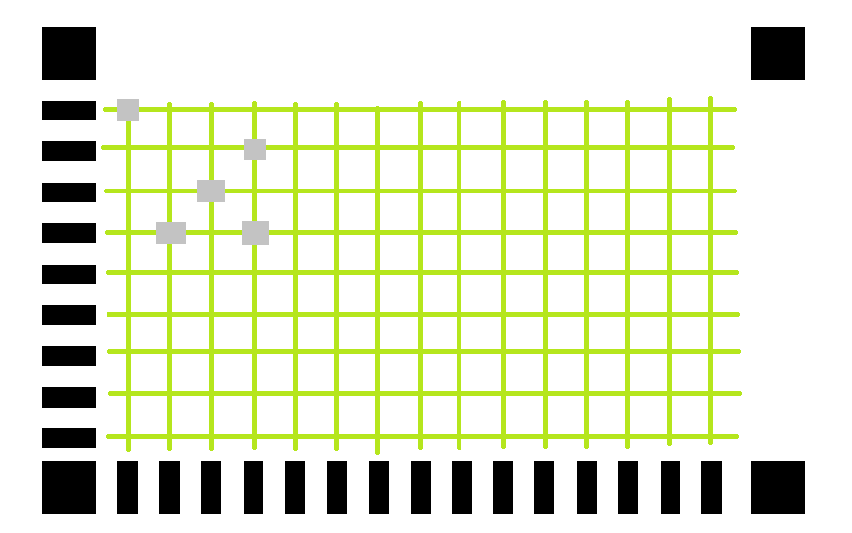
Nortnacs
Program description:
Java Application to read and print results of bubble-in forms. The application will be able to compare the selected image with answer key data. After comparison, a score will be assigned to the referenced image.

Slide 4
Nortnacs
Java api
import java.awt.Point;
import java.awt.image.BufferedImage;
import java.io.File;
import java.io.IOException;
import java.util.ArrayList;
import javax.imageio.ImageIO;

Slide 5


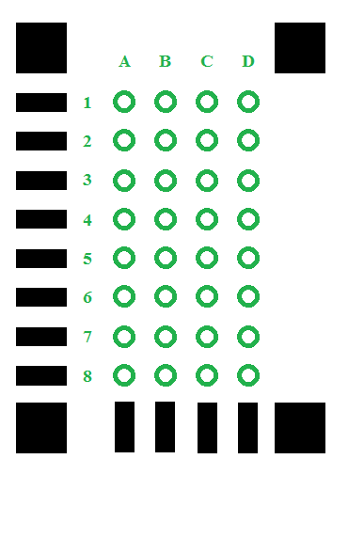
Nortnacs
Sample Image
Image file
Calibration points
Row and Column points
Intersection points

Slide 6
Nortnacs
Algorithm
Obtain image file and answer key
Locate calibration points
Locate answer points
Compare against answer key
Grade assignment

Slide 7
Nortnacs
Conclusion
Product release
Product support

