Slide 1
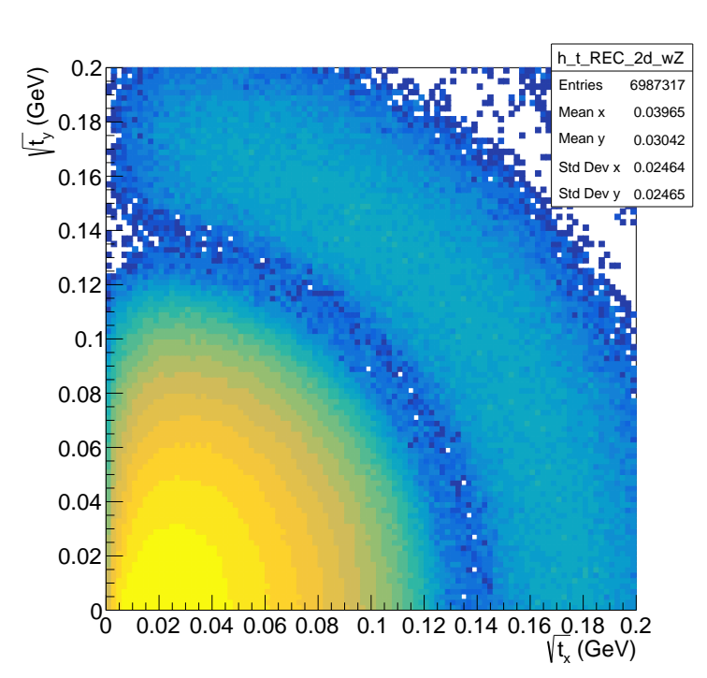
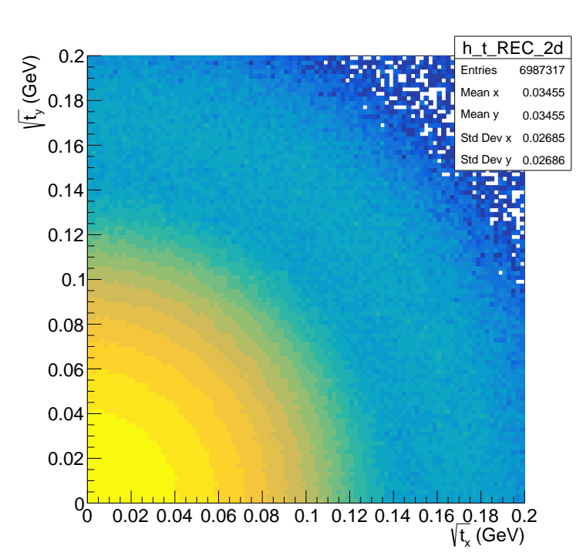
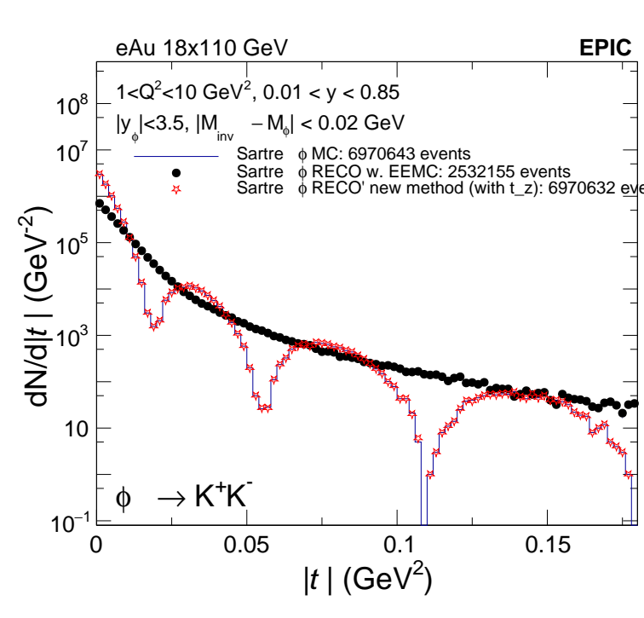
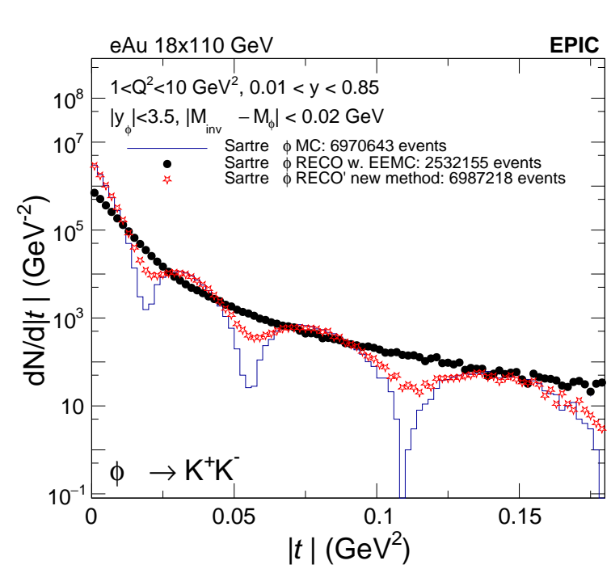
left column:
<-------------------------
qz absorbed into qx
qx = (qx, 0, qz, E)
qy = (0, qy, 0, 0)
Right column:
------------------------->
qz subtracted out of qx
qx = (qx, 0, 0, 0)
qy = (0, qy, 0, 0)
qz = (0, 0, qz, E)

Slide 2
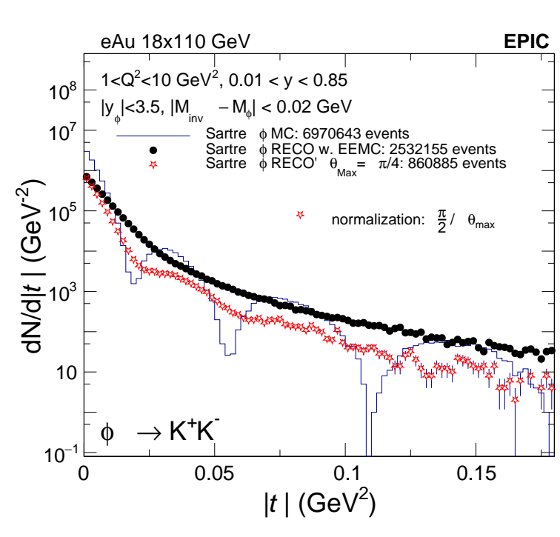
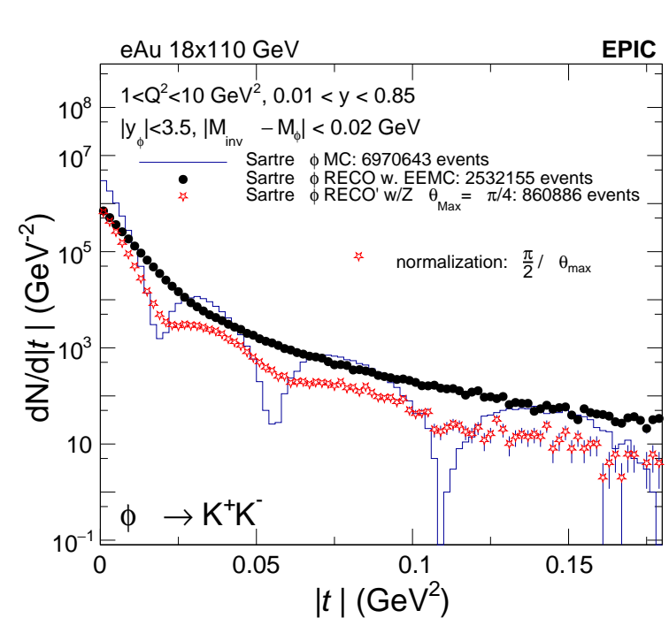
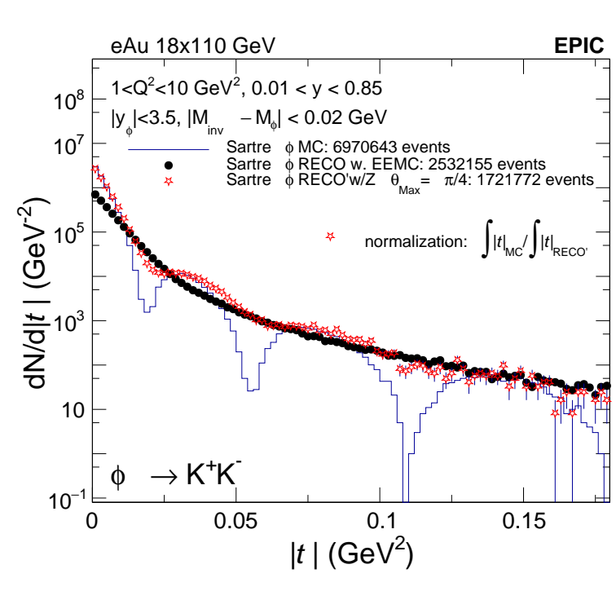
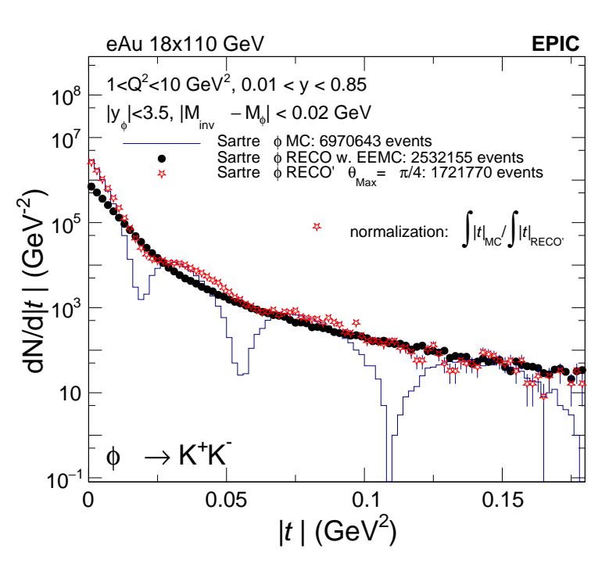
Theta = pi/4
left column:
<-------------------------
qz subtracted our of qx
Right column:
------------------------->
qz absorbed into qx

Slide 3
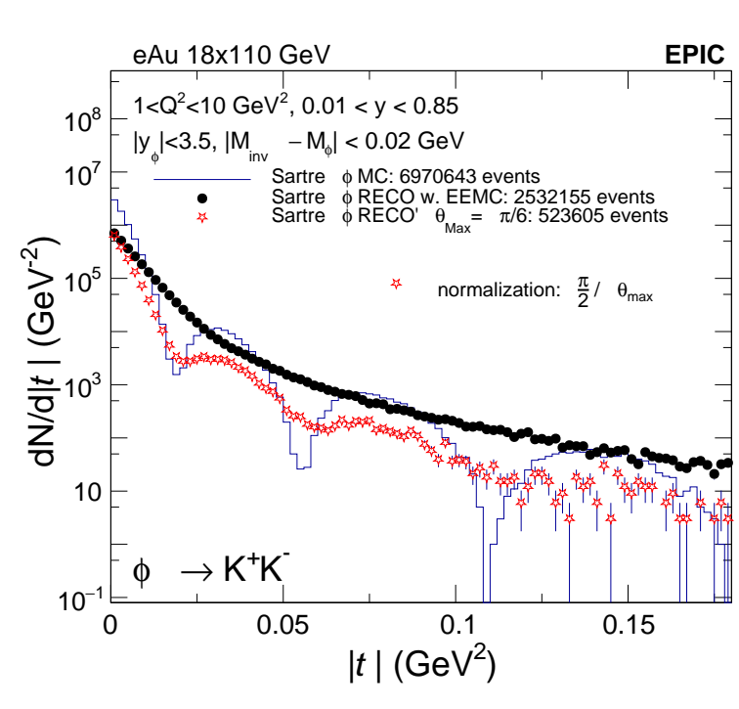
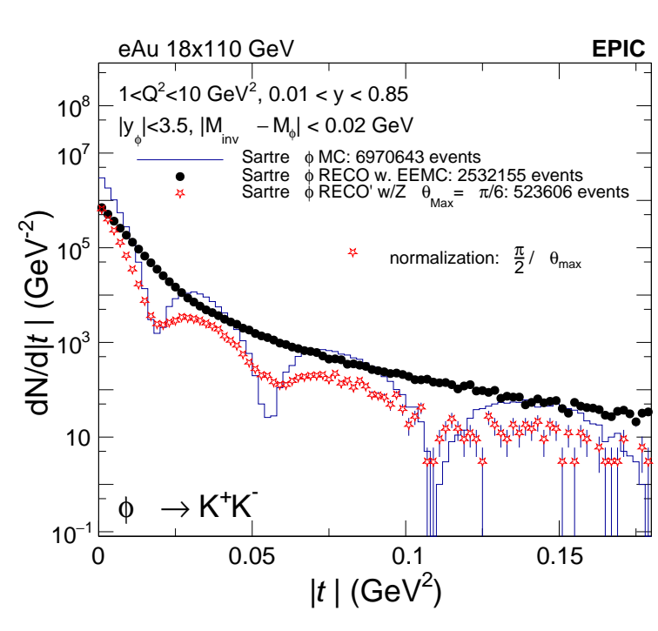
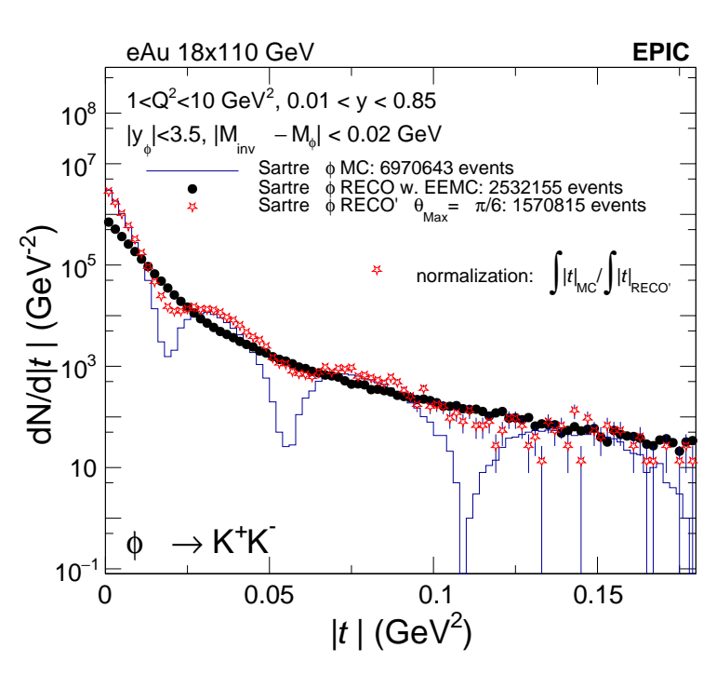

Theta = pi/6
left column:
<-------------------------
qz subtracted out of qx
Right column:
------------------------->
qz absorbed into qx

Slide 4
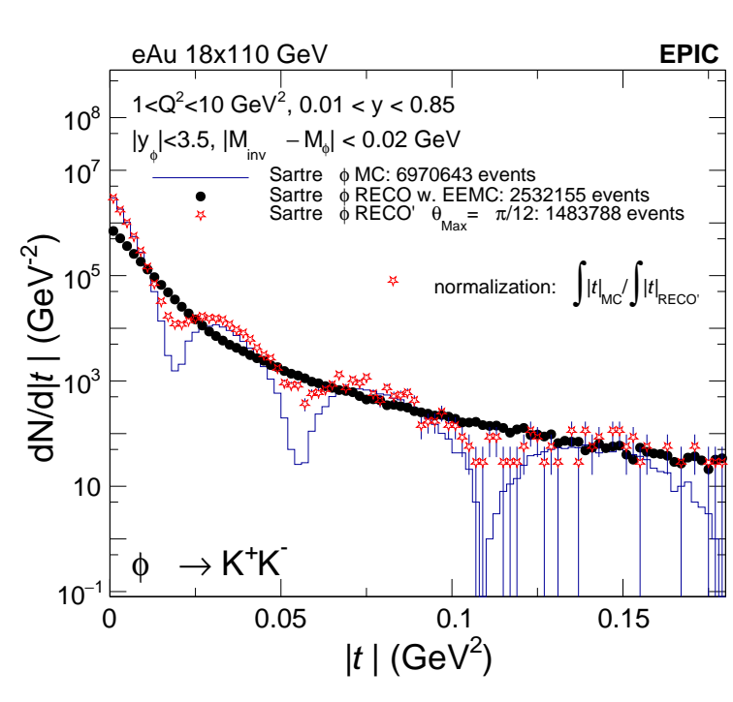

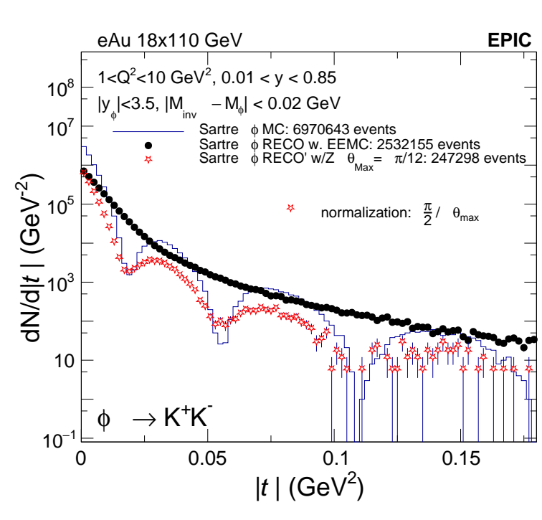
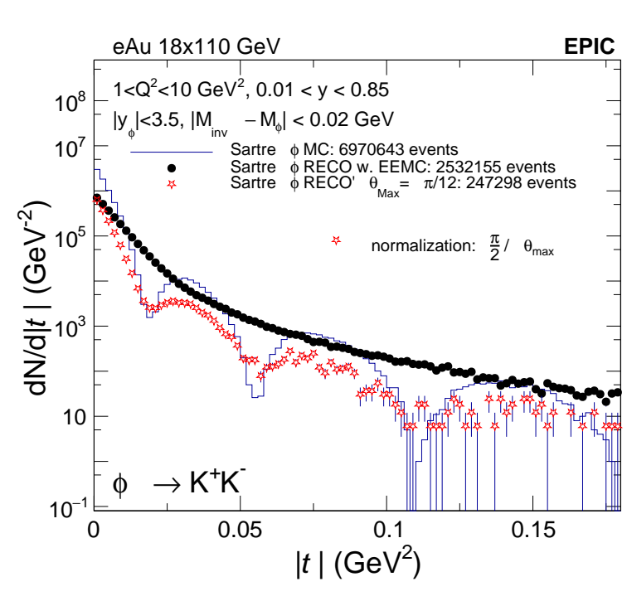
Theta = pi/12
left column:
<-------------------------
qz subtracted out of qx
Right column:
------------------------->
qz absorbed into qx

