Slide 1
BMD ENG 301 Quantitative Systems Physiology (Nervous System)
Lecture 1: Introduction to the Nervous System
2022_v1
Professor Malcolm A MacIver

Slide 2
Class Attendance
Let me know if you are unable to attend a class or exam
Recording of lectures
Masks are optional, but if you feel unwell best to wear one
If not feeling well, be sure to COVID test and follow the NU guidelines, which are found by Googling “Northwestern Procedures for Positive Cases of COVID-19”

Slide 3
Grading
Quizzes – keep up with Readings (see Files on Canvas)
Homework Assignments
Examinations
Group Project (Graduate Students Only)

Slide 4
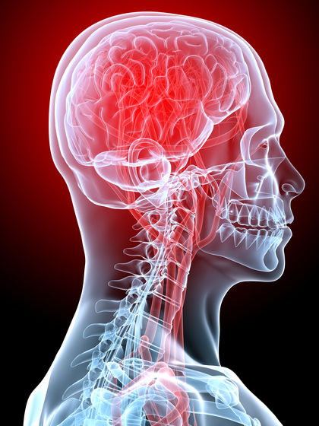
What are the components of the nervous system?
Main cellular components: neurons and glial cells
Vasculature
Lymphatic system
Ventricles: reservoirs of cerebrospinal fluid
Blood-brain barrier
Meninges

Slide 5
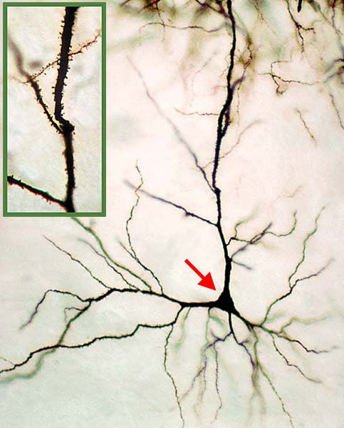
The Neuron and its functional components
Cell Body (Soma, Perikaryon)
10-30 µm diameter
Dendrites
Dendritic spines
Axon
Axon terminal arborization
This neuron is only visible because it has been stained

Slide 6
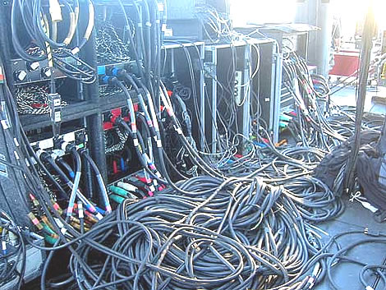
It has been said that there are one million miles of neural cabling in the human brain
If we assume that the average diameter of an axon or dendrite is 1 µm, what is the volume occupied by one million miles of neural cable?

Slide 7
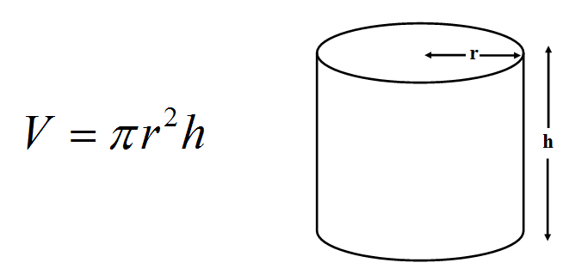
h = 10⁶ miles (1.61 x 10⁹ meters)
r = 0.5 x 10⁻⁶ m
V = 1.26 x 10⁻³ m³

Slide 8
It has been said that there are one million miles of neural cabling in the human brain
If we assume that the average diameter of an axon or dendrite is 1 µm, what is the volume occupied by one million miles of neural cable?
A cube of approximately 1 dm x 1 dm x 1 dm (or
4” x 4” x 4”)
That the human brain could have a million miles of neural cable seems plausible
GROWTH CONE VIDEO
All this wiring is accomplished by the neurons sending out growth cones to find targets
It should be possible to estimate what types of and how much material would be needed for one million miles of neural cable but that is for another day / course
A wave of disassembly follows the growth cone providing it with material to use as its front end

Slide 9
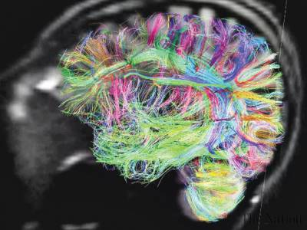
The size of the human brain is about 1,400 cm³
Most of this volume must be taken up by wiring
What this could mean
Although more numerous than neurons, glial cells cannot occupy as much space
The brain’s vasculature also occupies little space
As does the brain’s lymphatic system
Ventricular space is perhaps less than one might have imagined
There must be more water inside neurons and glia than outside them
A mechanism to carry neural signals over cm to dm distances seems essential
As does a mechanism for neurons to “speak” to other neurons
Assemblies of neurons (neural circuits) would seem to be fundamental to brain operation
The same might also be said of grouping neural circuits (into neural systems) and the interplay of these neural systems

Slide 10
Course Outline
Components of the Nervous System
Large scale view – Neuroanatomy
Small scale view – Cellular elements: Neurons and Glial Cells
Neural Signals
Passive electrical signals – short-range signaling
Action potential – long-range signaling mechanism
Neural Connections
Synapses
Neural Circuits
Emergent properties from neural ensembles
Neural Systems
Somatosensory System – capture information about one’s environment
Motor System – influence that environment
These need not be considered apart

Slide 11
Quote of the day
“If the human brain were so simple that we could understand it, we would be so simple that we couldn’t”
From “The Biological Origin of Human Values” by Emerson Pugh
Notes:
Perhaps a pessimistic view of neuroscience. The brain is a tissue and like any other is made of cells that behave like other cells.

Slide 12
If it is, what makes the human brain special?
Genes

Slide 13
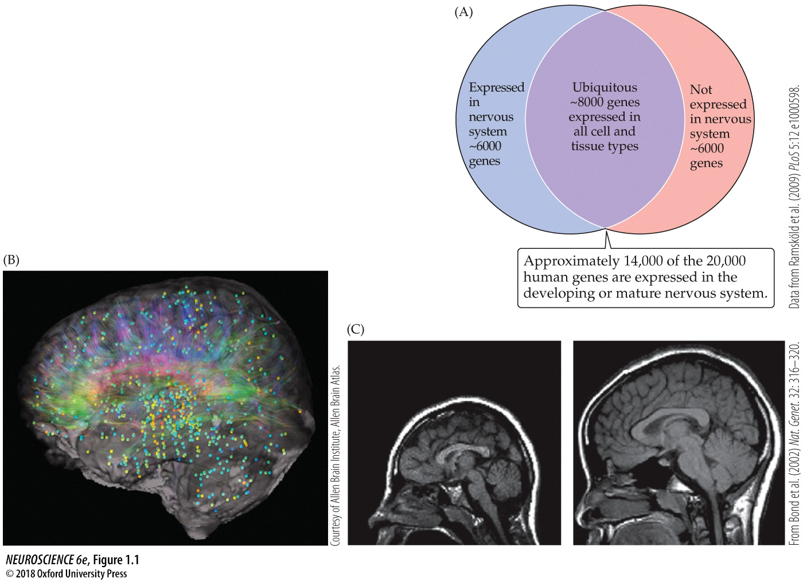
Notes:
FIGURE 1.1 Genes and the nervous system. (A) In this Venn diagram of the human genome, the blue and purple regions represent genes that are expressed selectively in the nervous system along with those that are expressed in the nervous system as well as in all other tissues. (B) The locations and levels of expression of a single gene in the human brain. Dots indicate brain regions where mRNA for this particular gene are found, while their color (blue to orange) indicates the relative level (lower to higher) of mRNA detected at each location. (C) The consequence of a single-gene mutation for brain development. The gene, ASPM (Abnormal Spindle-like Microcephaly-associated), affects the function of a protein associated with mitotic spindles and results in microcephaly. In an individual carrying the ASPM mutation (left), the size of the brain is dramatically reduced and its anatomical organization is distorted compared with the brain of a typical control (right) of similar age and sex. (A data from Ramsköld et al., 2009; B courtesy of Allen Brain Atlas; C from Bond et al., 2002.)

Slide 14
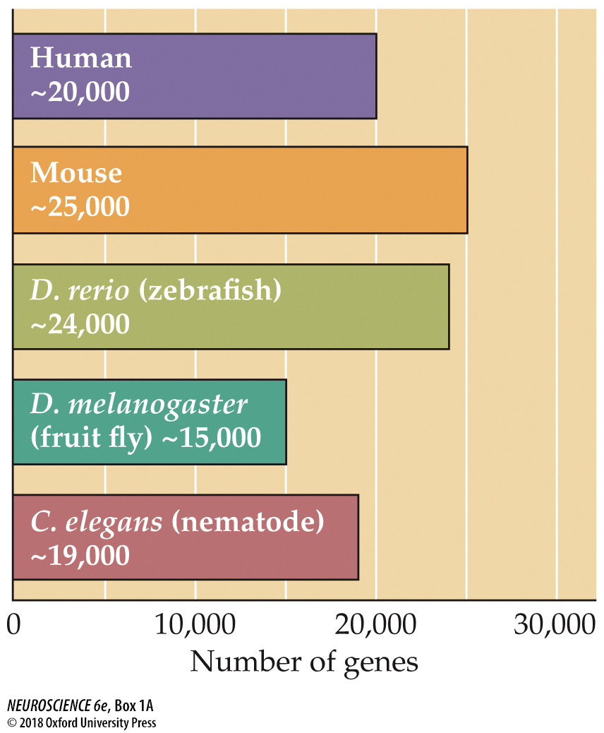
Notes:
BOX 1A Model Organisms in Neuroscience
Estimated genome sizes of humans and several model species. Note that the number of genes in an organism’s genome does not correlate with cellular or organismal complexity; the simple nematode Caenorhabditis elegans, for example, has almost the same number of genes as a human. Much genetic activity is dependent on transcription factors that regulate when and to what degree a given gene is expressed.

Slide 15
If it is, what makes the human brain special?
Genes
Number of neurons

Slide 16


Number of neurons
Nematode: 302
Drosophila: ~250,000
Zebrafish: ~10 million
Mouse: 71 million
Human: 8.6 x 10¹⁰
African elephant: 2.6 x 10¹¹

Slide 17
If it is, what makes the human brain special?
Genes
Number of neurons
Brain size

Slide 18
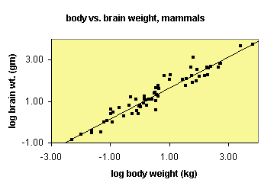

Slide 19
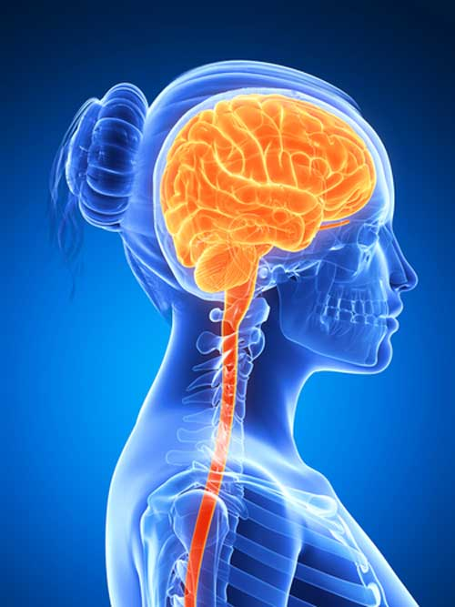
If it is, what makes the human brain special?
Genes
Number of neurons
Brain size
Relative brain size

Slide 20
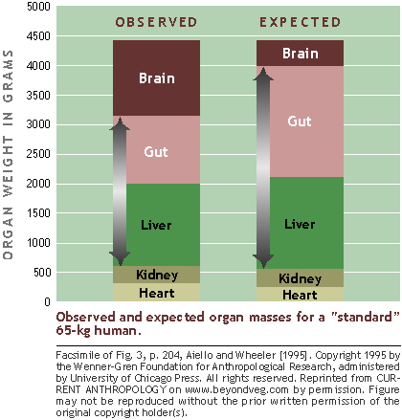

Slide 21
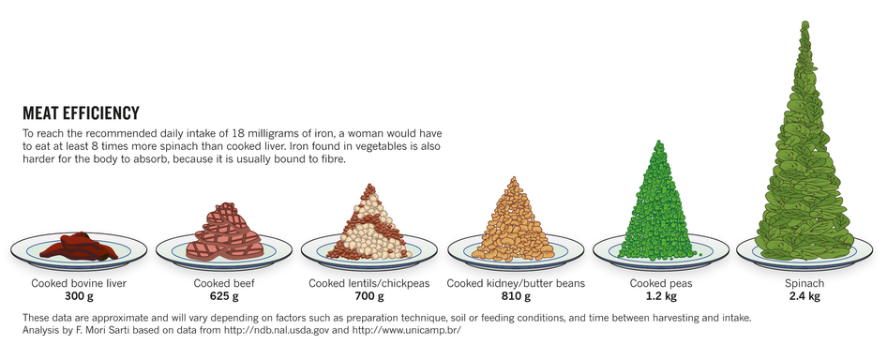
Meat eating is efficient

Slide 22
If it is, what makes the human brain special?
Genes
Number of neurons
Brain size
Relative brain size
Forebrain (neocortex)

Slide 23

Theories of human brain expansion
The social brain hypothesis (Robin Dunbar)
Primates’ disproportionately large brains evolved to handle the complex demands of social living

Slide 24
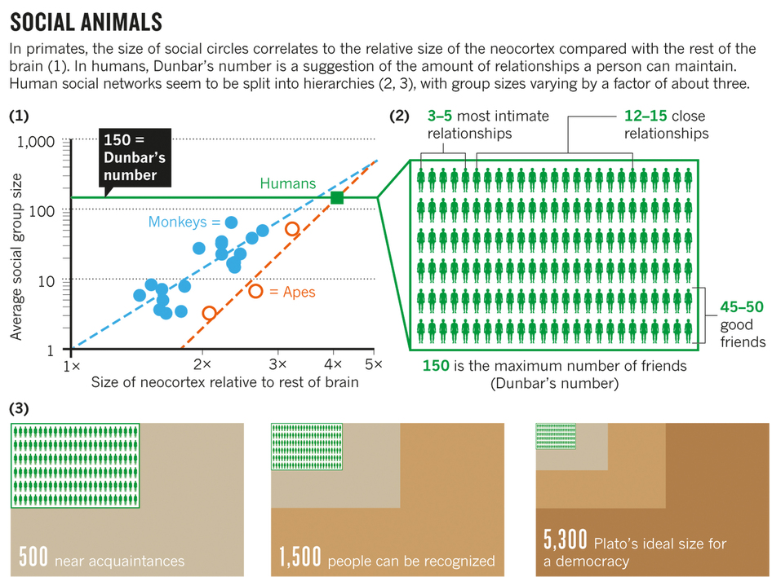
Notes:
Critique this figure. (1) Monkeys are more social animals than apes for neocortex size; (2) How do you determine the number of friends for a monkey or an ape?

Slide 25
Forebrain Neurons
Mouse: 14 million
Opossum: 22 million
Grey Squirrel: 77 million
Starling: 226 million
Brown Bear: 251 million
Raccoon: 453 million
Lion: 545 million
Rook: 820 million
Raven: 1.2 x 10⁹
Beluga: 2.7 x 10⁹
Mandrill: 3.1 x 10⁹
African Elephant: 5.6 x 10⁹
Human: 16.3 x 10⁹
Killer Whale: 43.1 x 10⁹

Slide 26
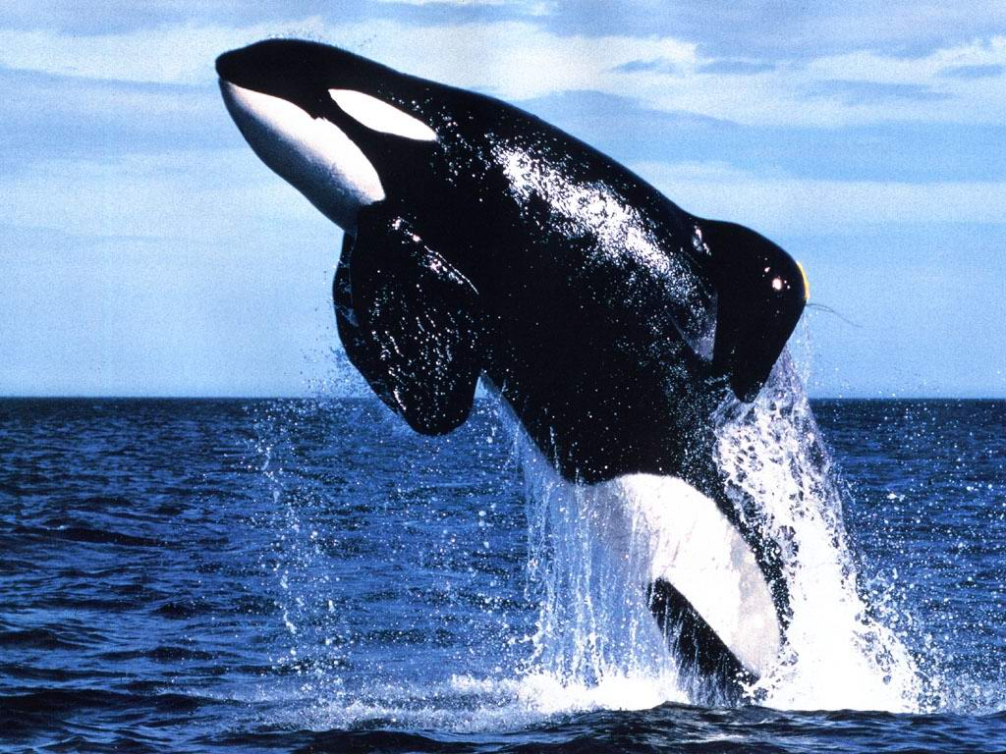

Slide 27

Forebrain Neurons Relative to Body Weight
Human: 16.3 x 10⁹
Killer Whale: 0.6 x 10⁹

Slide 28
Use of this presentation is exclusively for students in the Northwestern University Fall Quarter 2022 BMD ENG 301 course. It should not be downloaded and shared with people not associated with the course.
Wherever possible attribution is given for figures used.

