Slide 1
BMD ENG 301 Quantitative Systems Physiology (Nervous System)
Basal Ganglia
2022_v1
Professor Malcolm MacIver

Slide 2
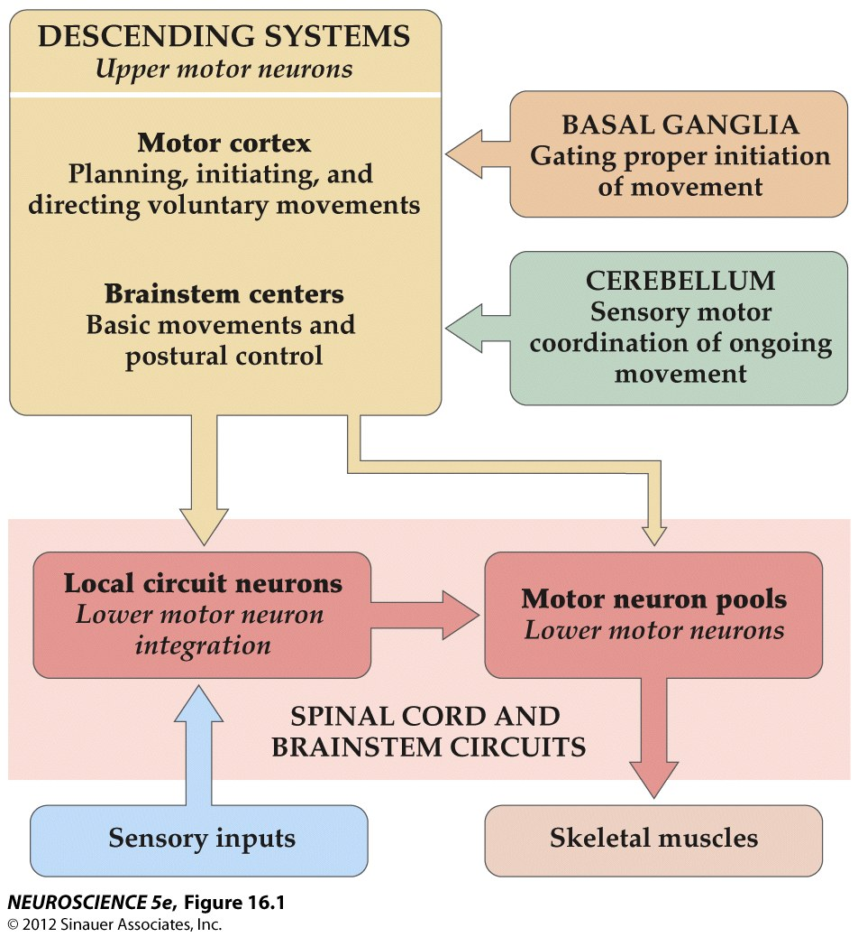
Organization of neural structures involved in the control of movement

Slide 3
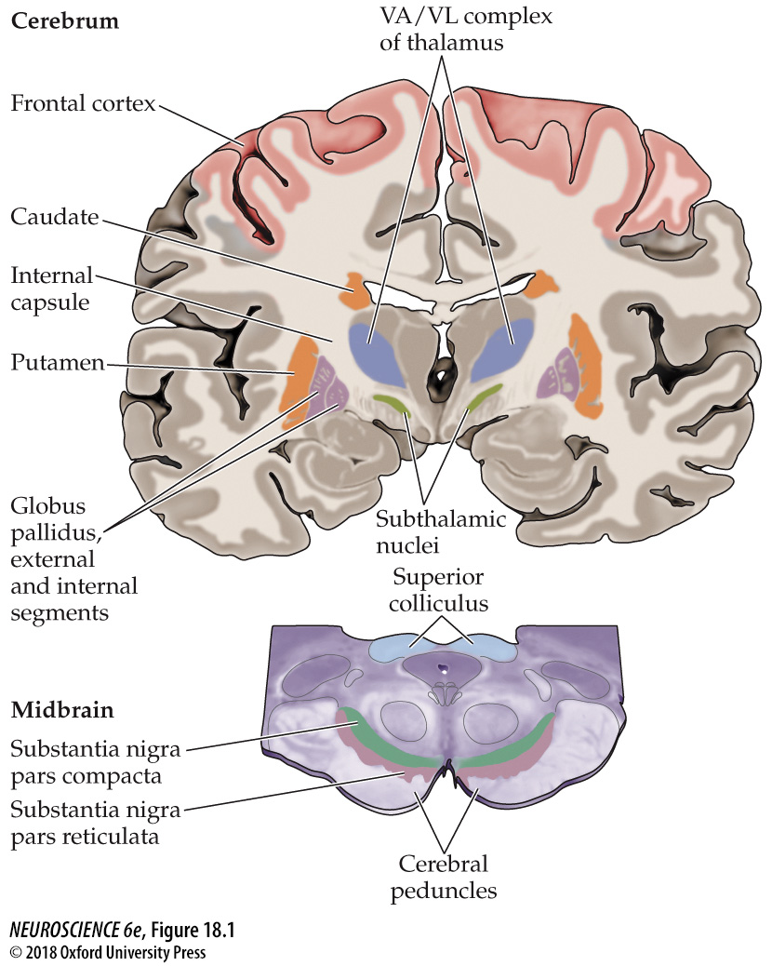
Motor components of the basal ganglia

Slide 4
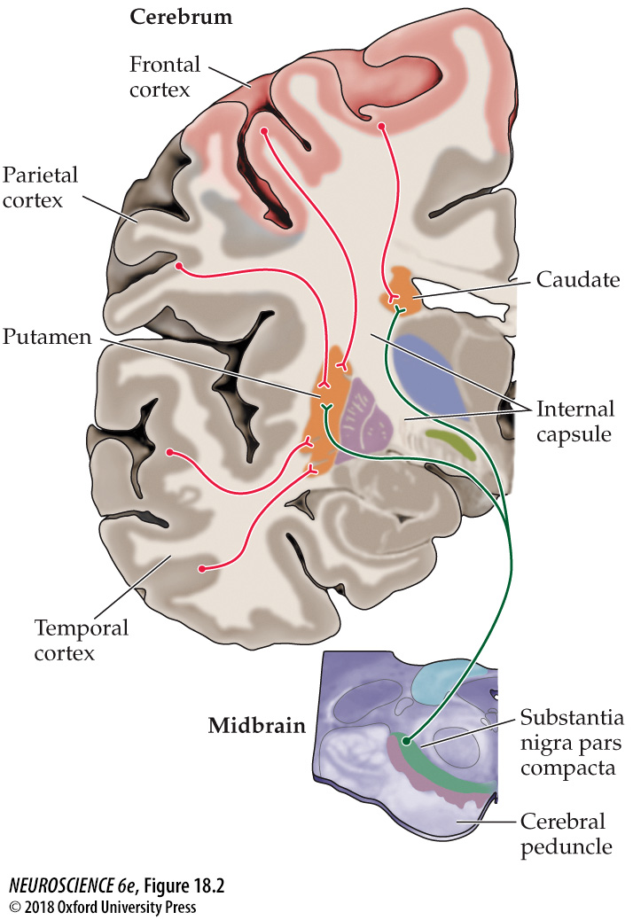
Anatomical organization of the inputs to the basal ganglia

Slide 5
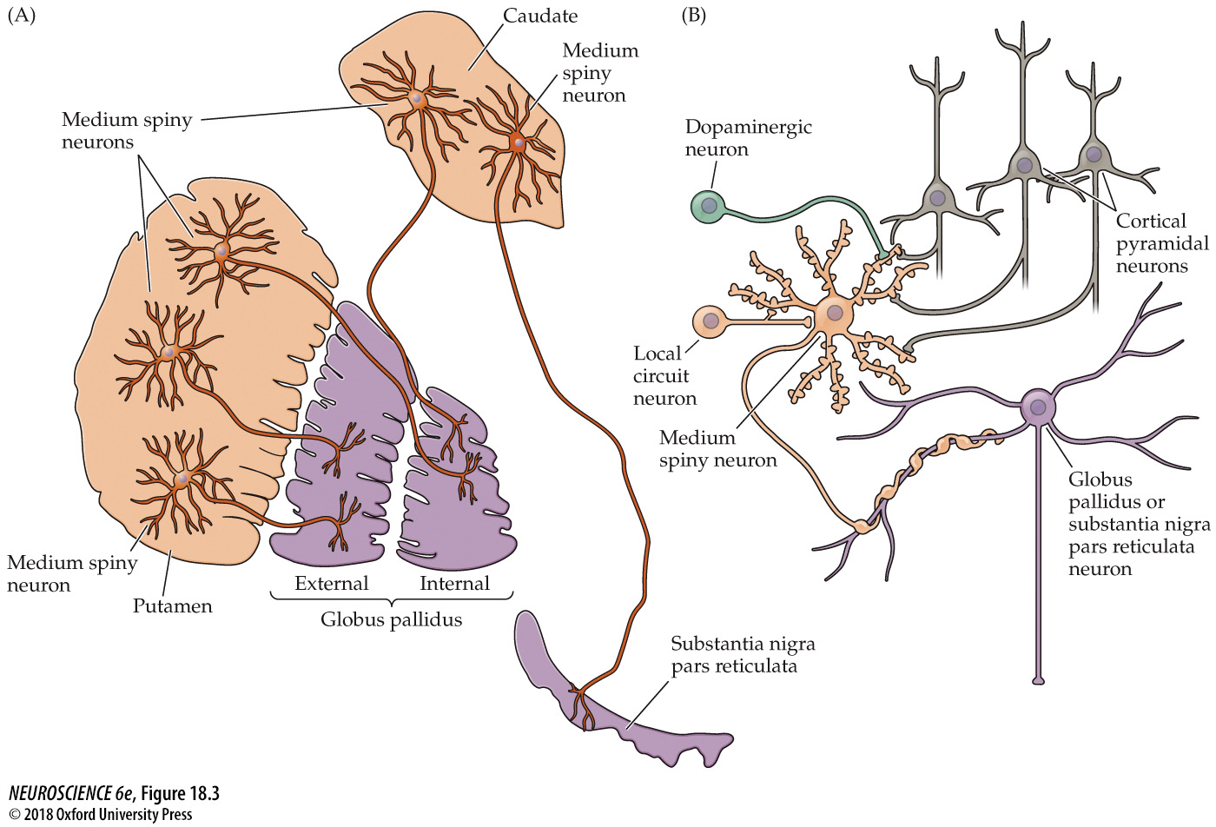
Neurons and circuits of the basal ganglia

Slide 6
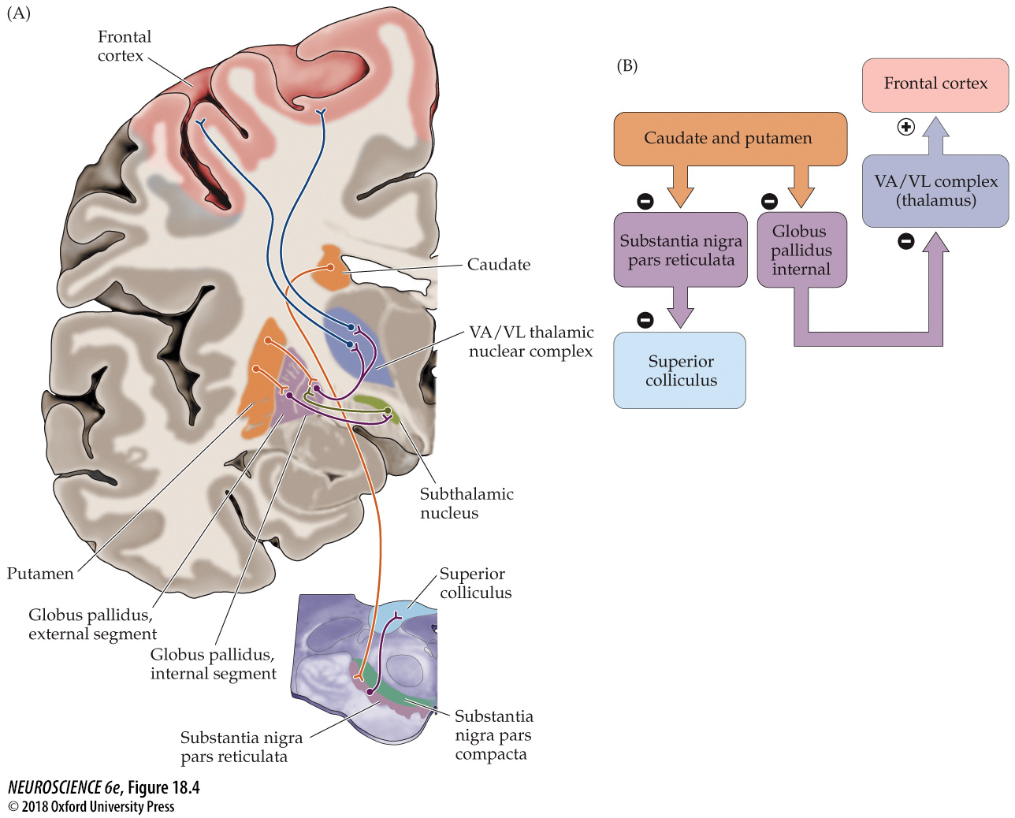
Functional organization of the intrinsic circuitry and outputs of the basal ganglia

Slide 7
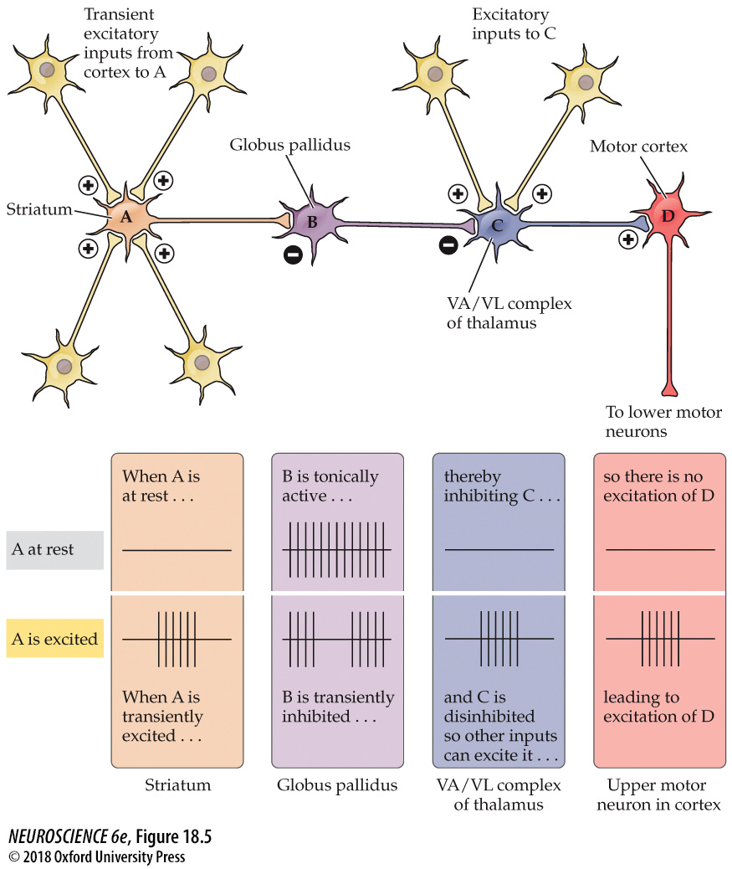
A chain of nerve cells arranged in a disinhibitory circuit

Slide 8
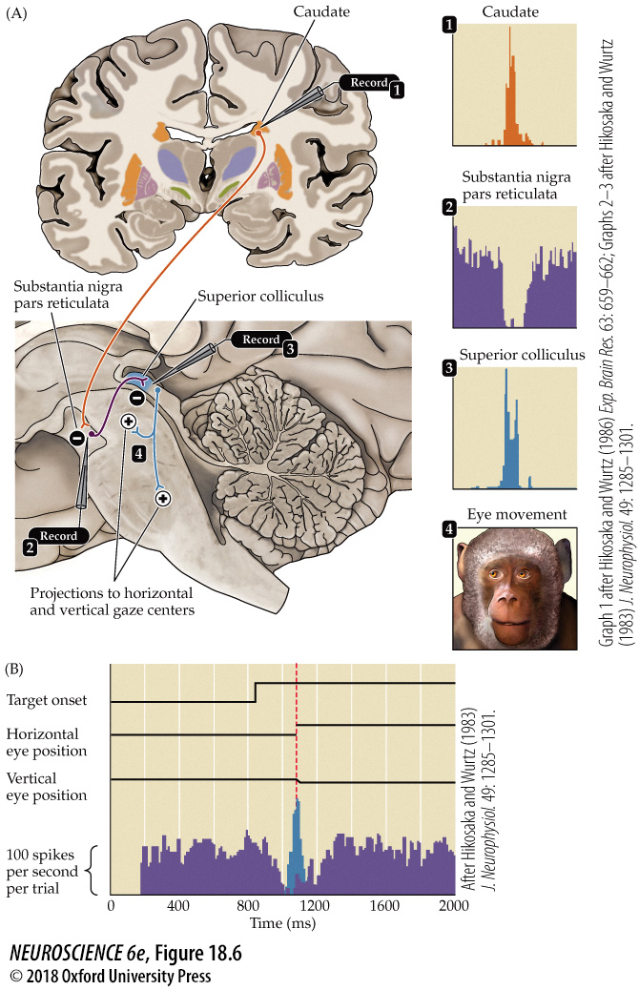
The role of basal ganglia disinhibition in the generation of saccadic eye movements

Slide 9
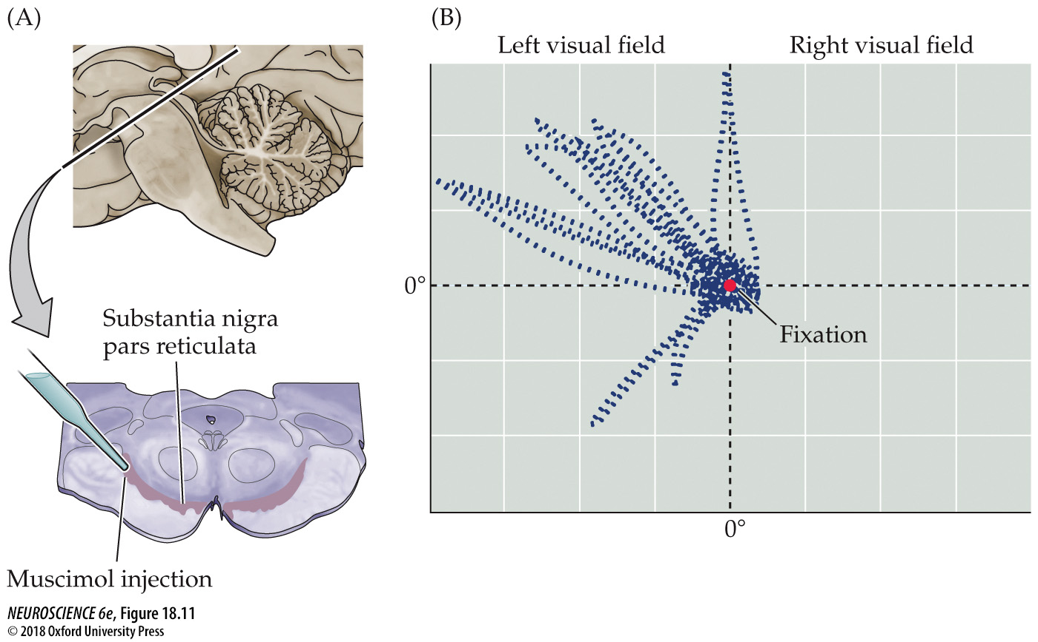
A GABA agonist produces involuntary movements resembling hyperkinesia

Slide 10
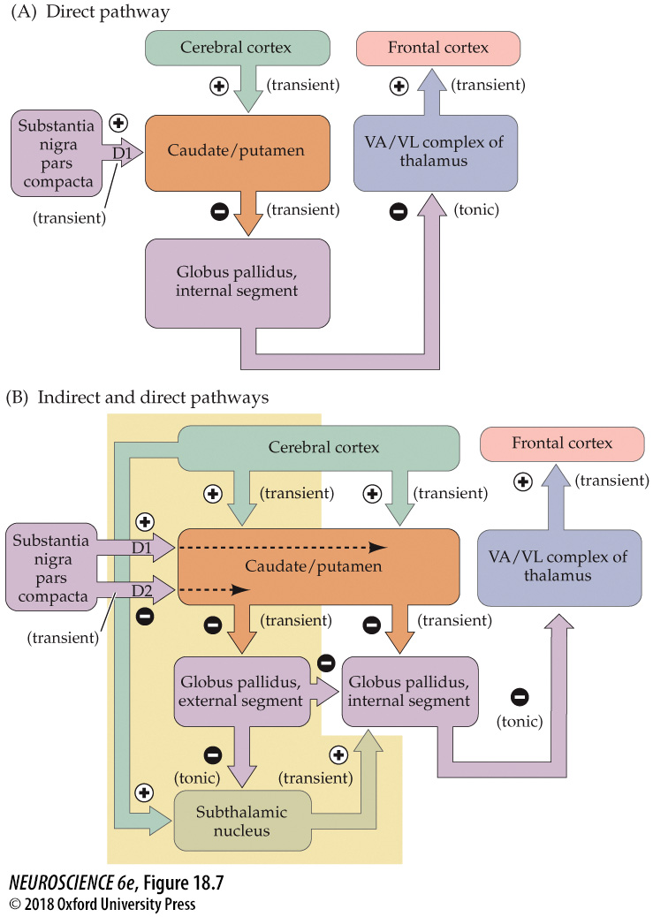
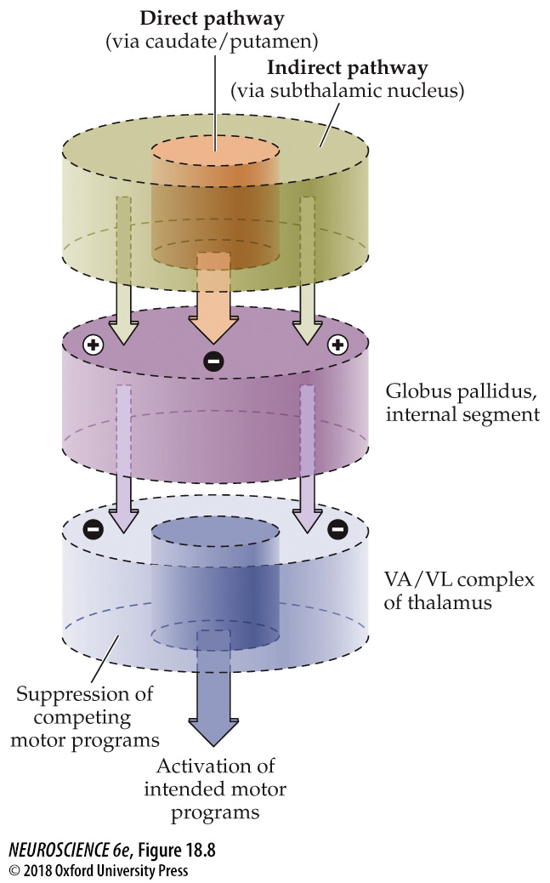
Disinhibition in the direct and indirect pathways through the basal ganglia

Slide 11
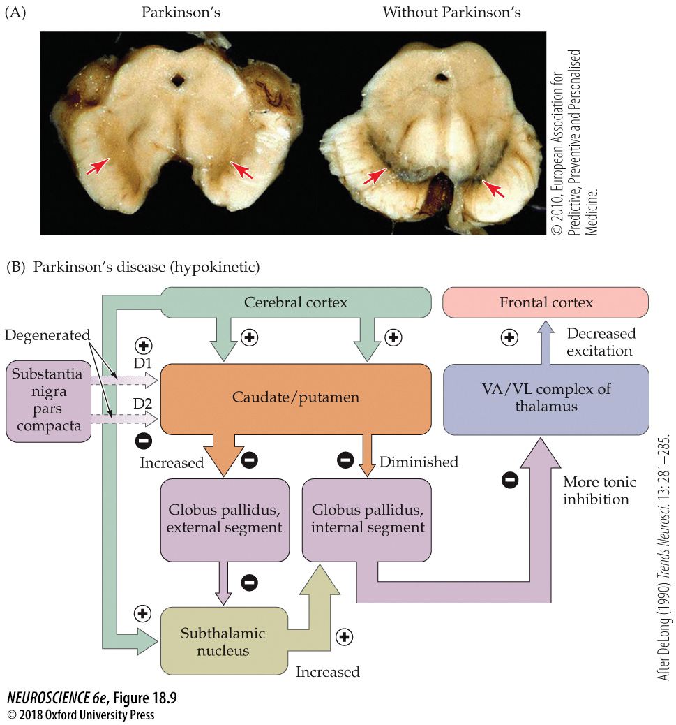
Parkinson’s Disease

Slide 12
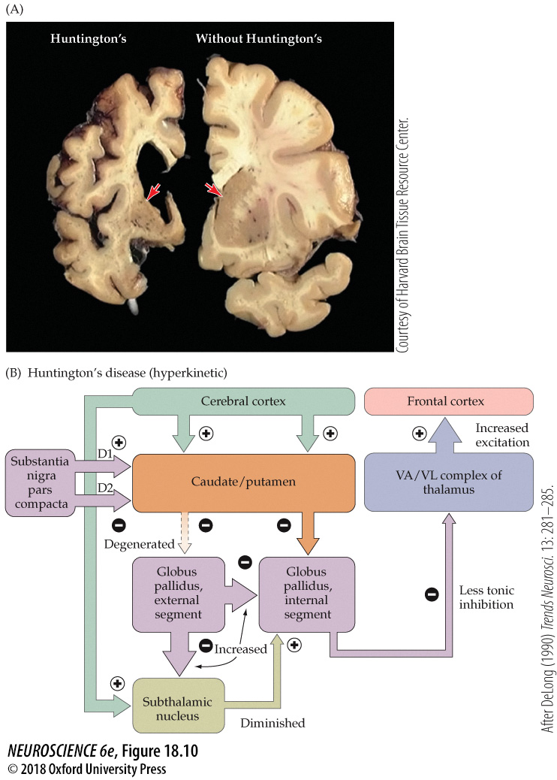
Huntington’s Disease

Slide 13
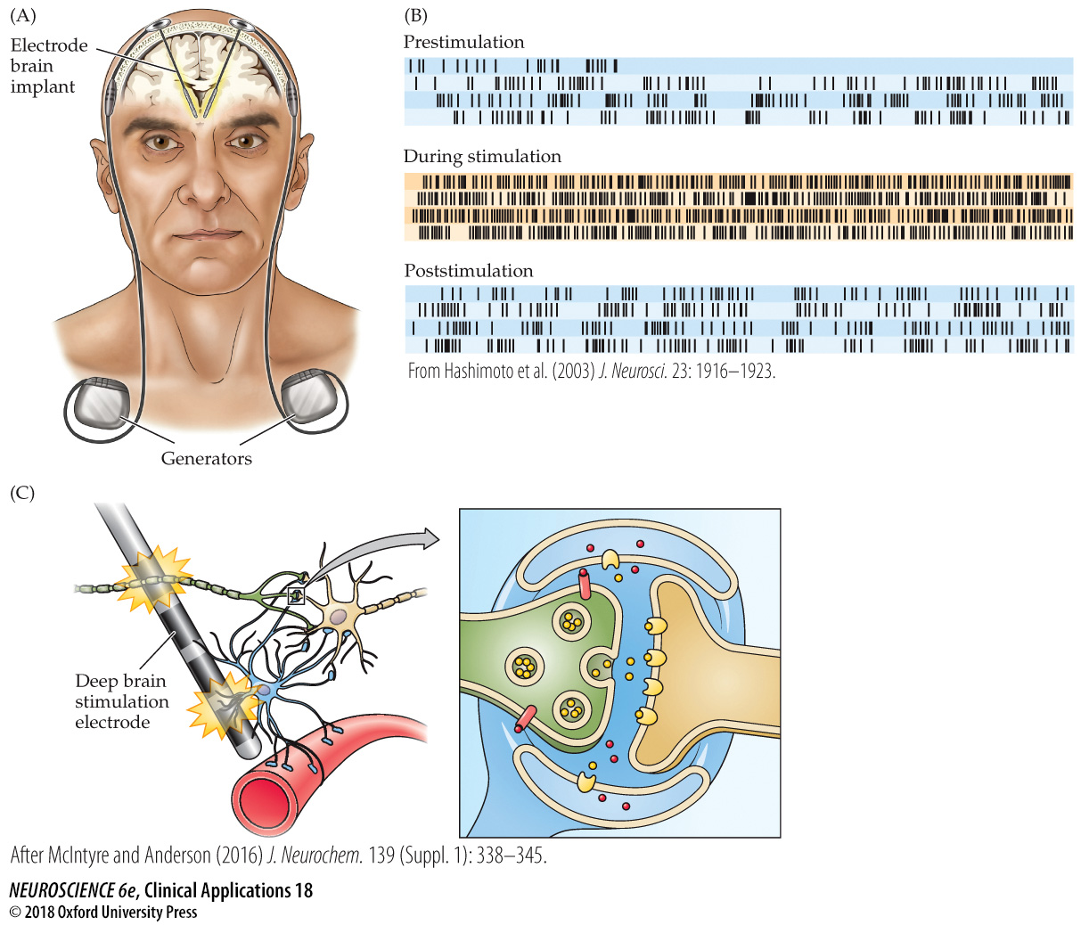
Deep brain stimulation

Slide 14
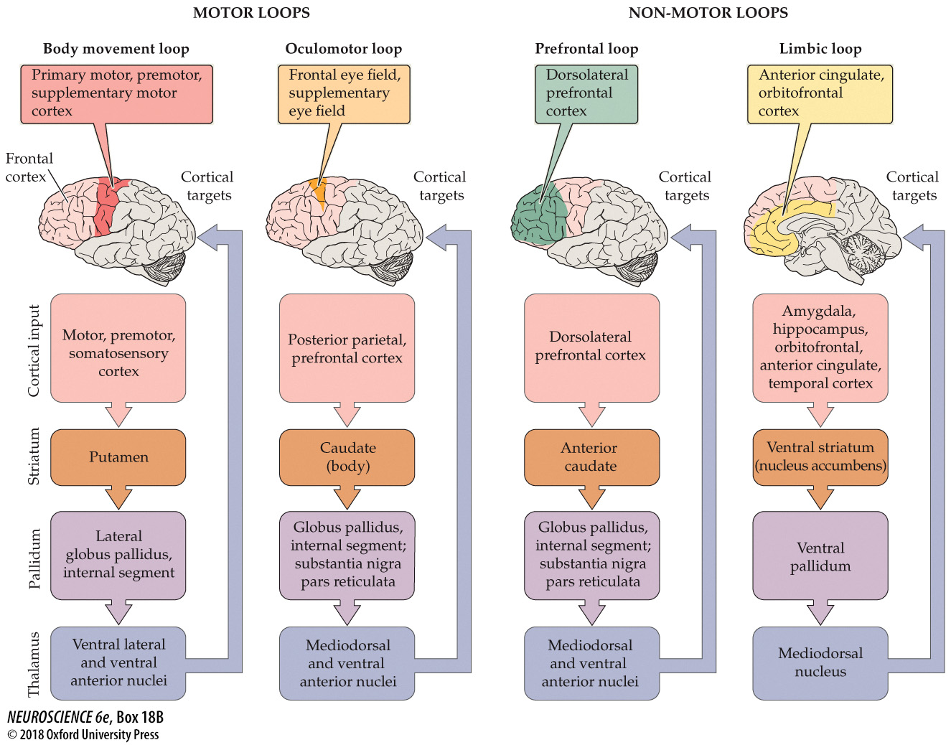
Basal ganglia loops and non-motor brain functions

