Slide 1
BEFORE WE GET STARTED: Please go to http://PollEv.com/emilyschafer216 in another browser for answering questions throughout discussion

Slide 2

BMD_ENG 301 Discussion 2: Cable Theory and Ion Channels
TA: Emily Schafer
emilyschafer2023@u.northwestern.edu October 4th and 7th

Slide 3
Question 1
Which of the following is a TRUE difference between graded potentials and action potentials?
A. Action potentials always hyperpolarize the cell, while graded potentials always depolarize the cell
B. Action potentials are an active response, while graded potentials are a passive response
C. Graded potentials are a response to a current stimulus, while action potentials are a response to a voltage stimulus
D. Graded potentials vary in frequency while action potentials do not
Go to: http://PollEv.com/emilyschafer216

Slide 4
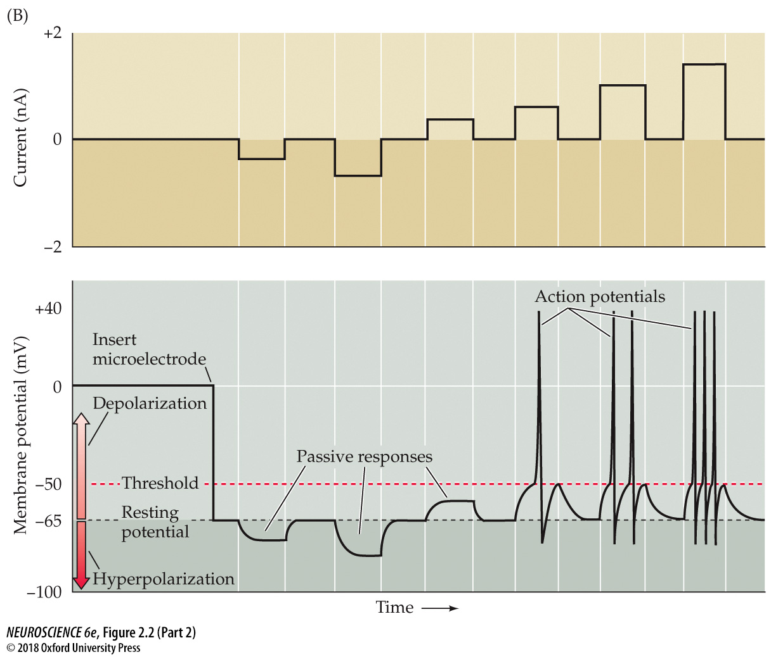

Slide 5
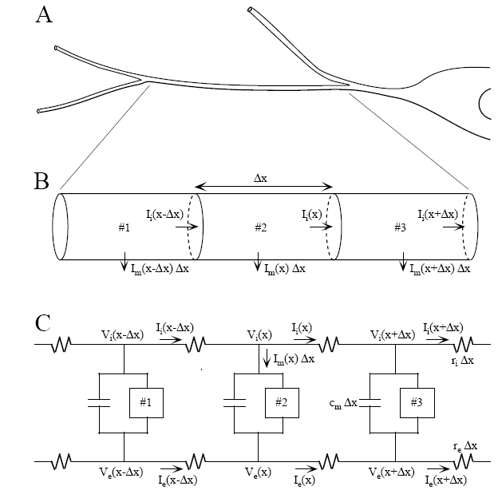
A. One portion of the dendritic tree
B. Divided into three sub-cylinders.
C. Discrete electrical model for the three sub-cylinders.

Slide 6
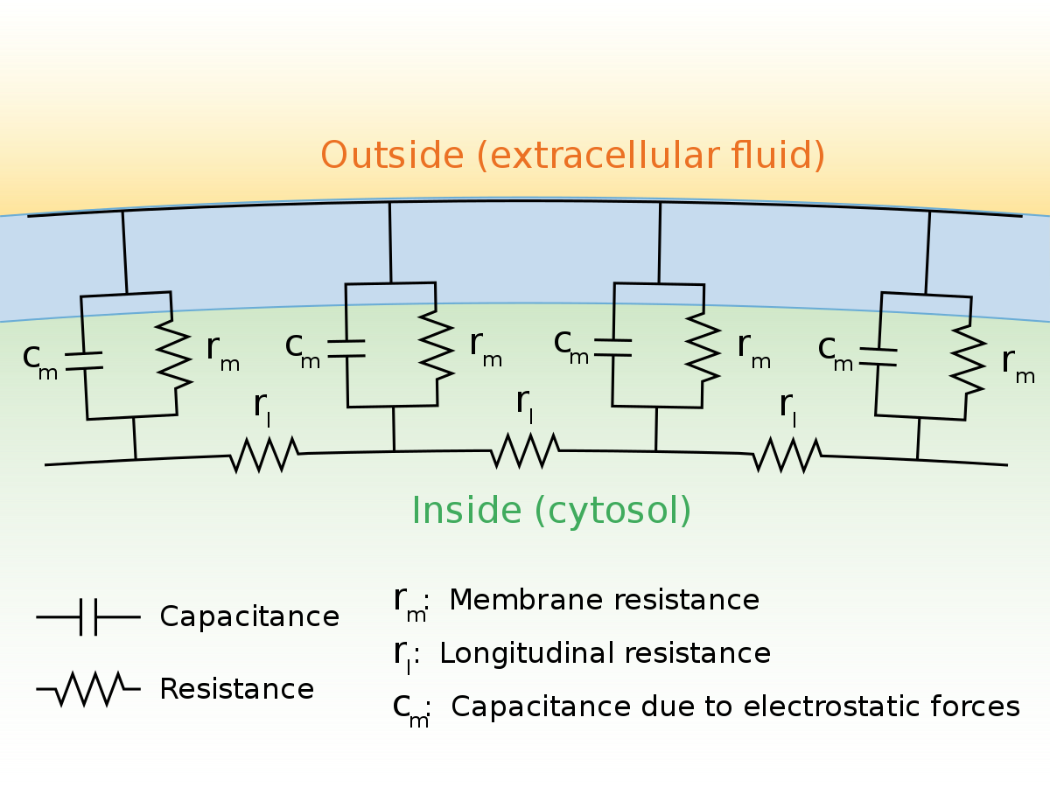
Ion transport
(assume membrane itself is infinitely high resistance)
Lipid bilayer

Slide 7
Question 2
What assumptions are made during Cable Theory to model the neuron cell membrane?
i. Ions can travel with no resistance in the cytosol and extracellular space.
ii. The total concentration of ions on each side of the membrane is always the same.
iii. The radial and angular components of the voltage in a dendrite can be neglected due to its morphology and high membrane resistivity
ii only
i and ii
ii and iii
i and iii
All of the above
Go to: http://PollEv.com/emilyschafer216

Slide 8
Question 3
In Cable Theory, the time constant of the circuit exists because of the ___, while the length constant exists because of the ___.
Membrane capacitance; membrane resistance
Membrane capacitance and membrane resistance; intracellular resistance
Membrane capacitance and membrane resistance; intracellular and membrane resistance
“space constant” and “length constant” are the same
Go to: http://PollEv.com/emilyschafer216

Slide 9
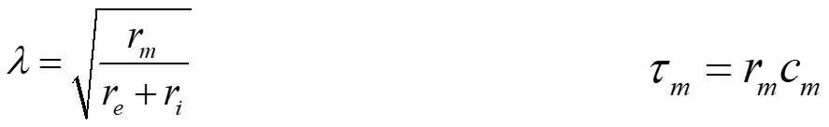
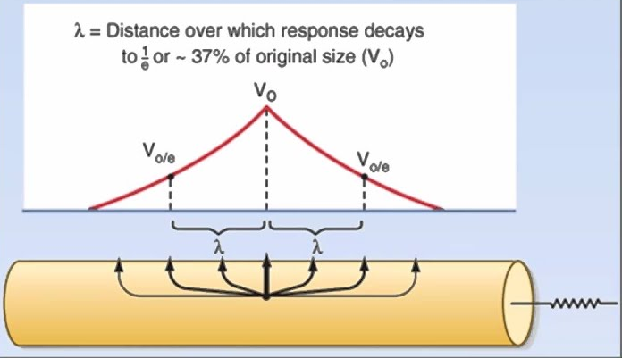
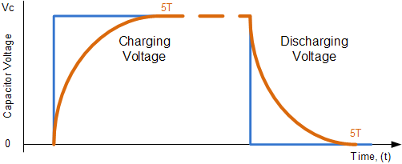
Remember – this (mostly) only applies to GRADED POTENTIALS.
can respond instantaneously to changes in current
requires charging and discharging time before reaching steady-state
Length constant
Time constant

Slide 10
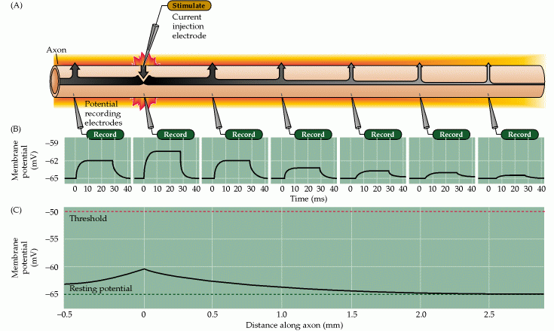
What does the effect of the length constant actually look like in real life?

Slide 11
Question 4
An imaginary neuron suddenly becomes perforated with small, permeable pores and thus has its membrane resistance drastically decreased. Which of the following would then be true?
A. The length constant of electrical signals would decrease
B. The capacitance of the membrane would take longer to charge and discharge
C. The intracellular resistance would increase
D. Less current would travel through the membrane capacitor
Go to: http://PollEv.com/emilyschafer216

Slide 12
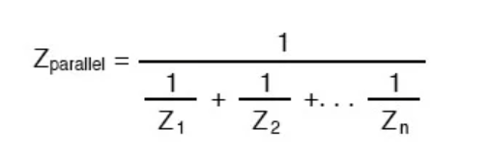
Question 4

Slide 13
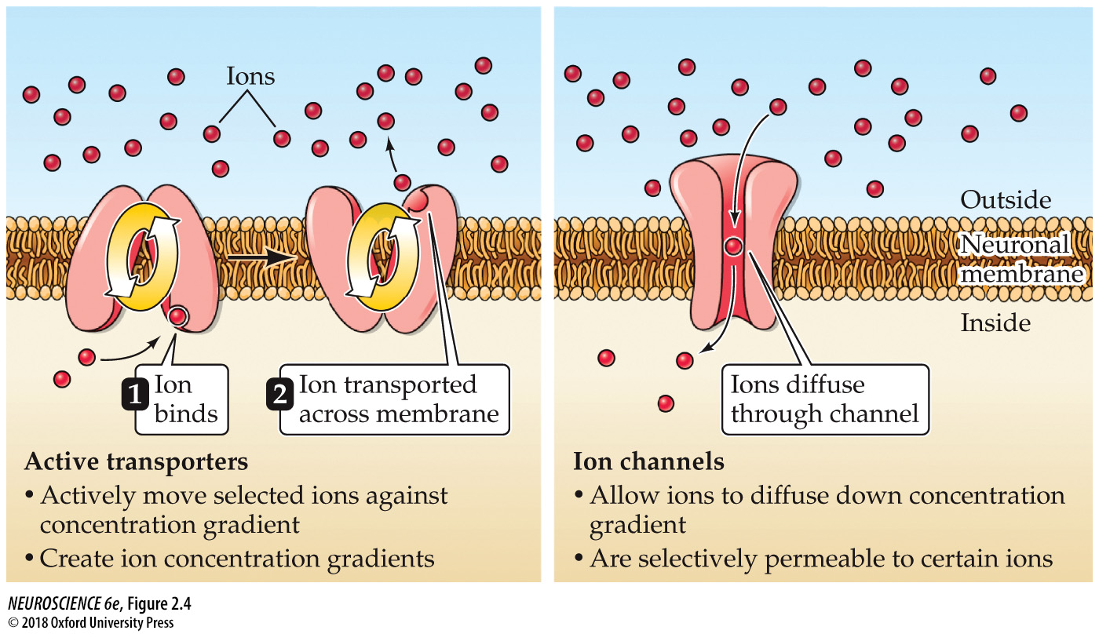
Ion Channels

Slide 14
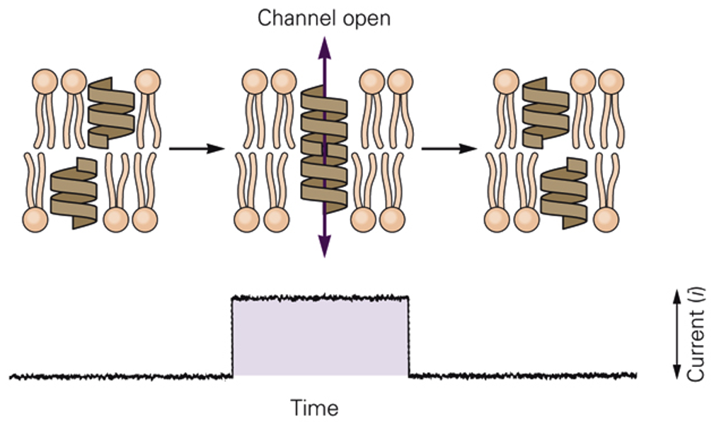
Ion Channels
Ion channel function
- a little more complicated: channel opening is probabilistic
- channels spontaneously open and close based on some sort of gating mechanism,
BUT the probabilities of opening/closing are not random!
- for this antibiotic (gramicidin A), it depends on alignment of two halves of channel
- natural channels have similar behavior, but for different reasons
Channels open and
allow ions to flow
Ions flowing creates
current

Slide 15

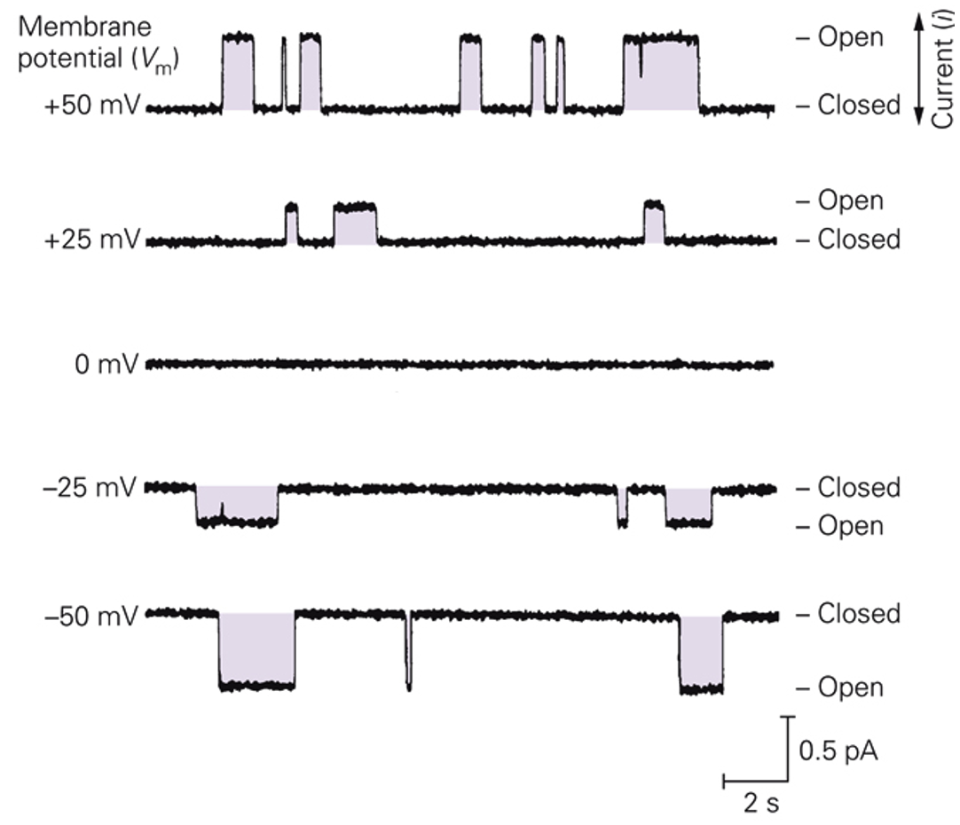
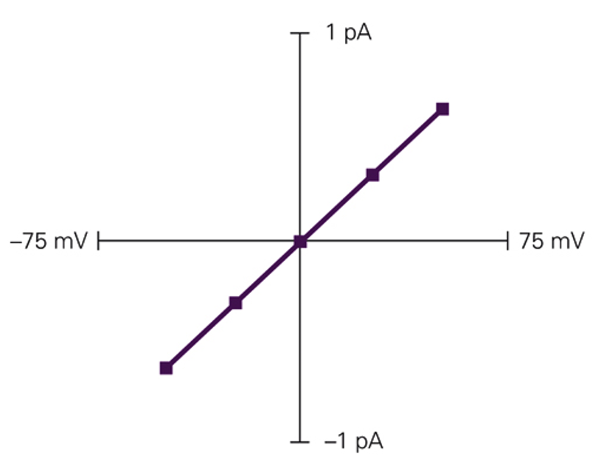
Ion Channels
Each ion has its own equilibrium potential:
Ion channel function
- current varies with membrane potential
plot current vs. voltage
“I-V curve”
Current out of the cell
Na⁺ ions move out of
the cell
inside of cell is
more negative
Slope = conductance
inside of cell is
more positive
Na⁺ ions move into
the cell
Current into the cell
For a single channel
For a population of channels

Slide 16
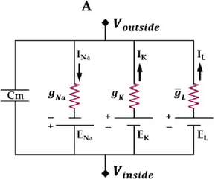
Ion Channels
Thévenin
theorem
Hodgkin-Huxley model
Resistor with a voltage offset (i.e. a battery)
- I = (V – E_{K})G
- E_{K} = reversal potential for K⁺
- (V-E_{K}) is the ‘driving force’ for K⁺
Again: For a population of channels

Slide 17
Question 5
Why is the equilibrium potential also called the reversal potential?
It is the voltage at which the orientation of the ion channel “reverses” in the cell membrane
It is the voltage at which the membrane potential of the neuron “reverses” due to ion movement
It is the voltage at which net flow of the ion “reverses” from into to out of the cell (or vice versa)
It is the voltage at which the membrane resistance “reverses” to become lower than the intracellular resistance
Go to: http://PollEv.com/emilyschafer216

Slide 18
Question 6
The conductance of an ion through the nerve membrane at any given time is best determined by:
The density of open ion channels selective to that ion
The concentration and electrical gradients of the ion
The total number of all ion channels in the membrane selective to that ion
The difference between the membrane potential and equilibrium potential for that ion
The movement of other ions across the membrane
Go to: http://PollEv.com/emilyschafer216

Slide 19
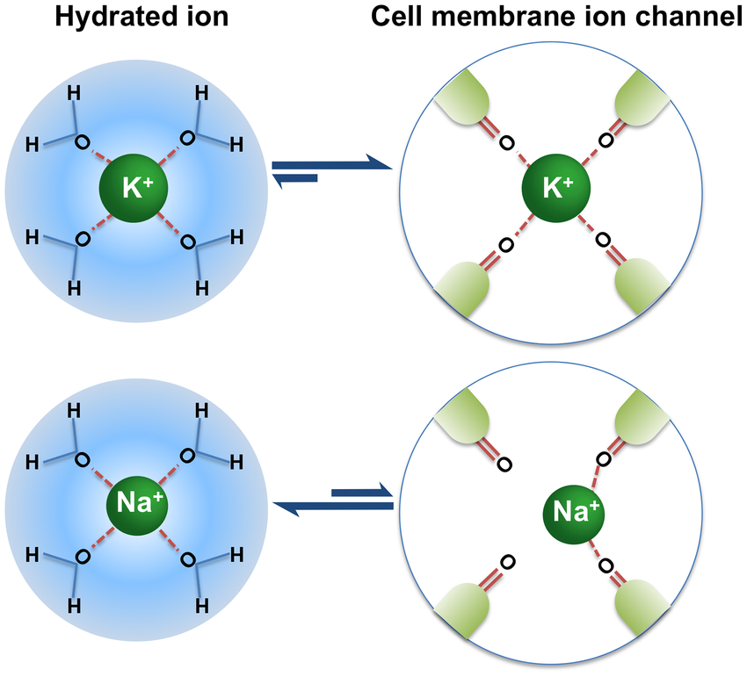
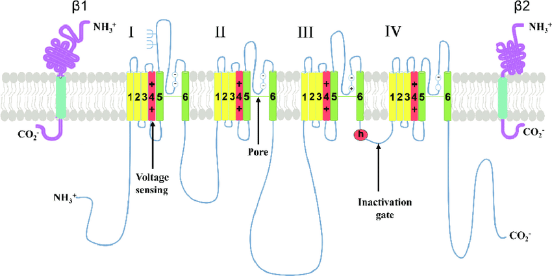
Ion Channels
What gives an ion channel its selectivity?
Charges of amino acids that make contact with the inner part of the pore
Size of the channel opening
For the potassium channel, i.e.:

Slide 20
Question 7
An imaginary neuron has an internal Cl⁻ ion concentration of 50 mM, while outside the cell the Cl⁻ ion concentration is 100 mM. Assuming the neuron is at a normal resting membrane potential, which choice below best describes the Cl⁻ ion?
Cl- ion movement into the cell is energetically favorable
The concentration gradient for Cl- ions favors movement into the cell, but the electrical gradient opposes inward movement of Cl-
Both the concentration gradient and electrical gradient favor movement of Cl- ions into the cell
Both the electrical and chemical gradients for Cl- ions favor outward movement of Cl- ions
Go to: http://PollEv.com/emilyschafer216

Slide 21
Question 8
Which statement below is FALSE about how the resting membrane potential of a neuron is maintained?
The Na+/K+ ATPase pump moves K+ ions into the cell and Na+ ions out of the cell to establish high concentration gradients
The negative membrane potential comes from leaky potassium channels that allow movement of K+ ions down their concentration gradient
The negative membrane potential comes from leaky sodium channels that allow movement of Na+ ions down their concentration gradient
Because the resting membrane potential is negative, there are more positive charges outside of the cell than inside the cell
Go to: http://PollEv.com/emilyschafer216

