Slide 1
BMD ENG 301 Quantitative Systems Physiology (Nervous System)
Overview of the Motor System
2022_v1
Professor Malcolm A. MacIver

Slide 2
Note correction to lecture 17: Not 200,000 motor units, rather 500,000 motor units in human body. Updated on Canvas (pptx and pdf) for Lecture 17.

Slide 3
Motor System Lecture Plan
Organization of the motor system
Alpha motor neuron and the motor unit
Muscle and the neuromuscular junction
Spinal reflexes
Myotatic reflex
Gamma motor neuron
Golgi tendon organ
Flexor reflex
Central pattern generators
Locomotion
Central motor program
Basal ganglia
Cerebellum
Notes:
neuro3e-15-unit-03.jpg

Slide 4
Motor System Lecture Plan
Organization of the motor system
Alpha motor neuron and the motor unit
Muscle and the neuromuscular junction
Spinal reflexes
Myotatic reflex
Gamma motor neuron
Golgi tendon organ
Flexor reflex
Central pattern generators
Locomotion
Central motor program
Basal ganglia
Cerebellum
Notes:
neuro3e-15-unit-03.jpg

Slide 5
dPM: dorsal pre-motor cortex
M1: primary motor cortex
PF: prefrontal cortex
SMA: supplementary motor area
S1: primary somatosensory cortex
V1: primary visual cortex
BG: basal ganglia
C: cerebellum
RF: reticular formation
RN: red nucleus
VN: vestibular nucleus
What is missing?

Slide 6
dPM: dorsal pre-motor cortex
M1: primary motor cortex
PF: prefrontal cortex
SMA: supplementary motor area
S1: primary somatosensory cortex
V1: primary visual cortex
BG: basal ganglia
C: cerebellum
RF: reticular formation
RN: red nucleus
VN: vestibular nucleus
Thalamus

Slide 7
Red: Motor control
Blue: Somatosensation (proprioception)
Black: Intrabrain communication
Green: Vision

Slide 8
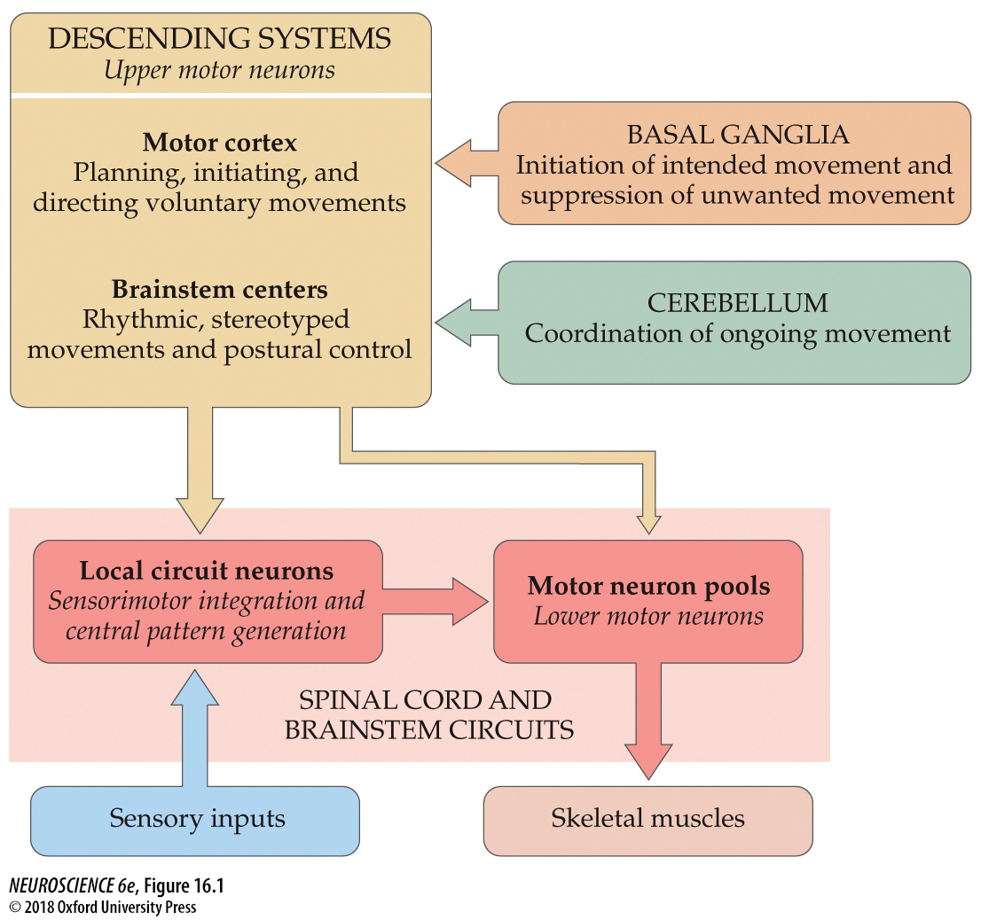
FIGURE 16.1 Organization of neural structures involved in the control of movement
Notes:
FIGURE 16.1 Organization of neural structures involved in the control of movement. Four systems—local spinal cord and brainstem circuits, descending control centers in the cerebral cortex and brainstem, the cerebellum, and the basal ganglia—make essential and distinct contributions to motor control.

Slide 9
Hierarchy of Motor Control
STRUCTURE | BEHAVIORS
Spinal Cord and Muscle | Basic reflexes and “preflexes”; basic coordination patterns
Brainstem | Multi-limb reflexes; postural stabilization
Cortex/telencephalon | Goals and planning; flexible sensorimotor tuning; adaptation
Preflexes are zero delay viscoelastic responses of muscle that correct for unintended stretch

Slide 10
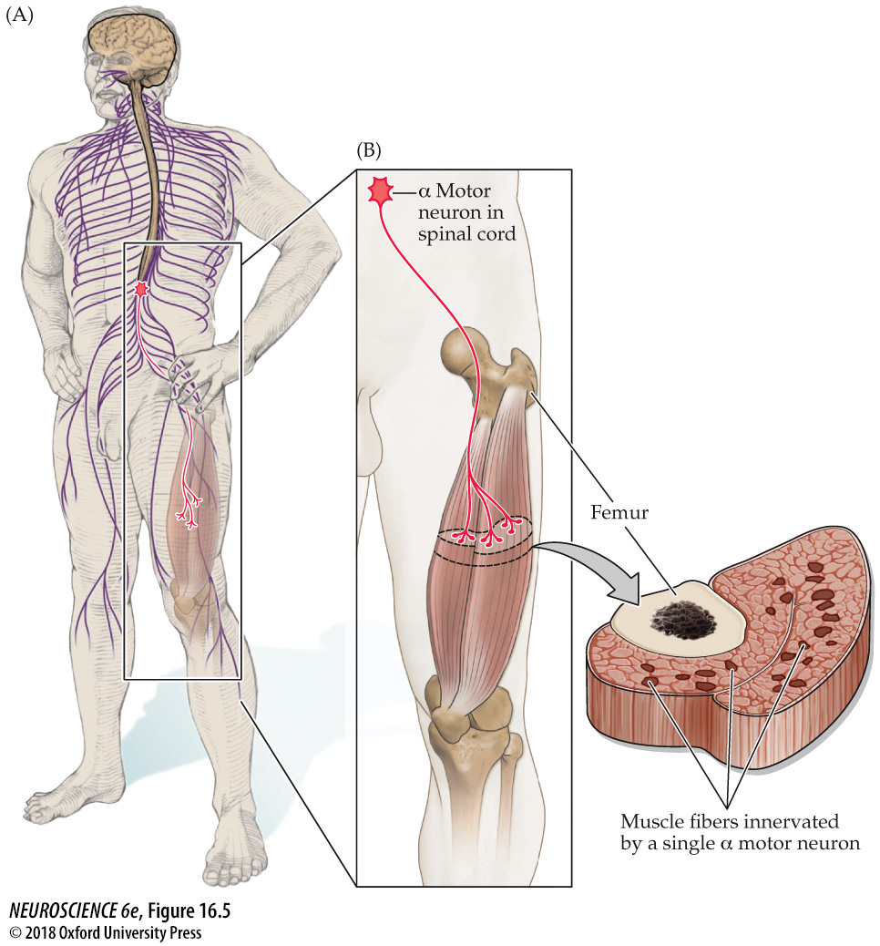
FIGURE 16.5 The motor unit
Notes:
FIGURE 16.5 The motor unit. (A) Diagram showing a lower motor neuron in the spinal cord and the course of its axon to its target muscle. (B) Each α motor neuron synapses with multiple fibers in the muscle. The α motor neuron and the muscle fibers it contacts define the motor unit. The cross section through the muscle shows the relatively diffuse distribution of muscle fibers (dark red) contacted by a single α motor neuron.

Slide 11
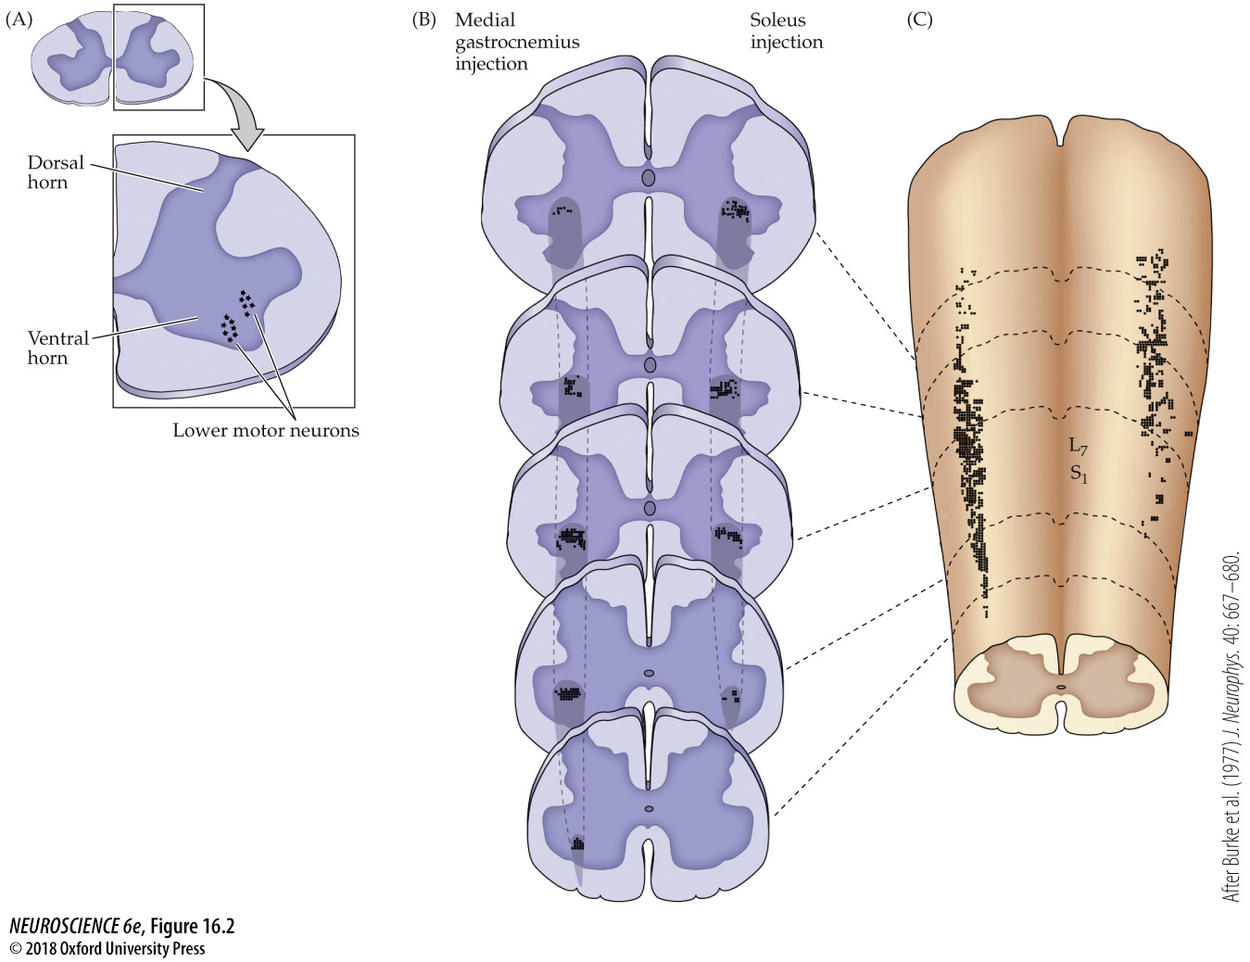
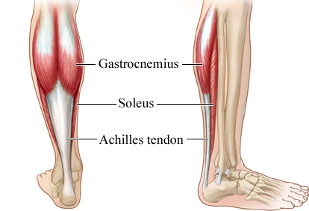
FIGURE 16.2 Distribution of lower motor neurons in the ventral horn of the spinal cord
Notes:
FIGURE 16.2 Distribution of lower motor neurons in the ventral horn of the spinal cord. Motor neurons were identified by injecting a retrograde tracer into either the medial gastrocnemius or soleus muscle of the cat, thus labeling neuronal cell bodies and revealing their spatial distribution. A transverse section through the lumbar level of the spinal cord (A) shows lower motor neurons forming distinct, rod-shaped clusters (motor neuron pools) in the ipsilateral ventral horn. Spinal cord cross sections (B) and a reconstruction seen from the dorsal surface (C) illustrate the distribution of motor neurons innervating individual skeletal muscles in both axes of the cord. The rodlike shape and distinct distribution of different motor neuron pools are especially evident in the dorsal view of the reconstructed cord. The dashed lines in (C) represent the locations of individual lumbar and sacral spinal cord sections shown in (B). (After Burke et al., 1977.)

Slide 12
FIGURE 16.2 Distribution of lower motor neurons in the ventral horn of the spinal cord
Motor neuron pools
Notes:
FIGURE 16.2 Distribution of lower motor neurons in the ventral horn of the spinal cord. Motor neurons were identified by injecting a retrograde tracer into either the medial gastrocnemius or soleus muscle of the cat, thus labeling neuronal cell bodies and revealing their spatial distribution. A transverse section through the lumbar level of the spinal cord (A) shows lower motor neurons forming distinct, rod-shaped clusters (motor neuron pools) in the ipsilateral ventral horn. Spinal cord cross sections (B) and a reconstruction seen from the dorsal surface (C) illustrate the distribution of motor neurons innervating individual skeletal muscles in both axes of the cord. The rodlike shape and distinct distribution of different motor neuron pools are especially evident in the dorsal view of the reconstructed cord. The dashed lines in (C) represent the locations of individual lumbar and sacral spinal cord sections shown in (B). (After Burke et al., 1977.)

Slide 13
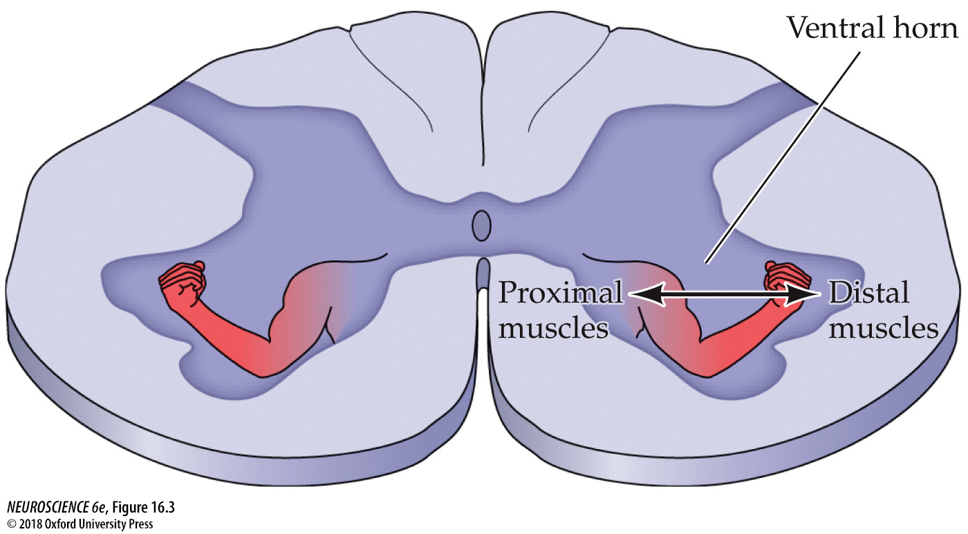
FIGURE 16.3 Somatotopic organization of lower motor neuron pools
Notes:
FIGURE 16.3 Somatotopic organization of lower motor neuron pools. A cross section of the ventral horn at the cervical level of the spinal cord, illustrating that the motor neurons innervating the axial musculature are located medially, whereas those innervating the distal musculature are located more laterally.

Slide 14
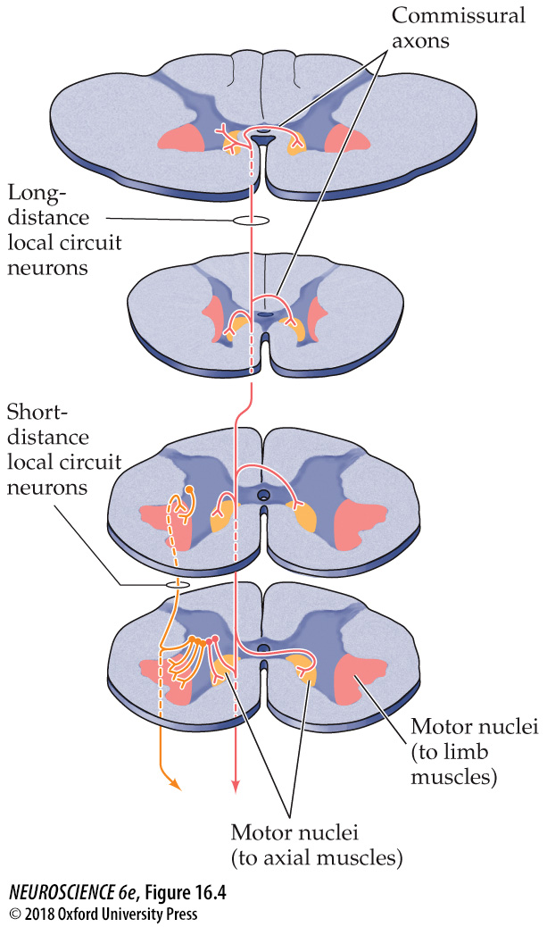
FIGURE 16.4 Local circuit neurons in the spinal cord gray matter
Notes:
FIGURE 16.4 Local circuit neurons in the spinal cord gray matter. Local circuit neurons that supply the medial region of the ventral horn are situated medially within the intermediate zone of the spinal cord gray matter. Their axons (red) extend over several spinal cord segments and terminate bilaterally. Those local circuit neurons that supply the lateral parts of the ventral horn are located more laterally; their axons (orange) extend over just a few spinal cord segments, always terminating on the same side of the cord as the cell body. Pathways that contact the medial parts of the spinal cord gray matter are involved primarily in the control of posture and locomotion; those that contact the lateral parts are involved in the fine control of the distal extremities.

Slide 15
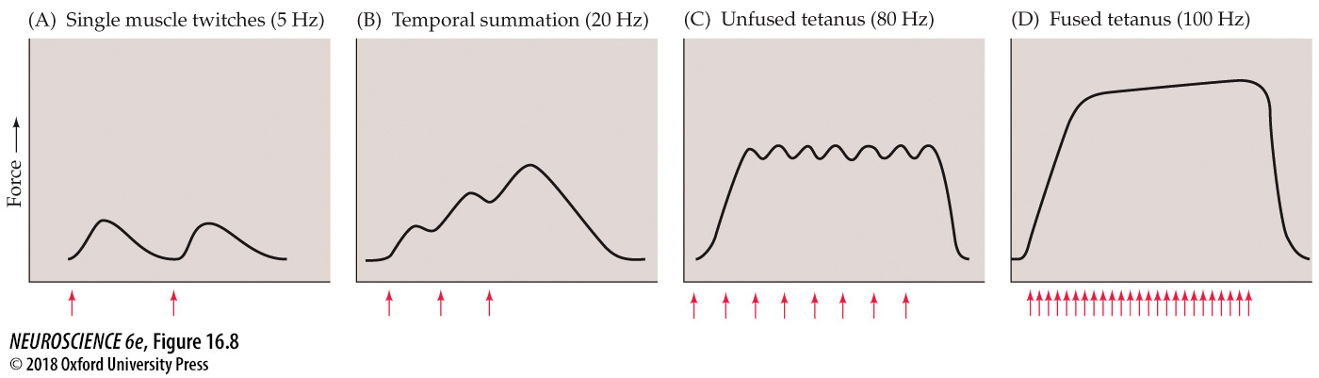
FIGURE 16.8 Effect of stimulation rate on muscle tension
Twitch: The cycle of muscle contraction and relaxation resulting from a single α motor neuron action potential
Notes:
FIGURE 16.8 Effect of stimulation rate on muscle tension. (A) At low frequencies of stimulation (red arrows), each action potential in the motor neuron results in a single twitch of the related muscle fibers. (B) At higher frequencies, the twitches sum to produce a force greater than that produced by single twitches. (C) At a still higher frequency of stimulation, the force produced is greater, but individual twitches are still apparent. This response is referred to as unfused tetanus. (D) At the highest rates of motor neuron activation, individual twitches are no longer apparent—a condition called fused tetanus.

Slide 16
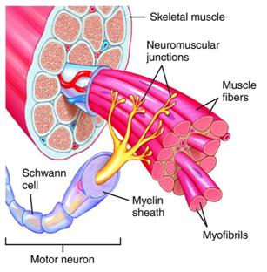
Motor Unit
Single α motor neuron and the muscle fibers that its axon innervates
Smallest unit of force generated by the motor system
Motor units and α motor neurons vary in size

Slide 17
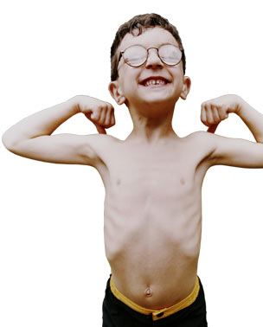

Alpha Motor Neurons
Small alpha motoneurons
Innervate few fibers
Generates small forces
Enable precise movements (i.e., fractionation of movement, eye movement)
Large alpha motoneurons
Innervate many fibers
Generate strong, powerful forces
Ex: Gastrocnemius

Slide 18
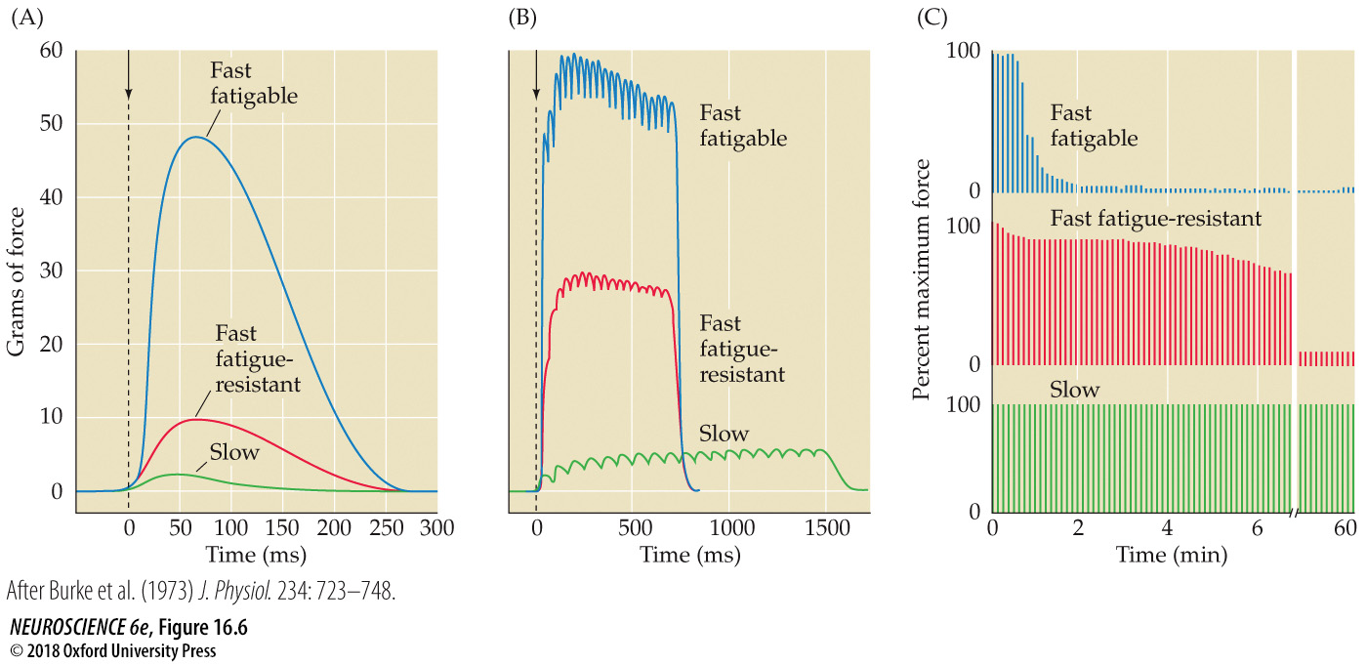
FIGURE 16.6 Force and fatigability of the three different types of motor units
Notes:
FIGURE 16.6 Force and fatigability of the three different types of motor units. In each case, the response reflects stimulation of a single α motor neuron. (A) Change in muscle tension in response to a single action potential. (B) Tension in response to repetitive stimulation of each type of motor unit. (C) Response to repeated stimulation at a level that initially evokes maximum tension. The ordinate represents the force generated by each stimulus. Note the different time scales in the three panels and the strikingly different tensions generated and fatigue rates among motor units. (After Burke et al., 1973.)

Slide 19
Types of motor units
 | Slow | Fast Fatigue Resistant | Fast Fatigable
Innervated by: | Small α motor neurons |  | Large α motor neurons
Made of: | Small red muscle fibers |  | Larger pale muscle fibers
Fatigue: | Resistant to fatigue |  | Easily fatigued
Speed of contraction: | Slow |  | Fast
Force generated: | Small |  | Large
Used for: | Posture |  | Running, jumping
Intermediate

Slide 20
Types of motor units
 | Slow | Fast Fatigue Resistant | Fast Fatigable
Innervated by: | Small α motor neurons |  | Large α motor neurons
Made of: | Small red muscle fibers |  | Larger pale muscle fibers
Fatigue: | Resistant to fatigue |  | Easily fatigued
Speed of contraction: | Slow |  | Fast
Force generated: | Small |  | Large
Used for: | Posture |  | Running, jumping
Intermediate

Slide 21
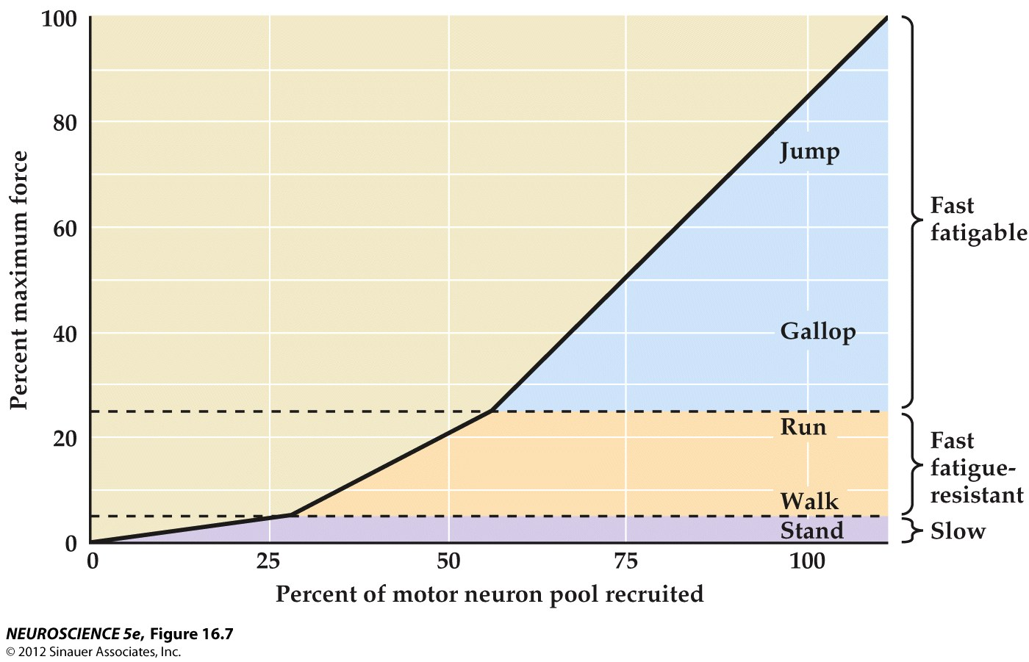
Motor neuron recruitment in the cat medial gastrocnemius muscle under different behavioral conditions
SIZE PRINCIPLE

Slide 22
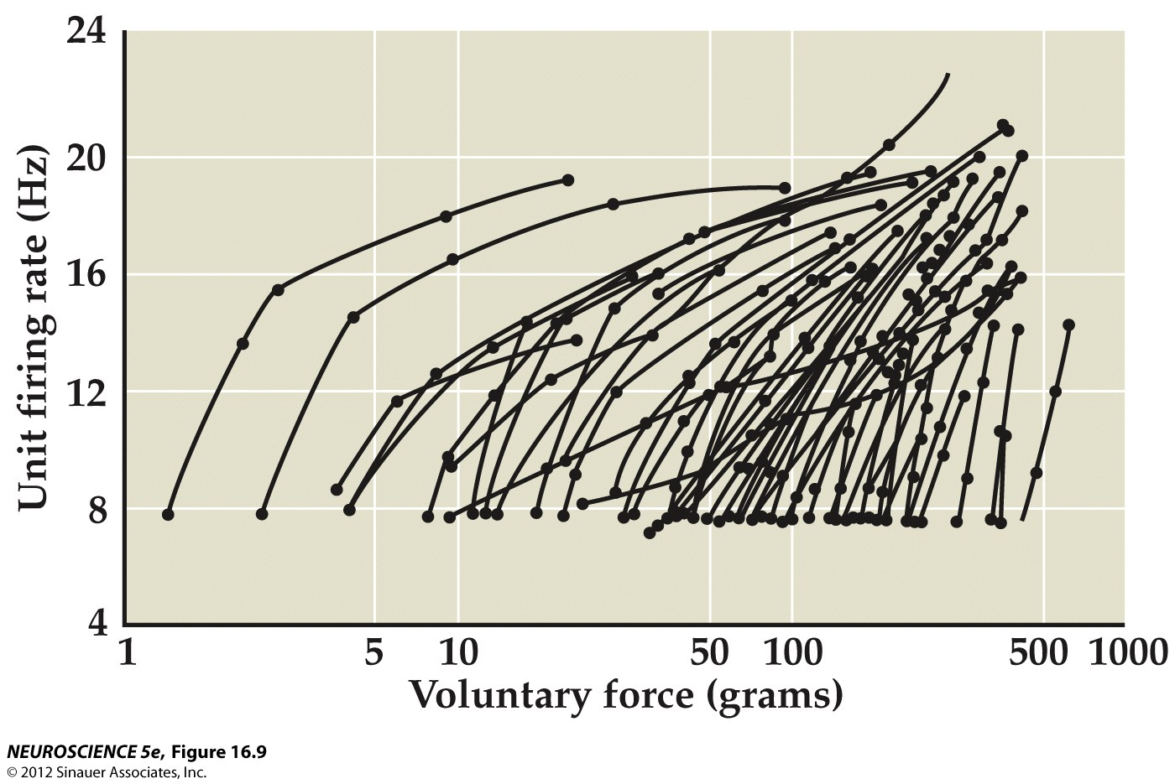
The number of active motor units and their rate of firing both increase with voluntary force

Slide 23
Features of α motor neurons
 | That innervate small motor units |  | That innervate large motor units
Axonal diameter | Smaller |  | Larger
Input resistance | Larger |  | Smaller
Excitability | Greater |  | Lesser
EPSP amplitude | Larger |  | Smaller
Duration of after-hyperpolarization | Longer |  | Shorter
 | -Easily depolarized -Slow rate of firing -Control slow muscle fibers needed for posture |  | -Difficult to depolarize -Fast rate of firing -Control fibers that produce max force used for jumping
Cont
I
nuum
Intermediate

Slide 24
Increase motor unit size, alpha motor neuron exhibits:
Increased | Decreased
Cell body size | Input resistance
Dendritic Complexity | Excitability
Short-term EPSP potentiation with repeated activation | Ia EPSP amplitude
Axonal diameter (i.e. faster conduction) | PSP decay constant
Number of axonal branches (i.e., more muscle fibers innervated) | Duration of after-hyperpolarization

Slide 25
Notes:
thresholds reached only when rapid movements requiring great force are made
Increased:
Cell body size
Dendritic complexity
Short-term EPSP potential with repeated activation
Axonal diameter (faster conduction)
Number of axonal branches (more muscle fibers innervated)
Decreased:
Input resistance
Excitability
1a EPSP amplitude
PSP decay constant
Duration of after-hyperpolarization

