Slide 1
BMD ENG 301 Quantitative Systems Physiology (Nervous System)
Overview of the Motor System (Part 2)
Start of spinal reflexes
Professor Malcolm MacIver

Slide 2
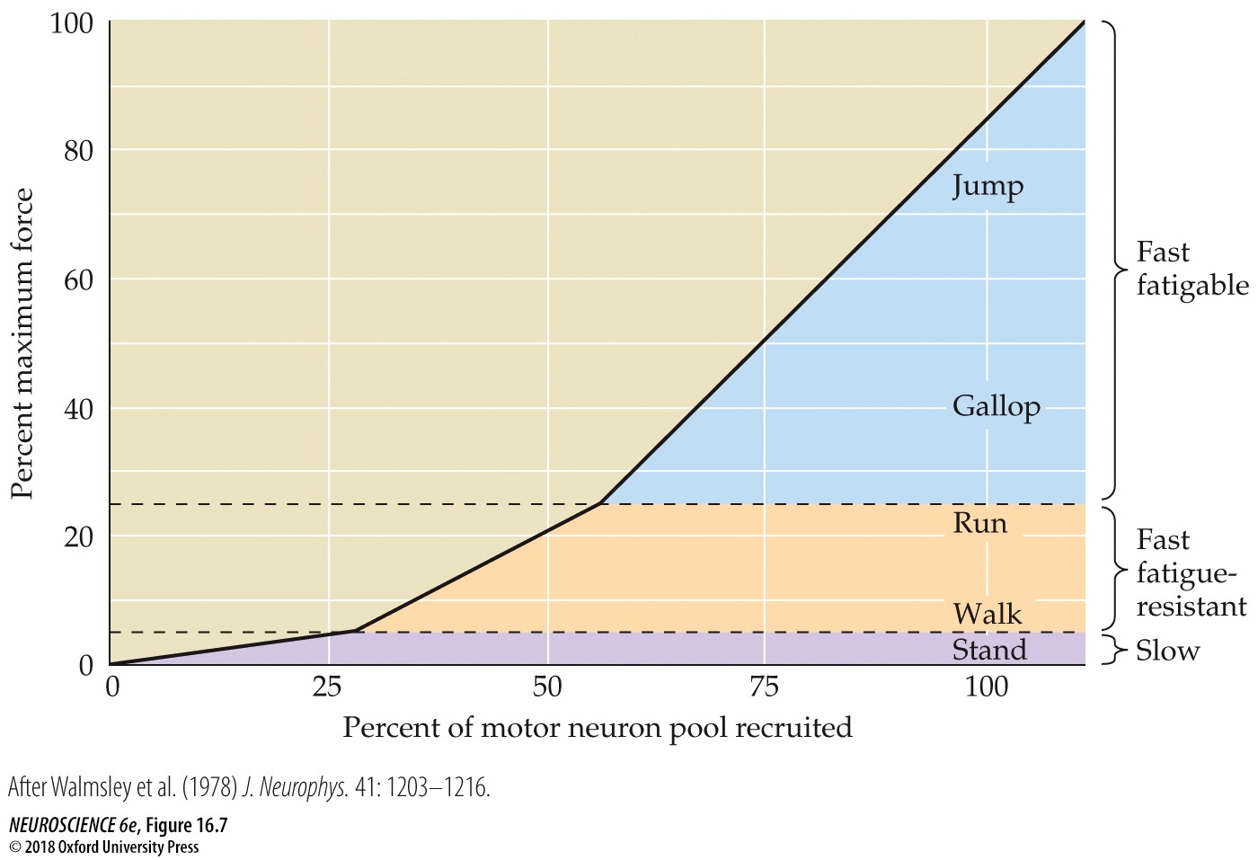
FIGURE 16.7 Motor neuron recruitment in the cat medial gastrocnemius muscle under different behavioral conditions
Notes:
FIGURE 16.7 Motor neuron recruitment in the cat medial gastrocnemius muscle under different behavioral conditions. Slow (S) motor units provide the tension required for standing. Fast fatigue-resistant (FR) motor units provide the additional force needed for walking and running. Fast fatigable (FF) motor units are recruited for the most strenuous activities, such as jumping. (After Walmsley et al., 1978.)

Slide 3
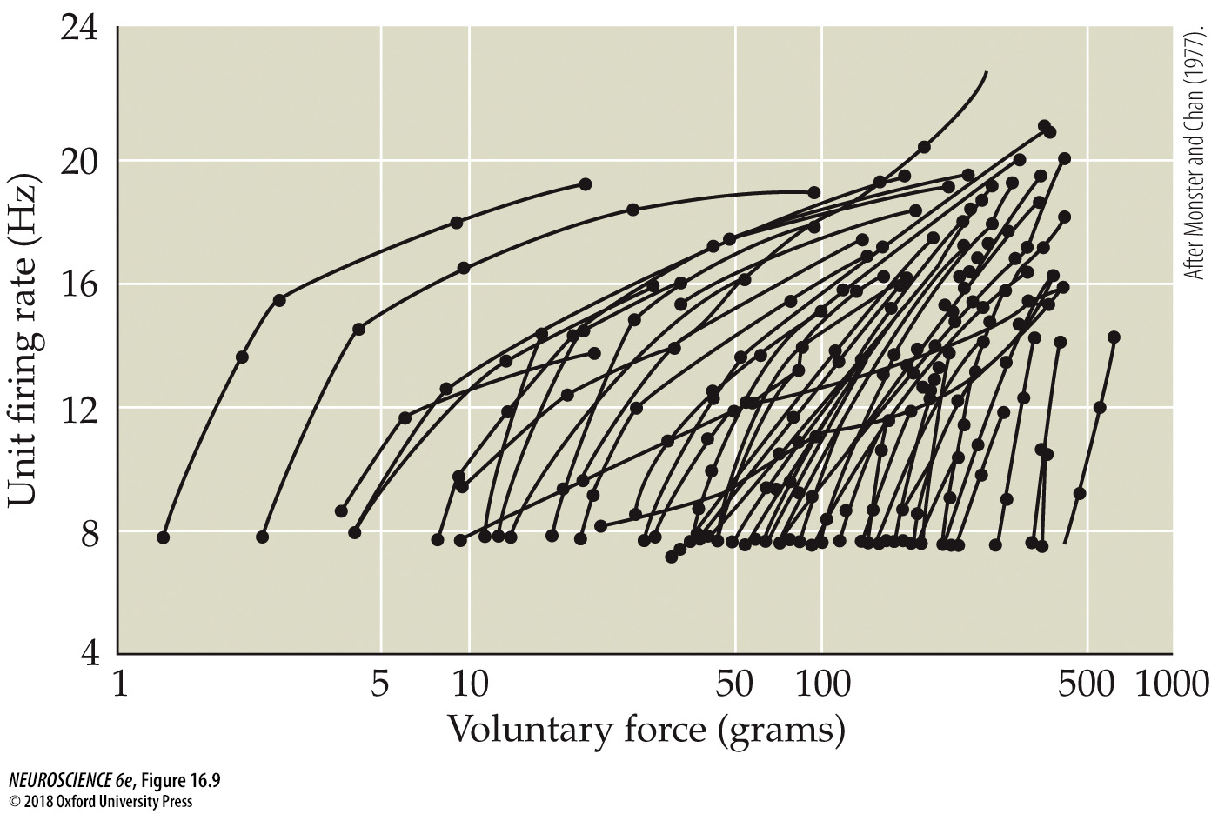
FIGURE 16.9 The number of active motor units and their rate of firing both increase with voluntary force
Notes:
FIGURE 16.9 The number of active motor units and their rate of firing both increase with voluntary force. Motor unit firing in a muscle of the human hand (each unit is represented here by a single trace) was recorded transcutaneously as the amount of voluntary force produced by the individual progressively increased. The lowest-threshold motor units generate the least amount of voluntary force and are recruited first. As the individual generates more and more force, both the number and the rate of firing of active motor units increase. (Note that all motor units fire initially at about 8 Hz.) (After Monster and Chan, 1977.)

Slide 4
Features of α motor neurons
 | That innervate small motor units |  | That innervate large motor units
Axonal diameter | Smaller |  | Larger
Input resistance | Larger |  | Smaller
Excitability | Greater |  | Lower
EPSP amplitude | Larger |  | Smaller
Duration of after-hyperpolarization | Longer |  | Shorter
 | -Easily depolarized -Slow rate of firing -Control slow muscle fibers needed for posture |  | -Difficult to depolarize -Fast rate of firing -Control fibers that produce max force used for jumping
Cont
I
nuum
Intermediate

Slide 5
Increase motor unit size, alpha motor neuron exhibits:
Increased | Decreased
Cell body size | Input resistance
Dendritic Complexity | Excitability
Short-term EPSP potentiation with repeated activation | Ia EPSP amplitude
Axonal diameter (i.e. faster conduction) | PSP decay constant
Number of axonal branches (i.e., more muscle fibers innervated) | Duration of after-hyperpolarization

Slide 6
Notes:
thresholds reached only when rapid movements requiring great force are made
Increased:
Cell body size
Dendritic complexity
Short-term EPSP potential with repeated activation
Axonal diameter (faster conduction)
Number of axonal branches (more muscle fibers innervated)
Decreased:
Input resistance
Excitability
1a EPSP amplitude
PSP decay constant
Duration of after-hyperpolarization

Slide 7
Motor System Plasticity
Nervous system is extremely plastic
Growth and development
Injury
Training
Upper motor centers vs. motor unit plasticity
Aids in understanding of motor neuron and muscle physiology
Great implications in training and rehabilitation

Slide 8
Motor system plasticity
Modification of strength and endurance of motor behavior through experience
Depends partly on changes in motor unit phenotype
But MAINLY on changes in supraspinal motor centers

Slide 9
Motor System Plasticity
Nervous system is extremely plastic
Growth and development
Injury
Training
Upper motor centers vs. motor unit plasticity
Aids in understanding of motor neuron and muscle physiology
Great implications in training and rehabilitation

Slide 10
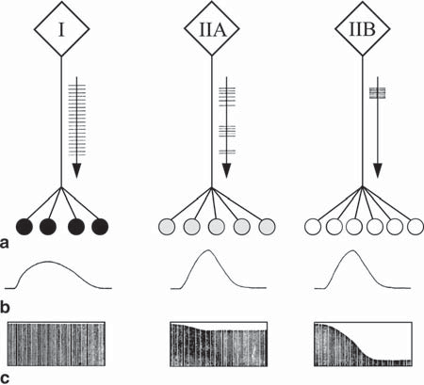
Types of Motor Unit
3 types of alpha motor neuron
Excitability
Discharge frequency
3 types of muscle fibers
Contraction speed
Fatigability

Slide 11
Motor unit plasticity
Motor units are important site of plasticity in the nervous system
Results of studies with cross-innervation and electrical stimulation show properties of motor neurons determine muscle fiber behavior
Motor unit behavior is modified by training
Important implications for exercise and rehabilitation programs

Slide 12
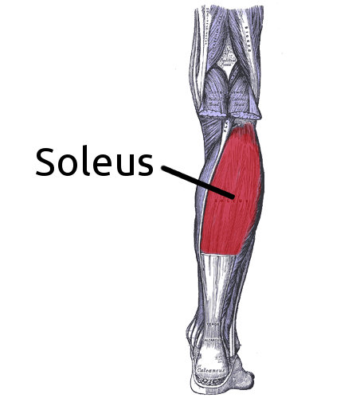
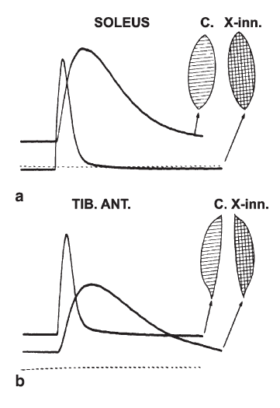
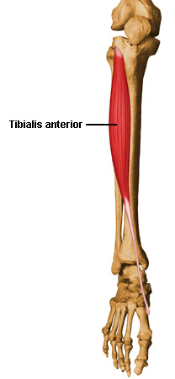
Cross-Innervation
Soleus- slow muscle with constant, low frequency innervation
TA- fast muscle with intermittent, high frequency innervation
With cross-innervation:
Soleus become fast
TA became slow
Shows motorneuron innervation determines muscle fiber phenotype
Tibius
anterior

Slide 13
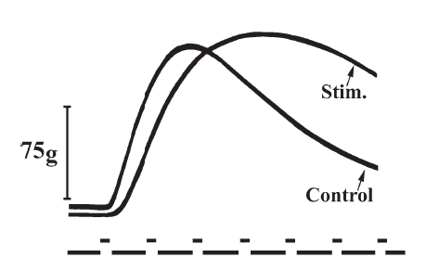
Electrical Stimulation
Electrical stimulation can change behavior of muscle fiber
Frequency dependence
Electrical stimulation at low frequencies can prevent slow muscle from becoming fast muscle with disuse
Fast muscle stimulated at 10 Hz

Slide 14
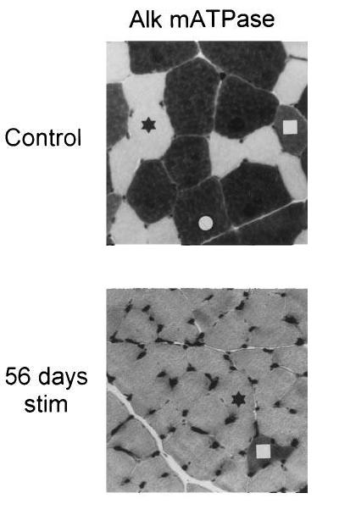
Cross-innervation experiments
Stained muscle for myosin ATPase activity
Before
Fast fatigable and fast fatigue resistant fibers are darker
Slow fibers are lighter
After chronic electrical nerve stimulation similar to the innervation that slow fibers receive
Almost all fibers show phenotype of slow fibers (lighter)
Before
Fast fatigable fiber
Fast fatigue resistant fiber
Slow

Slide 15
Motor Unit Plasticity
Ability of motor neurons and the muscles they innervate to change physically and functionally
Acquire new motor skills
Modify the strength and endurance of motor behavior
Notes:
Plasticity in general refers to structural or functional changes in the nervous system, or the ability to make such changes

Slide 16
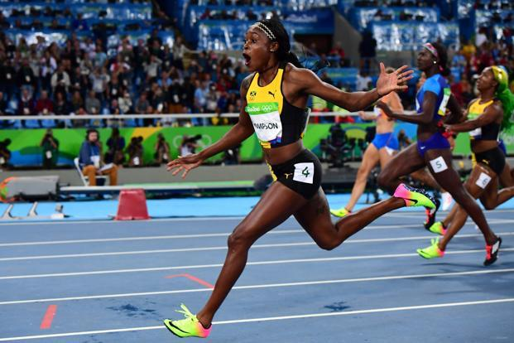
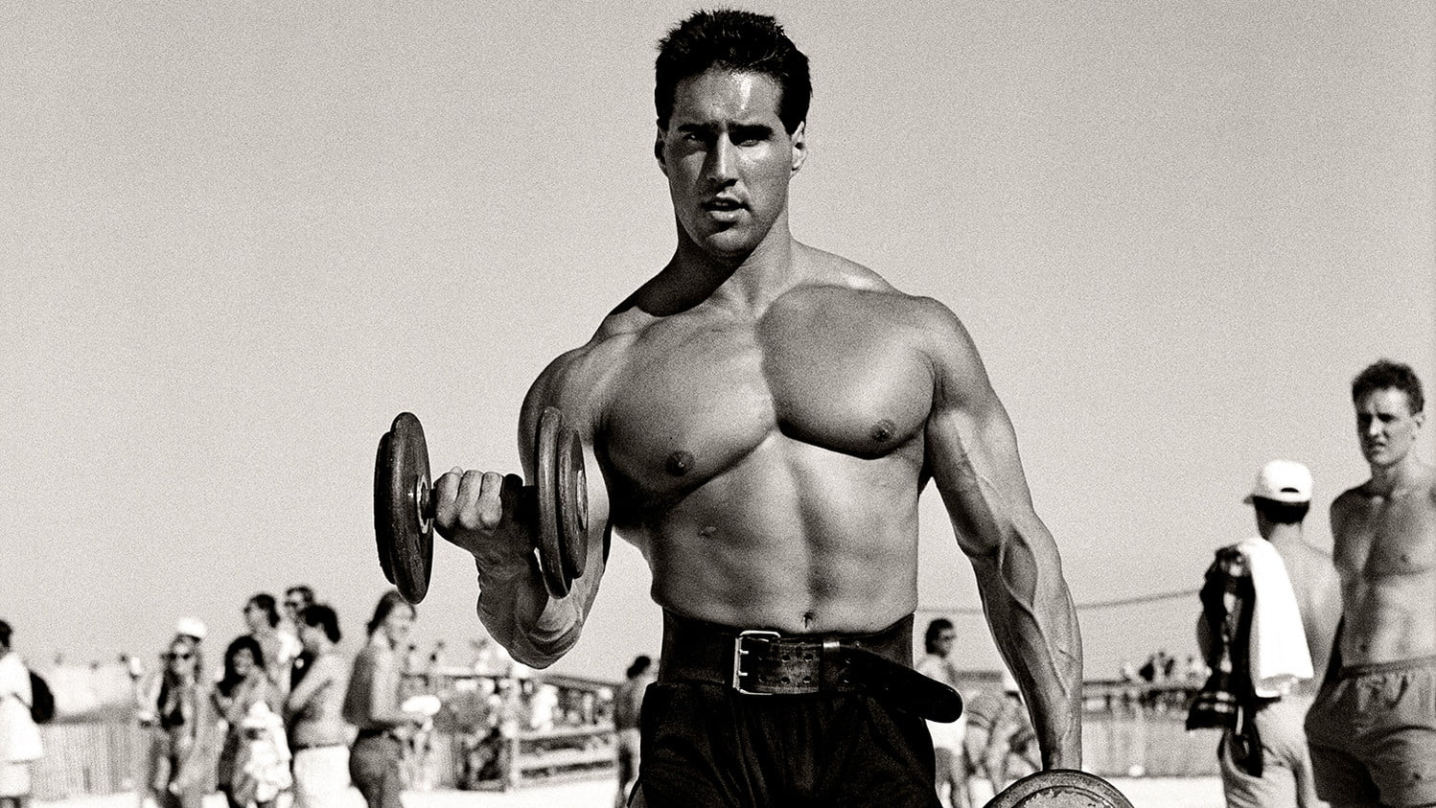
Adaptations from resistance and endurance training
In general exercise:
slows the contractile properties of motor units
Increases endurance of fibers
The impact of exercise is proportional to the order of recruitment
Exercise has a greater impact on slow motor units at low exertion levels
Only has an impact on fast fibers if high intensity exercise is performed

Slide 17
Exercise in Humans
Most commonly, exercise “slows” contractile properties of motor units while increasing endurance and strength of muscle fibers
S motor units affected most at low exertion levels
FR and FF motor units affected only if recruited by higher intensities of exercise
Notes:
Sprinters have larger proportion of powerful, but rapidly fatiguing, pale fibers in their leg muscles than do marathon runners

Slide 18
Unilateral and Imagined Exercise
Appreciable gains shown in non-exercised limb
Recruitment and adaptation of central neural circuits that have access to contralateral motor units
Documented gains in muscle strength with imagined exercise

Slide 19
Unilateral and Imagined Exercise
Appreciable gains shown in non-exercised limb
Recruitment and adaptation of central neural circuits that have access to contralateral motor units
Documented gains in muscle strength with imagined exercise

Slide 20
Unilateral and Imagined Exercise
Appreciable gains shown in non-exercised limb
Recruitment and adaptation of central neural circuits that have access to contralateral motor units
Documented gains in muscle strength with imagined exercise

Slide 21
BMD ENG 301 Quantitative Systems Physiology (Nervous System)
Spinal Reflex Circuits
Malcolm MacIver

Slide 22
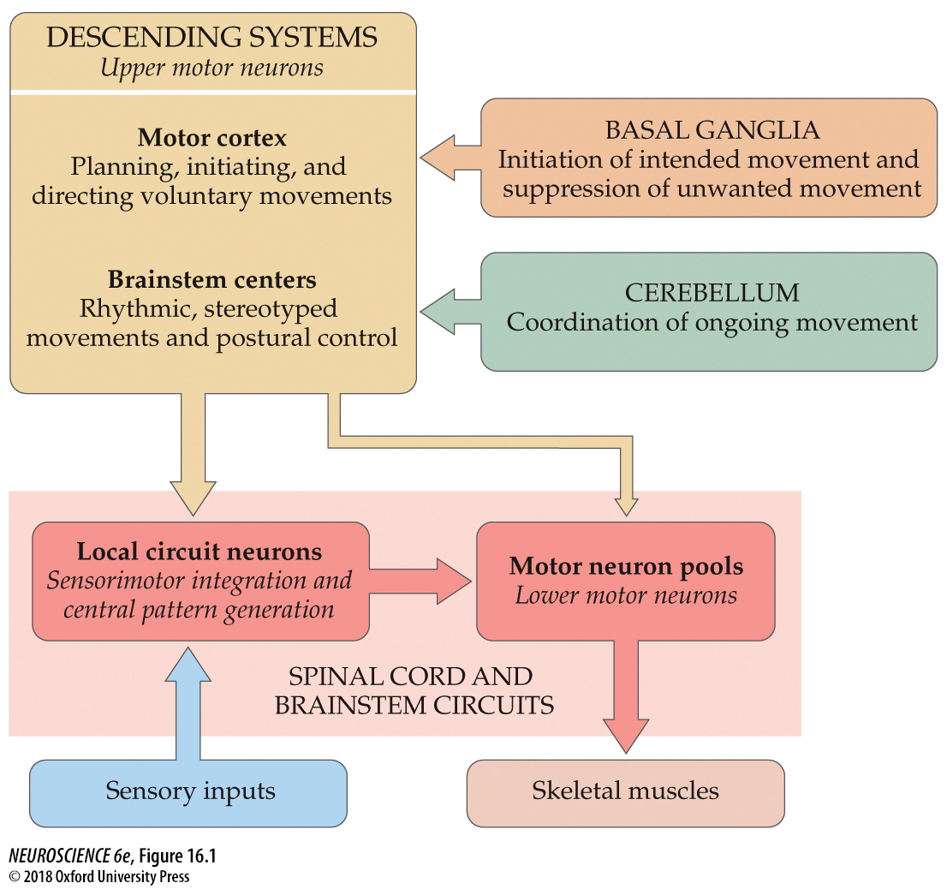
Organization of neural structures involved in the control of movement

Slide 23
Reflexes
A simple motor action that is stereotypical and repeatable
Elicited by a sensory stimulus, the strength of the motor action being graded with the intensity of the stimulus

Slide 24
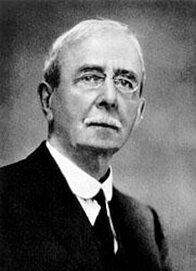
Origins/Discovery
Dr. Charles Sherrington 1857-1952 (1932 Nobel Prize for discoveries regarding functions of neurons)
Published “The integrative Action of the Nervous System” in 1906

Slide 25
Reflexes
Sensory input
Spinal circuit
Motor output

Slide 26
Benefits of Spinal Circuits
Speed of Signal transmission
If a signal needs to propagate to the brain and back, a typical reaction time is 0.25 seconds, whereas a reflex will typically take closer to 0.15 seconds.

Slide 27
Fixed Action Patterns versus Reflexes
Central or Sensory Input
Sensory Input
Reflex
Pattern Generator
Spinal Cord
Motor Output
Coordinated Motor Output
REFLEX
FIXED ACTION PATTERN

Slide 28
Fixed Action Patterns versus Reflexes
Reflex | Fixed Action Pattern
A simple stereotyped and repeatable motor action | A complex motor act, involving a specific temporal sequence of component motor acts
Elicited by a sensory stimulus. Magnitude of the motor response increases with the strength of the sensory drive. | Generated internally or initiated by a sensory stimulus. The stimulus triggers release of the coordinated motor act. The action may be all-or-none or graded in intensity, and it may be dependent on the type of sensory stimulus or internal state, but it maintains its basic pattern.

Slide 29
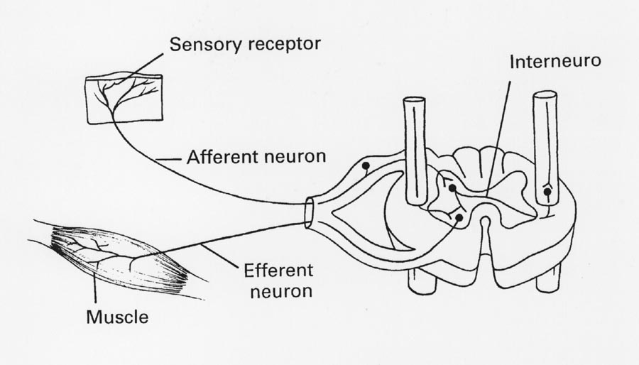
Simplest Circuit
n
Notes:
n

Slide 30
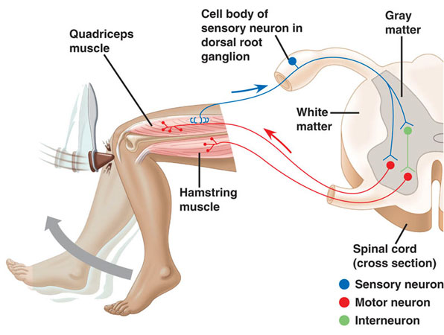
Extensor
Flexor

Slide 31
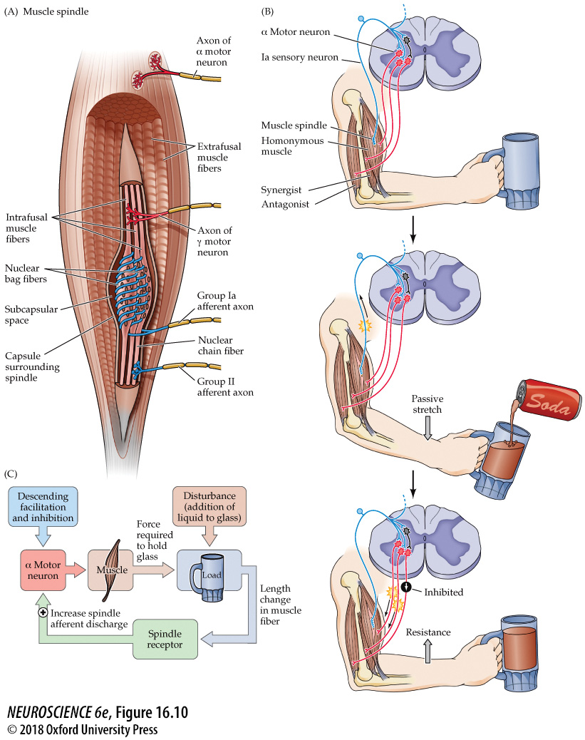
Stretch reflex circuitry

Slide 32
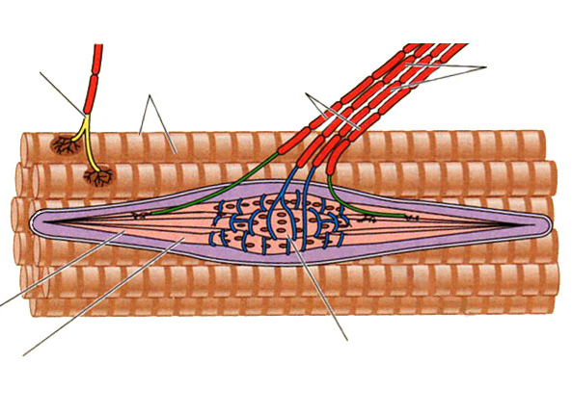
α motor neuron axon
Extrafusal muscle fibers
γ motor neuron axon
Group Ia and II afferent axons
Intrafusal muscle fibers
Nuclear bag fiber
Nuclear chain fiber

Slide 33
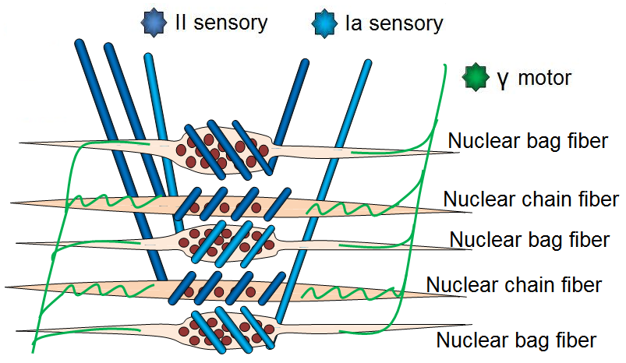
Structure of Spindle
Sensory axons coil around intrafusal fibers
Stretch in fibers activates mechanically gated ion channels in sensory axons
Ia sensory around bag fibers
II sensory around bag and chain

Slide 34
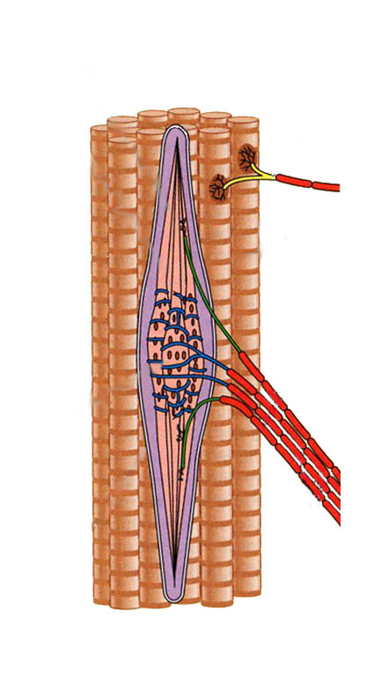
Structure of Spindles
Eight to ten intrafusal fibers
Contained in collagen sheath
Two types of fibers
Nuclear bag fibers
Excite Ia and II sensory afferents
Sensitive to dynamic changes (rapidly adapting)
Non-contractile
Nuclear chain fibers
Half the size of bag fibers
Excite II sensory afferents only
Sensitive to static levels of stretch
Contractile

Slide 35

Proprioceptors
Functions
Primary afferents (group Ia)
Sense changes in muscle length
Limb dynamics (velocity and direction)
Secondary afferents (group II)
Sense sustained muscle stretch
Static limb position

Slide 36
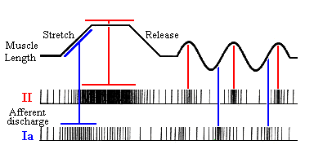
Proprioceptor Activity
Functions

