Slide 1
BMD ENG 301 Quantitative Systems Physiology (Nervous System)
Pain
2022_v3
Professor Malcolm MacIver

Slide 2
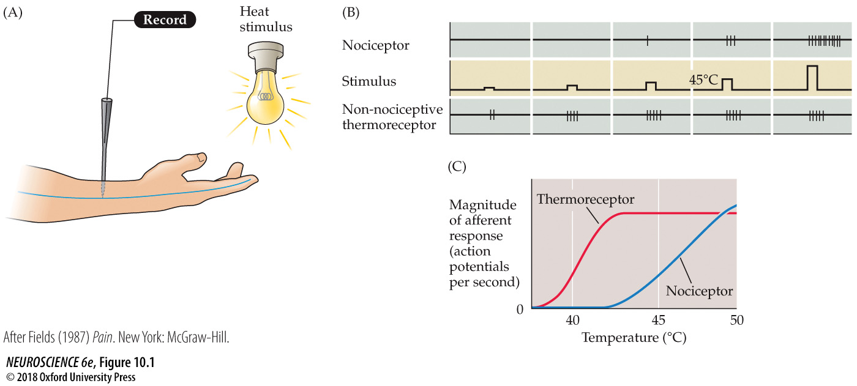
FIGURE 10.1 The neuronal basis of pain
Notes:
FIGURE 10.1 The neuronal basis of pain. Experimental demonstration that nociception involves specialized neurons, not simply greater discharge of the neurons that respond to innocuous stimulus intensities. (A) Arrangement for transcutaneous nerve recording. (B) In the painful stimulus range, the axons of thermoreceptors fire action potentials at the same rate as at lower temperatures; the number and frequency of action potential discharge in the nociceptive axon, however, continue to increase. (Note that 43°C is the approximate threshold for pain.) (C) Summary of results. (After Fields, 1987.)

Slide 3
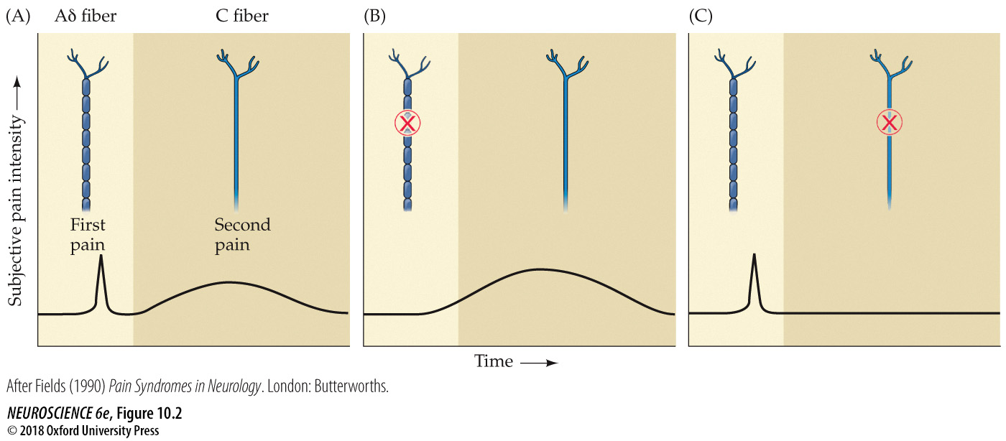
FIGURE 10.2 First and second pain
Notes:
FIGURE 10.2 First and second pain. Pain can be separated into an early perception of sharp pain and a later sensation that is described as having a duller, burning quality. (A) First and second pain, as these sensations are called, are carried by different axons, as can be shown by (B) the selective blockade of the more rapidly conducting myelinated axons that carry the sensation of first pain, or (C) blockade of the more slowly conducting C fibers that carry the sensation of second pain. (After Fields, 1990.)

Slide 4
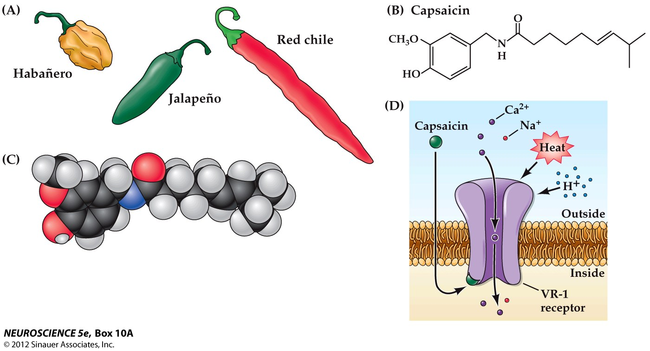
Box 10A Capsaicin

Slide 5
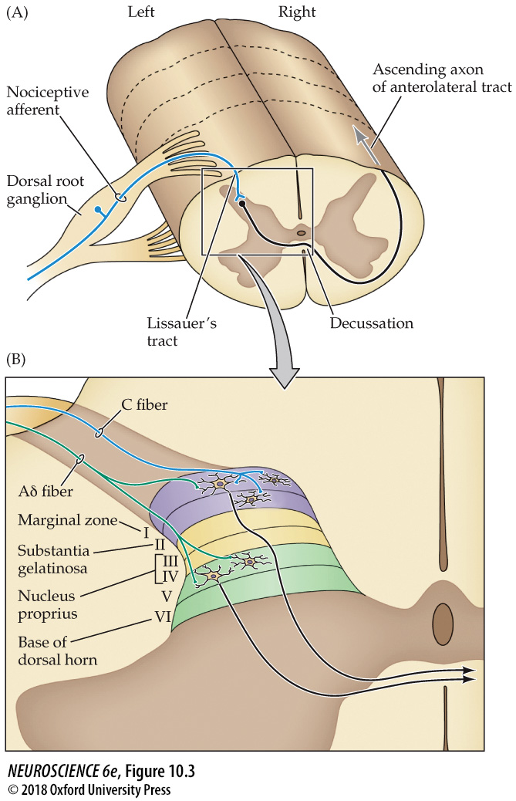
FIGURE 10.3 The anterolateral system
Notes:
FIGURE 10.3 The anterolateral system. (A) Primary afferents in the dorsal root ganglia send their axons via the dorsal roots to terminate in the dorsal horn of the spinal cord. Afferents branch and course for several segments up and down the spinal cord in Lissauer’s tract, giving rise to collateral branches that terminate in the dorsal horn. Second-order neurons in the dorsal horn send their axons (black) across the midline to ascend to higher levels in the anterolateral column of the spinal cord. (B) C-fiber afferents terminate in Rexed’s laminae I and II of the dorsal horn, while Aẟ fibers terminate in laminae I and V. The axons of second-order neurons in laminae I and V cross the midline and ascend to higher centers.

Slide 6
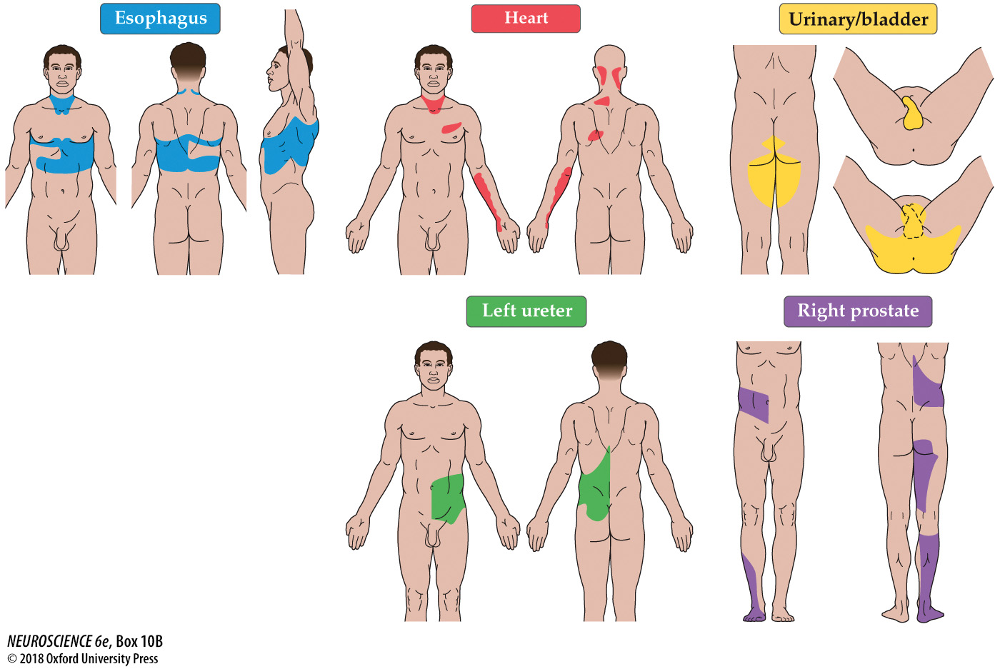
BOX 10B Referred Pain
Notes:
BOX 10B Referred Pain
Examples of pain arising from a visceral disorder referred to a cutaneous region (color).

Slide 7
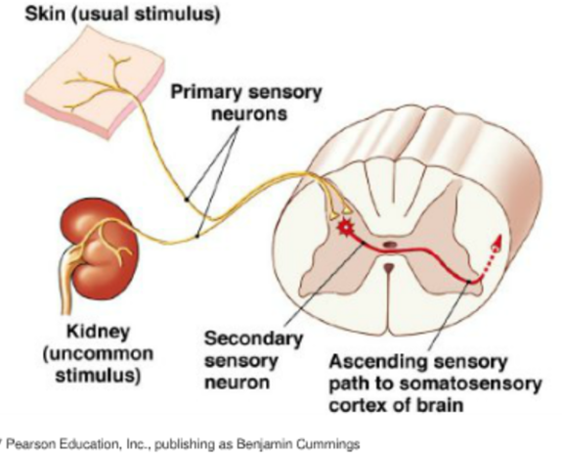
Convergence theory
The convergence of nociceptor input from the viscera and the skin.

Slide 8
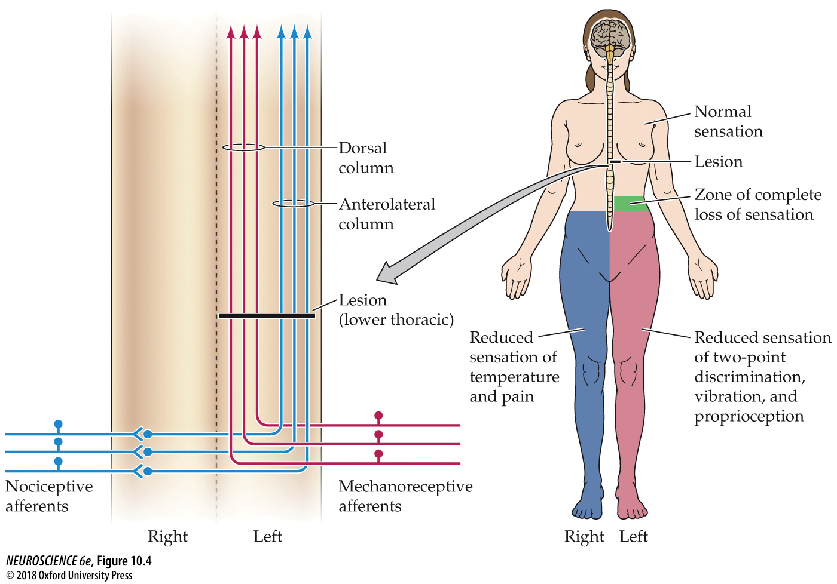
FIGURE 10.4 Nociceptive and mechanosensory pathways
Notes:
FIGURE 10.4 Nociceptive and mechanosensory pathways. As diagrammed here, the anterolateral system (blue) crosses and ascends in the contralateral anterolateral column of the spinal cord, while the dorsal column–medial leminiscal system (red) ascends in the ipsilateral dorsal column. A lesion restricted to the left half of the spinal cord results in dissociated sensory loss and mechanosensory deficits on the left half of the body, with pain and temperature deficits experienced on the right.

Slide 9
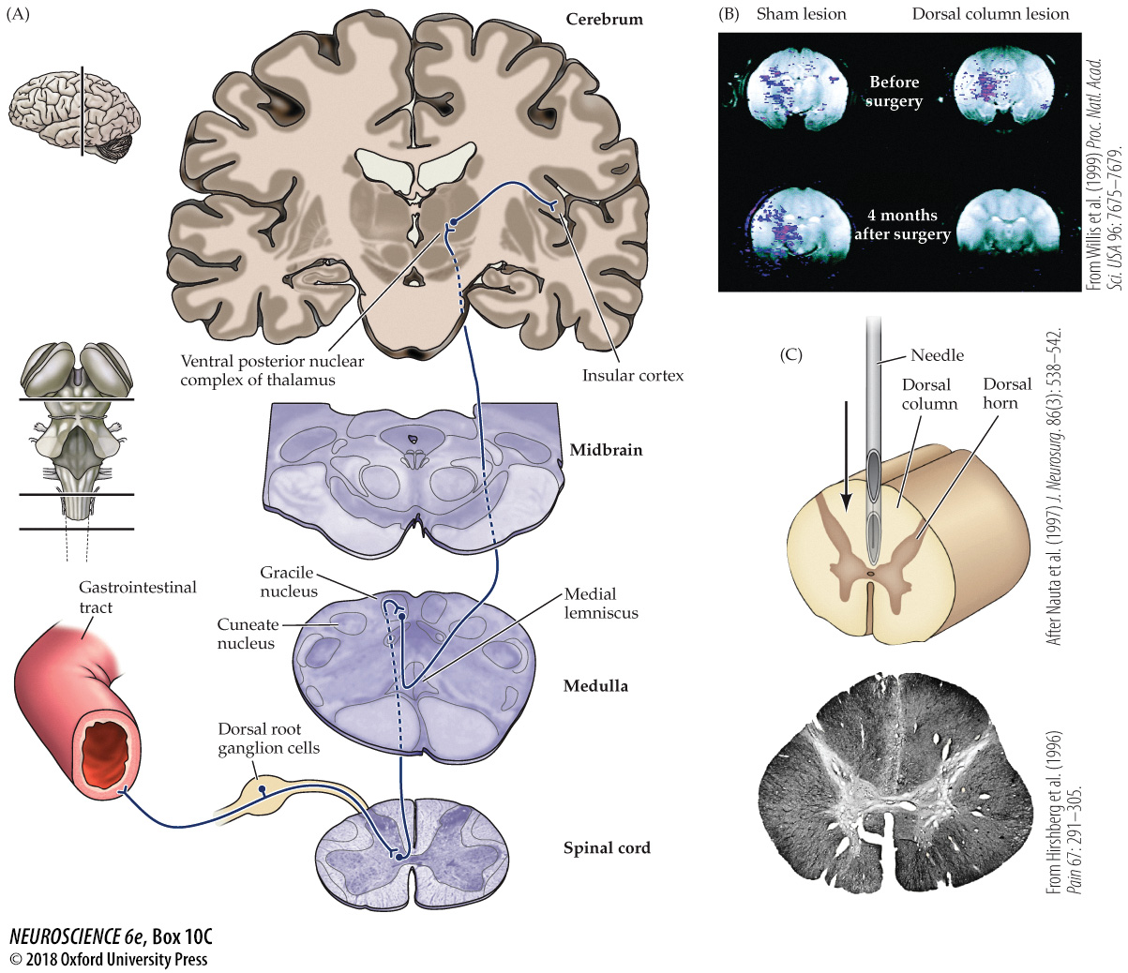
BOX 10C A Dorsal Column Pathway for Visceral Pain
Notes:
BOX 10C A Dorsal Column Pathway for Visceral Pain
(A) A visceral pain pathway in the dorsal column–medial lemniscal system. For simplicity, only the pathways that mediate visceral pain from the pelvis and lower abdomen are illustrated. (B) Empirical evidence supporting the existence of the visceral pain pathway shown in (A). Increased neural activity was observed with fMRI techniques in the thalamus of monkeys that were subjected to noxious distention of the colon and rectum, indicating the processing of visceral pain. This activity was abolished by lesion of the dorsal columns at T10, but not by “sham” surgery. (C) Left: One method of punctate midline myelotomy for the relief of severe visceral pain. Right: Myelin-stained section of the thoracic spinal cord (T10) from a patient who underwent midline myelotomy for the treatment of colon cancer pain that was not controlled by analgesics. After surgery, the patient experienced relief from pain during the remaining 3 months of his life. (B from Willis et al., 1999; C from Hirshberg et al., 1996; drawing after Nauta et al., 1997.)

Slide 10
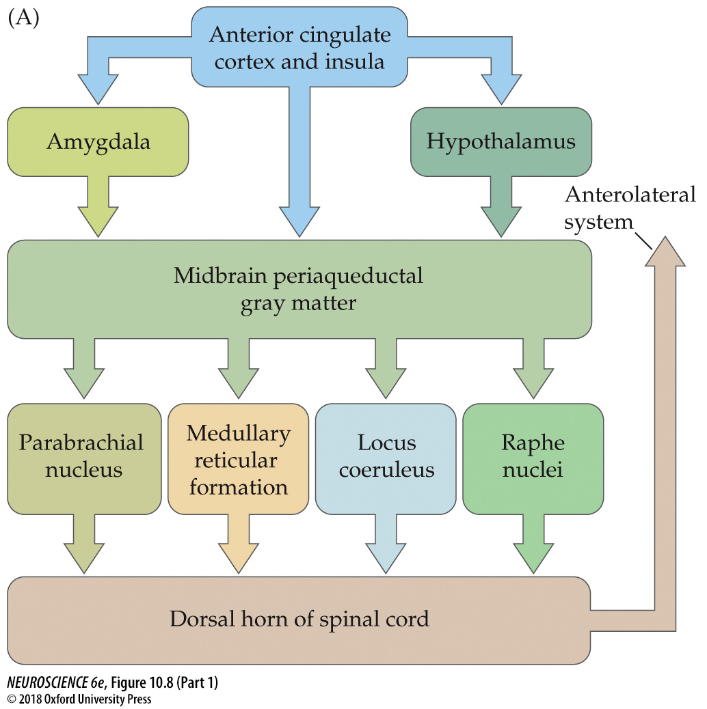
FIGURE 10.8 Descending systems modulate the transmission of ascending pain signals (Part 1)
Notes:
FIGURE 10.8 Descending systems modulate the transmission of ascending pain signals. (A) These modulatory systems originate in the anterior cingulate cortex and insula, the amygdala, the hypothalamus, the midbrain periaqueductal gray, the raphe nuclei, and other nuclei of the pons and rostral medulla. Complex modulatory effects occur at each of these sites, as well as in the dorsal horn. (B) Gate theory of pain. Activation of mechanoreceptors modulates the transmission of nociceptive information to higher centers. (C) Descending inputs from the brainstem modulate the transmission of pain signals in the dorsal horn. Some inputs interact directly with dorsal horn projection neurons or the presynaptic terminals of C fibers. Others interact indirectly via enkephalin-containing local circuit neurons.

Slide 11
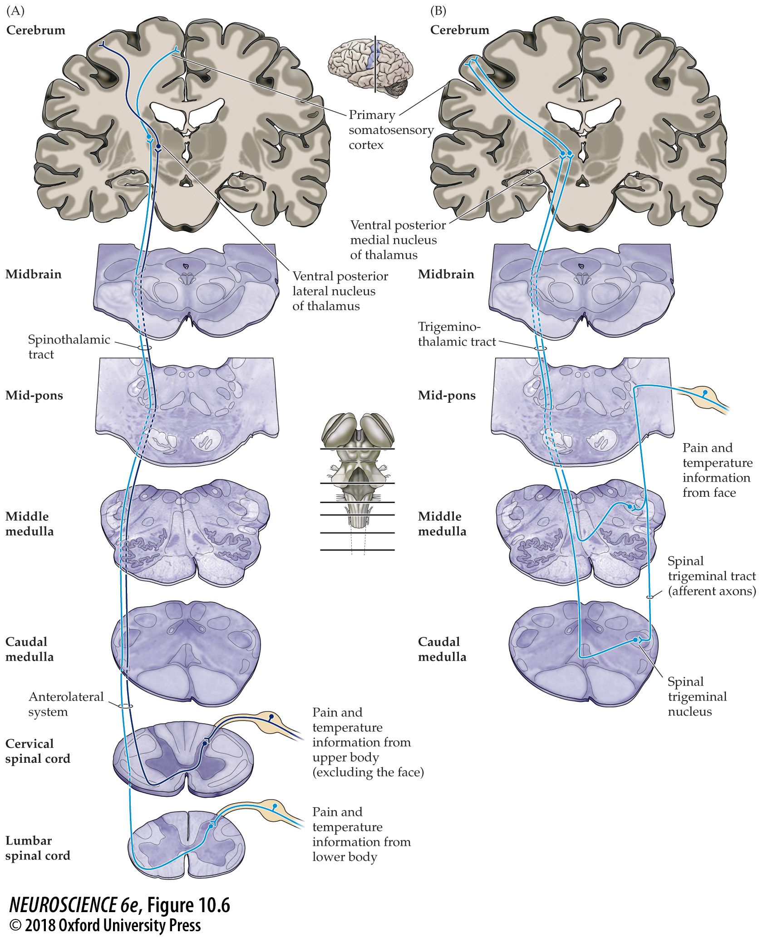
FIGURE 10.6 Discriminative pain pathways
Notes:
FIGURE 10.6 Discriminative pain pathways. Comparison of the pathways mediating the discriminative aspects of pain and temperature for (A) the body and (B) the face.

Slide 12
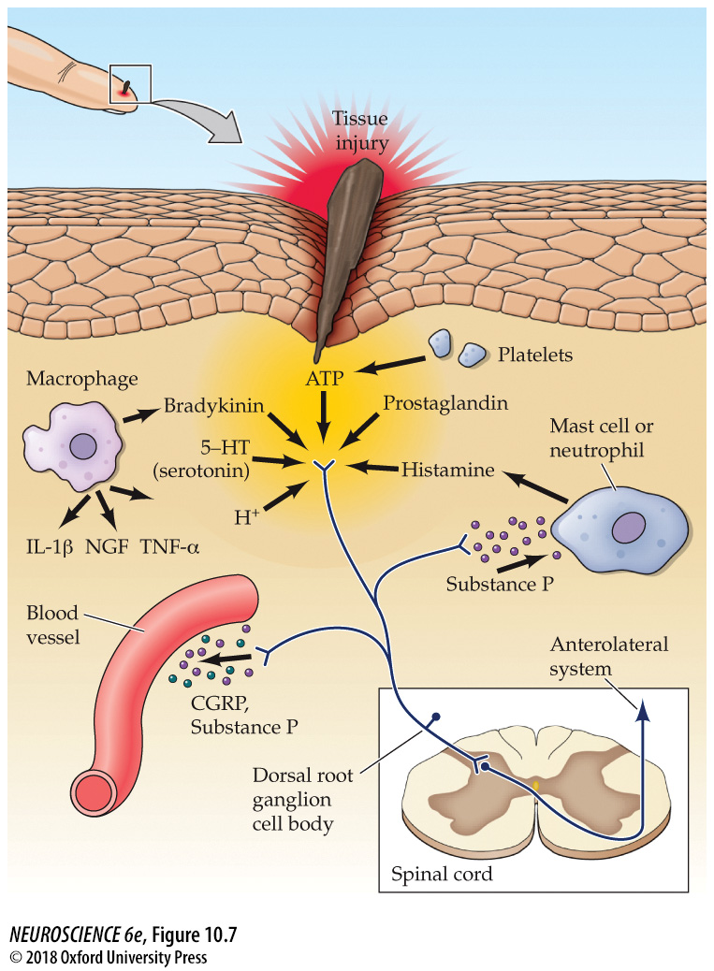
FIGURE 10.7 Inflammatory response to tissue damage
Notes:
FIGURE 10.7 Inflammatory response to tissue damage. Substances released by damaged tissues augment the response of nociceptive fibers. In addition, electrical activation of nociceptors causes the release of peptides and neurotransmitters that further contribute to the inflammatory response.

Slide 13

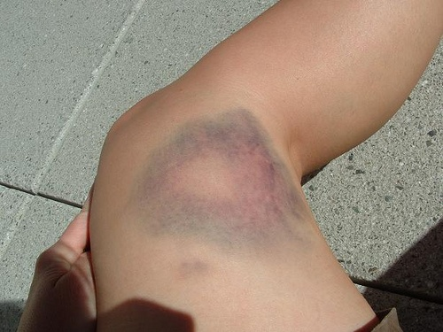
Sensitization
Hyperalgesia
http://www.hellobeautyblog.com/wp-content/uploads/2010/07/sunburn_hawk684.jpg
http://farm4.static.flickr.com/3096/2618585448_0705af5730.jpg

Slide 14
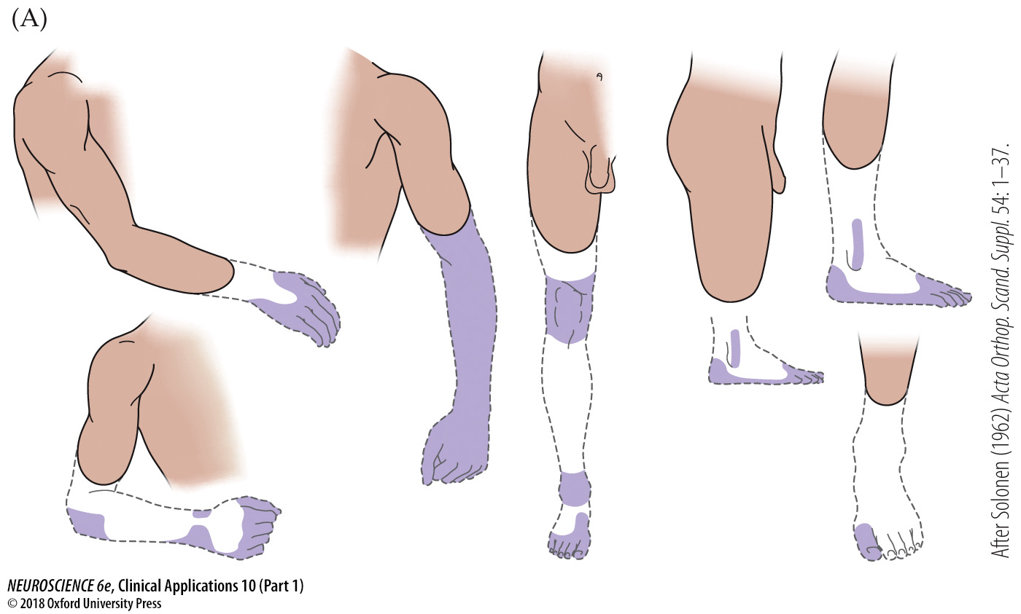
CLINICAL APPLICATIONS Phantom Limbs and Phantom Pain (Part 1)
Notes:
CLINICAL APPLICATIONS Phantom Limbs and Phantom Pain
(A) Drawings of phantom arms and legs, based on patients’ reports. The phantom is indicated by a dashed line, with the colored regions showing the most vividly experienced parts. Note that some phantoms are telescoped into the stump. (After Solonen, 1962.) (B) Illustration of the mirror box designed by Ramachandran to relieve phantom pain with upper limb loss. The subject views his intact limb and its reflection in a mirror while commanding symmetrical movements of the remaining hand and the corresponding phantom. For some subjects, this experience immediately produces mobility of the phantom with a remarkable degree of relief from pain sensations.

Slide 15
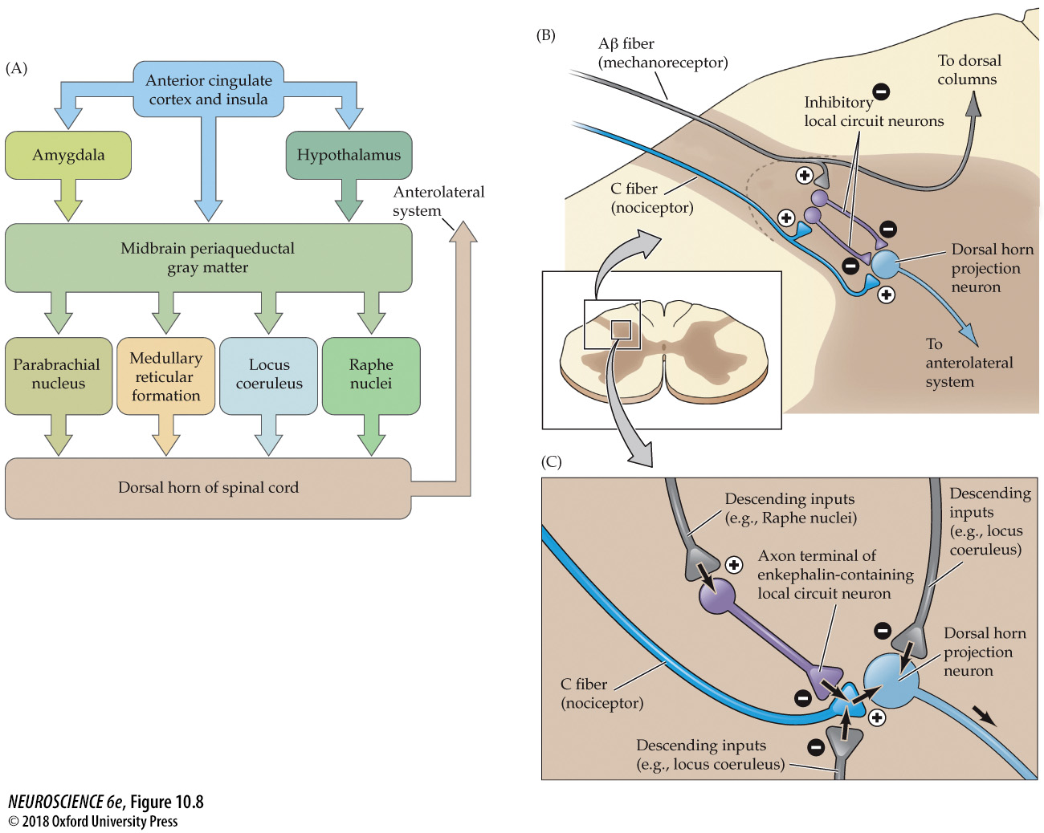
FIGURE 10.8 Descending systems modulate the transmission of ascending pain signals
Notes:
FIGURE 10.8 Descending systems modulate the transmission of ascending pain signals. (A) These modulatory systems originate in the anterior cingulate cortex and insula, the amygdala, the hypothalamus, the midbrain periaqueductal gray, the raphe nuclei, and other nuclei of the pons and rostral medulla. Complex modulatory effects occur at each of these sites, as well as in the dorsal horn. (B) Gate theory of pain. Activation of mechanoreceptors modulates the transmission of nociceptive information to higher centers. (C) Descending inputs from the brainstem modulate the transmission of pain signals in the dorsal horn. Some inputs interact directly with dorsal horn projection neurons or the presynaptic terminals of C fibers. Others interact indirectly via enkephalin-containing local circuit neurons.

Slide 16
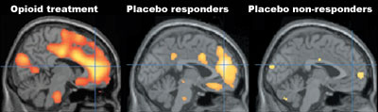
Placebo and opioid analgesia
Left Image: Brain activity most pronounced in the rostral anterior cingulate cortex (rACC) during the height of opioid treatment. Increased activity also in the lower pons.
Middle Image: rACC in high-placebo responders during “opioid” treatment.
Right Image: rACC in nonresponders during “opiod” treatment.
(Petrovic et al., Reprinted from Science, 295:1737-40, 2002.)

