Slide 1
BMD ENG 301 Quantitative Systems Physiology (Nervous System)
Lecture 5: Resting Membrane Potential
2022_v1
Professor Malcolm A. MacIver

Slide 2
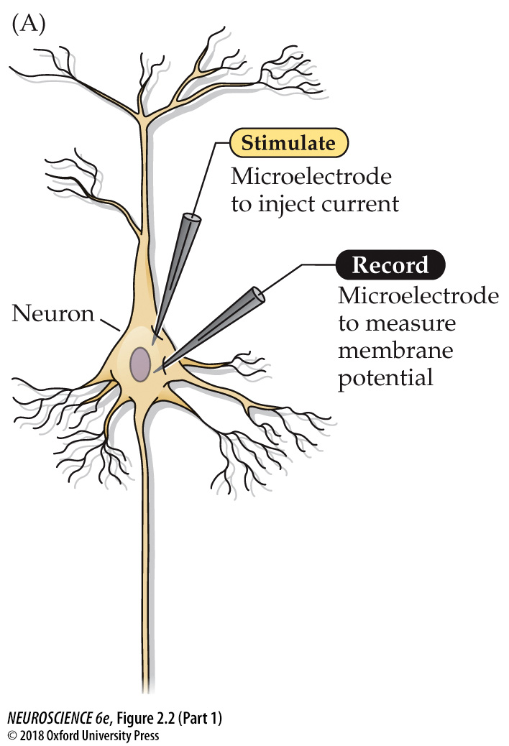
Recording passive and active electrical signals in a nerve cell
Notes:
FIGURE 2.2 Recording passive and active electrical signals in a nerve cell. (A) Two microelectrodes are inserted into a neuron; one of these measures membrane potential while the other injects current into the neuron. (B) Inserting the voltage-measuring microelectrode into the neuron (bottom) reveals a negative potential, the resting membrane potential. Injecting current through the other microelectrode (top) alters the neuronal membrane potential. Hyperpolarizing current pulses produce only passive changes in the membrane potential. While small depolarizing currents also elicit only passive responses, depolarizations that cause the membrane potential to meet or exceed threshold additionally evoke action potentials.

Slide 3
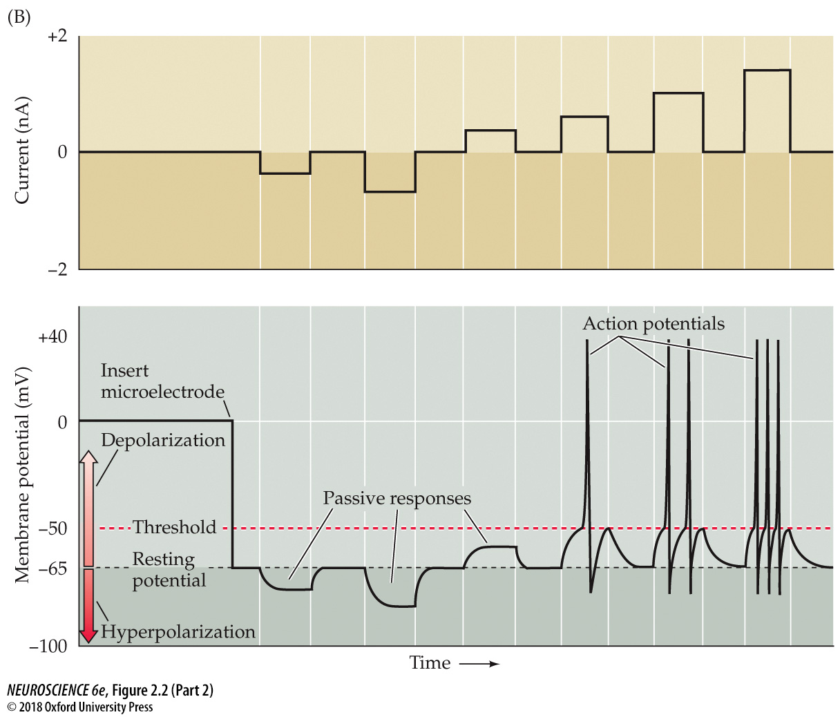
Recording passive and active electrical signals in a nerve cell
Why is there a resting membrane potential?
Notes:
FIGURE 2.2 Recording passive and active electrical signals in a nerve cell. (A) Two microelectrodes are inserted into a neuron; one of these measures membrane potential while the other injects current into the neuron. (B) Inserting the voltage-measuring microelectrode into the neuron (bottom) reveals a negative potential, the resting membrane potential. Injecting current through the other microelectrode (top) alters the neuronal membrane potential. Hyperpolarizing current pulses produce only passive changes in the membrane potential. While small depolarizing currents also elicit only passive responses, depolarizations that cause the membrane potential to meet or exceed threshold additionally evoke action potentials.

Slide 4
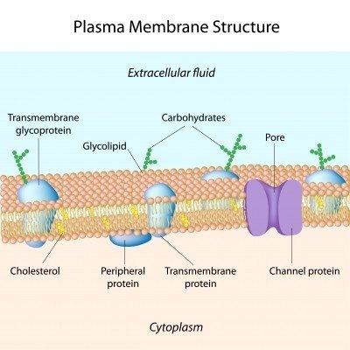

Slide 5
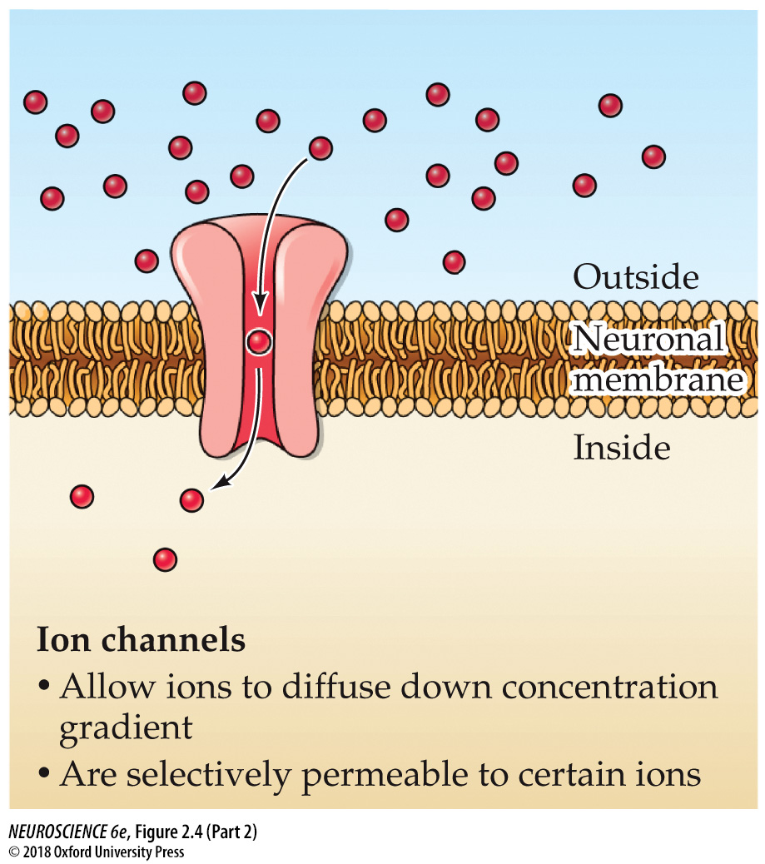
Ion channels provide a means for charge to move across neuronal membranes
Notes:
FIGURE 2.4 Active transporters and ion channels are responsible for ion movements across neuronal membranes. Transporters create ion concentration differences by actively transporting ions against their chemical gradients. Channels take advantage of these concentration gradients, allowing selected ions to move, via diffusion, down their chemical gradients.

Slide 6
Derivation on doc projector

Slide 7
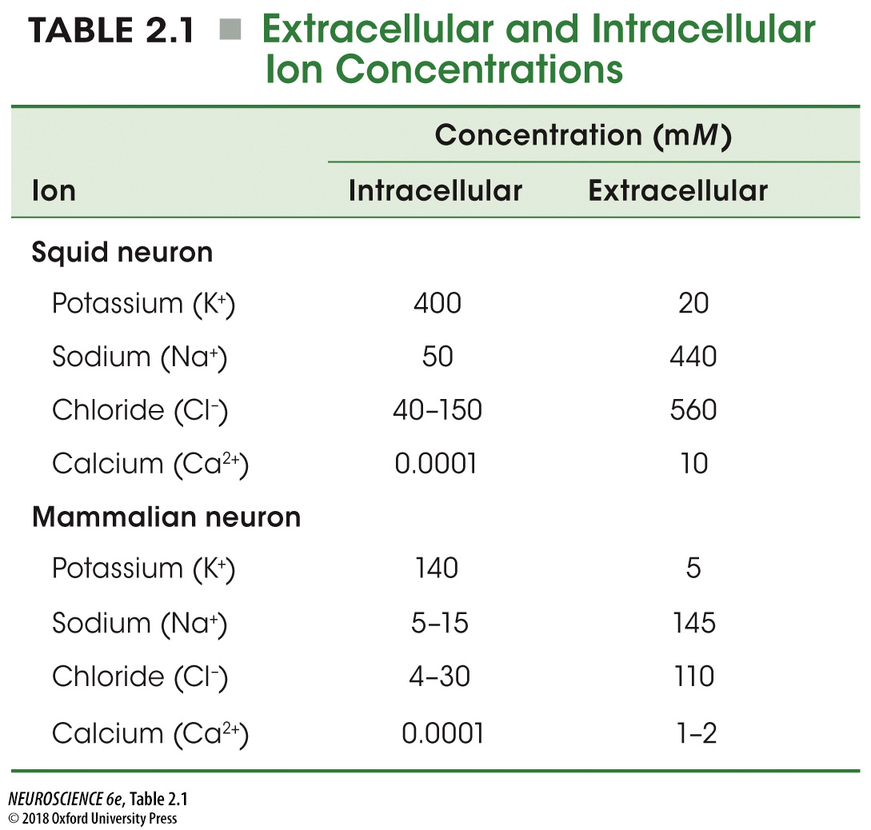
TABLE 2.1 Extracellular and Intracellular Ion Concentrations
Notes:
TABLE 2.1 Extracellular and Intracellular Ion Concentrations

Slide 8
Squid Axon
Intracellular: 400 + 50 – 95
Extracellular: 20 + 440 + 20 - 560
Mammalian Neuron
Intracellular: 140 + 10 -17
Extracellular: 5 + 145 + 3 - 110
Notes:
TABLE 2.1 Extracellular and Intracellular Ion Concentrations

Slide 9
What is wrong with the previous Table?
Squid neuron
Intracellular excess of cations
Extracellular excess of anions
Mammalian neuron
Intracellular excess of cations
Extracellular excess of cations
One might expect there to be an excess of intracellular anions and extracellular cations to account for the negative resting membrane potential, but a -65 mV membrane potential is obtained without affecting mM ion concentrations.

Slide 10
TABLE 2.1 Extracellular and Intracellular Ion Concentrations
Notes:
TABLE 2.1 Extracellular and Intracellular Ion Concentrations

Slide 11
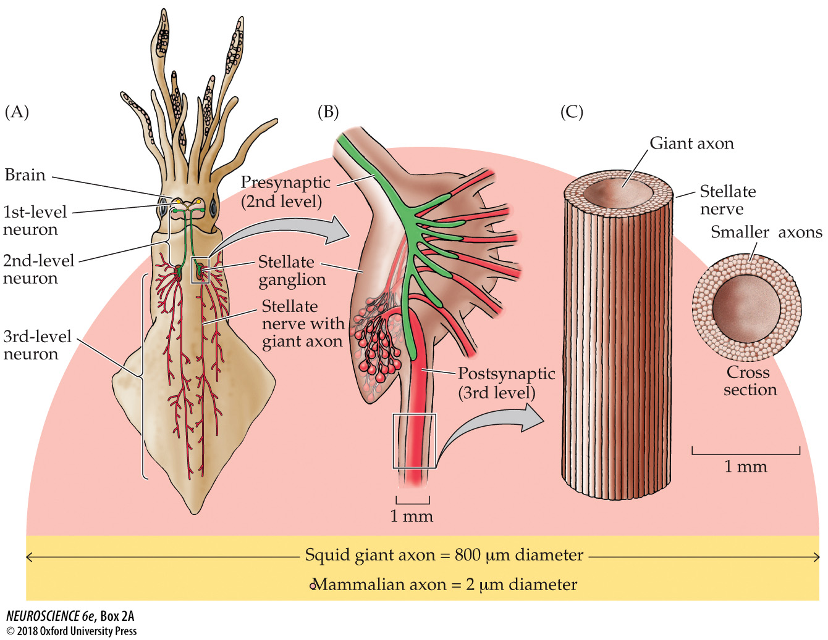
The Remarkable Giant Nerve Cells of Squid
Notes:
BOX 2A The Remarkable Giant Nerve Cells of Squid
(A) Diagram of a squid, showing the location of its giant nerve cells. Different colors indicate the neuronal components of the escape circuitry. The first- and second-level neurons originate in the brain, while the third-level neurons are in the stellate ganglion and innervate muscle cells of the mantle. (B) Giant synapses within the stellate ganglion. The second-level neuron forms a series of fingerlike processes, each of which makes an extraordinarily large synapse with a single third-level neuron. (C) Structure of a giant axon of a third-level neuron lying within its nerve. The enormous difference in the diameters of a squid giant axon and a mammalian axon are shown below.

Slide 12
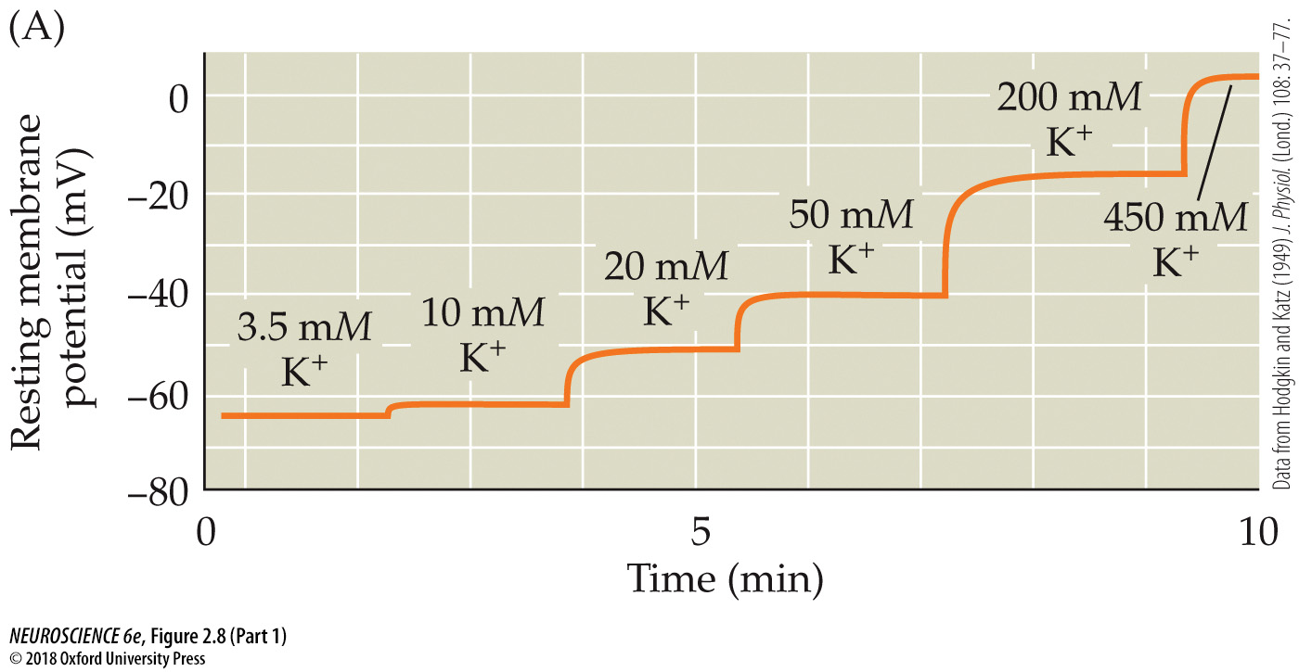
The resting membrane potential of a squid giant axon is determined by the K⁺ concentration gradient across the membrane
Notes:
FIGURE 2.8 The resting membrane potential of a squid giant axon is determined by the K⁺ concentration gradient across the membrane. (A) Increasing the external K⁺ concentration depolarizes the resting membrane potential. (B) Relationship between resting membrane potential and external K⁺ concentration, plotted on a semilogarithmic scale. The straight line represents a slope of 58 mV per tenfold change in concentration, as given by the Nernst equation. (After Hodgkin and Katz, 1949.)

Slide 13
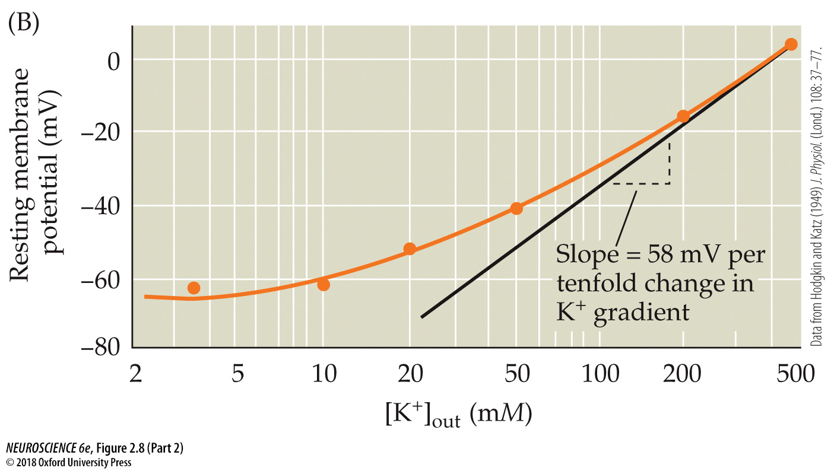
The resting membrane potential of a squid giant axon is determined by the K⁺ concentration gradient across the membrane
Notes:
FIGURE 2.8 The resting membrane potential of a squid giant axon is determined by the K⁺ concentration gradient across the membrane. (A) Increasing the external K⁺ concentration depolarizes the resting membrane potential. (B) Relationship between resting membrane potential and external K⁺ concentration, plotted on a semilogarithmic scale. The straight line represents a slope of 58 mV per tenfold change in concentration, as given by the Nernst equation. (After Hodgkin and Katz, 1949.)

Slide 14
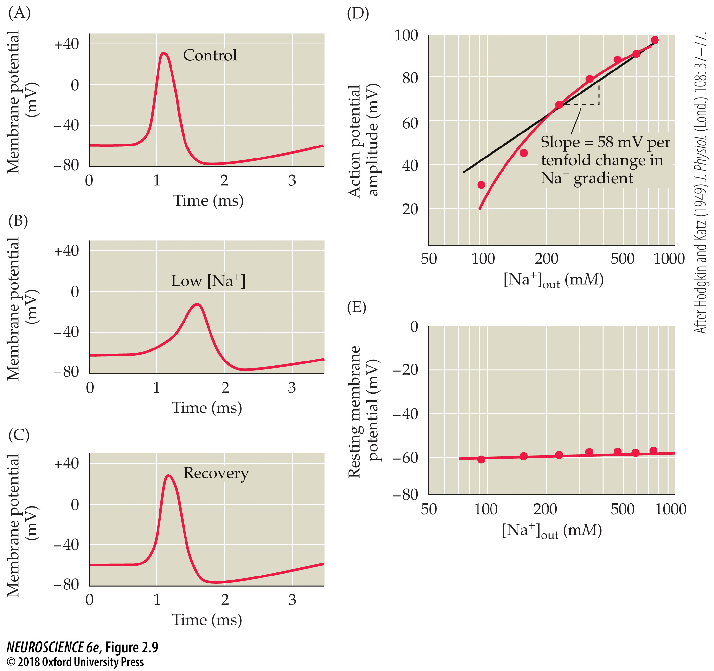
The role of Na⁺ in generating an action potential in a squid giant axon
Resting membrane potential does depend on [Na^{+]}_{OUT}
Notes:
FIGURE 2.9 The role of Na⁺ in generating an action potential in a squid giant axon. (A) An action potential evoked with the normal ion concentrations inside and outside the cell. (B,C) The amplitude and rate of rise of the action potential (B) diminish when external Na⁺ concentration is reduced to one-third of normal, but recover (C) when the Na⁺ is replaced. (D,E) Although the amplitude of the action potential (D) is quite sensitive to the external concentration of Na⁺, the resting membrane potential (E) is little affected by changing the concentration of this ion. (After Hodgkin and Katz, 1949.)

Slide 15
Resting Potential
Resting membrane potential depends on both K⁺ and Na⁺, but the dependence on K⁺ ions is clearly more important

