Slide 1
BMD ENG 301 Quantitative Systems Physiology (Nervous System)
Lectures 6: Neural Signals in Dendrites
2022_v1
Professor Malcolm A. MacIver

Slide 2
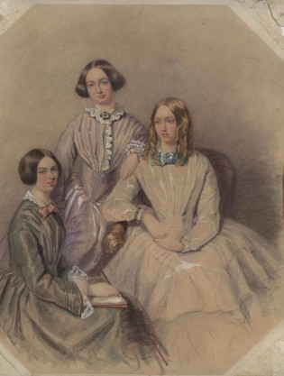
Never Too Late to Up One’s Game
Anne Bronte (1820-1849) The Tenant of Wildfell Hall (1849)
Charlotte Bronte (1816-1855) Jane Eyre (1847)
Emily Bronte (1818-1848) Wuthering Heights (1847)
James Bronte Gatenby (1892-1960) – zoologist known for his study of Golgi bodies

Slide 3
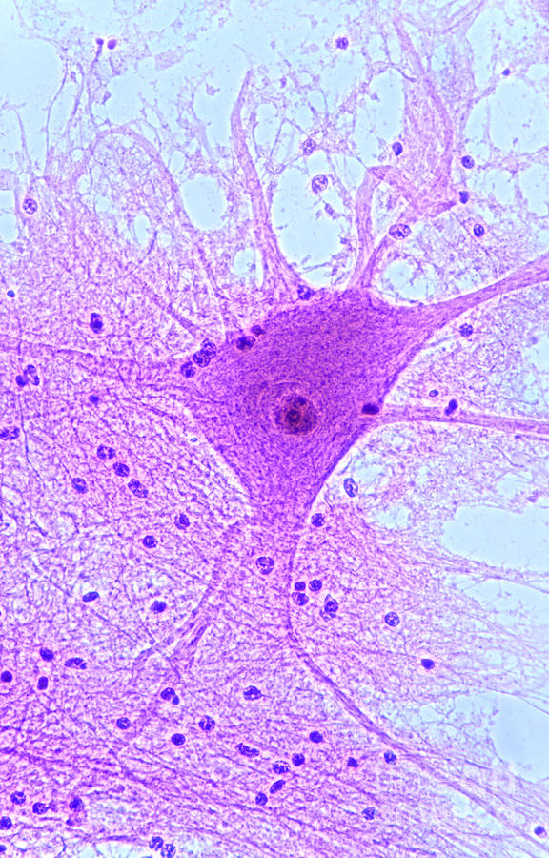
Spinal Motor Neuron
How can we model summation of synaptic inputs?
Axon

Slide 4
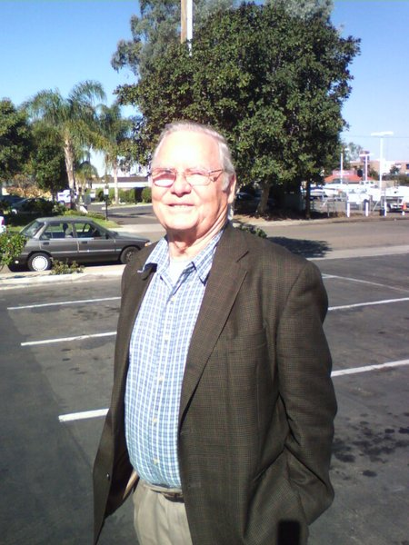
History of neural cable theory
Cable theory developed for signal flow along electrical cables in the 19th century
Original neural application by Hodgkin and Rushton (1946) to the conduction of potential along an axon
Rall (1959) extended theory and applied it to the dendritic trees of neurons.
Wilfred Rall

Slide 5
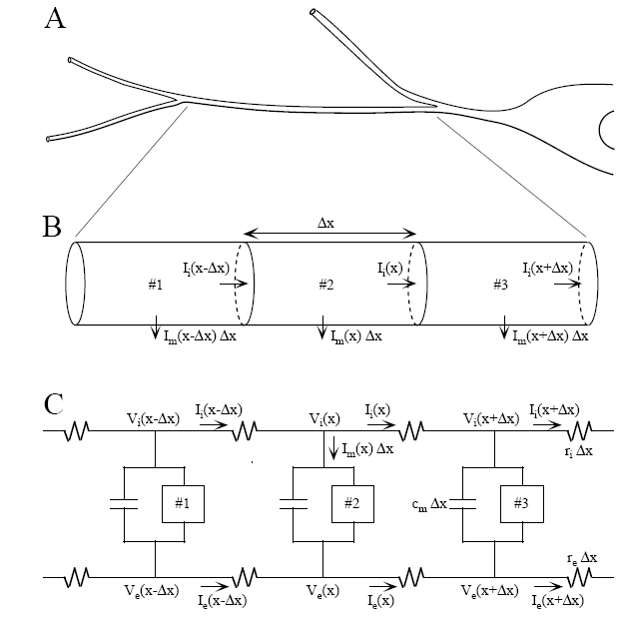
Dendritic Cable
A. One portion of dendrite
B. divided into three sub-cylinders.
C. Discrete electrical model for the three sub-cylinders.
Notes:
This figure show the modeling procedures of dendrites. Figure A shows one portion of dendrite. In Figure B, it’s divided into three sub-cylinders. Figure C is the discrete electrical model for the three sub-cylinders.

Slide 6
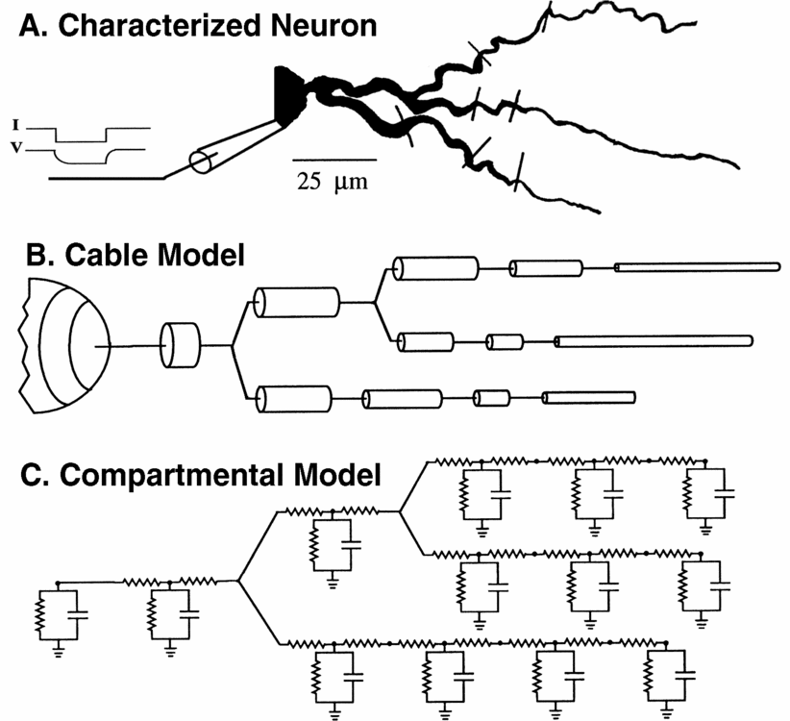

Slide 7
Equivalent electrical circuit
INSIDE
Ri/2
Ri/2
Poor conductor
Rm
Cm
Leaky insulator
VLeak
Parallel RC Circuit
OUTSIDE
V_{Leak} is the resting membrane potential

Slide 8
Cable equation
∂²V
(V – E_{leak})
∂V
= R_{a}
+ C_{m}
[
]
∂x²
R_{m}
∂t
Internal
Resistance
Membrane
Resistance
Membrane
Capacitance

Slide 9
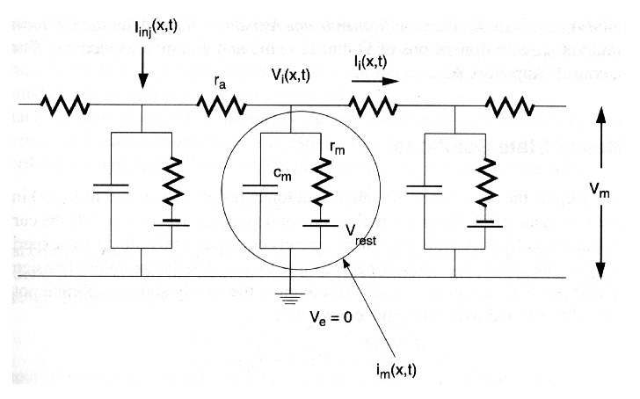
r_{i}
N.B.: r_{a} is often used to mean axial (internal) resistance but many use r_{i} instead

Slide 10
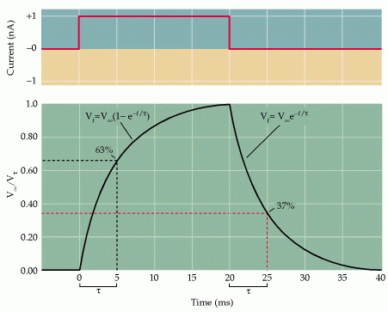
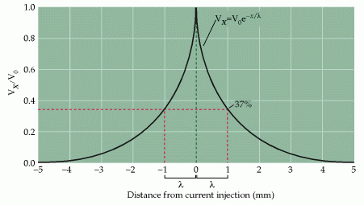
d/dt=0 d/dx=0
Assume conductor is a semi-infinite long cable that extends from x=0 to x=inf

Slide 11
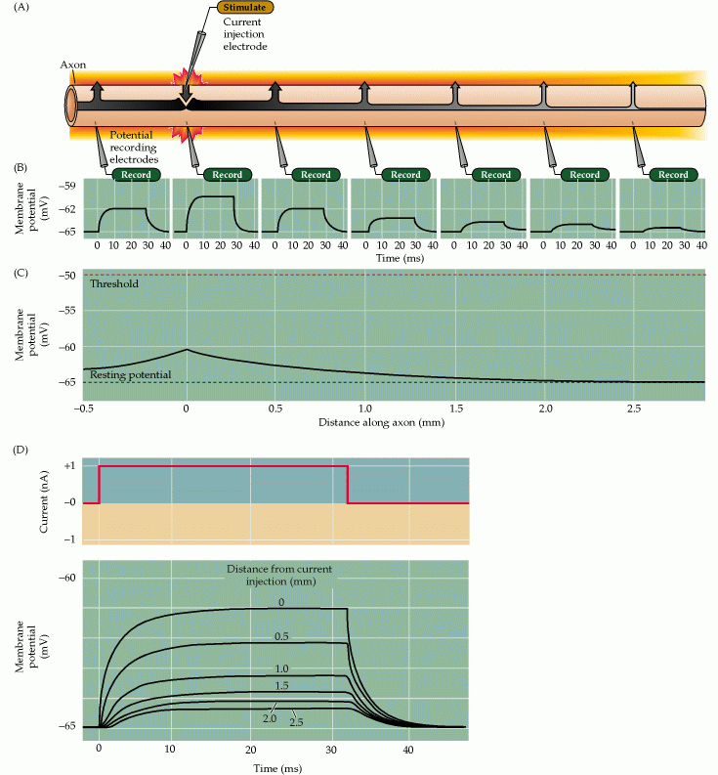
Signal propagation

Slide 12
Charge Degradation over Time
∂²V
Ignore space:
= 0
∂x²
∂ ²V
(V – V_{leak})
∂V
= R_{i}
+ C_{m}
[
]
∂x²
R_{m}
∂t
-t
So:
V = V0 exp(
)
R_{m}.C_{m}
Where R_{m}.C_{m} = τ = time constant

Slide 13
Representation of time constant
V0
V
37 %
τ
t

Slide 14
Charge Degradation over Distance
∂V
Ignore time:
= 0
∂t
∂²V
(V – V_{leak})
∂V
= R_{i}
+ C_{m}
]
[
∂x²
R_{m}
∂t
So:
V(x) = A₁e^{(x/λ)} + A₂e^{(-x/λ)}
Where λ = length constant
λ = sqroot(R_{m}/R_{i})

Slide 15
Representation of length constant
V0
V
37 %
λ
x

Slide 16
Equivalent Cylinder Theorem
Equivalent cylinder
L₂₁, d₂₁
L₃₁, d₃₁
L, d
Original tree
L₁₁, d₁₁
L₂₂, d₂₂
L₃₂, d₃₂
Equivalent Cylinder Theorem: an entire class of dendritic trees can be reduced into a single equivalent cylinder if the following conditions are met:
The values of r_{i} and r_{m} are the same in all branches;
All terminals end at the same boundary condition;
All terminal branches end at the same electrotonic distance from the origin in main branch
The 3/2 power law at every branch point
Notes:
ri: intracellular resistance; rm: membrane resistance
Three seconds power law

Slide 17
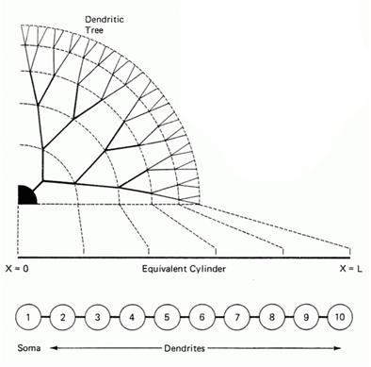
Rall Model

Slide 18
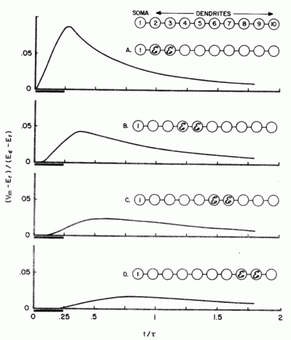
Rall Model
Allowed modeling of dendritic behavior
Confirmed by experimental results
Stimulation at different distances along arbor
Modeling of EPSPs

Slide 19
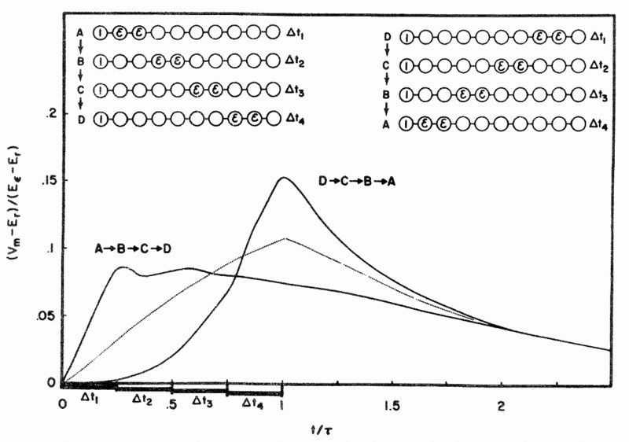
Rall Model

Slide 20
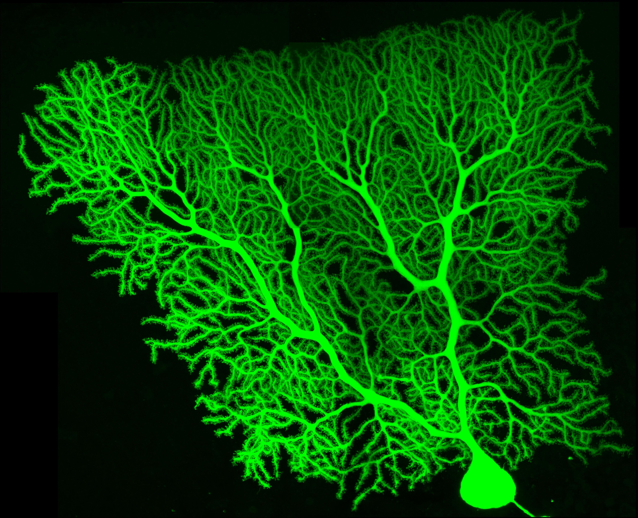
What if R_{m} is not constant, depending on x, V and t?

