Slide 1

G I
+
jit.team 2018

Slide 2




Intro
Version control system
Contributing
Open source
jit.team 2018

Slide 3
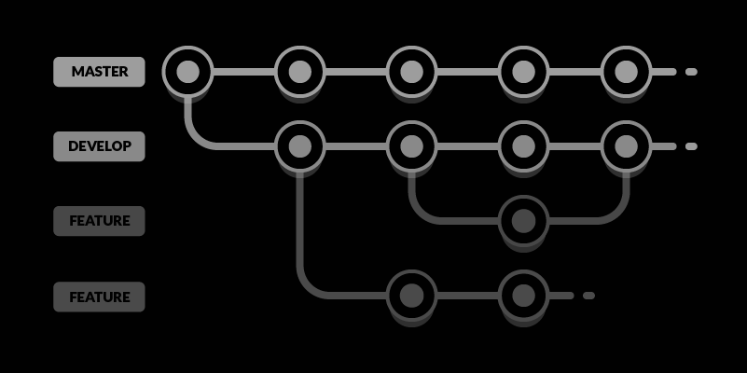
Workflow
jit.team 2018

Slide 4
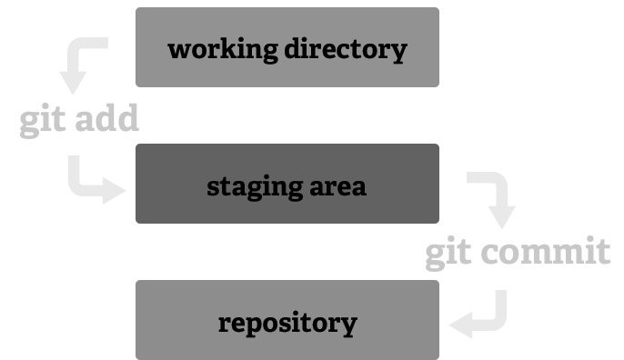
Local repository
jit.team 2018

Slide 5



Remote repository
local
remote
jit.team 2018

Slide 6


Remote repository
jit.team 2018

Slide 7
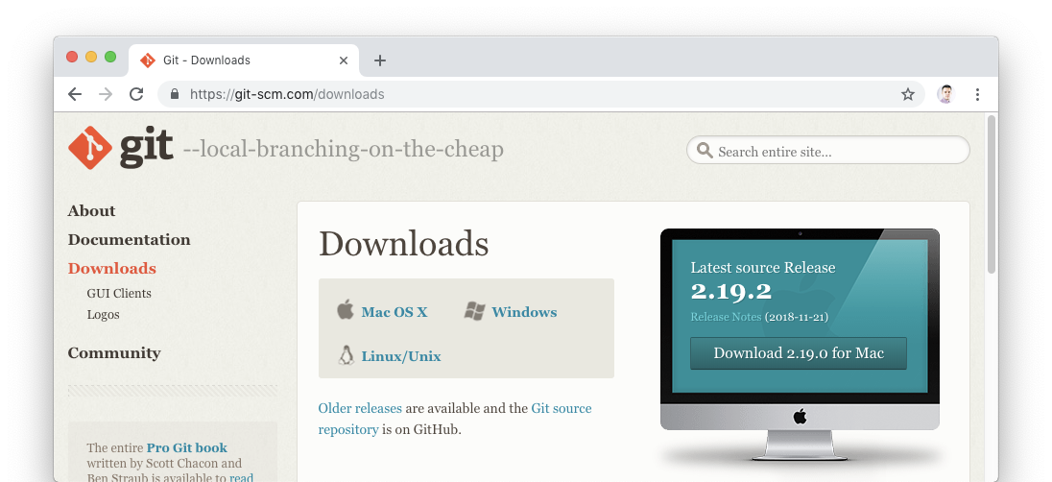
Download
jit.team 2018

Slide 8
Create new repository
git init
jit.team 2018

Slide 9
Copy repository
git clone
git clone path/to/repo
git clone username@host:/path/to/repository
jit.team 2018

Slide 10
Propose changes
git add <filename>
git add *
Add to Index (Staging area)
jit.team 2018

Slide 11
Propose changes
git commit -m “Commit message”
Add to HEAD
(but not on remote yet)
jit.team 2018

Slide 12
Pushing
git push origin master
Send changes
to remote repository
jit.team 2018

Slide 13
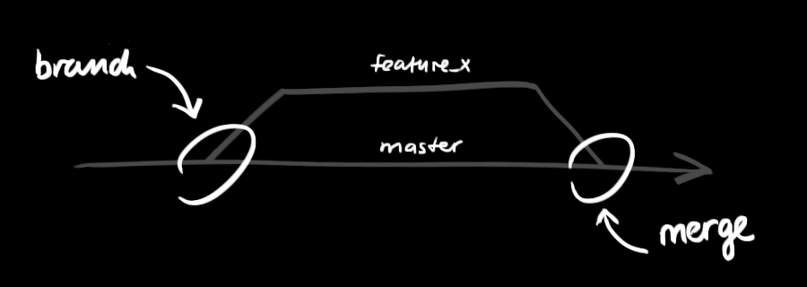
Branching
git checkout -b feature_x
git checkout master
jit.team 2018

Slide 14
Updating
Both download data from remote repository
git fetch
“harmless”
git pull
“integrates”
jit.team 2018
Notes:
https://www.git-tower.com/learn/git/faq/difference-between-git-fetch-git-pull

Slide 15
Merging
git merge <branch>
Conflicts!!!
jit.team 2018

Slide 16
Playground
Conflicts???
BEAT IT!
jit.team 2018

Slide 17

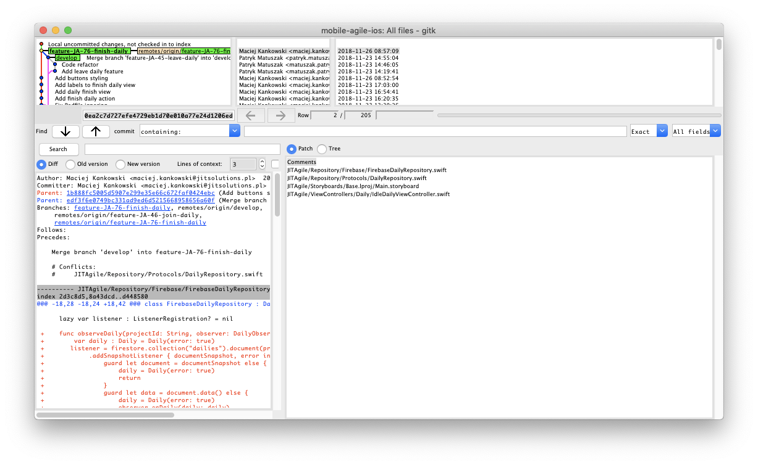
Clients
jit.team 2018

Slide 18

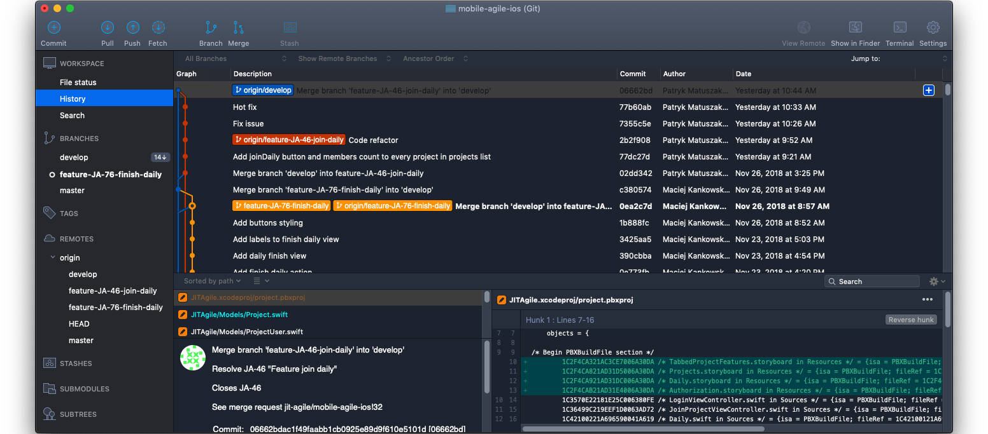
Clients
jit.team 2018

Slide 19
Extra
“git - the simple guide”
rogerdudler.github.io/git-guide/
“Git cheat sheet by Atlassian”
www.atlassian.com/git/tutorials/atlassian-git-cheatsheet
jit.team 2018

