Slide 1

< HTML >
jit.team 2018

Slide 2
It's a markup language
but not programming language​
​
Used to tell browser how to structure web pages​
jit.team 2018

Slide 3
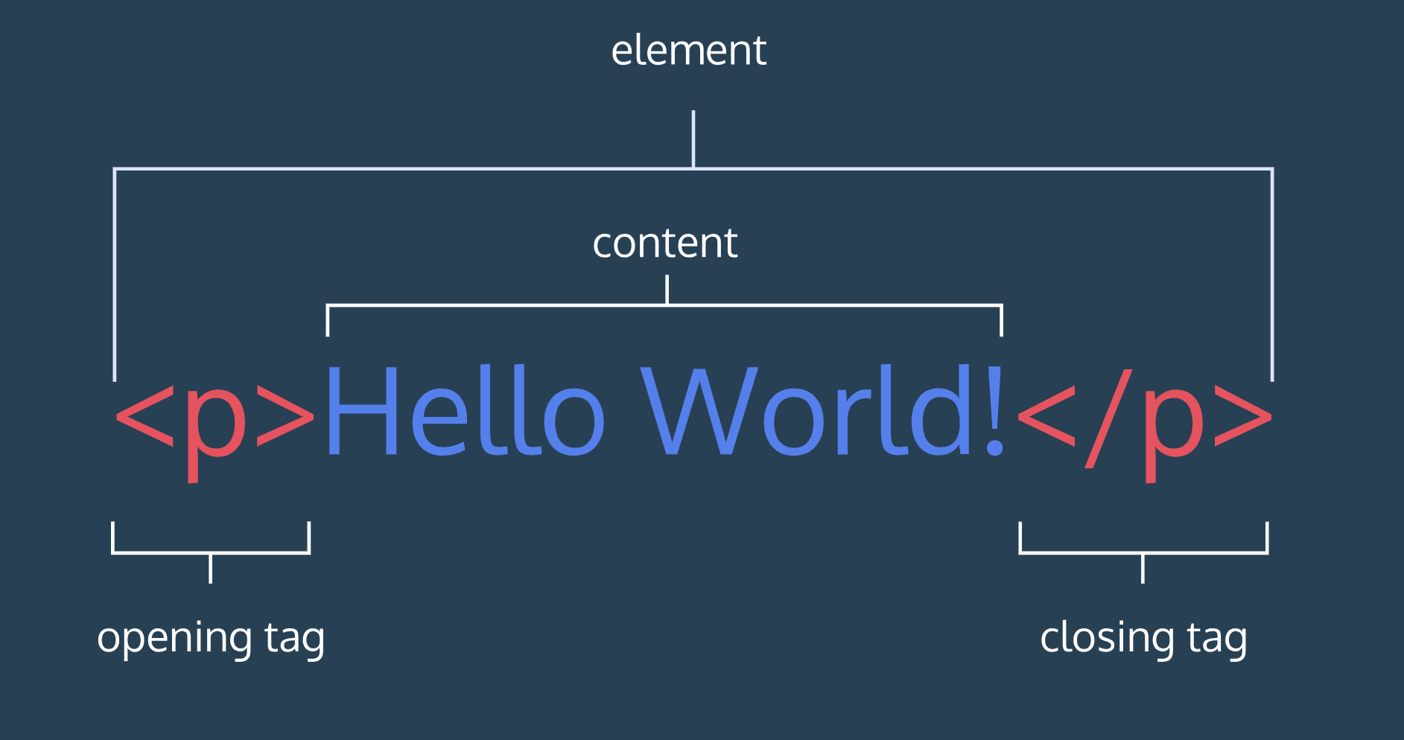
HTML element anatomy
jit.team 2018

Slide 4
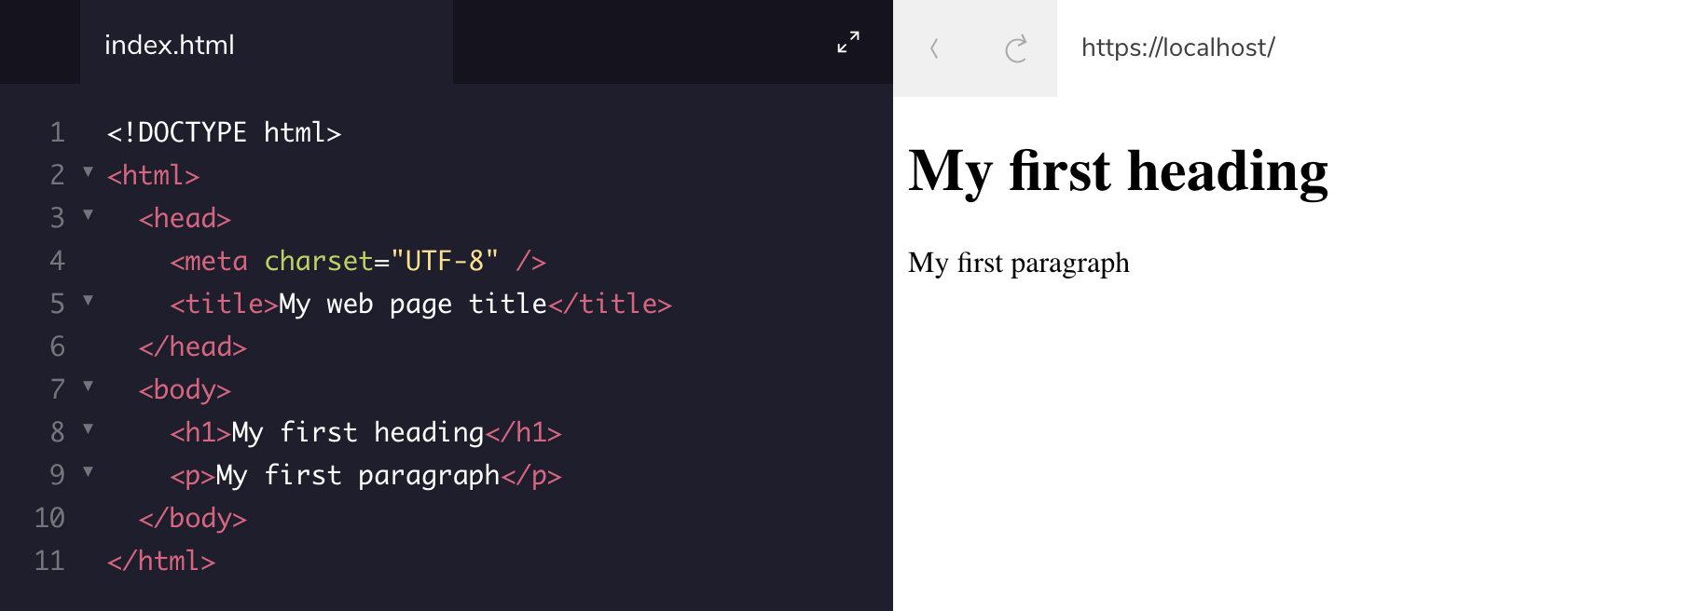
HTML document structure
jit.team 2018

Slide 5
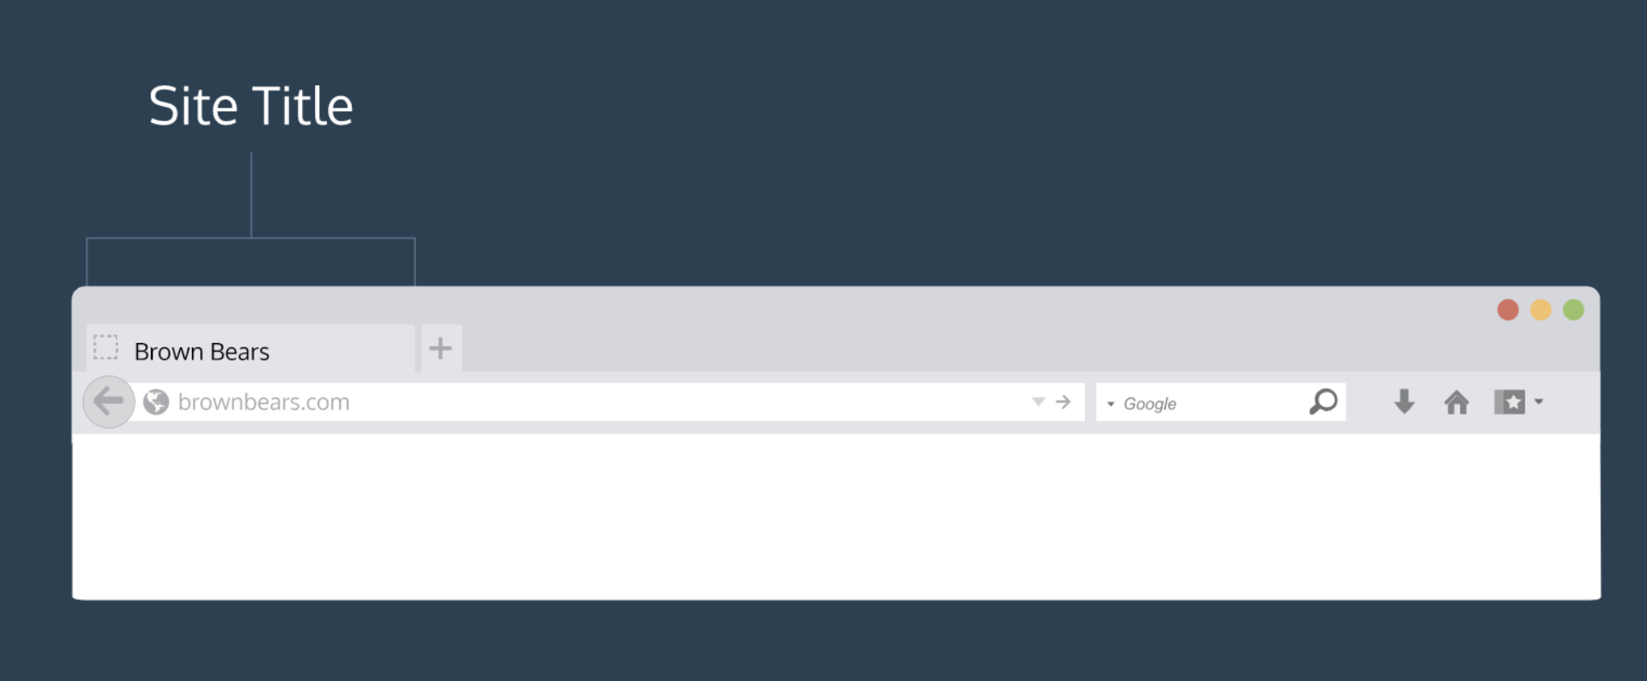
HTML document structure
jit.team 2018

Slide 6
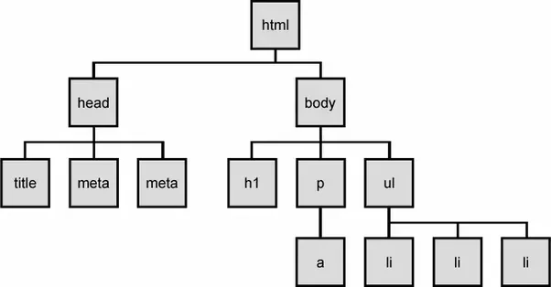
DOM
jit.team 2018

Slide 7

Attributes
name
value
jit.team 2018

Slide 8
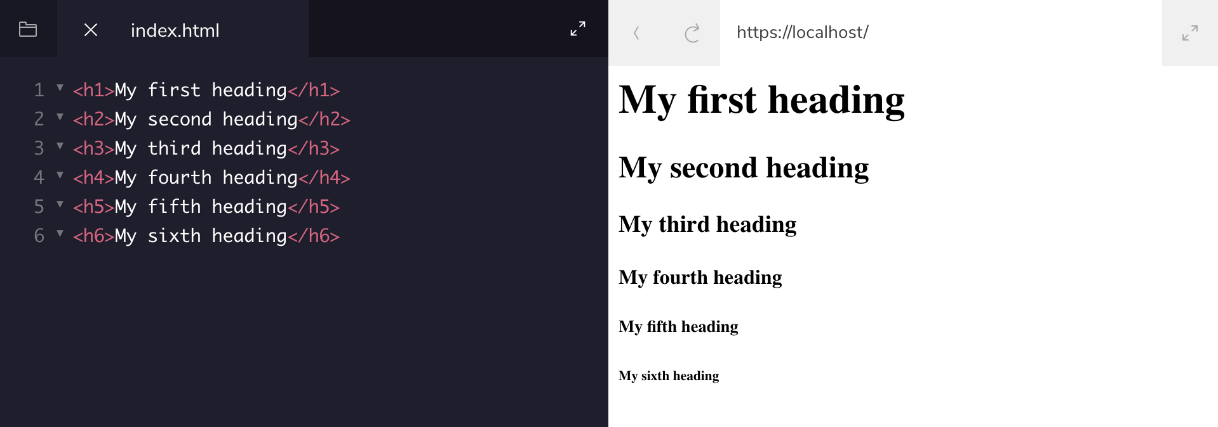
Headings
jit.team 2018

Slide 9
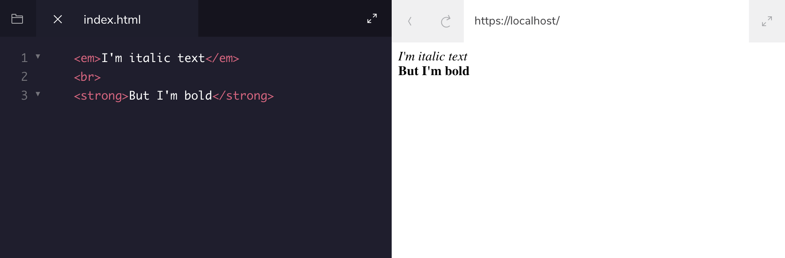
Text styling
jit.team 2018

Slide 10
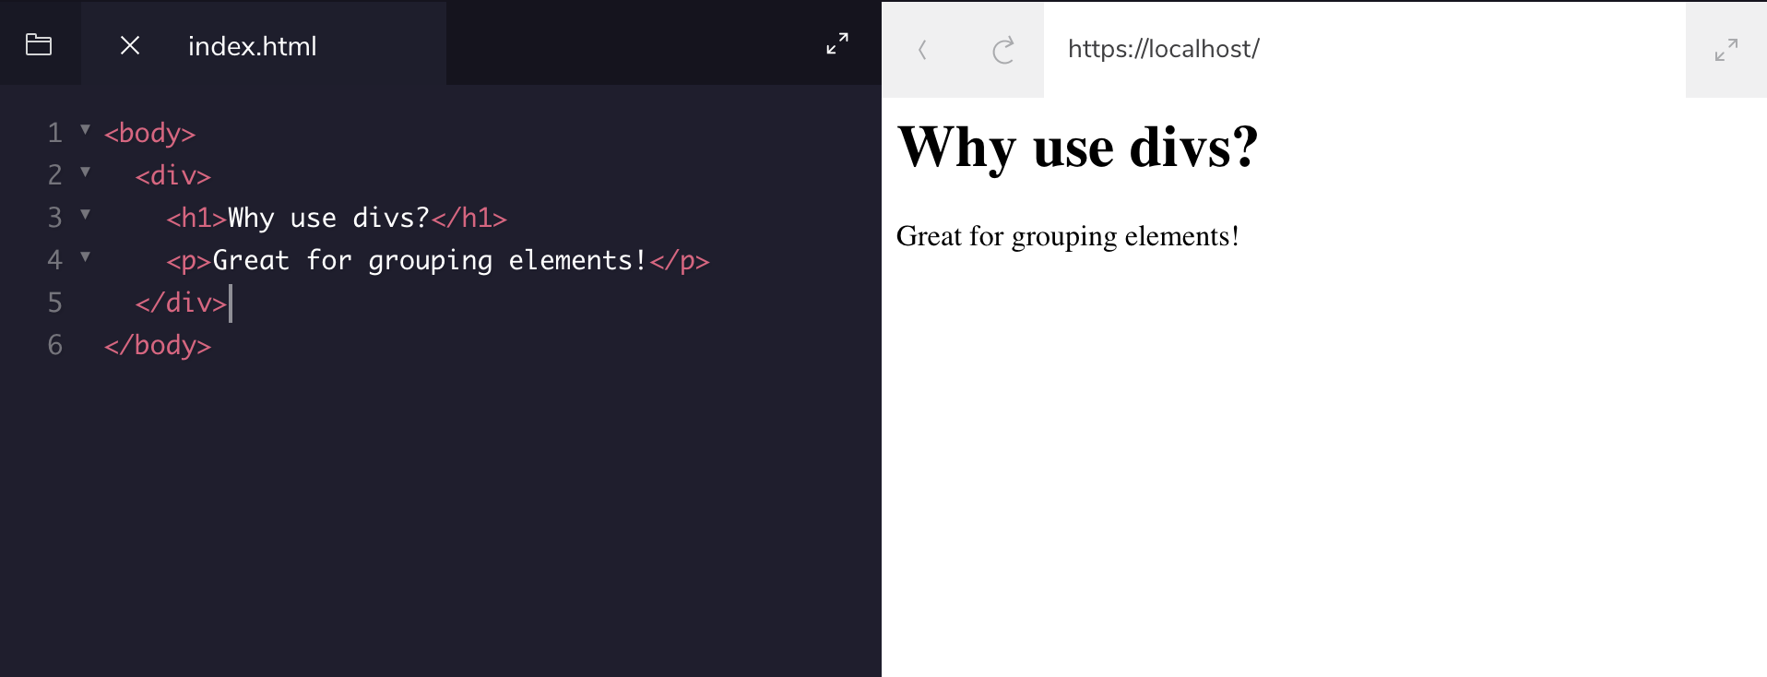
Divs
jit.team 2018

Slide 11
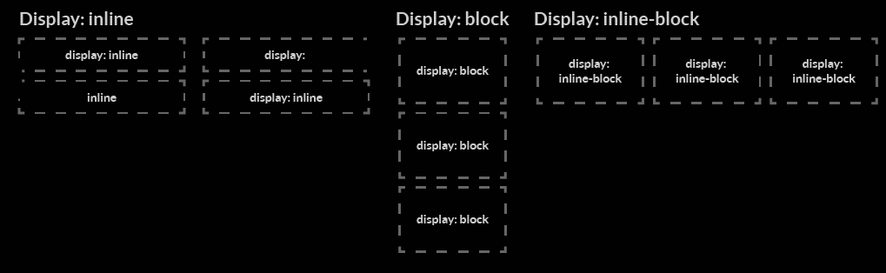
Categories of HTML elements
jit.team 2018

Slide 12
Block <div>
they will appear on a new line from whatever content went before it, and any content that goes after it will also appear on a new line
paragraphs, lists, navigation menus, footers etc.
Inline <span>
they will not cause a new line to appear in the document
surrounds only small parts of the document’s content, not entire paragraphs; they would normally appear inside a paragraph of text
<a> (hyperlink), emphasis elements (<em>, <strong>)
jit.team 2018

Slide 13
Comments
<!-- This is a comment
that the browser will not display -->
jit.team 2018

Slide 14
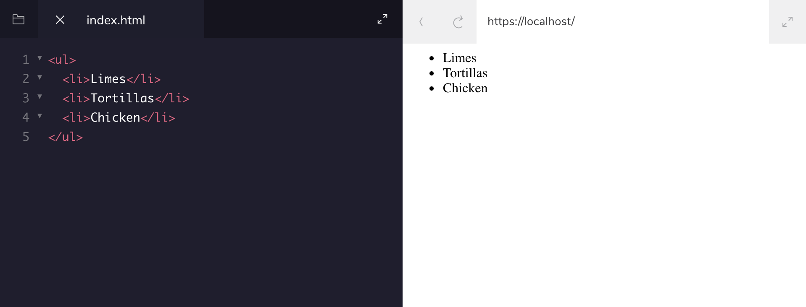
Lists (unordered)
jit.team 2018

Slide 15
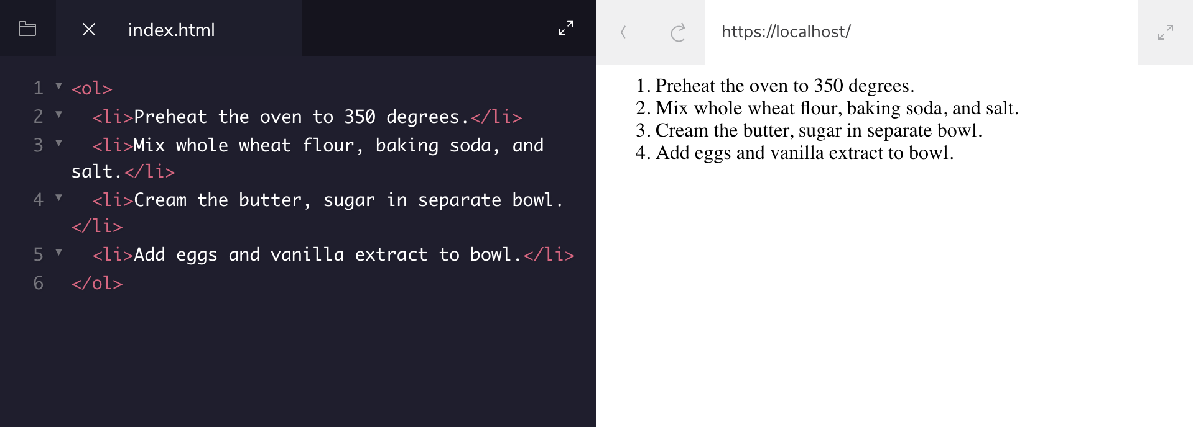
Lists (ordered)
jit.team 2018

Slide 16
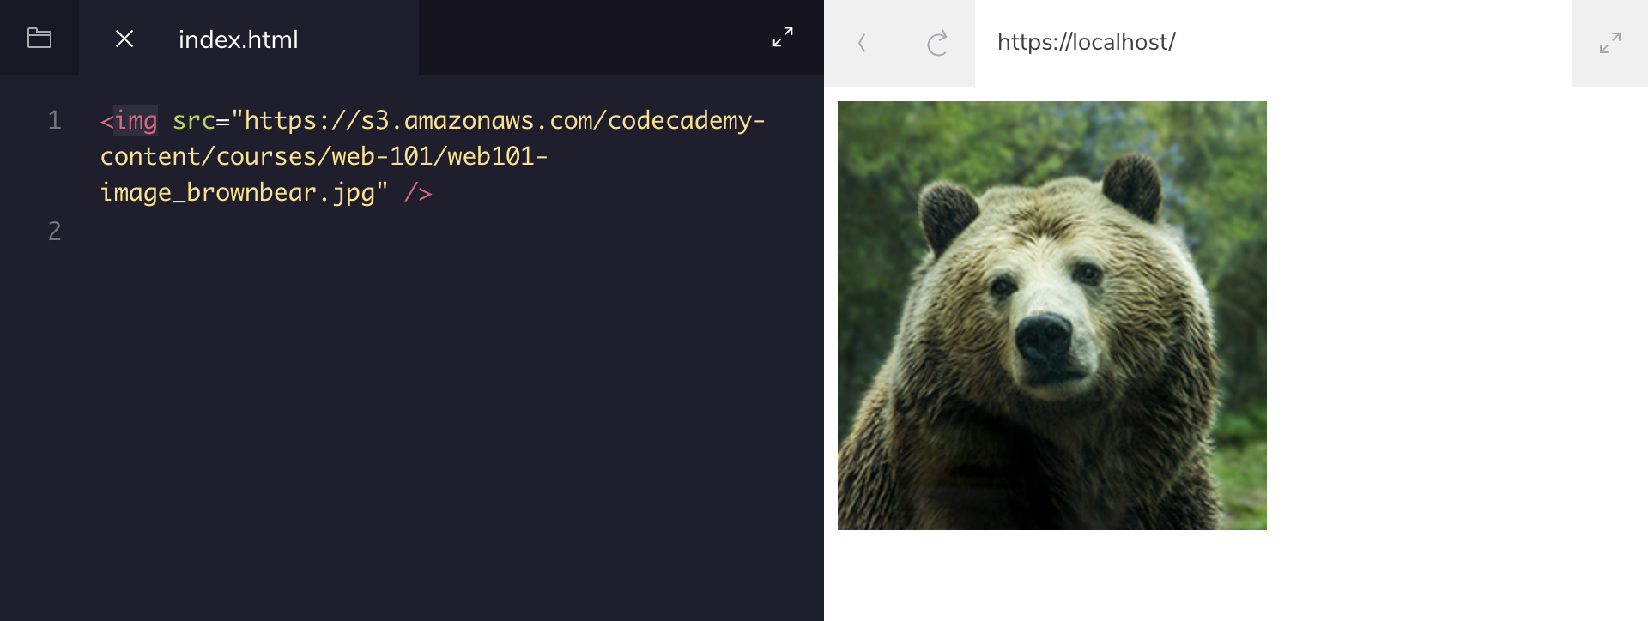
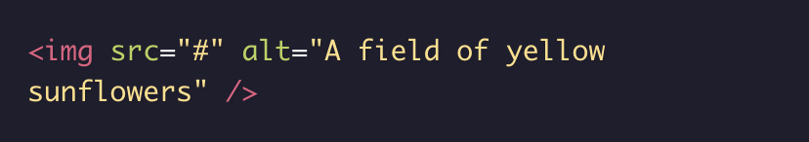
Images
jit.team 2018

Slide 17
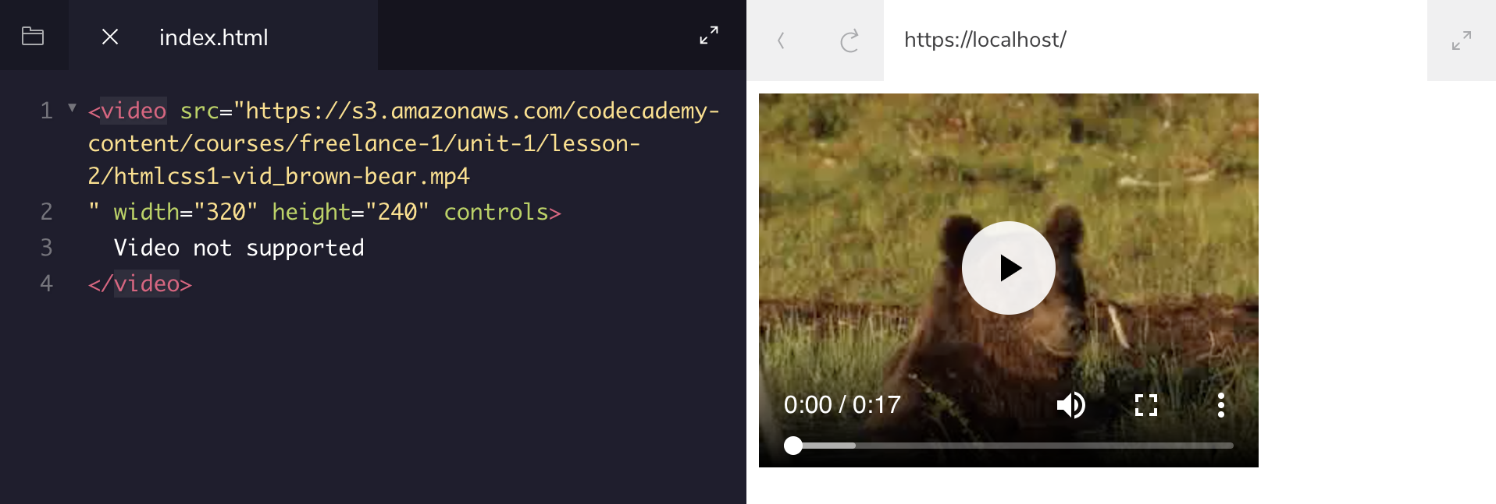
Videos
jit.team 2018

Slide 18
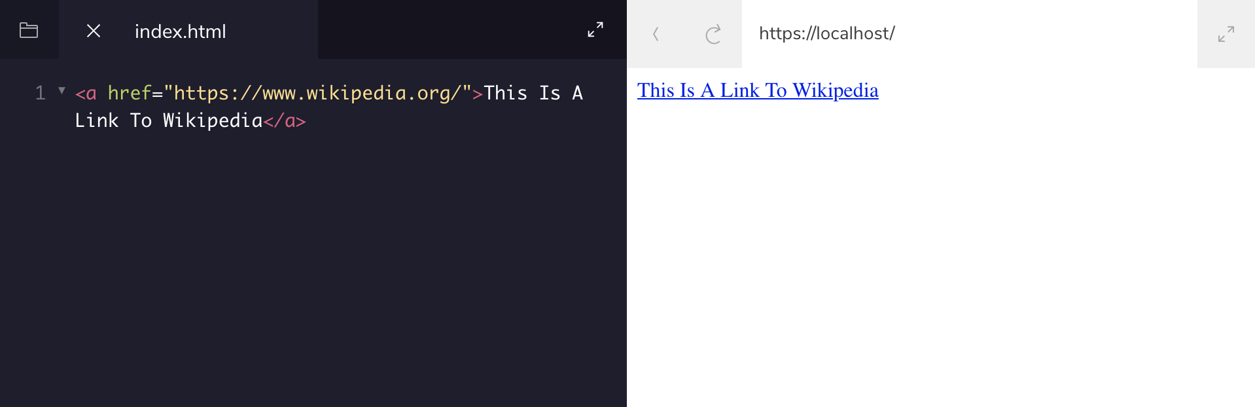
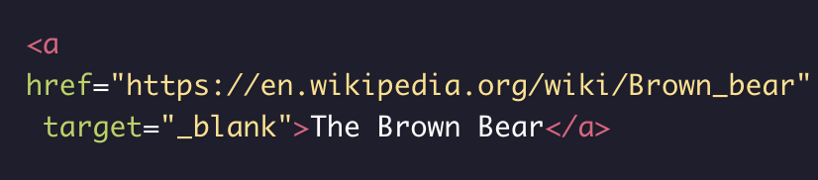
Linking to external page
jit.team 2018

Slide 19
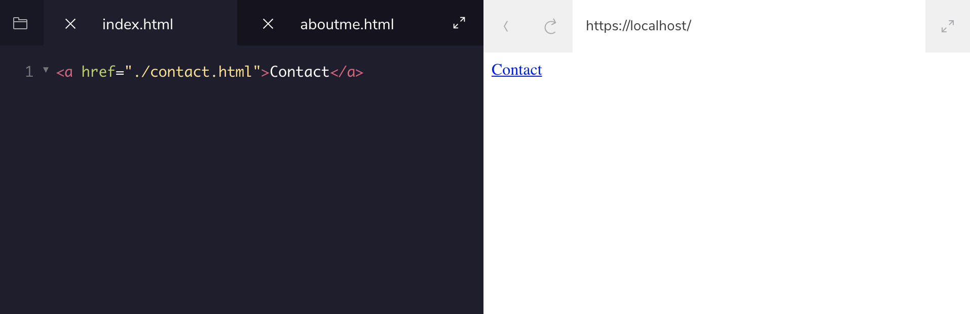

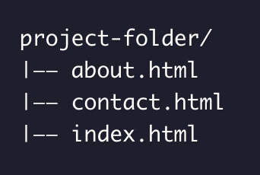
Linking to relative path
jit.team 2018

Slide 20
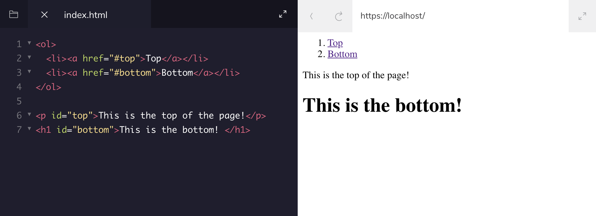
Linking to same page
jit.team 2018

Slide 21
Tables
<table>
<tr> row <td> cell (data)
<th> header
<tbody> <thead> <tfoot>
colspan rowspan attributes
jit.team 2018

Slide 22
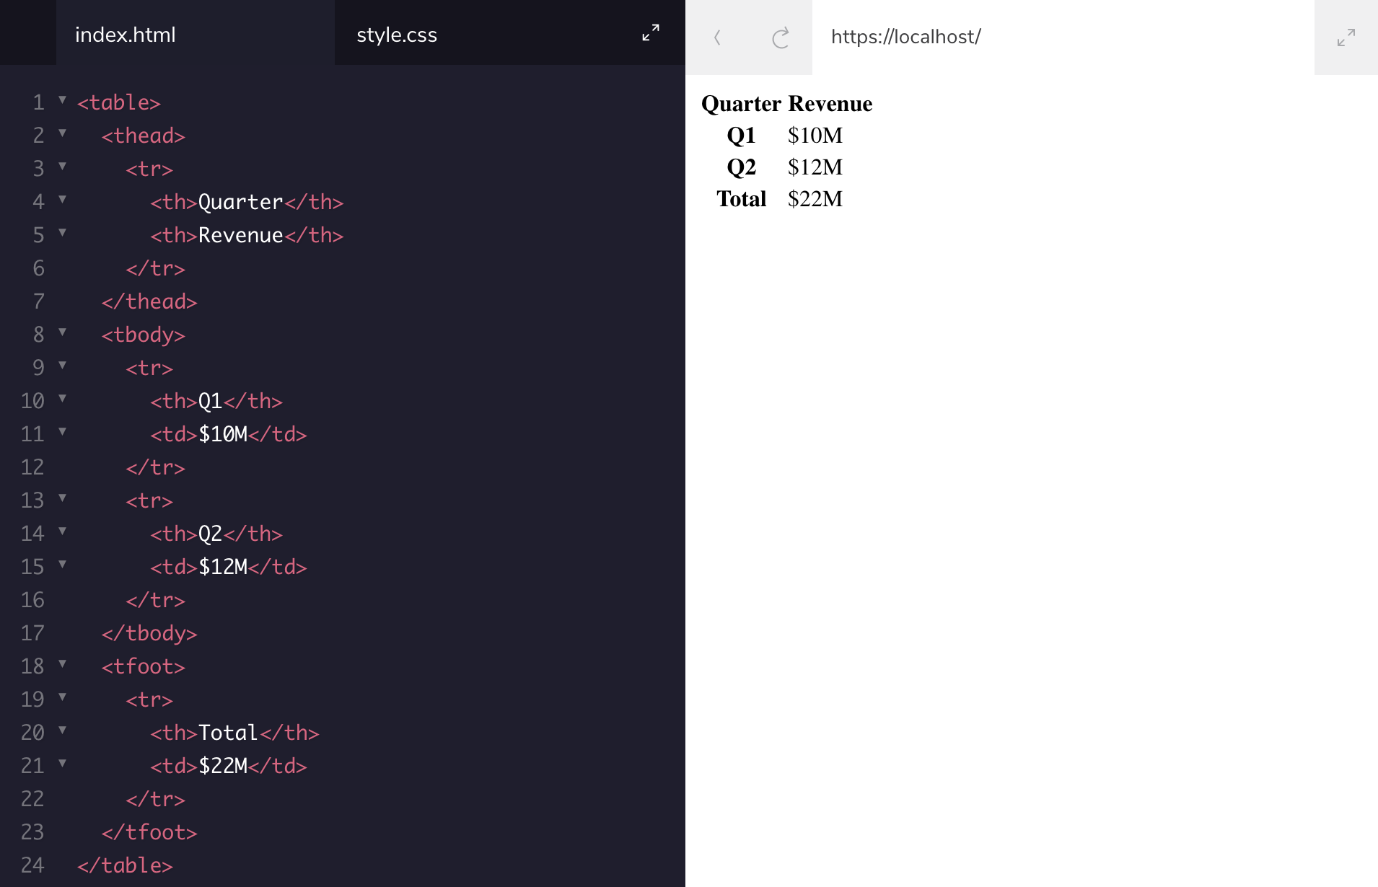
Tables
jit.team 2018

Slide 23
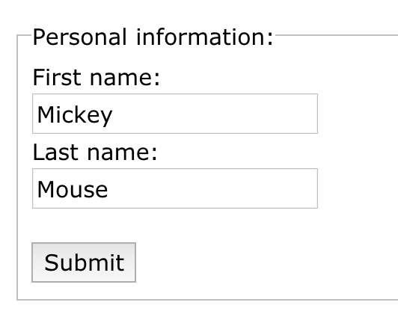
Forms elements
<form> action, method (attributes)
<input> type, name, value (attributes)
<select> <option>
<textarea>
<fieldset> <legend>
jit.team 2018

Slide 24
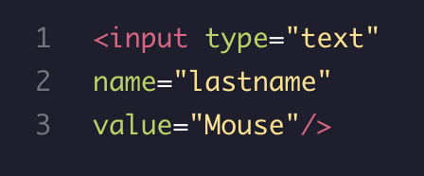
Forms name attribute
Each input field must have a name attribute to be submitted. If the name attribute is omitted, the data of that input field will not be sent at all.
jit.team 2018

Slide 25
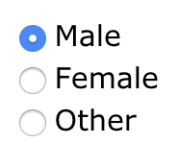
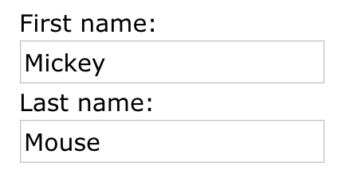

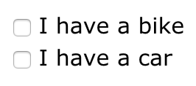

Forms input types
<input type = “text”>
<input type = “radio”>
<input type = “checkbox”>
<input type = “button”>
<input type = “password”>
<input type = “submit”>
jit.team 2018

Slide 26
Forms input attributes
action
specifies the URL of a file that will process the input control when the form is submitted
overrides the action attribute of the <form> element
is used with type="submit" and type="image"
jit.team 2018

Slide 27
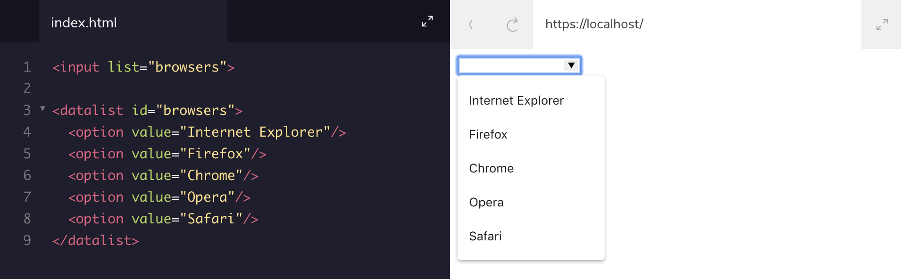
Forms input attributes
list - refers to a <datalist> with pre-defined options for an <input> element
jit.team 2018

Slide 28
Forms input attributes
value - attribute specifies the initial value for an input field
disabled - specifies that the input field is disabled
size - specifies the size (in characters) for the input field
maxlength - specifies the maximum allowed length for the input field
placeholder - specifies a hint that describes the expected value
required - specifies that an input field must be filled out before submitting
jit.team 2018

Slide 29
Forms
GET
The default method when submitting form data
Visible in the page address field
Appends form-data into the URL in name/value pairs
POST
If the form data contains sensitive or personal information
Does not display the submitted form data in the page address field.
/action_page.php?firstname=Mickey&lastname=Mouse
jit.team 2018

Slide 30

Responsive Web Design
jit.team 2018

Slide 31
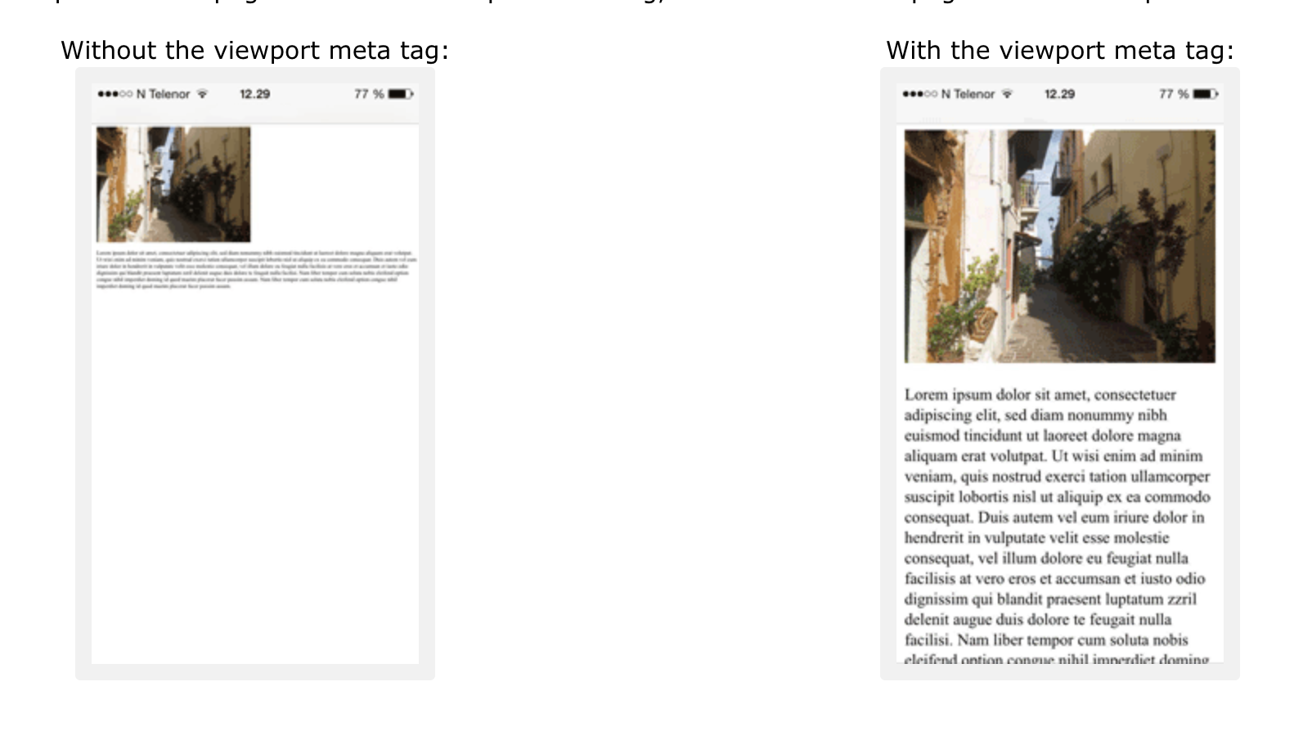
<meta name="viewport" content="width=device-width, initial-scale=1.0">
jit.team 2018

Slide 32

jit.team 2018

Slide 33
HTML5 API’s
HTML Geolocation HTML Drag and Drop HTML Local Storage HTML Application Cache HTML Web Workers HTML SSE
jit.team 2018

Slide 34
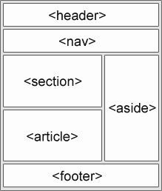
Semantic elements
jit.team 2018

Slide 35
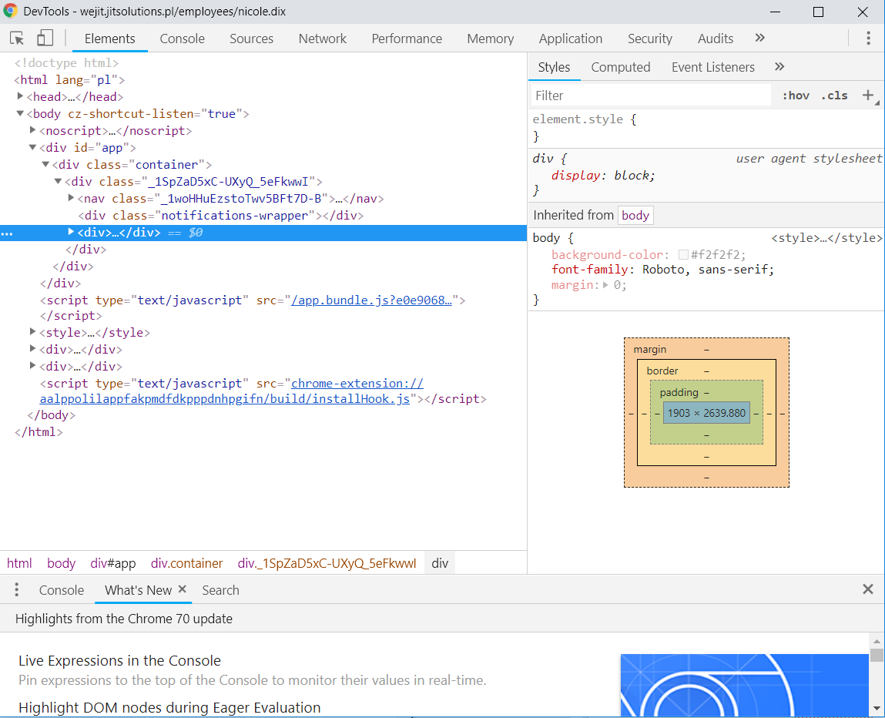
Debugging
jit.team 2018

Slide 36
Workshop #1
First page
navigation and postcards list
jit.team 2018

Slide 37
Workshop #2
Second page
postcards share form
jit.team 2018

