Slide 1








Editors and IDEs
PyCharm
Atom
Emacs
VI(M)
Visual Studio Code
Spyder
Python-IDLE
Sublime

Slide 2
Editors vs. IDEs
Editor
easier to work with
not as many features
usually able to edit all types of files
natively don’t compile or debug code
can have plug ins and extensions for that
→ Sublime, VIM, Atom, Emacs
IDE
more functionality and features
integrated debugging and compiling
sometimes specific for one coding language
it supports you with conventions, auto-complete, points out errors,...
→ PyCharm, Python-IDLE
VS Code

Slide 3

Python environments
Why do we need them?
  Specific package version for project
  Different package versions for different projects
  Collaboration with different people
  Deploying code
https://www.freecodecamp.org/news/why-you-need-python-environments-and-how-to-manage-them-with-conda-85f155f4353c/
https://upload.wikimedia.org/wikipedia/en/c/cd/Anaconda_Logo.png

Slide 4
Python environments
How to set them up
  Using Anaconda / Minicona
  Conda is a package and environment management system
https://www.freecodecamp.org/news/why-you-need-python-environments-and-how-to-manage-them-with-conda-85f155f4353c/
https://upload.wikimedia.org/wikipedia/en/c/cd/Anaconda_Logo.png

Slide 5
Conda Commands
Creating an environment:
conda create --name myenv
conda create -n myenv python=3.6
conda create -n myenv scipy
conda create -n myenv python
conda install -n myenv scipy
Getting information:
conda env list
conda info --envs
https://docs.conda.io/projects/conda/en/latest/user-guide/tasks/manage-environments.html
https://upload.wikimedia.org/wikipedia/en/c/cd/Anaconda_Logo.png

Slide 6
Conda Commands
Interacting with environments:
conda activate myenv
conda deactivate myenv
conda install PKGNAME==3.4.1
conda list --explicit > pkgs.txt
conda create --clone myenv --name newenv
https://docs.conda.io/projects/conda/en/latest/user-guide/tasks/manage-environments.html
https://upload.wikimedia.org/wikipedia/en/c/cd/Anaconda_Logo.png

Slide 7
Let’s choose an IDE
for your project
and set up an environment

Slide 8
Naming Conventions
Variables:
var_name
Classes:
CapWords
Functions:
lower_case_under_score_separators
Constants:
ALL_UPPER_CASE
https://github.com/zedr/clean-code-python

Slide 9
Coding Conventions
Variables:
meaningful and pronounceable names
same vocab for the same type of variable
use searchable names
ymdstr = datetime.date.today()
current_date = datetime.date.today()
get_user_info()
get_client_date()
get_customer_record()
get_user_info()
get_user_date()
get_user_record()
time.sleep(86400)
SECONDS_IN_A_DAY = 60 * 60 * 24
time.sleep(SECONDS_IN_A_DAY)
https://github.com/zedr/clean-code-python

Slide 10
Coding Conventions
Variables:
avoid mental mapping / make it as easy to read as possible
seq = ('Austin', 'New York', 'San Francisco')
for item in seq:
do_stuff()
do_some_other_stuff()
# ...
# Wait, what's `item` for again?
dispatch(item)
locations = ('Austin', 'New York', 'San Francisco')
for location in locations:
do_stuff()
do_some_other_stuff()
# ...
dispatch(location)
https://github.com/zedr/clean-code-python

Slide 11
Coding Conventions
Functions:
try to keep number of input parameters small
functions should do one thing
function names should say what they do
def func_class_obj(self):
return self.name
def get_name(self):
return self.name
https://github.com/zedr/clean-code-python

Slide 12
Coding Conventions
Document your code!
    in-line comments
    function definitions
    → you will forget what you coded two weeks earlier – believe me...
KISS:
  keep it simple, stupid
DRY:
  don’t repeat yourself
→ reuse your code and write it reusable
https://github.com/zedr/clean-code-python

Slide 13
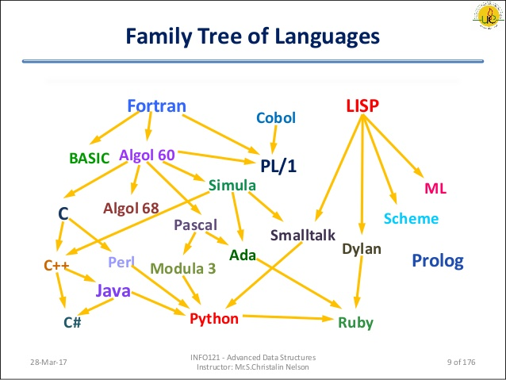
https://external-content.duckduckgo.com/iu/?u=https%3A%2F%2Fimage.slidesharecdn.com%2Fprogramminginc-170328141719%2F95%2Fprogramming-in-c-9-638.jpg%3Fcb%3D1490710907&f=1&nofb=1

Slide 14
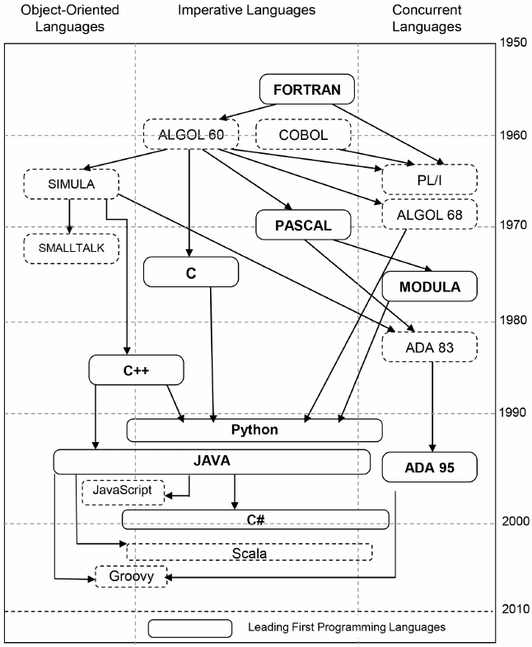
https://www.researchgate.net/profile/Saeed_Islam2/publication/260447599/figure/fig1/AS:297126874632198@1447851975744/Genealogy-of-Programming-Languages-doi101371-journalpone0088941g001.png

Slide 15
Java
Python
OOP
Good for server-side applications
Mobile apps
Video games
Portable
Runs across multiple platforms
OOP
High level, interpreted
mulit-purpose
Easy to learn
Interpreted language
Used a lot in education
Runs across multiple platforms
https://www.inc.com/larry-kim/10-most-popular-programming-languages-today.html

Slide 16
C
C++
More low level
Lots of languages derive from C
Compiled language (needs a compiler)
Built into operating systems
Enhanced version of C
OOP
Compiled language
Still rather low level
https://www.codeconquest.com/what-is-coding/common-programming-languages/

Slide 17
SQL
PHP
Structured Query Language
Interaction with data bases
For producing dynamic web pages
Link between data base and the HTML to view data
https://www.codeconquest.com/what-is-coding/common-programming-languages/

Slide 18
For Loops

Slide 19
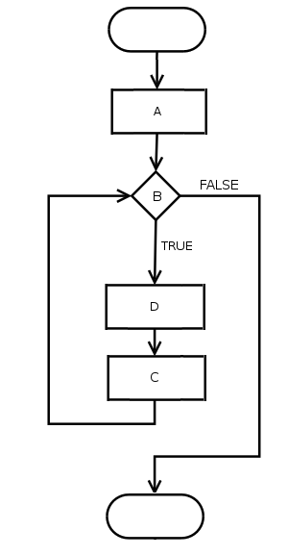

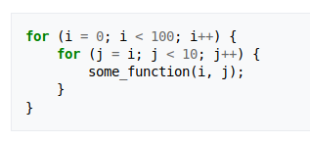
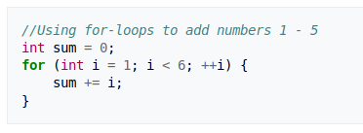
Python:
C:
Java:
B: condition
D: code within for loop
C: increment
https://en.wikipedia.org/wiki/For_loop
https://en.wikipedia.org/wiki/For_loop#/media/File:For-loop-diagram.png

Slide 20
Object Oriented Programming
  Programming paradigm
  Provides a means of structuring programs
  Main components:
      Classes
      Objects (instances of classes)
https://realpython.com/python3-object-oriented-programming/

Slide 21
Object Oriented Programming
  Classes have class attributes that apply for all objects of the class
  Objects have instance attributes that are specific for each object
  The same with functions
https://realpython.com/python3-object-oriented-programming/

Slide 22
Object Oriented Programming
Class
Object
class name
Dog
dog1
object name
fur_colour
name
eye_colour
fur_colour = ‘white’
name = ‘Sam’
eye_colour = ‘brown’
class attributes
object attributes (with values)
bark()
nuzzle()
eat()
bark()
nuzzle()
eat()
class functions
object functions

Slide 23
Object Oriented Programming
Class
Object
class name
Neuron
myneuron
object name
firing_rate
nr_connections
time_constant
firing_rate = 30
nr_connections = 50
time_constant = 0.5
class attributes
object attributes (with values)
fire()
connect(Neuron: n)
fire()
connect(Neuron: n)
class functions
object functions

Slide 24
Object Oriented Programming
Inheritance
Dog
Terrier and Bulldog inherit from Dog
Russell Terrier inherits from Terrier and therefore implicitly also from Dog
A Bulldog is a (more specific) Dog
more specific
Terrier
Bulldog
Russell Terrier

Slide 25
References:
Content:
https://realpython.com/python3-object-oriented-programming/
https://github.com/zedr/clean-code-python
https://docs.conda.io/projects/conda/en/latest/user-guide/cheatsheet.html
https://docs.conda.io/projects/conda/en/latest/user-guide/tasks/manage-environments.html
https://www.freecodecamp.org/news/why-you-need-python-environments-and-how-to-manage-them-with-conda-85f155f4353c/
https://www.python.org/dev/peps/pep-0008/#naming-conventions
Images:
https://upload.wikimedia.org/wikipedia/commons/thumb/a/a1/PyCharm_Logo.svg/2000px-PyCharm_Logo.svg.png
https://cdn.worldvectorlogo.com/logos/sublime-text.svg
https://external-content.duckduckgo.com/iu/?u=https%3A%2F%2Fseeklogo.com%2Fimages%2FA%2Fatom-logo-19BD90FF87-seeklogo.com.png&f=1&nofb=1
https://external-content.duckduckgo.com/iu/?u=https%3A%2F%2Fpbs.twimg.com%2Fprofile_images%2F90141999%2Fcarbon-emacs-icon.png&f=1&nofb=1
https://external-content.duckduckgo.com/iu/?u=https%3A%2F%2Fpbs.twimg.com%2Fprofile_images%2F64545277%2Fvim_logo_400x400.png&f=1&nofb=1
https://codefluegel.com/wp-content/uploads/2019/08/Visual_Studio_code_logo.png
http://www.pngall.com/wp-content/uploads/2016/05/Python-Logo-Free-Download-PNG.png

