Slide 1
TIME TRACKING AND TASK MANAGEMENT SYSTEM FOR THESIS
PROPONENTS:
ACHACOSO, MARK VINCENT R.
MORENO, PAOLO JOSEPH L.
NACUA, MARY B.
ROA, JULIEREN P.

Slide 2
CHAPTER 1
INTRODUCTION

Slide 3
BACKGROUND OF THE STUDY
● Task management is the process of managing tasks through its life cycle.
● This involves planning, testing, tracking and reporting.
● Task management can help an individual achieve a goal, or a group of individuals collaborate and share their knowledge for the achievement of common goals.
● Project management is acknowledged as a discipline that greatly increases the efficiency of the implementation projects.

Slide 4
STATEMENT OF PROBLEM
Currently most schools don't have a system that monitors student progress on doing thesis in groups which results in some "hitch hikers" students and the completion of the tasks will be delayed. In this section, it represents other problems that this system will be solving:
Disorganized distribution of the tasks and monitoring the progress per tasks given.
Lack of time management of the team members causes delays of the project/tasks completion.
No visual representation of the individuals and teams progress on the thesis project.

Slide 5
OBJECTIVES
This study aims to develop a web-based application online system that will notify the team of those tasks that need to be prioritized based on a defined time-schedule.
Specifically, this study aims to:
To make a web-based application online system that will be used by the adviser to monitor all the assigned tasks given by the project manager/team leader to the team members for their thesis project.
To design and develop a web-based application online system that will do the following:
The project leader can add tasks, assign and transfer the tasks, set the percentage and date of the completion according to the module given.
Track the time/hours work by the students/members on doing their tasks.
To evaluate the points/grade on per members tasks that will be reported by the team leader to the adviser according to the members completed tasks or the groups finished thesis projects.

Slide 6
SCOPE AND LIMITATIONS
Scope
The proposed system is a web-based application online system called TickTack: Time Tracking and Task Management System for Thesis that will help students monitor and organize their tasks. Through the system, the project leader and the adviser will get to monitor the team’s progress and the time they spent on their tasks. The adviser can input ratings equivalent to the tasks completed. It is intended for the student’s who’s doing their thesis projects.
Limitation
The proposed system is flexible for students who are doing their thesis projects. This doesn’t include a feature like version control that can track the other members past works upon editing. The project leader and the adviser can’t edit on the system but the adviser can give comments about the task's and its progress along the way. It only focuses on uploading and downloading a file.

Slide 7
SIGNIFICANCE OF THE STUDY
The proposed system can help manage project schedules and tasks to ensure that a certain project is delivered on time. It helps to track the progress of an individual task assigned accordingly by the project leader. It will help students to manage their time properly and improve the productivity of their work. The system will help the students show the visual representation of the individual’s progress and team’s progress.

Slide 8
CHAPTER II
REVIEW AND RELATED LITERATURE

Slide 9
Title | Feature 1 Track and monitor employees work time spent of their assigned task. | Feature 2 Automate the process of the admin and user management and user task. This software provides facilities to assign task, send messages, and view notifications to the users of the users of this software notifications to use. | Feature 3 The students can create, edit, upload, delete and manage their project all at one place. | Feature 4 It is a system for managing, controlling, monitoring the final year projects of the students. It is a web based portal or application which is useful for students, project, coordinator and project guide. | Feature 5 Track the location status of the work. | Feature 6 Monitor and assign task, track time, and evaluate the grade on per members tasks according to the completed task.
A new Web Based Application | ✔
Online Task Management System(OTMS) |  | ✔
Student Project Management System(SPMS) |  |  | ✔
Project Management System(PMS) |  |  |  | ✔
Students Paperwork Tracking System(SPATRASE) |  |  |  |  | ✔
Ticktack:Time tracking and Task Management for Thesis | ✔ | ✔ |  | ✔ |  | ✔

Slide 10
CHAPTER III
RESEARCH DESIGN AND METHODOLOGY

Slide 11
DIAGRAMS

Slide 12
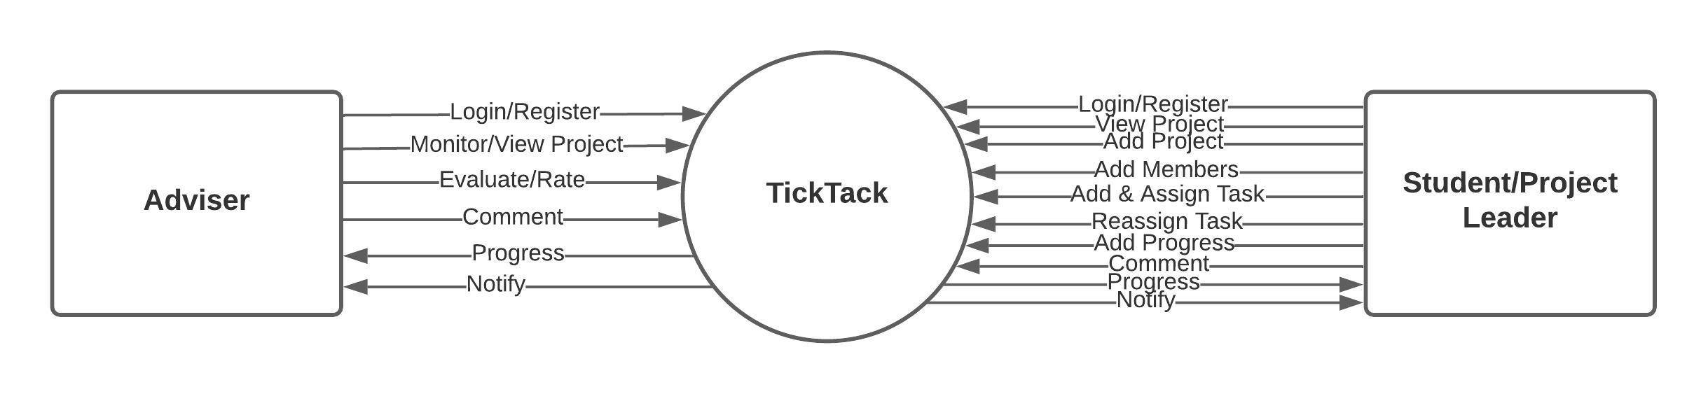
CONTEXT DIAGRAM

Slide 13
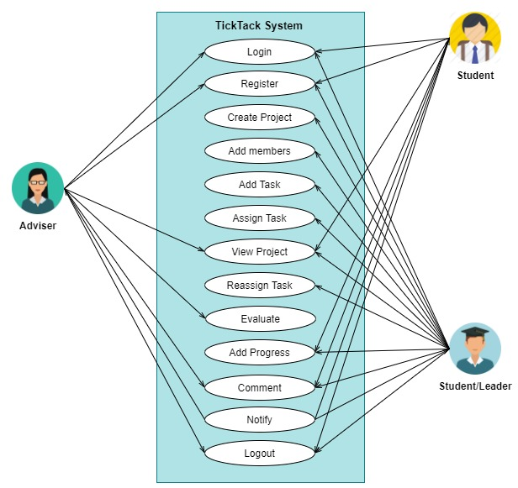
USE CASE DIAGRAM

Slide 14
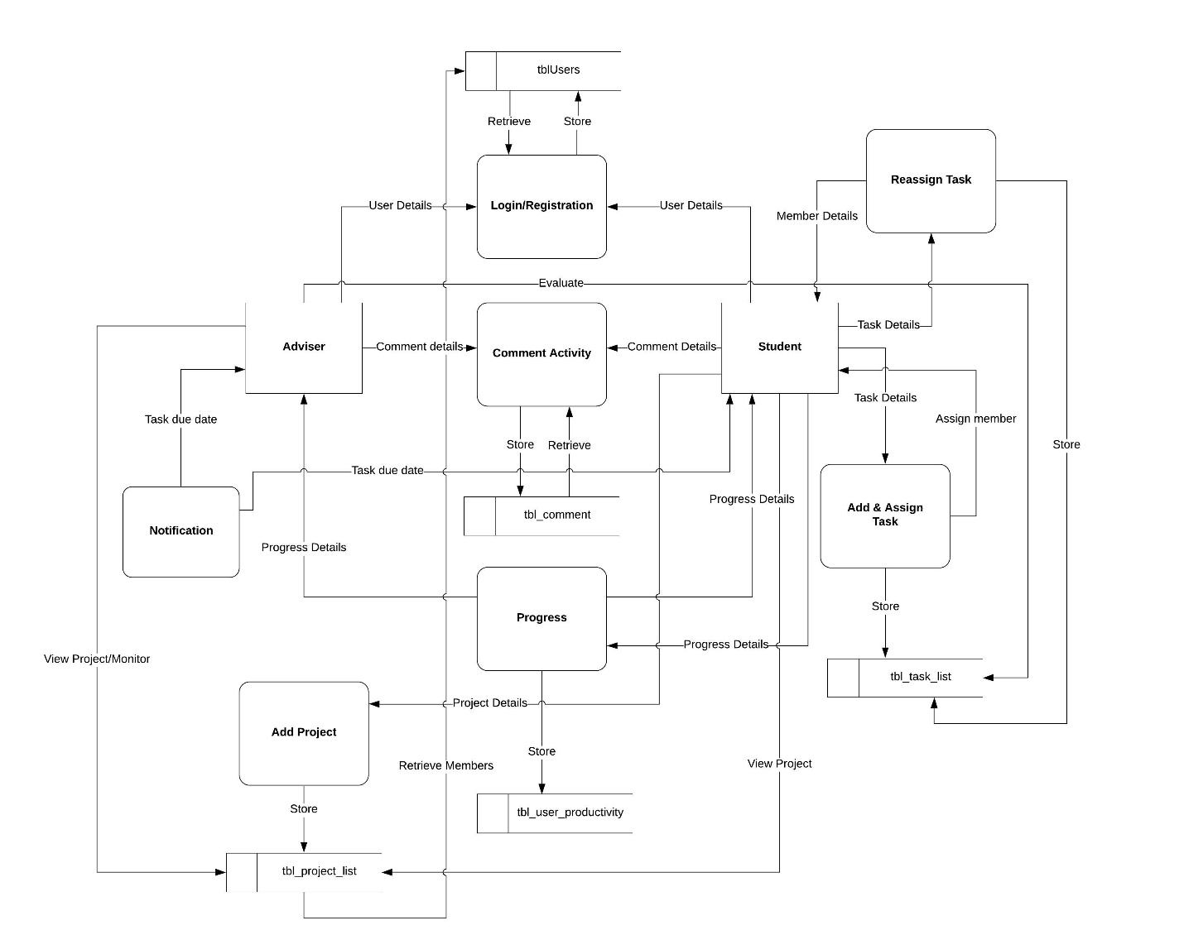
DATA FLOW DIAGRAM

Slide 15
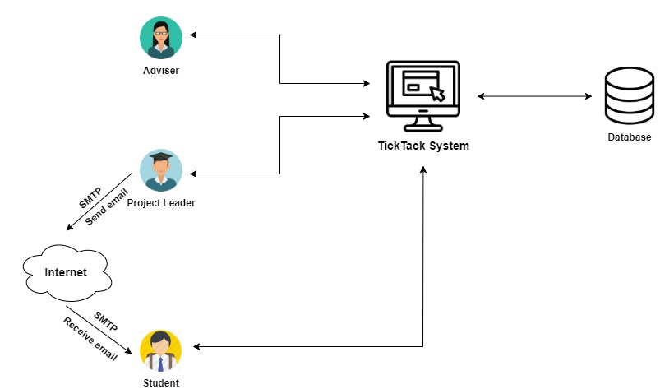
SYSTEM ARCHITECTURE

Slide 16
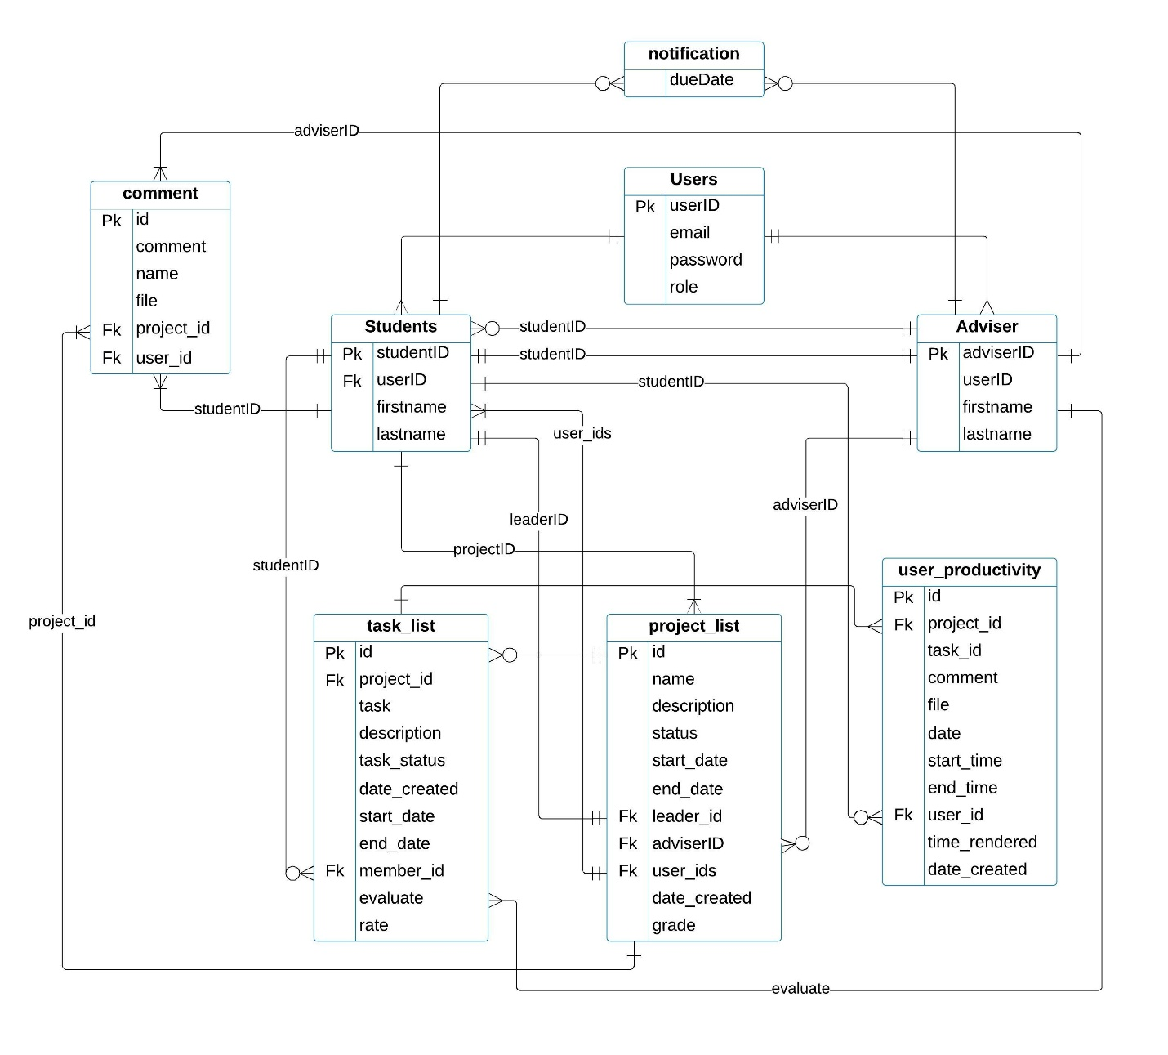
DATABASE DESIGN

Slide 17





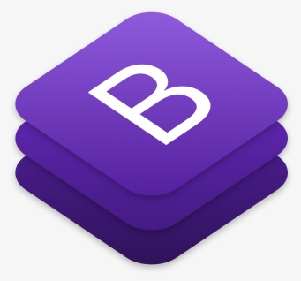
TOOLS AND TECHNOLOGIES USED

Slide 18
CHAPTER IV
RESULTS AND DISCUSSIONS

Slide 19
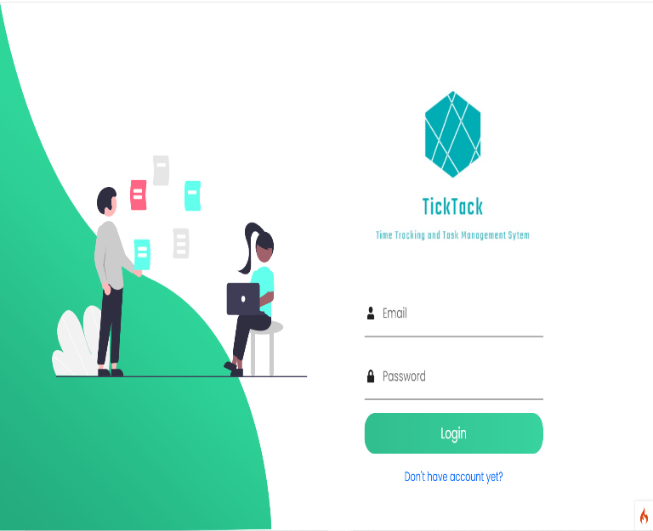
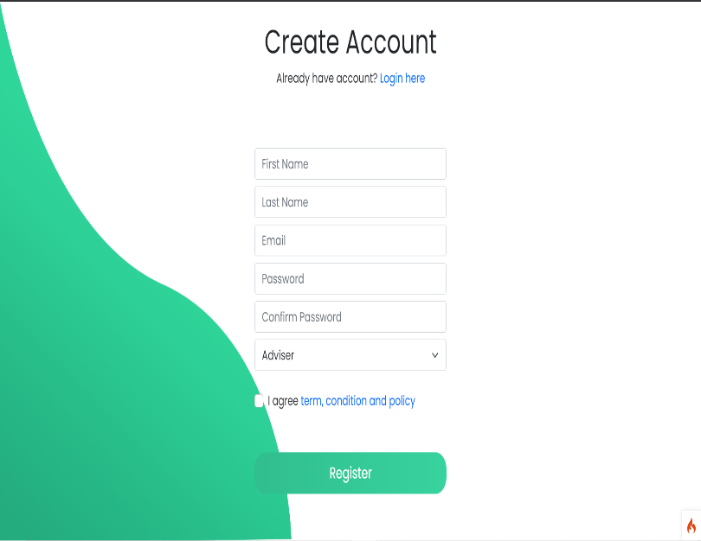
Web User Interface
Login Page and Registration Page of the Time Tracking and Task Management System for Thesis Web Application. To gain access to the application, the user must create an account first before logging in to the system. The user must input all the information needed by the registration page to be able to be registered. After the registration the user will now be able to login to the system according to the username and password registered.
Login Page and Registration Page

Slide 20
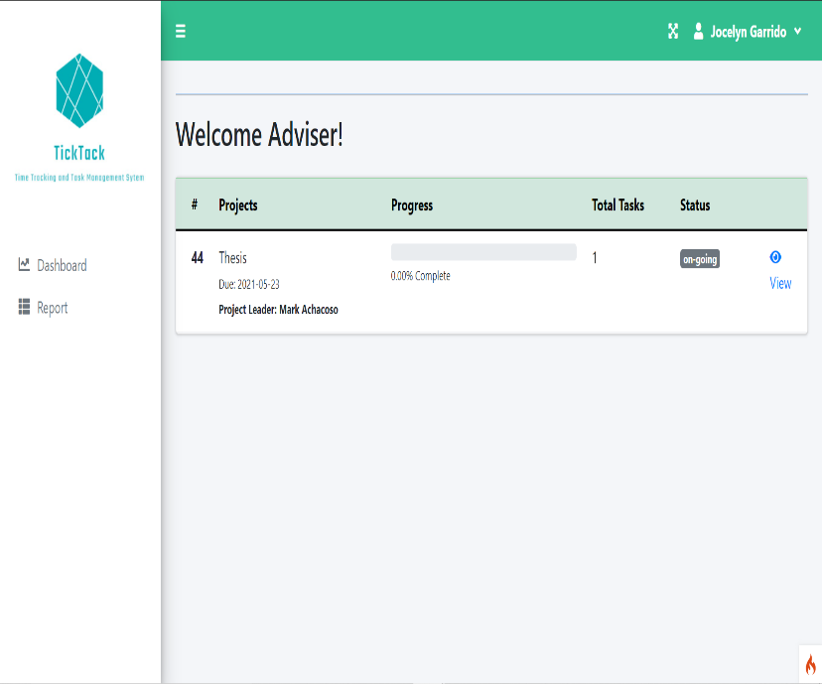
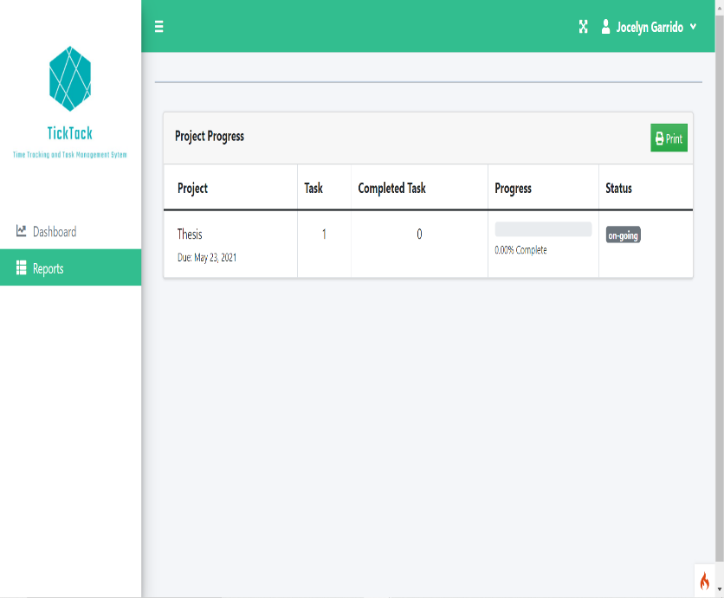
Adviser Dashboard and Adviser Report Dashboard
In this dashboard, reflects the Projects, team and individual’s progress, Total Tasks and Status of projects. In Adviser Report Dashboard, reflects the Project Progress, Task, Completed Tasks, Progress and the Status. Through this, adviser will now be able to monitor the students who are under their advisory.

Slide 21
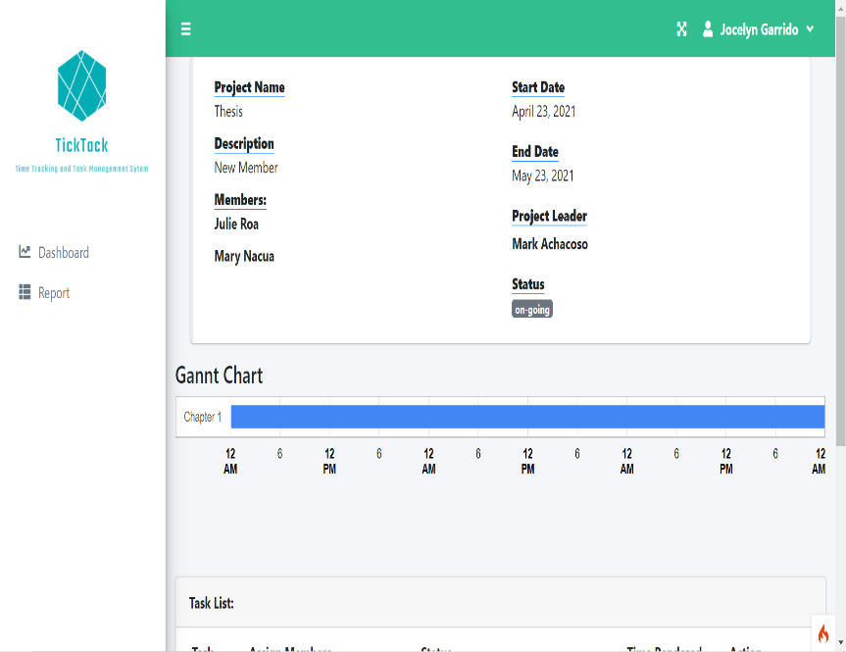
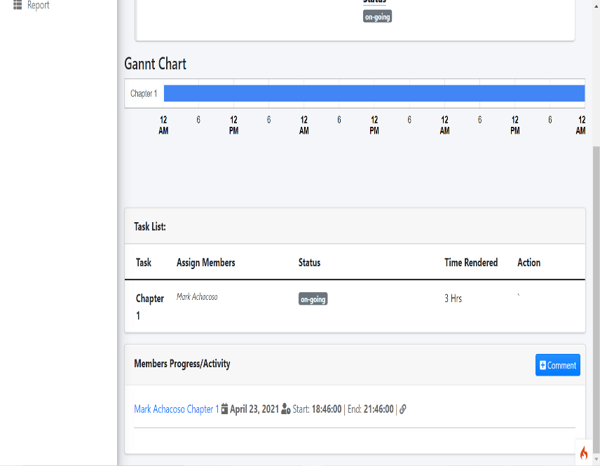
Adviser View Project Dashboard
Adviser would be able to monitor the team under their advisory, it reflects the name of the project, description of the project, members, date, the assign project leader and status of the project. The adviser also monitor through Gantt Chart the date of when started and when it will be finish. The adviser can also monitor through the Task List the Tasks that was assign, the assign members, status of the tasks, and the time rendered to the tasks.

Slide 22
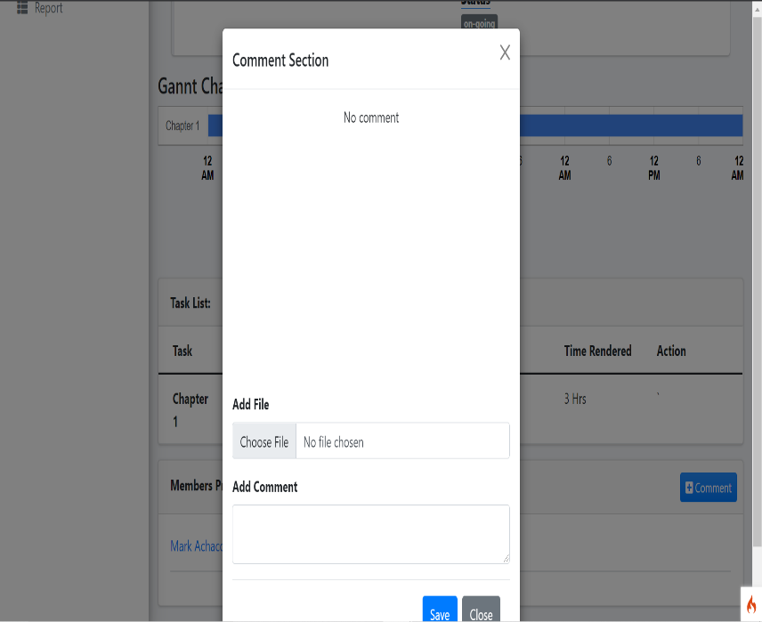
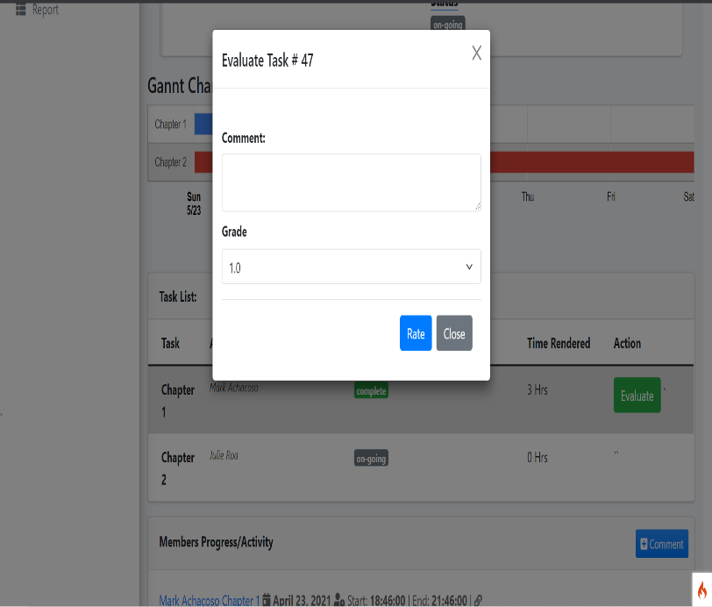
Adviser Comment Dashboard and Adviser Evaluation Dashboard
The adviser can evaluate and give comment to student who finish the assign task by the project leader. The adviser can input the grade according to the finish task after the evaluation. The adviser can also upload a file if there is any revision to be made.

Slide 23
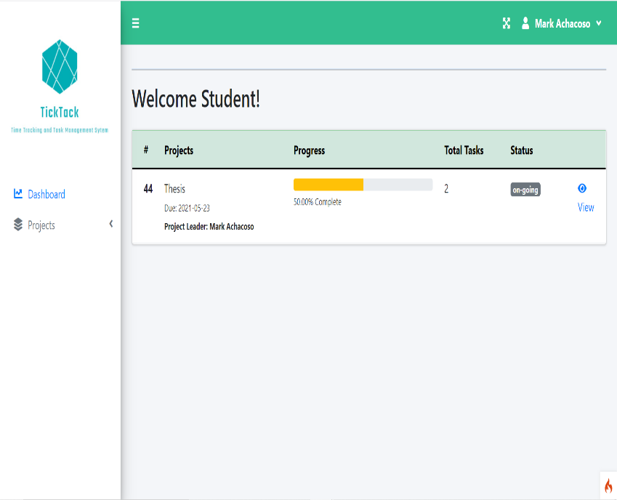
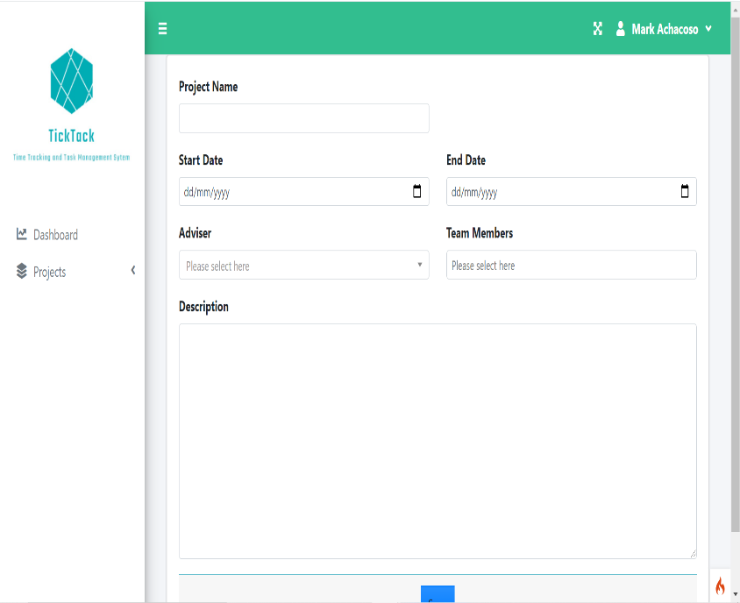
Project Leader Dashboard and Project Leader Create Project Dashboard
The Project Leader Dashboard reflects the Projects where the Projects listed, Progress where it reflects the percentage of project, Total Tasks assign and the Status of the project. The Project Leader will be the one to create and assign to the members, the start and end date of the project, choose the adviser, assign team member’s task and description of the task to Create Project Dashboard

Slide 24
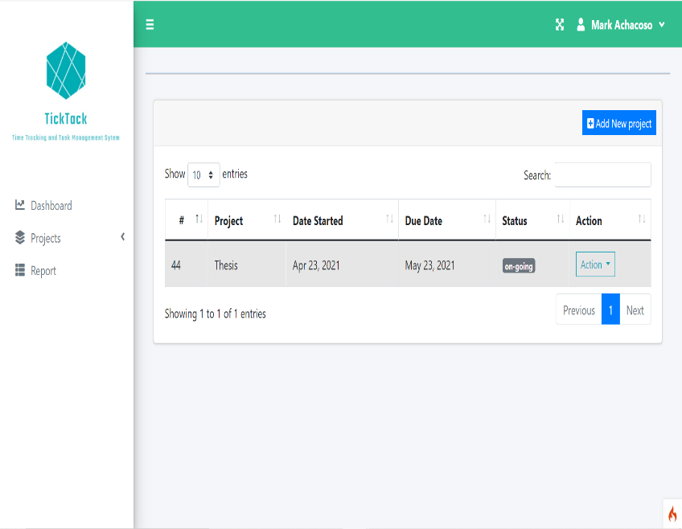
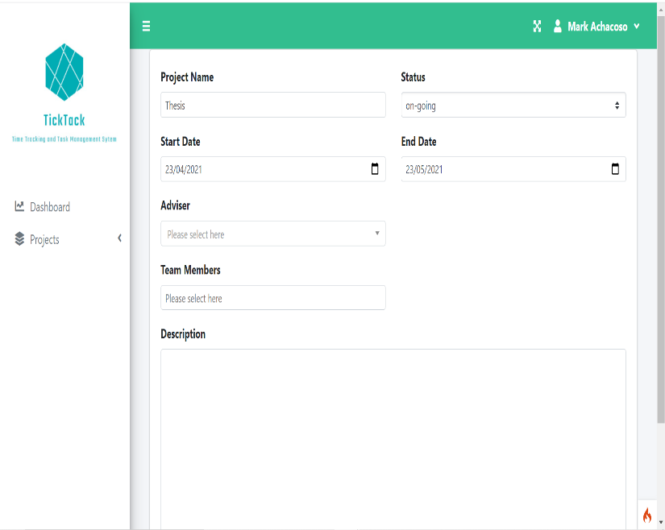
Project Leader Project List Dashboard and Project Leader Edit Project Dashboard
Project leader will be the one to assign task to the team members, on the project list dashboard reflects the list of the project, date started, due date, status and action. The action button where the project leader can edit and reassign task.

Slide 25
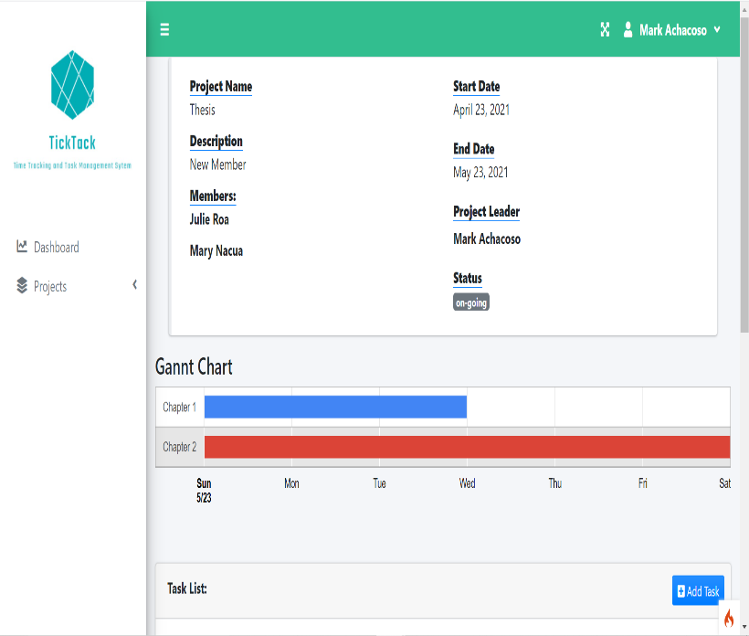
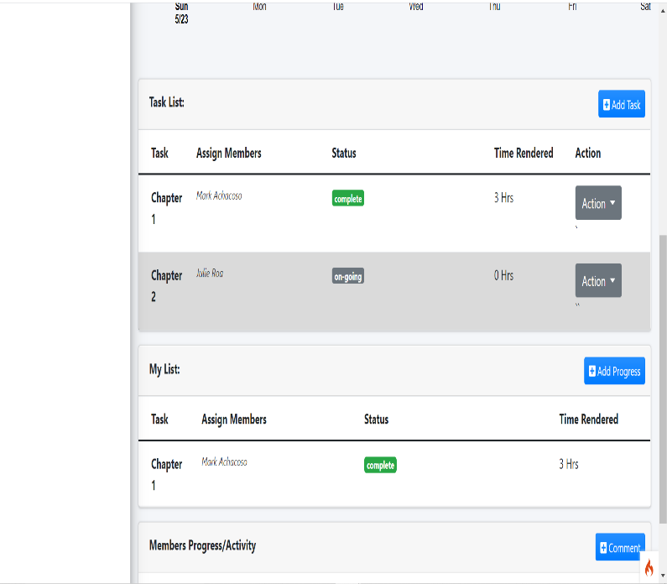
Project Leader Board
The project leader board reflects the project name, description, members, the date of the project, project leader and the status. The project leader can add task and assign it to the team members. After assigning the task it will reflect to the Task List table, and if the project leader has also task it will reflect to the My List table. The project leader board has also Gantt chart where the scheduling of the projects reflects.

Slide 26
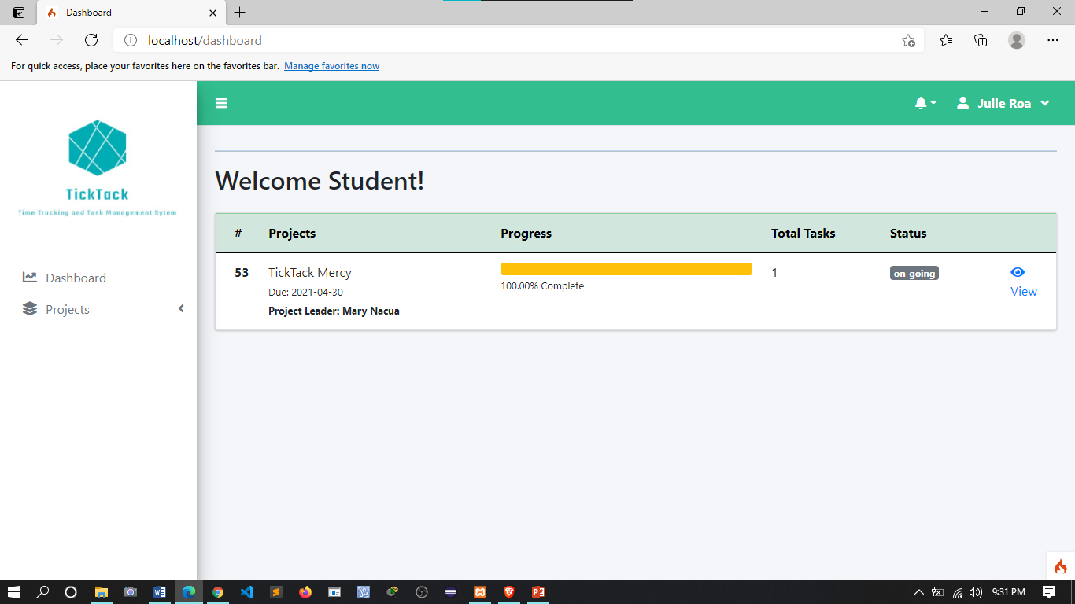
The student dashboard reflects the projects details including the progress bar, total tasks and status of the project.
Student/Member Dashboard

Slide 27
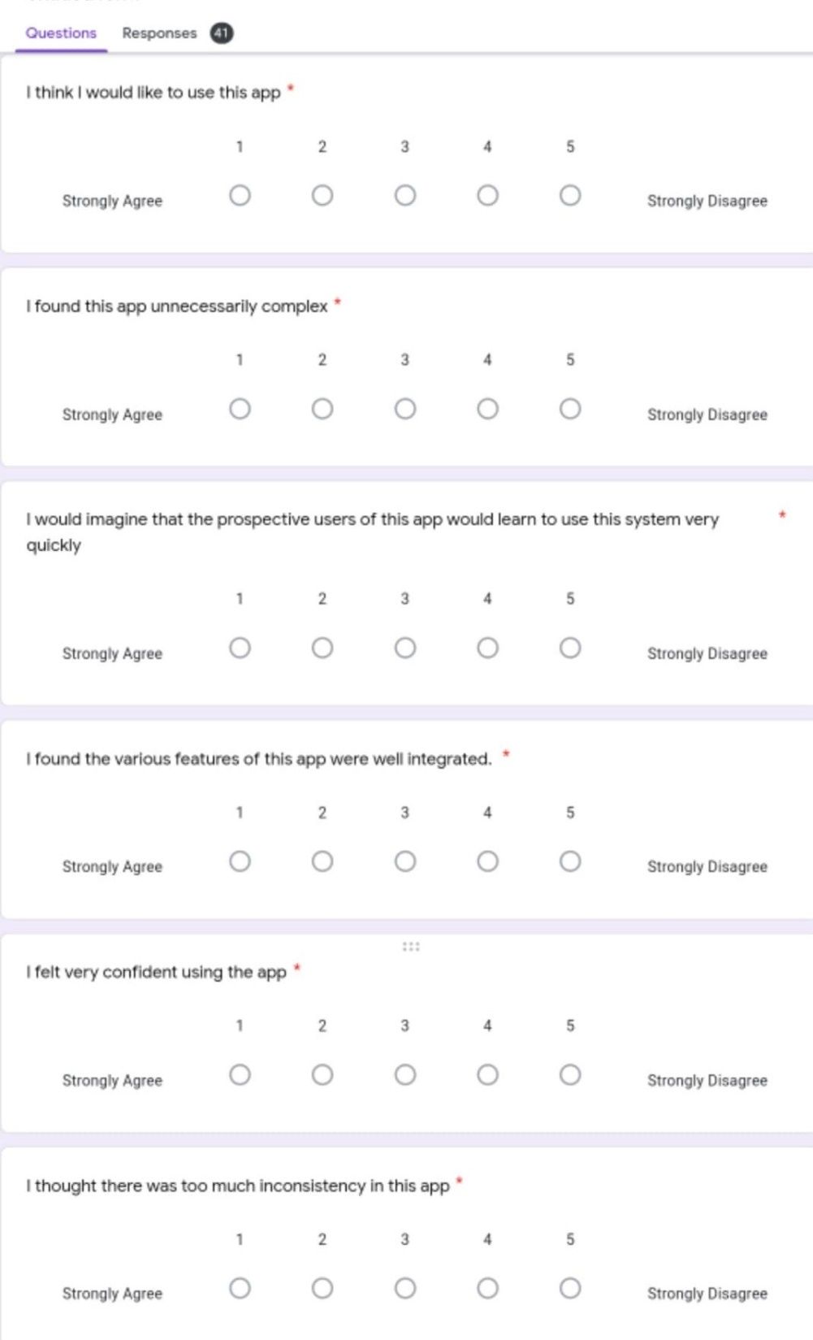
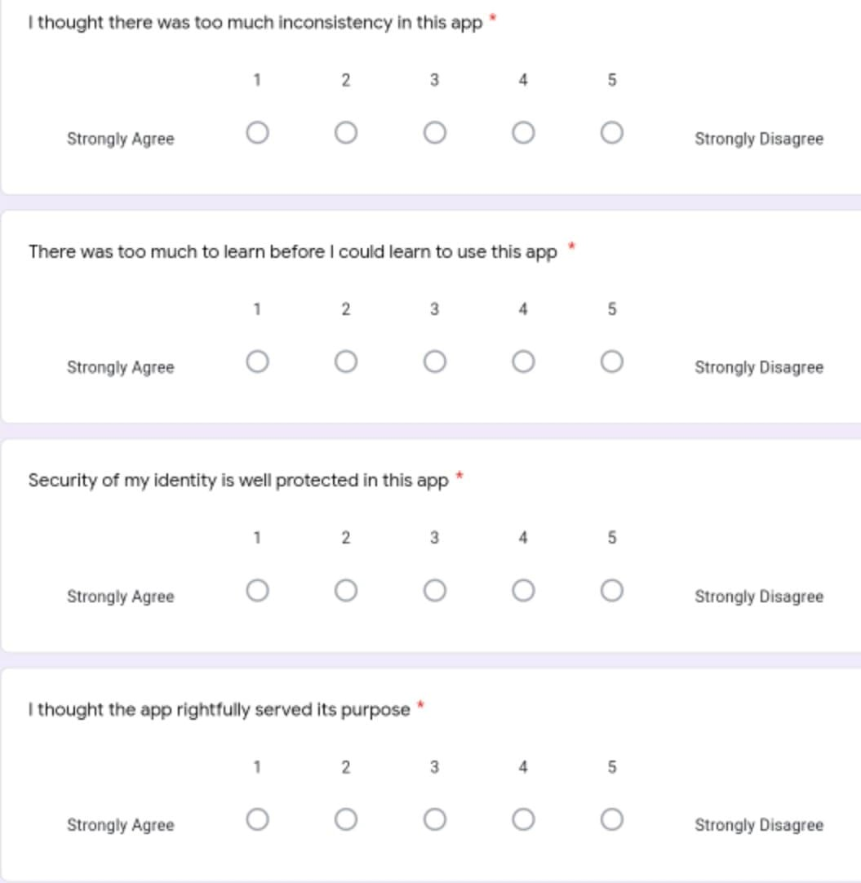
USABILITY TEST RESULT

Slide 28
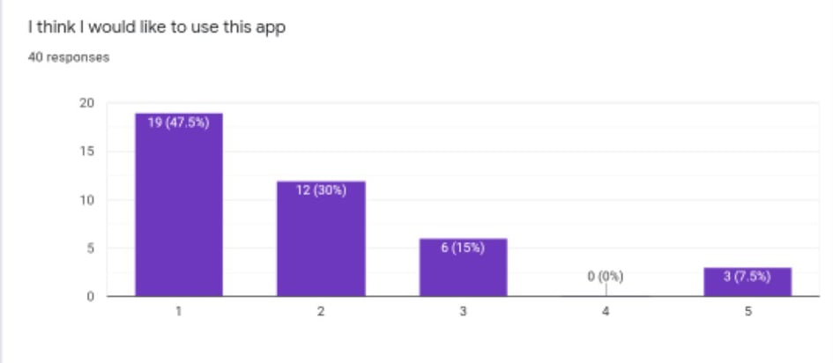
Shows that out of 40 respondents (19) 47.5% agreed to use the app while (3) 7.5% disagreed.

Slide 29
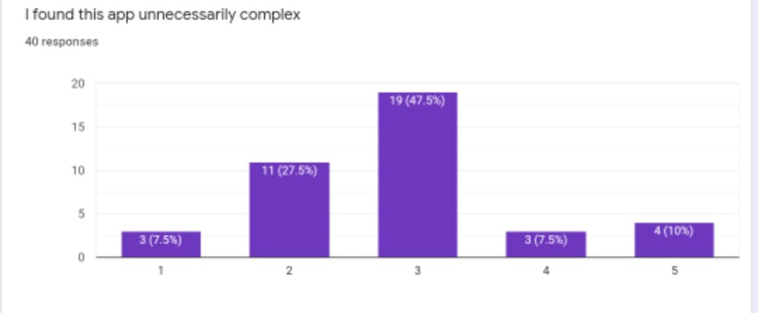
Shows that out 0f 40 respondents 19 or 47.5% agreed nor disagreed that the app is unnecessarily complex.

Slide 30
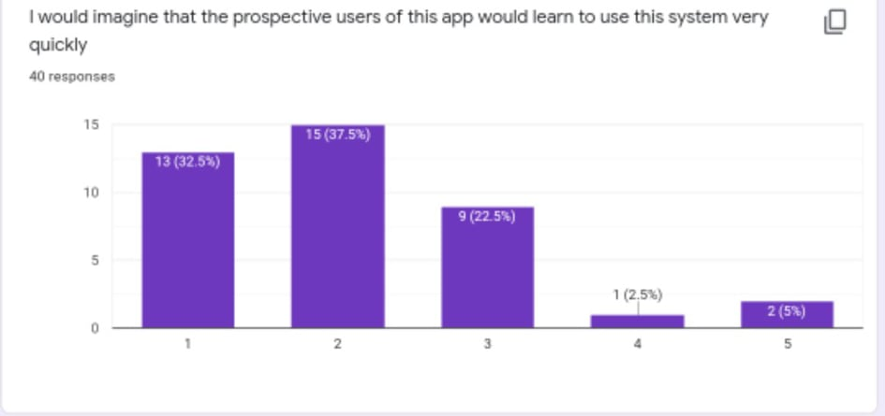
Shows that 15 or 37.5% of the respondents agreed that the prospective users of the app would learn to use this system very quickly and 1 or 2.5% disagreed.

Slide 31
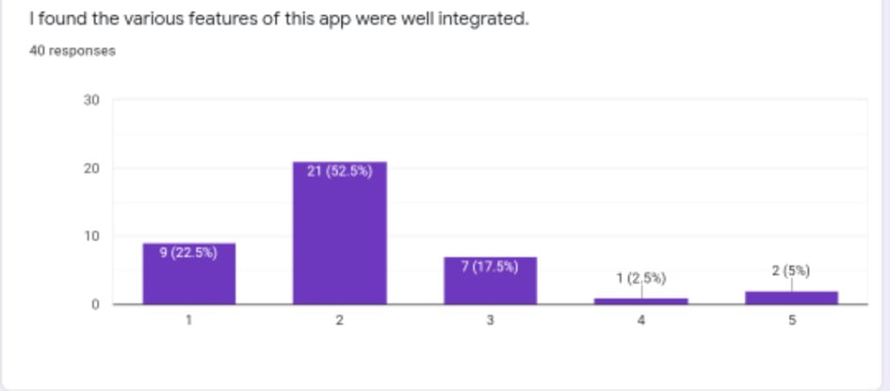
Shows that 21 or 52.5% agreed that the various were very well integrated and 1 or 2.5% disagreed.

Slide 32
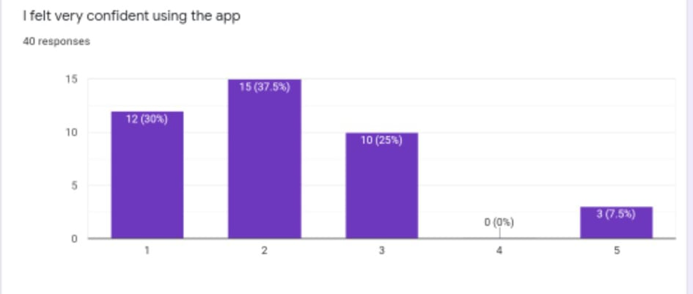
Shows that 15 or 37.5% felt very confident using the app and 10 or 25% of the respondents agreed nor disagreed felt confident using the app.

Slide 33
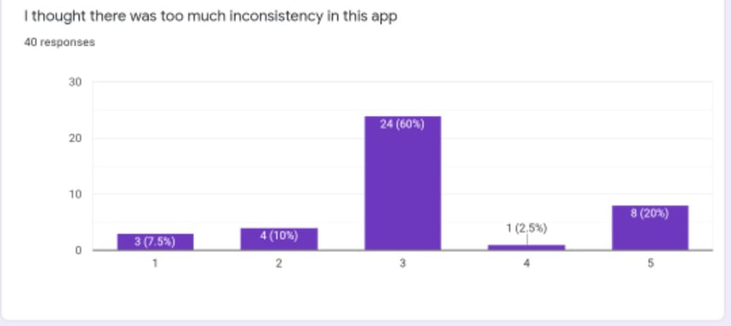
Shows that out of 40 respondents 24 or 60% agreed nor disagreed that there was too much inconsistency on the app.

Slide 34
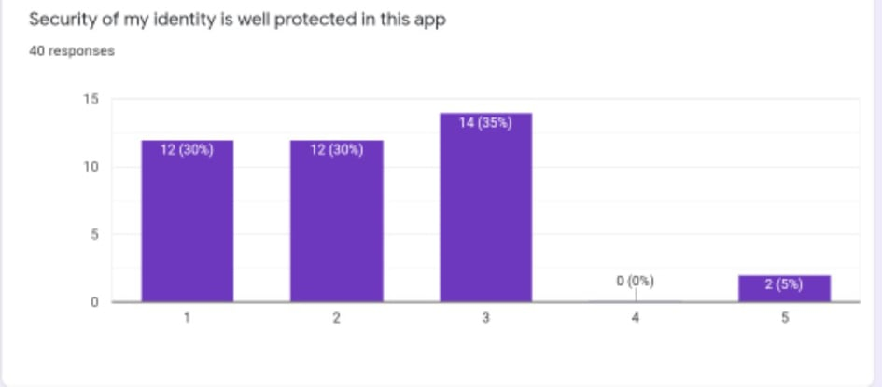
Shows that 14 or 35% of the respondents agreed nor disagreed that security of the identity is well protected.

Slide 35
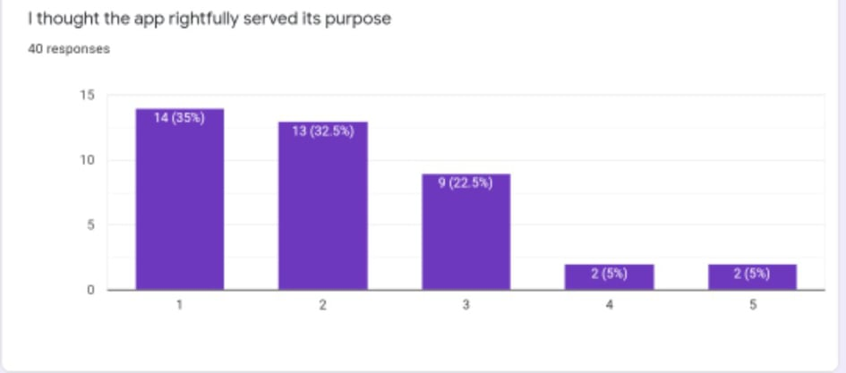
Shows that 14 or 35% of the respondent agreed that the rightfully served its purpose and 2 or 5% of the respondents disagreed.

Slide 36
CHAPTER V
CONCLUSION AND RECOMMENDATIONS

Slide 37
The research project’s aim is to fulfill the objectives of the study stated by the Proponents.
First, to develop a web-based application online system that will notify the team of those tasks that need to be prioritized based on a defined time-schedule.
Second, it aims to make a web-based application online system that will be used by the adviser to monitor all the assigned tasks given by the project leader to the team members for thesis project.
Third, to develop a web-based application online system that will do the following: The project leader can add tasks, assign and transfer the tasks, set the date of the completion according to the tasks given, Track the hours work by the students/members on doing the tasks and to evaluate the grade on members tasks that will be reported by the project leader to the adviser according to the members completed tasks or the groups finished thesis projects.
Lastly, it will help students to manage their time properly and improve the productivity of their work. The system will help the students show the visual representation of the individual’s progress and team’s progress to avoid hitch hikers student.
CONCLUSION

Slide 38
RECOMMENDATION
The following are a set of recommendations highly recommended by the
Proponents to address future works in order to improve the system:
A feature such as Video Conference

Slide 39
END OF THE PRESENTATION
THANK YOU SO MUCH!!!

