Slide 1

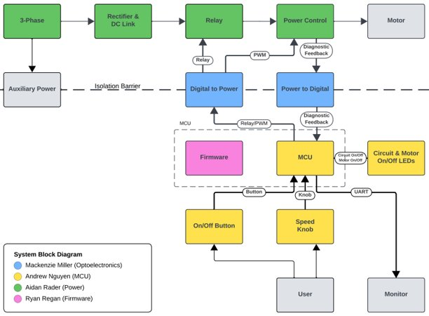
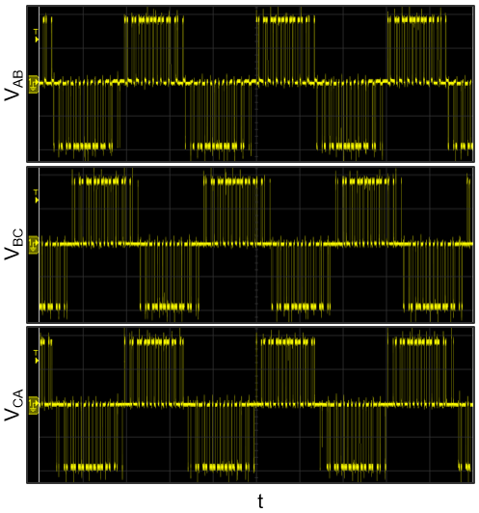
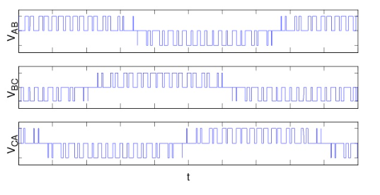
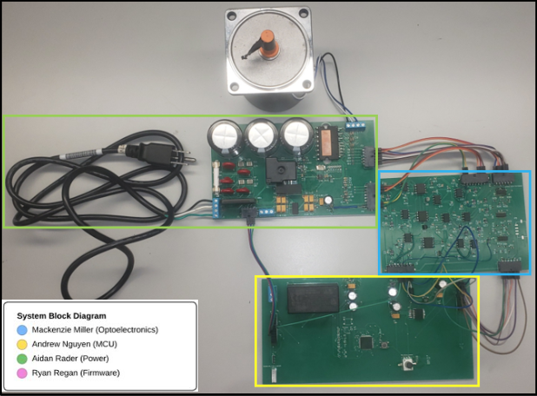
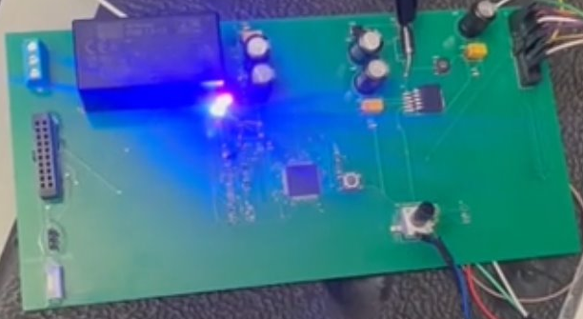
Booth Number: 337
VFD Motor Controller
Mackenzie Miller, Andrew Nguyen, Aidan Rader, Ryan Regan
Faculty Mentor: John Lusher
Problem Definition
Traditional motor control systems cannot adjust to varying load demands, resulting in poor energy efficiency, excessive heat generation, and premature component failure.
The VFD Motor Controller operates at a high voltage when fully powered. In order to properly test this, safety precautions were taken, including separating the grounds into PGND and GND which were used on the high voltage and low voltage sides, respectfully. Helped to create an isolation barrier that protects the MCU from coming into contact with 120 V_{AC} from the wall.
Methodology
The Variable Frequency Drive (VFD) Motor Controller created allows the user to control the speed of a motor using a knob. The knob adjusts the frequency of pulse width modulation (PWM) signals which changes the speed of the motor for various loads. Additionally, there is a button for added start/stop (quick press) and direction (3s hold) control.
SPECIFICATIONS
Input 120 V_{AC} from wall
Operates from 10 Hz to 60 Hz
Runs clockwise and counterclockwise
POWER
Configured 15 V_{DC} to isolated 15 V_{DC} converter and 3.3 V_{DC} to isolated 5 V_{DC} converter for auxiliary power
Developed rectifier and DC link to convert AC to DC and power control to convert DC to AC
Integrated relay to turn on and off the motor
Generated voltage, current, and temperature signals for diagnostic feedback
OPTOELECTRONICS
Turned 3.3 V_{DC} PWM to 5 V_{DC} PWM waves via isolation barrier to power control
Transported voltage, current, and temperature signals from isolation barrier – decreased from 60 V_{DC} to 15 V_{DC} for MCU safety
Relay signal across isolation barrier for on/off
MICROCONTROLLER
Converted 120 V_{AC} to 3.3 V_{DC} for MCU
Received feedback through low-voltage analog signals that represent voltage and current
Sent out PWM signals to the H bridge
Power control system to adjust the output voltage and frequency supplied to the motor
FIRMWARE
Instructed a dsPIC33CK256MP508 microcontroller
PWM signals' duty cycles oscillate on sine wave
Potentiometer and button inputs
Figure 5. Measured Inverter Line-Line Waveforms
Figure 1. Block Diagram of VFD Motor Controller
Converter | V_{spec} [V] | V_{min} [V] | V_{nom} [V] | V_{max} [V]
2-Phase to 15V | 15.0 |  | 15.0
15V to Iso15V​ | 15.0 | 14.9 | 15.1 | 15.3
15V to 3.3V​ | 3.3 | 3.2 | 3.3 | 3.3
3.3V to Iso5V​ | 5.0 | 4.6 | 5.1 | 5.6
Table 1. Auxiliary Power
Figure 3. Expected Inverter Line-Line Waveforms
Impact
The impact of the VFD Motor Controller can be felt operationally, environmentally, ethically, and socially. A few impacts include:
Environmental: The VFD increases energy efficiency and decreases heat generation. This lowers the greenhouse gasses emitted during the energy generation process.
System Reliability: VFDs allow for a smoother start and stop which relieves mechanical stress and allows for less wear on equipment.
neque dignissim, and in aliquet nisl et umis.
Outcomes
The VFD Motor Controller was successful in spinning the motor. The motor responds to the speed knob, spinning faster and slower when the knob is turned accordingly. The motor also responds to the on/off button (indicated by the LEDs). In its current state, the motor has not been successfully tested with the 120 V_{AC} input from the wall, but it works at a lower input voltage of 30 V_{DC} to 40 V_{DC}. The auxiliary power, turning 120 V_{AC} into the various necessary voltages, was successfully completed, providing the correct voltages to each component.
Figure 2. System Diagram of VFD Motor Controller
Engineering Analysis
The VFD Motor Controller was a very complex and hardware heavy project. The design and integration processes proved to be very difficult and included PCB design and assembly, MPLab coding, and high voltage testing.
All three PCBs and accompanying schematics were designed and fabricated using Altium. The PCBs and components were assembled by hand.
The MCU was coded using MPLab and the code was flashed using a PICkit 5.
The full system integration took place in three different phases: auxiliary power, PWMs, and diagnostic feedback
References
Ogbuka, Cosmas & Agu, Marcel. (2009). A Generalized Rectified Sinusoidal PWM Technique for Harmonic Elimination.
“Lucidchart | Diagramming Powered by Intelligence.” Lucidchart, www.lucidchart.com/pages.
National Electrical Code, NFPA 70, Article 430, National Fire Protection Association, Quincy MA, USA, 2023.
Acknowledgements
Dr. John Lusher
Figure 4: Operational LEDs

