Slide 1


VFD Motor Control Introduction Mackenzie Miller
Andrew Nguyen
Aidan Rader
Ryan Regan

Slide 2
Overview
Problem Statement: A motor control system is needed for an AC induction motor. Traditional motor control systems cannot adjust to varying load demands, resulting in poor energy efficiency, excessive heat generation, and premature component failure.
Solution Proposal: Develop a Variable Frequency Drive (VFD) motor control system to adjust frequency and voltage to load demands, resulting in improved motor controllability, optimized energy efficiency, enhanced safety, and extended component lifespan.
Notes:
Mackenzie
This is technical solution, you can also do a more common term solution explanation: allows use to controlcan I say up to 208 v and 60 hx the speed of the motor for different stages of the motor as to not skip

Slide 3
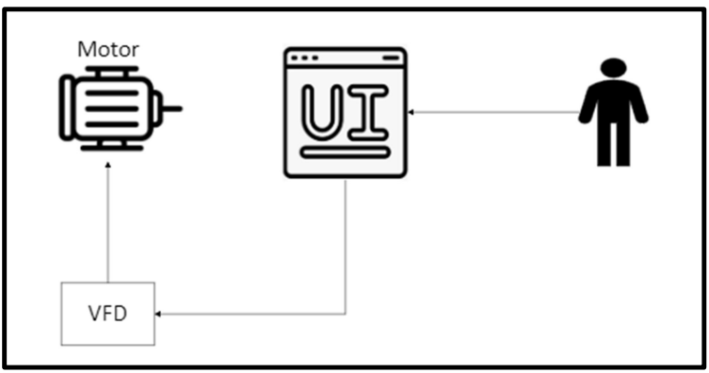
.
System Overview
Notes:
Drew

Slide 4
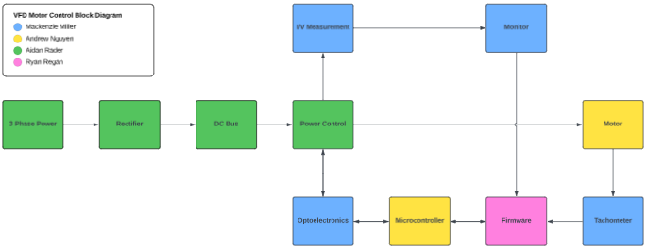
System Overview
Notes:
Aidan -> Mackenzie -> Drew -> Ryan

Slide 5
Task Partition
Mackenzie: Design optoelectronic circuit, tachometer, and voltage and current monitoring circuit. Optoelectronics makes the analog and digital sides communicate via light so they do not touch.
Andrew: Design PCB for the MCU, MCU will send PWM signals to power control system to control the frequency of VFD, step down voltage to a usable 3.3V,take inputs from a user and output the frequency needed for the task
Aidan: Design PCB with rectifier to convert AC to DC, DC link circuit to filter DC, and power control to convert DC to AC.
Ryan: Design and write all firmware necessary for microcontroller and any other systems; create a user interface to make controlling and monitoring the system more straightforward
Notes:
All

Slide 6
Subsystem progress in past 1.5 months
Mackenzie: Researched materials and concepts, almost completed subsystem introduction project, and started schematic design
Andrew: Researched needed materials, almost completed subsystem introduction, began creating schematics for my PCB
Aidan: Researched concepts and components, started subsystem introduction project (SIP, steps 1-4), completed schematic design (SIP, steps 1-3)
Ryan: Researched microcontroller and development board to outline main firmware for VFD, designed GUI for user interface
Notes:
All

Slide 7
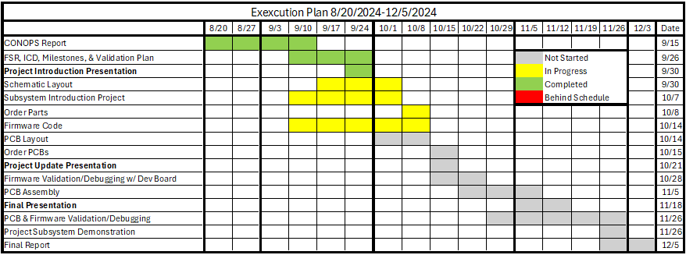
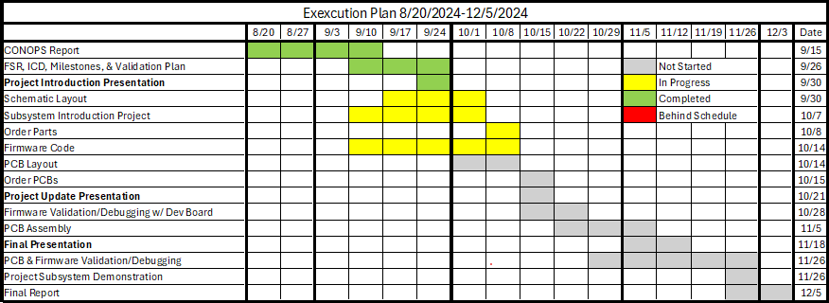
Spreadsheet with biweekly deliverables that are measurable and have owners
Notes:
Aidan
Ryan: Firmware

Slide 8
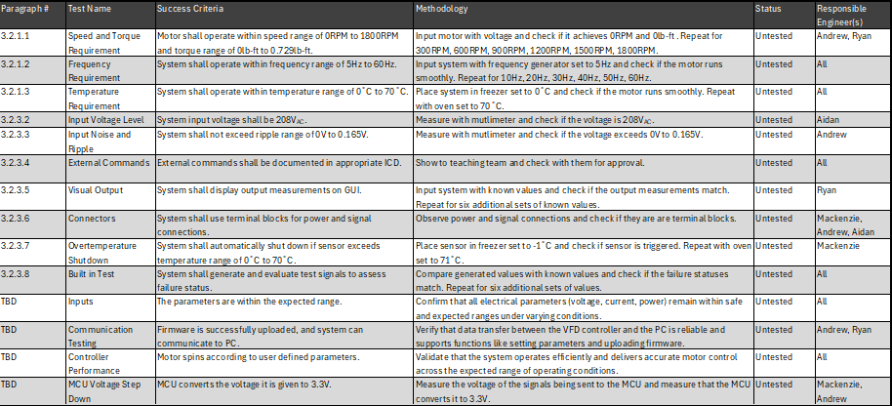
Validation plan

