Slide 1


VFD Motor Control Introduction Mackenzie Miller
Andrew Nguyen
Aidan Rader
Ryan Regan

Slide 2
Overview
Problem Statement: A motor control system is needed for an AC induction motor. Traditional motor control systems cannot adjust to varying load demands, resulting in poor energy efficiency, excessive heat generation, and premature component failure.
Solution Proposal: Develop a Variable Frequency Drive (VFD) motor control system to adjust frequency and voltage to load demands, resulting in improved motor controllability, optimized energy efficiency, enhanced safety, and extended component lifespan.

Slide 3
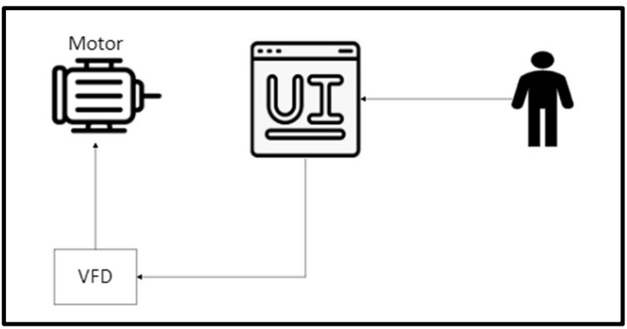
System Overview

Slide 4
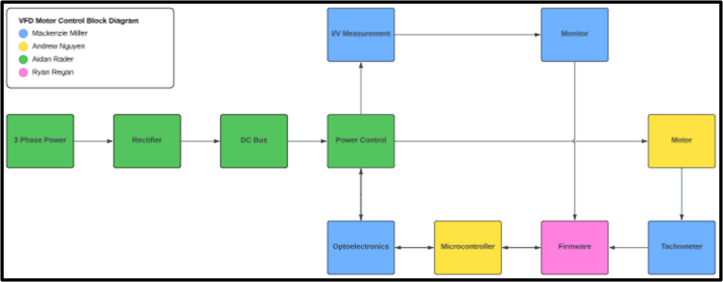
System Overview

Slide 5
Optoelectronics
Mackenzie Miller
Accomplishments since the last presentation <12> hrs | Ongoing progress/problems and plans until the next presentation
Solidified part numbers and added to part order sheet Ordered first round of parts Finished PCB schematic Started PCB layout | Confirm with groupmates which connectors we want to use Finish PCB layout Start to route Validate PCB and resolve the errors Order PCB

Slide 6
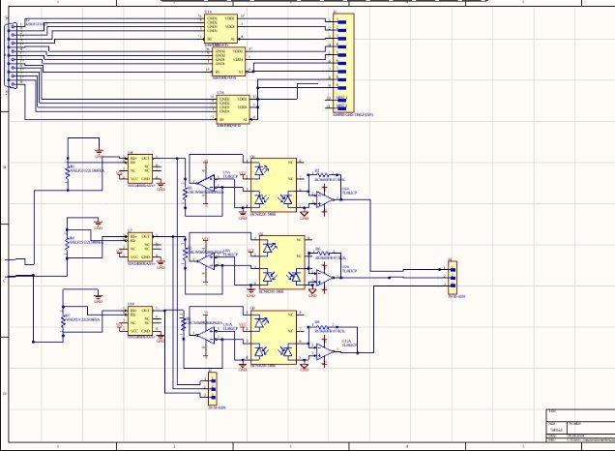
Optoelectronics circuit

Slide 7
Microcontroller
Andrew Nguyen
Accomplishments since the last presentation <30> hrs | Ongoing progress/problems and plans until the next presentation
Updated parts order spreadsheet Put proper symbol/footprints on schematic Created schematics for MCU, USB to UART interface, potentiometer, push buttons, LEDs, connectors/headers, temperature sensor, oscillator On final part of schematics/validating schematic for PCB routing and ensuring net labels are correct | Finalize USB to UART schematic. Validate schematic and resolve all errors. Route and order PCB and all necessary parts

Slide 8
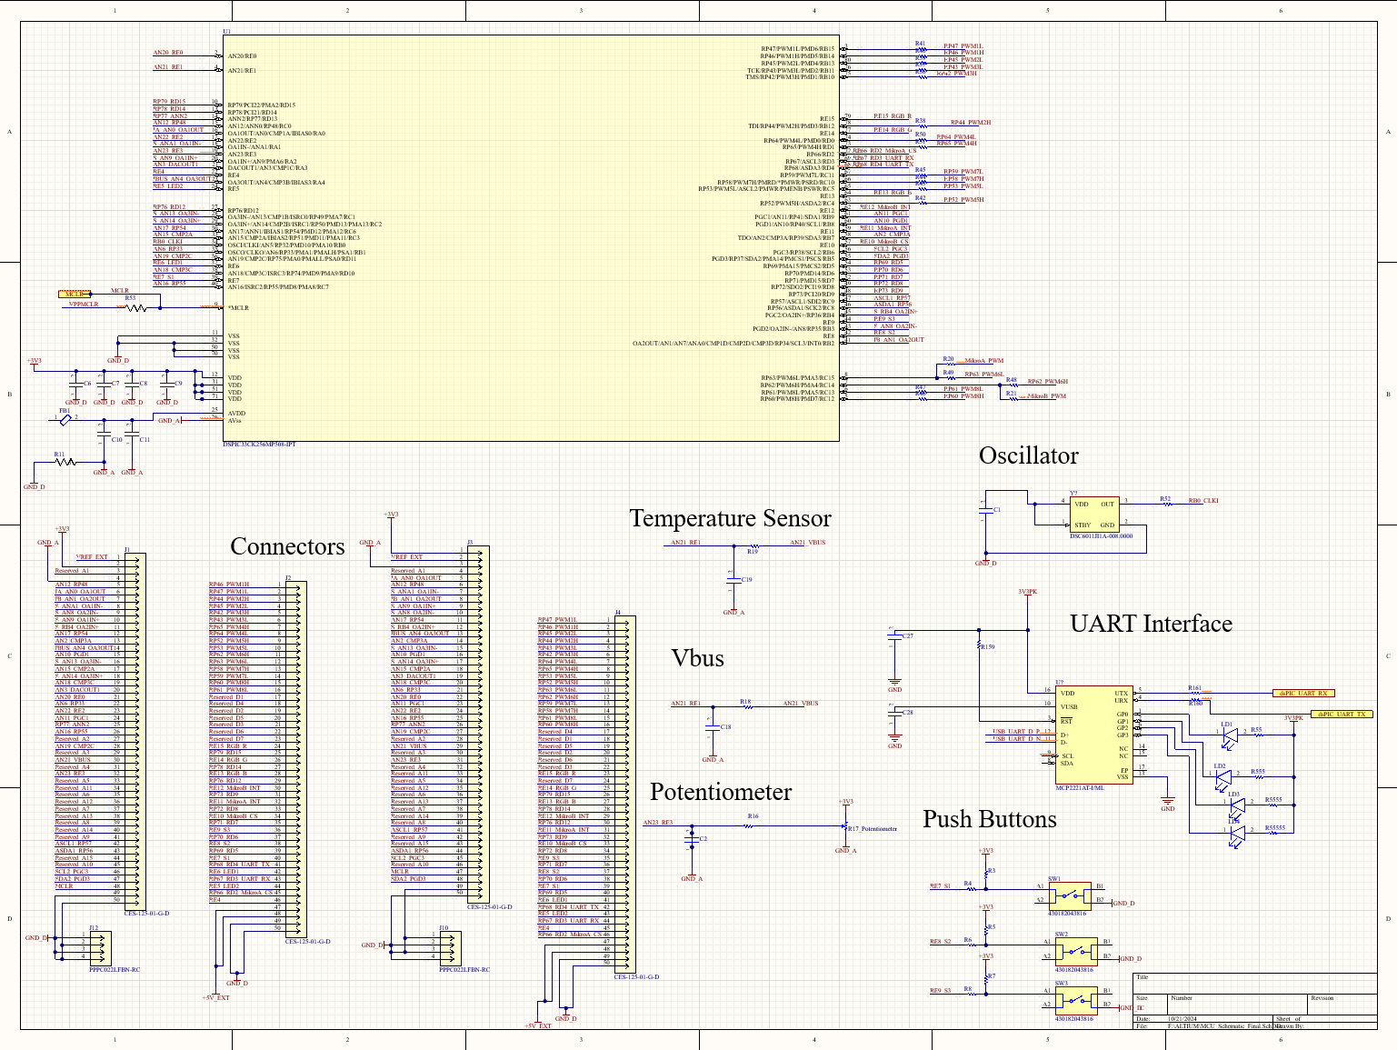
Current MCU Schematic

Slide 9
Power
Aidan Rader
Accomplishments since the last presentation 28 hrs | Ongoing progress/problems and plans until the next presentation
-Completed subsystem introduction project (9 hrs) -Ordered parts (1.5 hrs) -Completed rectifier schematic (6.5 hrs) -Completed DC link calculations & schematic (3 hrs) -Completed power control schematic (3 hrs) -Started MCU power supply schematic (2 hrs) -Completed Project Update Presentation (3 hrs) | Ongoing: -MCU power supply schematic -Connector selection -Order more parts -PCB layout Plans: -Complete PCB layout -Complete PCB order -Complete PCB assembly

Slide 10
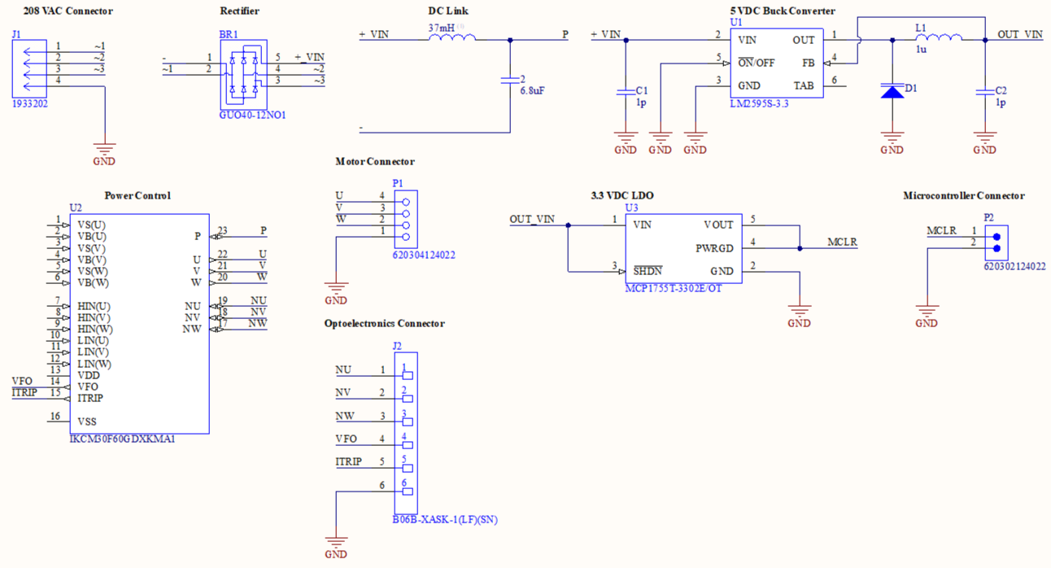
Power
Aidan Rader

Slide 11
Firmware
Ryan Regan
Accomplishments since the last presentation 20 hours | Ongoing progress/problems and plans until the next presentation
Working GUI demo Rough outline of final project code Implementation of buttons and LEDs on Development Board as well as print statements used for debugging Progress on setting up ADC (Analog-DC) and PWM (Pulse-Width Modulation) modules for use in programming the potentiometer | Research and finish programming the modules and writing the commands necessary to demonstrate the potentiometer through dimming the RGB LEGS Determine a better toggling method of using the buttons to reduce potential user error if pressed too fast or too slow Research on whether implementation of the GUI in MPLab is possible and/or necessary

Slide 12
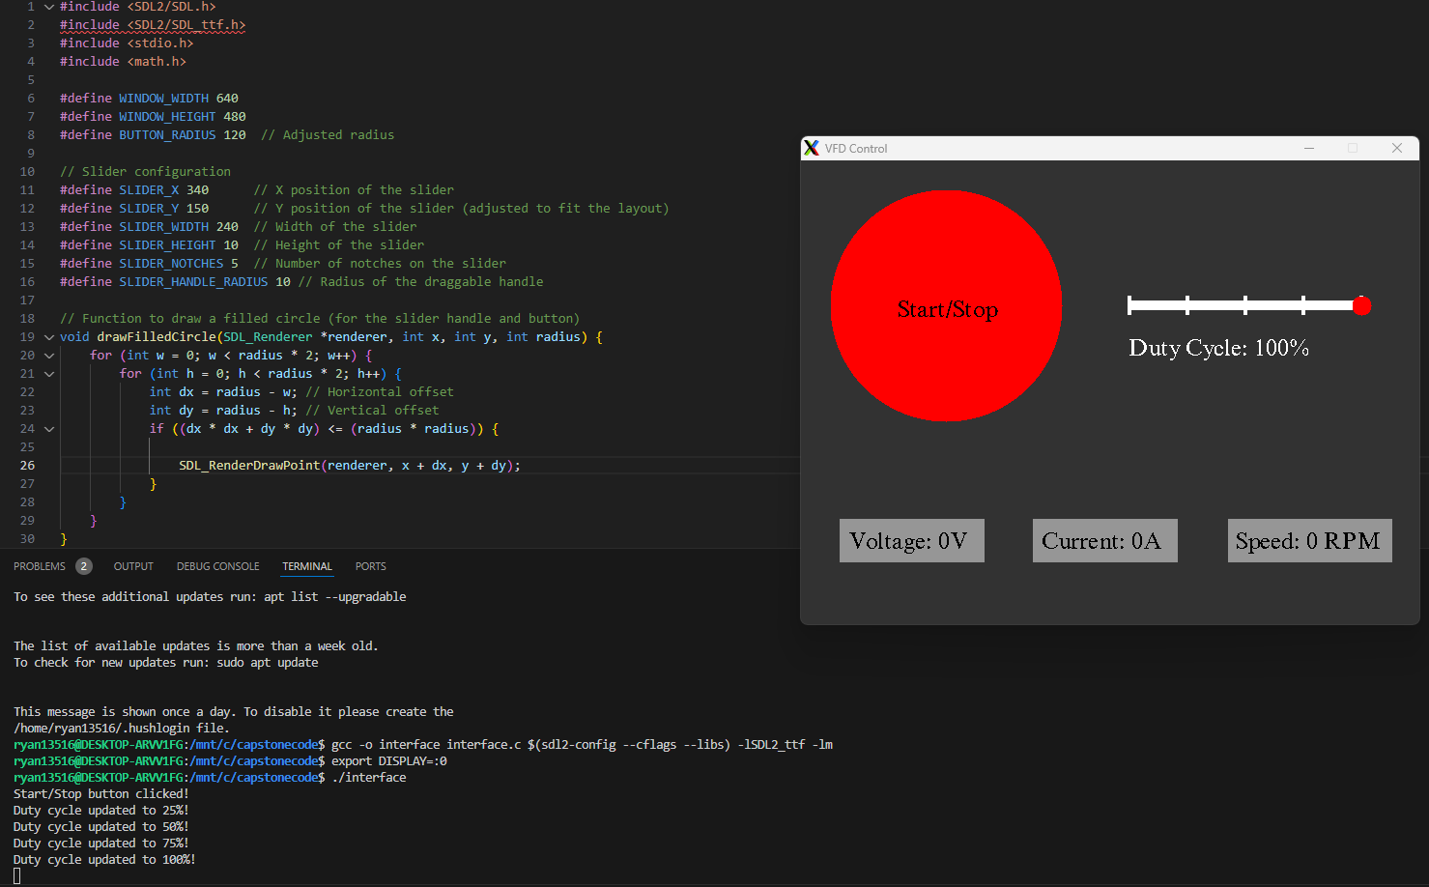
VSCode GUI Demonstration

Slide 13
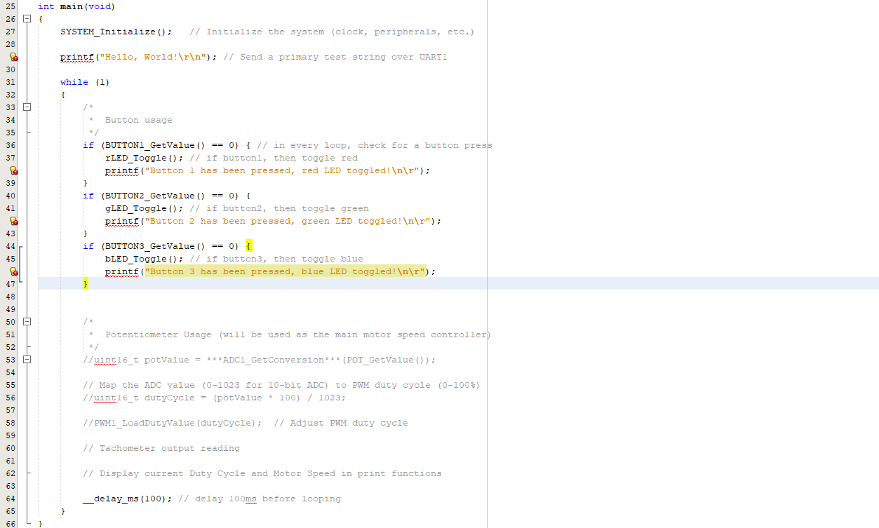
Screenshot of Current Firmware

Slide 14
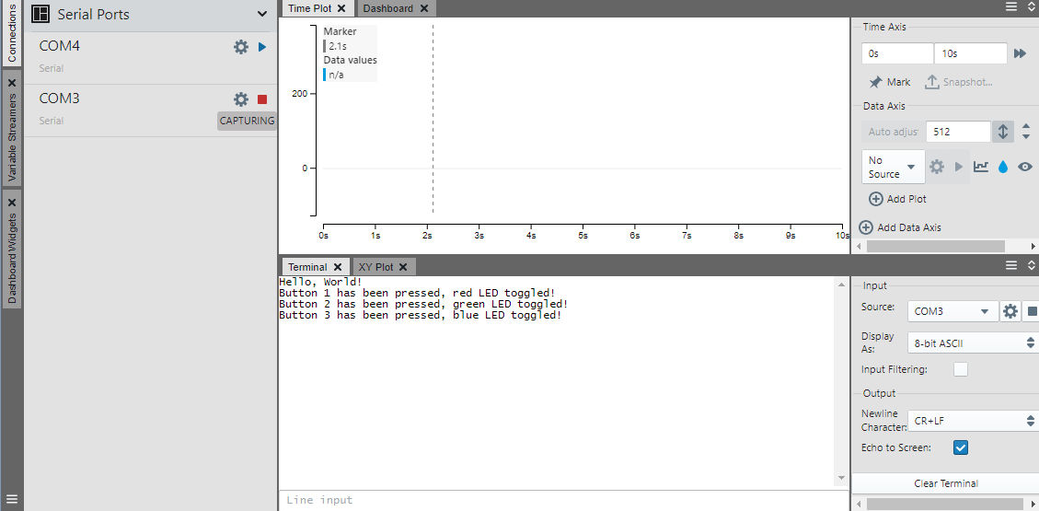
Example Output of Firmware

Slide 15
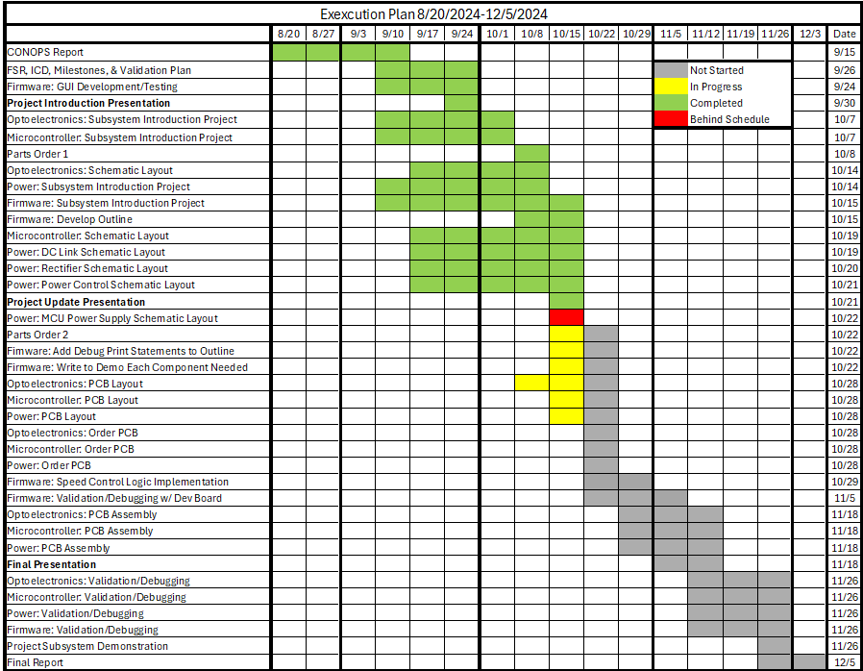

Slide 16
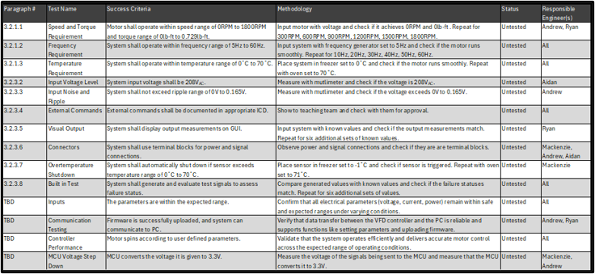
Validation plan

