Slide 1


Team 70: VFD Motor Controller
Bi-Weekly Update 1
Mackenzie Miller
Andrew Nguyen
Aidan Rader
Ryan Regan Sponsor: John Lusher TA: TA Name
Notes:
Mackenzie
30 seconds

Slide 2
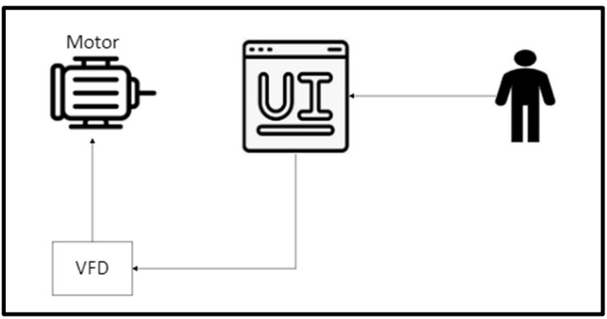
Project Summary
Problem: Traditional motor control systems cannot adjust to varying load demands, resulting in poor energy efficiency, excessive heat generation, and premature component failure
Solution: Develop a Variable Frequency Drive (VFD) motor control system to adjust frequency and voltage to load demands
Notes:
Mackenzie
30 seconds

Slide 3
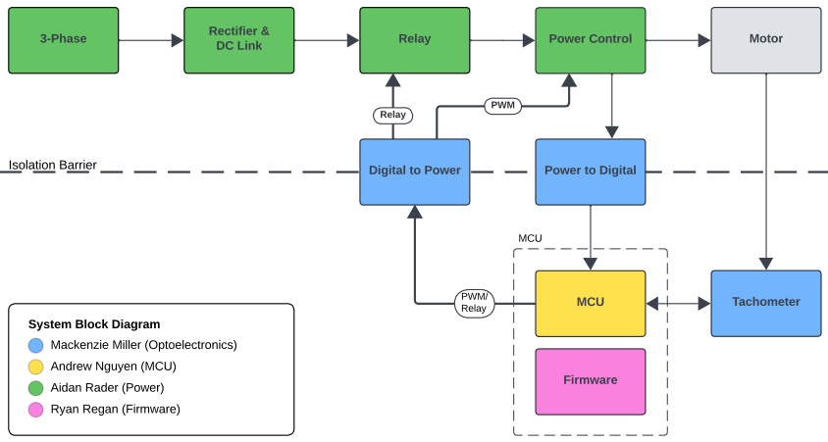
Project/Subsystem Overview
Auxiliary Power – See Next Page
Notes:
Aidan
45 Seconds
Diagram showing subsystems – with labels showing subsystem owners
Bullets giving essential system/subsystem characteristics
If major changes in subsystems, show before and after … see next slide

Slide 4
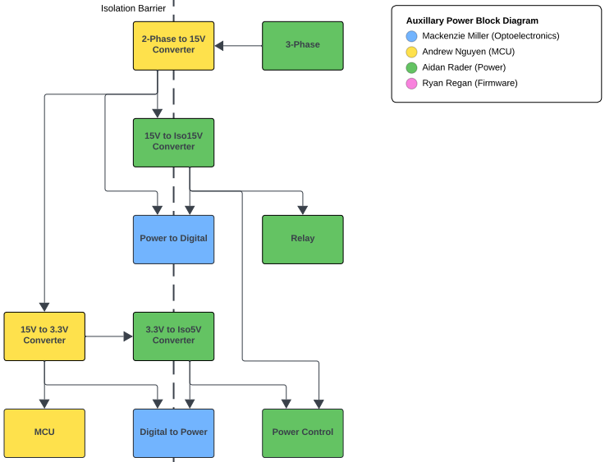
Project/Subsystem Overview
Notes:
Aidan
45 Seconds
Diagram showing subsystems – with labels showing subsystem owners
Bullets giving essential system/subsystem characteristics
If major changes in subsystems, show before and after … see next slide

Slide 5
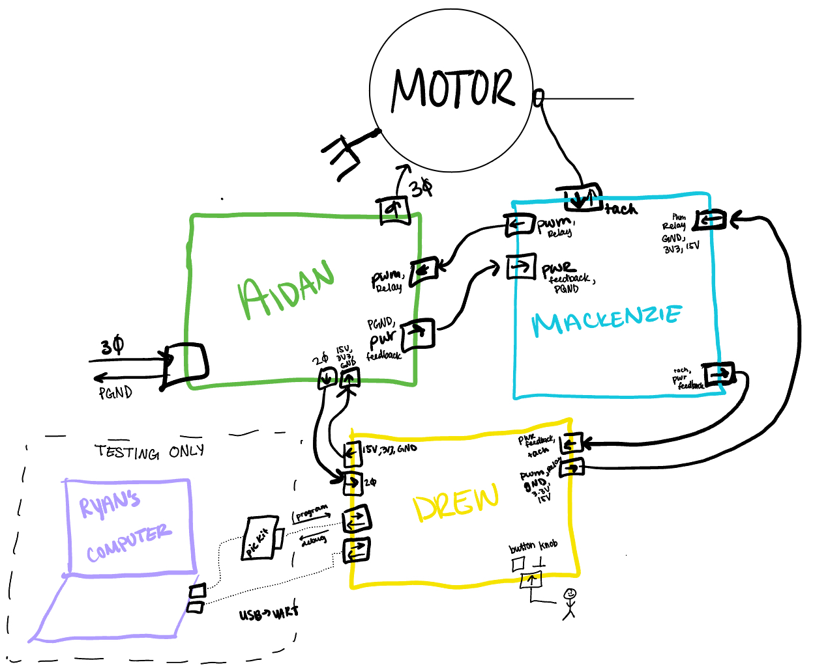
Full Design Review
Planned Physical Orientation
Notes:
Mackenzie
45 Seconds
Diagram showing subsystems – with labels showing subsystem owners
Bullets giving essential system/subsystem characteristics
If major changes in subsystems, show before and after … see next slide

Slide 6
Major Project Changes for 404
No major changes are being made for 404
Notes:
Ryan
45 seconds

Slide 7
Project Timeline
2/12 | 2/19 | 3/7 | 3/19 | 4/2 | 4/16 | 4/28
Subsystem PCBv1 Designs & Testing | Auxiliary Power & MCU/Firmware Integration | PWM Control Integration | System Integration | System Testing | System Validation | Demo, Showcase, & Report
Notes:
Aidan
30 seconds
High level figure showing where you are at in the project, what’s completed, what’s underway – it should take about 30 seconds to summarize where you are in the timeline
-- Save discussion for subsystem update
-- Save detail for execution plan & validation plan status

Slide 8
Optoelectronics
Mackenzie Miller
Accomplishments since 403 14 hrs of effort | Ongoing progress/problems and plans until the next presentation
Redesigned PCB to prepare for integration Completed a Design Review | Order new PCB and parts and assemble new board Order tachometer and attach to motor
Notes:
Mackenzie
45 seconds

Slide 9
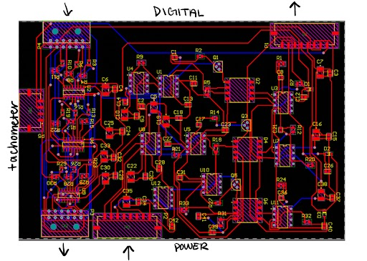
Optoelectronics
Mackenzie Miller
PCB is functional – one digital isolator does not work
Op-amps were getting hot at the beginning – did not maintain proper isolation between 15V and iso15V during initial testing
PCB rerouting consisted of moving connectors around for convenience when integration starts
Notes:
Mackenzie
45 seconds

Slide 10
Microcontroller
Andrew Nguyen
Accomplishments since 403 15 hrs of effort | Ongoing progress/problems and plans until the next presentation
Revised connector, buck converter, and MCU schematics. Rerouted and rearranged PCB layout for easier integration Ordered PCB board. | Order new parts Begin assembling PCB
Notes:
Drew
45 seconds

Slide 11
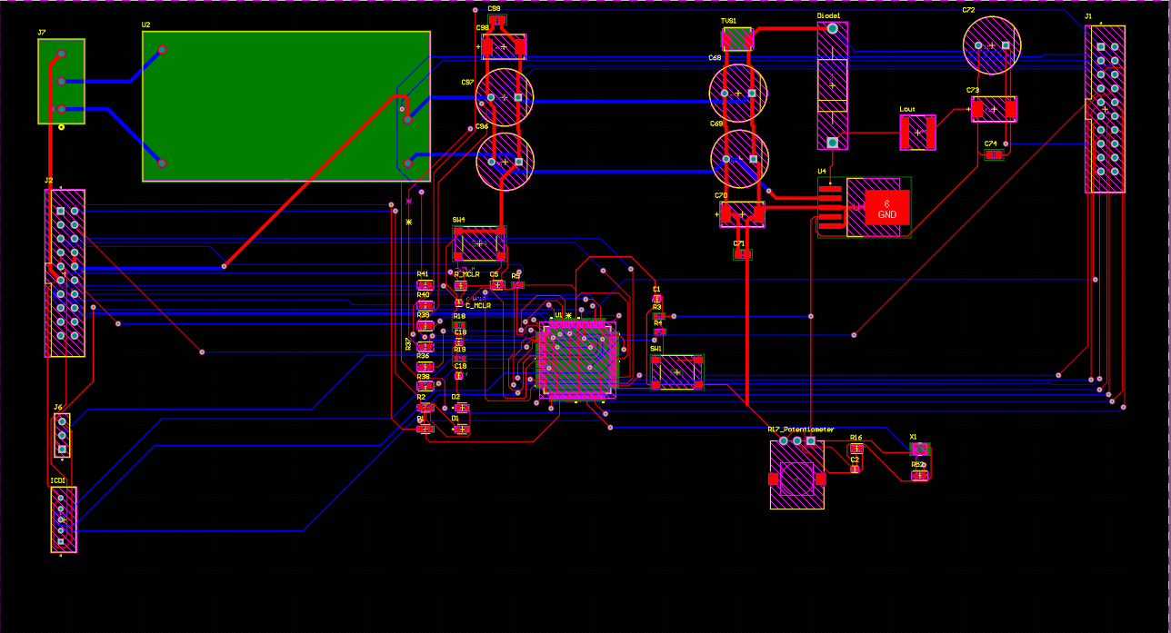
Microcontroller
Andrew Nguyen
Original PCB did not provide MCU with proper voltage and some parts were heating up
New PCB has updated trace widths as I forgot to increase the width of a few lines along with updated buck converter, MCU, and connector design
Board layout changed to make integration easier
Notes:
Drew
45 seconds

Slide 12
Power
Aidan Rader
Accomplishments since 403 30.5 hrs of effort | Ongoing progress/problems and plans until the next presentation
Completed Full Design Review Designed PCBv1 | Routing PCBv1 (pending Altium access) Ordering PCBv1 Ordering Parts Order 4 Testing iso5V to 3.3V Converter Test Power Control Assemble PCBv1 Start Auxiliary Power Integration (15V, 3.3V, iso15V, iso5V)
Notes:
Aidan
45 seconds
What has been accomplished (not just started) – is it back up and running from 403?
What are you going to accomplish in the next 2 weeks
-- “Started, began, initiated…” are not accomplishments
-- You do not need to have any accomplishment on some updates if you describe in “Ongoing” what work you have been doing
-- Make things here specific and measurable/verifiable

Slide 13
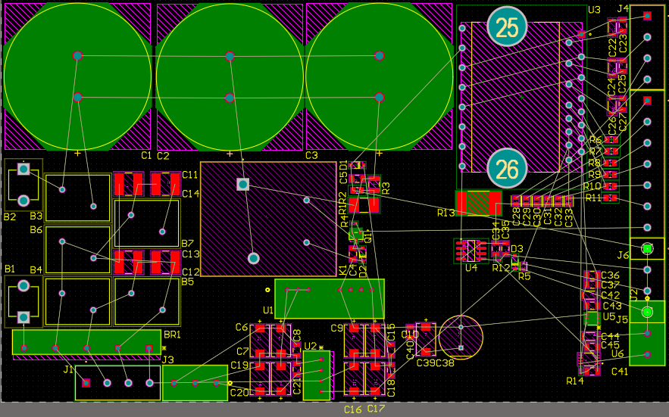
Power
Aidan Rader
Full Design Review
Increased board density
Changed screw connectors to ribbon
Aligned connectors to system's physical orientation
Added missing 2 pin connector for 2 phase to 15V Converter
Added missing 3.3V to iso5V converter pin
Rectifier, DC link, 15V to iso15V converter work
Relay is waiting on parts order 4
Power control is waiting on parts order 4
Short due to connecting power supply to wrong pin
Notes:
Aidan
45 seconds
Interesting figure related to your subsystem progress
Detail on what works, what doesn’t, what is changing

Slide 14
Firmware
Ryan Regan
Accomplishments since 403 15hrs of effort | Ongoing progress/problems and plans until the next presentation
Verified correct voltage of PWM waves Found a temporary/loophole fix for the problem with the frequency range being too low Discussed integration and validation strategies with team | Find out how to display PWM sine wave on oscilloscope, and use it to calibrate the frequency more accurately Integrate with microcontroller PCB and debug
Notes:
Ryan
45 seconds

Slide 15
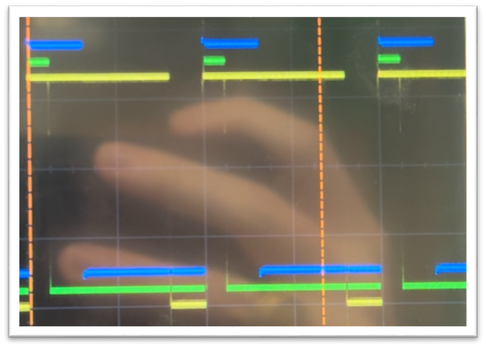
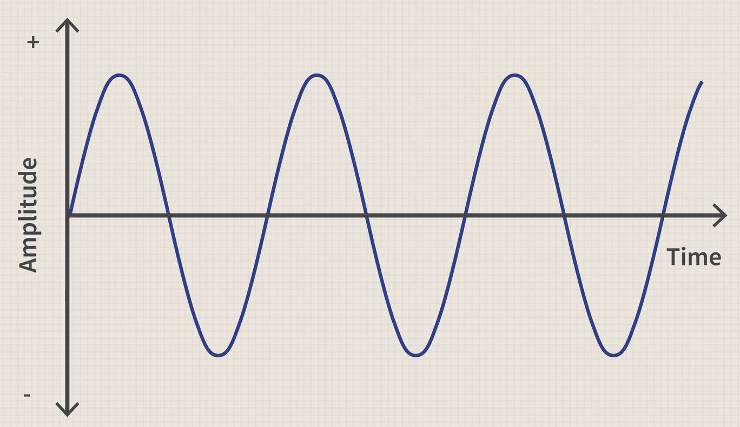
Firmware
Ryan Regan
Temporary/loophole frequency fix:
Change PWM frequency variable used for calculations within code
This fix could be permanent if I am able to calibrate it to have to correct frequency bounds for the motor (10-60Hz)
Need to find out how turn the separate three phases displayed into a singular sine wave on the oscilloscope, this will allow for simpler calibration and a better visualization of the output – specifically frequency changes
Notes:
Ryan
45 seconds

Slide 16
Parts Ordering Status
Order PCBv1s
Optoelectronics: 1/30
Microcontroller: 1/29
Power: 1/30 or 1/31 (pending Altium access)
Order Tachometer: 1/30
Order Parts Order 4: 1/30
Notes:
Mackenzie/Drew/Aidan
30 seconds

Slide 17
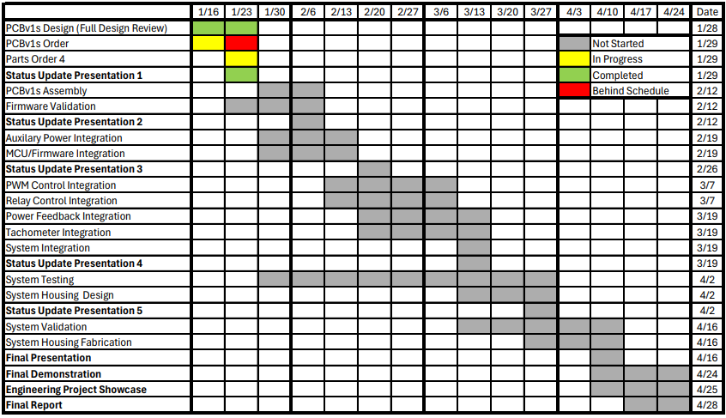
Execution Plan
Notes:
Aidan
45 seconds
Execution plan
-Your team planned milestones for completion of any remaining subsystem functionality, integration of specific subsystems, test, and validation plans should be presented.
-Milestones should have owners … things like final integration can be group owned
-Gantt chart – should indicate some 404 progress.
-Try to complete all subsystem function in next 3 weeks.
-Try to complete all integration 2 weeks before demo to allow for system validation and documentation

Slide 18
Validation Plan
Paragraph # | Test Name | Success Criteria | Methodology | Status | Responsible Engineer(s)
3.2.1.1 | Speed and Torque Requirement | Motor shall operate within speed range of 0RPM to 1800RPM and torque range of 0lb-ft to 0.729lb-ft. | Input motor with voltage and check if it achieves 0RPM and 0lb-ft . Repeat for 300RPM, 600RPM, 900RPM, 1200RPM, 1500RPM, 1800RPM. | Untested | Andrew, Ryan
3.2.1.2 | Frequency Requirement | System shall operate within frequency range of 5Hz to 60Hz. | Input system with frequency generator set to 5Hz and check if the motor runs smoothly. Repeat for 10Hz, 20Hz, 30Hz, 40Hz, 50Hz, 60Hz. | Untested | All
3.2.1.3 | Temperature Requirement | System shall operate within temperature range of 0˚C to 70˚C. | Place system in freezer set to 0˚C and check if the motor runs smoothly. Repeat with oven set to 70˚C. | Untested | All
3.2.3.2 | Input Voltage Level | System input voltage shall be 208V_{AC}. | Measure with multimeter and check if the voltage is 208V_{AC}. | Untested | Aidan
3.2.3.3 | Input Noise and Ripple | System shall not exceed ripple range of 0V to 0.165V. | Measure with multimeter and check if the voltage exceeds 0V to 0.165V. | Untested | Andrew
3.2.3.4 | External Commands | External commands shall be documented in appropriate ICD. | Show to teaching team and check with them for approval. | Untested | All
3.2.3.5 | Visual Output | Oscilloscope displays each of the three phases of the PWM sine wave. | Connect oscilloscope probes to the set output pins for the PWM signals, ensure that the signals' duty cycles span from 0-100% and are rougly separated by thirds. | Tested | Ryan
3.2.3.6 | Connectors | System shall use terminal blocks for power and signal connections. | Observe power and signal connections and check if they are are terminal blocks. | Untested | Mackenzie, Andrew, Aidan
3.2.3.7 | Overtemperature Shutdown | System shall automatically shut down if sensor exceeds temperature range of 0˚C to 70˚C. | Place sensor in freezer set to -1˚C and check if sensor is triggered. Repeat with oven set to 71˚C. | Untested | Mackenzie
3.2.3.8 | Built in Test | System shall generate and evaluate test signals to assess failure status. | Compare generated values with known values and check if the failure statuses match. Repeat for six additional sets of values. | Untested | All
3.2.3.9 | Optoelectronics Voltage Constraint | The optoelectronics subsystem shall convert the voltage it receives down to a voltage in the range of 15-20 V. | Test at full power where the opto receives ~60 V. Use a multimeter to measure voltage level on other side of opto barrier. | Untested | Mackenzie
3.2.3.10 | Digital to Power Continuity | The digital to power opto-isolators shall have a voltage of 0V across each component when connecting input to output. | Use a multimeter to ensure that the voltage across each digital isolator is zero. | Tested-retest with new parts | Mackenzie
Notes:
Ryan
45 seconds
Execution plan
-Your team planned milestones for completion of any remaining subsystem functionality, integration of specific subsystems, test, and validation plans should be presented.
-Milestones should have owners … things like final integration can be group owned
-Gantt chart – should indicate some 404 progress.
-Try to complete all subsystem function in next 3 weeks.
-Try to complete all integration 2 weeks before demo to allow for system validation and documentation

Slide 19
Validation Plan
Paragraph # | Test Name | Success Criteria | Methodology | Status | Responsible Engineer(s)
3.2.3.11 | Power to Digital Continuity | The power to digital opto-isolators shall have a voltage of 0V across each component when connecting input to output | Use a multimeter to ensure that the voltage across each power isolator is zero. | Tested-retest with new parts | Mackenzie
TBD | Inputs | The parameters are within the expected range. | Confirm that all electrical parameters (voltage, current, power) remain within safe and expected ranges under varying conditions. | Untested | All
TBD | Firmware Code Compiles | MPLab firmware successfully compiles without errors or warnings | Attempt to compile code in MPLab and examine output logs to check for errors or warnings | Tested | Ryan
TBD | Controller Performance | Motor spins according to user defined parameters. | Validate that the system operates efficiently and delivers accurate motor control across the expected range of operating conditions. | Untested | All
TBD | MCU Voltage Step Down | MCU converts the voltage it is given to 3.3V. | Measure the voltage of the signals being sent to the MCU and measure that the MCU converts it to 3.3V. | Untested | Mackenzie, Andrew
TBD | Rectifier Full System | System input voltage shall be rectified from 208V_{AC} to 295V_{DC}. | Measure with multimeter and check if the voltage after the rectifier is 295V_{DC}. | Untested | Aidan
TBD | Rectifier Power Subsystem | System input voltage shall be rectified from 5V_{AC} to 7.1 V_{DC}. | Input 5V_{AC} at differing angles of 120˚ on three waveform generators. Measure with multimeter and check if the voltage after the rectifier is 7.1 V_{DC}. | Tested | Aidan
TBD | Isolated 15V Conversion | System shall convert 15V_{DC} to isolated 15V_{DC}. | Input 15V_{DC} on a dc power supply. Measure with multimeter and check if the voltage after the converter is 15V_{DC}. | Tested | Aidan
TBD | Isolated 5V Conversion | System shall convert 3.3V_{DC} to isolated 5V_{DC}. | Input 3.3V_{DC} on a dc power supply. Measure with multimeter and check if the voltage after the converter is 5V_{DC}. | Untested | Aidan
TBD | User Interface | User is able to change the speed of the rotating PWM values by turning the potentiometer. | Change potentiometer position to lowest, highest, and middle notch to observe that the target frequency of the system is close to 60, 10, and 35 respectively, and the rotating PWM values change pace accordingly | Tested | Ryan
TBD | Frequency Testing | Code properly changes the frequency of the PWM signals | Use oscilloscope or a timer to measure the PWM waves to ensure that the program's target frequency is similar to the actual frequency of the PWM signals. | Untested | Ryan
TBD | Debugger Connection | The Microcontroller shall be able to properly communicate with Pickit4 debugger | Connect the Pickit4 Debugger to microcontroller PCB using the 5 pin connector and ensure that MPLAB X IDE can recognize the device. | Untested | Andrew
Notes:
Ryan
45 seconds
Execution plan
-Your team planned milestones for completion of any remaining subsystem functionality, integration of specific subsystems, test, and validation plans should be presented.
-Milestones should have owners … things like final integration can be group owned
-Gantt chart – should indicate some 404 progress.
-Try to complete all subsystem function in next 3 weeks.
-Try to complete all integration 2 weeks before demo to allow for system validation and documentation

Slide 20
Thank You

