Slide 1
Full System Block Diagram
https://lucid.app/lucidchart/f1290464-5c59-4b55-a978-b496a95ca333/edit?viewport_loc=-11%2C-11%2C936%2C1075%2C0_0&invitationId=inv_8ed0c904-ebcf-4e1b-a631-0f5b2b6984ae

Slide 2
VFD Motor Control Block Diagram RD
3 phase power
Key:
Aidan
Mackenzie
Drew
Ryan
Power
Signals
Node
DC Link
Rectifier
DC Bus
Power Control/Microprocessor
Motor
I/V Measurement
Optoelectronics
Monitor
MCU Power Supply
Microcontroller (MCU)
Firmware
Tachometer
Tachometer Power Supply

Slide 3
Power Subsystem RD
DC Link Subsystem Block Diagram
Key:
Aidan
Power
3 phase power
Rectifier
DC Link
Diode
Diode
Diode
Diode
Diode
Diode
DC Bus
Capacitor
Capacitor
Power Control/Microprocessor

Slide 4
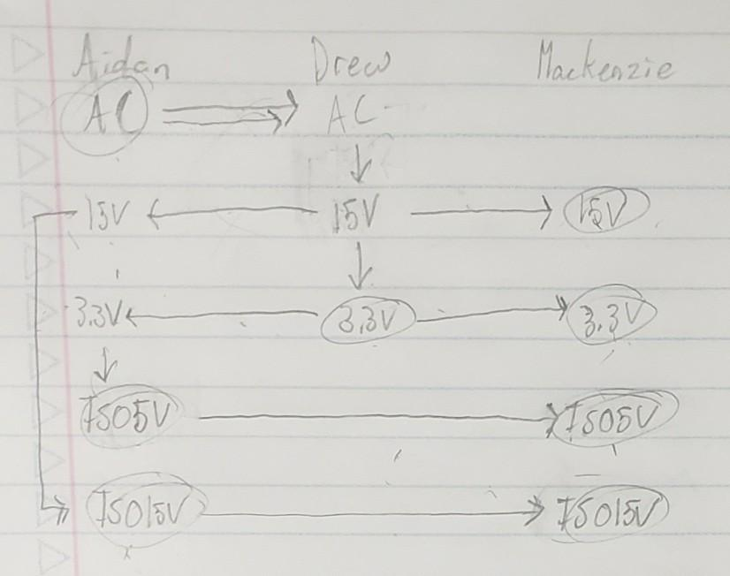
Power Distribution RD

Slide 5
Physical Orientation RD
Motor
Motor
PWM
PWM
Tach
iPWM
Power
Power
Wall
i15V/i5V/PGND
i15V/i5V/PGND
Tach
Wall
AC*2
15V/5V/GND
AC*2
15V/5V/GND
Tach
Ryan
MCU
iPWM

Slide 6
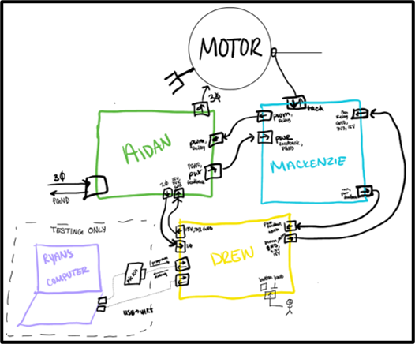
Physical Orientation RD

